Slide 1
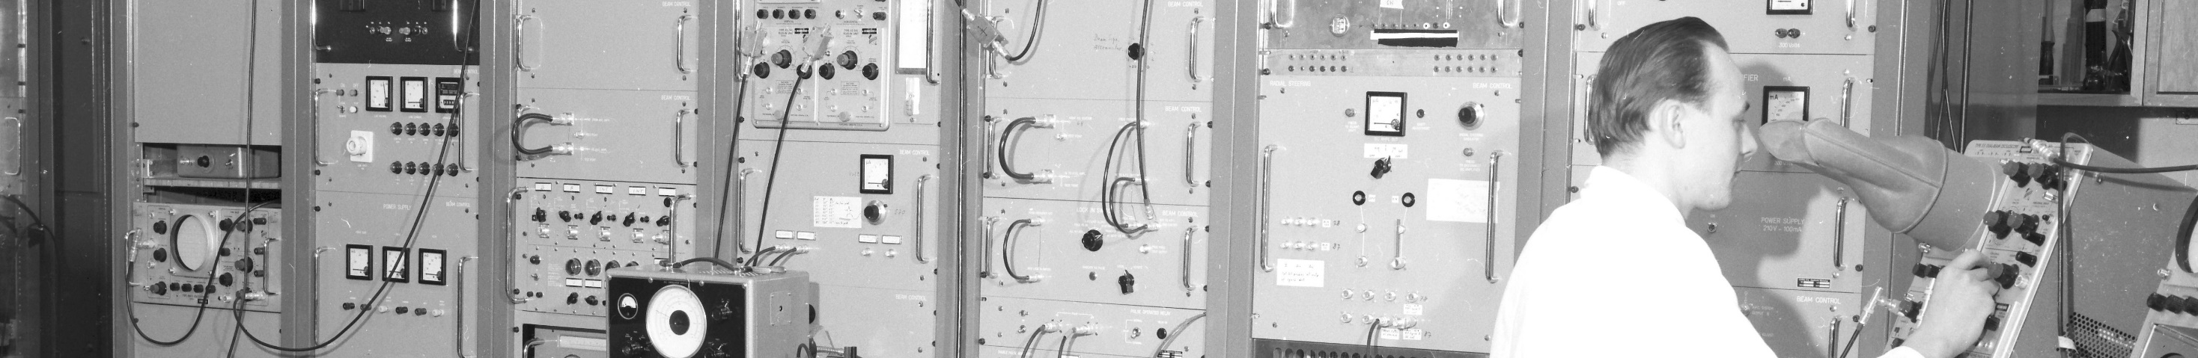
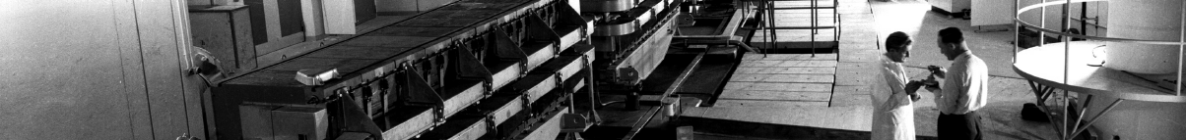
PS Report week 33
Many thanks
to the PS OP and coordination teams as well as all equipment experts and support teams!

Slide 2
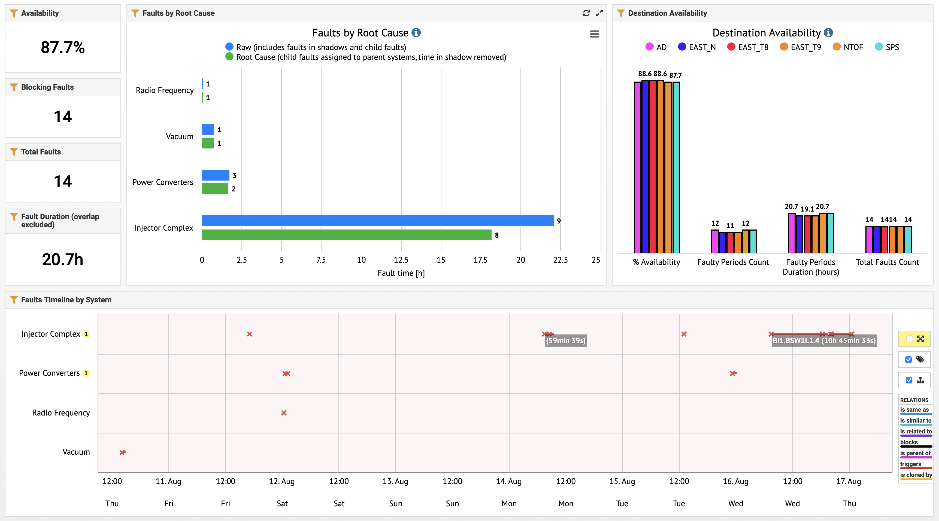
Availability W32/33 (Thu – Thu 9am)

Slide 3
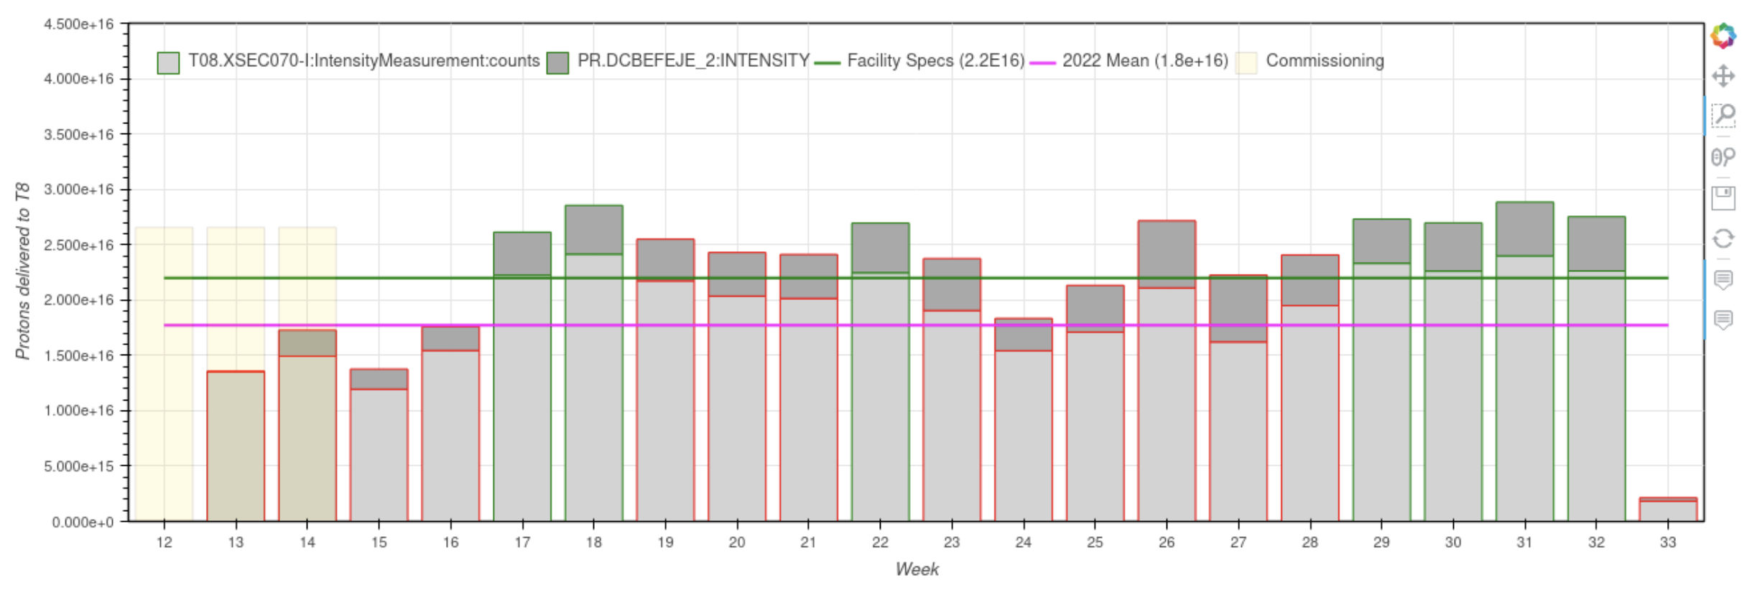
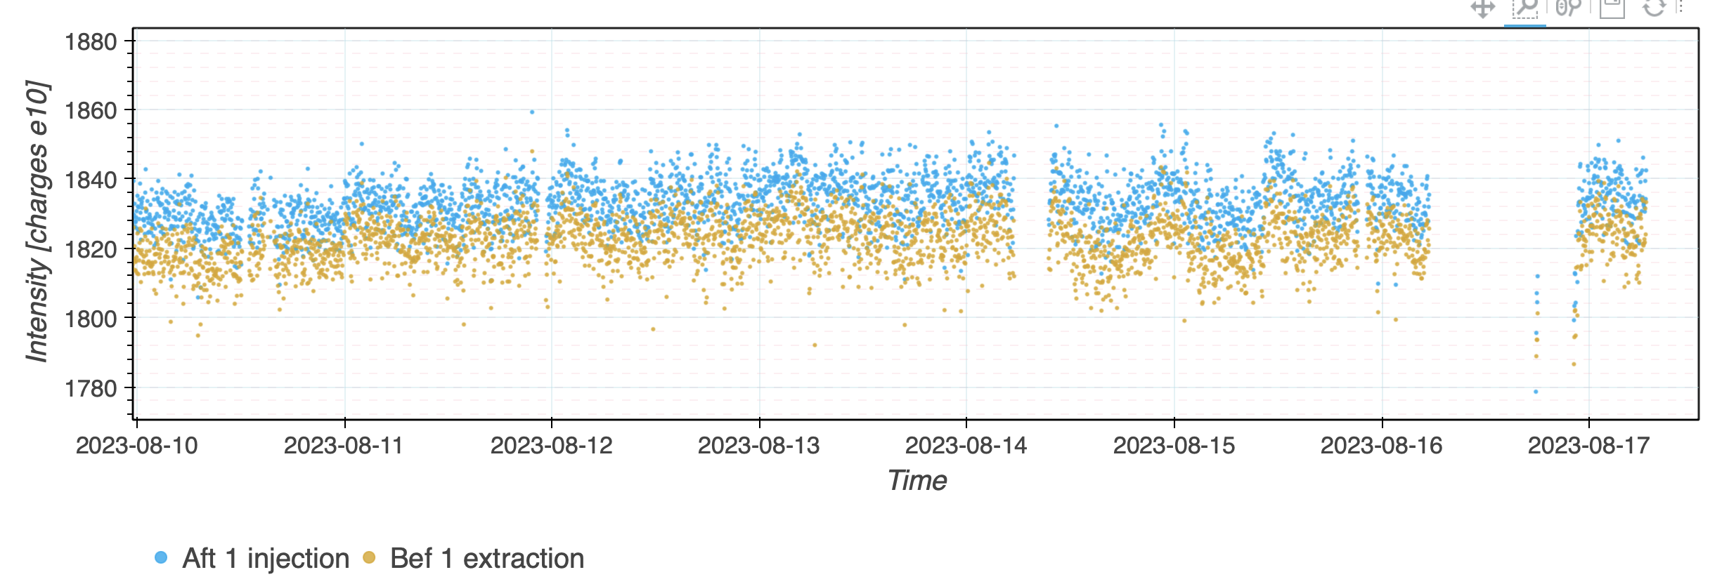
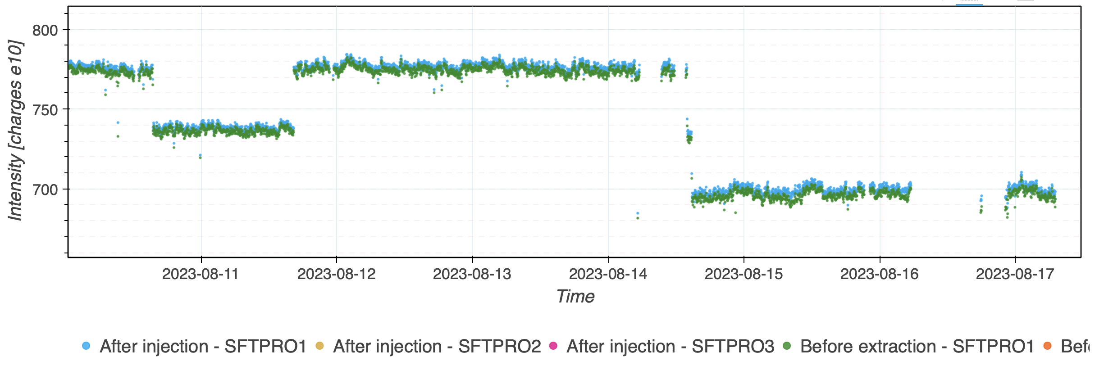
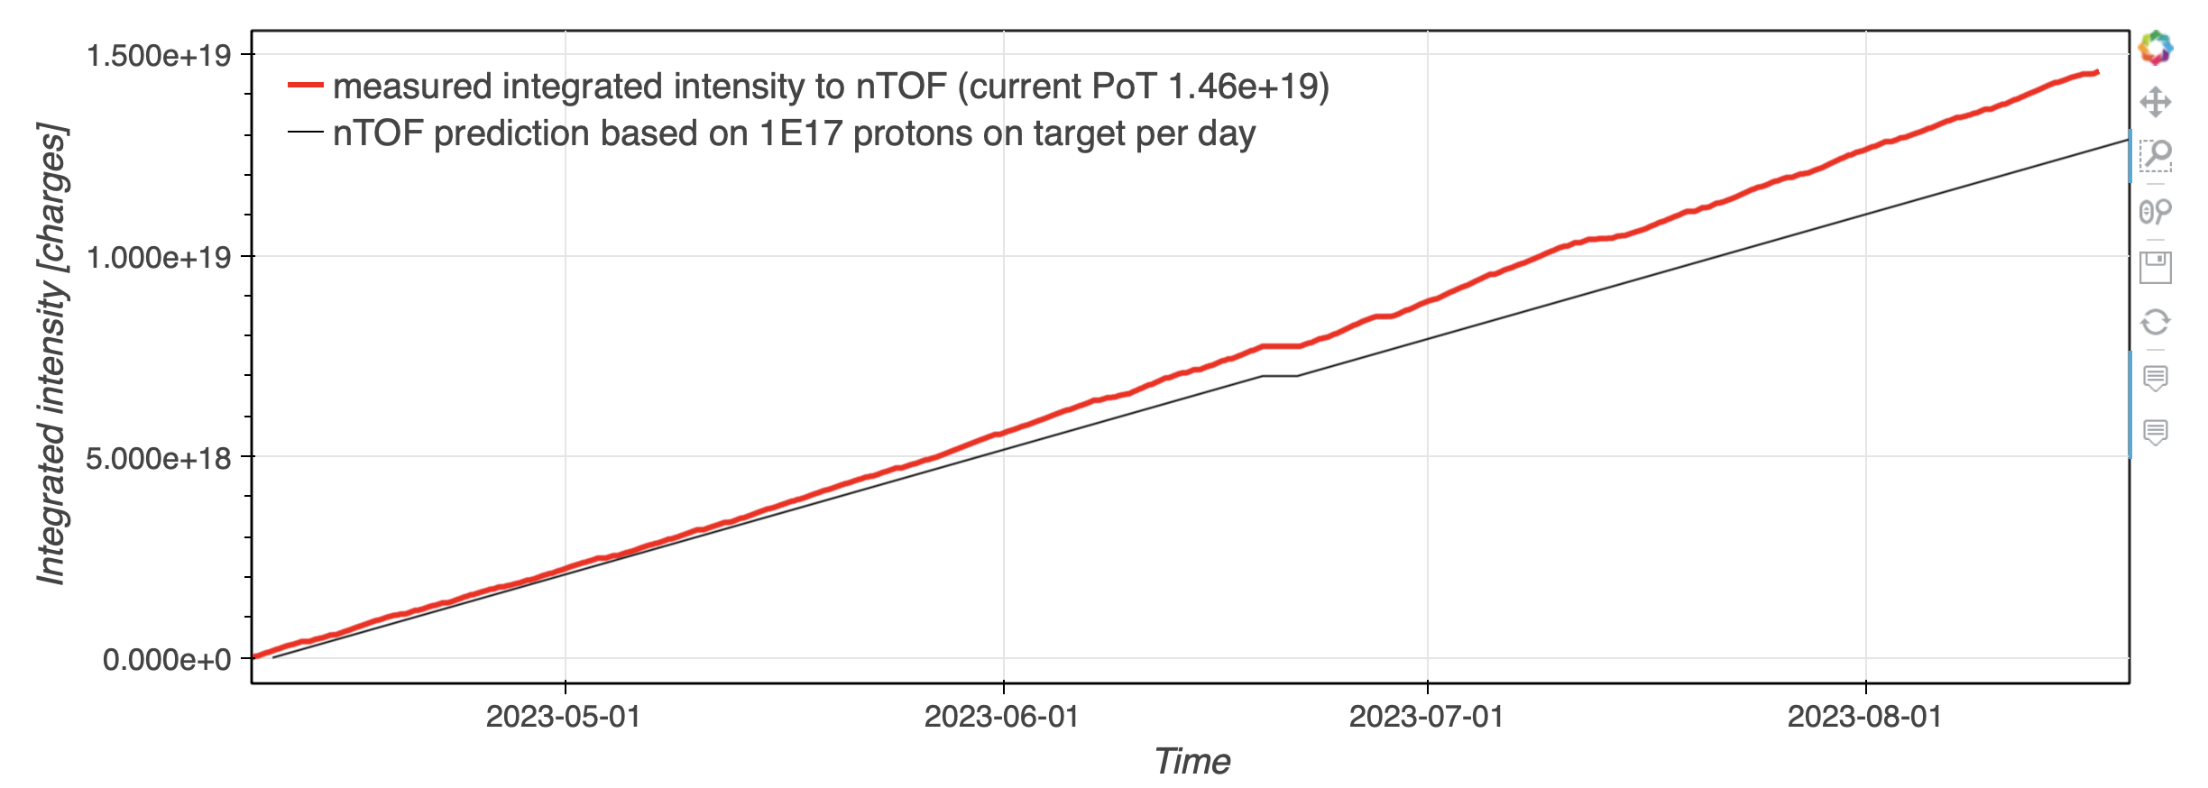
Delivered Intensity
                EAST_T8 above facility specs for the 4th week in a row (left); AD stable intensity of ~1820e10 p at PS extraction (right)
                SFTPRO intensity (left) and n_TOF delivered flux curve (right)

Slide 4
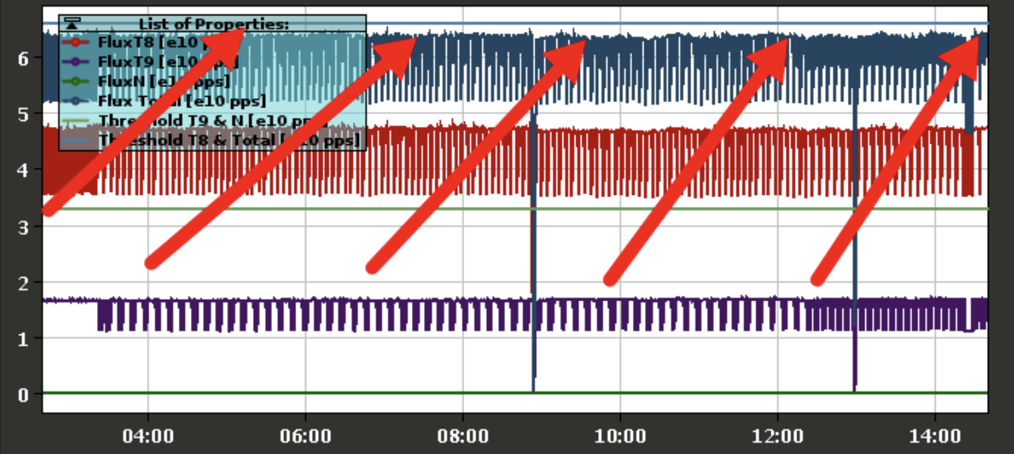
Reminder: EAST proton sharing
                T8: 1 spill every 10 s
                T9 and TN: 1 spill every 20 s
                RP limits need to be respected:
                Total EAST area flux limit: 6.6 x 10¹⁰ p/s
                T8 flux limit: 6.6 x 10¹⁰ p/s
                T9 flux limit: 3.3 x 10¹⁰ p/s
                TN flux limit: 3.3 x 10¹⁰ p/s
              Any arbitration for increased number of spills at
              the expense of another experiment needs to
              go through the physics coordinator.

Slide 5

PS Coordinator for week 34 – Alexander Huschauer
Questions and Comments
9:00 live meeting in the CCC on Wednesday and Friday
Zoom link to follow the meeting on remote: https://cern.zoom.us/j/9372114100?pwd=L29BcmlHUENCdFBRSytXYVcrM1B4Zz09
Meeting ID : 937 211 4100
Passcode: 525463

