Slide 1
Status of the Experiments
2023 run
A few physics results
Progress Phase II upgrades
NextGen trigger proposal
WLCG & Computing
Plenary RRB 57th Meeting
Joachim Mnich
October 24rd, 2023

Slide 2
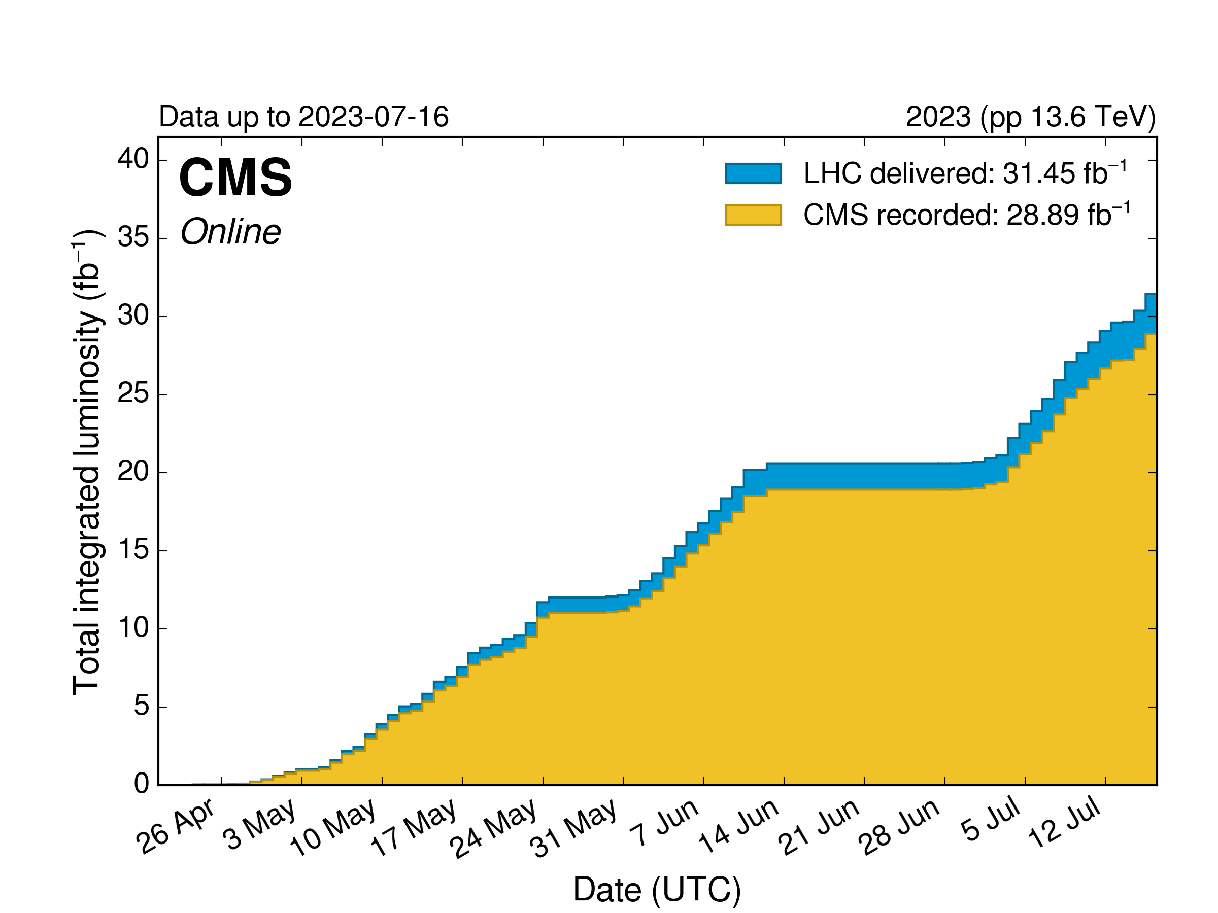
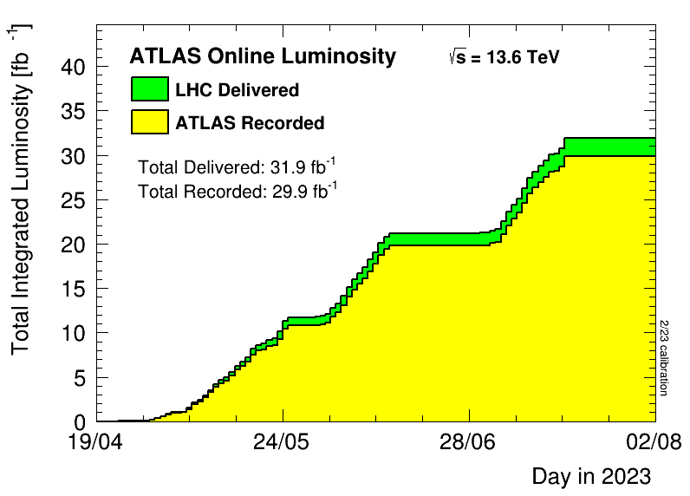
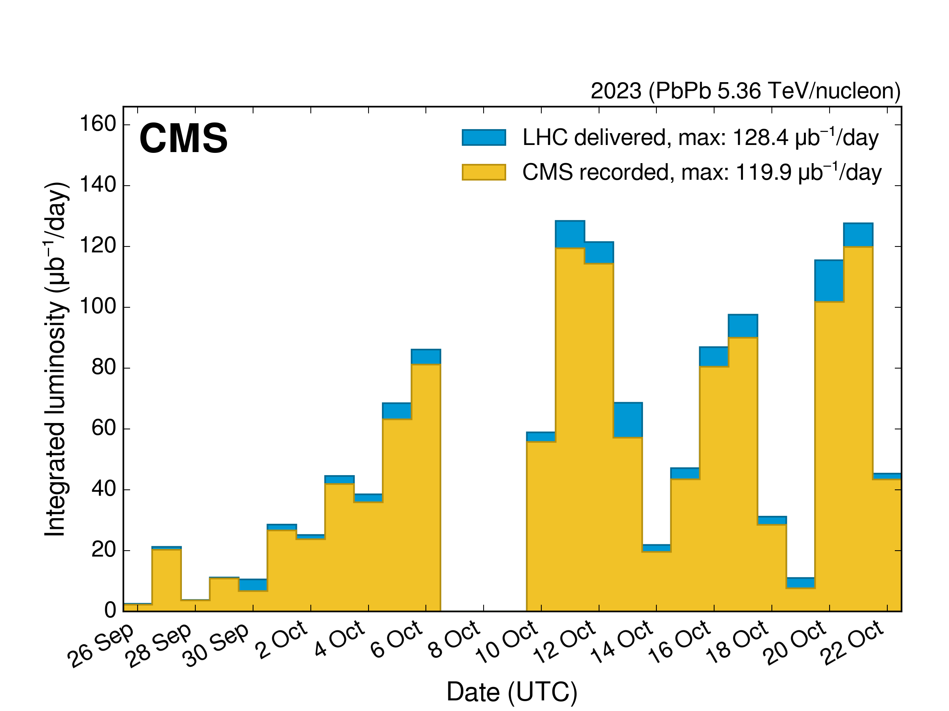
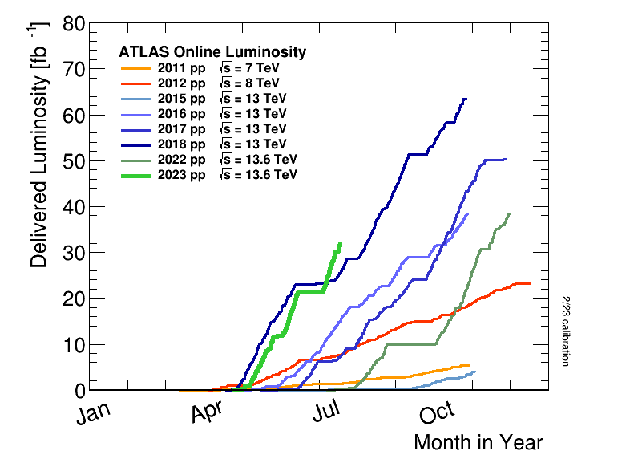
2023 Data Taking
Approx. 32 fb⁻¹ pp luminosity delivered to ATLAS & CMS
Until mid July best year ever!
Due to several issues the goal of 75 fb⁻¹ was not reached
Heavy Ion run still ongoing until October 30th
pp
pp
PbPb
pp

Slide 3




ATLAS: Search for Magnetic Monopoles
Magnetic
Dipole Monopole
Contrary to electric charge magnetic monopoles have never been observed
Offer an explanation for the quantization of electric charge
Predicted by extension of the Standard Model, e.g. Grand Unification Theories
Masses could be at the TeV scale
Dirac’s quantization conditions for the fundamental magnetic charge
Magnetic charge should be a multiple of this fundamental charge
Would give rise to spectacular signals in the detectors!
Drell-Yan
Photon fusion
exist, e.g muon not yet
anomalous muon observed
dipole moment
ATLAS using full Run 2 data
New improved limits on monopole mass from searches in Drell-Yan and photon fusion processes
$$g_{D}= \frac{e}{2α}≈68.5e$$
$$g_{D}, 2g_{D}, 3g_{D}, ...$$
Notes:
PF: Photon Fusion

Slide 4

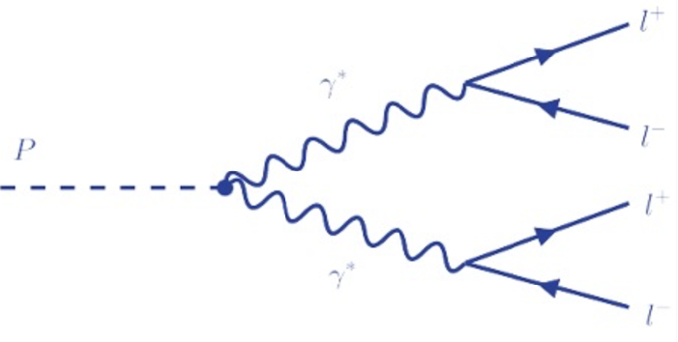
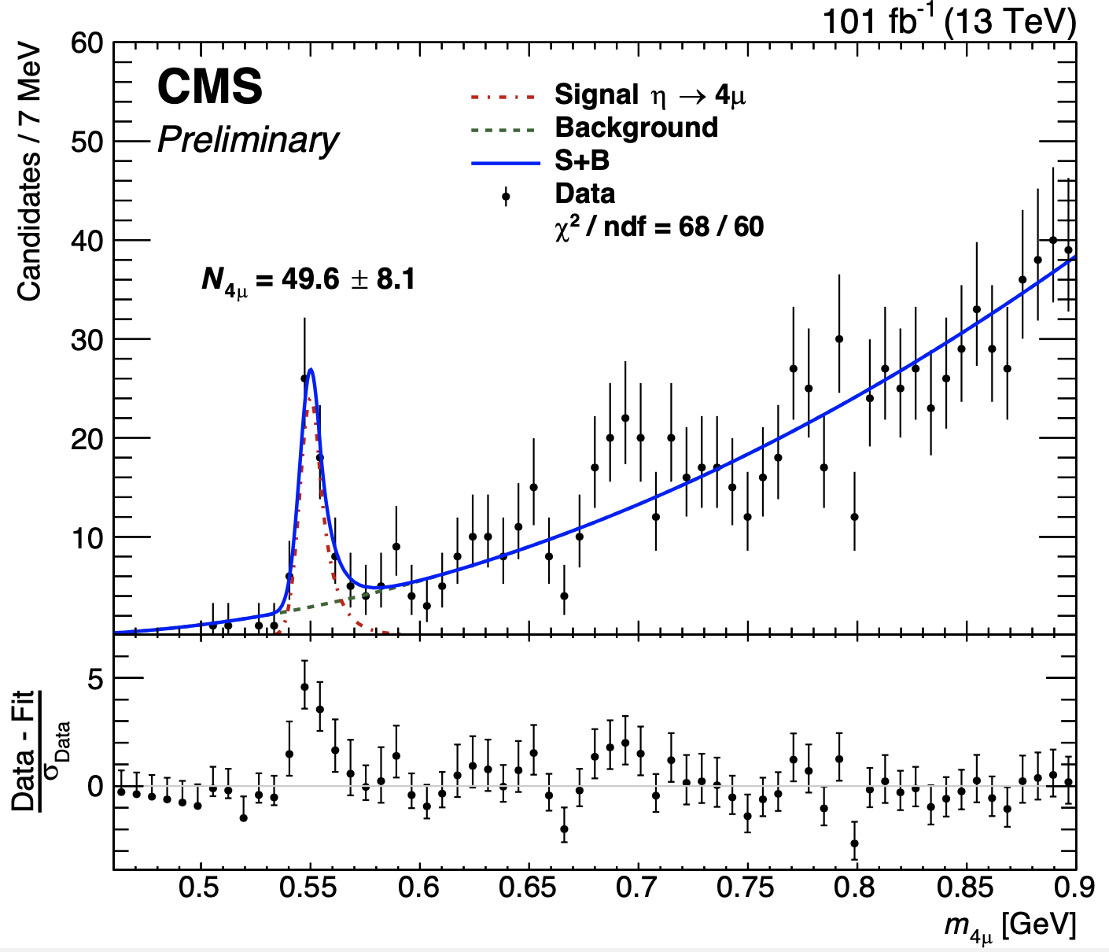
Observation of η → 4µ
A rare double Dalitz decay (BR O(10⁻⁹)) that has eluded discovery so far
Search performed on data scouting
Loose L1 triggers, no HLT selection
Stored HLT muons for offline analysis
High-rate trigger that extends the CMS sensitivity to low mass di-muon and four-muon resonances
Exploit η→µ⁺µ⁻ decay as normalisation
BR(η→µ⁺µ⁻ µ⁺µ⁻) = (5.0 ± 0.8_{stat} ± 0.7_{sys} ± 0.7_{bkgd}) × 10⁻⁹
In agreement with theoretical estimates
Significance > 5σ

Slide 5
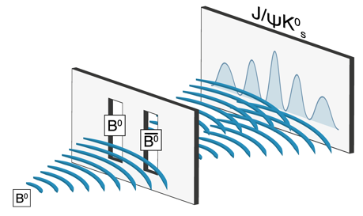
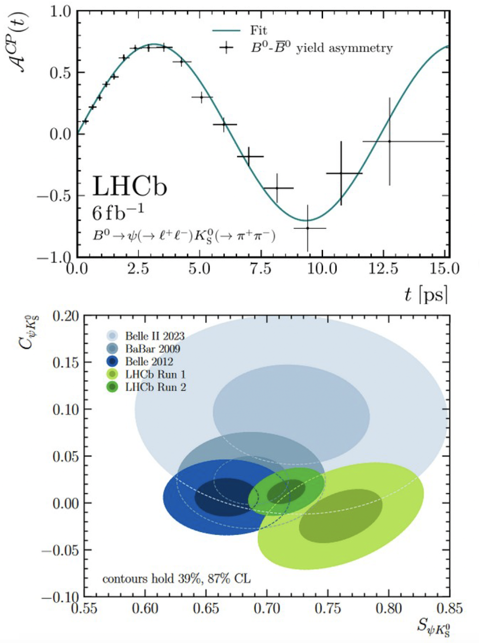
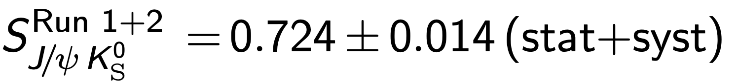
LHCb: Most Precise Measurement of sin(2β)
World’s best measurement of sin(2β) from B₀→→J/ψ K_{S}
This was the golden measurements of B factories
With the addition of Run-2 data LHCb has greatly improved the precision
The measurement is still dominated by statistical uncertainties

Slide 6
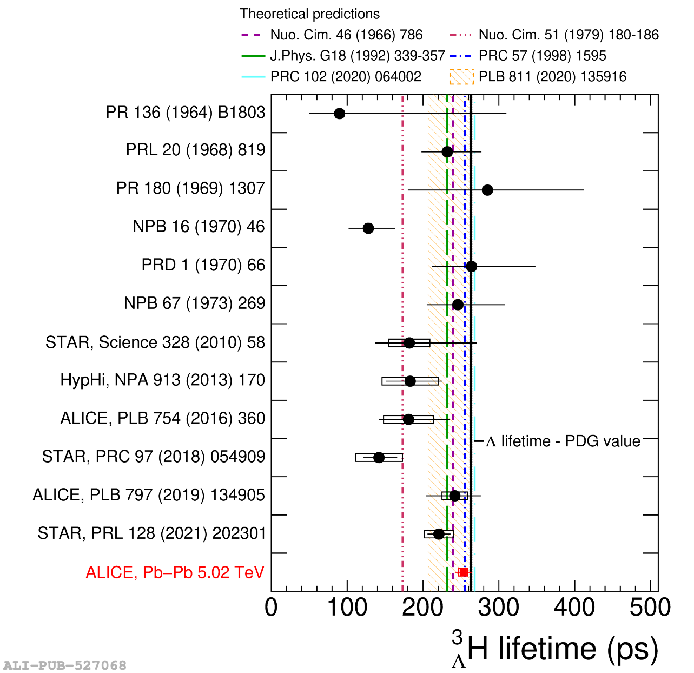
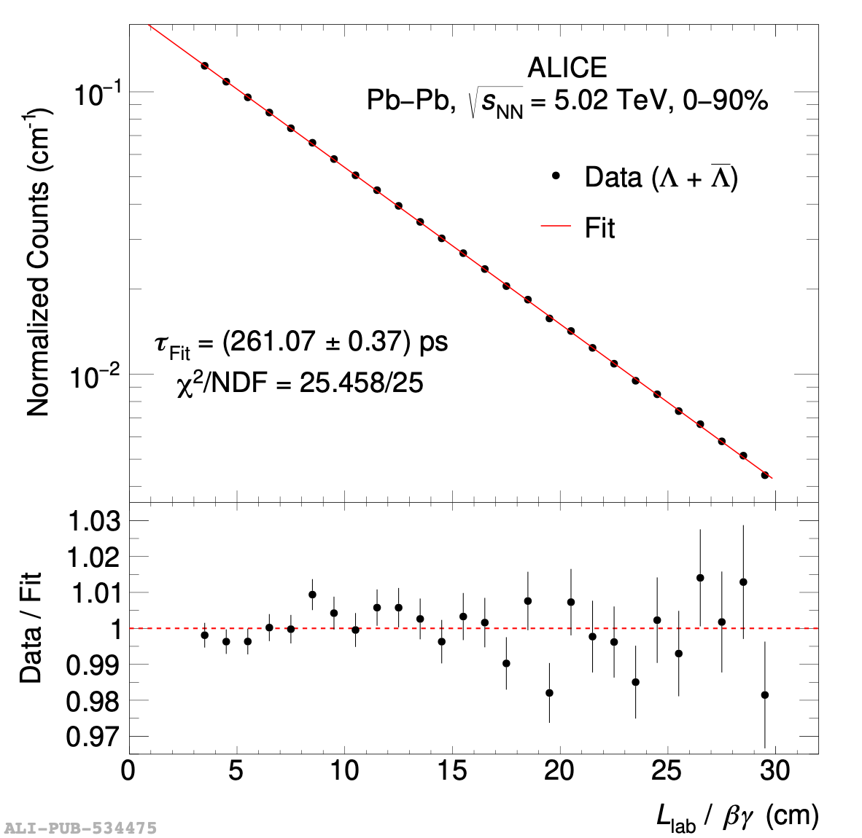
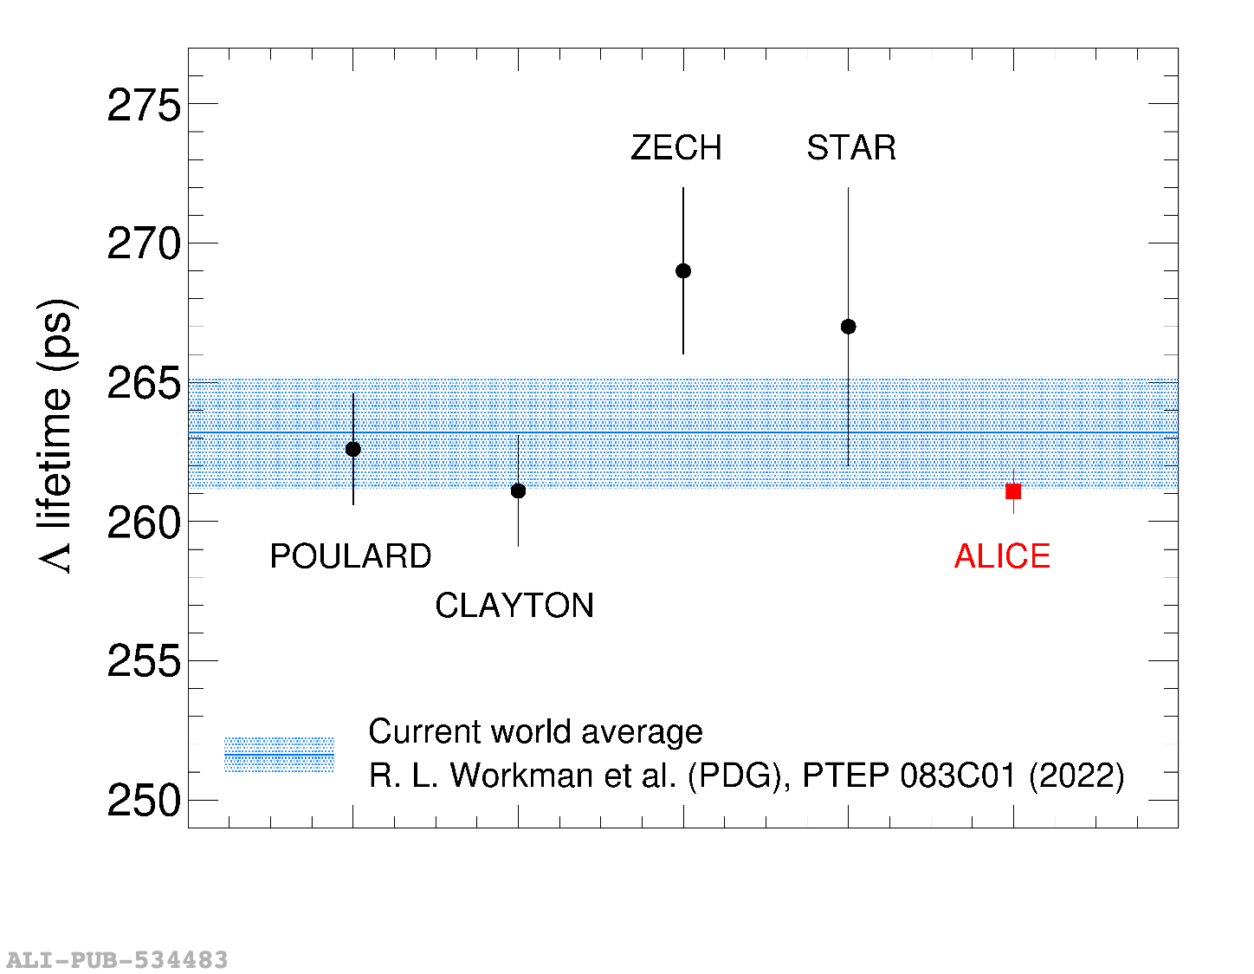
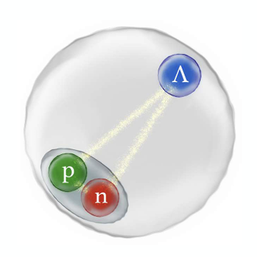


ALICE: Lifetime of Strange Baryons and Nuclei
Hypernuclei life time
Proper decay length distribution
Life time: comparison to existing results
$$π^{−}$$
arXiv:2303.00606
p
$$Λ^{0}$$
arXiv:2209.07360
Llab
Life time measurements of hyperons and hypernuclei competitive with world data

Slide 7
Phase II Upgrade ATLAS & CMS
Projects are making very good progress
  Now in transition to (pre-)production
However, schedule for both experiments remains extremely tight with no significant contingency

Slide 8
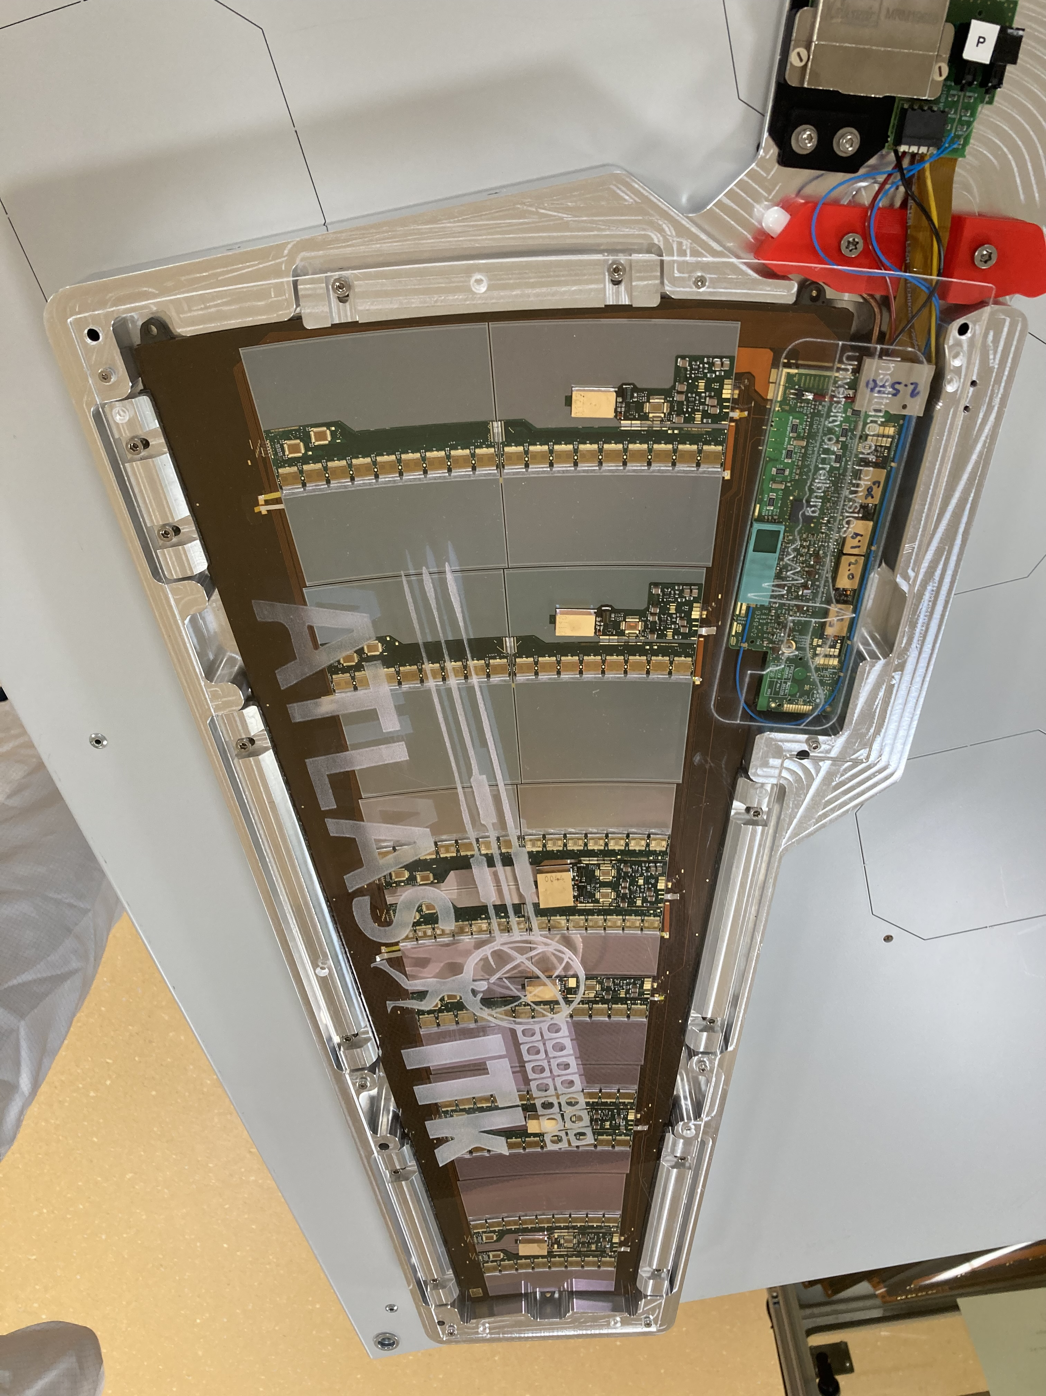
Status ATLAS Phase II Upgrade
Projects are making very good progress
Overall status:
Huge progress in all projects transiting towards production, critical final design reviews passed, but still a few technical challenges to overcome
ITk Pixel and Strip define critical path of schedule and have continued to use up contingency due to technical & procurement challenges, urgent actions taken to improve services situation
Muon upgrade (RPC) also entering critical schedule
Increasing resources mobilised for Phase-II upgrade
First fully functioning petal of the ITk endcap

Slide 9
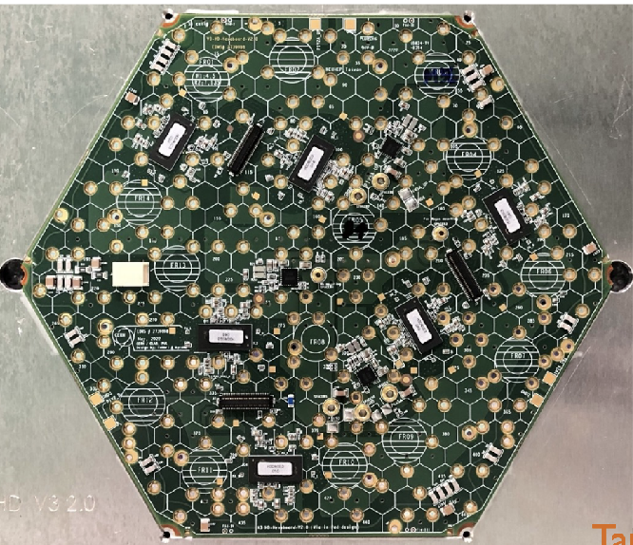
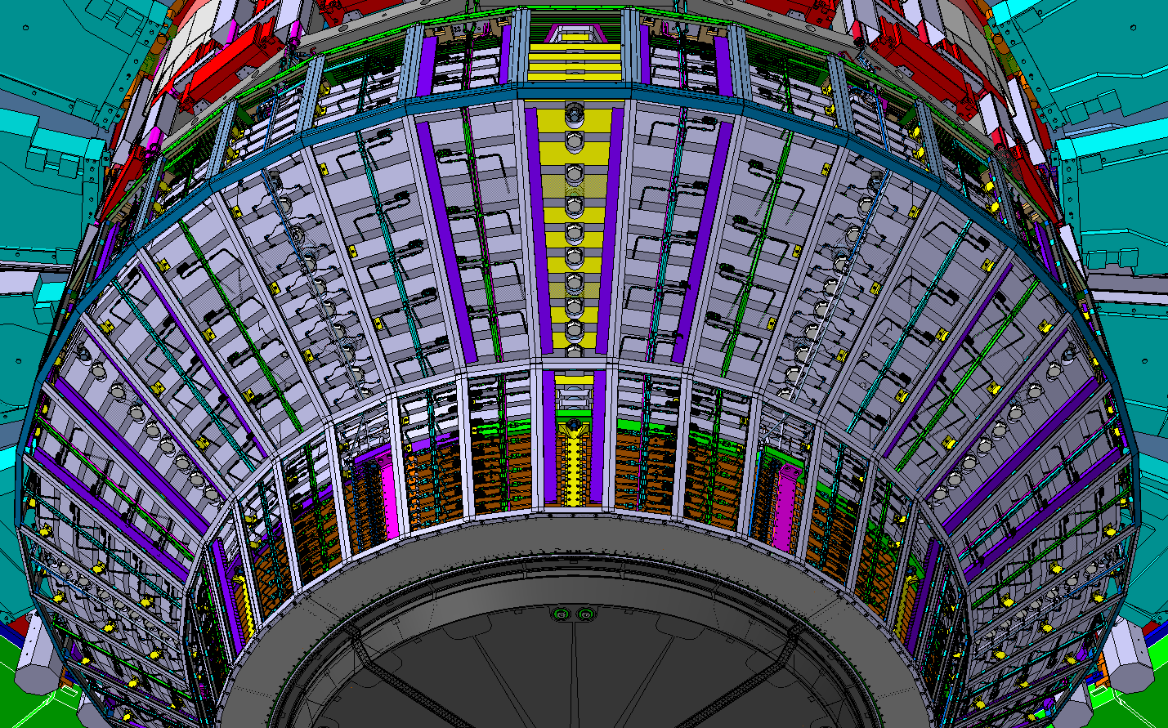
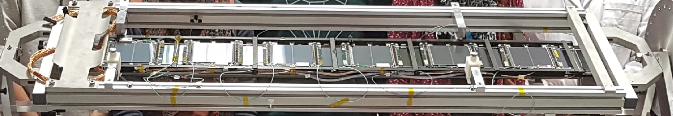
Status CMS Phase II Upgrade
Detector upgrade projects are making good technical progress
L1 Trigger decision shown to fit into 9.5 𝜇s with 12.5 𝜇s available
ASIC designs are proceeding well and nearly complete
Many more items are moving into pre-production or production
Global float for the upgrade is now ~3-4 months
Focus on understanding the resources needed to complete the upgrades
Collaboration building - “Upgrade Days” with broad participation across the projects
There has been progress in securing mitigations for CMS Upgrade deliverables that are at risk on account of the war in Ukraine
First ladder fully equipped with 12 functional 2S modules

Slide 10
ATLAS & CMS Phase II Upgrades
Workshop with Fraunhofer IPA
Factory Planning and Production Management
Two workshops on CMS HGCAL
26.06. - 28.06.2023
30.08. - 01.09.2023
One workshop on ATLAS ITk project
11.10 – 13.10.2023
Follow-up in February 2024
Complementary to LHCC, P2UG reviews
ATLAS and CMS spent a lot of effort in the preparation of the review
Perhaps this is the largest benefit of the review!
Fraunhofer impressed by the quality and depth of the planning, tools developed to plan, simulate production and estimate schedule
No obvious mistake, no important items overlooked
  Potential for production identified and under study (for CMS, ATLAS to be discussed in Feb 2024)
  Larger engagement of collaboration, more personnel required

Slide 11
Conception of a “Next Generation Triggers” Proposal
Sep 2022
A group of private donors interested in supporting CERN scientific mission visits CERN to share ideas with CERN management and physics/computing experts
Eric Schmidt contacts CERN impressed by its vision and contributions to the advancement of science and proposes that his foundation could fund work on advanced Artificial Intelligence (AI) and Quantum Computing techniques to improve the LHC experiments data acquisition, analysis, and simulation workflows.
A task force composed of experts from EP, IT, TH, ATLAS, CMS and external experts works on a concept proposal. A 5-page concept is submitted to the Eric and Wendy Schmidt Fund for Strategic Innovation for a project with a value of 48M USD over 5 years
The Foundation informs CERN that they have positively evaluated the proposal and are ready to enter into a more detailed discussion of technical milestones, budget and legal/admin procedures
The task force prepares a detailed proposal which is validated from the administrative, legal, financial points of view, as well as international relations and reputation aspects, by the respective CERN competent bodies
The proposal NextGen is positively considered by CERN management, legal negotiations with the Foundation lead to a draft agreement. A proposal for approval submitted to CERN Council
NextGen approved by CERN Council, grant agreement being finalised to start project in January 2024
Oct 2022
Nov 2022
Dec 2023
Feb 2023
Jun 2023
Aug 2023
Sep 2023
Oct 2023

Slide 12
NextGen Objectives
Enhance the trigger and analysis capabilities, and thus the scientific potential, of ATLAS and CMS in the HL-LHC phase beyond the currently projected scope
Accelerate the evaluation and introduction of novel computing, engineering and scientific ideas already for Run 3, but with main focus on HL-LHC
Provide a major push to the work already ongoing in the experiments, by enabling lines of research currently not feasible within existing financial, human and technological resources limits
Provide critical insight to develop future detectors and data flows for the even more ambitious objectives of a future collider, such as the Future Circular Collider (FCC) currently in its Feasibility Study phase
The EP, IT and TH departments are also involved to ensure that other current & future CERN experiments benefit from the results in terms of computing frameworks and physics theory models.
All project results will be released under a valid open science policy and IP generated will be released under appropriate open licenses in compliance with the CERN Open Science Policy.

Slide 13
NextGen Activities
WP0: “Project management and communications” to ensure overall project coordination, management of the relations between CERN and the E&W Foundation, the LHC experiments collaborations, the external partners, and the internal CERN services
WP1: “Infrastructure, Algorithms and Theory” to improve ML-assisted simulation and data collection, develop common frameworks and tools, and better leverage available and new computing infrastructures and platforms
WP2: “Enhancing the ATLAS Trigger and Data Acquisition” to focus on improved and accelerated filtering and exotic signature detection
WP3: “Rethinking the CMS Real Time Data Processing” to design a novel AI-powered real-time processing workflow to analyze every single collision produced in the LHC
WP4: “Education Programmes and Outreach” to foster and train computing skills in the next generation of high energy physicists

Slide 14
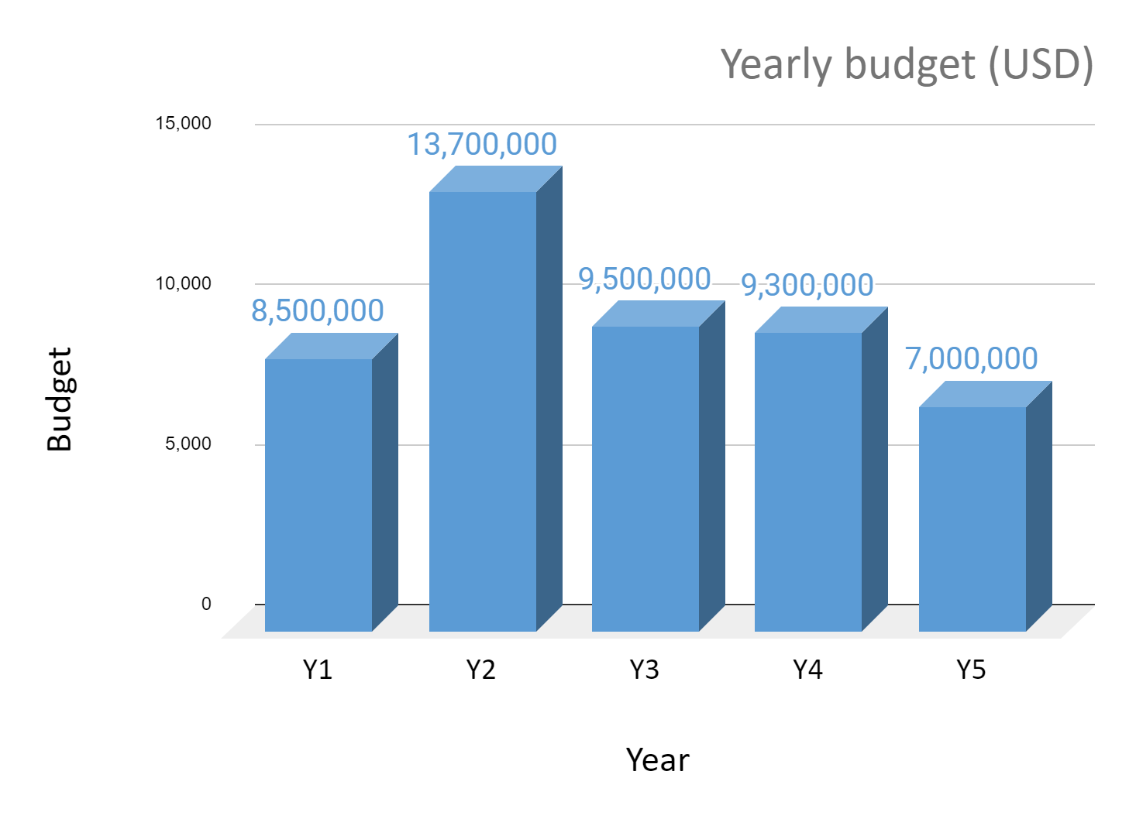
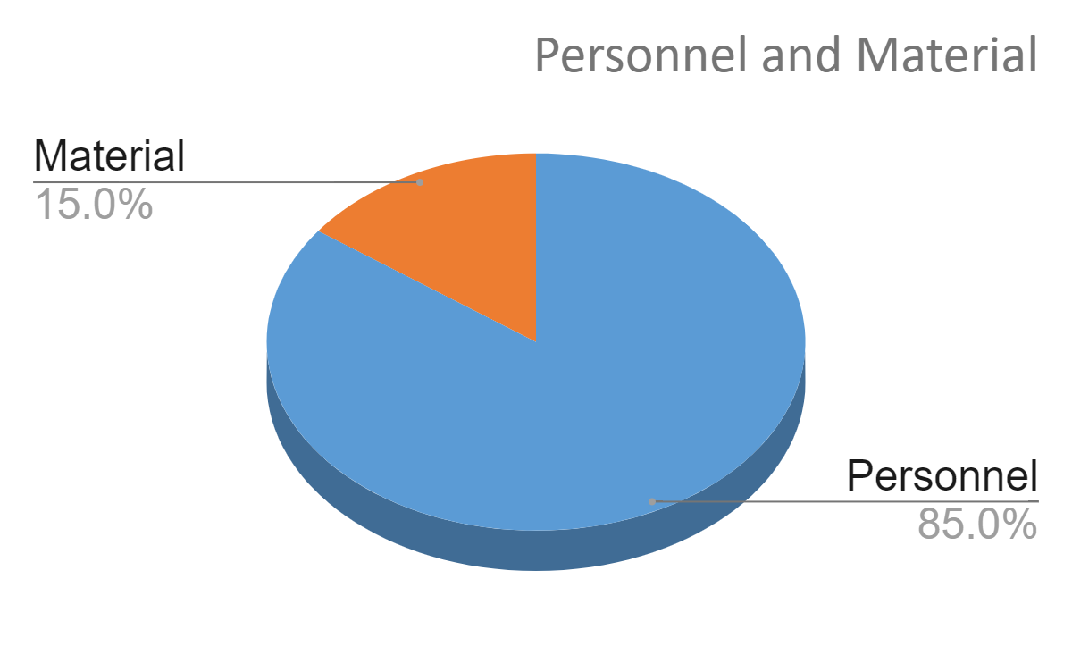
NextGen Budget

Slide 15
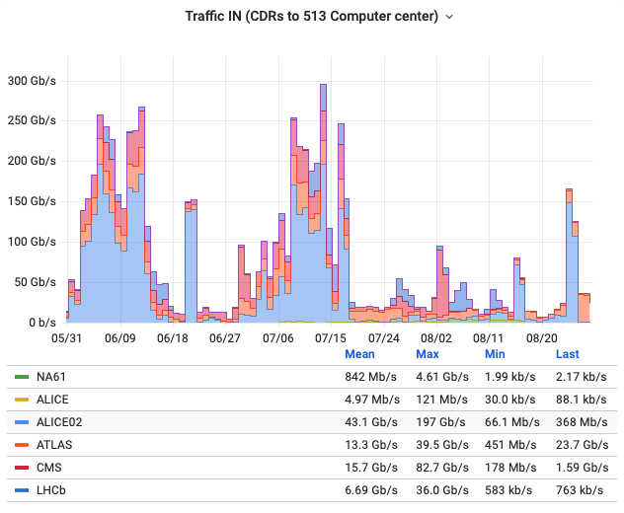
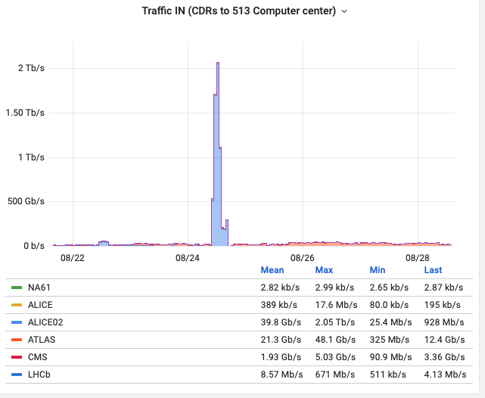
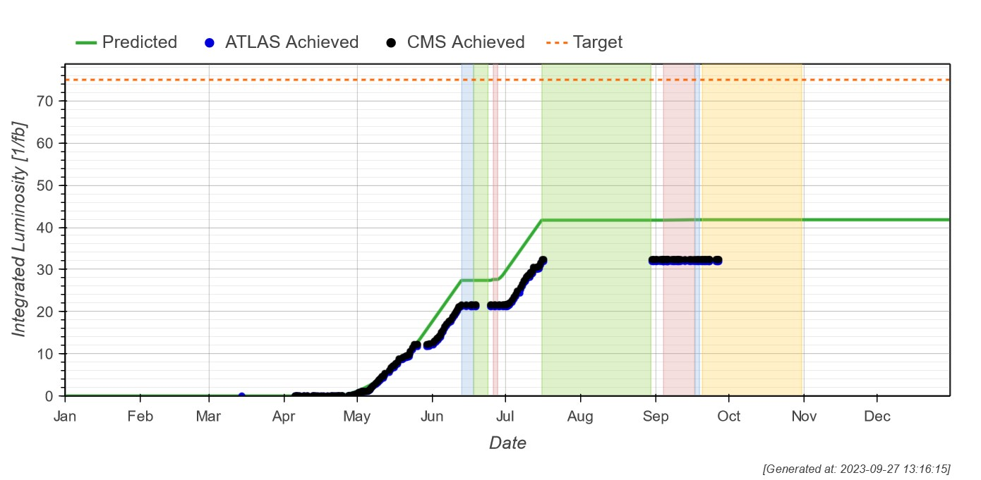
Computing: 2023 LHC data taking
Traffic experiments → T0 in the last 6 months
P2 (ALICE) → T0 throughput test
Before and after proton runs, time was dedicated to expanding peak capabilities for heavy ion run

Slide 16
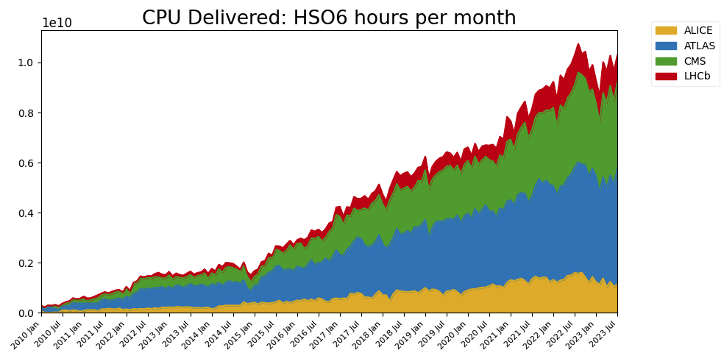
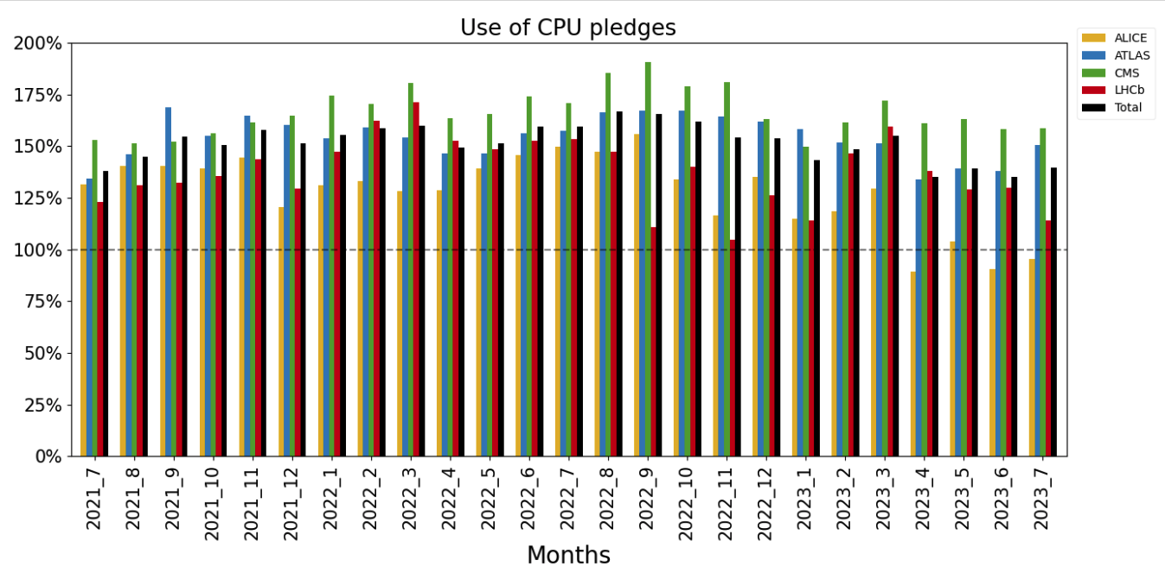
WLCG Computing Resources
Reduction of processing activity at WLCG sites in winter 2023 due to ~ energy crisis
Mostly recovered now, still not reaching the peak of summer 2022
Experiments globally can leverage ~40% beyond pledge capacity at WLCG sites

Slide 17
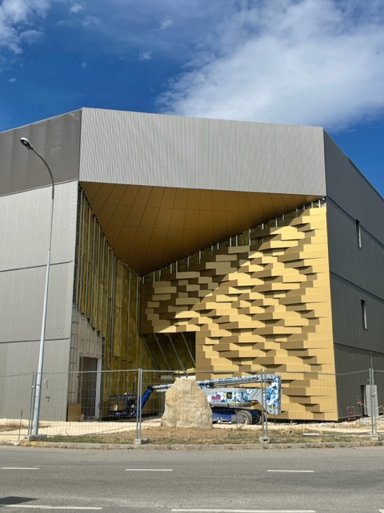
Prévessin Data Centre
  to end October 2023
  Commissioning (incl. building and services such as electrical, cooling, ventilation)
  to end December 2023
  IT trial installation and tests (incl. one POD)
  POD = 2 rows of racks with hot aisle containment
  during January 2024
  Installation of the rest of the first batch of equipment

Slide 18
Summary
Detectors took successfully data in 2023
  however, luminosity goal could not be reached
Experiments continue to produce excellent physics results
Good progress in Phase II upgrades
  but challenges remain on the schedule and due to worldwide economic and political situation
  work with Fraunhofer experts to optimize production and to identify opportunities to accelerate production schedule
WLCG is running smoothly
  progress in addressing HL-LHC and energy challenges
  Prévessin Data Centre nearing completion
Big thank you to the Funding Agencies for their continuous support!

Slide 19
Thank you for your attention!

Slide 20
Backup

