Slide 1


Status of field quality in D1 and D2
T. Nakamoto, M. Sugano, K. Suzuki, S. Farinon, A. Pampaloni, F. Levi, B. Caiffi, L. Fiscarelli, P. Rogacki, E. Todesco
CERN, 29 August 2023

Slide 2
D1 STATUS: MBXF1 MEASUREMENTS AT 12.11 kA
D1 cross section went through three iterations to cope with stringent targets for b₃ and b₅
From first to second model (MBXFS1 → MBXFS2)
From third model to prototype (MBXFS3 → MBXFP1)
From prototype to first series (MBXFP1 → MBXF1) EDMS 2612909
  Change made via modification of wedges, b₃ +4 unit, b₅ -5.5 units
  Note that target range is [-2.9,2.9] units for b₃ and is [-1.5,1.5] units for b₅
News: first series magnet MBXF1 has been measured at 12.11 kA
  The increase of b₃ and the reduction of b₅ have been confirmed
  Integral b₃ measured in the vertical KEK test station: -4.1 units, that projected in the CERN final cryostat gives 2.0 units (to be verified by measurements)
  Integral b₅ measured in the vertical KEK test station: 1.4 units, that projected in the CERN final cryostat gives 1.7 units (to be verified by measurements)

Slide 3
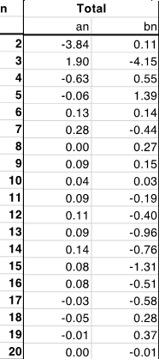
D1 STATUS: MBXF1 MEASUREMENTS AT 12.11 kA
In general, multipoles are well within the targets
  Nearly 4 units of b₂ to be better understood
As shown in previous slide, these data are measured in
KEK cryostat, and not in CERN cryostat – this effect is not
negligible and will be measured at CERN with the MBXFP1
(prototype) in October 2023
Magnetic measurements (room temperature H and V, 12.11 kA,
In the KEK cryostat
[K. Suzuki, T. Nakamoto, M. Sugano]

Slide 4
ROOM TEMPERATURE MEASUREMENTS OF MBFX5
News: MBXF5 is the second series magnet – it has been completed in April and room temperature measurements give a good indication of the reproducibility
  Note: these are on a portion of the magnet, full measurements will be made in vertical position
  Within 1 unit for b₃, and within 0.2 units for b₅: good!
b₃
b₅
Magnetic measurements (room temperature H and V, 12.11 kA, and projection for final configuration at CERN
[K. Suzuki, T. Nakamoto, M. Sugano]

Slide 5
D2 FIELD QUALITY
For D2 there were two iterations on cross section (wedges) from short model to prototype and from prototype to series, to correct b₃ and b₅
Prototype has been measured in operational conditions at CERN in October last year
  The problem is simpler than in D1, since impact of saturation is lower, but there is a coupling with the preload/shimming/coil size that has to be dealt with the shimming plan
  Moreover there is a large discrepancy between simulations and measurements of 10 units of b₃ – not understoood, and applied to the series
News: in early August 2023, the first series magnet MBRD1 has been measured at room temperature at the end of the magnet assembly https://indico.cern.ch/event/1314538/

Slide 6
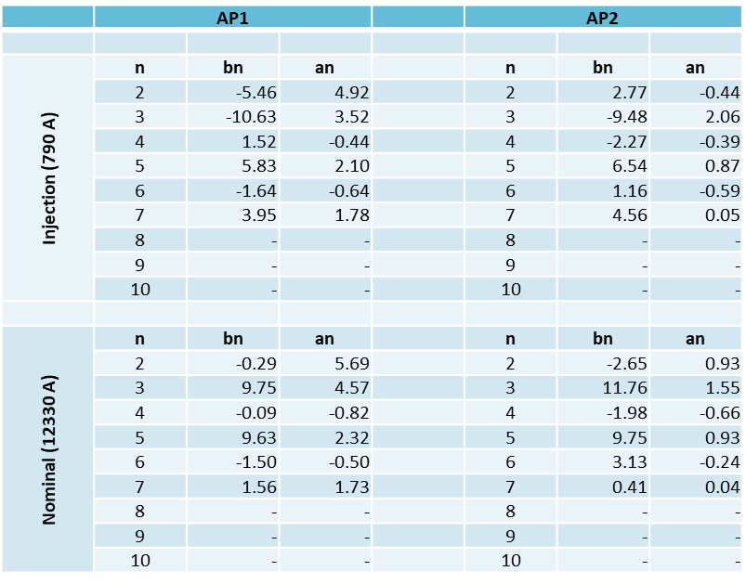
D2 FIELD QUALITY
Measurements of the prototype MBRDP1 https://indico.cern.ch/event/1286742/
  b₃: 10 to 12 units
  b₅: 9 to 10 units

Slide 7
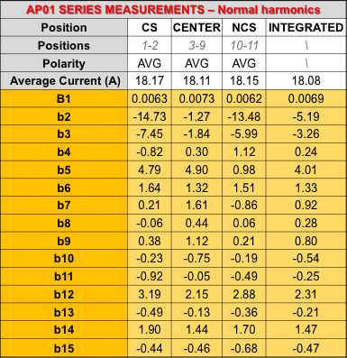
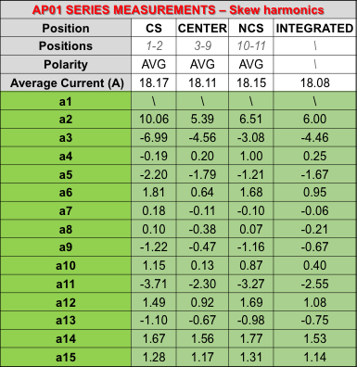
D2 FIELD QUALITY
First series measured at room temperature – first aperture
  b₃: -3.2 b₅:4.0

Slide 8
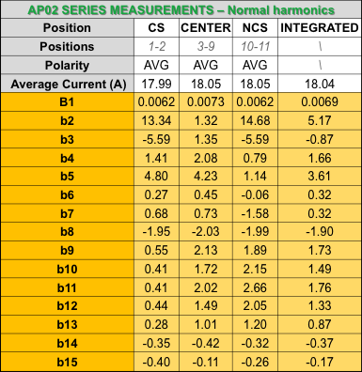
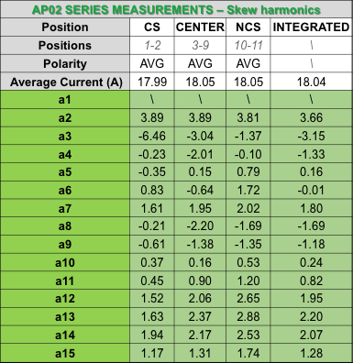
D2 FIELD QUALITY
First series measured at room temperature – second aperture
  b₃: -0.9 b₅: 3.6

Slide 9
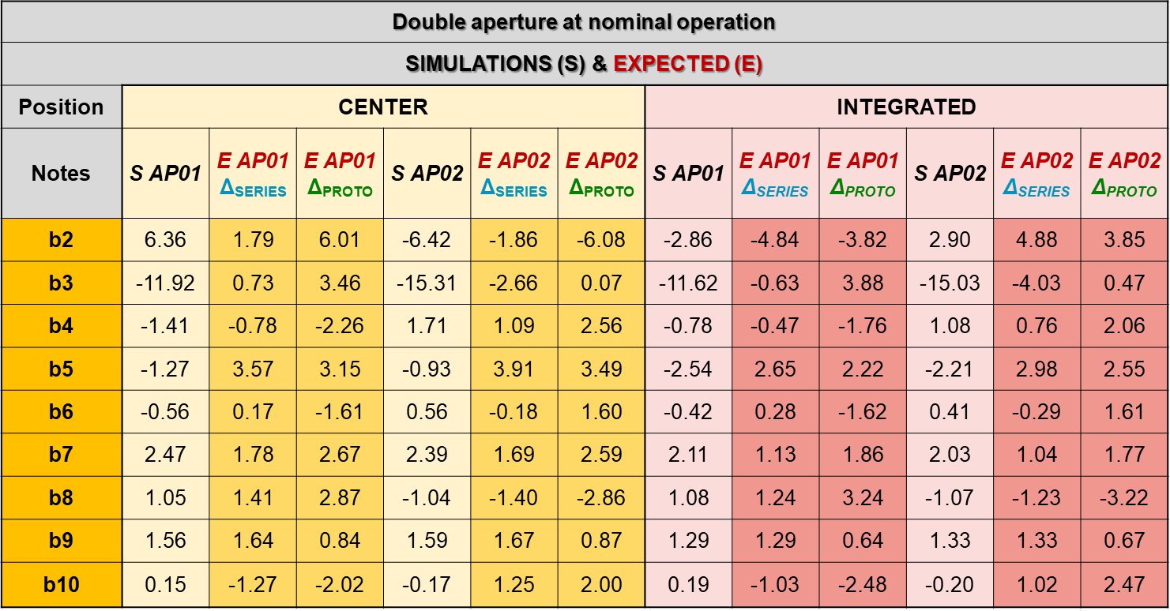
D2 FIELD QUALITY
First series projected at nominal current
  Two ways of projecting, little data available on correlations → forecast on b₃ is affected by a large error
  b₃: between -0.5 and 4 (ap. 1) and between -4 and 0.5 (ap. 2)
  b₅: between 2.5 and 3 (both apertures)
  We will have second order components of the order of 5 units
  Magnet will arrive at CERN in September, then assembly of cold mass and cryostating → measurements of MBRD1 will be available in second half of 2024
Second magnet MBRD2 will be completed in November, and magnetic measurements at room temperature will be available before the end of 2023

Slide 10
CONCLUSIONS
Both D1 and D2 present challenges for the steering of b₃ and b₅ field quality
  Several cross sections iterations have been done, and initial values of b₃ and b₅ were above 10 units
For the first series magnets, both D1 and D2 indications are positive, with b₃ and b₅ within 5 units
  D1 first series: b₃ and b₅ within 3 units
  D2 first series: b₃ within 4 units, b₅ at 3 units
  These are indirect measurements (at room temperature for D2, and not in the final cryostat for D1)
  Final validation for D1 will arrive with measurements at CERN (within 2023)
  Final validation for D2 will arrive in the second half of 2024
Reproducibility
  For D1, we have measurements of the second series magnet (MBXF5) confirming the reproducibility
  For D2, measurements of second series magnet MBRD2 will be available at the end of the year
No additional iterations on field quality are foreseen
  For D2 there will be a careful selection of shimming plan, based on the coil size, that could give higher b5 to control b3

