Slide 1
Update on DA studies
Yannis Angelis,
HL-LHC WP2 Meeting, 29 August 2023

Slide 2
Contents
Optics for Collapse and Start of Levelling
DA tune scans for flat and round optics (v1.6 Optics)
DA octupole scans for flat optics (v1.6 Optics)
Next steps and conclusions

Slide 3
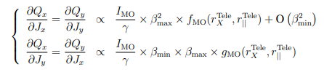
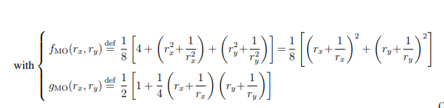
Collapse process
Collapse process is defined by the target lumi in the range of 1-2.5e34
L-Nb [10^34] | Energy | beta sep | beta cross | MO | Emit [um] | ppb | Crab | sep | crossing | Q' | LHCb - 1.5m / Alice 10m [10^34] | ATS Factor | f_{MO}/g_{MO} | Optics
2.5 - 2200 | 7 | 0.7 | 0.7 | 450 | 2.3 | 2.3 | 0 | 0 | 250 | 15 | 0.2/0.014 | 1 | 1/1 | 700_thick, 700_thin
2.5 - 2200 | 7 | 0.6 | 1.2 | 450 | 2.3 | 2.3 | 0 | 0 | 250 | 15 | 0.2/0.014 | 0.83/0.42 | 1.50/1.21 | 600_1200_thick, 600_1200_thin
2.5 - 2200 | 7 | 0.45 | 1.8 | 450 | 2.3 | 2.3 | 0 | 0 | 250 | 15 | 0.2/0.014 | 1.1 / 0.28 | 2.36/1.47 | 450_1800_thick, 450_1800_thin
2.3 - 2200 or 2.0 - 1960 | 7 | 0.5 | 2 | 450 | 2.3 | 2.3 | 0 | 0 | 250 | 15 | 0.2/0.014 | 1/0.25 | 2.76/1.56 | 500_2000_thin
2.5 - 2748 or 1.8 - 1960 | 7 | 1.1 | 1.1 | 450 | 2.3 | 2.3 | 0 | 0 | 250 | 15 | 0.2/0.014 | 1 | 1/1 | 1100_thick
2.5 - 2748 or 1.8 - 1960 | 7 | 0.9 | 1.8 | 450 | 2.3 | 2.3 | 0 | 0 | 250 | 15 | 0.2/0.014 | 0.55/0.28 | 2.56/1.64 | 900_1800_thick, 900_1800_thin
2.5 - 2748 or 1.8 - 1960 | 7 | 0.7 | 2.8 | 450 | 2.3 | 2.3 | 0 | 0 | 250 | 15 | 0.2/0.014 | 0.71/0.18 | 4.67/2.02 | 700_2800_thick, 700_2800_thin
 | 7 | 1.0 | 1.0 | 450 | 2.3 | 2.3 | 0 | 0 | 250 | 15 | 0.2/0.014 | 1 | 1/1 | 1000_thick,1000_thin
https://cds.cern.ch/record/2622595/files/CERN-ACC-2018-0018.pdf
Tune scan on the bunch with max of long range

Slide 4
Start of levelling
Start of leveling is defined by pile-up e.g. 140
Bunch scheme | Pile up | Energy | beta cross | beta sep | MO | emit | ppb | Crab | sep | crossing | ATS Factor | f_{MO}/g_{MO} | Q' | LHCb - 1.5m / Alice 10m [10^34] | Optics
hybrid | 140 | 7 | 0.58 | 0.58 | 60 | 2.5 | 2.2 | 190 | 0 | 250 | 1 | 1/1 | 15 | 0.2/0.014 | 580_1500_thick, 580_1500_thin
hybrid | 140 | 7 | 0.42 | 0.84 | 60 | 2.5 | 2.2 | 190 | 0 | 250 | 0.59/1.19 | 1.51/1.25 | 15 | 0.2/0.014 | 420_840_thick, 420_840_thin
hybrid | 140 | 7 | 0.3 | 1.2 | 60 | 2.5 | 2.2 | 190 | 0 | 250 | 0.417/1.67 | 1.74/1.34 | 15 | 0.2/0.014 | 300_1200_thick, 300_1200_thin
8b4e | 140 | 7 | 0.58 | 0.58 | 60 | 2.5 | 2.2 | 190 | 0 | 250 | 1 | 1/1 | 5 | 0.2/0.014 | 580_thick, 580_thin
8b4e | 140 | 7 | 0.42 | 0.84 | 60 | 2.5 | 2.2 | 190 | 0 | 250 | 0.59/1.19 | 1.51/1.25 | 5 | 0.2/0.014 | 420_840_thick, 420_840_thin
8b4e | 140 | 7 | 0.3 | 1.2 | 60 | 2.5 | 2.2 | 190 | 0 | 250 | 0.417/1.67 | 1.74/1.34 | 5 | 0.2/0.014 | 300_1200_thick, 300_1200_thin
Tune scan on the bunch with max of long range

Slide 5
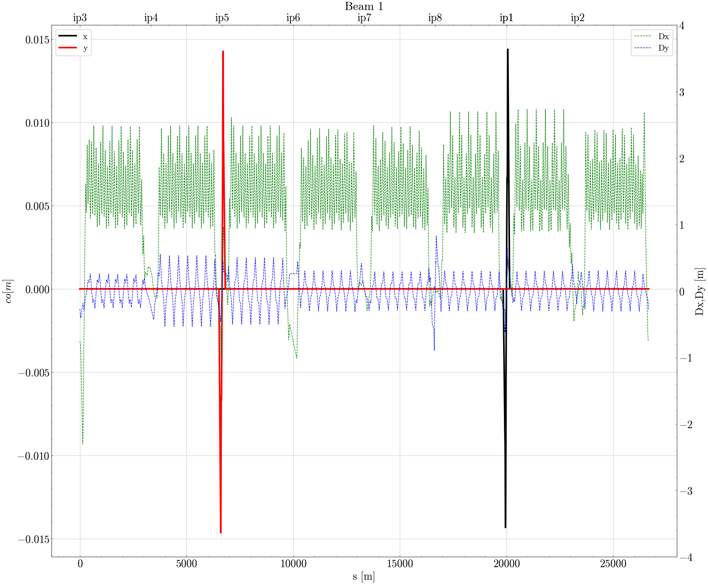
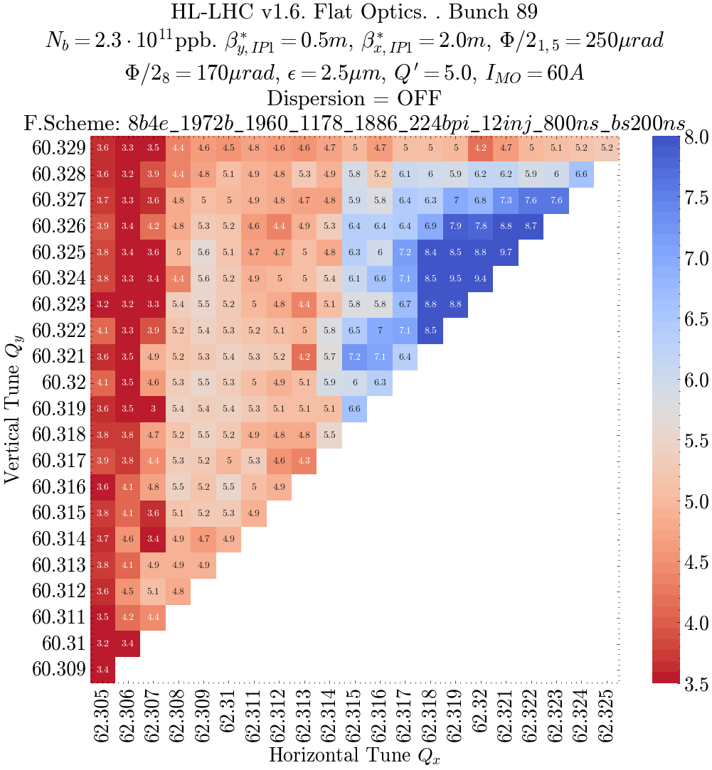
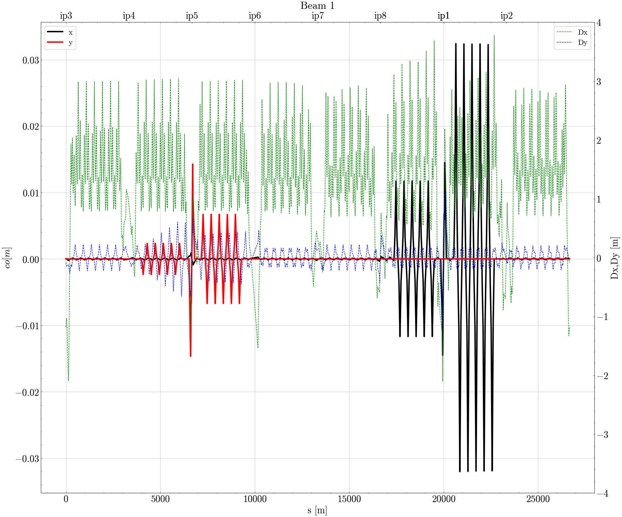
First test scan with 0.5/2.0m flat optics
Dispersion knobs are not optimal for this optics, causes, due to
sextupoles strength opimized also for off-momentum beta-beating in point 8
beta function too low to make it effective
No Dispersion
Why dispersion is OFF???
With Dispersion

Slide 6
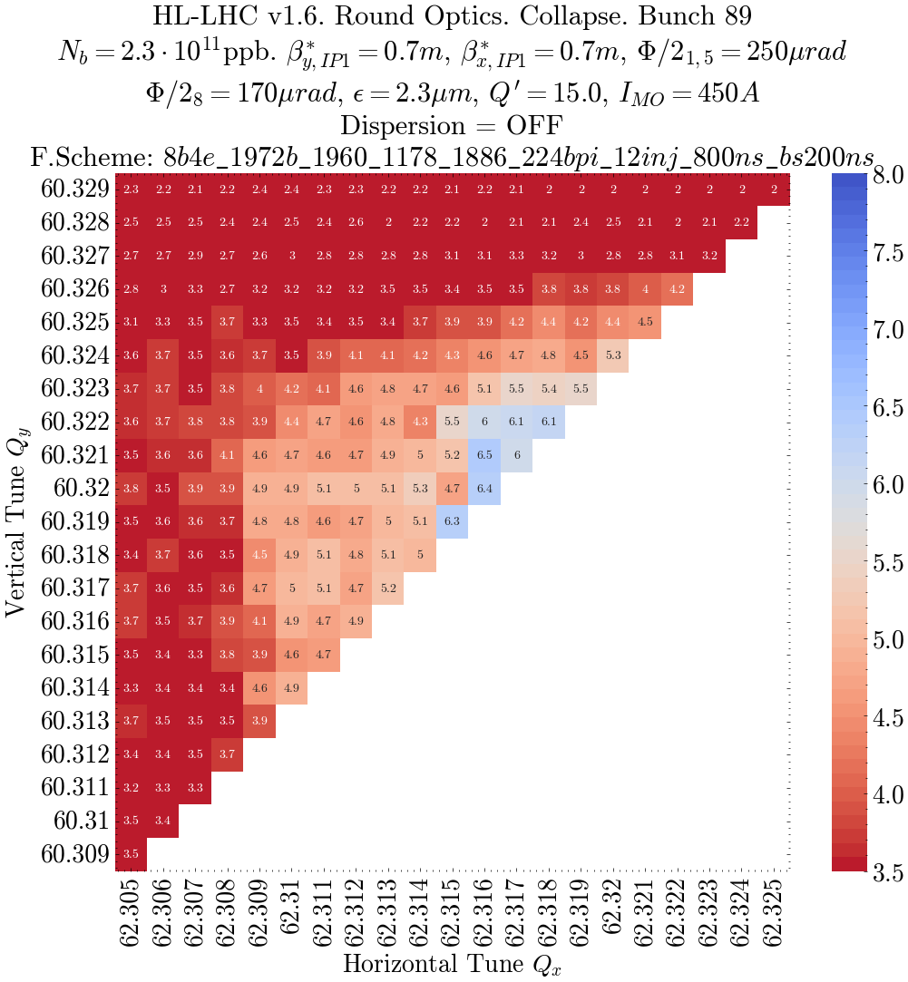
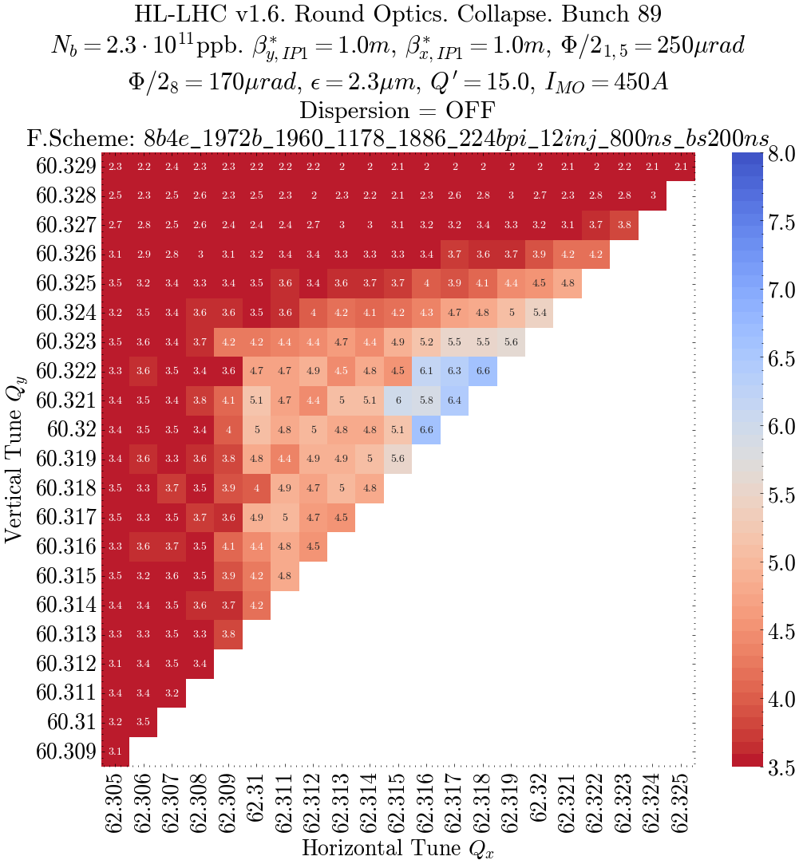
Collapse DA tune scans

Slide 7
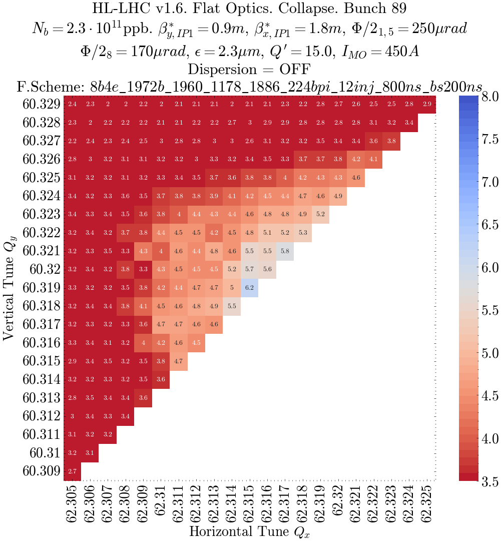
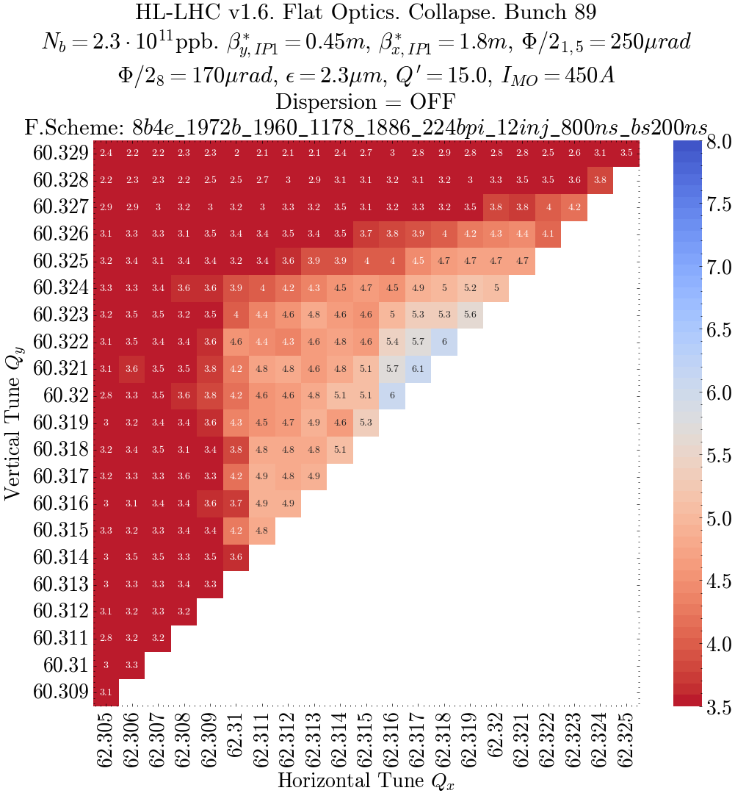
Collapse DA tune scans
f=2.36, g=1.47
rx=0.55 ry=0.28 f=2.56 g=1.64

Slide 8
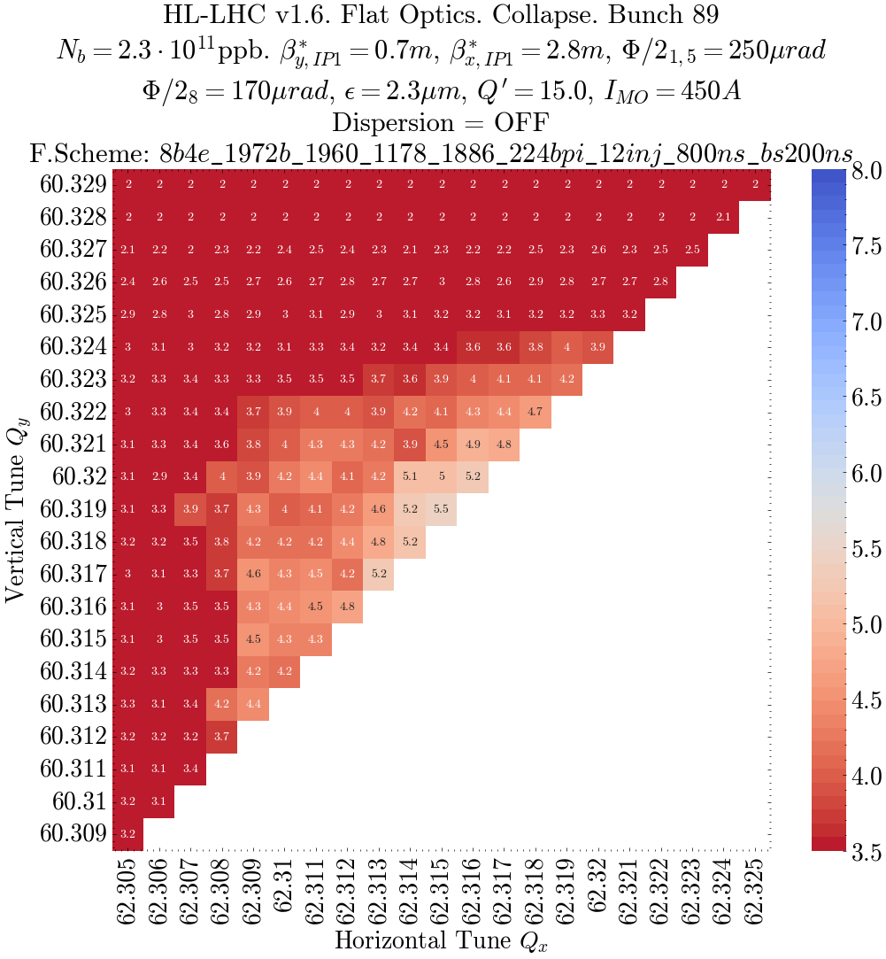
Collapse DA tune scans

Slide 9
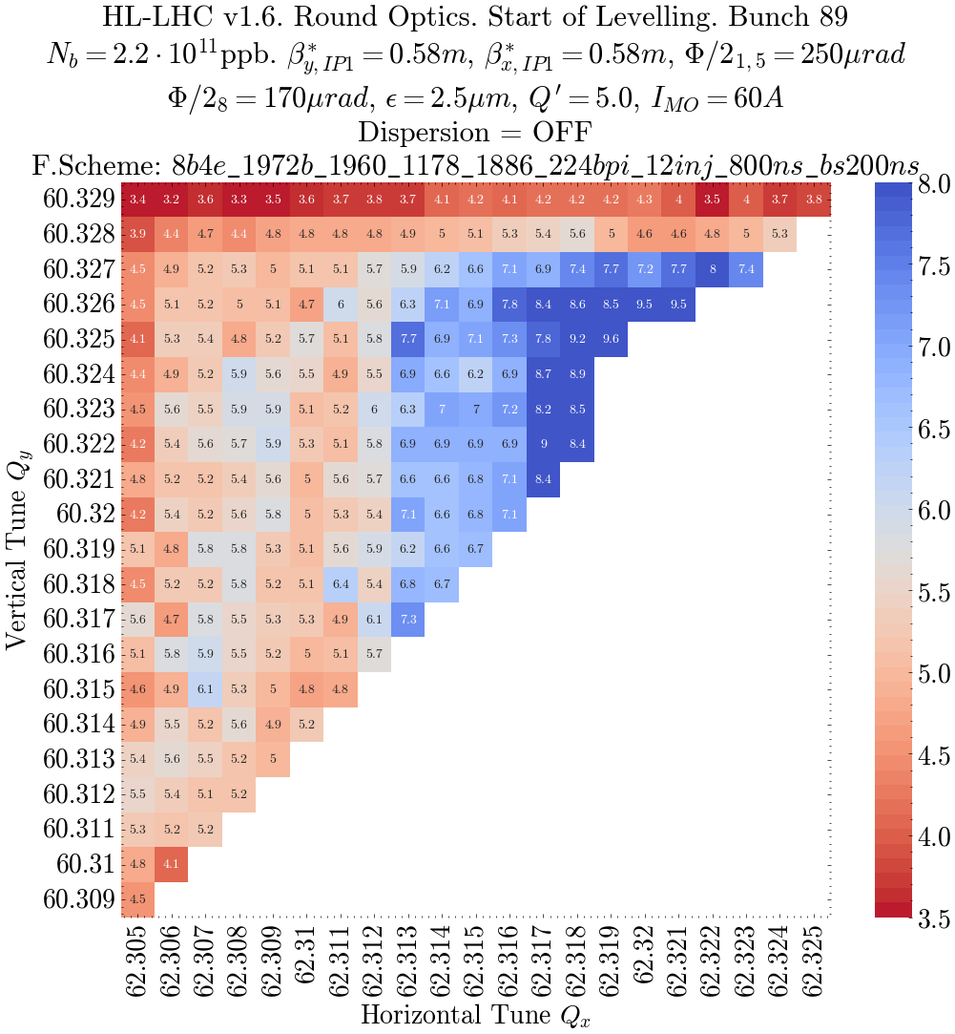
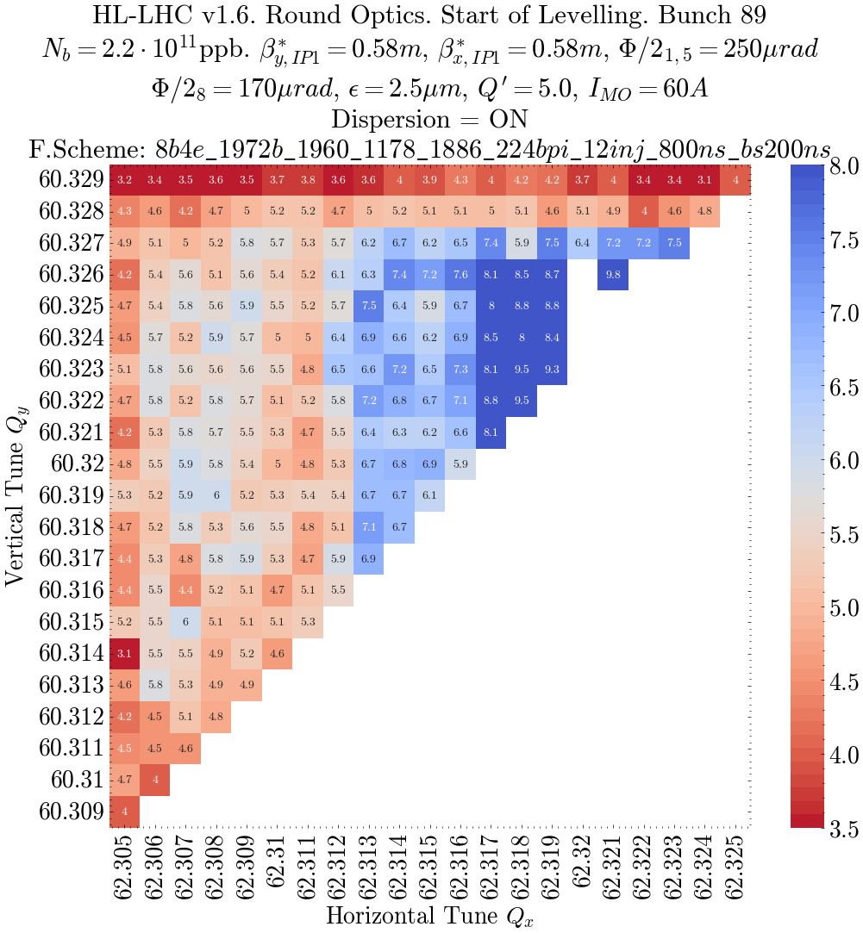
Start of Levelling

Slide 10
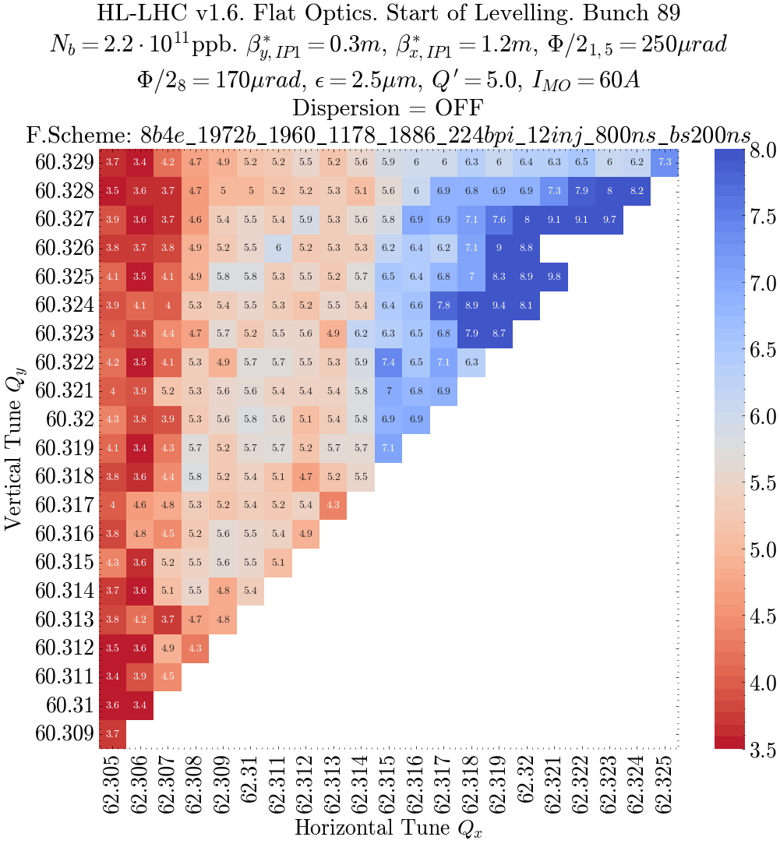
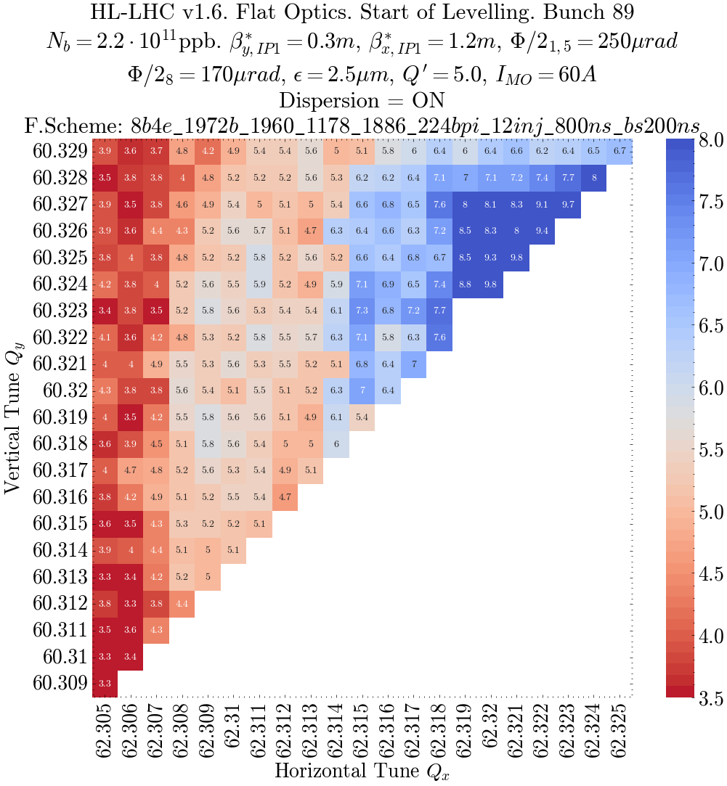
Start of Levelling

Slide 11
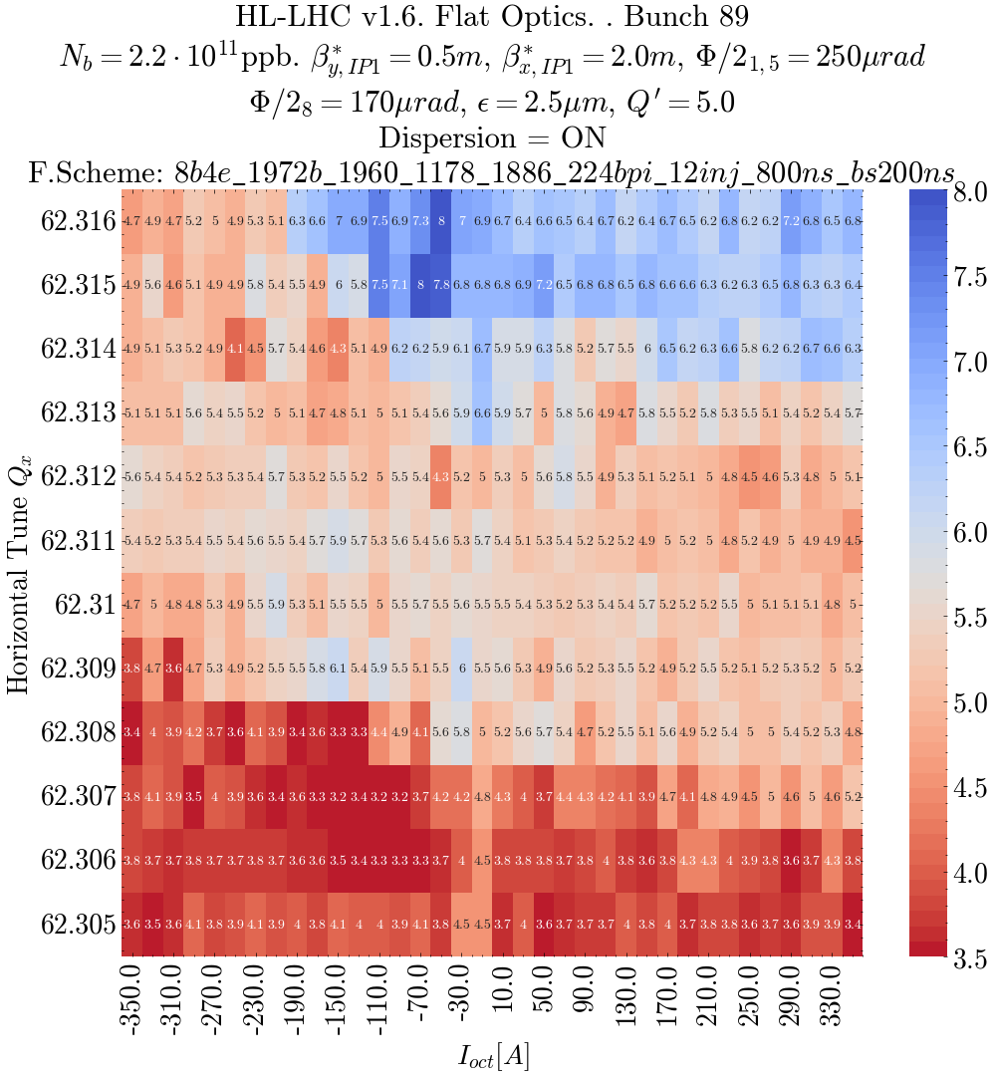
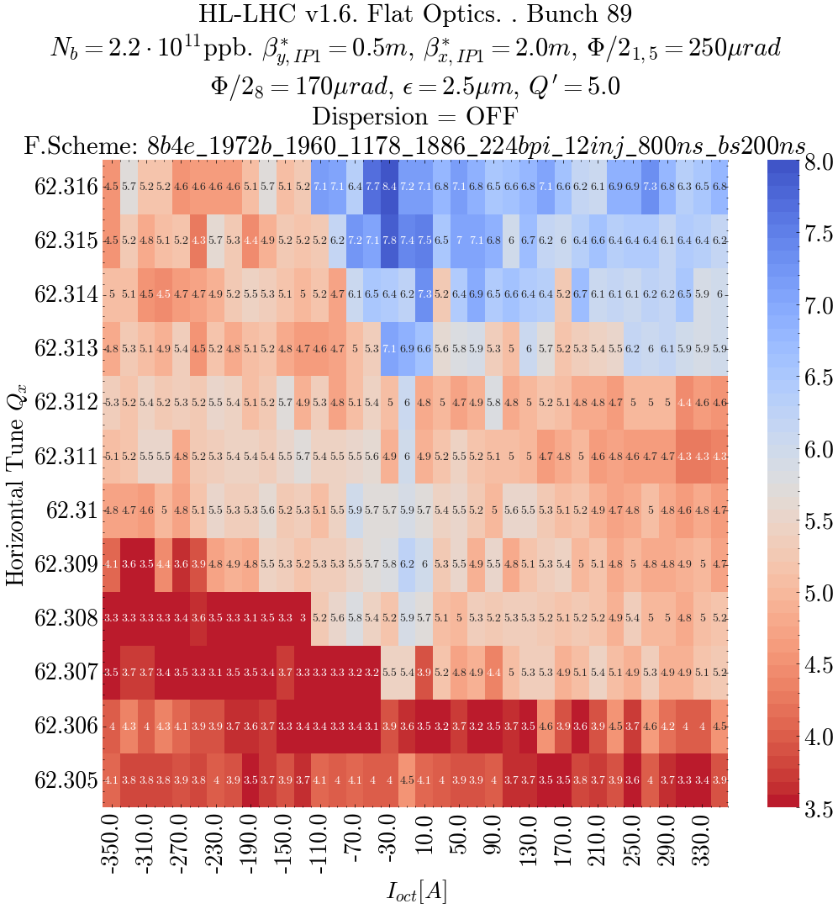
MO scans
Keeping Q_{y}=60.32
Instead of scanning the diagonal

Slide 12
Conclusions and next steps:
Optics for collapse and start of levelling
Scans for collapse and SoL can be done without dispersion
Dispersion knobs not working correctly for all the optics shown

Slide 13
