Slide 1
Automation of the Warm magnet Interlock Controller Commissioning (WIC)
BALLEJOS Lilian
22 / 08 / 2023

Slide 2
Plan
Context
  Short presentation of what is a WIC system
  What elements should be tested in a WIC
What has been done
  Algorithm created with MOMPO Richard and DUTRUEL Aymeric
  CCDA and PyCCDA extension for WIC commissioning
  Recovery of missing relationships
  Python code to apply the different algorithms
  Creating a GUI with PyQt to meet user needs (1/2)
What still needs to be done
  Add the missing information
  Solve both problems related to Power Converter
  Incorporate the WIC commissioning into AccTesting

Slide 3
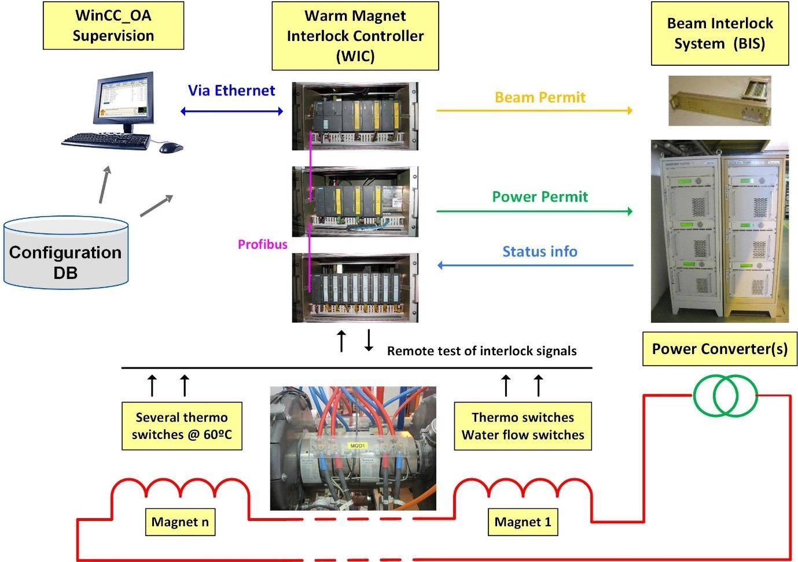
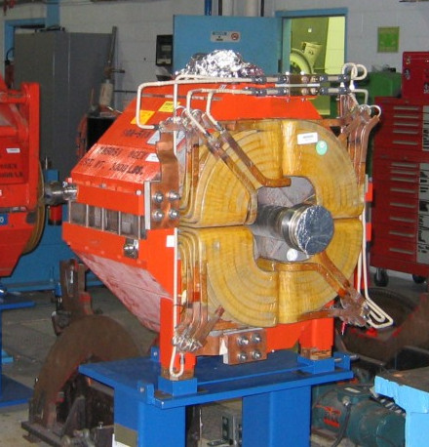
Short presentation of what is a WIC system (1/2)
Diagram from the WIC team website representing a WIC and all its entities
Magnet covered by a WIC system

Slide 4
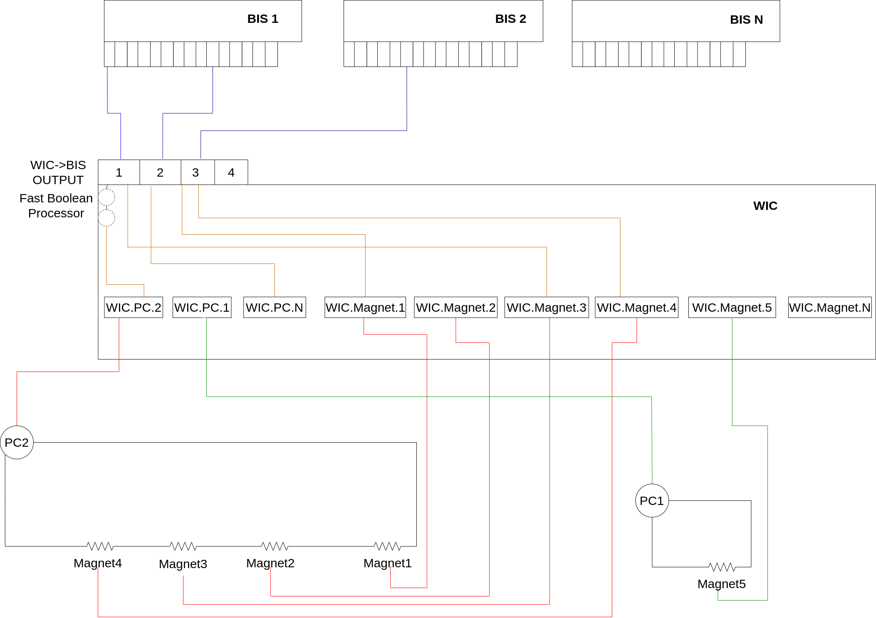
Short presentation of what is a WIC system (2/2)
0 to 4 possible connections to BIS systems
1-1 relationship between a WIC signal and the device it covers
Each WIC signal can be connected or not to one of the 4 WIC-> BIS outputs
On the WIC->BIS n°1 output only, there can be 0, 1 or 2 Fast boolean processors
1 Power converter can power multiple magnets
1 magnet can be powered by multiple Power Converters

Slide 5
What elements should be tested in a WIC (1/3)
WIC Power Converter Signals (WIC PC)
A WIC PC signal must receive a fault signal from a Power Converter if this one is in an internal fault
A WIC PC signal must in case of a detected error and connection to a WIC->BIS output, send a USER_PERMIT at False to the connected BIS

Slide 6
What elements should be tested in a WIC (2/3)
WIC Magnet Signals (WIC Magnet)
A WIC magnet signal must receive a fault signal from a magnet if this one is in a faulty state
A WIC magnet signal must put all Power Converter connected to the covered magnet in external fault (FAST_ABORT)
For safety, the error sent to a Power Converter is accomplished by two independent operating relays connected in series
A WIC magnet signal must in case of a detected error and connection to a WIC->BIS output, send a USER_PERMIT at False to the connected BIS

Slide 7
What elements should be tested in a WIC (3/3)
WIC->BIS relations
If there is a fast boolean processor on output 1, the following rule is respected: more than 12 Power Converters covered by the WIC: 2 fast boolean processors, otherwise 1
Reaction time with a fast boolean processor is around 6µs and around 50ms without
Only USER_PERMIT from WIC Power Converter signals use fast boolean processors
For security, the USER_PERMIT sent to the BIS are duplicated

Slide 8
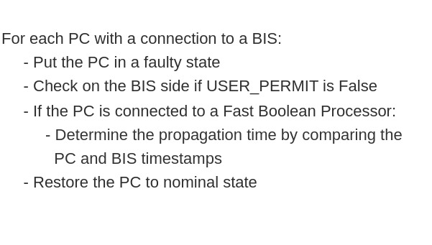
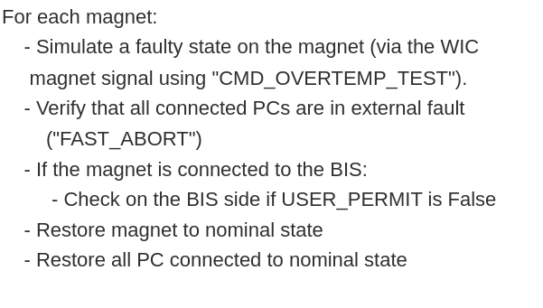
Algorithm created with MOMPO Richard and DUTRUEL Aymeric (1/2)
Stage 1: Checking the Power Converters
Stage 2: Checking the magnets

Slide 9
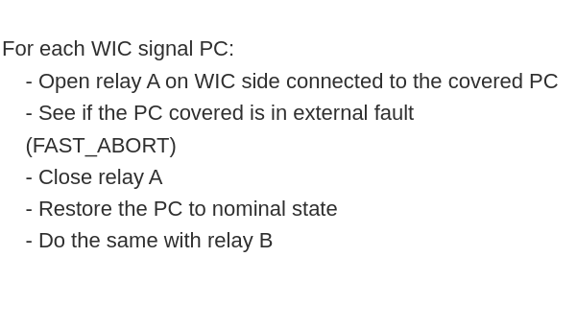

Algorithm created with MOMPO Richard and DUTRUEL Aymeric (2/2)
Stage 3: Checking USER_PERMIT redundancy
Stage 4: Checking relays redundancy

Slide 10
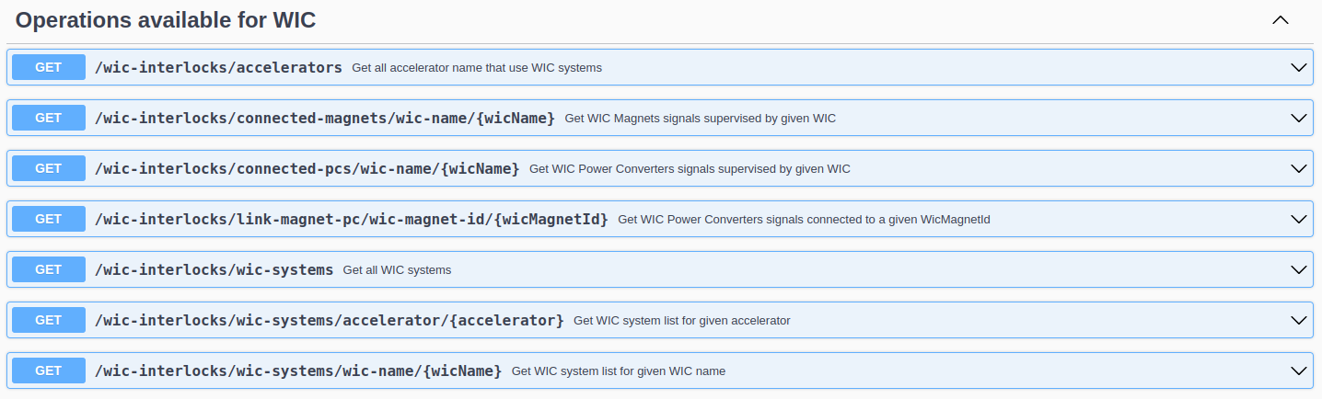
CCDA and PyCCDA extension for WIC commissioning
Modification of views to retrieve the necessary information for the commissioning of the WIC from the CCDB
Creation of endpoints to retrieve this information via the CCDA
Updating the PyCCDA Python module to cover the newly created endpoints
Management of these available endpoints start from PyCCDA release 1.18.2

Slide 11
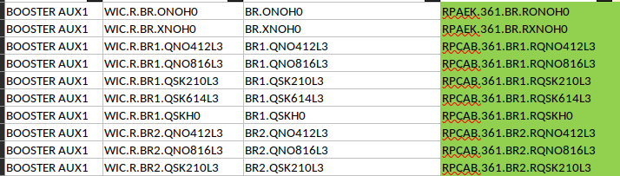
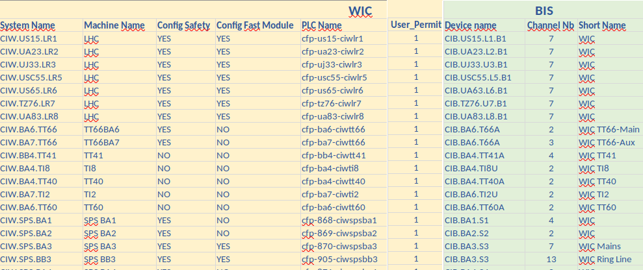
Recovery of missing relationships
Relation between WIC PC signals and covered PCs
Relation between WIC systems and BIS systems
Recovered approximately 90% of the 1279 relationships to be found using a Python script that searches for correlations between the names of WIC PC signals and PCs.
Rest completed by hand by Richard Mompo
Identified specific cases to be addressed
Filled by hand by Richard Mompo
Indicates for each WIC system which WIC ->BIS output is used
Indicates which channel of which BIS is connected to each WIC output.

Slide 12

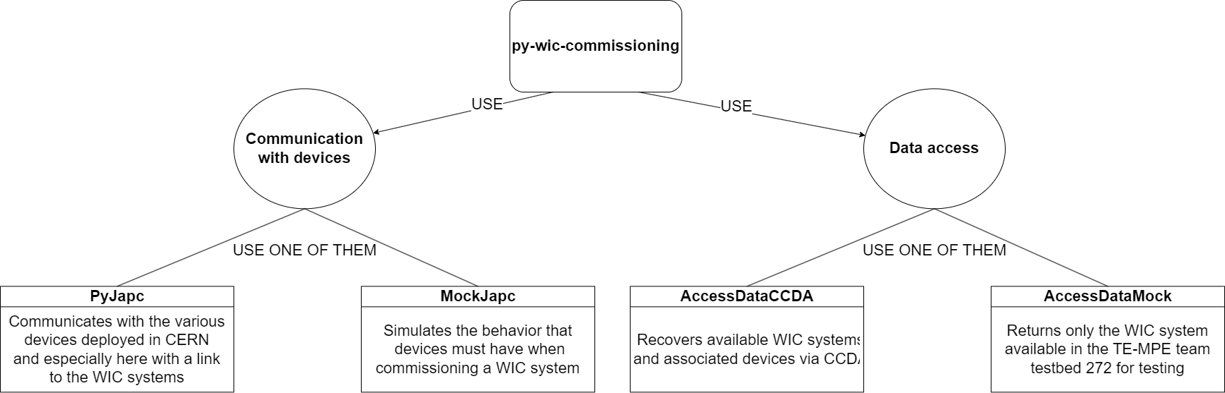
Python code to apply the different algorithms
Used the Python module PyJapc to communicate with different devices related to WIC systems
Used the Python PyCCDA module for data retrieval related to WIC systems
Researched and documented a way to use dependency injection in Python to manage the different behaviours created: module Dependency Injector
I created for each behaviour implemented a simulated version to perform the necessary tests
Performed all tests on a WIC system present in the testbed in 272

Slide 13
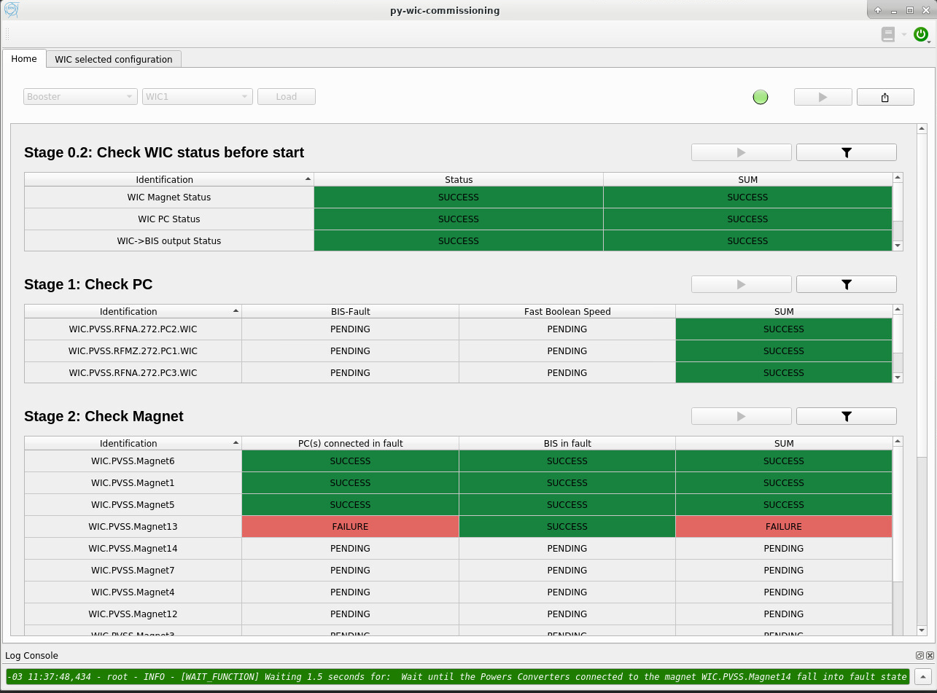
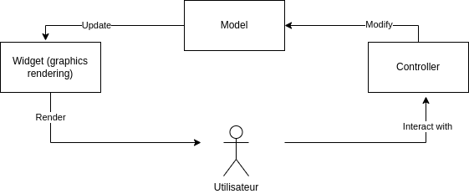
Creating a GUI with PyQt to meet user needs (1/2)
Appearance of the GUI
Logic behind the GUI
Researched the best way to organize a GUI in PyQt
Documented each of my choices in the code for the future of the team
Shared my new discoveries about PyQt to the team

Slide 14
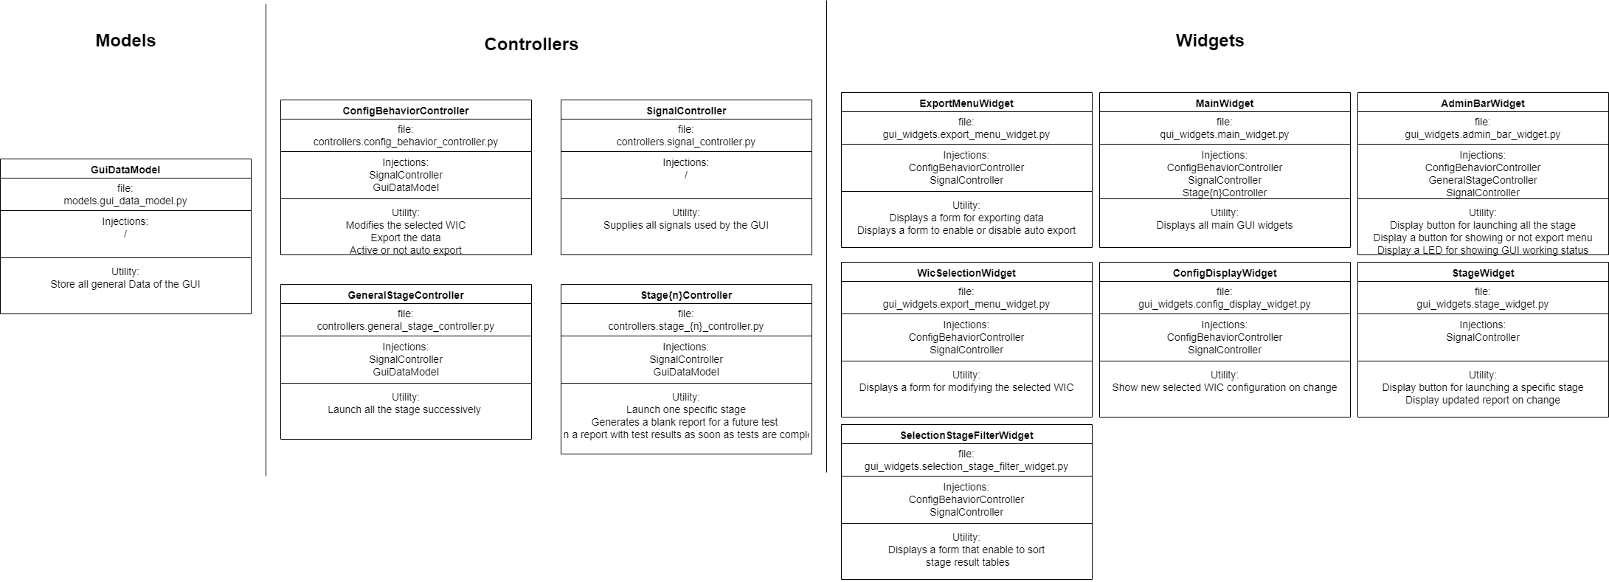
Creating a GUI with PyQt to meet user needs (2/2)
What has been implemented

Slide 15
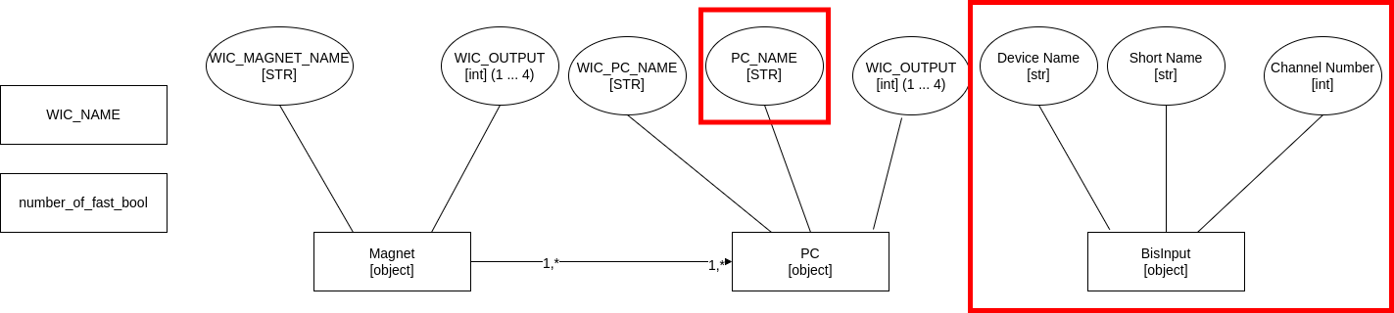
Add the missing information
Create new tables with missing information inside
Update CCDA
Update PyCCDA

Slide 16
Solve both problems related to Power Converter
Find a stable way to find non-FGC Power Converters
Fix in the Powers Converters test the problem with the recovery of timings
Some old Power Converters covered by WIC systems have no FGC layer
This means that if they are set in external fault by simulating a fault on a magnet, they cannot be restored to normal conditions remotely
They must absolutely be excluded from testing
Some of these non-FGC Power Converters are not even referenced in the CCDB
To calculate the time elapsed between the moment when a Power Converter goes into fault and the moment when the USER PERMIT passes in False on the BIS side, I retrieve the timestamp of the change of status on the BIS side and the time stamp of the change of status on the Power Converter side and performs the subtraction
I noticed aberrant results in some cases (negative elapsed time) that needs to be investigated

Slide 17
Incorporate the WIC commissioning into AccTesting
My project enabled us to clarify the organization and usage of WIC systems at our section level. It also allowed WIC experts to gain a better understanding of their true needs.
During the implementation of my Python program, I ensured to properly isolate the testing logic of my program from the GUI part so that it can be easily extracted.
We could now extract the logic of my Python code to automate the WIC commissioning to incorporate it in a more general project developed by our team
The next step of this project is to implement the testing logic on a server in order to integrate the WIC commissioning into AccTesting.

