Slide 1
Performance Limits
Daniel Novelli, for discussion 11.8.23

Slide 2
OLD APPROACH

Slide 3
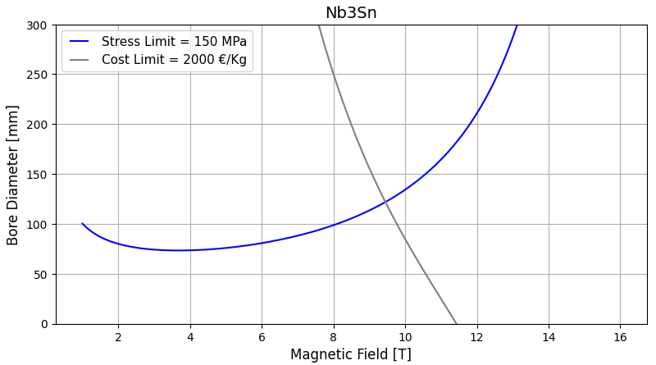




Dipole - Bore Diameter vs Bore Field
OLD APPROACH – J = Jc
B
J=Jc(B) with fixed T
w(B,J) from load line
$a_{1}$($σ$, w, Jc)
$a_{1}$(w, $A_{max−cost}$)
For high values of B, the critical current density follow the Jc with his margin. So, good assumption.
For low values of B, the critical current density is too high. So, bad assumption.

Slide 4
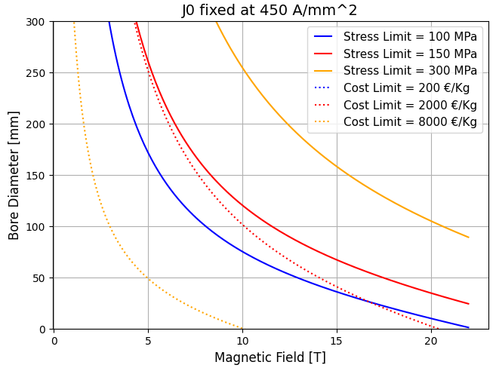


Dipole - Bore Diameter vs Bore Field
OLD APPROACH – J = J0
B
J=J0 fixed !
w(B,J) from load line
$a_{1}$($σ$, w, J0)
$a_{1}$(w, $A_{max−cost}$)
For low values of B, the critical current density is limited and doesn’t reach high values. So, good assumption.
For high values of B, the critical current density is too high (above the Jc). So, bad assumption.

Slide 5
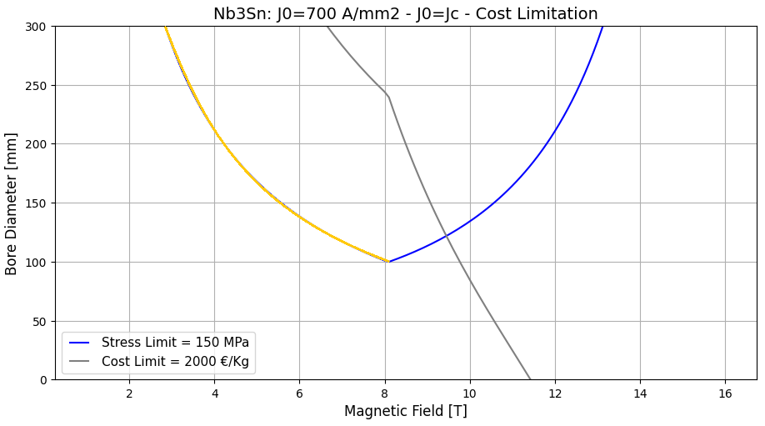
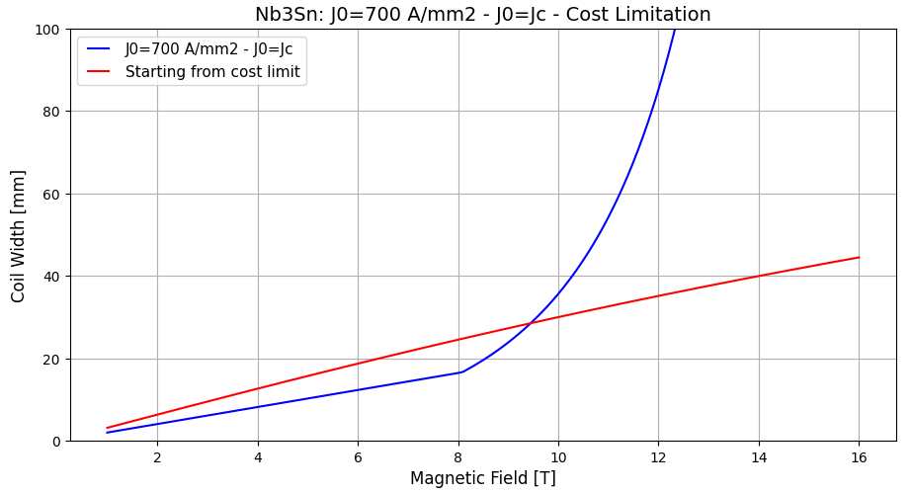
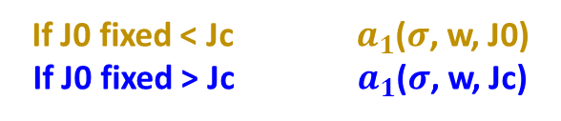
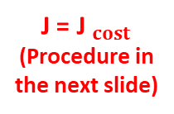
Dipole - Bore Diameter vs Bore Field
OLD APPROACH – Use the old approaches in their best approximation of reality
J=J0 fixed!
J=Jc(B) with fixed T
If J0 fixed < Jc $a_{1}$($σ$, w, J0)
If J0 fixed > Jc $a_{1}$($σ$, w, Jc)
B
J0 fixed = Jc
J=J0 fixed
J=Jc
J = J$_{cost}$
(Procedure in the next slide)
We are using the assumption in their best field of validity.
We are not taking into account the cost and protection limits

Slide 6
NEW APPROACH

Slide 7
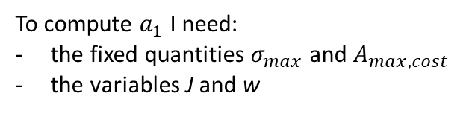




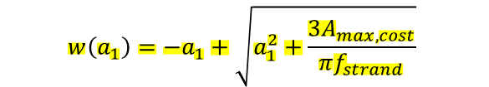



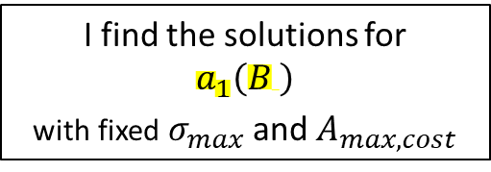
Dipole - Bore Diameter vs Bore Field
NEW APPROACH – Starting from the cost limit – Summary with formulas
Midplane Pressure
Cost (60° sector)
$σ\left(a_{1}, w, J\right)=\frac{2μ_{0}J_{ }^{2}}{πw} sinα cosα$ $\left(−\frac{2}{3}\frac{{a_{2}^{3}−a}_{1}^{3}}{3}−\frac{a_{1}^{3}}{3}\ln\left(\frac{a_{2}}{a_{1}}\right)+\frac{a_{2}^{3}−a_{1}^{2}a_{2}}{2} \right)$
$$A_{max, cost}\left(w, a_{1}\right)=\frac{π}{3}\left(w^{2}+2a_{1}w\right)$$
$$a_{2}=a_{1}+w$$
$$\frac{π}{3}\left(w^{2}+2a_{1}w\right)−A_{max, cost}=0$$
$\frac{2μ_{0}J_{ }^{2}}{πw} sinα cosα$ $\left(−\frac{2}{3}\frac{{a_{2}^{3}−a}_{1}^{3}}{3}−\frac{a_{1}^{3}}{3}\ln\left(\frac{a_{2}}{a_{1}}\right)+\frac{a_{2}^{3}−a_{1}^{2}a_{2}}{2} \right)−σ_{max}=0$
$$w\left(a_{1}\right)=−a_{1}+\sqrt{a_{1}^{2}+\frac{3A_{max, cost}}{πf_{strand}}}$$
To compute $a_{1}$ I need:
the fixed quantities $σ_{max}$ and $A_{max, cost}$
the variables J and w
Load Line
$$B\left(w, J\right)=\frac{2μ_{0 }J_{ }w}{π} sinα$$
$$J\left(w, B\right)=\frac{π B}{2μ_{0} w sinα}$$
Function of${ ( J, a}_{1}^{ } , w$)
or similarly of ${(B, a}_{1}^{ }$)
I find the solutions for
$$a_{1}\left(B \right)$$
with fixed $σ_{max}$ and $A_{max, cost}$
$$w\left(B, J\right)=\frac{π B}{2μ_{0} J sinα}$$

Slide 8
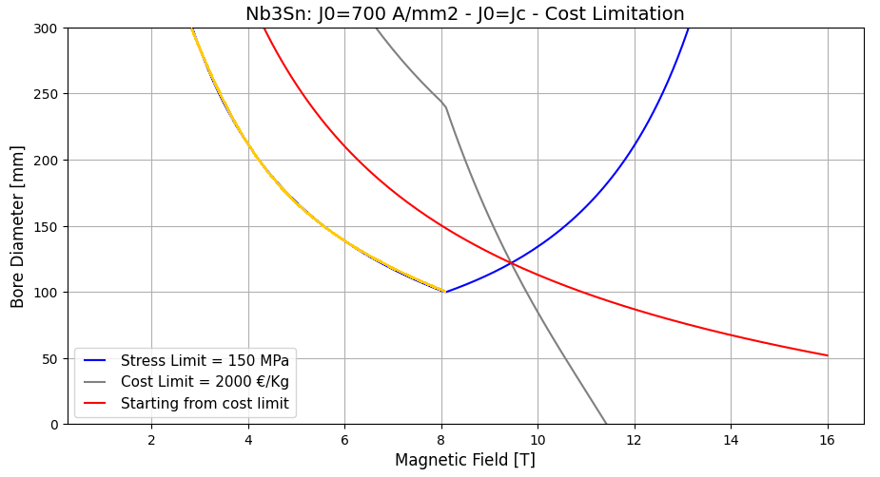
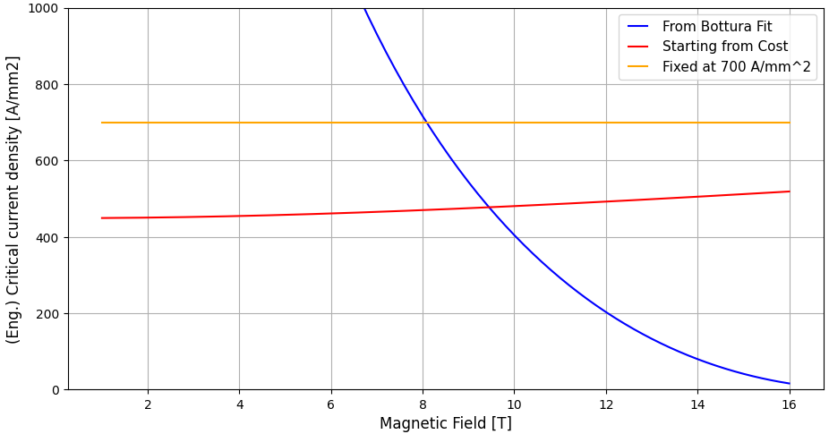


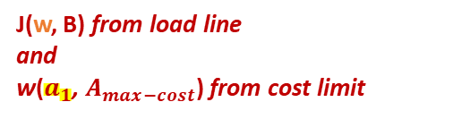
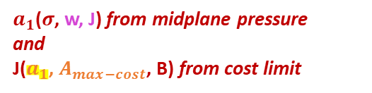

Dipole - Bore Diameter vs Bore Field
NEW APPROACH – Outline
J(w, B) from load line
and
w($a_{1}$, $A_{max−cost}$) from cost limit
$a_{1}$($σ$, w, J) from midplane pressure
and
J($a_{1}$, $A_{max−cost}$, B) from cost limit
B
$a_{1}$($σ$, $A_{max−cost}$, B)
J0 fixed = Jc
J=J0 fixed
J=J0 fixed
J=Jc
J = J$_{costo}$
J = J$_{costo}$
J=Jc
At HF region, above , the J$_{cost}$ > Jc!
At LF region, below , the critical current density is fixed by the cost.

Slide 9
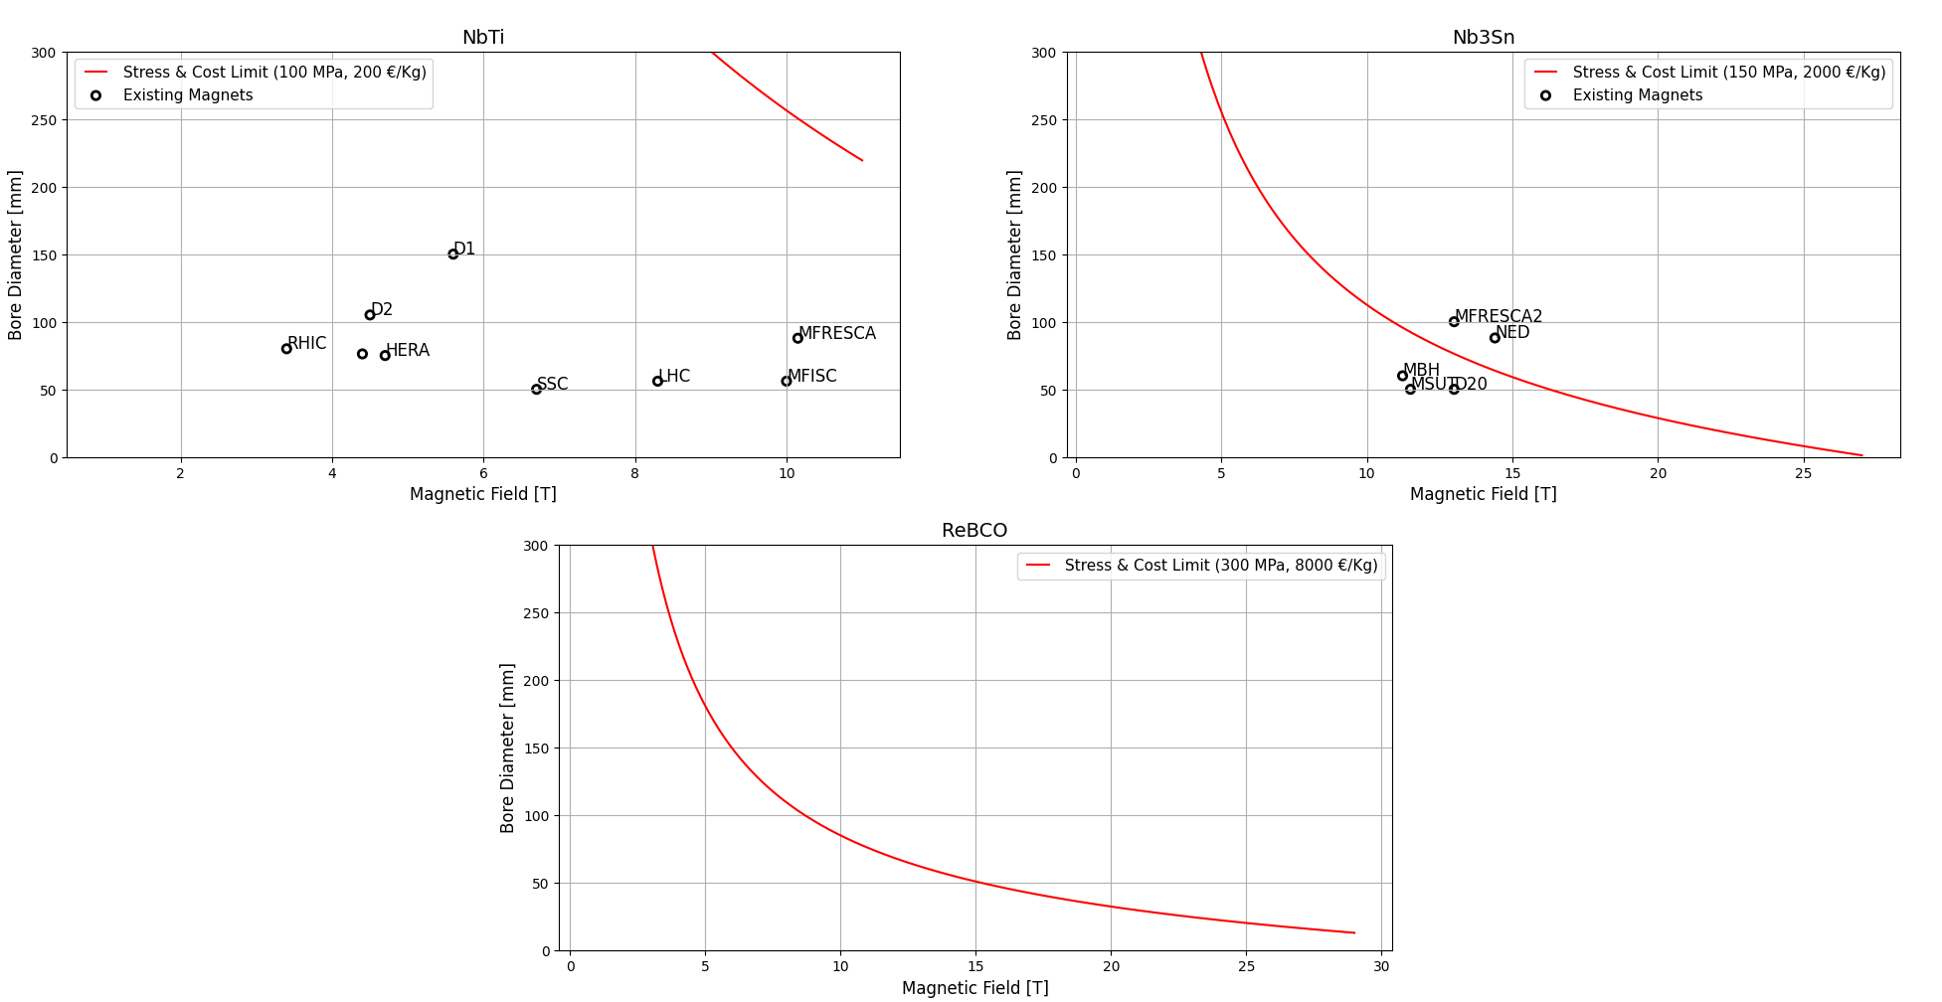
Dipole - Bore Diameter vs Bore Field
NEW APPROACH – New plots
Cost Limit for the magnet (only superconductor) = 100 K€
Tevatron
!
||
Allowed region
We must consider Jc

Slide 10
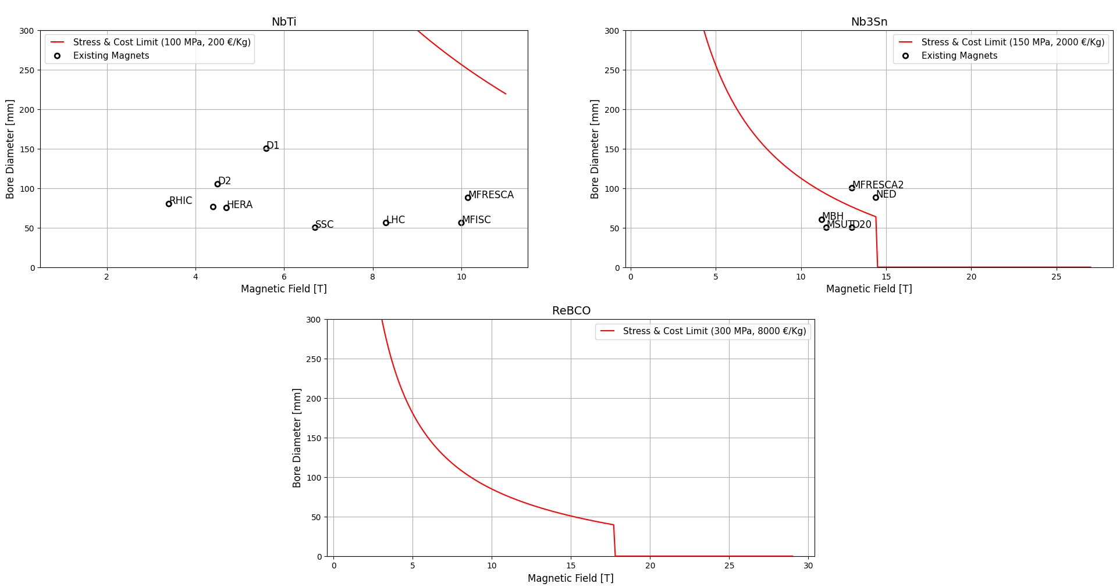
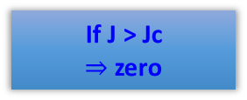
Dipole - Bore Diameter vs Bore Field
NEW APPROACH – New plots (Jc limitations)
Cost Limit for the magnet (only superconductor) = 100 K€
@ 1.9 K
@ 4.2 K
Different cost limit
No iron hypothesis
Tevatron
@ 4.2 K
If J > Jc
$⇒$ zero
Jc (T) !

Slide 11
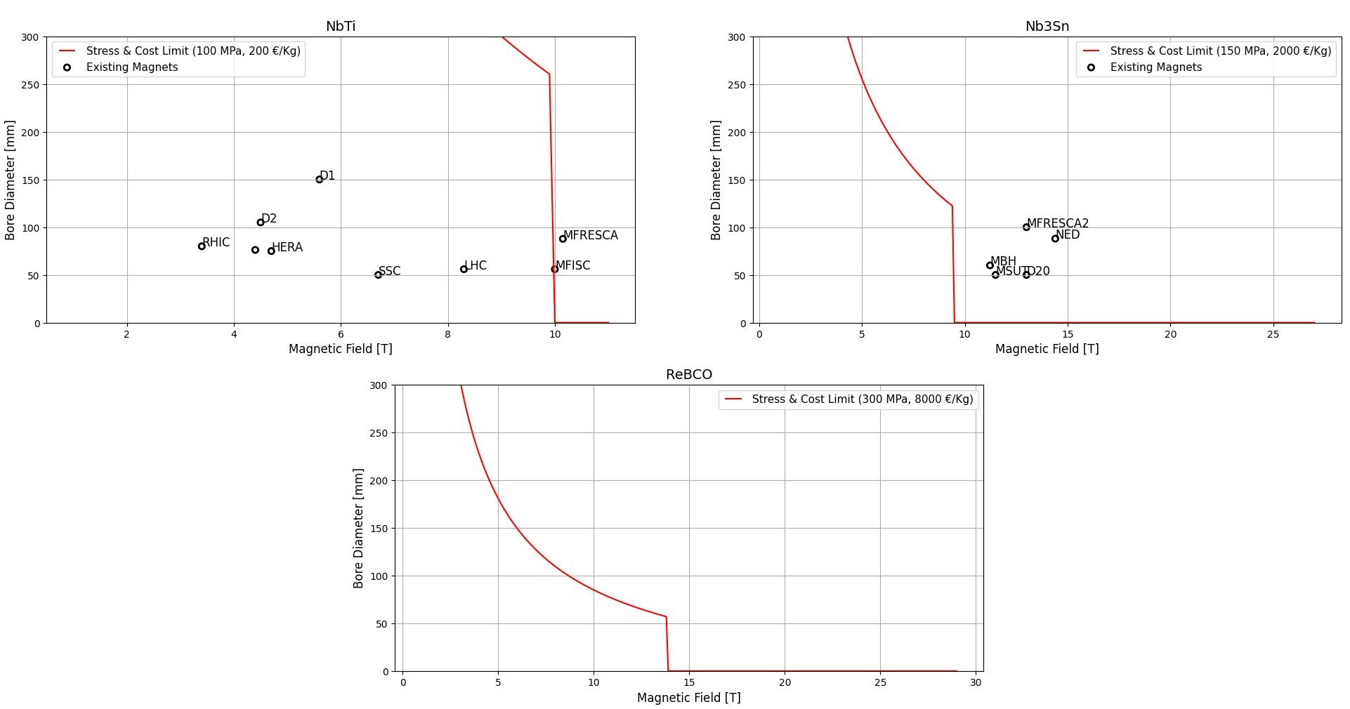
Dipole - Bore Diameter vs Bore Field
NEW APPROACH – New plots (Different Jc)
Cost Limit for the magnet (only superconductor) = 100 K€
@ 1.9 K + 2 K
@ 4.2 K + 4.5 K
Tevatron
@ 4.2 K + 4.8 K
Enthalpy margins translated in terms of temperature margins
Strong
cost limit

Slide 12
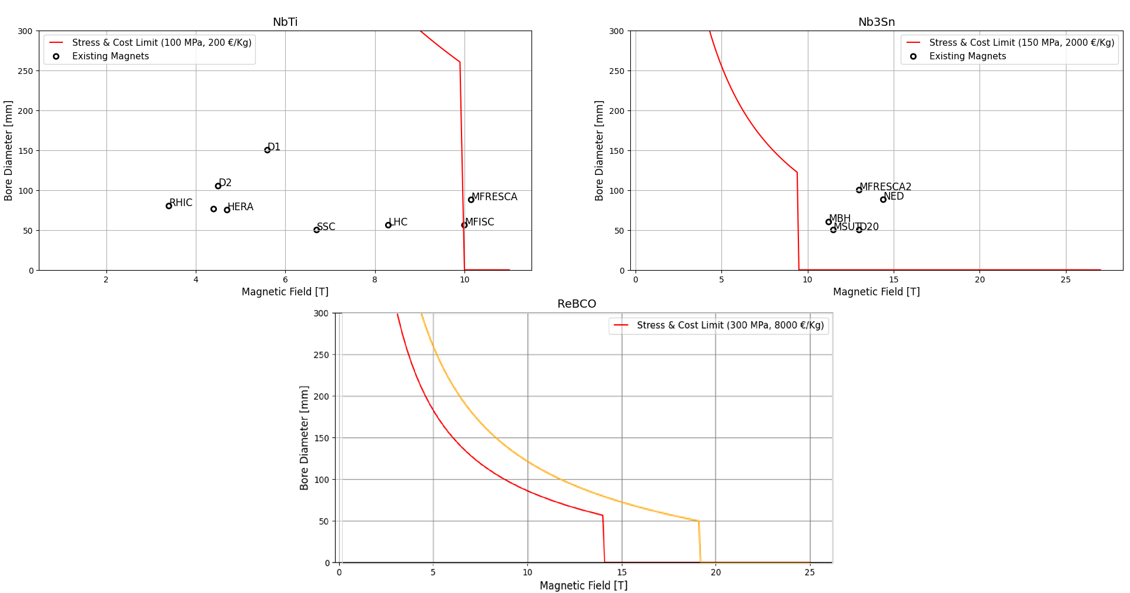
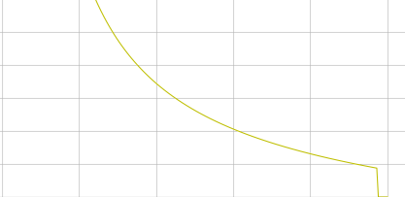
Dipole - Bore Diameter vs Bore Field
NEW APPROACH – New plot (Cost Variation)
Cost Limit for the magnet (only superconductor) = 100 K€
@ 1.9 K + 2 K
@ 4.2 K + 4.5 K
Tevatron
@ 4.2 K + 4.8 K
Reducing the cost by a factor of 4
Reducing the cost by a factor of 2

Slide 13
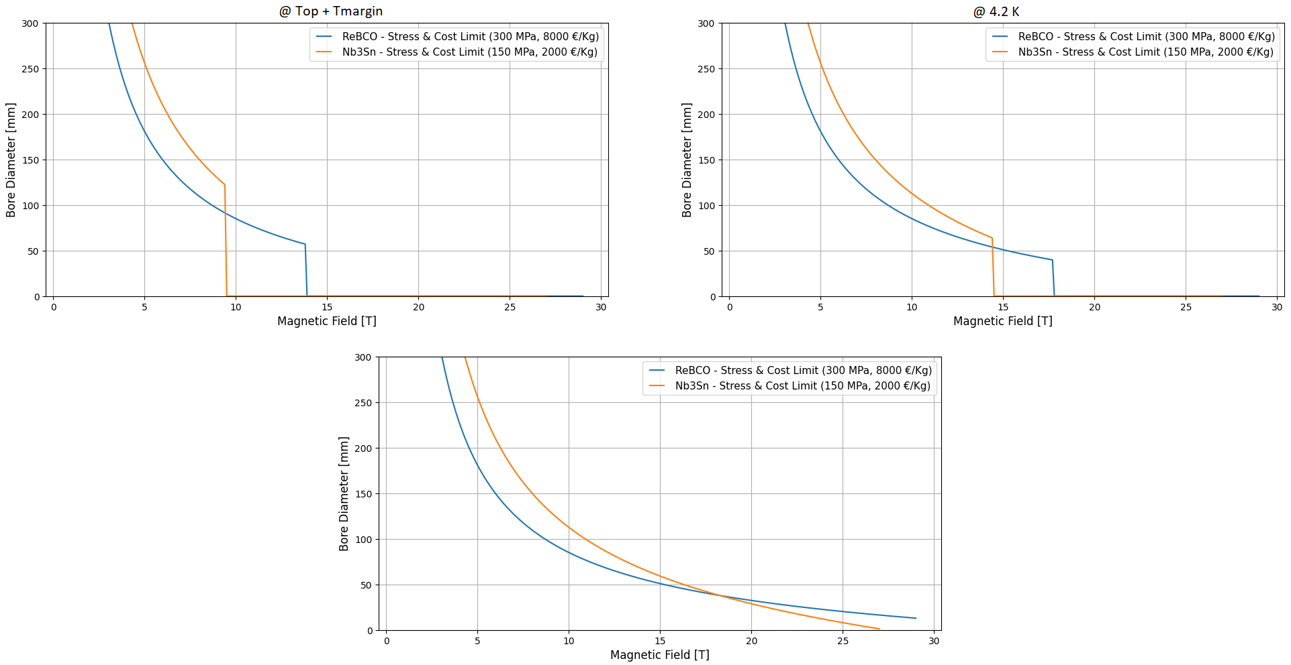
Dipole - Bore Diameter vs Bore Field
NEW APPROACH – Compare
Cost Limit for the magnet (only superconductor) = 100 K€

Slide 14
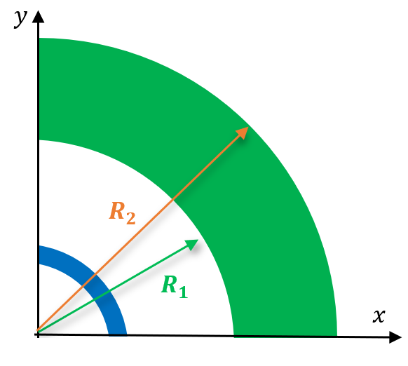

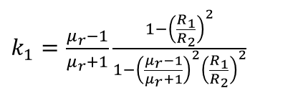


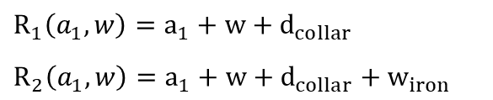

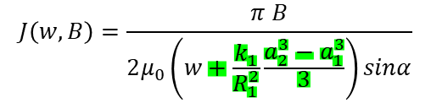




Dipole - Bore Diameter vs Bore Field
IRON YOKE
$$a_{1}=internal radius$$
$$w=coil width$$
$$a_{2}=a_{1}+w$$
$$R_{1}=a_{2}+d_{collar}$$
$R_{2}=R_{1}+w_{iron}$
Assumptions
$$d_{collar}∼30 mm$$
$$R_{1}\left(a_{1},w\right)=a_{1}+w+d_{collar}$$
$R_{2}\left(a_{1},w\right)=a_{1}+w+d_{collar}+w_{iron}$
$$w_{iron}∼150 mm$$
Midplane Pressure, sector dipole (first order of approx.)
$\frac{2μ_{0}J_{ }^{2}}{πw} sinα cosα$ $\left(−\frac{2}{3}\frac{{a_{2}^{3}−a}_{1}^{3}}{3}−\frac{a_{1}^{3}}{3}\ln\left(\frac{a_{2}}{a_{1}}\right)+\frac{a_{2}^{3}−a_{1}^{2}a_{2}}{2}−\frac{k_{1}}{R_{1}^{2}}\frac{a_{2}^{3}−a_{1}^{3}}{3}\frac{a_{2}^{2}−a_{1}^{2}}{2} \right)−σ_{max}=0$
$$a_{2}$$
Load Line
$k_{1}=\frac{μ_{r}−1}{μ_{r}+1}\frac{1−{\left(\frac{R_{1}}{R_{2}}\right)}^{2}}{1−{\left(\frac{μ_{r}−1}{μ_{r}+1}\right)}^{2}{\left(\frac{R_{1}}{R_{2}}\right)}^{2}}$
$$B\left(w, J\right)=\frac{2μ_{0 }J_{ }}{π}\left(w+\frac{k_{1}}{R_{1}^{2}}\frac{a_{2}^{3}−a_{1}^{3}}{3}\right) sinα$$
$$a_{1}$$
$$J\left(w, B\right)=\frac{π B}{2μ_{0}\left(w+\frac{k_{1}}{R_{1}^{2}}\frac{a_{2}^{3}−a_{1}^{3}}{3}\right)sinα}$$
$$d_{collar}$$
$$w_{iron}$$
Coil

Slide 15
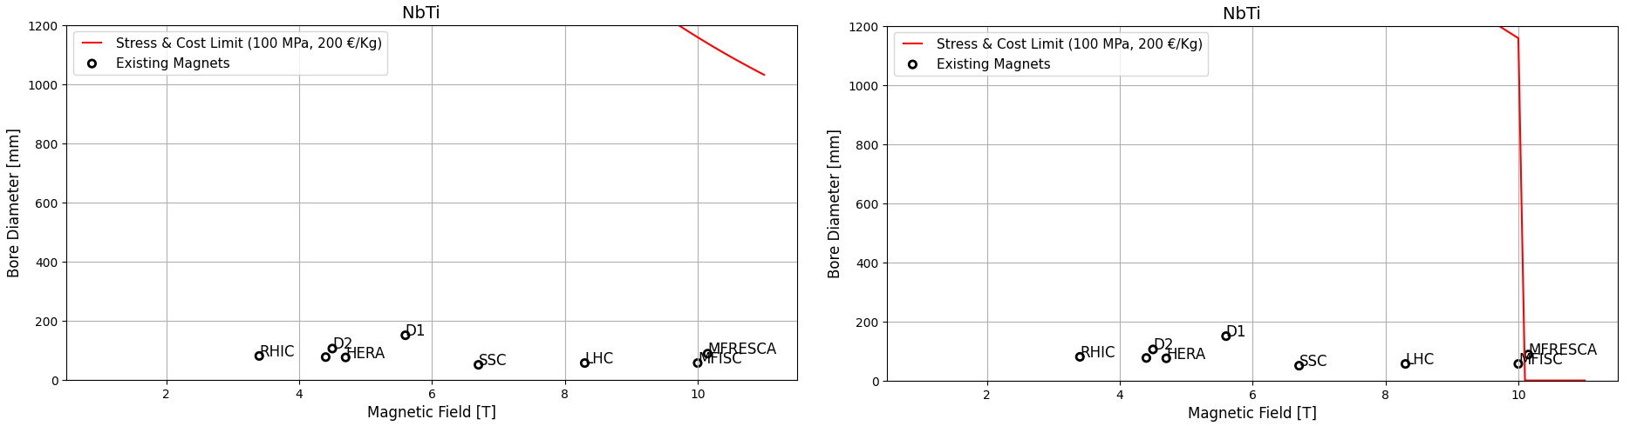
Dipole - Bore Diameter vs Bore Field
IRON YOKE – NbTi
Cost Limit for the magnet (only superconductor) = 100 K€
Cost of superconductor = 200 €/Kg
Density of the material = 8000 Kg/m3
@ 1.9 K
@ 1.9 K + 2 K

Slide 16
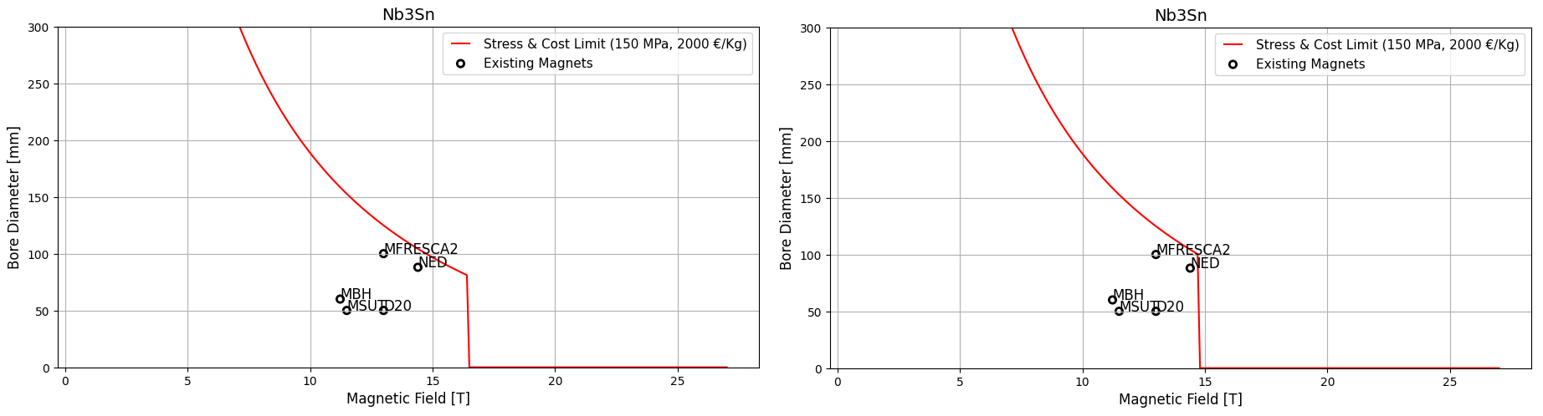
Dipole - Bore Diameter vs Bore Field
IRON YOKE – Nb3Sn
Cost Limit for the magnet (only superconductor) = 100 K€
Cost of superconductor = 2000 €/Kg
Density of the material = 8000 Kg/m3
@ 1.9 K
@ 4.2 K

Slide 17
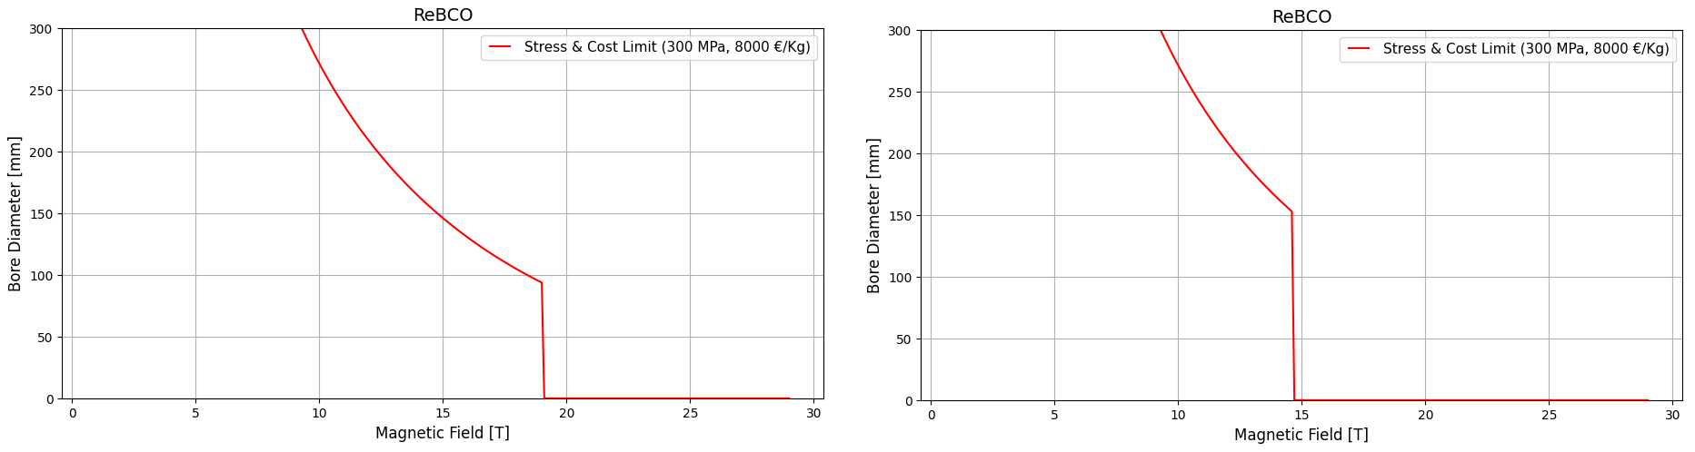
Dipole - Bore Diameter vs Bore Field
IRON YOKE – ReBCO
Cost Limit for the magnet (only superconductor) = 100 K€
Cost of superconductor = 8000 €/Kg
Density of the material = 8000 Kg/m3
@ 4.2 K
@ 4.2 K + 4.8 K

Slide 18
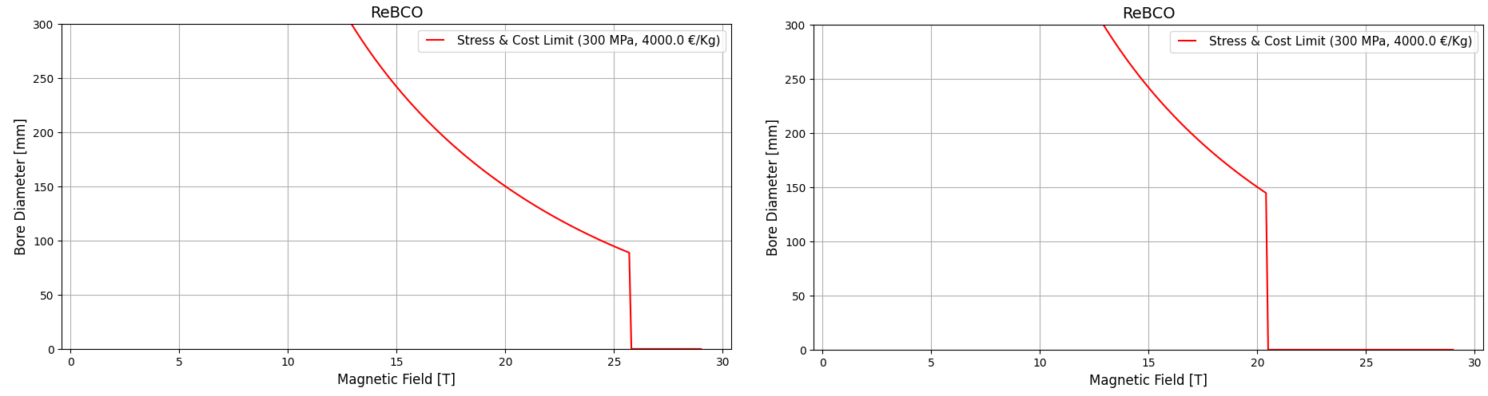
Dipole - Bore Diameter vs Bore Field
IRON YOKE – ReBCO (cost reduction, factor 2)
Cost Limit for the magnet (only superconductor) = 100 K€
Cost of superconductor = 4000 €/Kg
Density of the material = 8000 Kg/m3
@ 4.2 K
@ 4.2 K + 4.8 K

Slide 19
QUADRUPOLE

Slide 20


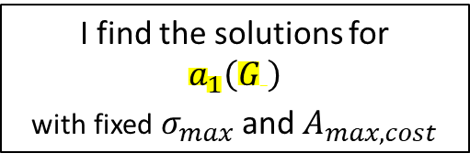



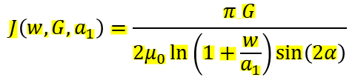
Quadrupole - Bore Diameter vs Bore Field
Starting from the cost limit – Summary with formulas
Midplane Pressure
Midplane Pressure
Cost (30° sector)
$σ\left(a_{1}, w, J\right)=\frac{μ_{0}J_{ }^{2}}{πw}\sin\left(2α\right)\cos\left(2α\right)$ $\left(\frac{7}{36}\left({a_{2}^{3}−a}_{1}^{3}\right)−\frac{a_{1}^{3}}{3}\ln\left(\frac{a_{2}}{a_{1}}\right)+\frac{a_{1}^{4}−a_{1}^{3}a_{2}}{4a_{2}}\right)$
$$A_{max, cost}\left(w, a_{1}\right)=\frac{πf_{strand}}{3}\left(w^{2}+2a_{1}w\right)$$
$$a_{2}=a_{1}+w$$
$$\frac{πf_{strand}}{3}\left(w^{2}+2a_{1}w\right)−A_{max, cost}=0$$
$\frac{μ_{0}J_{ }^{2}}{πw}\sin\left(2α\right)\cos\left(2α\right)$ $\left(\frac{7}{36}\left({a_{2}^{3}−a}_{1}^{3}\right)−\frac{a_{1}^{3}}{3}\ln\left(\frac{a_{2}}{a_{1}}\right)+\frac{a_{1}^{4}−a_{1}^{3}a_{2}}{4a_{2}} \right)−σ_{max}=0$
$$w\left(a_{1}\right)=−a_{1}+\sqrt{a_{1}^{2}+\frac{3A_{max, cost}}{πf_{strand}}}$$
To compute $a_{1}$ I need:
the fixed quantities $σ_{max}$ and $A_{max, cost}$
the variables J and w
Load Line
$$G\left(w, J,a_{1}\right)=\frac{{2μ}_{0 }J_{ }}{π}\ln\left(1+\frac{w}{a_{1}}\right)\sin\left(2α\right)$$
$$J\left(w, G,a_{1}\right)=\frac{π G}{2μ_{0}\ln\left(1+\frac{w}{a_{1}}\right)\sin\left(2α\right)}$$
Function of${ ( J, a}_{1}^{ } , w$)
or similarly of ${(G, a}_{1}^{ }$)
I find the solutions for
$$a_{1}\left(G \right)$$
with fixed $σ_{max}$ and $A_{max, cost}$
$$w\left(G, J,a_{1}\right)=a_{1}\left[\exp\left(\frac{πG}{2μ_{0}Jsin\left(2α\right)}\right)−1\right]$$

