Slide 1


Cryogenics for HL-LHC: from cooling requirements to procurement and future challenges
S. Claudet, on behalf of HL-WP9-Cryogenics project team
25th Apr 2023
CERN,
Geneva (CH)

Slide 2
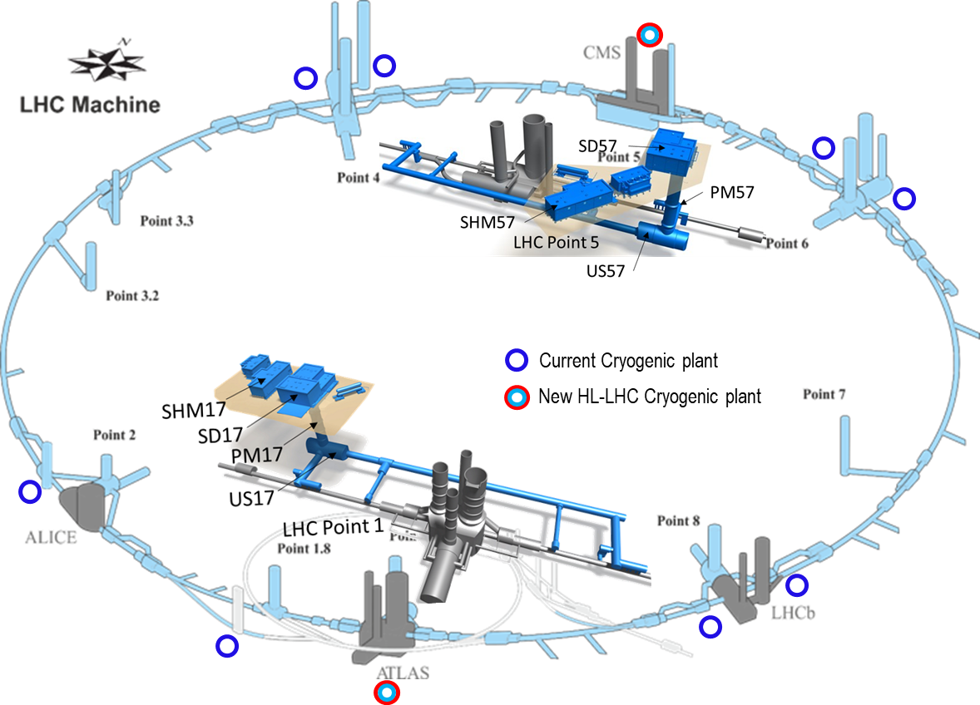
Content
Brief introduction to CERN, LHC and HL-LHC
HL-LHC Cryogenic scope and architecture
Refrigerators and Cryogenic distribution line
Complementary items
Schedule
Summary

Slide 3

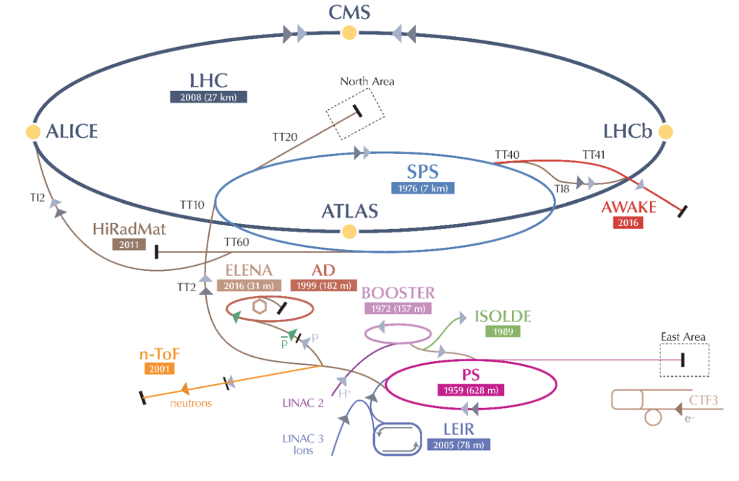
CERN in brief
Funded in 1954 as “Science for Peace”
Now with 23 member states
2’300 staff, 1’600 others & 10’500 users
1’200 MCHF annual budget (pro GDP)
A very large technical site for a series of accelerators, detectors and computing serving particle physics towards high energies and diversity

Slide 4



The LHC accelerator
proton-proton collisions at 2 x 7 TeV, 500 MJ stored energy
2007-2009: Cool-down and commissioning
2010-2012: Collisions and Higgs boson discovery
Since: much more Higgs and all kind of physics,
Keep going like this ?!?
2012
24 km of superconducting magnets (8.33T) @ 1.9K, 140t Helium

Slide 5
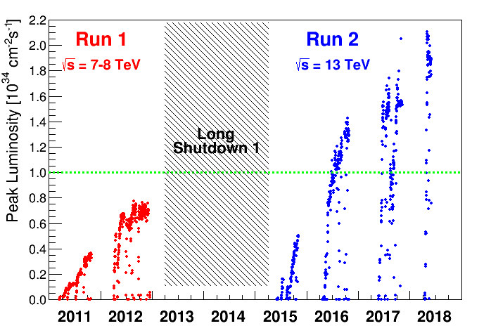
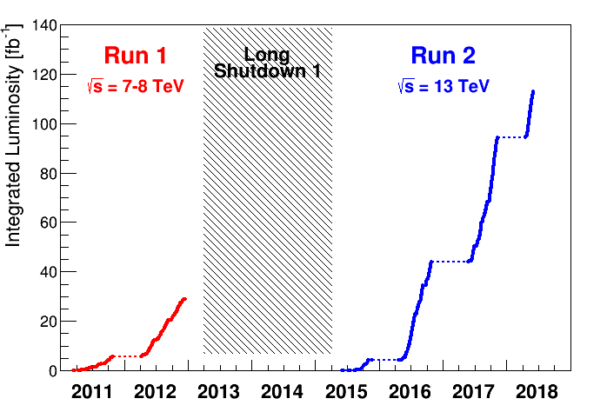
Basic KPIs of a collider
Peak Luminosity
=> Performance
Integrated Luminosity,
=> Qualification – Global availability - Time
Nominal luminosity
“ The potential of the facility”
“What allows science” (statistics)

Slide 6
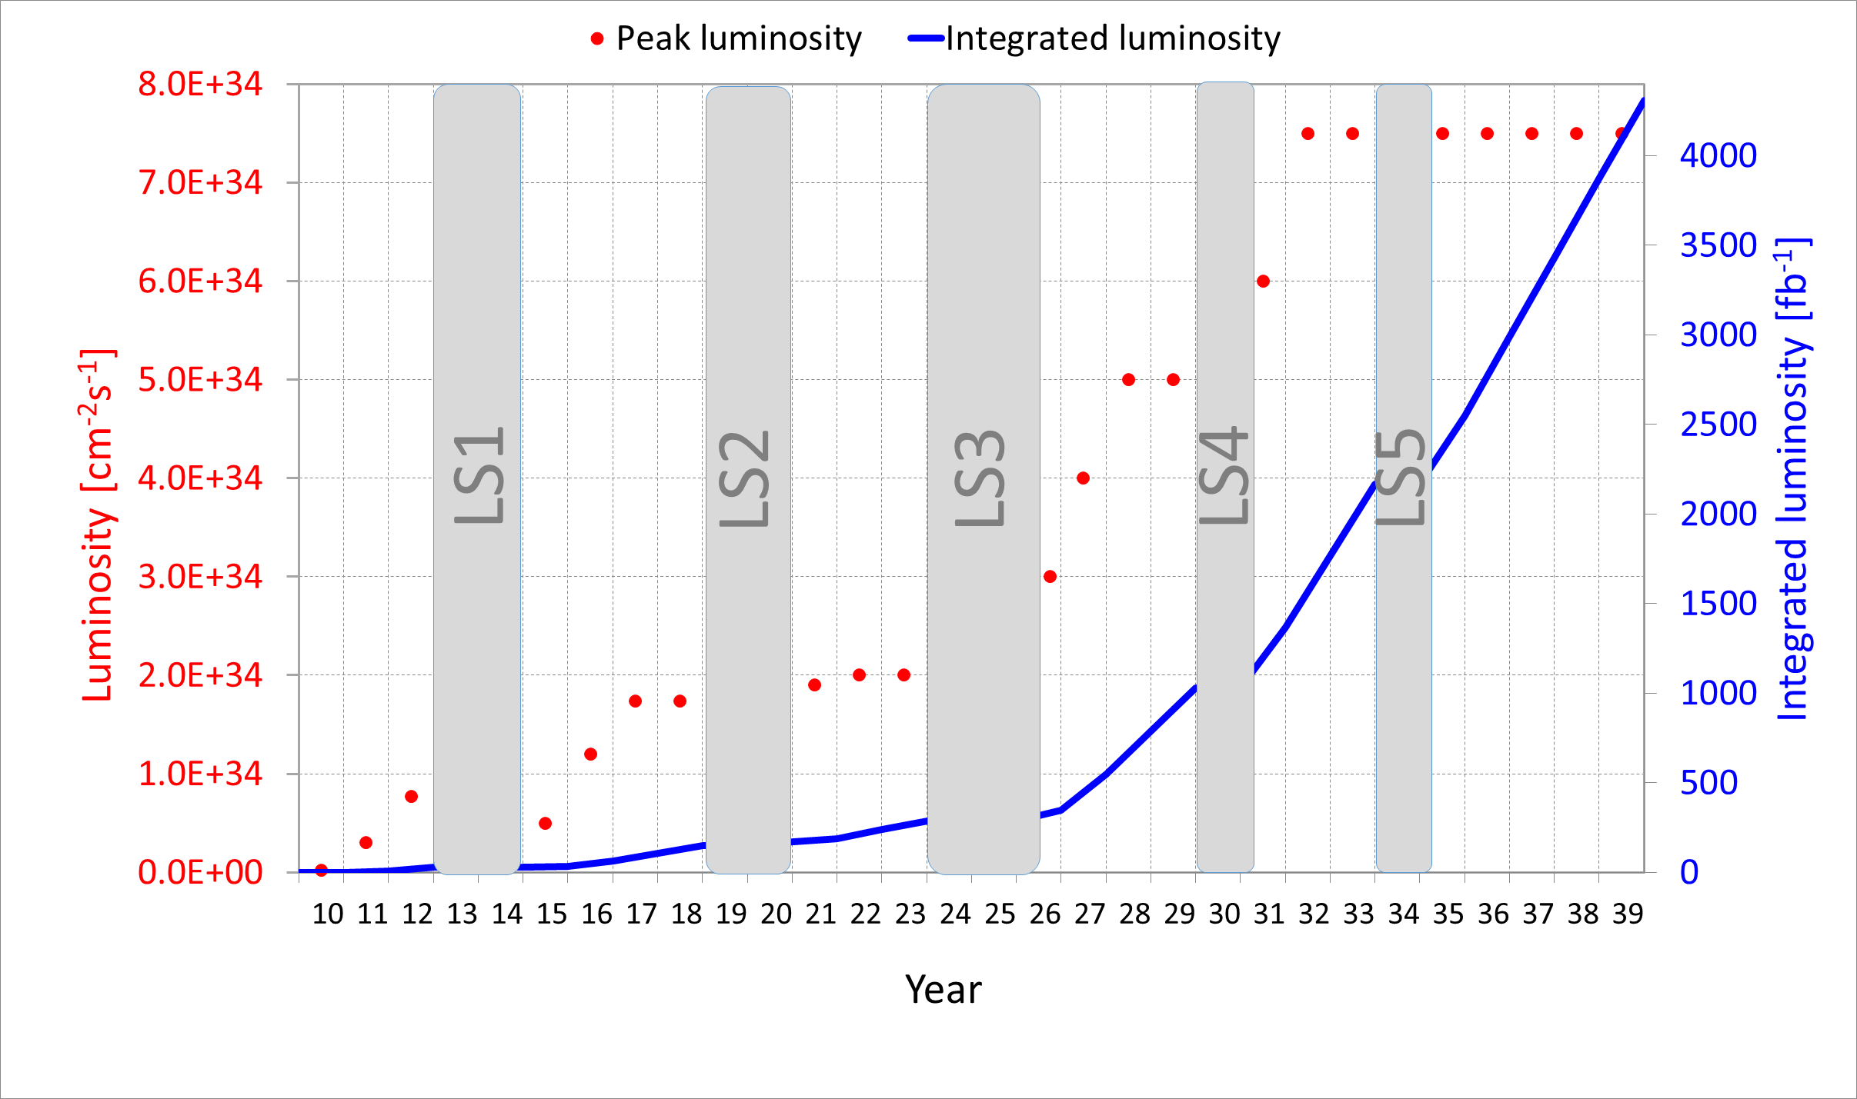
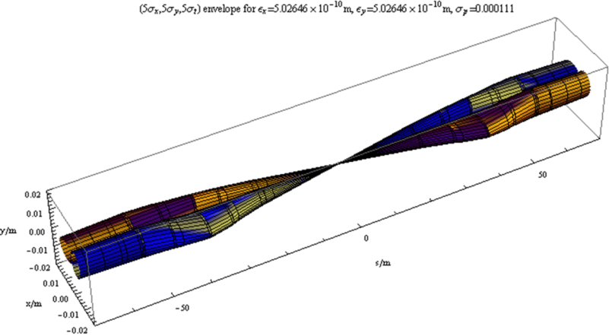


Towards higher collision rates
New discoveries or precision measurements need integrated luminosity !!!
Luminosity = f * N² / 4π σ²
Need for more protons in a smaller area !!!
Plans as defined few years ago, timing not up-to-date
stronger focusing
Target for physics:
doubling integrated Luminosity for each new run
More intensity
LIU
LHC injector upgrade: x2 beam intensity
HL-LHC: 1km of machine to be changed (stronger focussing quadrupoles)

Slide 7




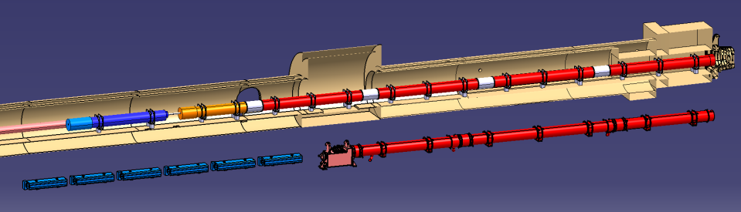

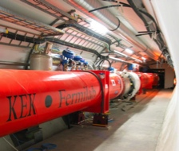
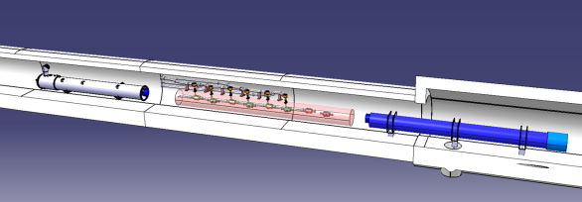


Final focussing: from LHC to HL-LHC
Q2a
Q1
Corrector
Package
Q2b
SC D1
Q3
NC D1
Existing LHC
Q4
CC
D2
HL-LHC relies on more powerful final focussing quadrupoles, associated recombination dipoles and crab cavities,
Local heat loads expected x5 w.r.t LHC

Slide 8
Content
Brief introduction to CERN, LHC and HL-LHC
HL-LHC Cryogenic scope and architecture
Refrigerators and Cryogenic distribution line
Complementary items
Schedule
Summary

Slide 9
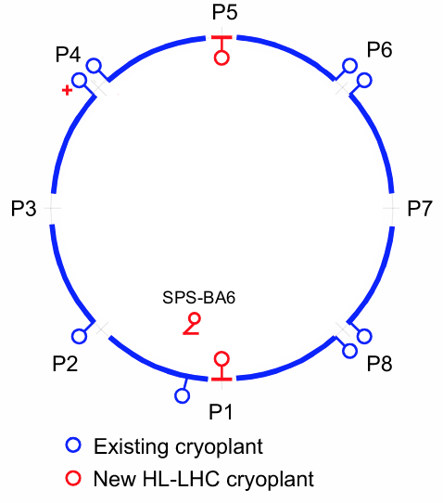
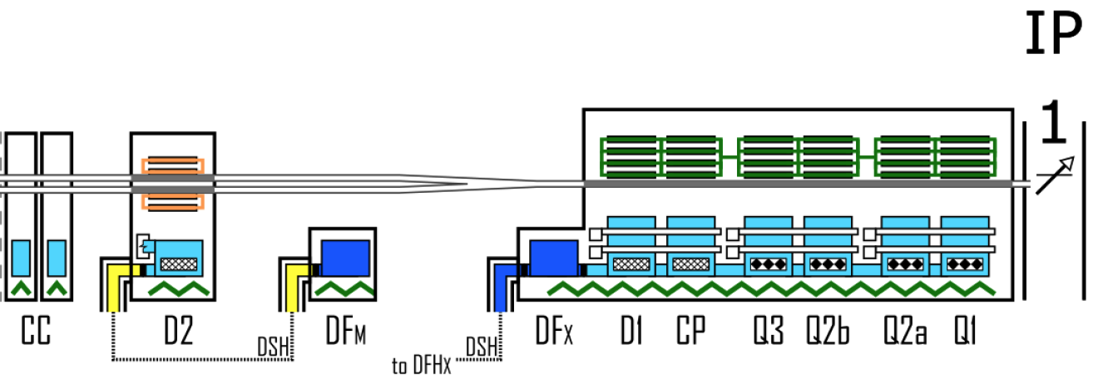
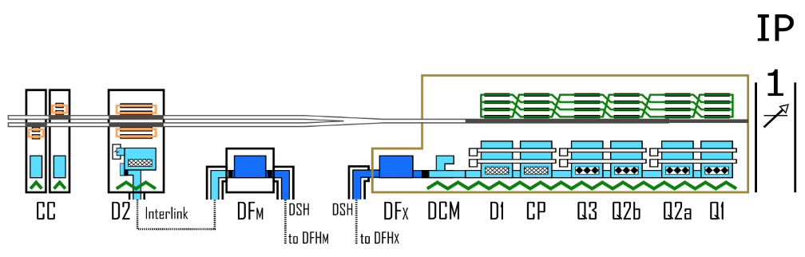
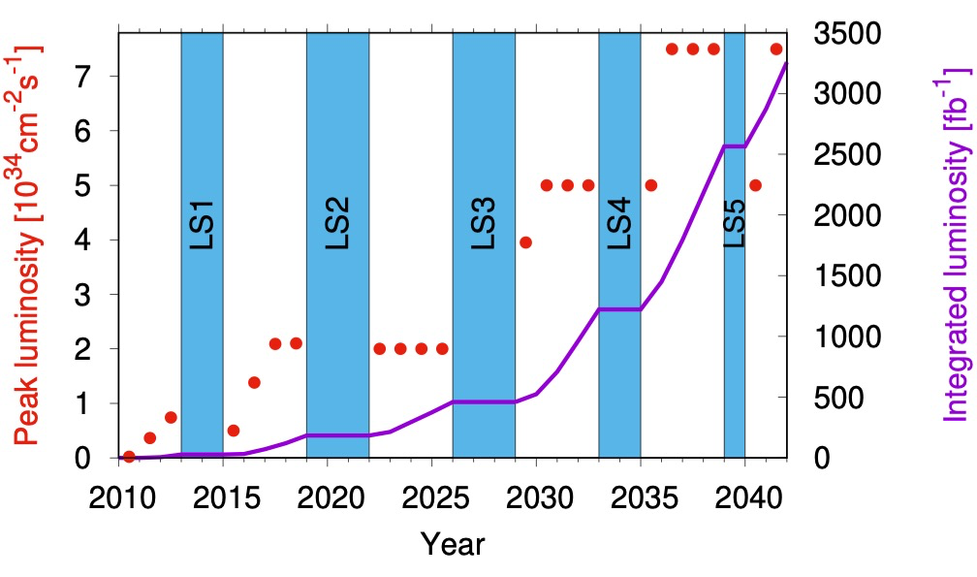
HiLumi-Cryogenics, Global scope overview
P1-P5: 2 new cryoplants (~14 kW @ 4.5 K incl. 3.25 kW @ 1.9 K ) and 2 x 750m cryo-distribution for high-luminosity insertions
P4: upgrade (+2 kW @ 4.5 K) of an existing LHC 18 kW @ 4.5K cryoplant
SPS-BA6: SRF test facility with beam primarily for Crab-Cavities
To provide adequate cooling for:
P1-P5 machine devices
HL-LHC performance
Other test facilities related activities are not part of this WP9-Cryogenics

Slide 10
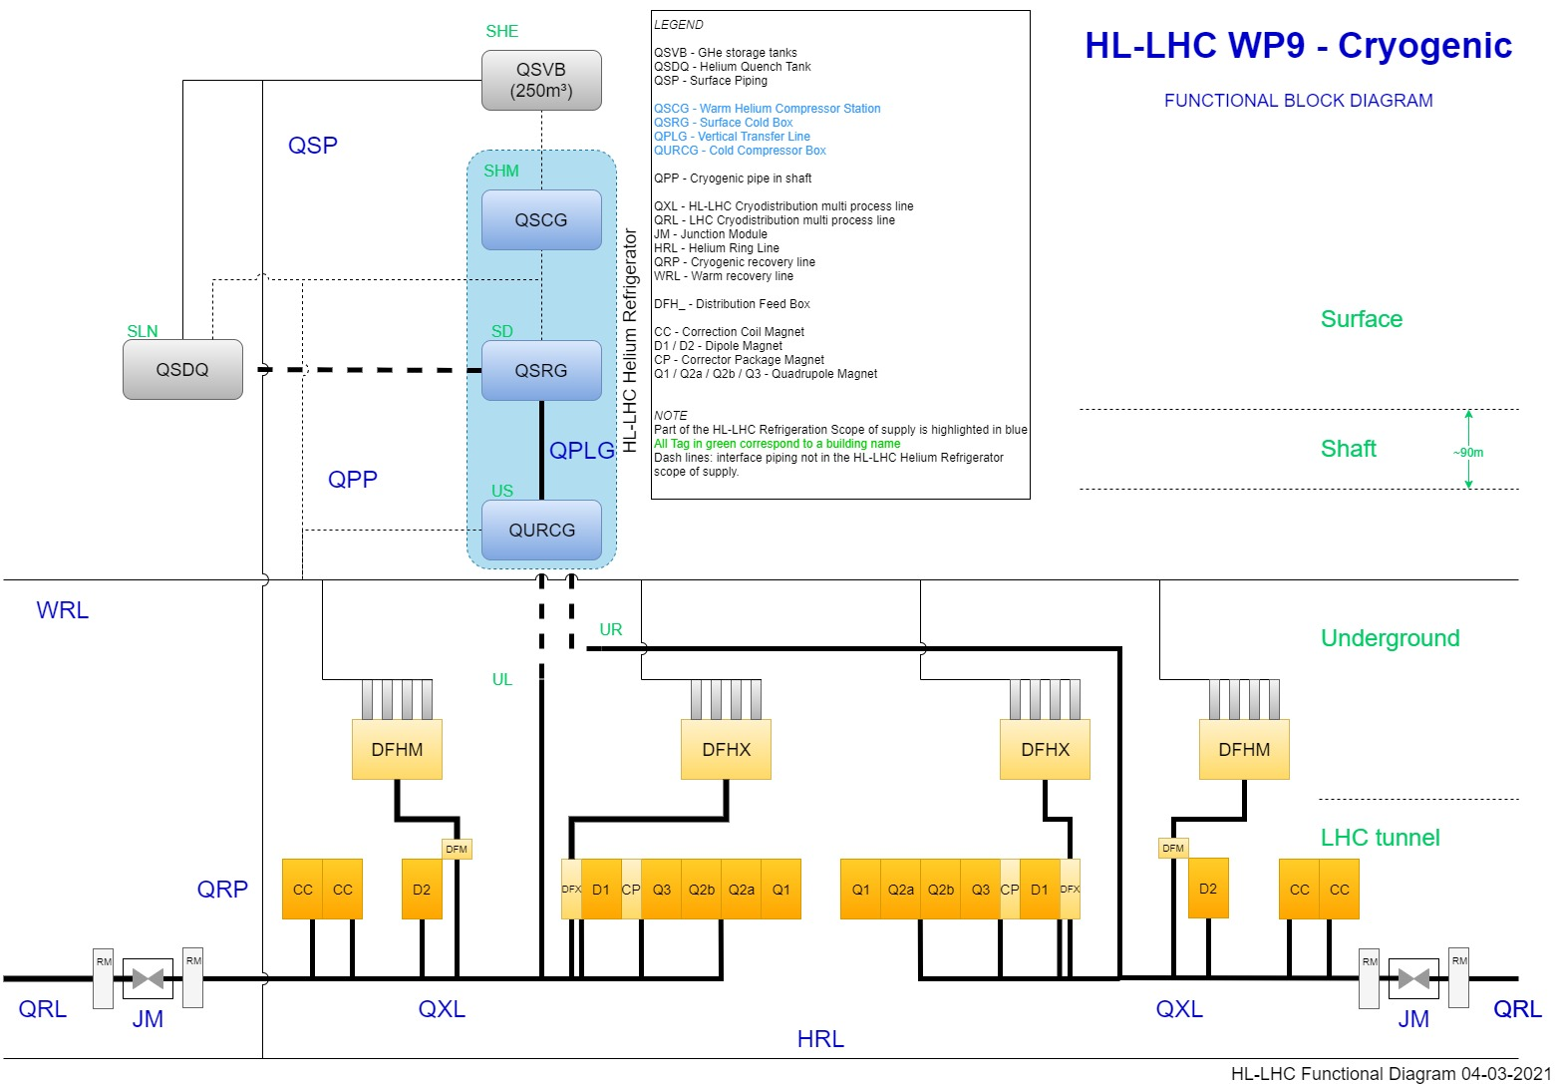
HL-LHC P1/P5 Cryogenic architecture
QSRG : Compressor station providing gaseous helium 20 B
QSRG : 4.5K refrigerator providing supercritical helium at 3 bara and 4.6 K
QXL : Distribution line distributing C,E and returning B,D,F
70 m for the common branch
270 m for the long branch
60 m for the short branch
QPLG : Vertical transfer line (~100 m height)
QURCG : Cold compressor box providing cooling capacity at 1.8 K
RM/JM : Return module and junction module at extremities for transient handling and back-up
Users at tunnel level

Slide 11
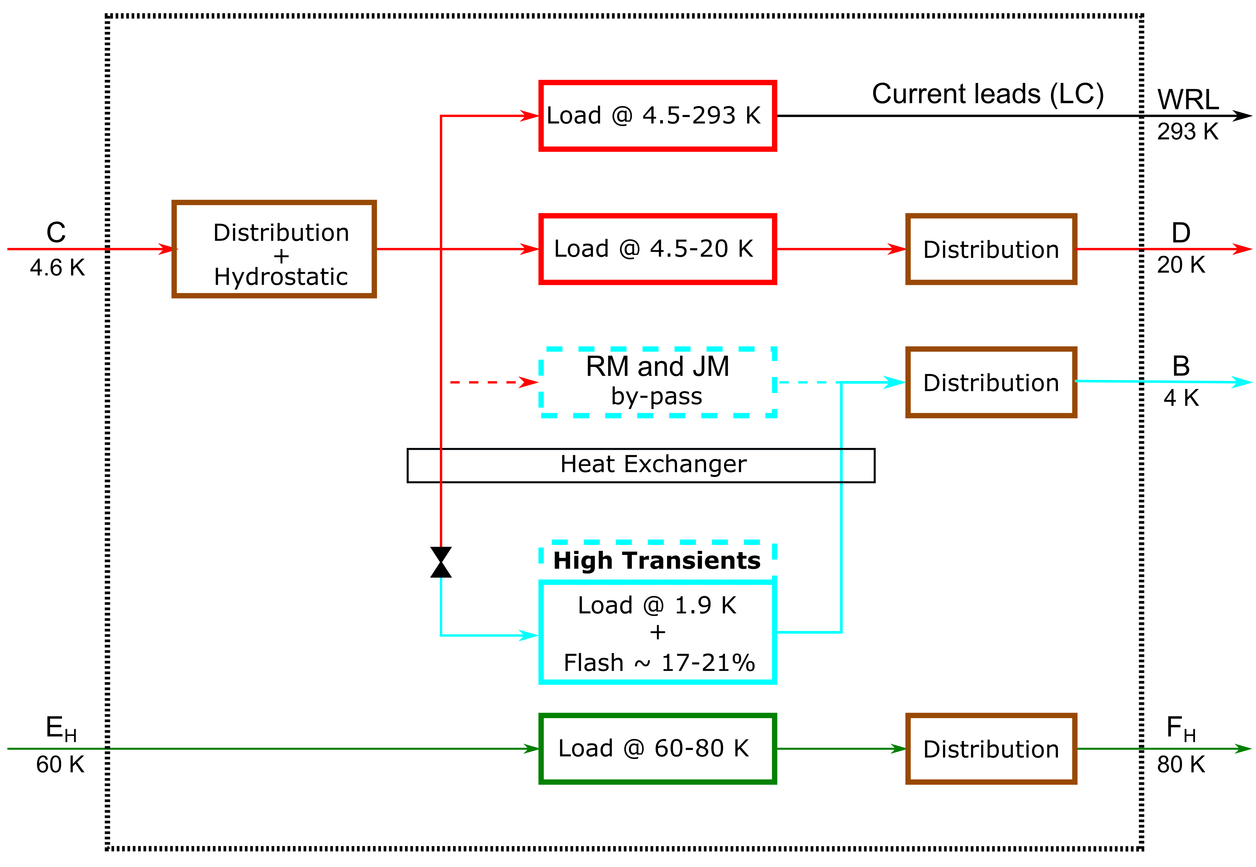
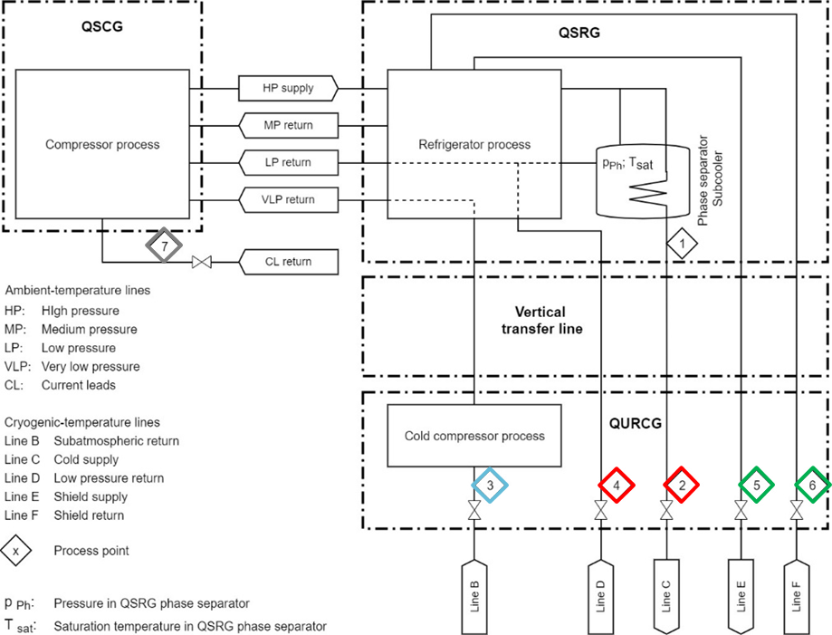
From cooling requirements to refrigeration capacity
Limits of supply for Refrigerator delivery
7
2
4
3
Parasitic loads
Hydrostatic losses
Heat loads
Friction losses
5
6
3
Proper evaluation of Refrigerator supply to proceed with Call for Tender.
1
Evaluation of Heat loads at User level considering proper margin
2
Parasitic loads from distribution to be taken into account

Slide 12
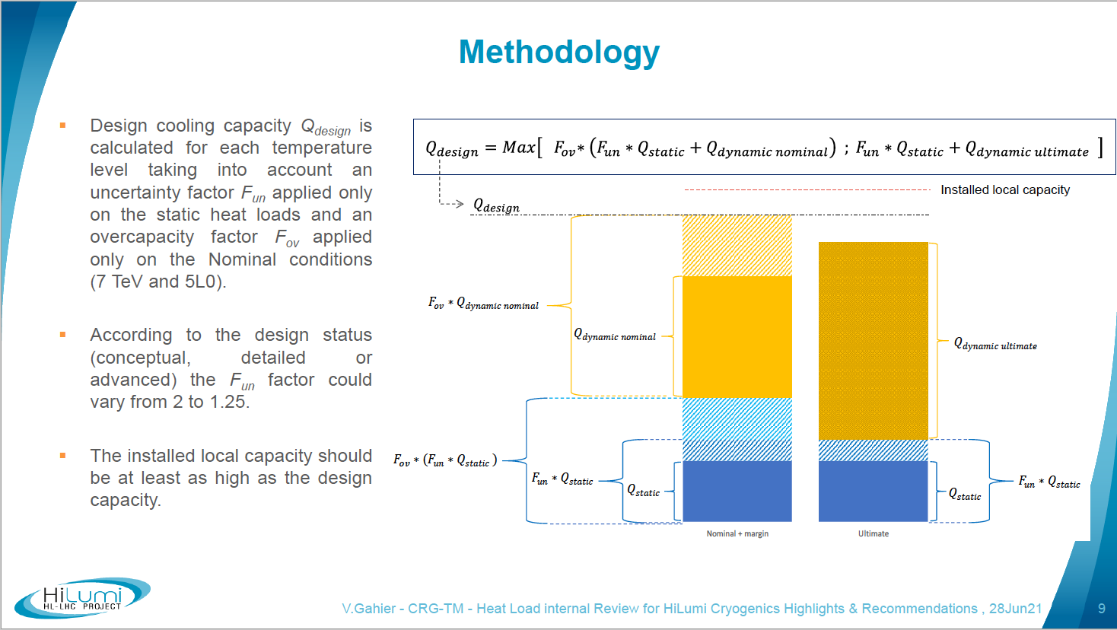
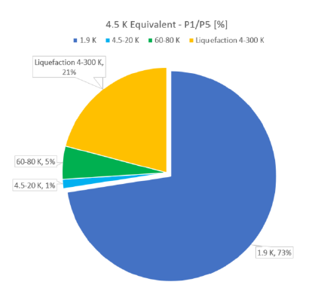
Heat Load Review, methodology
A consistant management of heat loads uncertainties & necessary over-capacity
Outcome 1 => 2 refrigerators of 14kW@4.5K, including 3.25kW@1.9K

Slide 13
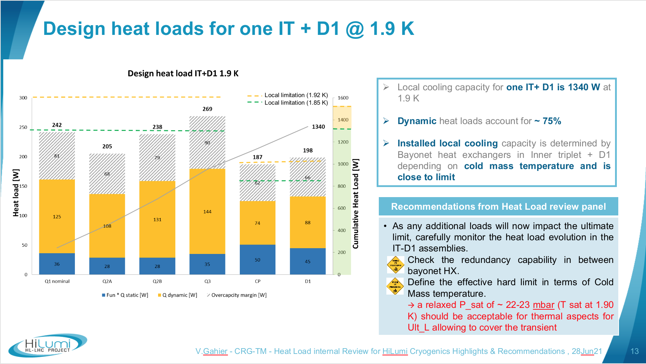
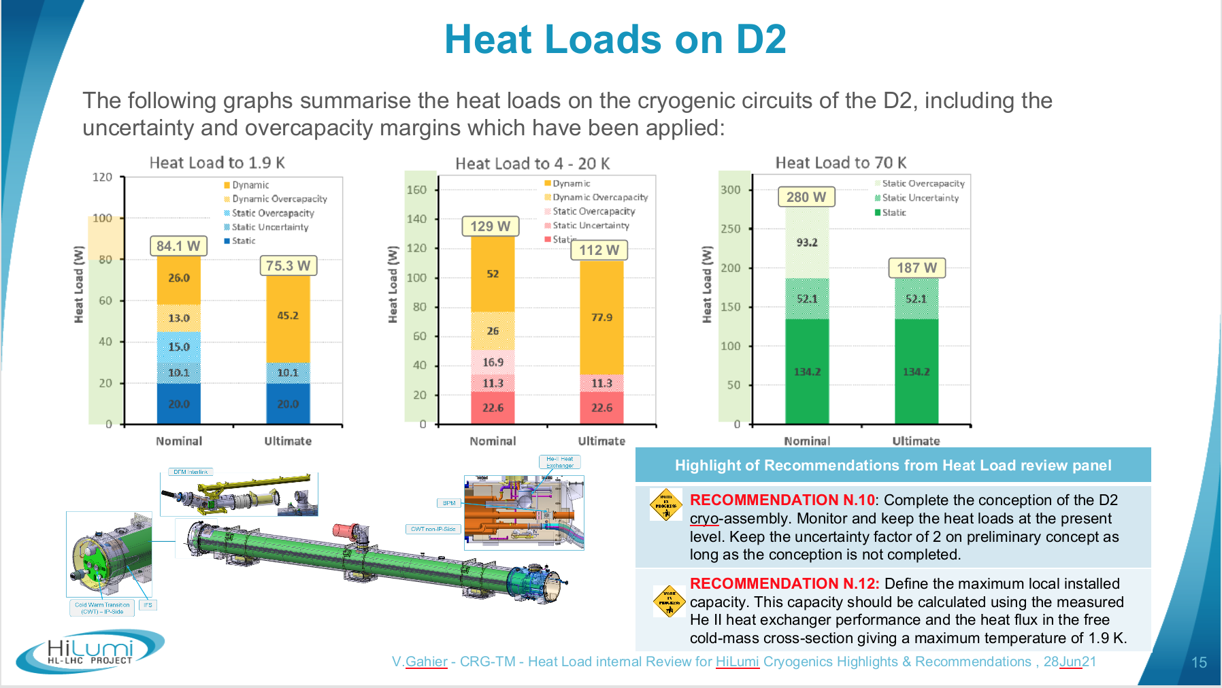
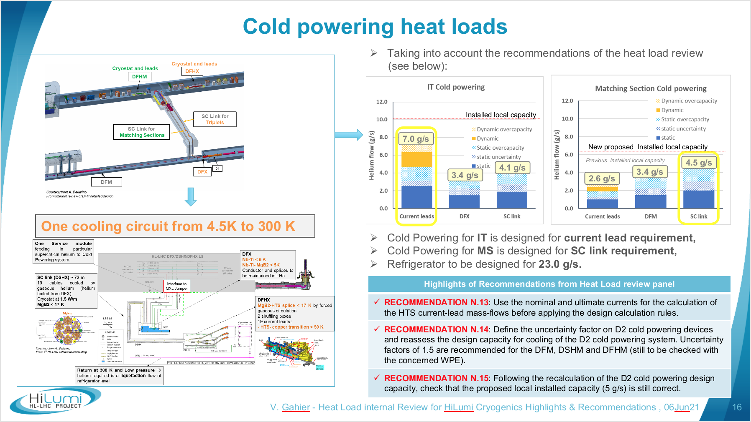
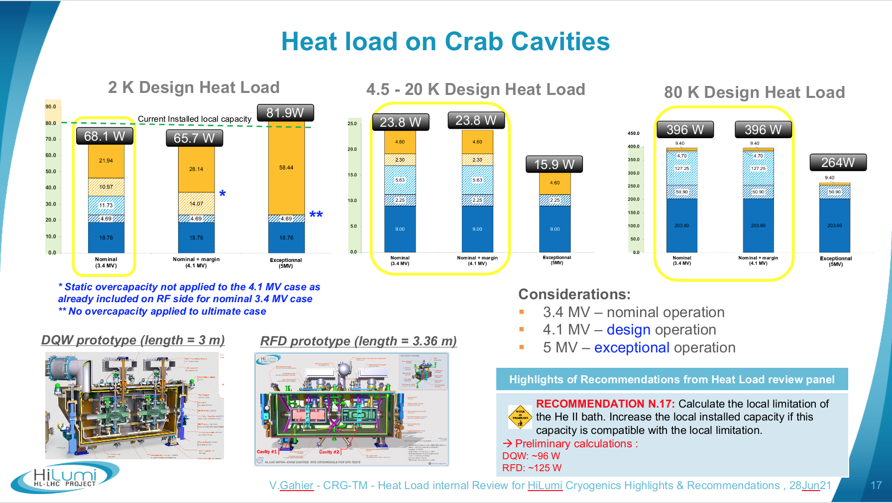
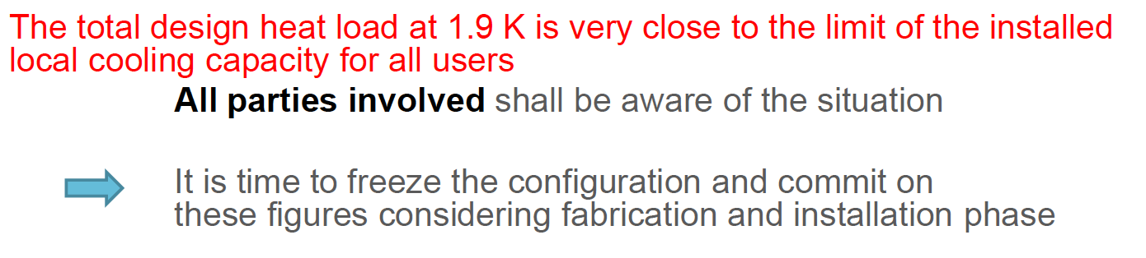
Heat Load Review, detail
Outcome 2 => No point to install more capacity if you cannot distribute it !!!

Slide 14
Content
Brief introduction to CERN, LHC and HL-LHC
HL-LHC Cryogenic scope and architecture
Refrigerators and Cryogenic distribution line
Complementary items
Schedule
Summary

Slide 15
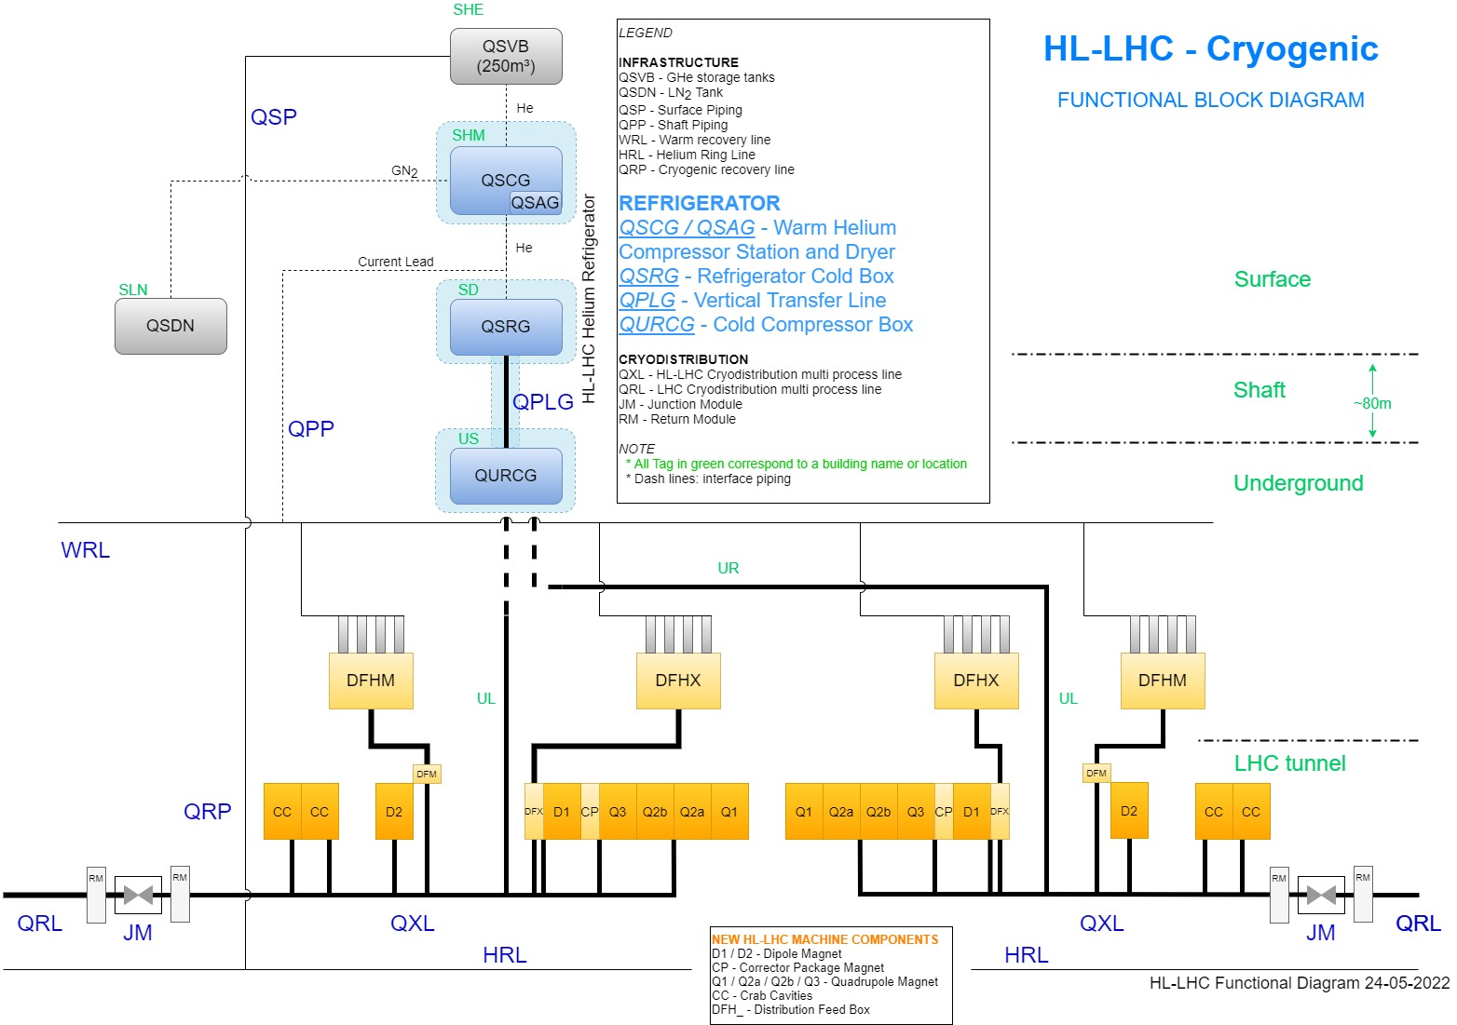
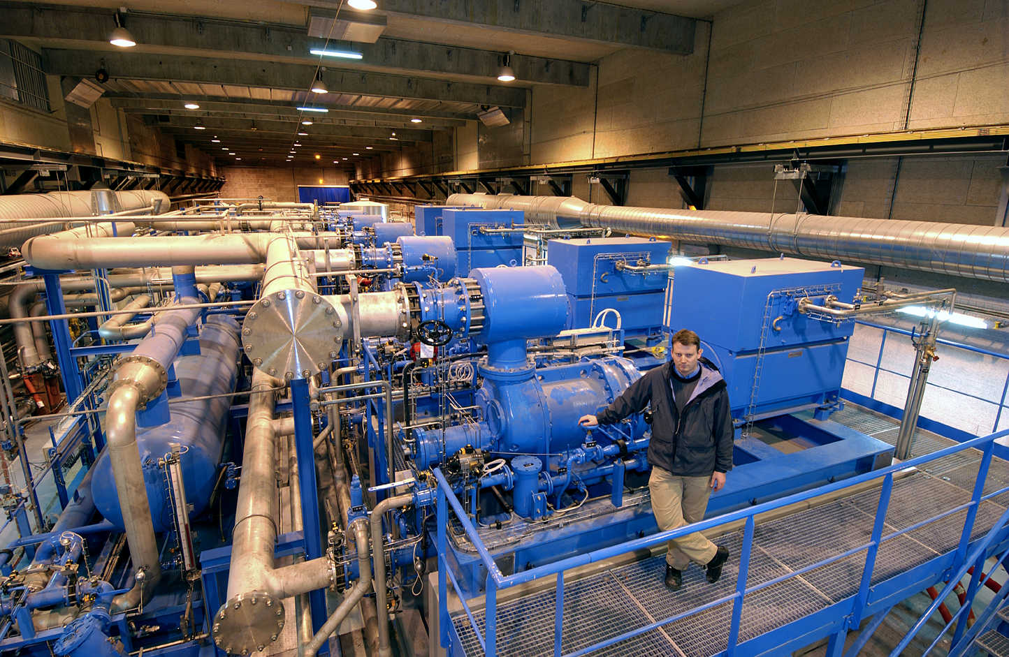
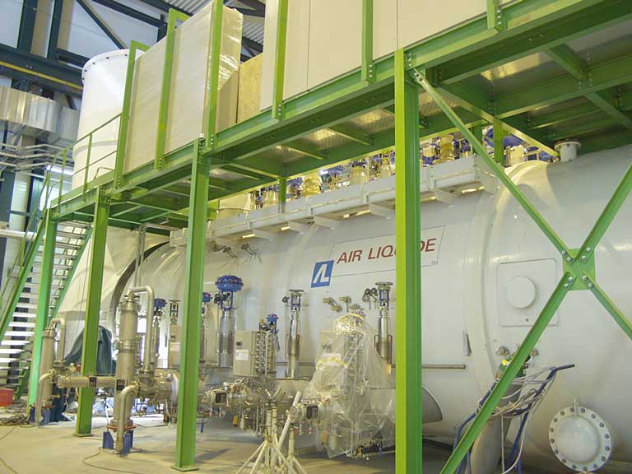
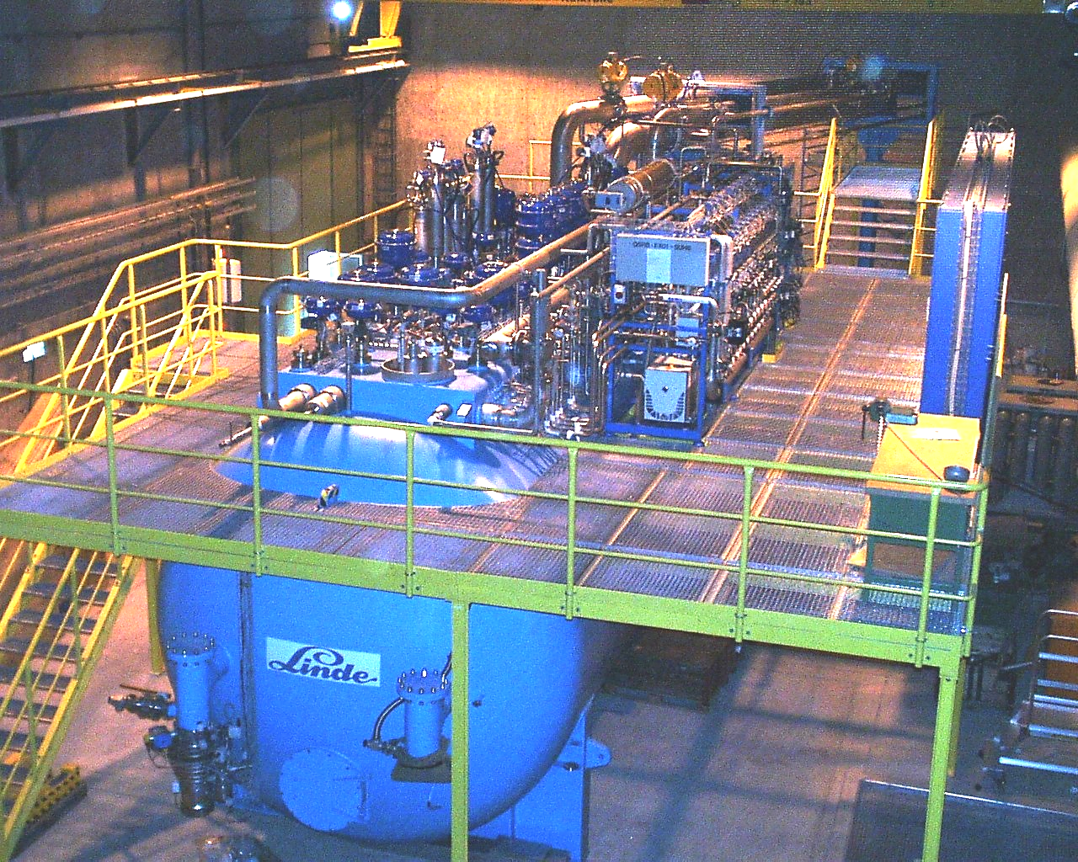
Helium Refrigerators at LHC P1 and P5 for HL-LHC
P1-P5 Cryogenic Architecture
Helium Refrigerators
2 x 14kW@4.5K, including 3.25kW@1.9K
LHC Helium Refrigerators
similar capacity required
for P1 and for P5,
in addition to 8 existing ones
Compressor station
(100t, 4MW input power)
Cold boxes from world wide leading industries
(>100t, Heat exchangers, expansion turbines, valves, controls)

Slide 16













Tendering process & contractors
Q2-Q3 2020: Market Survey to qualify firms
Q1-Q2 2021: Process & feasibility studies
(minimised risk of mis-understanding)
Q4-21-Q2-22: Invitation to Tender (extended)
A set of requirements (performance, technology) to allow industry to provide the optimum for a given scenario
Adjudication: CAPEX + OPEX (10 years)
Capacity tests at CERN (bonus/malus)
Selection of single source for the two refrigerators
with major partners identified

Slide 17
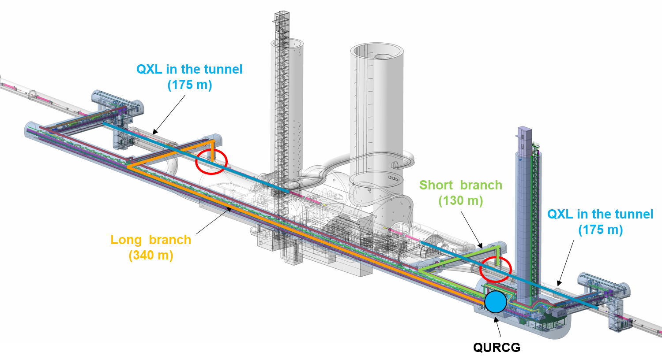
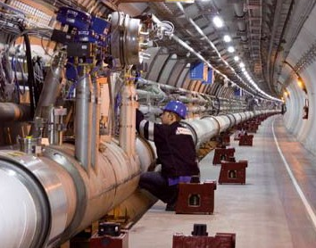
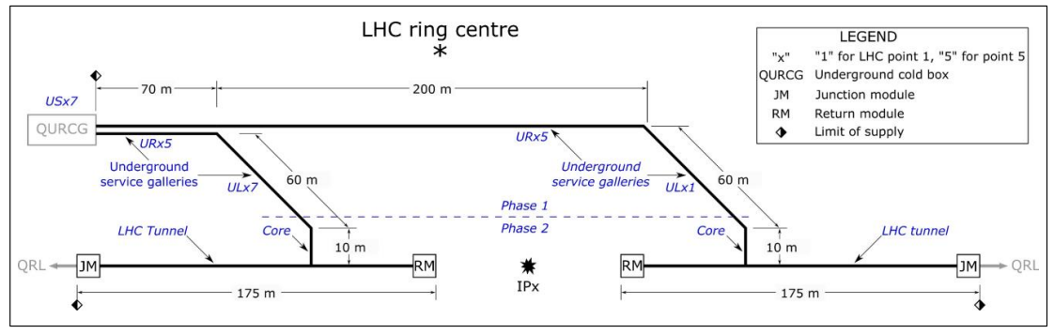
Cryogenic distribution line at P1 and P5
Cryogenic Distribution Lines
2 x 750 m, 5 process pipes, vacuum insulated
(Diam 40 to 273, 650 to 800mm)
LHC Line
~145 t
per point
Gallery available
LHC tunnel
Tendering process Q1-Q2_2022,
Contract signed Dec'22

Slide 18


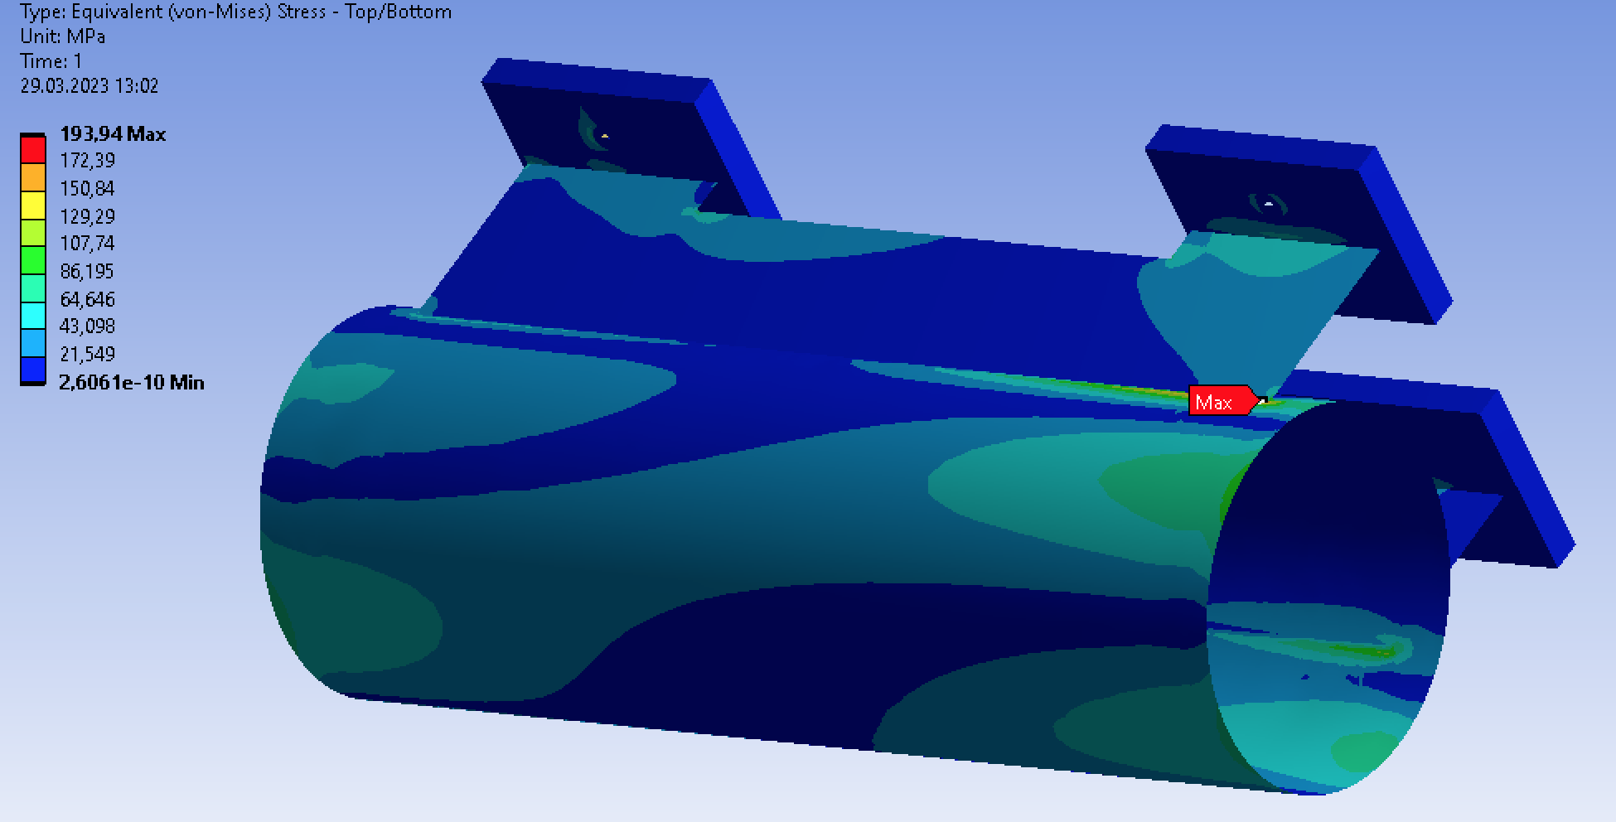
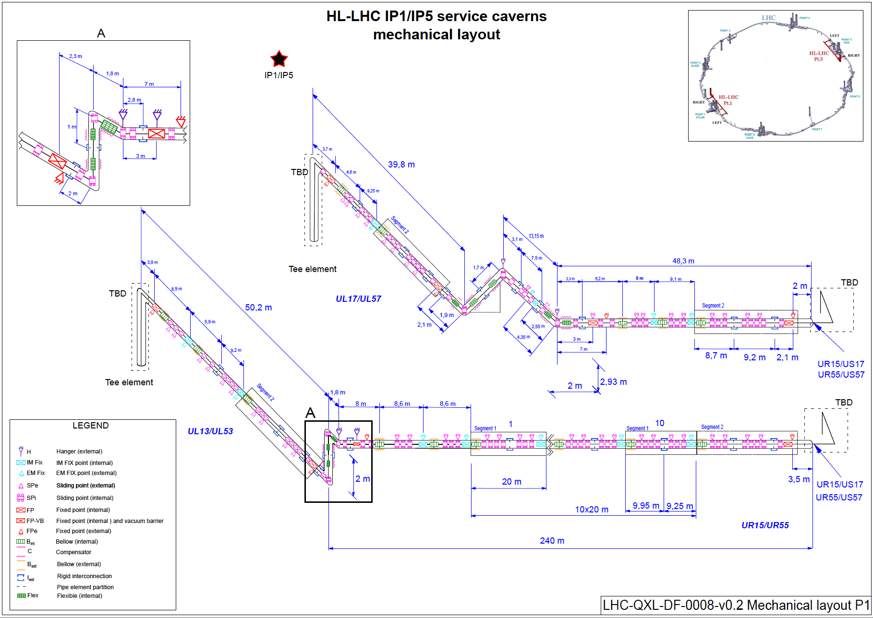
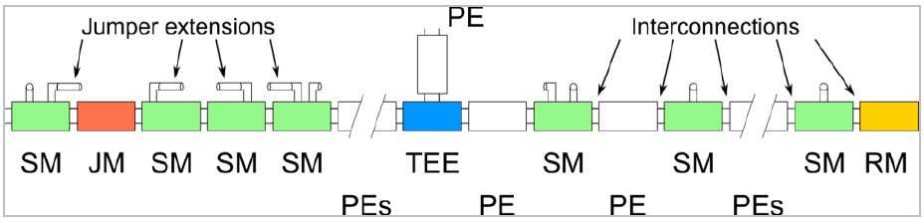
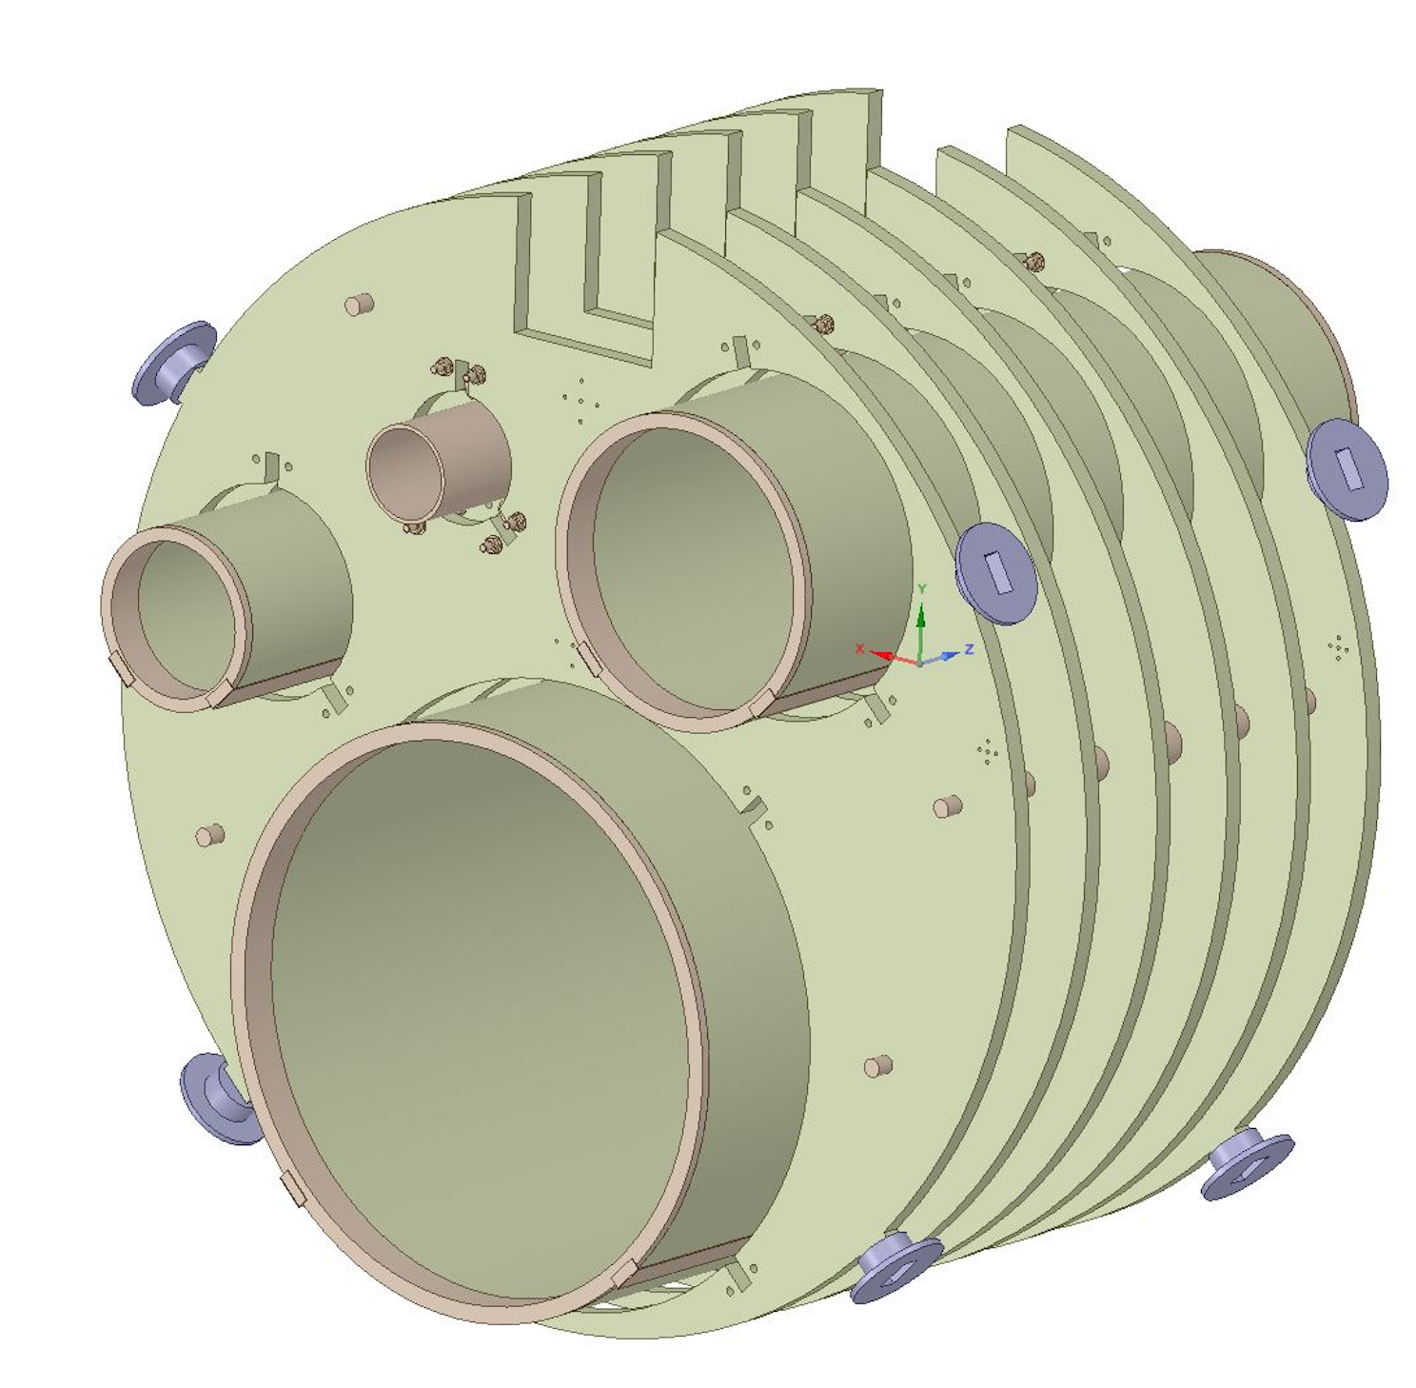
Preliminary design started with
External fixed support
Internal
sliding support
Extracted from Kriosystem documentation under F779-780
3D models and internal piping design being reviewed

Slide 19
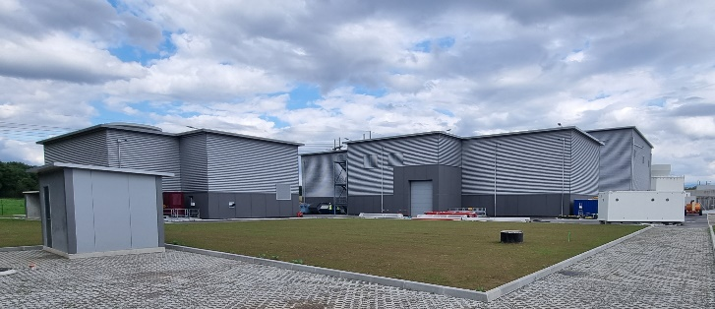
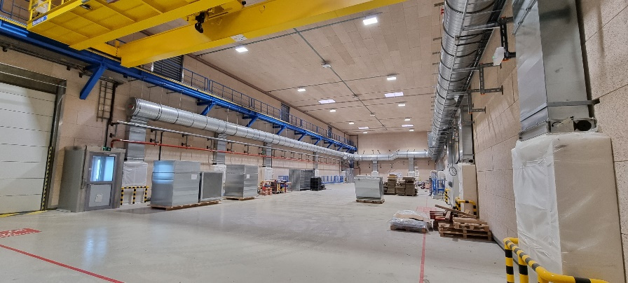
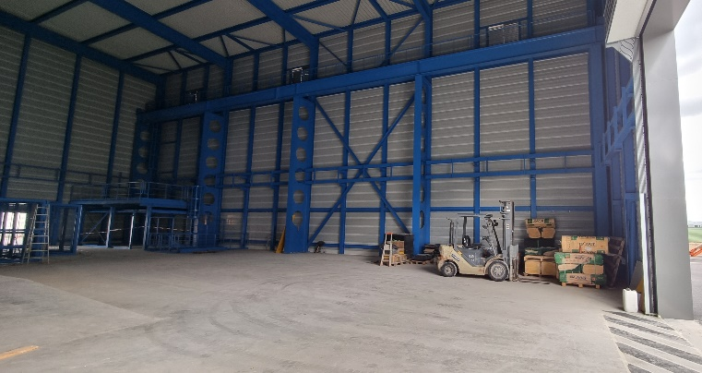
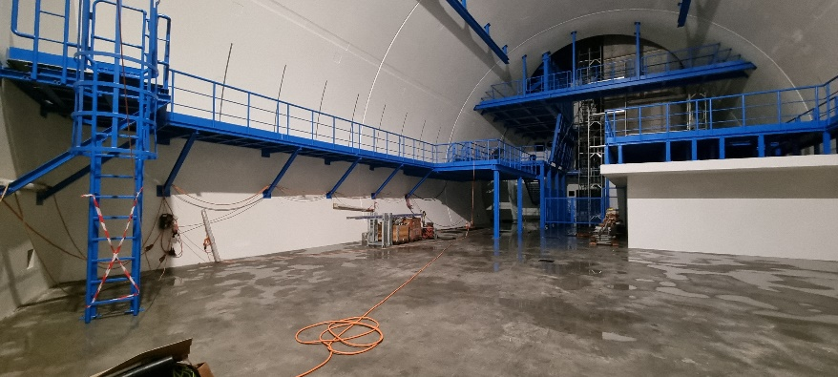
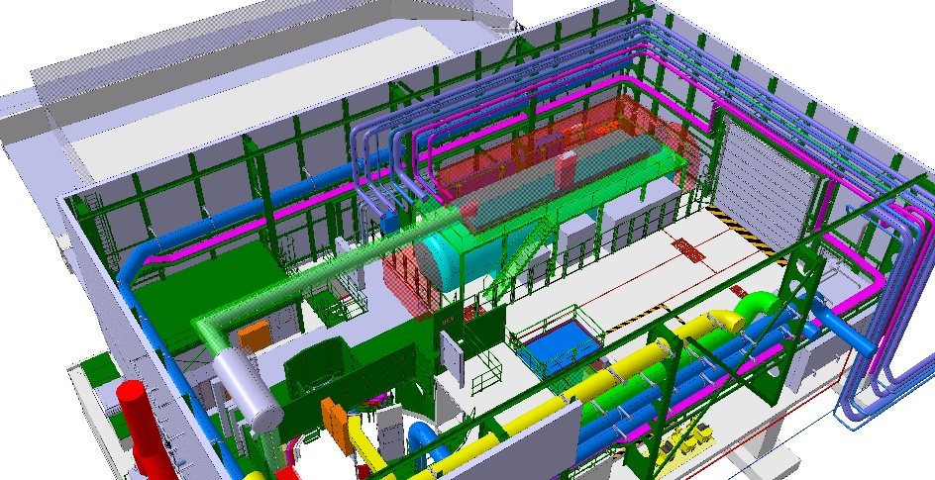
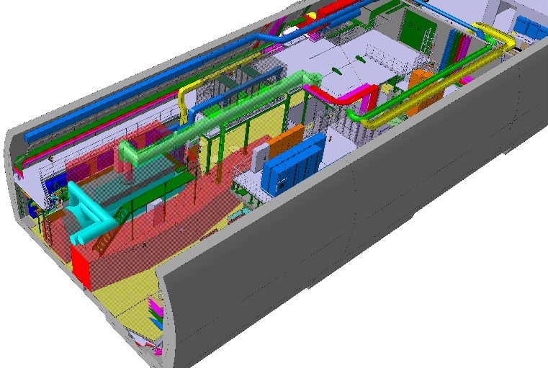
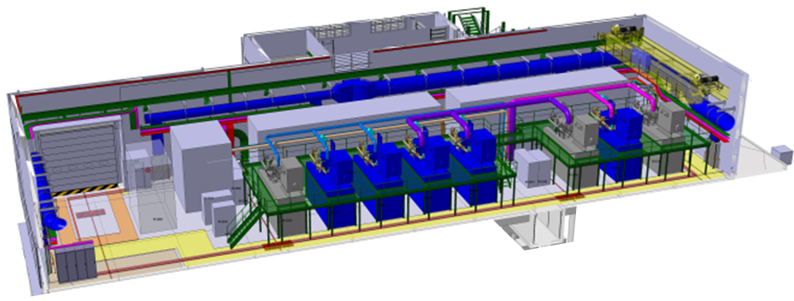
new HL-LHC buildings already done !!!
Civil Engineering @ LHC P1 Sept. 2022
SHM – Compressor Station
SD – Refrigerator Cold Box
US – Cold Compressors Box
CERN HL-LHC Refrigerators Conceptual Design
14kW@4.5K including 3.25kW@1.9K

Slide 20
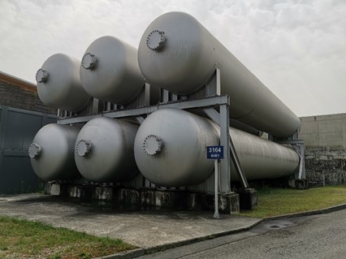
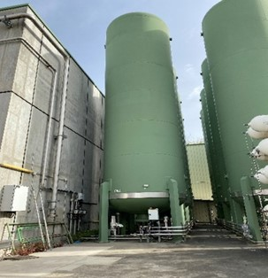
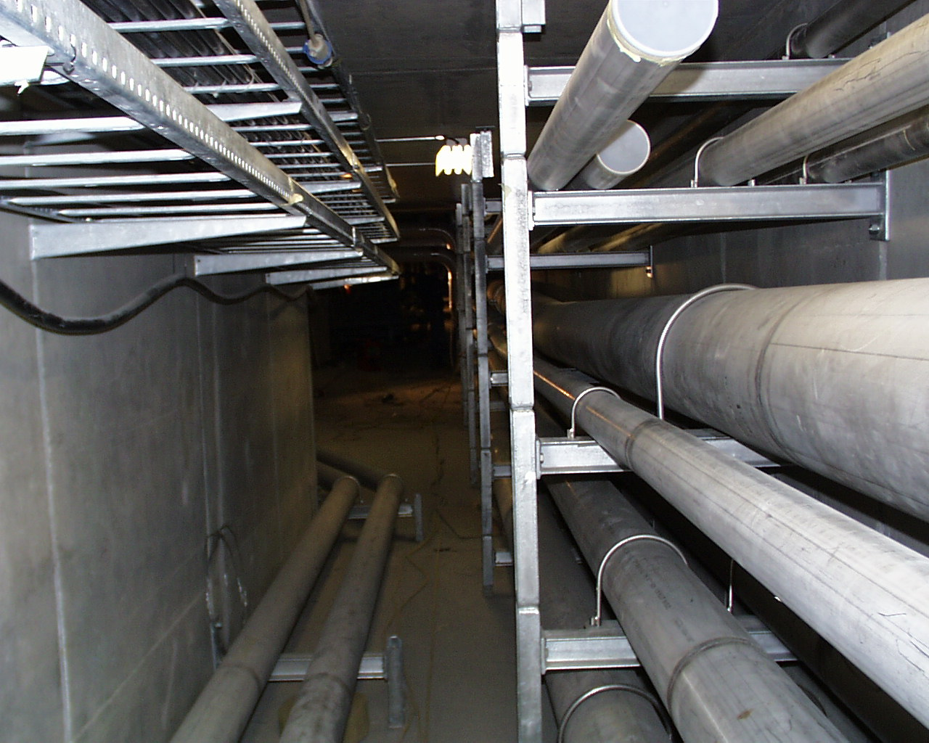
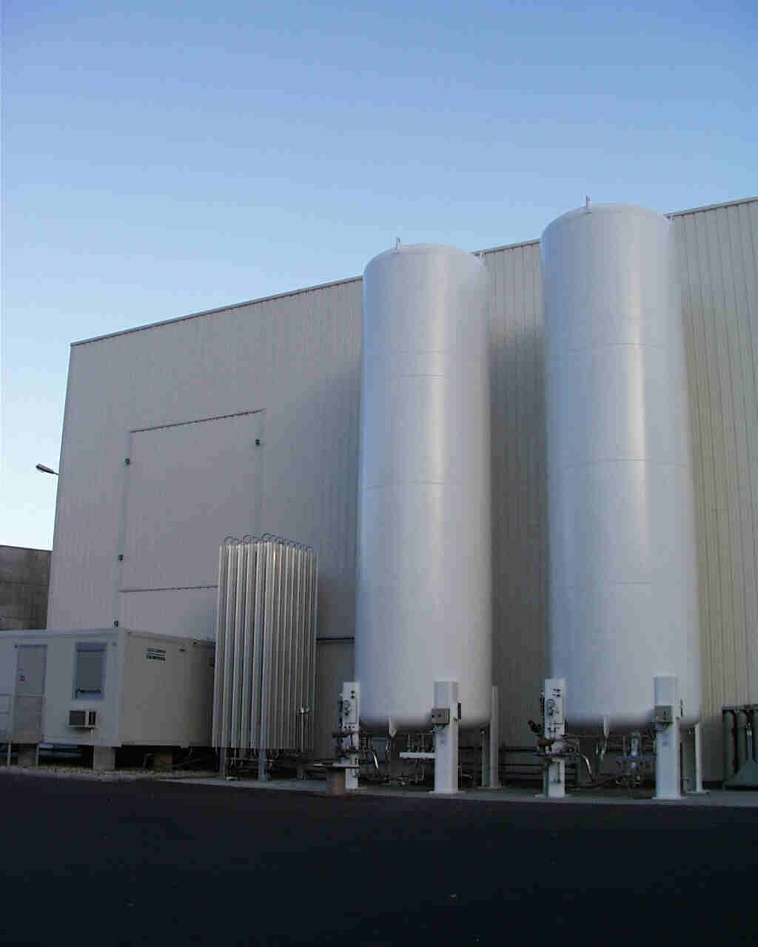
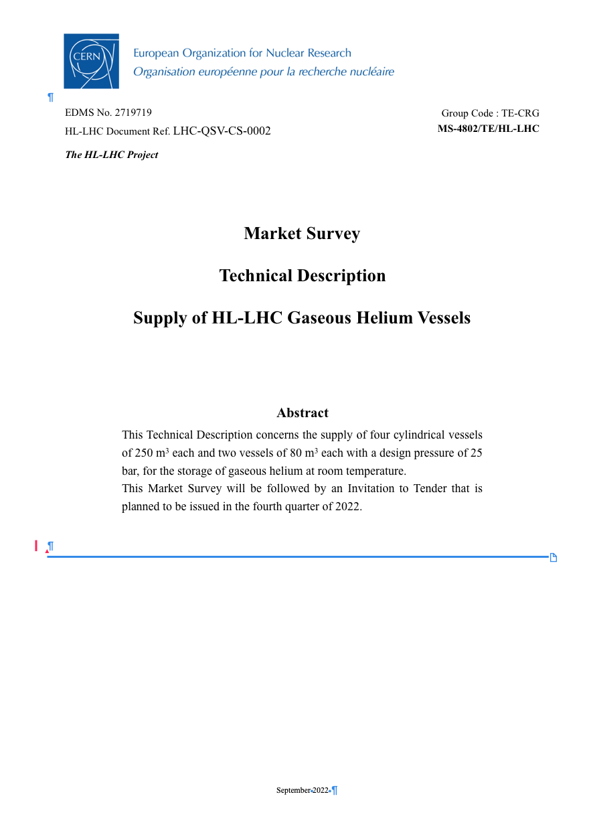
Procurement of storage tanks and piping
Industrial sub-systems, illustrations from LHC existing similar equipment
(58) existing 250 m3
GHe 250 m3
GHe 80 m3
Industrial stainless steel piping
Necessary tenders done, results
submitted for approval from our governing bodies (Jun'23),
=> Contracts to follow
LN2 existing 50 m3

Slide 21
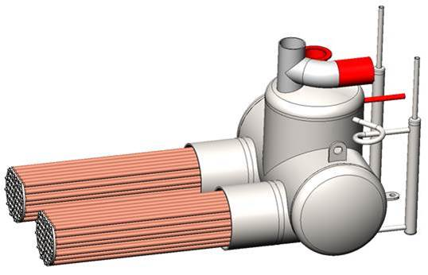

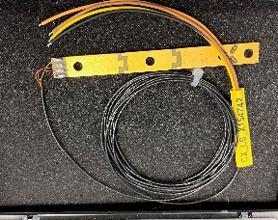
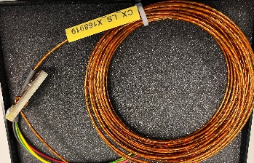
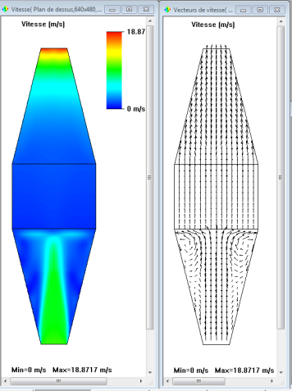




Some specific developments
A selection based on items developped for LHC or specifically for HL-LHC
Subcooling Heat exchangers
HeII Heat exchangers
Instrumentation
Block ~ 20 x 30 cm, L_tot ~ 1m
Cu + SS, L_tot ~ 1m
Accuracy few mK @ 1.9K
Long block
Short block

Slide 22

Masterplan of HL-WP9-Cryogenics
In operation
In operation
Refrigerators
Cryolines
Tanks, piping

Slide 23
Summary
Cooling requirements reviewed mid 2021, allowing to confirm the refrigeration capacity with final tuning of the global cryogenic architecture
Major tenders (Refrigerators, cryogenic distribution line) done following process & technical feasibility studies with shared cost risks for post-covid & Ukraine impacts, continued efforts to get industrial contracts on good tracks
Procurement of complementary items (gaseous tanks, piping, items as LHC spares, existing QRL cryoline refurbishment) started, to be continued
Instrumentation and controls activites now well structured and delivering
Contracts and team in place with objective to commission the refrigerators in 2026, cool-down magnets in 2028 for operation with beams to resume in 2029 for a decade of new physics results !!!

Slide 24
Complements

Slide 25

Recent progress & Perspectives
Revisiting distribution line & interfaces
Parallel HX scenario studied to overcome:
- pressure drop issue on VLP
- capacity of cooling loop (bayonets of the magnets and not cryo equipment)
- distribution (parallel CY-bayonets)
Study asked to original manufacturer (LHC, 20 yrs ago), now with modern numerical tools:
- Confirmed "jet" at inlet cone-HX
- possibility to shorten outlet cone

Slide 26

IT side: potential pipe routing
No show-stopper identified, being further studied with WP3-MSC team
Jumper elbow (IT side)
Existing HXI
XB lines
(pumping)
ISO DN65
New HXI
LD line
(quench)
E_{H}E’_{H} line
(thermal shield)
CY lines
(injection)
Interface to the magnet HX
M. Sisti (TE/CRG)

Slide 27

Feasibility study

