Slide 1
CERN future projects,
Cryogenics for superconductivity
Serge CLAUDET, as deputy Cryogenic group leader & HiLumi Cryo WP leader
CERN, 29th Jan’20

Slide 2



CERN present infrastructure and future projects
From LHC to HiLuminosity LHC
and behond …
LHC ring:
27 km circumference
Notes:
2

Slide 3
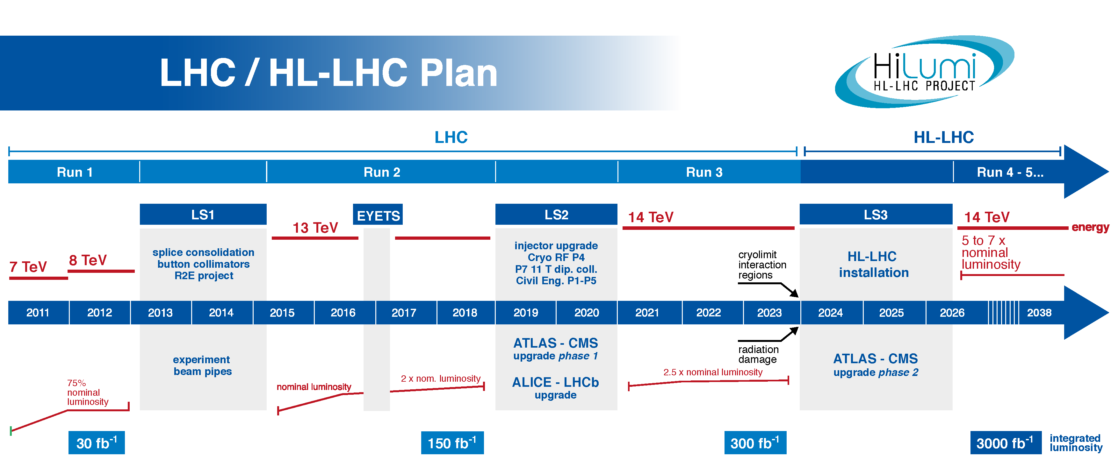
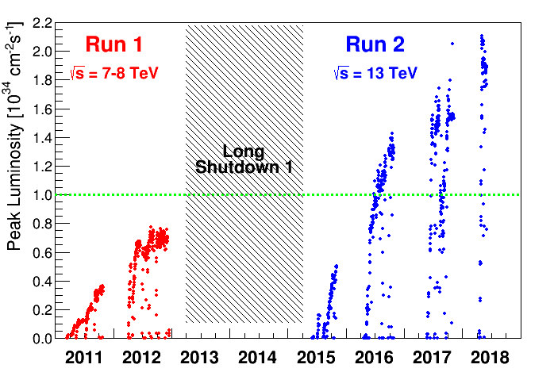
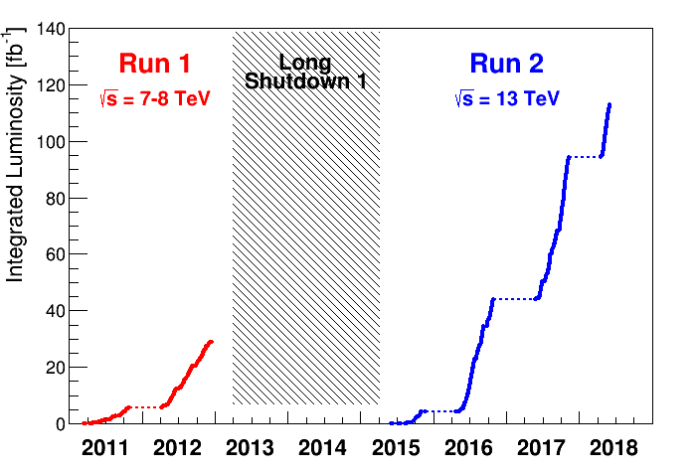
today
Peak Luminosity
“ The potential of the facility”
Integrated Luminosity
“What allows science” (statistics)
Nominal luminosity
Performance
Qualification – Global availability - Time
S. Claudet - Jan'20
CERN future projects, Cryogenics

Slide 4
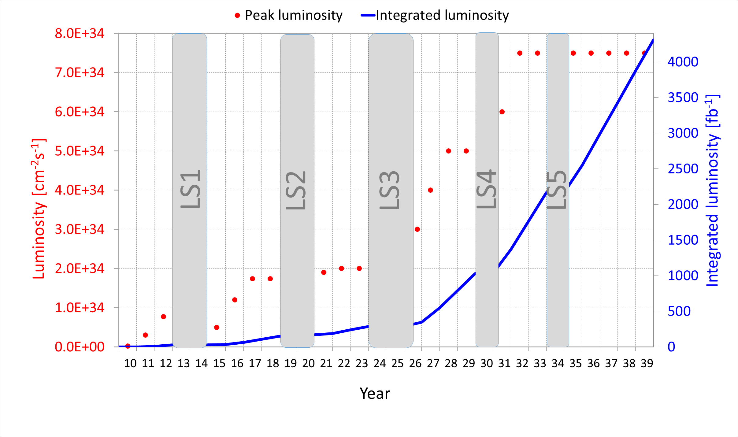


Towards higher collision rates
New discoveries or precision measurements need integrated luminosity !!!
Luminosity = f * N² / 4π σ²
stronger focusing
More intensity
LIU

Slide 5
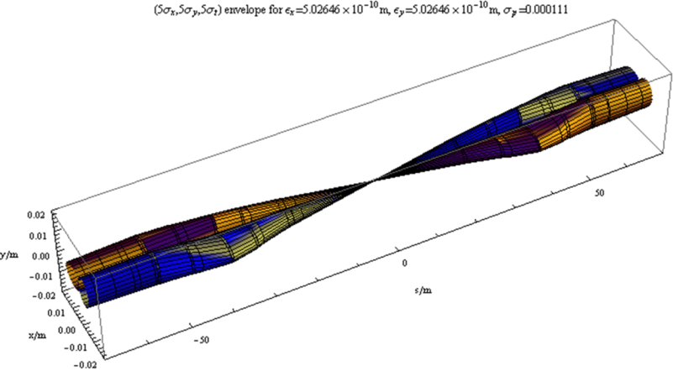
The most straight forward action: reducing beam size with a «local» action
To increase Luminosity
LHC has better aperture than anticipated: now all margin can be used; however is not possible to have β∗ < 40 cm
Quadrupole triplet and D1
Smaller β∗ ⇒ larger IT aperture
With stronger gradients
S. Claudet - Jan'20
CERN future projects, Cryogenics

Slide 6




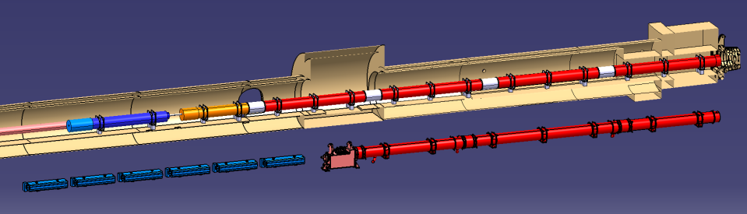

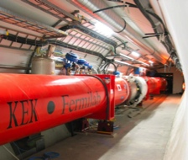
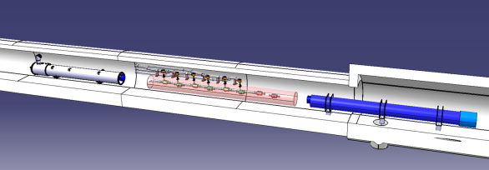


HL-LHC configuration
HL-LHC
Q2a
Q1
Corrector
Package
Q2b
SC D1
Q3
NC D1
Existing LHC
Q4
CC
HL-LHC relies on more powerful final focussing quadrupoles, associated recombination dipoles and crab cavities,
Local heat loads expected x5 w.r.t LHC
D2
S. Claudet - Jan'20
CERN future projects, Cryogenics

Slide 7
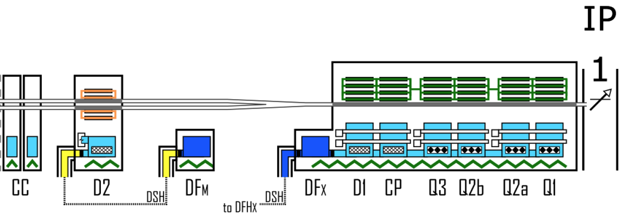
HL-LHC cryogenic upgrade
P1-P5: 2 new cryoplants (~15 kW @ 4.5 K incl. ~3 kW @ 1.8 K ) and 2 x 750m cryo-distribution for high-luminosity insertions
P4: upgrade (+2 kW @ 4.5 K) of an existing LHC 18 kW @ 4.5K cryoplant
SPS-BA6: SRF test facility with beam primarily for Crab-Cavities
+
SPS-BA6
P1/P5: Provide adequate cooling for this
Other test facilities related activities not reported here
S. Claudet - Jan'20
CERN future projects, Cryogenics

Slide 8
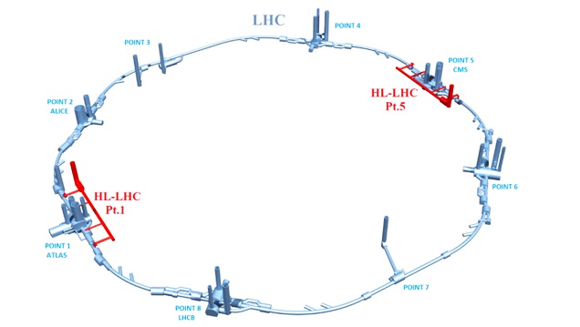
P1/P5 Cryogenic architecture
15 kW equivalent at 4.5 K, including 3 kW at 1.8 K
Warm compressor station
SHE
QSVB
GHe storage tanks
Surface piping
SHM
QSCG
QSAG
Dryer
QSP
Surface cold box
SLN
SD
SLN
Liquid Nitrogen tank(s)
Quench tank
QSDQ
QSRG
QSDN
Surface
QPP
QPLG
Vertical transfer line
Shaft
Underground
US
Cold compressors box
QURCG
DFHX
DFHM
(existing)
DFBL
UR
UL
QUIG
DSHX
DSHM
LHC tunnel
Interconnection box
DFX
DFM
DSL
Q1
Q2a
Q2b
Q3
CP
D1
D2
CC
CC
CC
CC
Q4
Q5
Q6
QRP
QXL
HRL
S. Claudet - Jan'20
CERN future projects, Cryogenics

Slide 9
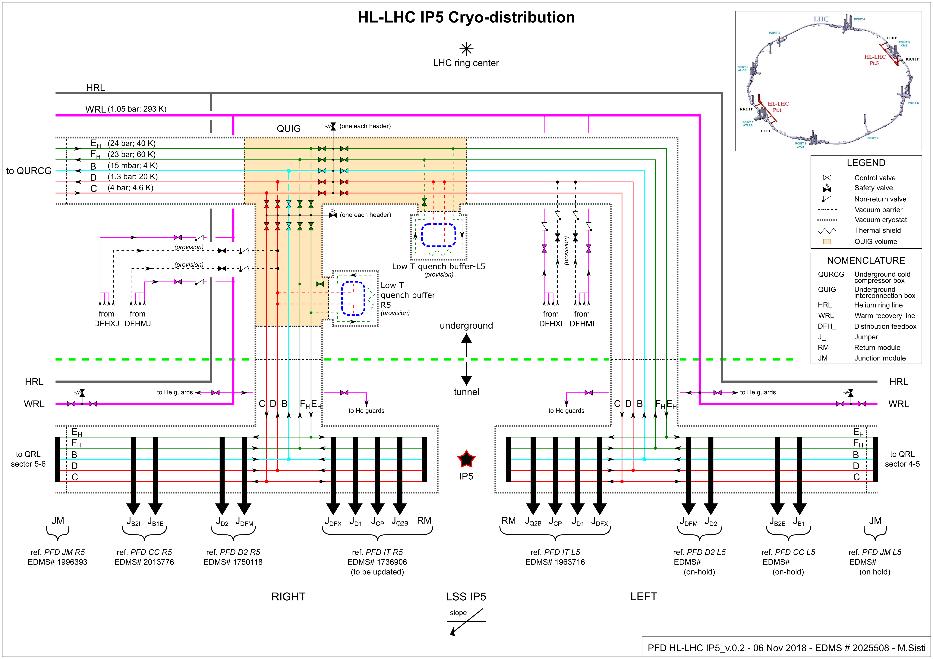
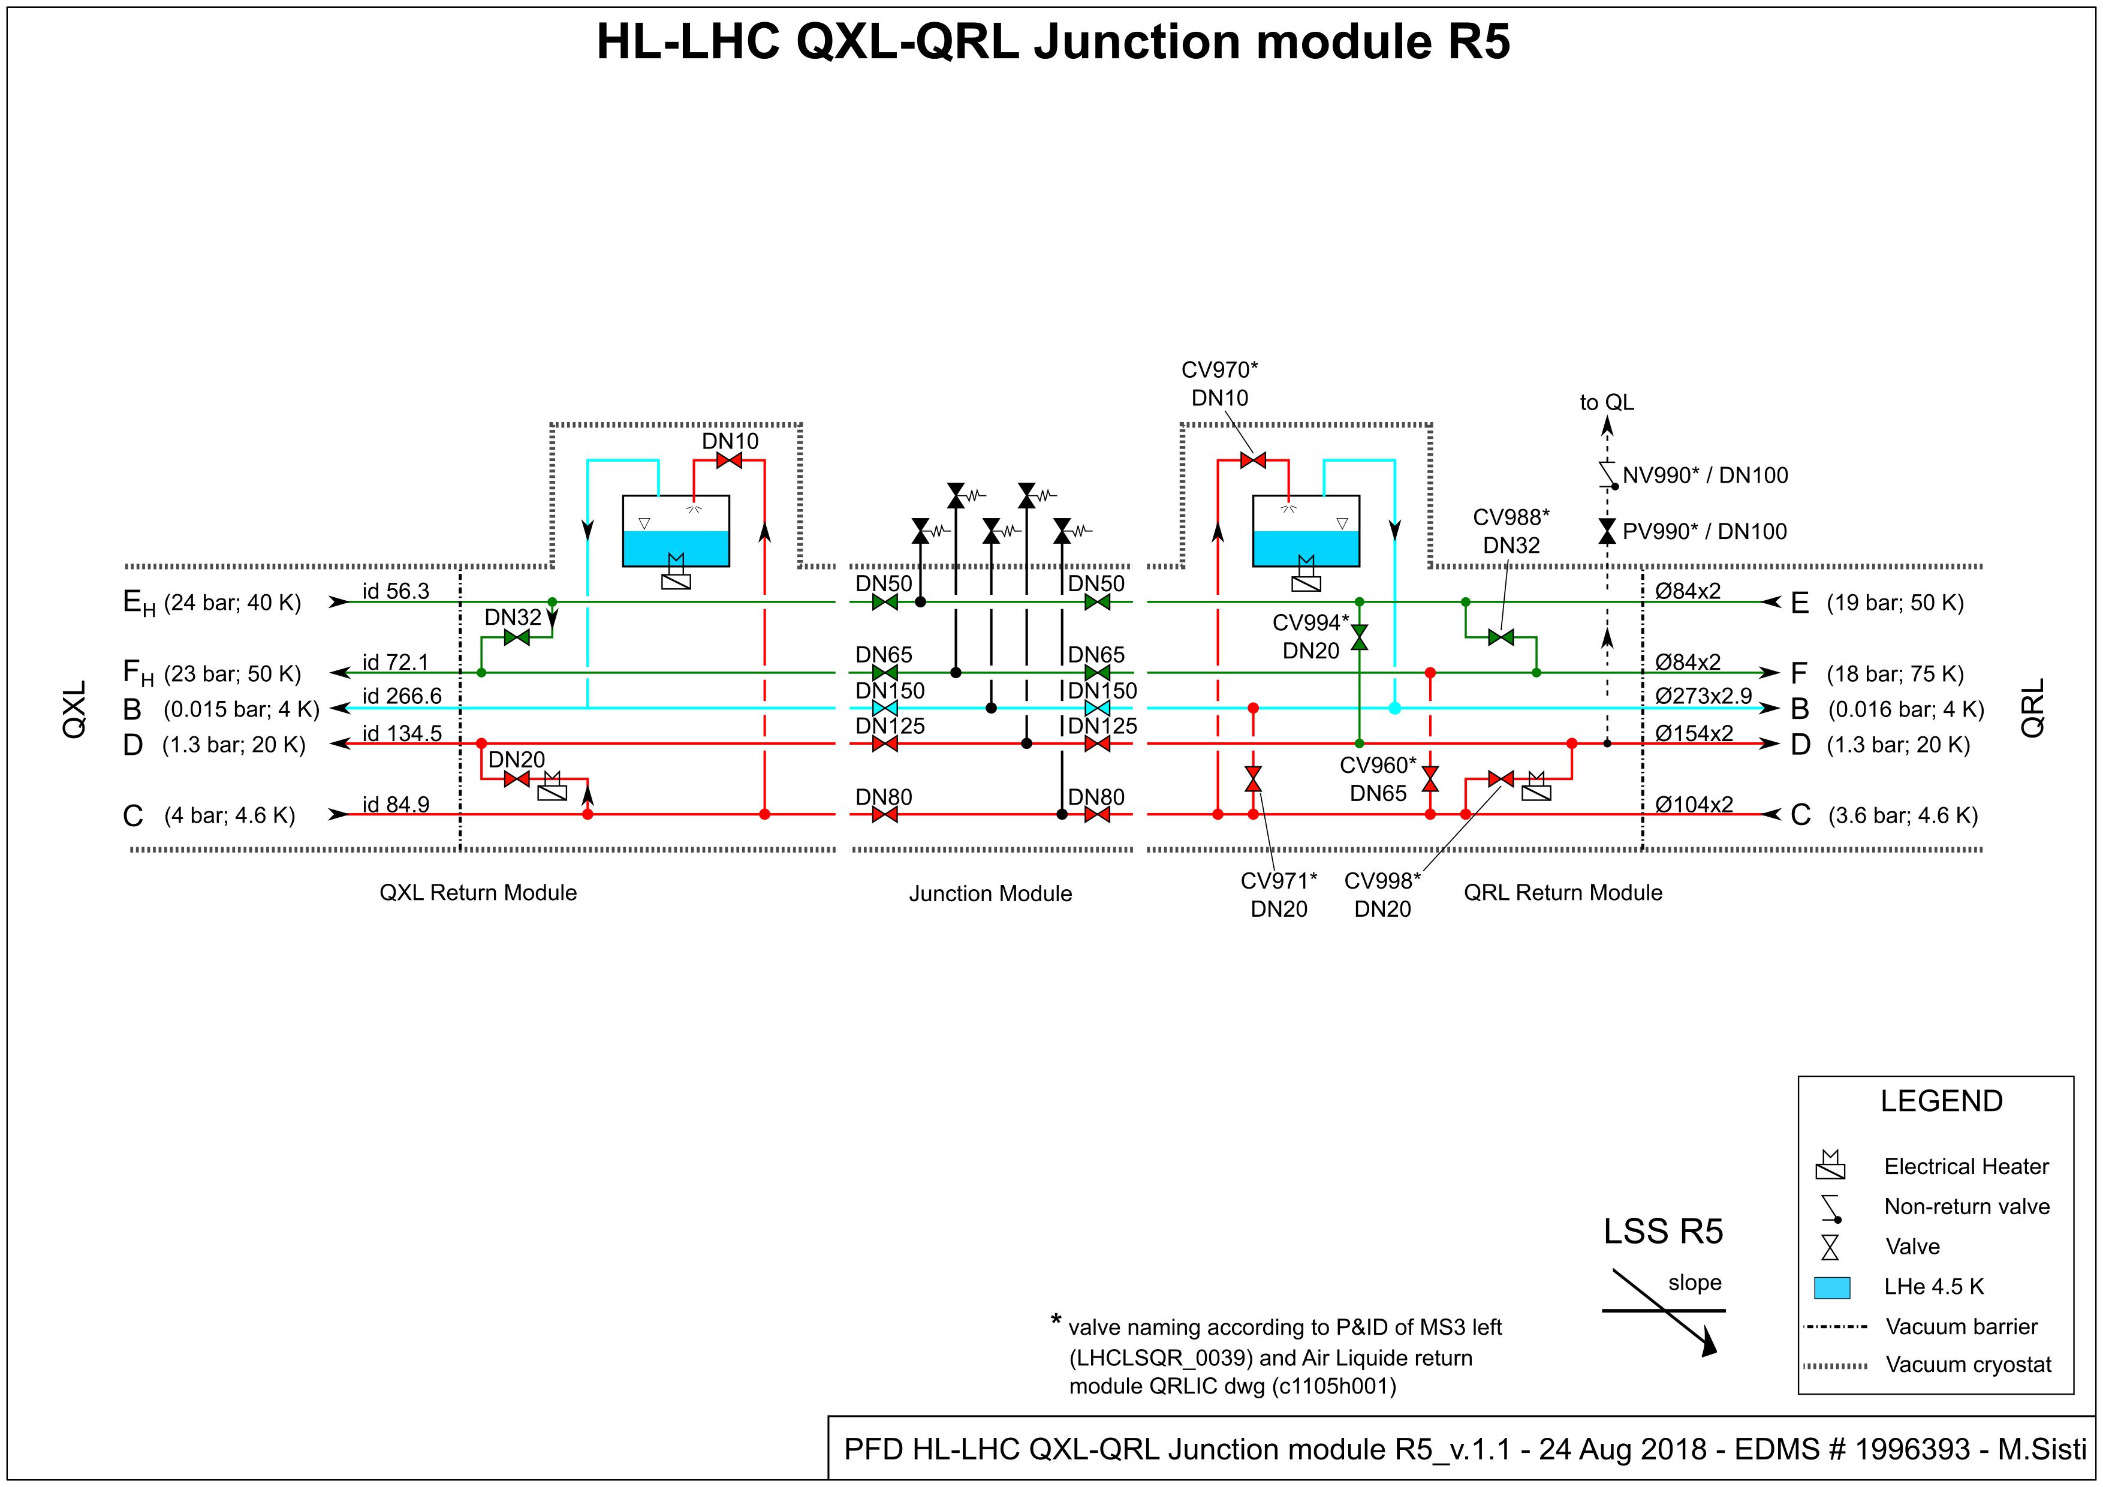
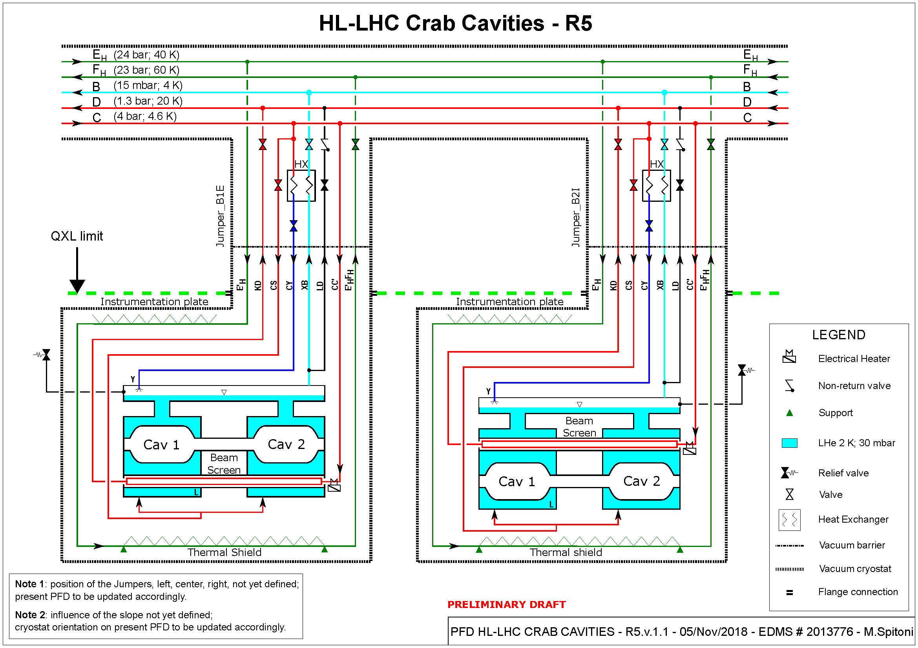
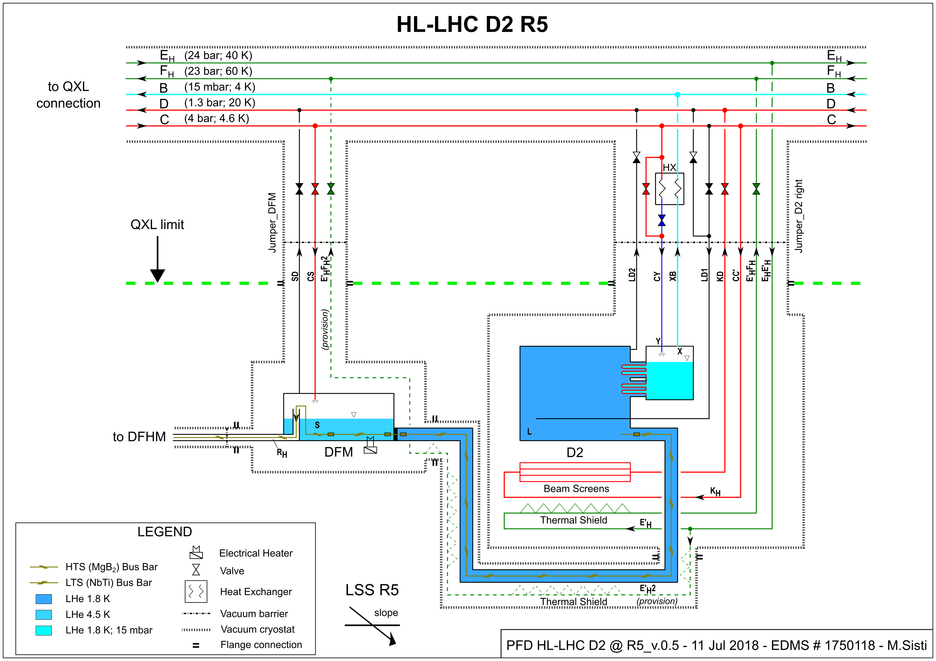
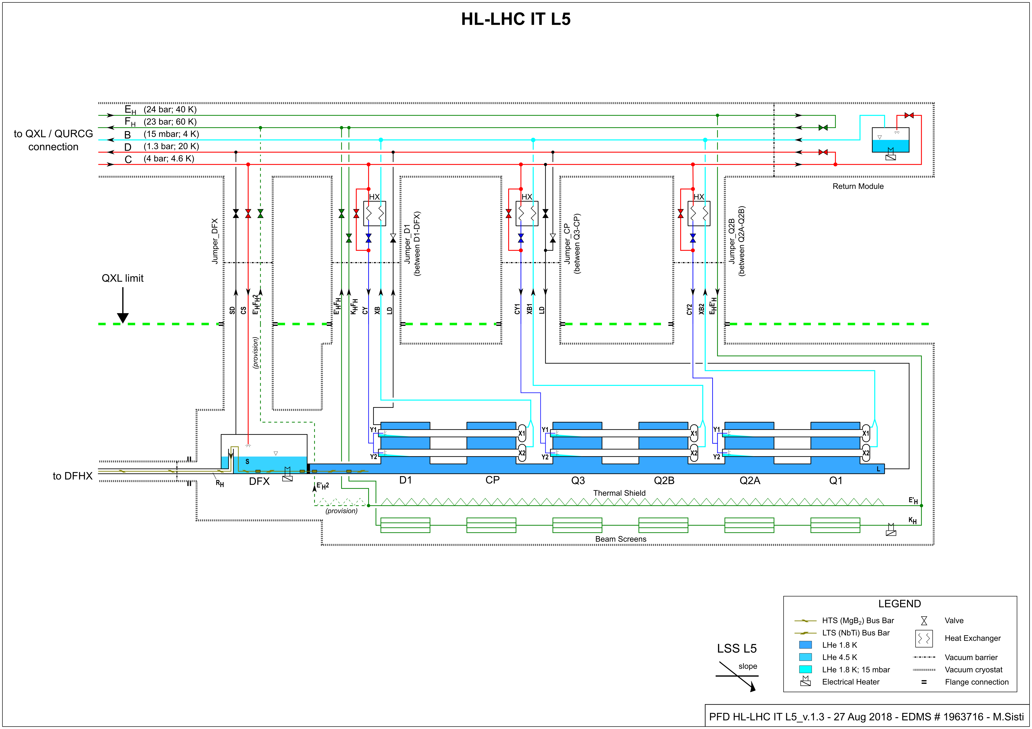
Cryo-distribution reference
Identification of needs,
Proposal of a possible architecture
Proposal of a reference configuration with size
3D models
CC
D2
QRL-QXL
IT-D1
Reference established, optimised considering project requirements and CRG expertise
S. Claudet - Jan'20
CERN future projects, Cryogenics

Slide 10
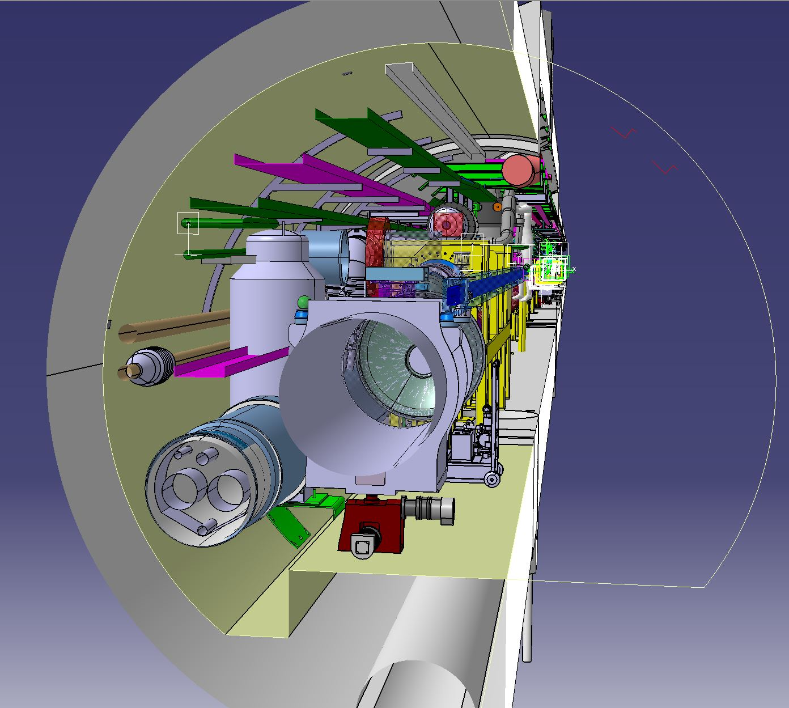
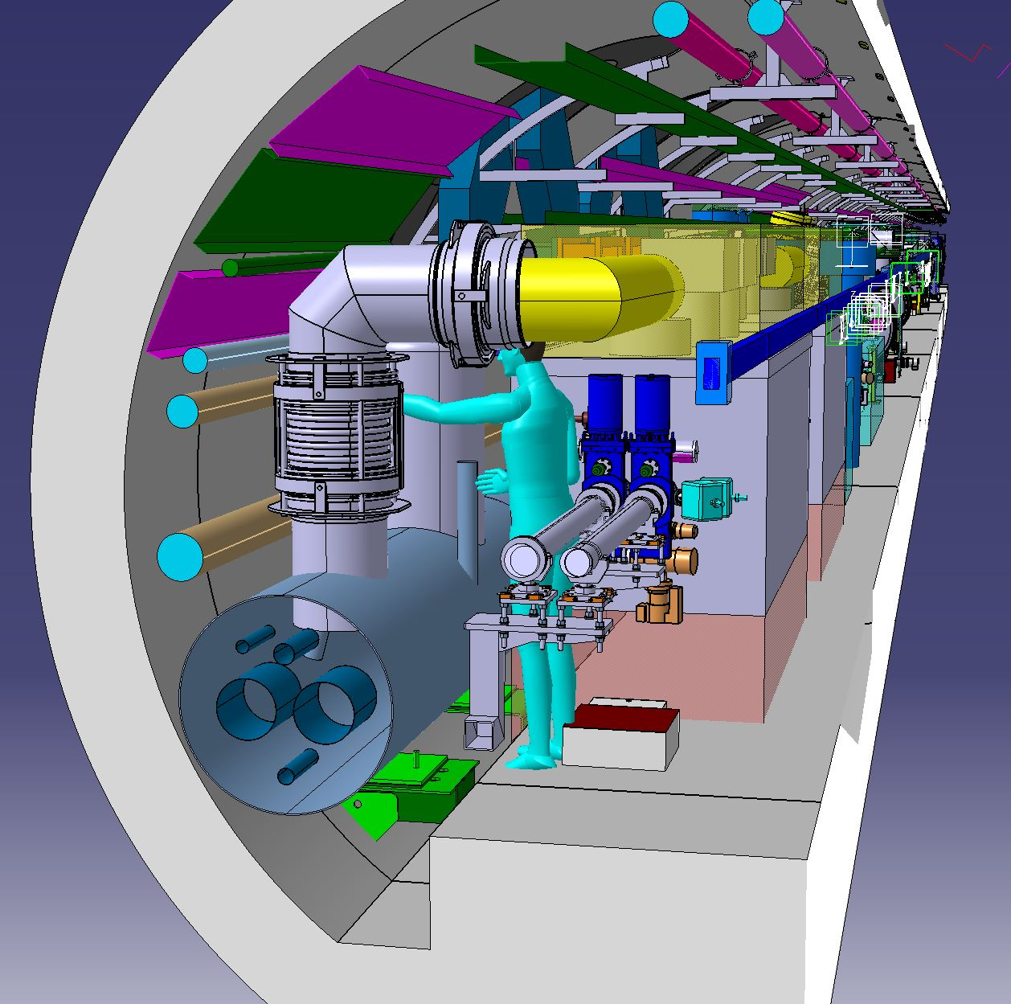
QXL cryoline, 3D models and integration
1’500m, 5 tubes in a shell diam 650-800mm, similar to existing LHC QRL cryoline
Tender 2021,
Following 60m demonstrator mid 2020
S. Claudet - Jan'20
CERN future projects, Cryogenics

Slide 11
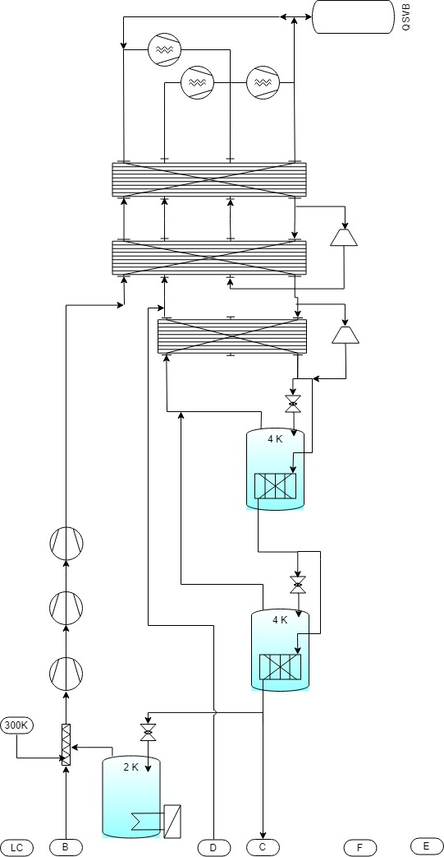
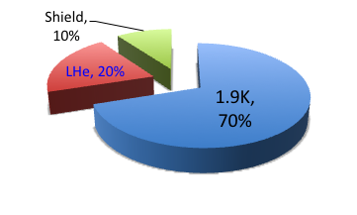
From cooling requirements to Refrigeration capacity and process
300 K
LC
Load @
4.5-300K
QSCG
C
4,5 K
20 K
D
Load @
4.5-20K
QSRG
4 K
B
HX
Load @
1.9-2K
QPLG
E
40 K
60 K
F
Load @
40-60K
(4 CC’s)
QURCG
Obvious need for 15mbar header (1.8K cold source), no special need for 4.5K loads
Process options now under study
Pulsed loads @ 1.9K !!!
S. Claudet - Jan'20
CERN future projects, Cryogenics

Slide 12
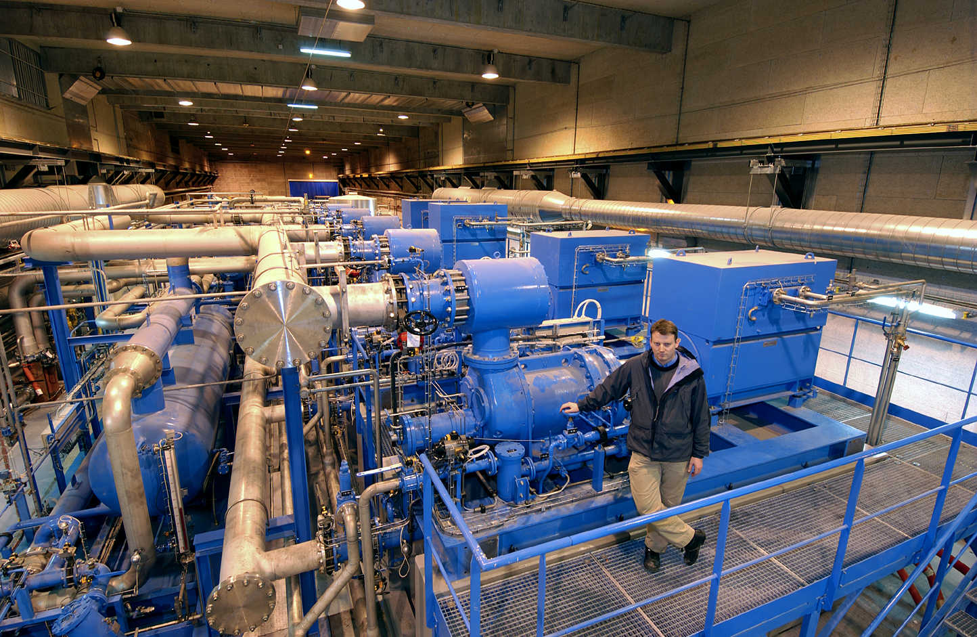
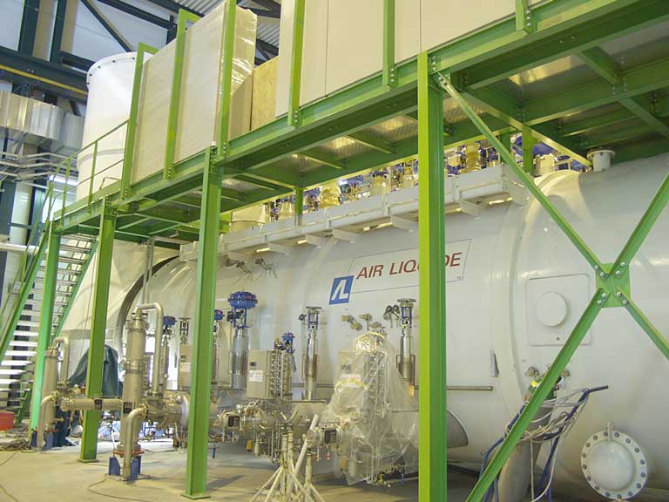
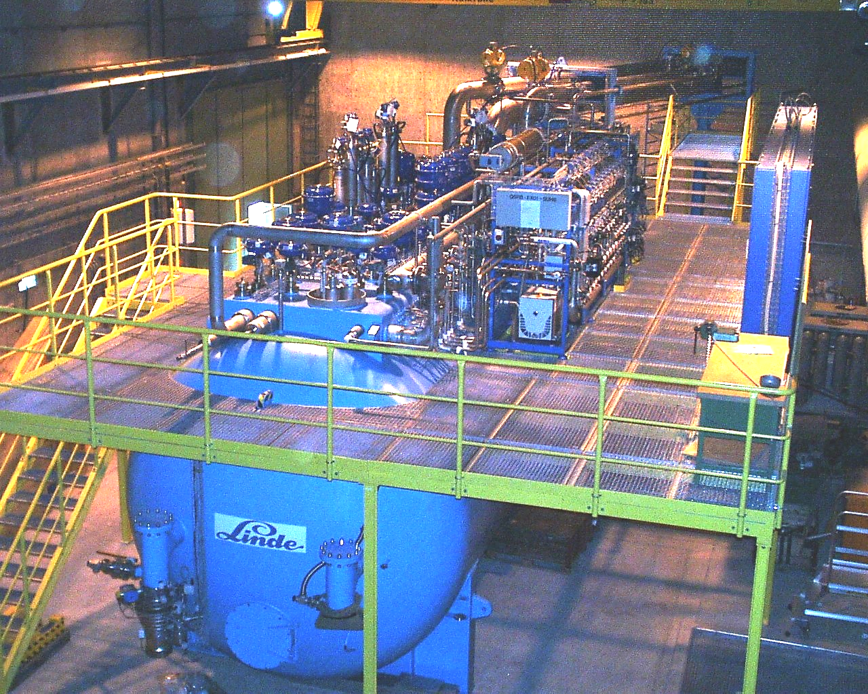
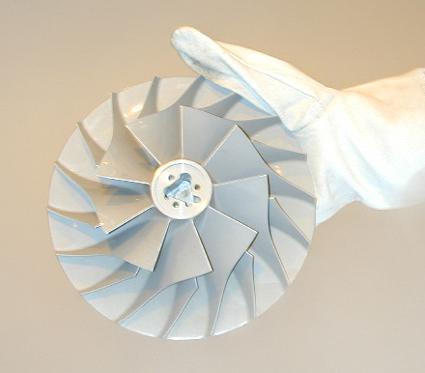
2 x 15 kW eq. @ 4.5K He Refrigerators, incl 3kW @ 1.8K
Best Capex + Opex offer matching specified requirements
Compressors, dryers, cold box(es), vertical cryoline, cold compressors
Tender Q1 2021
S. Claudet - Jan'20
CERN future projects, Cryogenics

Slide 13
Complementary infrastructure
Valve boxes (2): 25 valves in a 2m Diam & 8-10m long box
GHe storage tanks (4): 250 Nm3 – PN25
LN2 storage tanks (2): 50’000 l + vaporiser
Interconnecting piping: 2’000m Diam 250 eq. stainless steel
Instrumentation for tunnel equipment (accuracy, radiation)
Controls (integration with existing LHC infrastructure)
S. Claudet - Jan'20
CERN future projects, Cryogenics

Slide 14
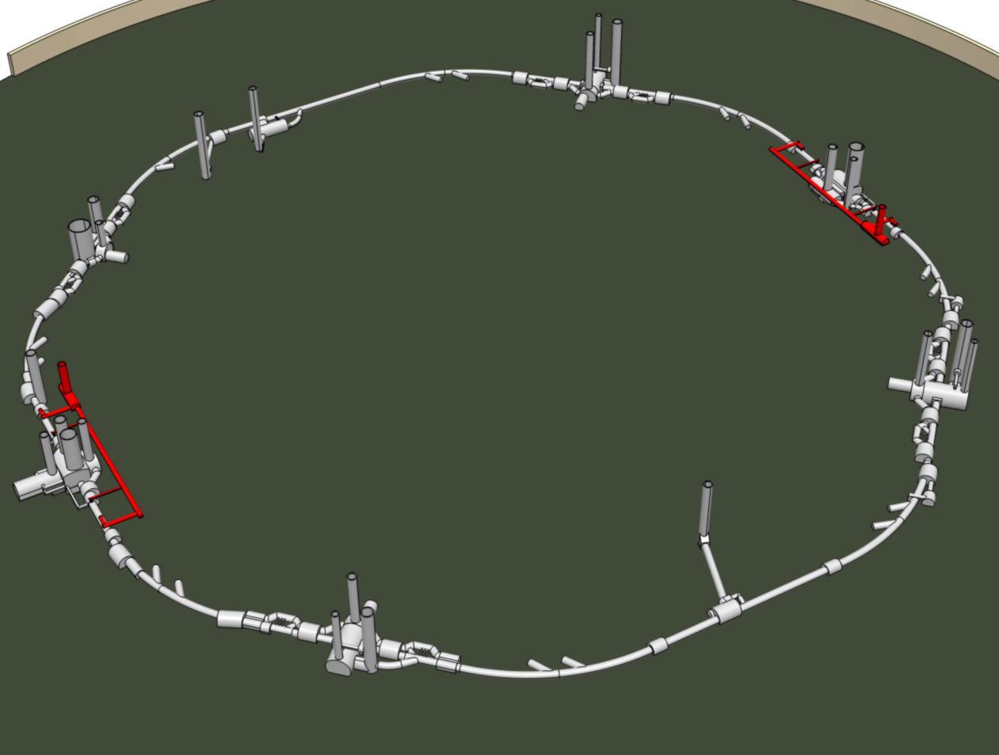
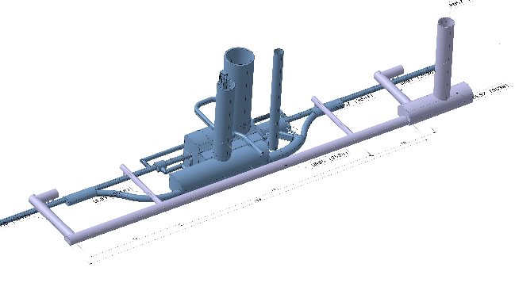
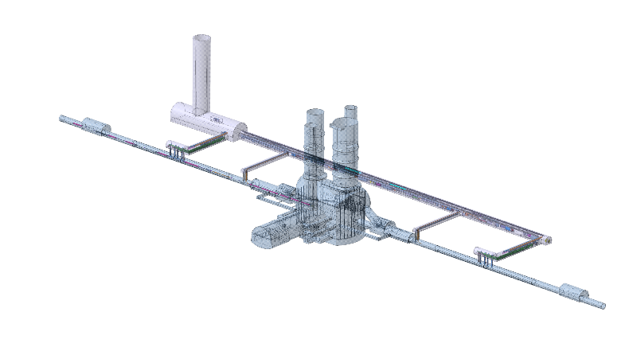
Major civil engineering required at P1-P5
All underground infrastructure being prepared during LS2
POINT 5
POINT 1
S. Claudet - Jan'20
CERN future projects, Cryogenics

Slide 15
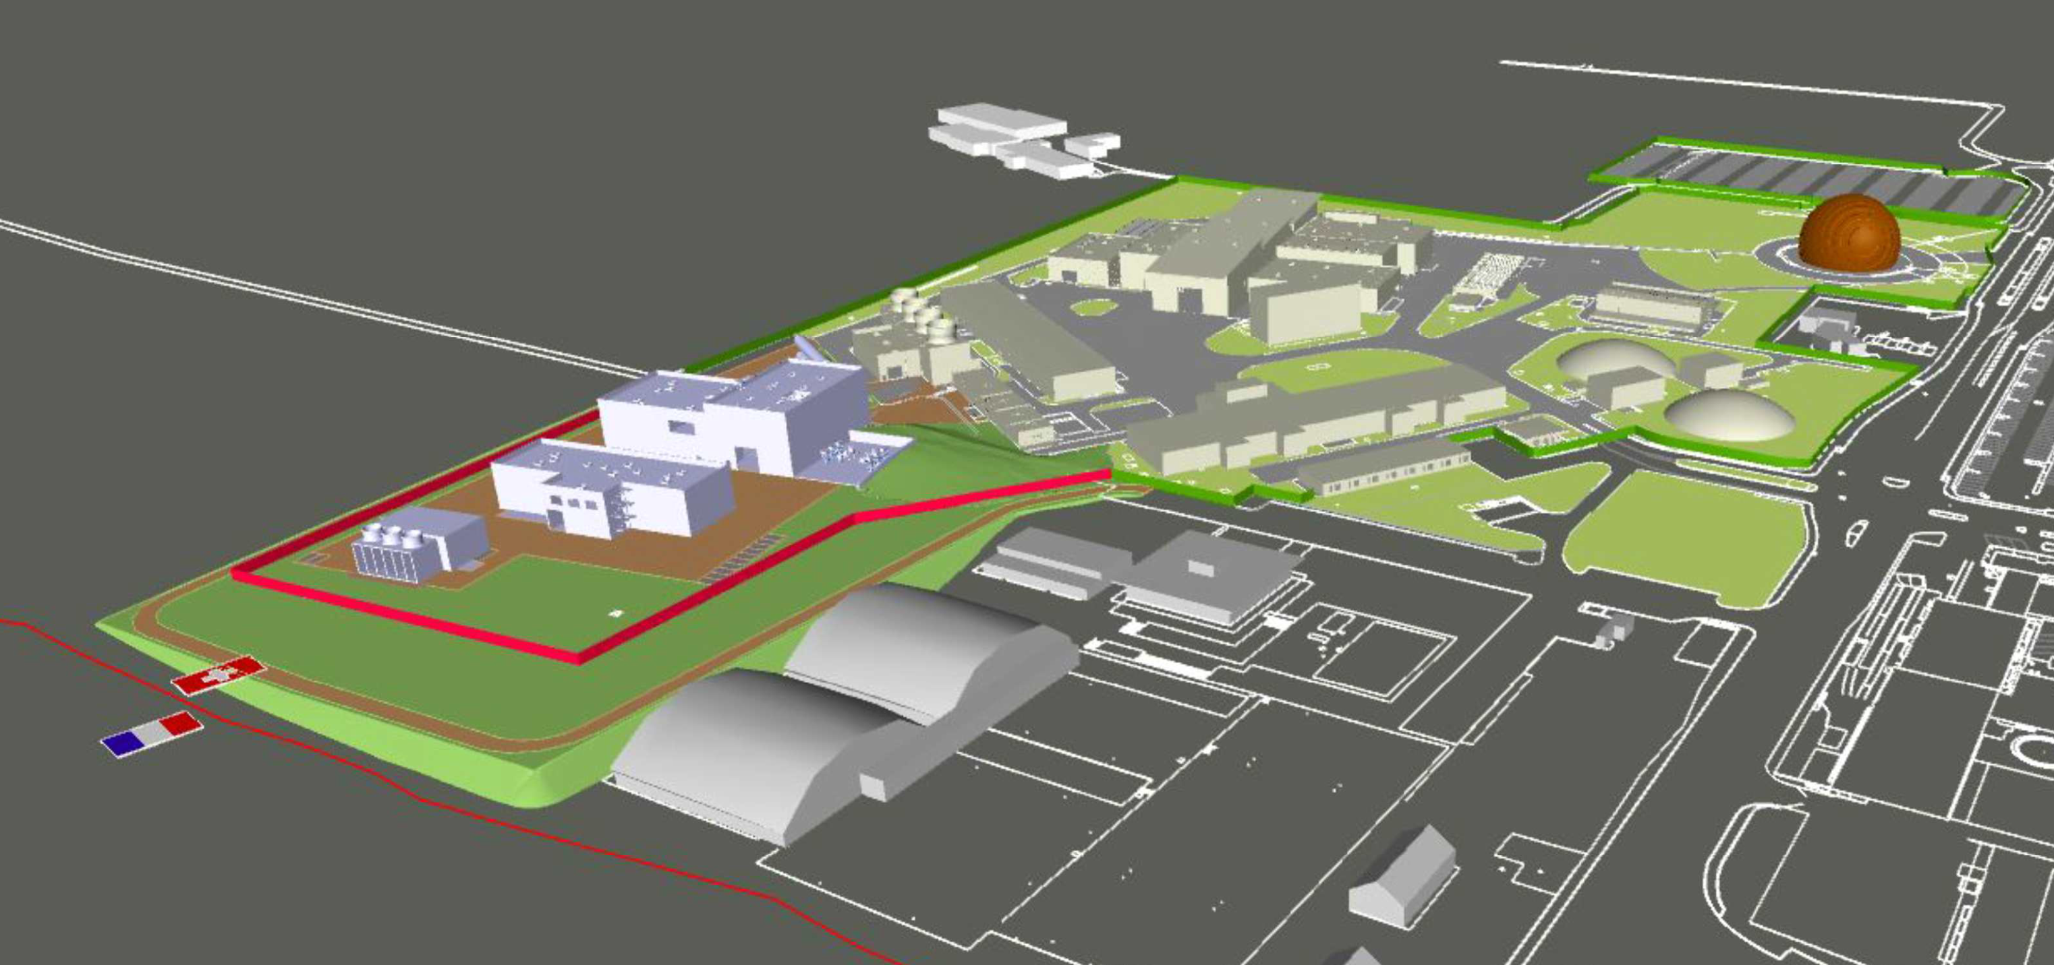
Inventory of the surface works (P1, ATLAS)
All surface buildings during Run3
S. Claudet - Jan'20
CERN future projects, Cryogenics

Slide 16
LHC roadmap
Physics
LS2 starting in 2019 => 24 months + 3 months BC
LS3 LHC: starting in 2024 => 30 months + 3 months BC
Injectors: in 2025 => 13 months + 3 months BC
Shutdown
Beam commissioning
Technical stop
Run 3
Run 2
LS 2
LIU installation
PHASE 1
Run 3
LS 3
Run 4
HL-LHC installation
PHASE 2
LS 4
LS 5
LS 4
Run 5
LS 5
S. Claudet - Jan'20
CERN future projects, Cryogenics

Slide 17
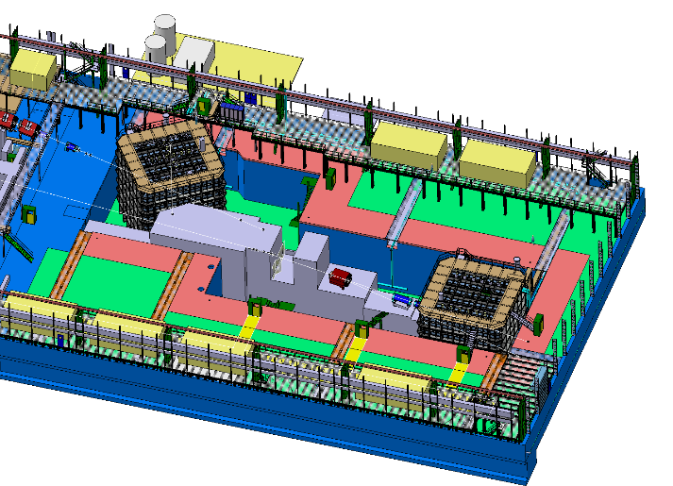
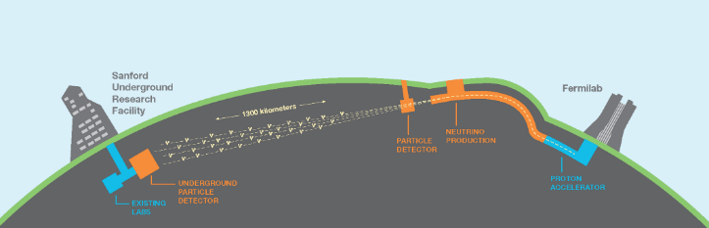
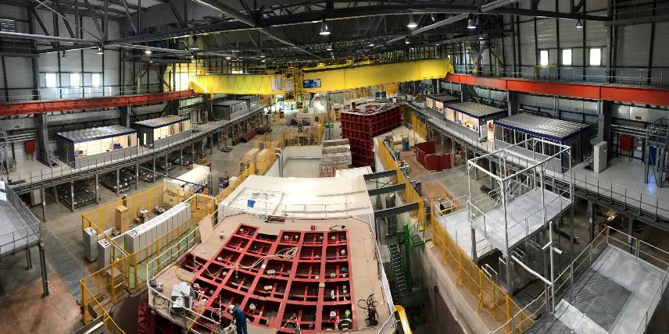
Neutrino Platform (new extension of North Area)
Larg.,
USA
LBNF/DUNE project in USA:
dual-phase
proto-DUNE
single-phase
proto-DUNE
Recently done at CERN
Neutrino platform as a test area with charged beams for neutrino detectors (e.g. R&D for large liquid argon detectors).
S. Claudet - Jan'20
CERN future projects, Cryogenics

Slide 18
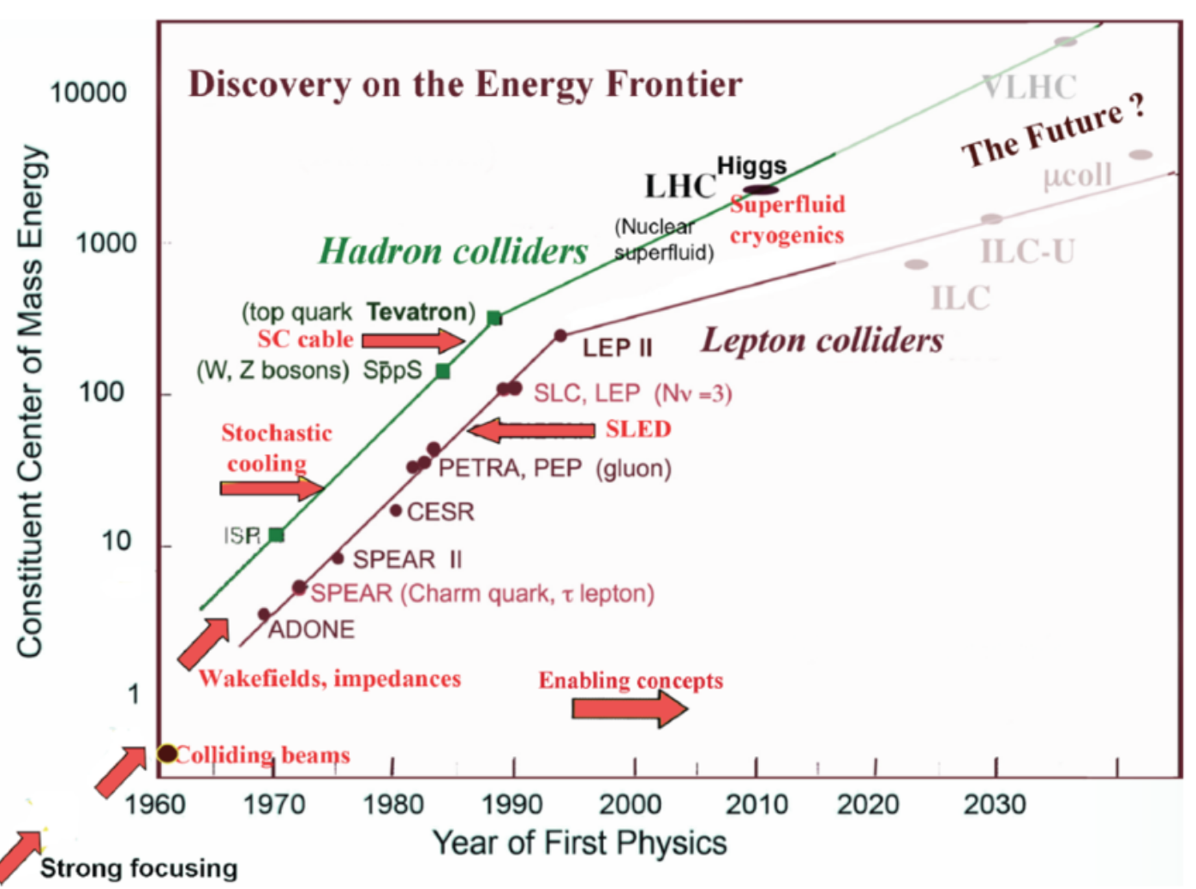
S. Claudet - Jan'20
CERN future projects, Cryogenics

Slide 19
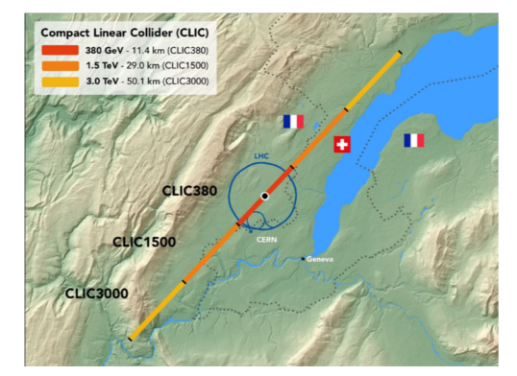
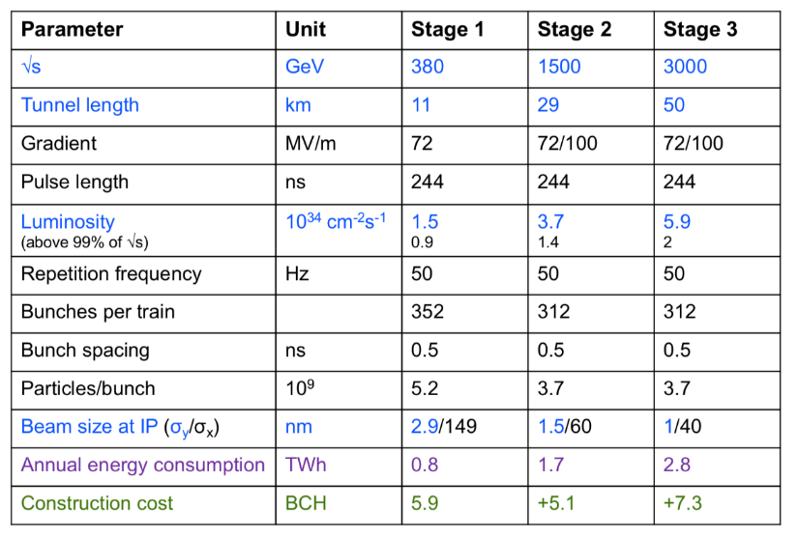
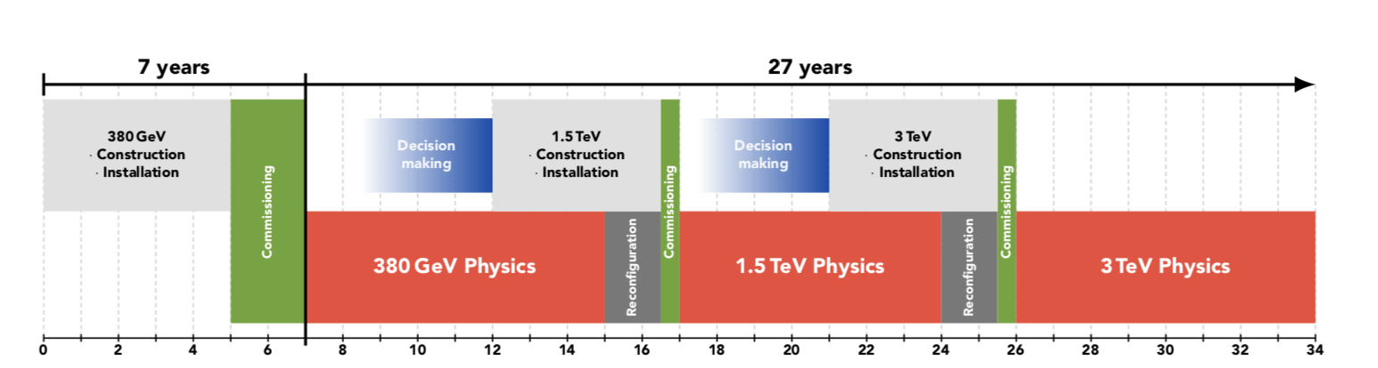
CLIC: multi-TeV e⁺e⁻ linear collider
Cu !
100 MV/m accelerating gradient needed
for compact (~50 km) machine at 3 TeV
based on normal-conducting
accelerating structures and a two-beam
acceleration scheme
Technically, construction could start in ~2026 (TDR in 2025) → first collisions at √s=380 GeV
in ~2035 → 25-30 years of physics exploitation
1 ab⁻¹
2.5 ab⁻¹
5 ab⁻¹

Slide 20
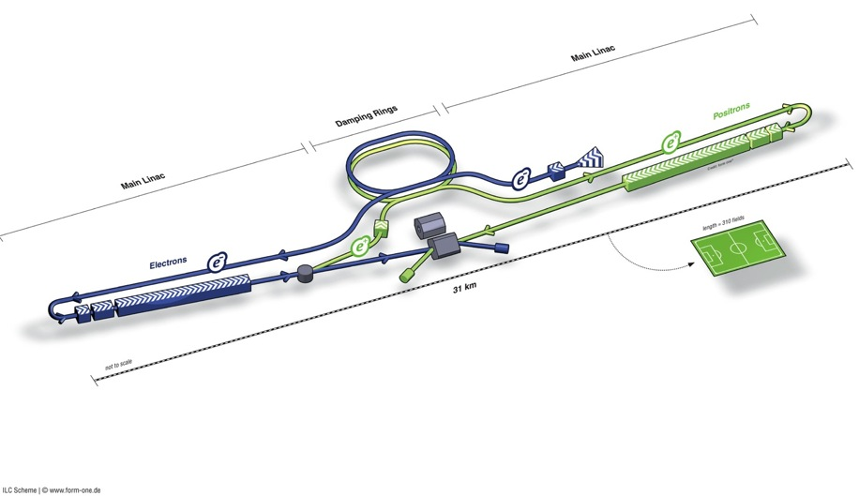
Cryogenics for ILC; TDR Design
HeII,
JP
Damping Rings
Polarised electron source
Ring to Main Linac (RTML)
(including
bunch compressors)
e+ Main Linac
e- Main Linac
E+ source
Parameters | Value
C.M. Energy | 500 GeV
Peak luminosity | 1.8 x10³⁴ cm⁻²s⁻¹
Beam Rep. rate | 5 Hz
Pulse duration | 0.73 ms
Average current | 5.8 mA (in pulse)
E gradient in SCRF acc. cavity | 31.5 MV/m +/-20% Q₀ = 1E10
10 cryogenic plants
19 kW @ 4.5 K
including 2.4 kW @ 2 K;
10 technical sites;
84 t of helium inventory;
cryogenic distribution line
Updated proposal: 50% of nominal energy;
6 cryogenic plants in 1st phase
S. Claudet - Jan'20
CERN future projects, Cryogenics

Slide 21

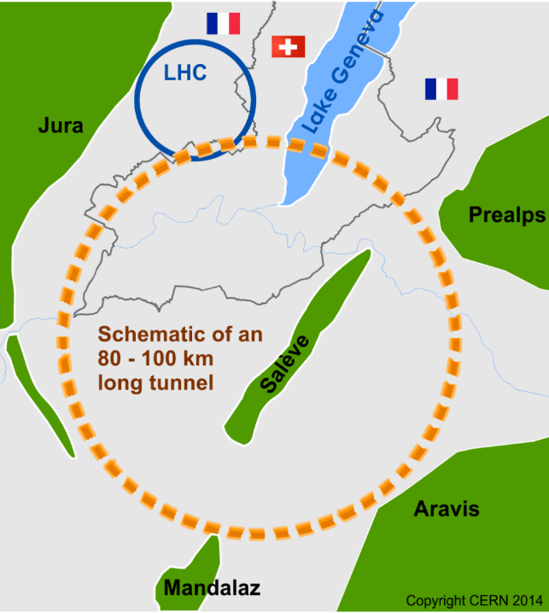
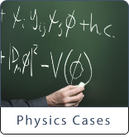
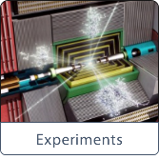
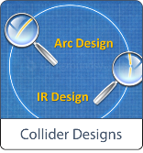
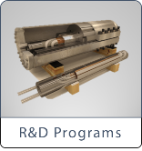


Future Circular Collider Study
International FCC collaboration (CERN as host lab) to study:
~100 km tunnel infrastructure in Geneva area, linked to CERN
e⁺e⁻ collider (FCC-ee), as potential first step
pp-collider (FCC-hh) → long-term goal, defining infrastructure requirements
HE-LHC with FCC-hh technology
~16 T ⇒ 100 TeV pp in 100 km
2018 CDR (studies involving industry)
2020 European Strategy (discussion)
Up to 1’000 kW eq. @ 4.5K
800 t He
S. Claudet - Jan'20
CERN future projects, Cryogenics

Slide 22
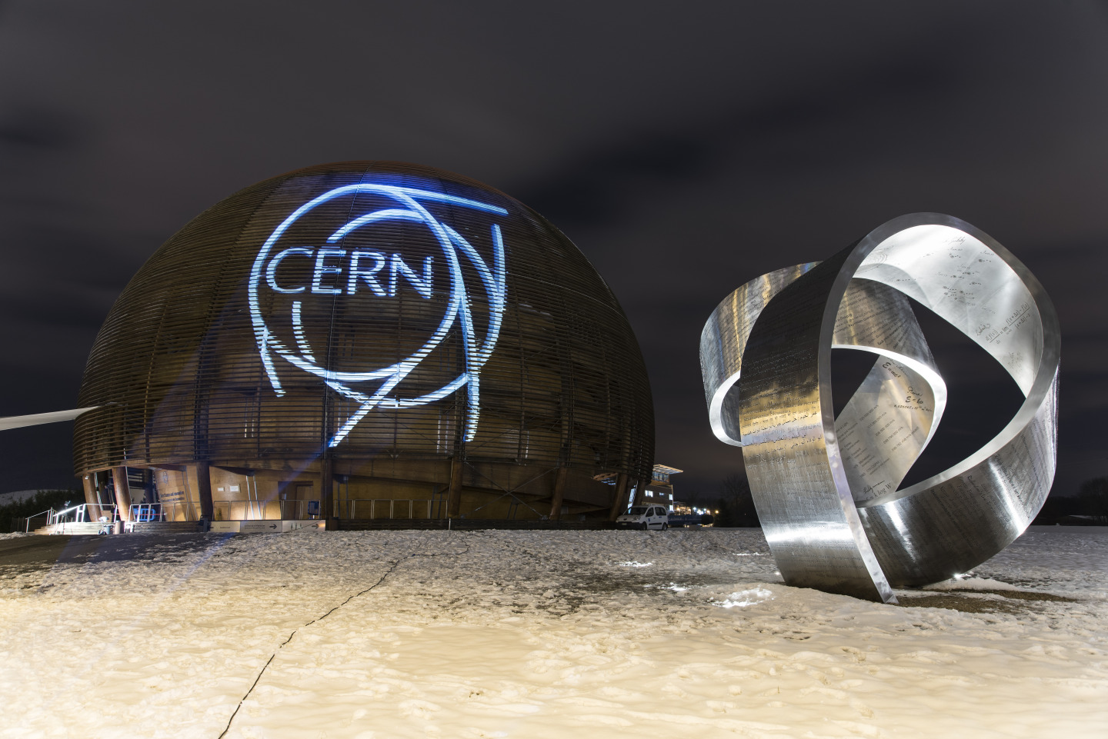
Les accélérateurs sont notre coeur de métier
Merci pour votre attention!
L’électricité est notre énergie,
L’Hélium est notre sang !
S. Claudet - Jan'20
CERN future projects, Cryogenics

