Slide 1


Considering Complex Problems
A personal approach
Pablo Garcia Tello, CERN IdeaSquare

Slide 2
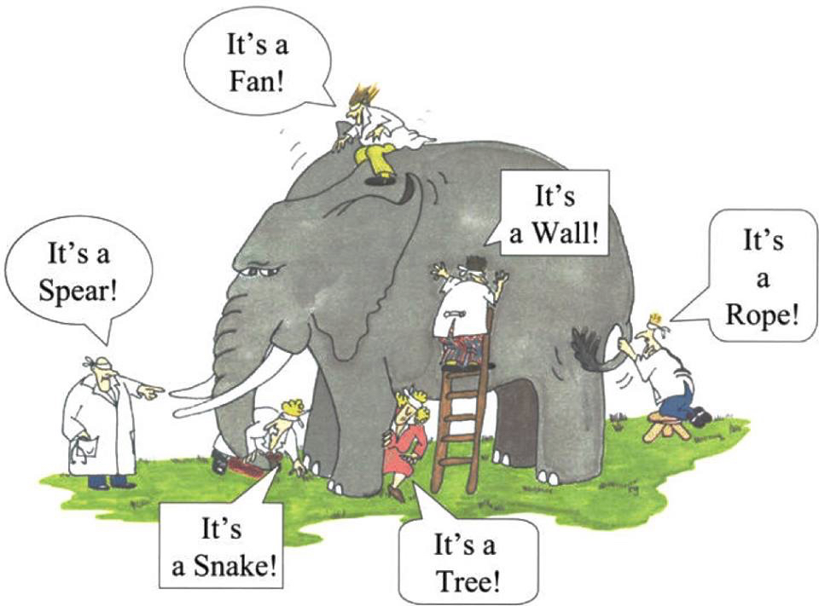
What’s wrong with these poor guys?

Slide 3
How could somebody make life even more difficult for them?

Slide 4
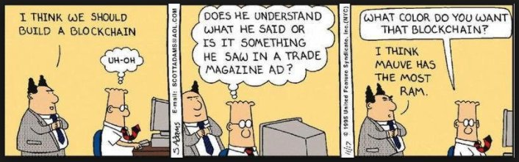
First seek to understand…only after, and eventually, seek to “solve”.

Slide 5
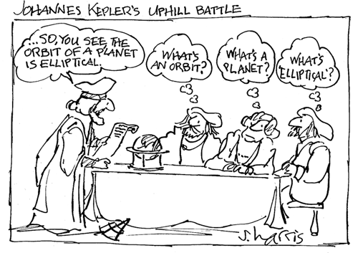
What is understanding?

Slide 6
Knowing is not understanding. There is a great difference between knowing and understanding: you can know a lot about something and not really understand it.
– Charles Kettering

Slide 7
Three steps strategy
1
2
3
Identify
Key
Variables
Visualize
Numbers
Do the Math!

Slide 8
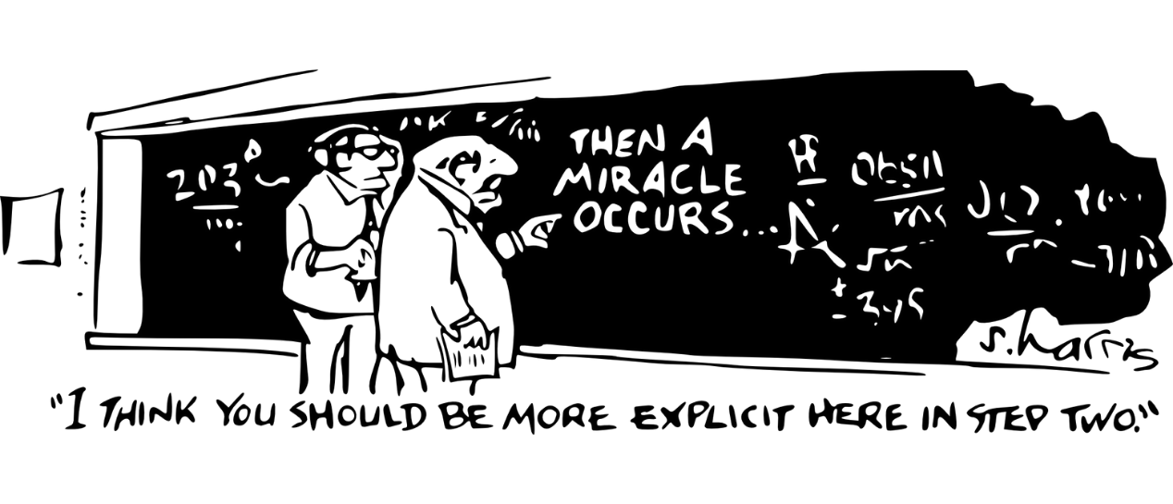

Slide 9
Cosmetics Industry and Plastics
Key Variables?

Slide 10
Cosmetics Industry and Plastics
Heterogeneity
Volume
Producer/Consumer Behaviour

Slide 11
Australia: 12000 tonnes of cosmetic packaging from across the sector is currently being landfilled each year.

Slide 12
Volume
12 000 tonnes/year = 12 000 000 Kg/year
1 AEC Routemaster bus ~ 12 000 Kg
Cosmetics landfill in Australia ~ 1000 buses/year
Let’s say we go for increasing efforts of recycling …
Typical throughput of a plastic recycling plant ~ 20,000 tonnes/year ~ 20 000 000 Kg/year ~ 1500 buses/year
BUT…is it ALL recycled plastic, cosmetic plastic? What % shall we assume? Reality 9%
Assuming 9% recycling (of 1000 buses/year) means 90 buses/year
So, 910 buses/year goes still to landfill.
Note: Interesting Plastic Recycling Plant https://www.svenskplastatervinning.se/en/
(Cost ~ 1 Billion USD construction)
(200,000 tonnes of plastic packaging per year)
Operating at Net Zero

Slide 13

Heterogeneity
Only 1/3 of the recycling comes from “take back boxes in stores”.
Manual sorting necessary.
Low throughput: 20 bags/day (Weight estimation?)
Manufacturers: Oh dear! 70% comes from them.
Microplastics!
Not enough demand for recycled stuff!
Barely a business model.

Slide 14
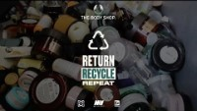
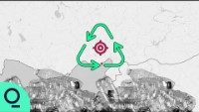
Manufacturer and Consumer Irresponsible Behaviours

Slide 15

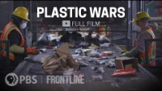
Please, do not miss them!

Slide 16
A word about “solving” and “solutions”

Slide 17

Blurry
Inherently impossible to be framed
Solution Defiant
The solution is a moving target
Meta-interconnected
Apparently despaired wicked problems are interconnected
Unique
Not two of them alike
Every Single Wicked Problem is…
Non-binary
No y/n solutions but trade-offs
Paradoxical
Multiple stakeholders with conflicting agendas
Multi-everything interconnected
Multi-causal
Multi-scalar
Multi-dimensional
…
Prototype Defiant
Can take LONG time to test and verify solutions

Slide 18
V
H
B
Volume
Heterogeneity
Producer/
Consumer Behavior
What type of plastic use would you like to substitute?
How much % will it represent wrt the total plastic production volume?
A take back incentive scheme?
How many people will adopt your solution? 10% , 20%?
Why?
Could you beat a plastic sorting of
245 tons per day?
How?
“Solution” means Impact
And Impact is quantifiable, not just wishful thinking
Please, do the math.

Slide 19
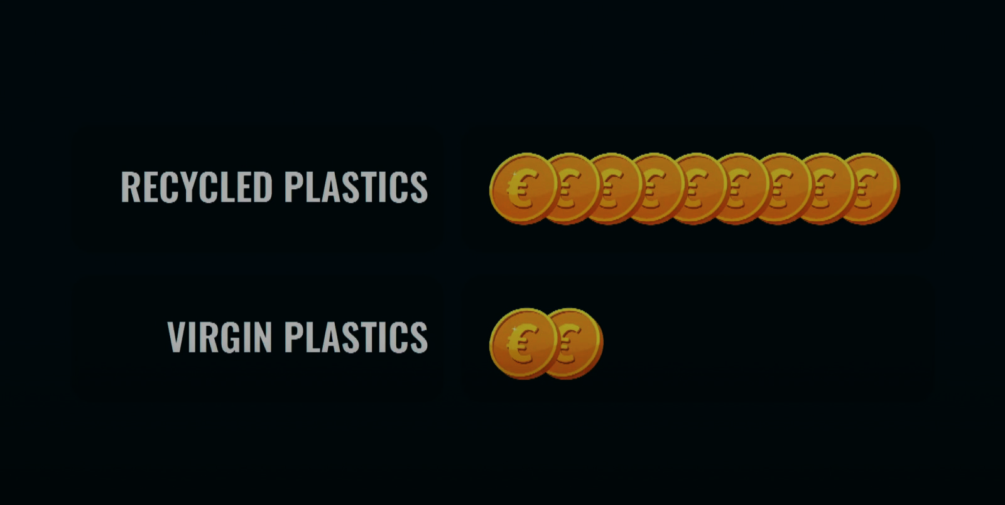
Also…could you beat this?

Slide 20
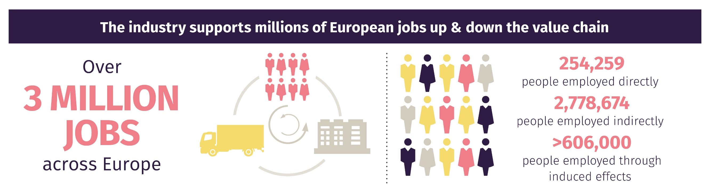
And don’t forget…
Is your solution creating or destroying jobs?

Slide 21
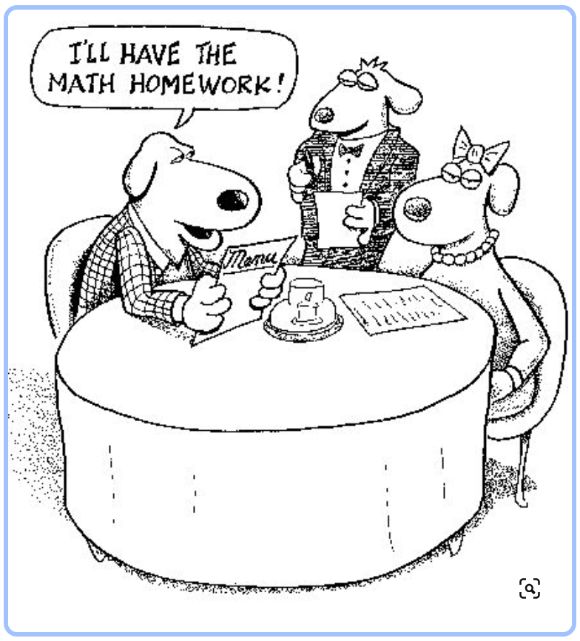
Shall you work out another case?

