Slide 1
SDGs and Systems Thinking
CBI A3, 7th November 2023
Catarina Batista

Slide 2
Let’s solve world hunger in 30min

Slide 3
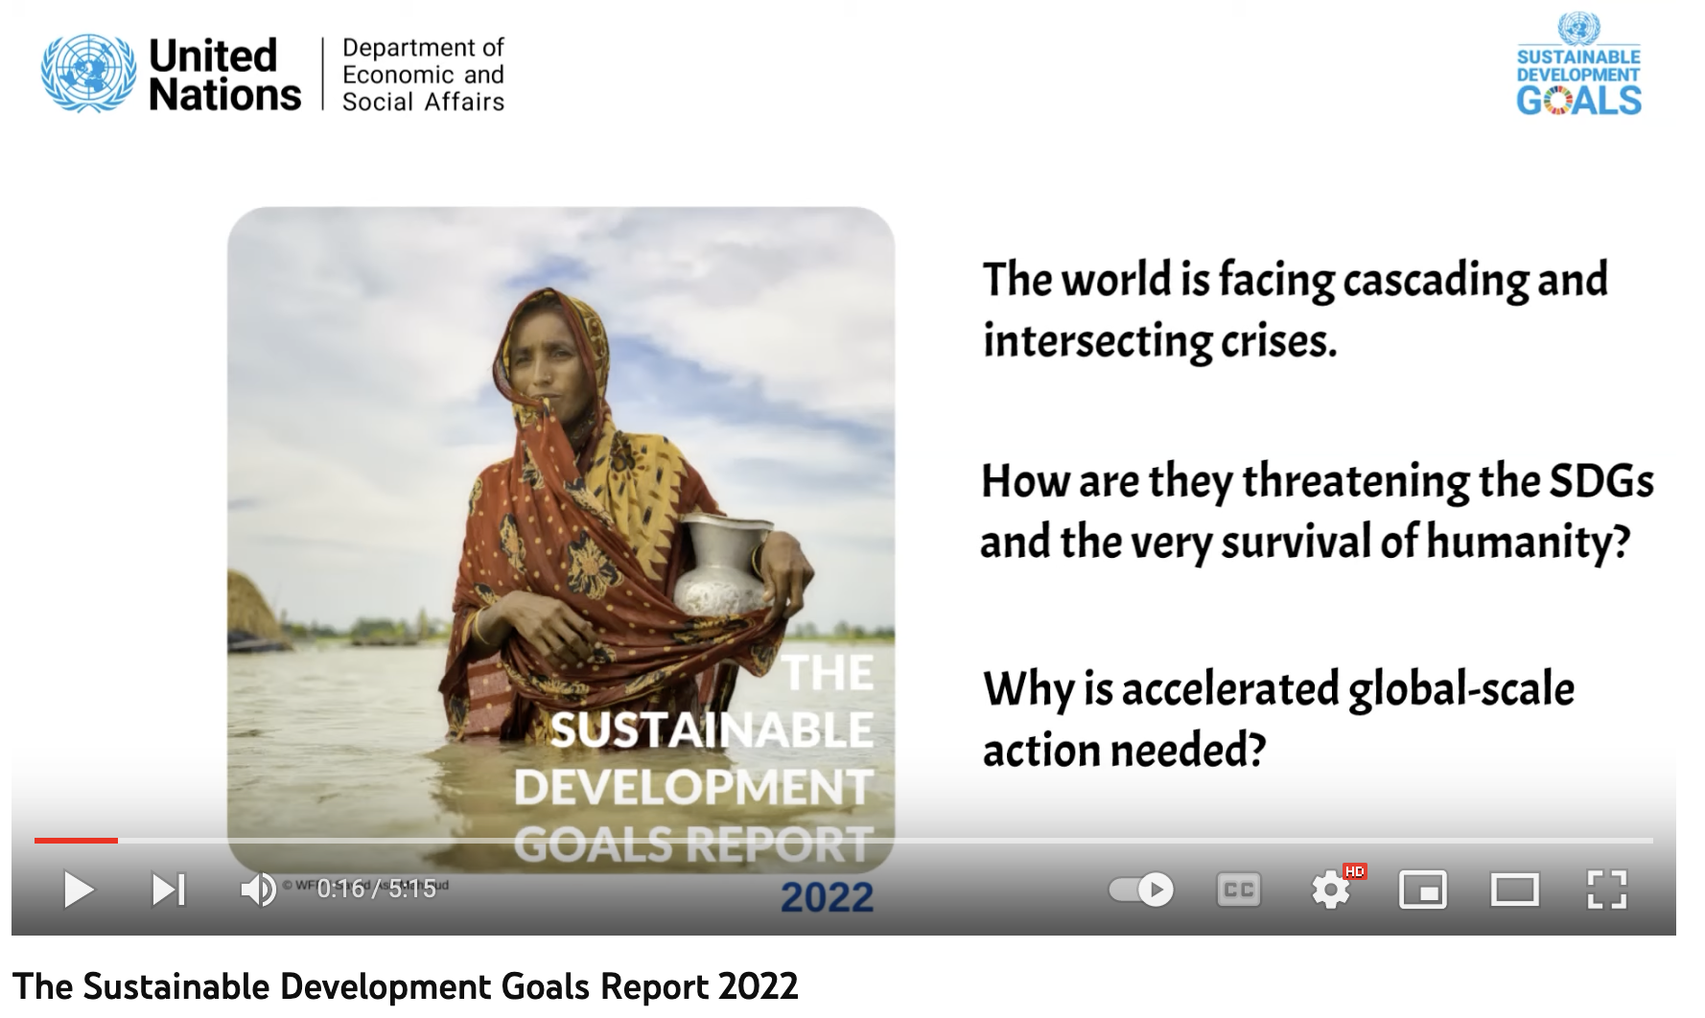
How much progress has been made?

Slide 4
One step forward, two steps back (?)
Digital transformation and quick adaptation from cities and communities were positive results of COVID-19.
The confluence of crises, dominated by COVID-19, climate change, and conflicts, are creating spin-off impacts on food and nutrition, health, education, the environment, and peace and security, and affecting all the SDGs.
“Call for cooperation and inclusion of private sector, government institutions, academics, and municipalities in a ‘whole-of society’ effort to achieve sustainable development and a fairer societies.”
https://unstats.un.org/sdgs/report/2022/
https://www.weforum.org/agenda/2022/11/the-un-sustainable-development-goals-a-positive-perspective/

Slide 5


Thinking linear
Problem:
hunger
Solution:
increase food production.

Slide 6
Thinking linear
Problem:
hunger
Solution:
increase food production.
Solved?

Slide 7
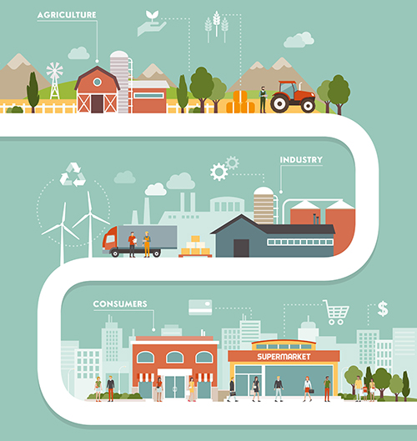
Tackling hunger
We could feed much more than the world’s population.
  Main cause: food waste.
  Reasons: cold storage, relative prices, and portion size
Tackling areas such as responsible consumption and production (SDG 12), or even education (SDG 4) could contribute to changing the paradigm.
In turn, we could be aiming at reduced inequalities (SDG 10).
https://www.redwoodlogistics.com/five-challenges-in-food-and-beverage-supply-chains/

Slide 8
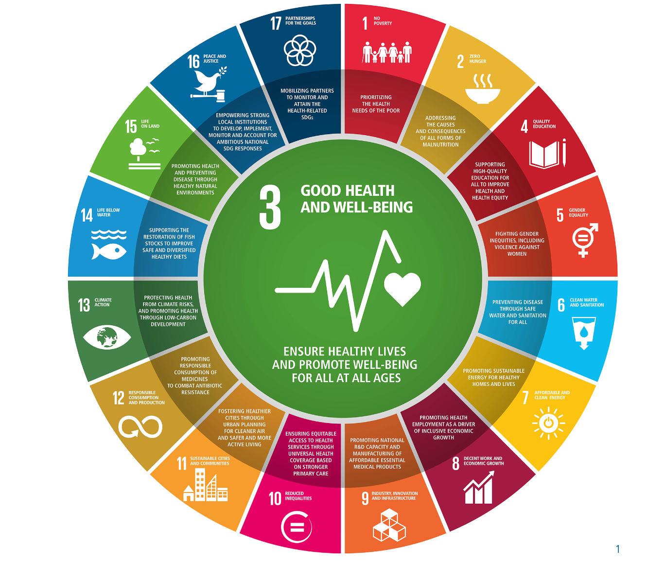
SDGs have linkages between eachother
The 2030 SDG agenda recognizes that "ending poverty and other deprivations must go hand-in-hand with strategies that improve health and education, reduce inequality, and spur economic growth – all while tackling climate change and working to preserve our oceans and forests.”
https://sdgs.un.org/goals

Slide 9
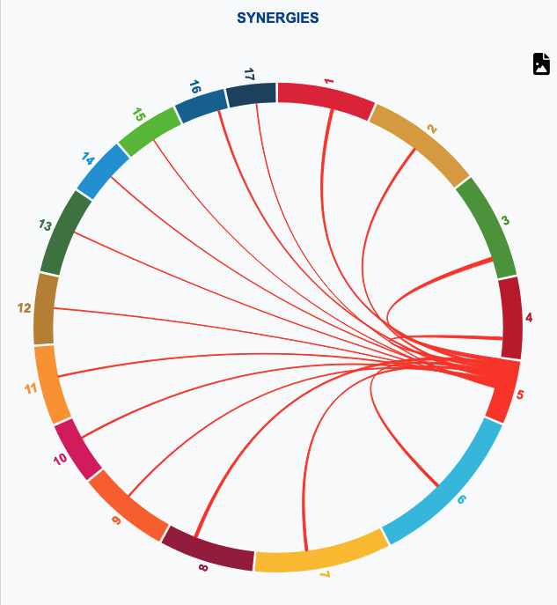
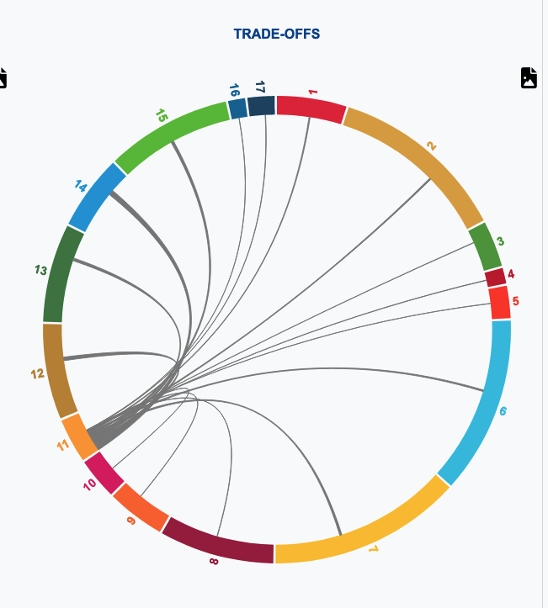
https://knowsdgs.jrc.ec.europa.eu/interlinkages/goals

Slide 10
We need systemic approaches to tackle these interconnected, ill-defined problems

Slide 11
catarina.batista@cern.ch

