Slide 1
Cultivating a Growth Mindset
November 6th 2023
Catarina Batista

Slide 2
It’s time to reconfigure your environment

Slide 3
Getting Hammered!
Notes:
What can you use a hammer for?
3 rounds of 15-30 seconds each.
Sharing different rounds at the end.

Slide 4

Functional Fixedness
Tendency to see the functions of different objects in the way you usually use them.
Blocks our ability to see its utility for other purposes.
Many problems might require the problem-solver to use an object in the solution in an unusual way.
Photo by DevVrat Jadon on Unsplash
Notes:
Representation can have a strong in􀃗uence on how easy or hard it is for you to solve problems. One of the
reasons you have dif􀃖culty with certain problems is functional 􀃖xedness. Functional 􀃖xedness refers to the
tendency to see the functions of different objects, tools and so on in the way you usually use them. For
example, you normally use hammers to drive nails into wood, but they can just as well serve as
paperweights, or as doorstops. Having a well-learned use for an object does not only make it easy to decide
to use that object as a tool for its normal use, it also blocks your ability to see its utility for other purposes;
you become 􀃖xed on its normal function. Many problems take advantage of this by requiring the problemsolver
to use an object in the solution in an unusual way.

Slide 5
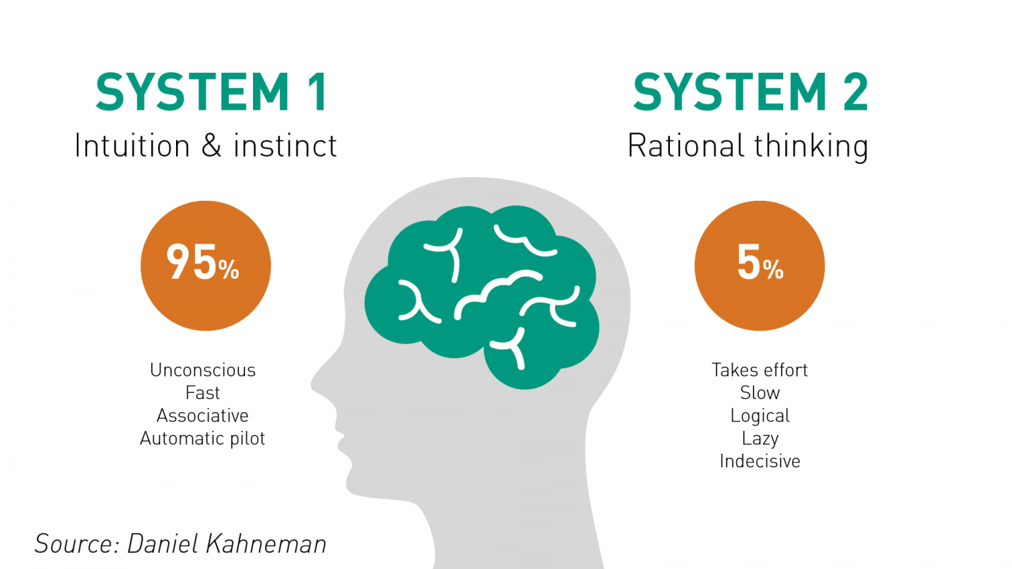
2 systems
https://www.rogerleishman.com/2017/12/thing1.html

Slide 6
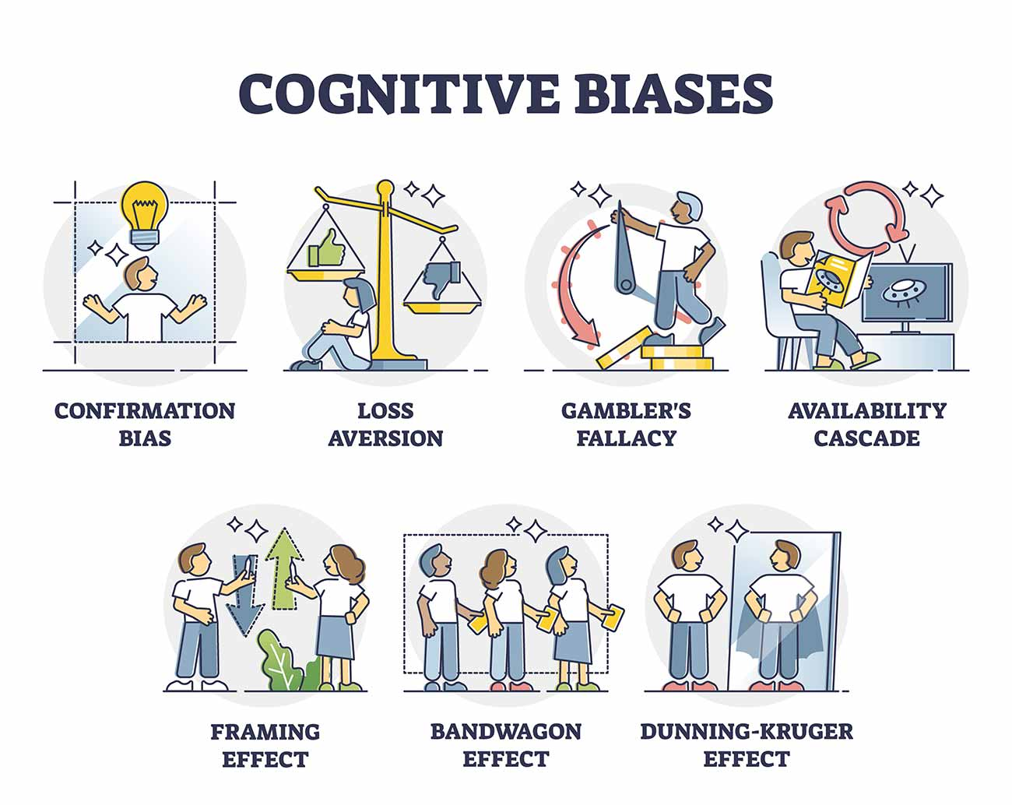
Biases
Graphic from: https://www.simplypsychology.org/cognitive-bias.html

Slide 7
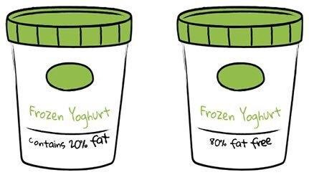

Slide 8

Bounded rationality
We are constantly making decisions with insuffiencient data, information, abilities and memory.
We need to select which information we should collect and prioritize it.
Our decision process is bounded by practical, often cognitive, factors (Simon,1957).
Photo by Katya Korovkina on Unsplash
Notes:
Herbert Simon 1957
Known and unknown (benefit of being okay with the unknown)

Slide 9

How can we get better at solving problems and driving disruptive solutions?
Not doing “business as usual” requires more than conventional thinking…
Photo by Adam Nieścioruk on Unsplash

Slide 10
How can we get better at solving problems and driving disruptive solutions?
Engaging in practices that kick up our System 2 and make us look at problems in a different light.
Taking a step back to look at the bigger picture.
Cultivating a growth mindset.
Photo by Adam Nieścioruk on Unsplash

Slide 11
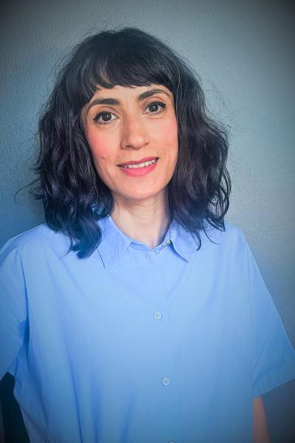
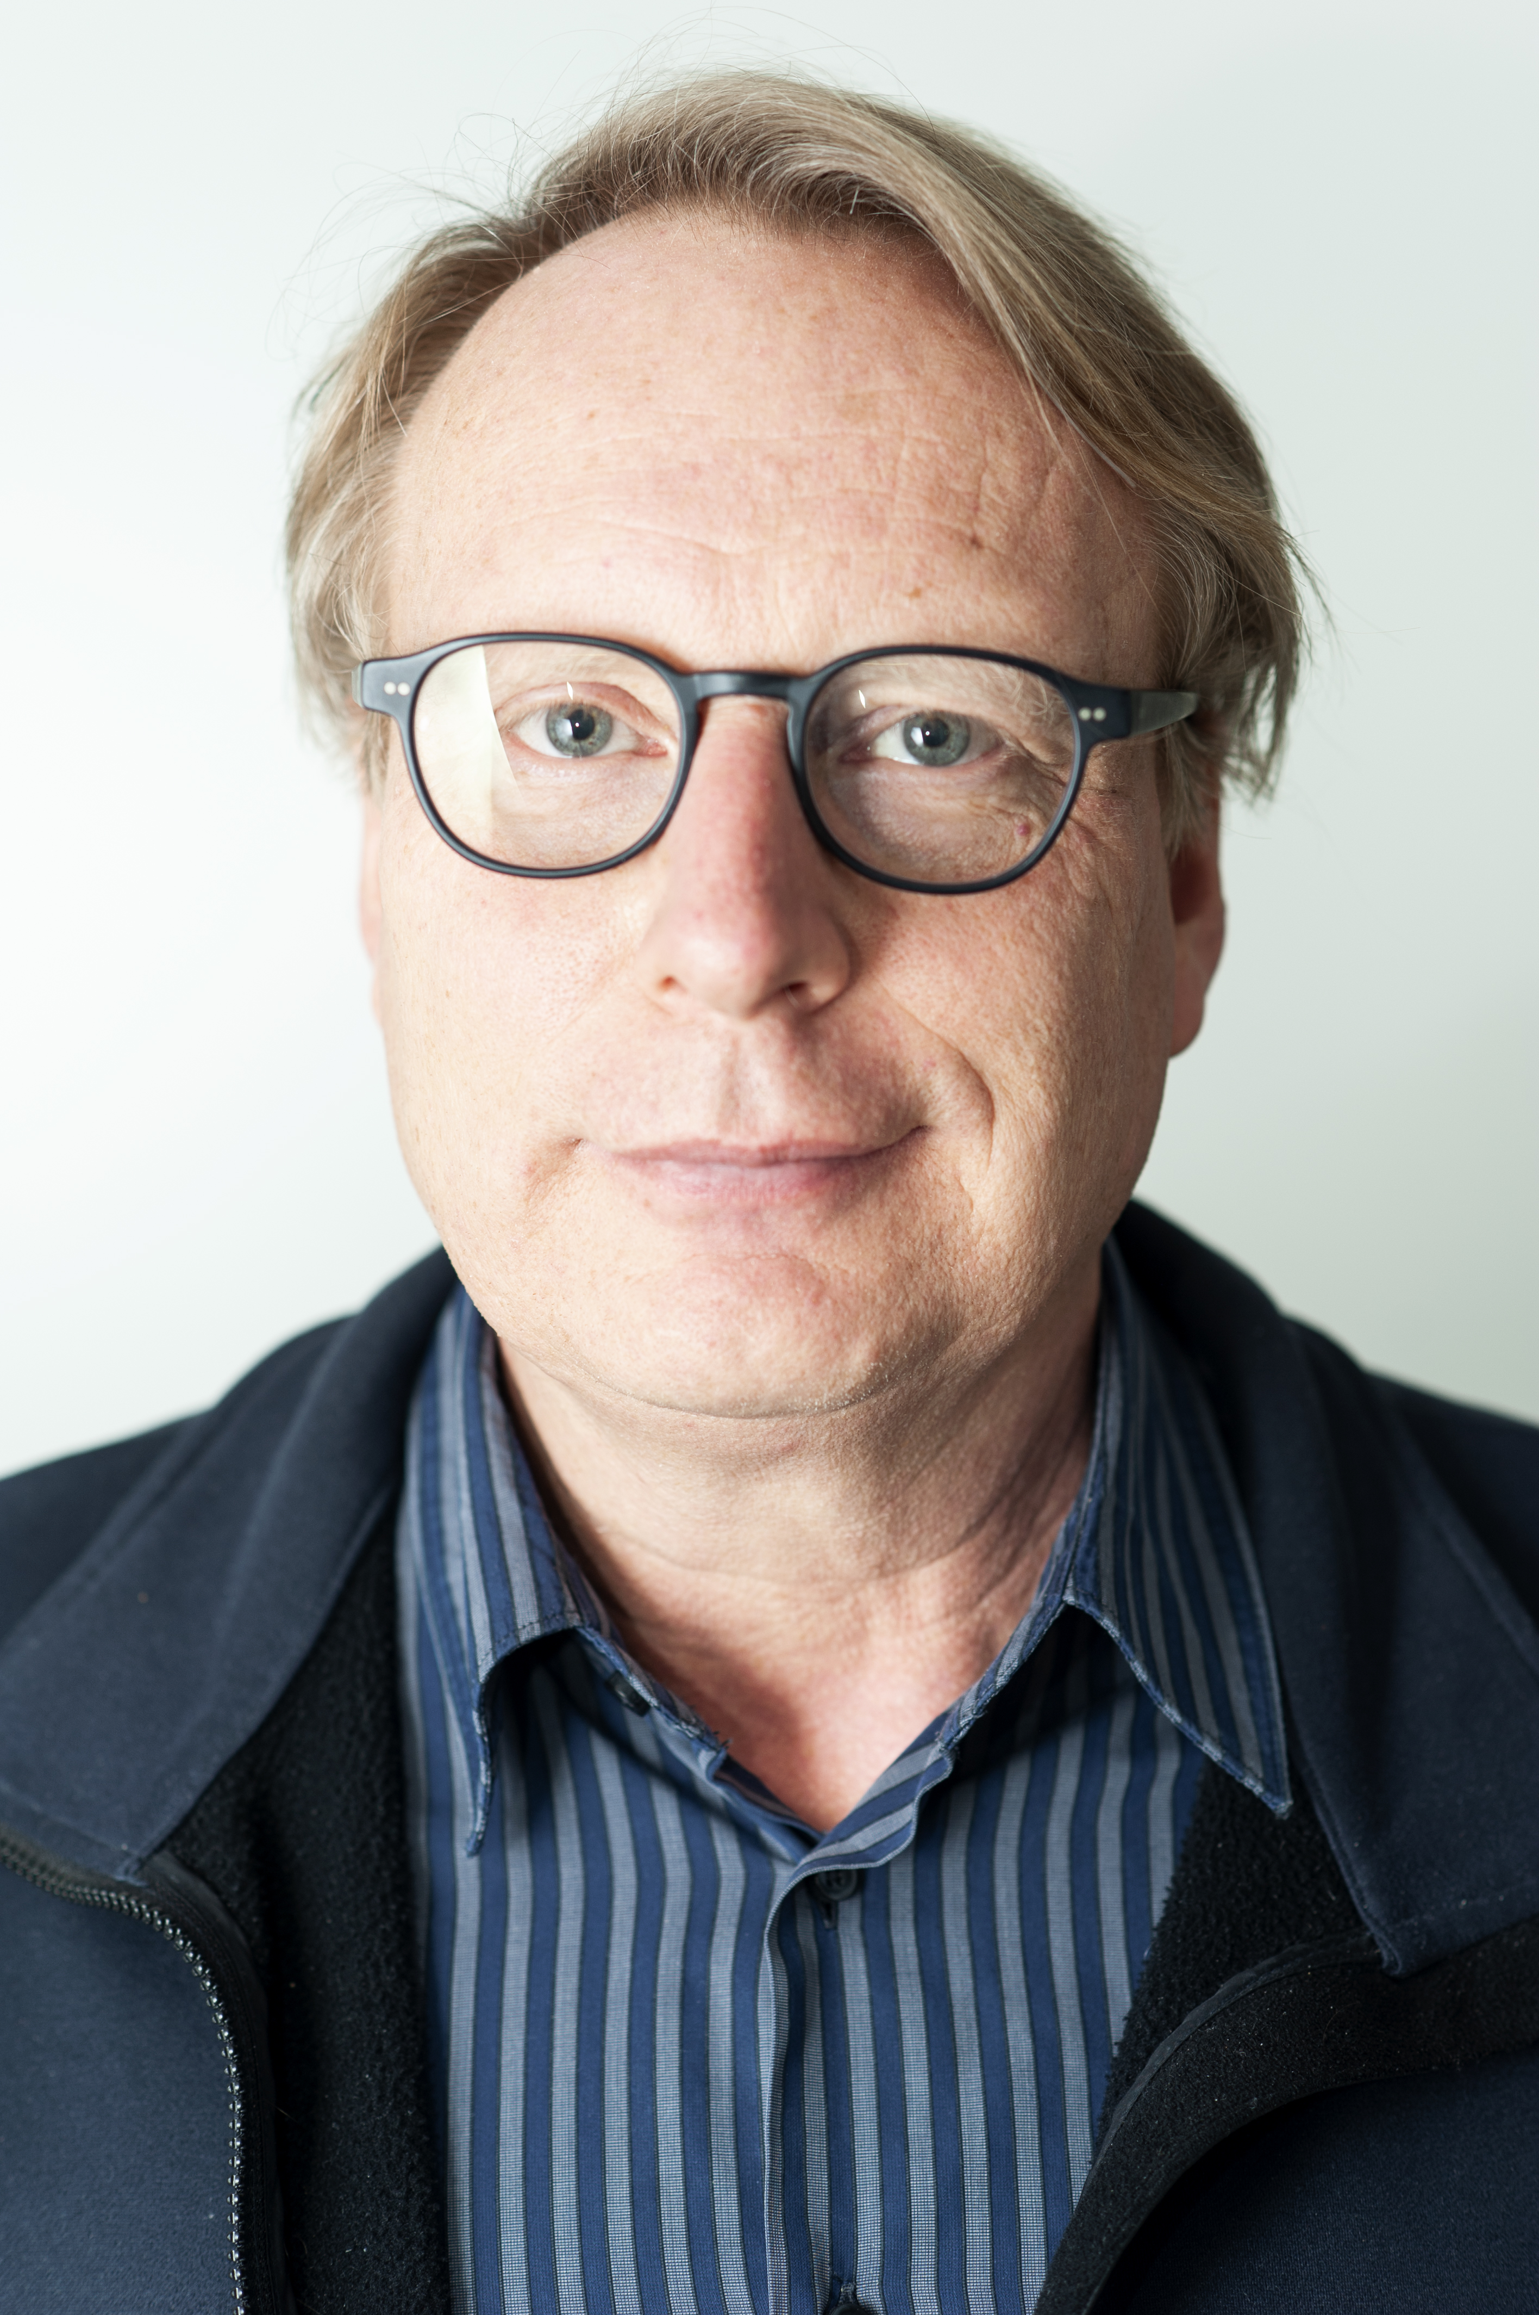
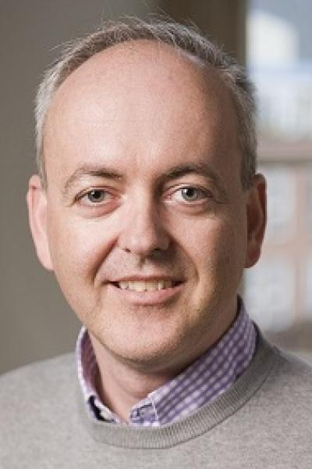
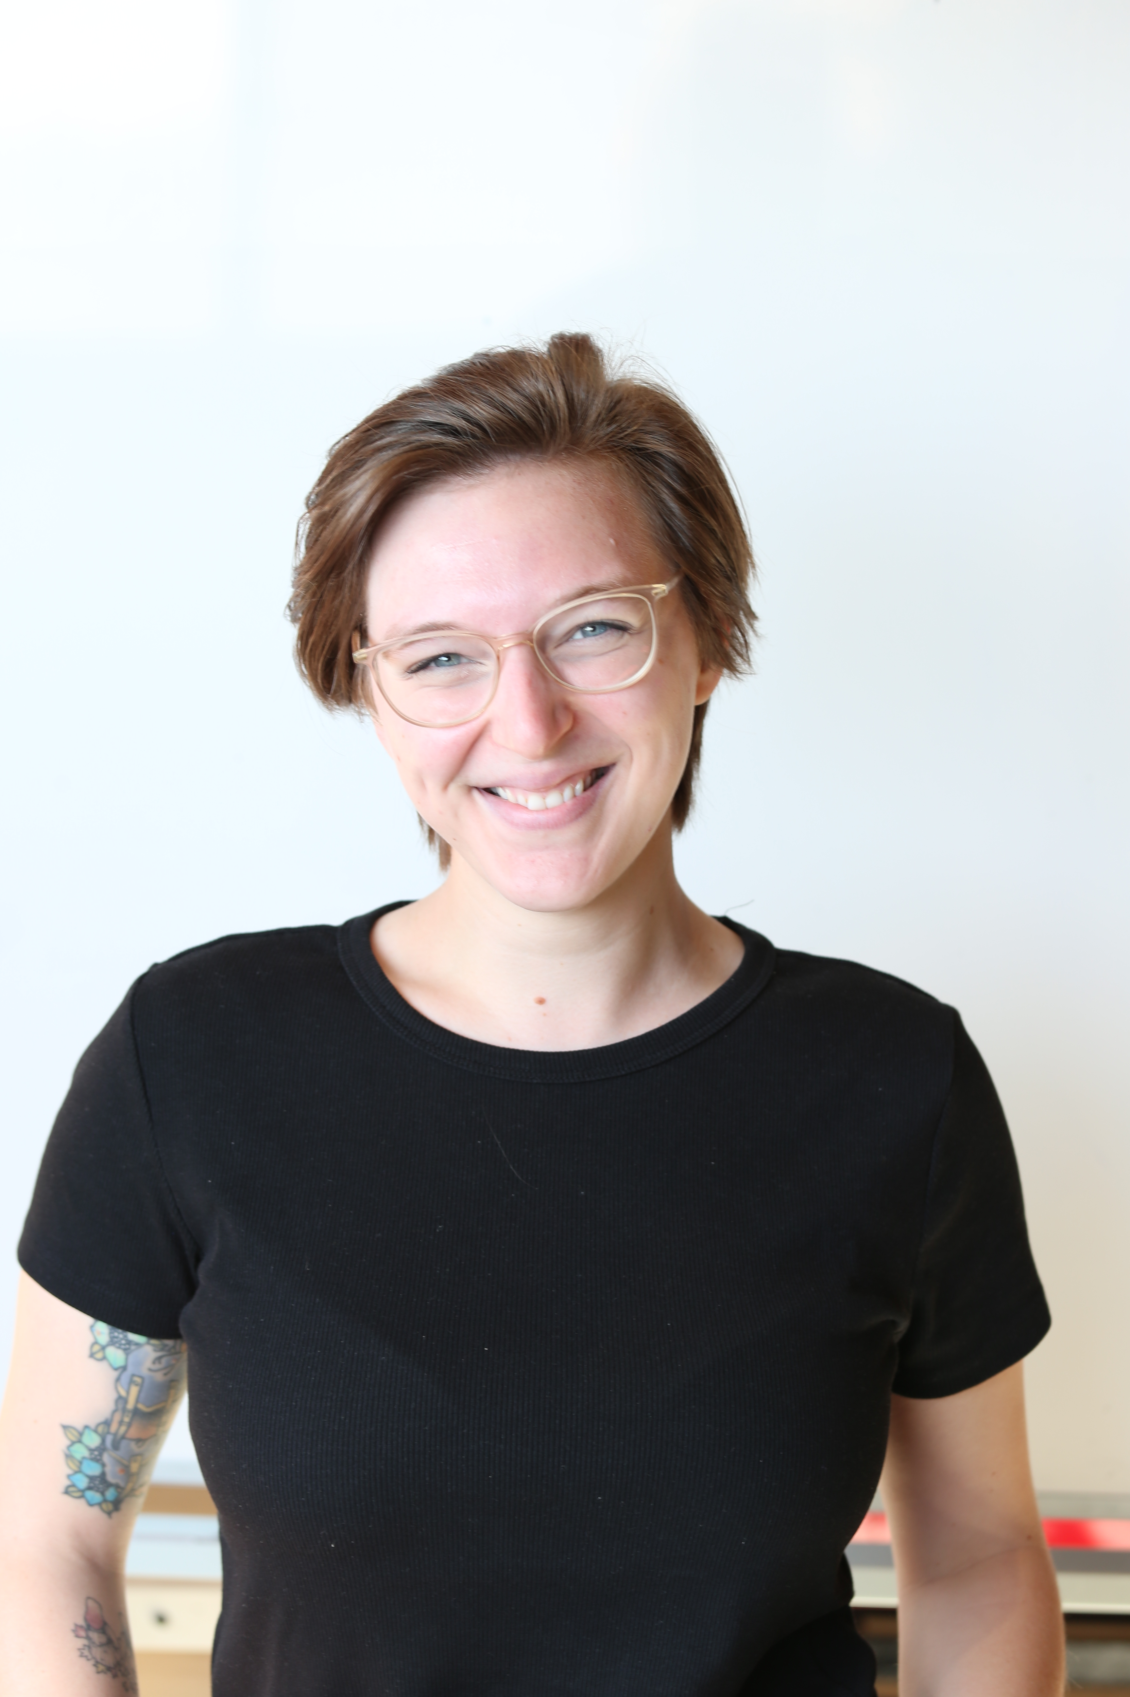
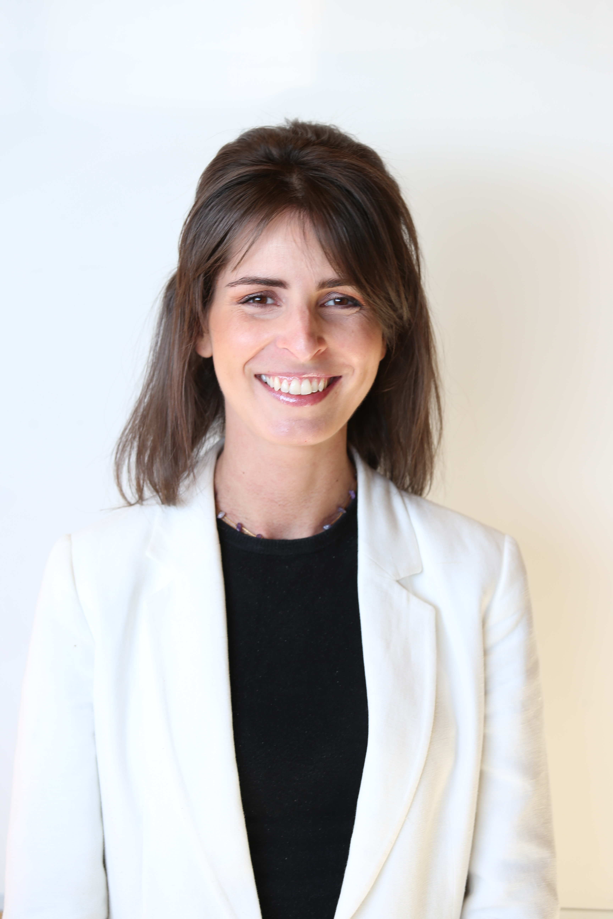
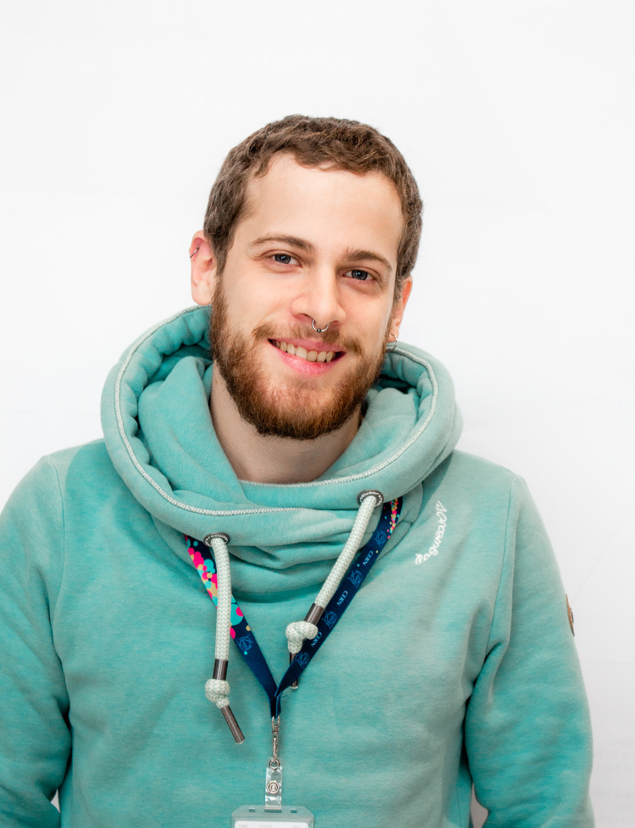
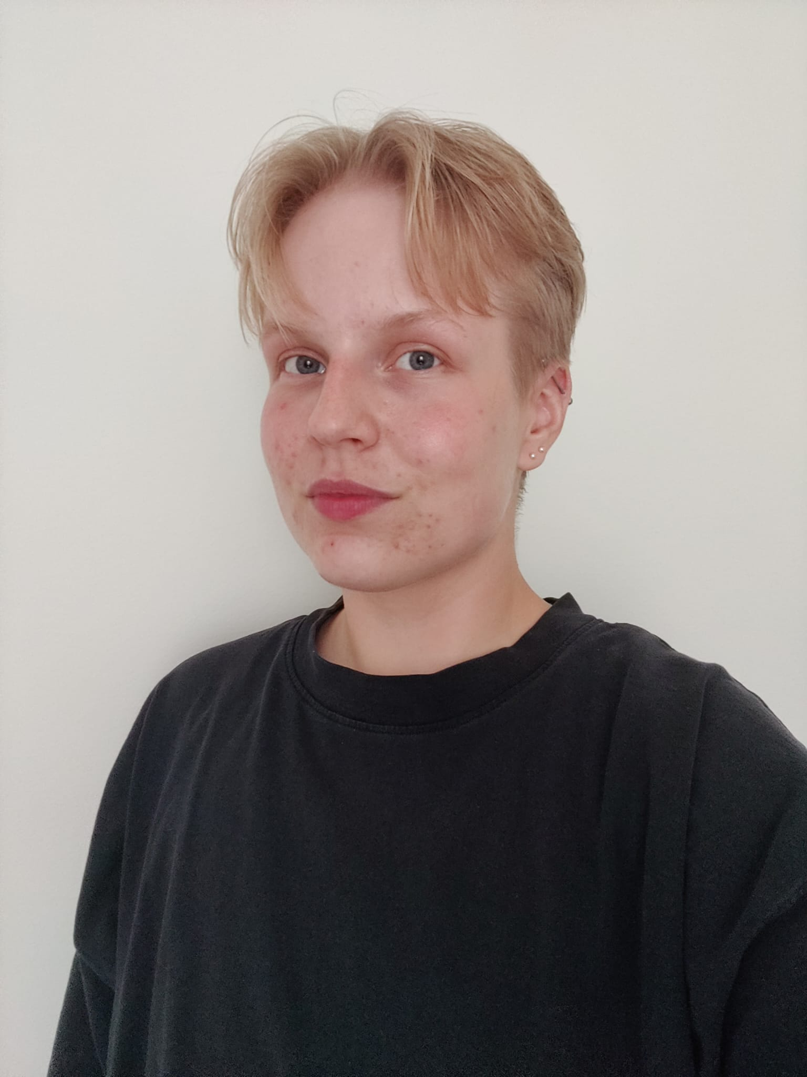
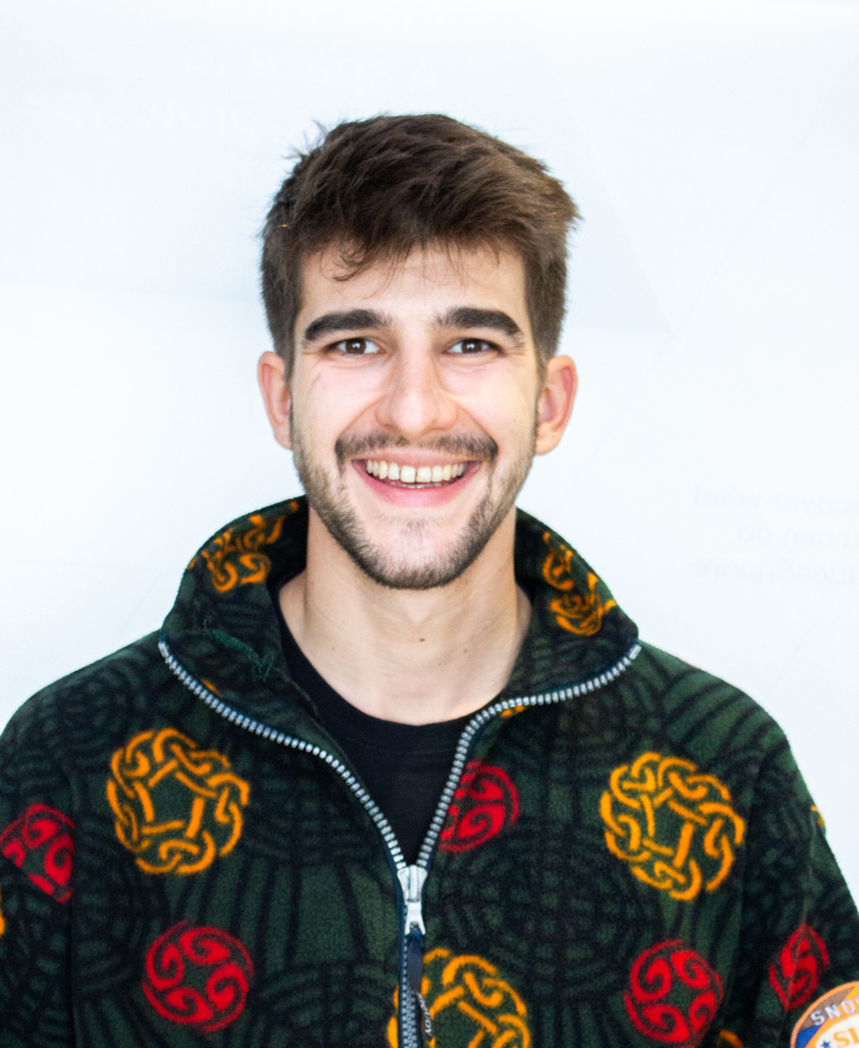
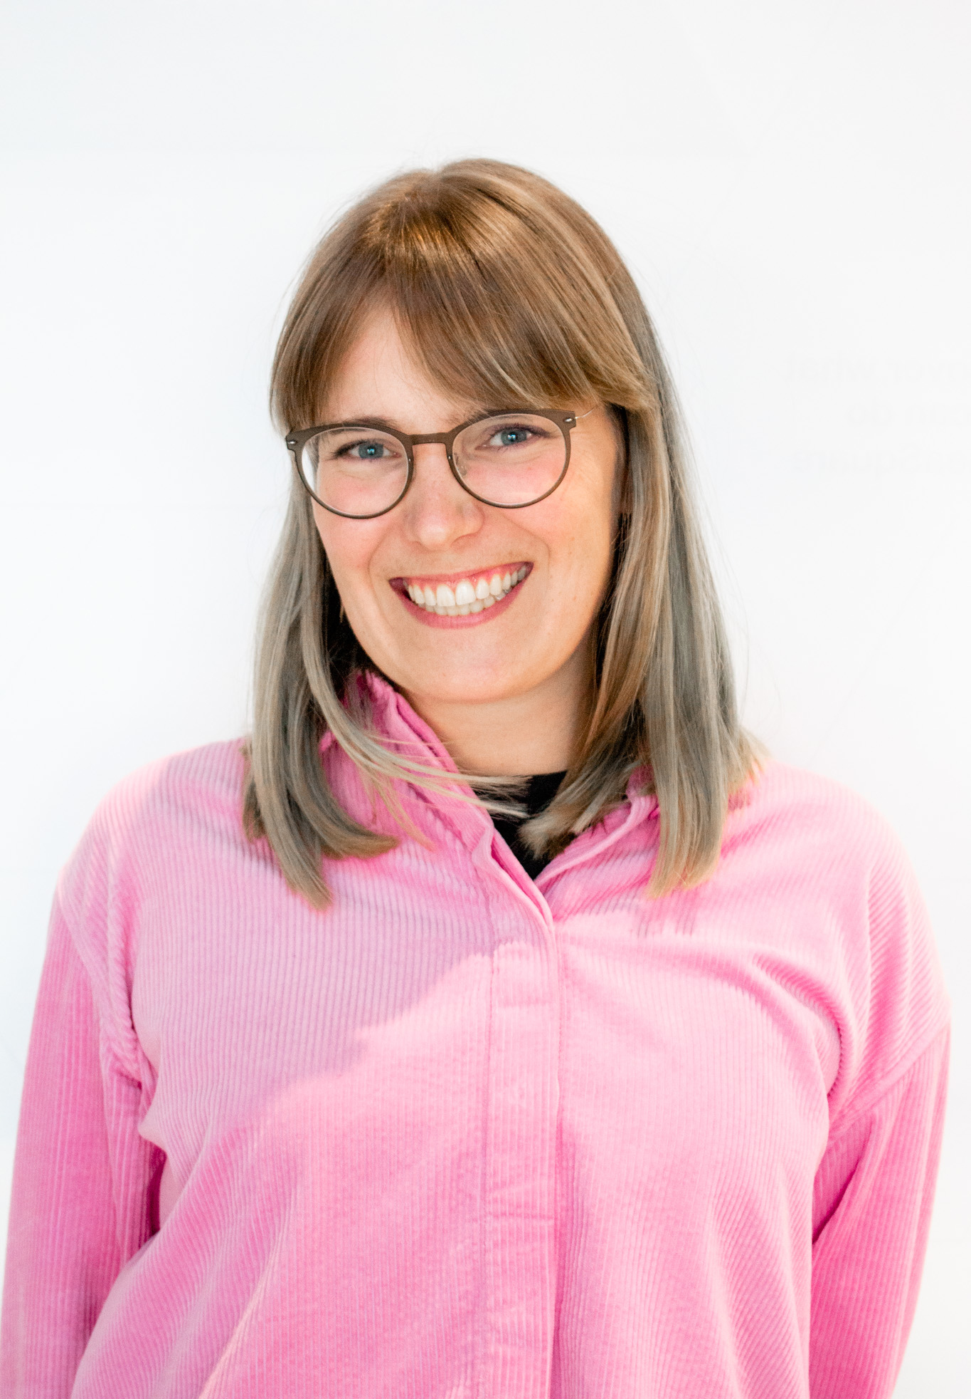
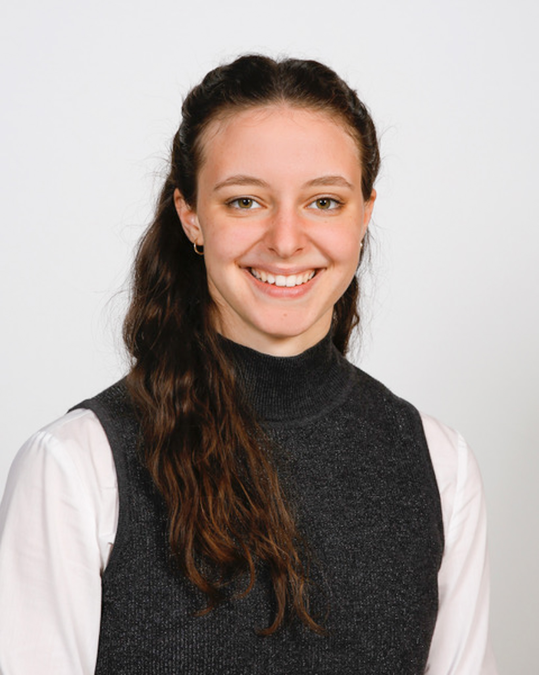
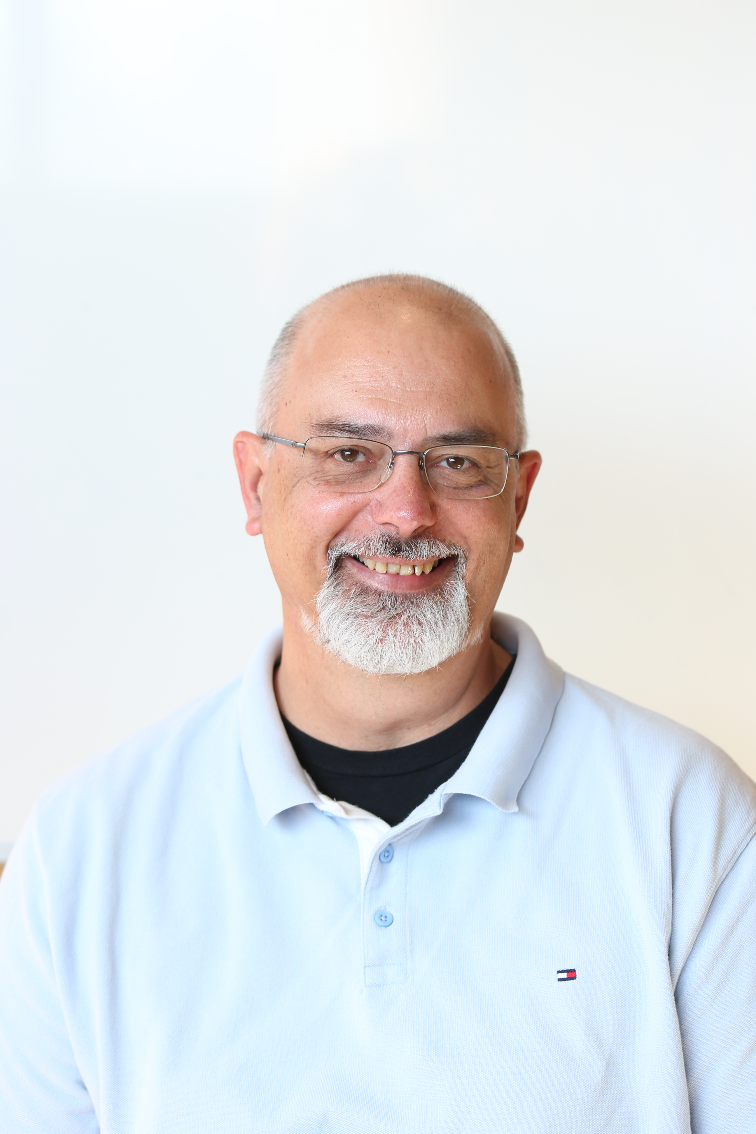
The CREW at IdeaSquare
Faezeh Abbasi
Senior Fellow
Catarina Batista
Edu programmes
Markus Nordberg
Fixing things
Laëtitia Pedroso
Events
Roy Pennings
CashMoneyMaster
Jimmy Poulaillon
Communications
Pablo Garcia Tello
Wizard of EU
Lauri Valtonen
CIJ
Ole Werner
Edu Programmes
Dina Zimmermann
Prototyping
Laura Wirtavuori
Edu programmes
Notes:
CHANGE DESCRIPTIONS

Slide 12
Growth mindset
What does growth mindset mean and why is it important?

Slide 13
“Mindset change is not about picking up a few pointers here and there. It's about seeing things in a new way.“
Dr. Carol Dweck, Mindset: The New Psychology of Success

Slide 14

What does “mindset” mean?
“…a mindset is a set of assumptions, methods, or notions held by one or more people or groups of people. ” (Cambridge English Dictionary)
“in cognitive psychology, a mindset represents the cognitive processes activated in response to a given task” (French, 2016)
Photo by Bekir Dönmez on Unsplash
Notes:
“A mindset may be so firmly established that it creates a powerful incentive within these people or groups to continue to adopt or accept prior behaviors, choices, or tools. The latter phenomenon is also sometimes described as mental inertia, "groupthink", and it is often difficult to counteract its effects upon analysis and decision making processes.”
https://en.wikipedia.org/wiki/Mindset#cite_note-2

Slide 15

Growth Mindset
“Why waste time proving over and over how great you are, when you could be getting better?”
Photo by Jeremy Bishop on Unsplash
Notes:
“In a growth mindset, people believe that their most basic abilities can be developed through dedication and hard work—brains and talent are just the starting point. This view creates a love of learning and a resilience that is essential for great accomplishment” (Dweck, 2015).

Slide 16
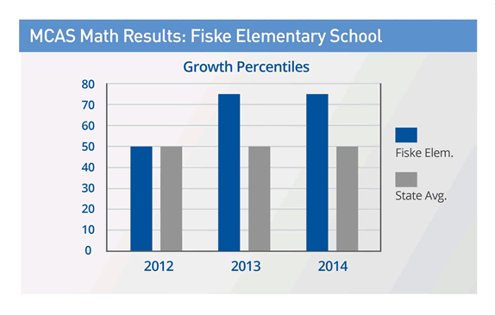
Case Study: Fiske Elementary School
https://www.mindsetworks.com/science/Case-Studies
Notes:
Fiske Elementary School
Lexington, Massachusetts
Download the Fiske Case Study
Fiske Case Study.pdf
(PDF 320 KB)
School Profile
Fiske Elementary School is a school with 350 students in grades K-5, located in the Metro West suburbs of Boston. Despite its location in an affluent community of Wellesley, Fiske is a diverse school due to its status as a magnet school for the district’s English language learners and its proximity to the town’s low-income housing complex. Hence, Fiske is diverse with respect to socio-economics, language learning, and special education status.
Case Study of MindsetMaker™
THE CHALLENGE
How to best provide student feedback and praise to a diverse student population as a way to encourage greater student effort, resulting in gains in academic achievement.
Overarching Goals
The Fiske School staff wanted to leverage teacher praise to close the achievement gap with high needs students (ELL, SPED, minority populations, and low income).
Action Plan
The plan started with a small staff-led team who had previously developed and implemented an anti-bullying initiative throughout the school in 2011-12. An incoming principal who had done some preliminary work on growth mindset in another school district embraced this group’s work. Together, the group saw the connections between growth mindset and anti-bullying initiatives, and they decided to share their work with the school.
In the first year, in addition to a whole school book study on Mindset, teachers engaged in professional development sessions using components of the LeaderKit™. That first year, the focus was on changing teacher praise from performance-based to effort-based. Teachers practiced changing their language, and were supported by observations and feedback sessions from the principal. Data was collected, and teachers were encouraged by initial results, so they sought out more resources and tools to keep learning and improving.
In the second year, the MindsetMaker™ Online Professional Development course was used to deepen the work. At grade level meetings, in the teachers' lounge, and throughout the hallways, staff discussed and questioned common teaching practices. The schools' new common vocabulary was forged from language presented in the videos, articles, and activities Fiske teachers engaged in with MindsetMaker™.
RESULTS
Both teacher-reported student growth and standardized test gains were powerful. Student growth percentile in math MCAS scores rose dramatically in 2013 and were maintained in 2014. Typical average growth in the state is 50 points, but in Fiske, student growth percentile was an average of 75.5 and the growth was maintained in 2014 across all fourth and fifth grade students. Just recently in 2016, Fiske learned that they are one of 39 schools that are being commended by the state for "high achievement, high progress or narrowing the proficiency gap." This means that Fiske made significant progress in moving students to proficiency as indicated by MCAS scores.
CONCLUSION
At Fiske, growth mindset discussions and continued professional development have become part of the school culture. In developing annual teacher goals, teachers often reference a growth mindset as part of their approach. The growth mindset culture has paid off in collegiality, student learning and achievement gains, and in closing the achievement gap.
https://www.mindsetworks.com/science/Case-Studies

Slide 17

Case Study: Chicago High School

Slide 18
The power of ”not yet”
“If you get a failing grade, you think, „I’m nothing, I’m going nowhere.“ But if you get the grade ‘not yet’, you understand that you’re on a learning curve. It gives you a path into the future.”
Dweck, 2014
Notes:
https://fs.blog/2015/03/carol-dweck-mindset/
https://onedublin.org/2012/06/19/stanford-universitys-carol-dweck-on-the-growth-mindset-and-education/
https://www.youtube.com/watch?v=-71zdXCMU6A

Slide 19
2 truths and
1 “not yet”

Slide 20






Fixed mindset
Avoid challenges
See effort as fruitless or worse
Feel threatened by the success of others
Ignore useful negative feedback
Give up easily
Intelligence is static/ desire to look smart
Notes:
Icons made by <a href="https://www.flaticon.com/authors/smashicons" title="Smashicons">Smashicons</a> from <a href="https://www.flaticon.com/" title="Flaticon"> www.flaticon.com</a>

Slide 21
Fixed mindset
Avoid challenges
See effort as fruitless or worse
Feel threatened by the success of others
Ignore useful negative feedback
Give up easily
Intelligence is static/ desire to look smart
Growth mindset
Persist in the face of setbacks
Learn from criticism
Intelligence can be developed/ desire to learn
Embrace challenges
Find lessons and inspiration in the success of others
See effort as the path to mastery
Adapted from Two Mindsets graphic by Nigel Holmes
Notes:
Making the reflection about where each individual stands on the mindset spectrum; where your team stands in the spectrum.
Connection to the fact that we will never simply be on the fixed or growth side, it is not linear and we will always be challenged in our personal and professional lives (triggers, team conflitcts, etc).
Icons made by <a href="https://www.flaticon.com/authors/smashicons" title="Smashicons">Smashicons</a> from <a href="https://www.flaticon.com/" title="Flaticon"> www.flaticon.com</a>

Slide 22
Notes:
It’s not about the environment or what is happening arounds us, is about we perceive it and frame it.
How can we best support ourselves and each other in our growth journey? (as a prompt for movement exercise).

Slide 23
Fixed mindset
Avoid challenges
See effort as fruitless or worse
Feel threatened by the success of others
Ignore useful negative feedback
Give up easily
Intelligence is static/ desire to look smart
Growth mindset
Persist in the face of setbacks
Learn from criticism
Intelligence can be developed/ desire to learn
Embrace challenges
Find lessons and inspiration in the success of others
See effort as the path to mastery
Adapted from Two Mindsets graphic by Nigel Holmes
Notes:
Making the reflection about where each individual stands on the mindset spectrum; where your team stands in the spectrum.
Connection to the fact that we will never simply be on the fixed or growth side, it is not linear and we will always be challenged in our personal and professional lives (triggers, team conflitcts, etc).
Icons made by <a href="https://www.flaticon.com/authors/smashicons" title="Smashicons">Smashicons</a> from <a href="https://www.flaticon.com/" title="Flaticon"> www.flaticon.com</a>

Slide 24
Supporting each other’s growth journeys
Notes:
Walking gears
Pairs walking
Finding a place to go to – first no talking, then talking allowed
Reflect

Slide 25
Sources
"MINDSET - meaning in the Cambridge English Dictionary". Retrieved 2019-12-10.
French, R. P. II. (2016). The fuzziness of mindsets: Divergent conceptualizations and characterizations of mindset theory and praxis. International Journal of Organizational Analysis, 24(4), 673–691. https://doi.org/10.1108/IJOA-09-2014-0797
The power of believing you can improve, Dweck C. 2014 https://www.ted.com/talks/carol_dweck_the_power_of_believing_that_you_can_improve
Stanford University's Carol Dweck on the Growth Mindset and Education". OneDublin.org. 2012-06-19.

