Slide 1
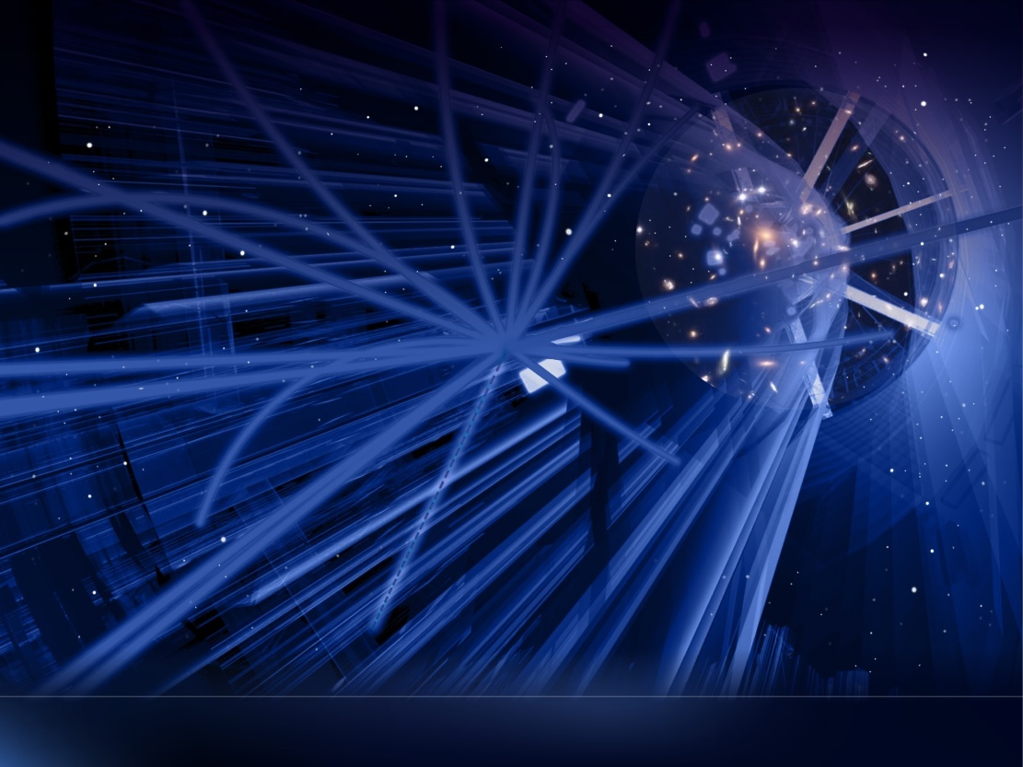

Why Are We Here?: Connecting the Micro and Macro
About CERN, Physics, and Innovation
CBI-A3 November 7, 2023
Markus Nordberg (CERN)

Slide 2

What is Wrong with this Picture?

Slide 3
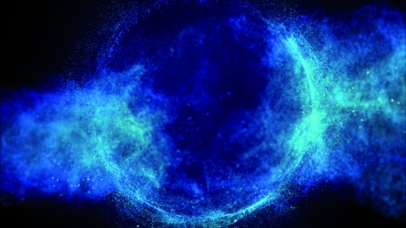

Slide 4
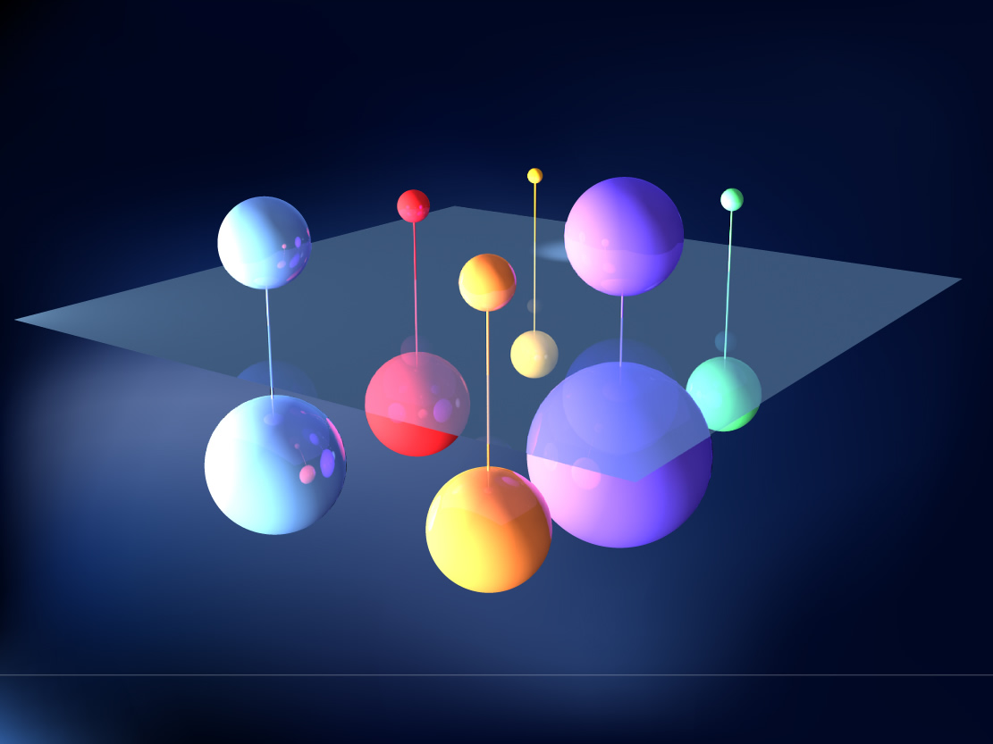

Slide 5
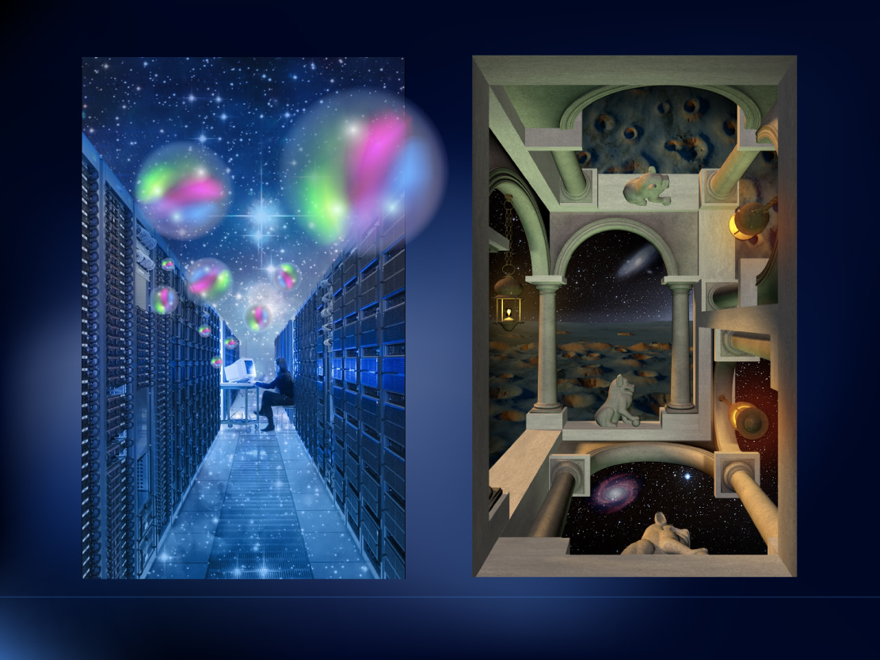

Slide 6

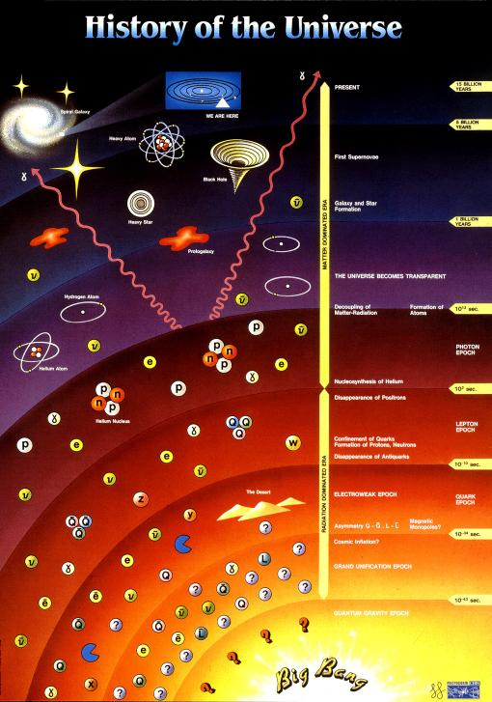
How does CERN Connect?

Slide 7
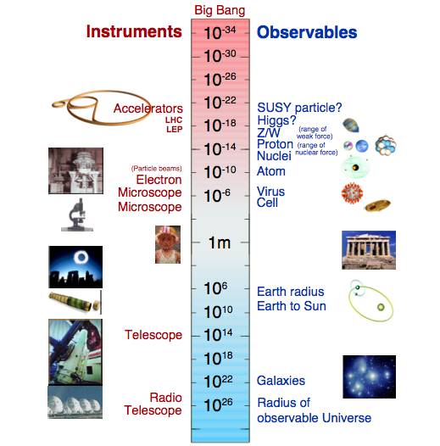
Size of things
How does CERN Measure?

Slide 8
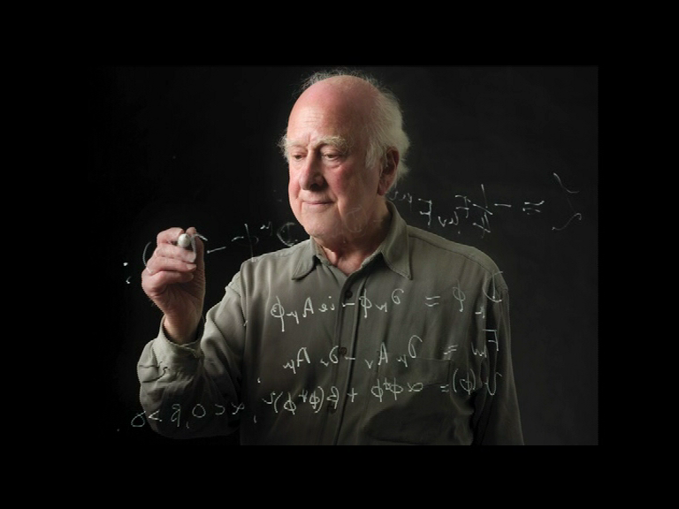
Where do we start?

Slide 9
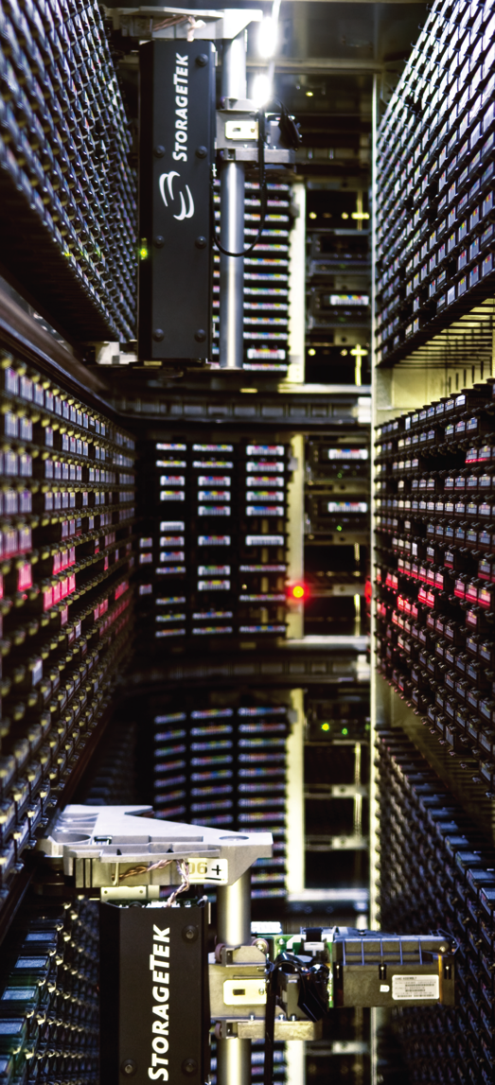
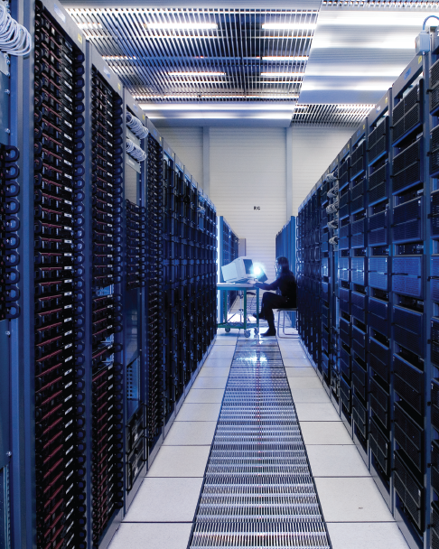

Slide 10
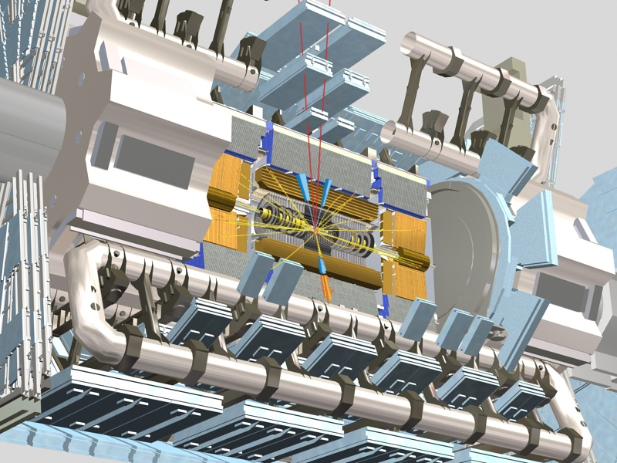

Slide 11
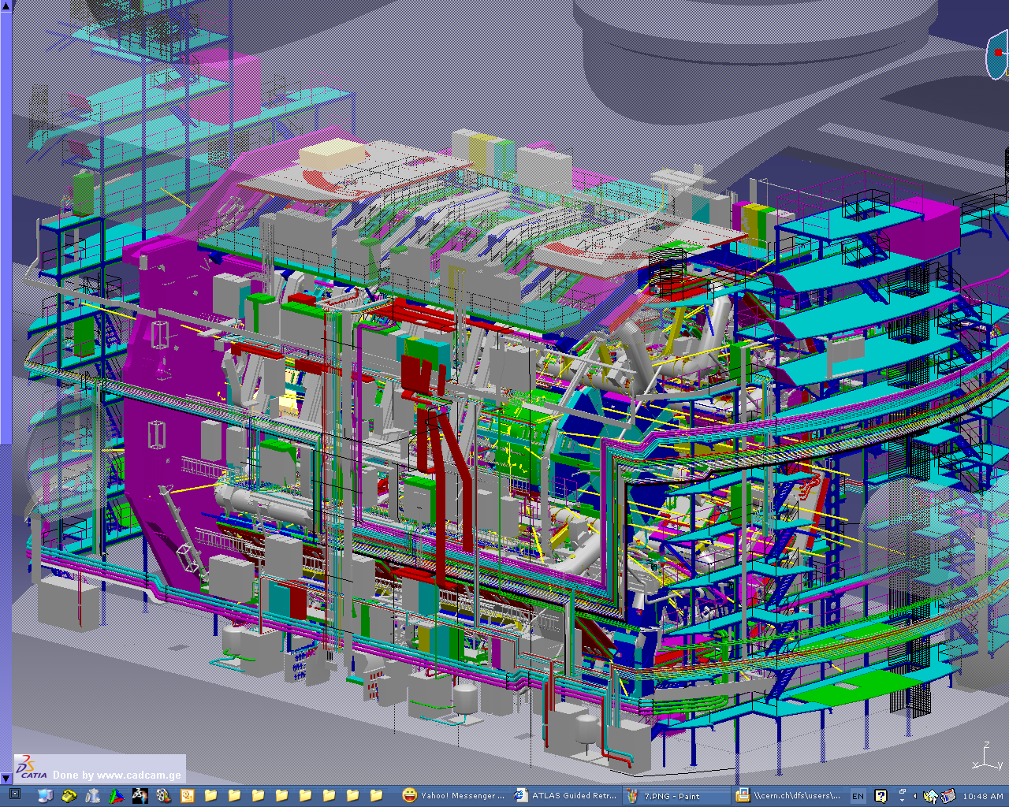

Slide 12
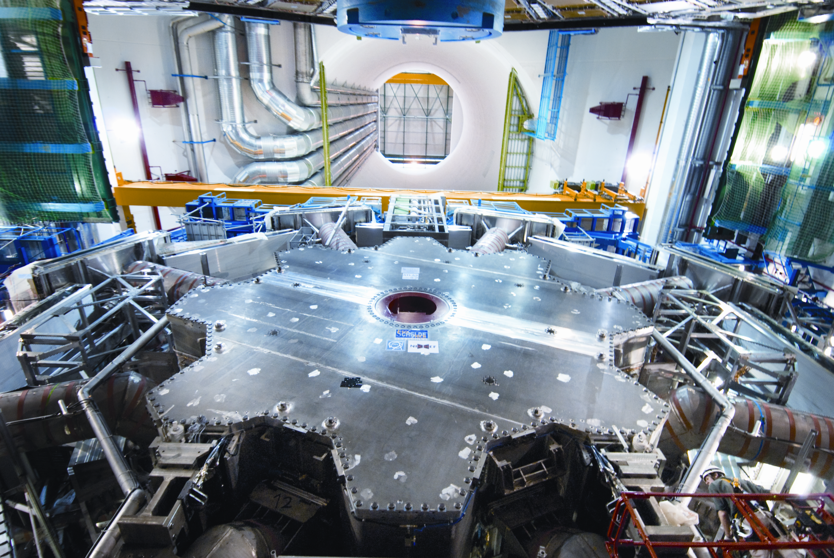

Slide 13



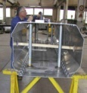
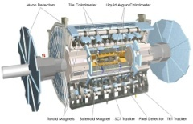
Implementing Strategy is Not Linear
Progress
B
Parallel reality 1
Parallel reality 2
Theory
A
Design
Prototyping
Construct
Install
Operate
Time

Slide 14
Absorbing vs. Reducing Uncertainty
Uncertainty
A
B
Time

Slide 15
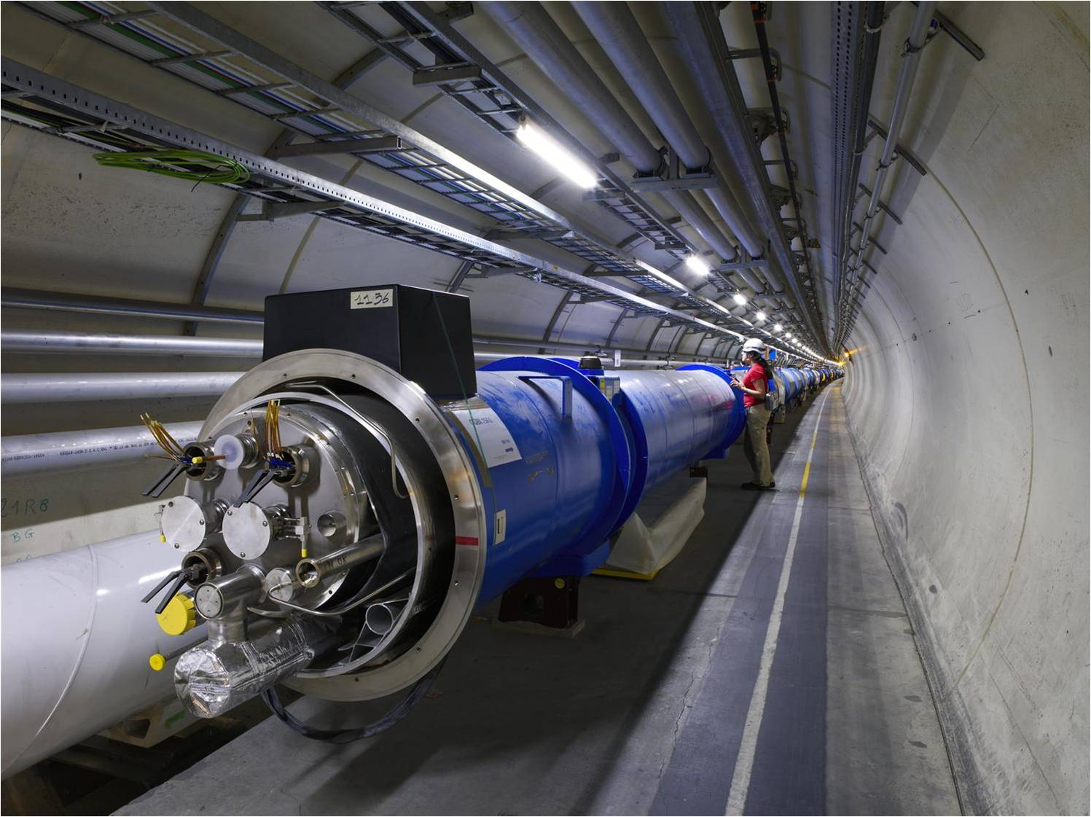
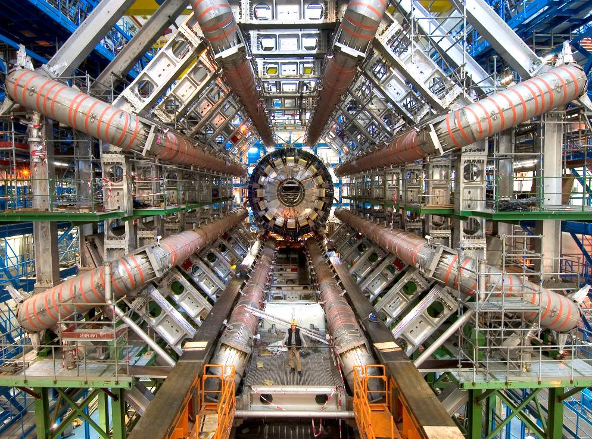
Seeing the Micro needs the Macro (scopes)

Slide 16
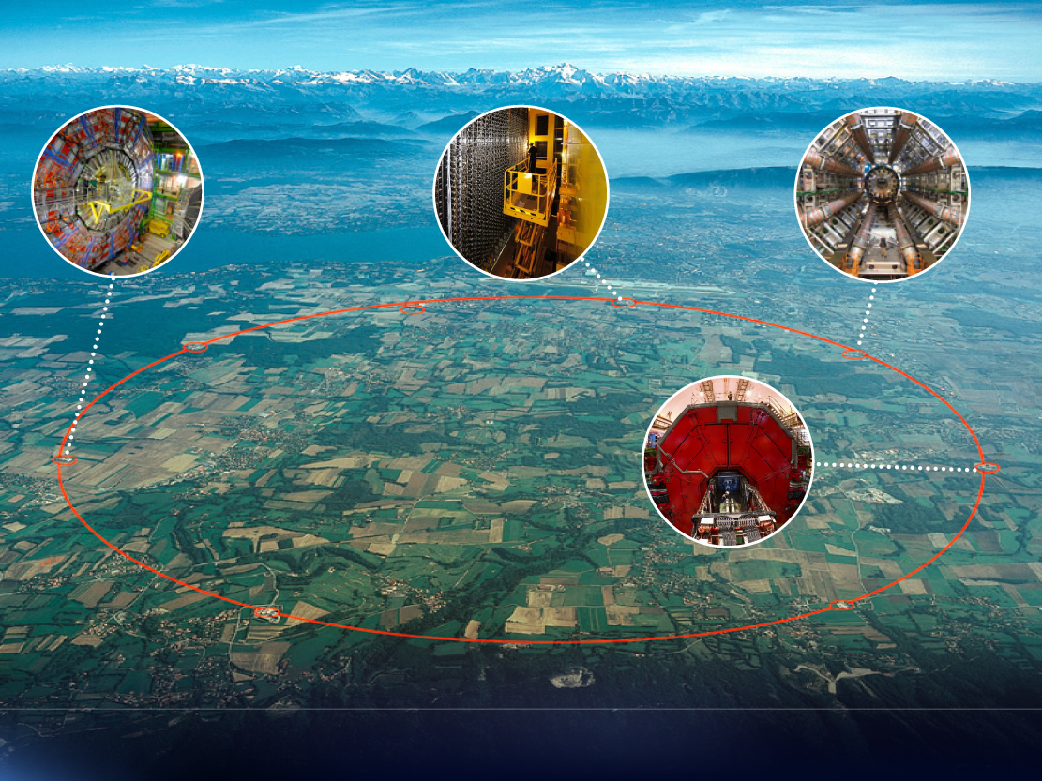

Slide 17
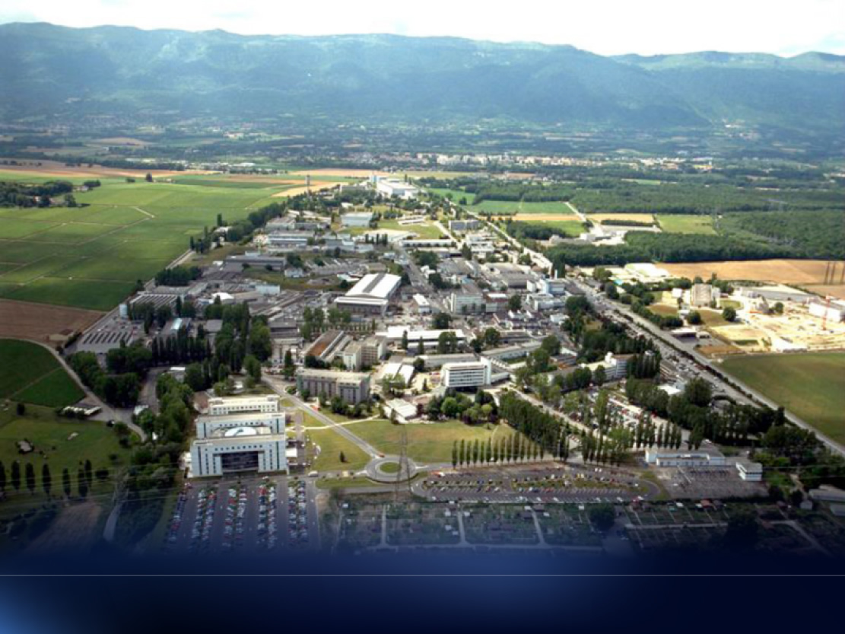

Slide 18
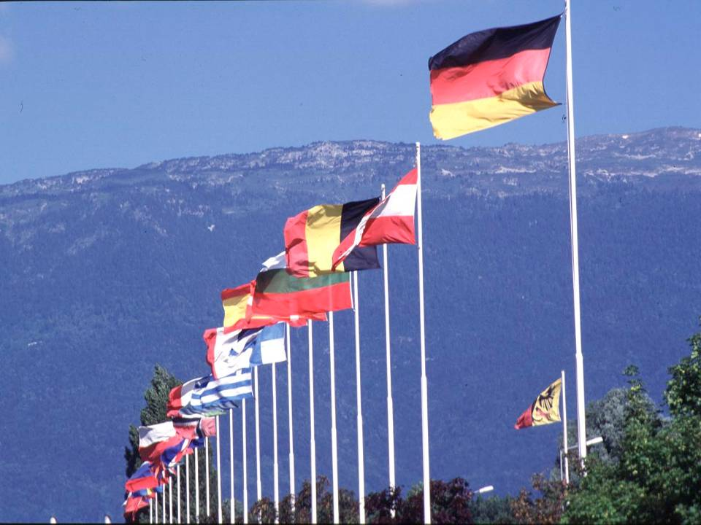

CERN was founded 1954: 12 European States
Today: 23 Member States
~ 2676 staff, 783 Fellows
~ 1700 other paid personnel
~ 11 200 users
Budget (2022) ~1200 MCHF
23 Member States: Austria, Belgium, Bulgaria, the Czech Republic, Denmark, Finland, France, Germany, Greece, Hungary, Israel, Italy, Netherlands, Norway, Poland, Portugal, Romania, Serbia, Slovakia, Spain, Sweden, Switzerland and the United Kingdom.
9 Associate Members: Croatia, Cyprus, Estonia, India, Lithuania, Pakistan, Slovenia, Turkiye, Ukraine.
6 Observers to Council: Japan, the Russian Federation, the United States of America, Turkey, the European Commission and Unesco
18
Notes:
18

Slide 19
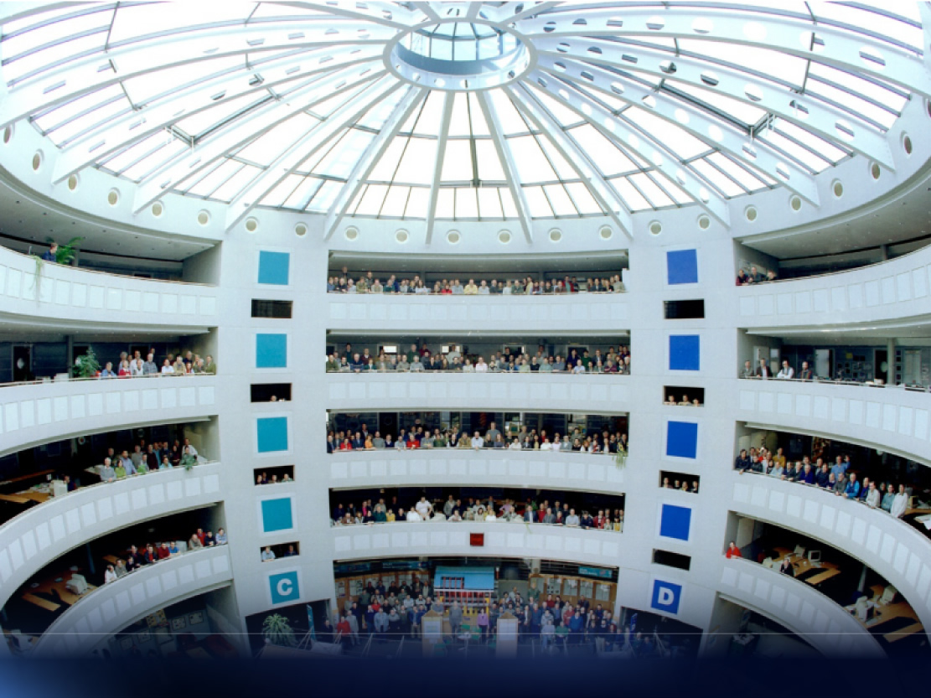

Slide 20
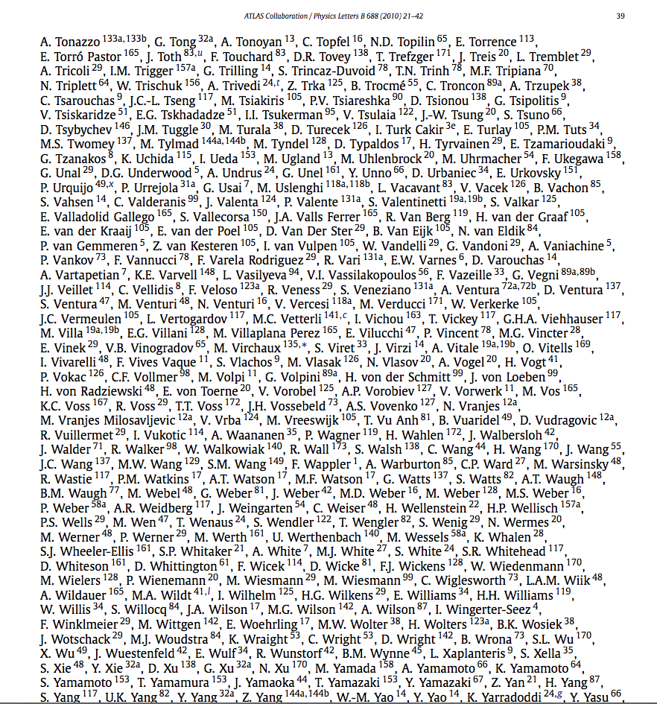
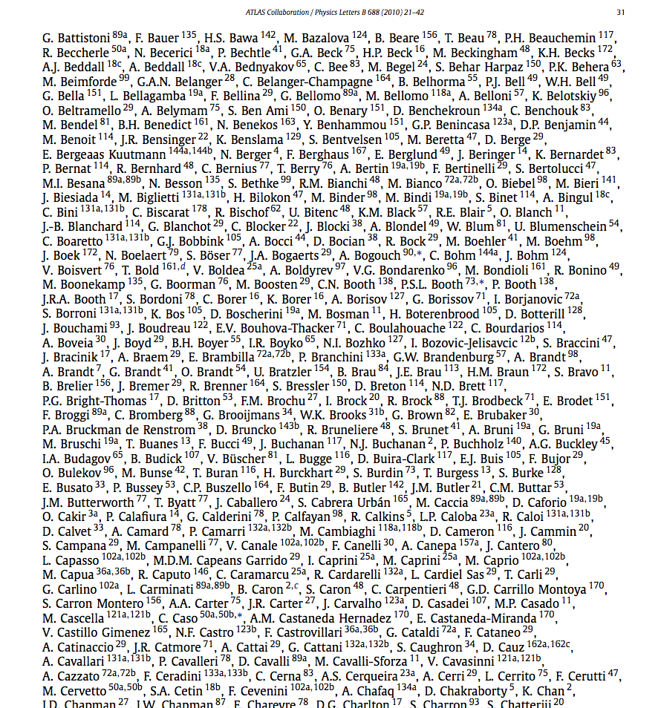
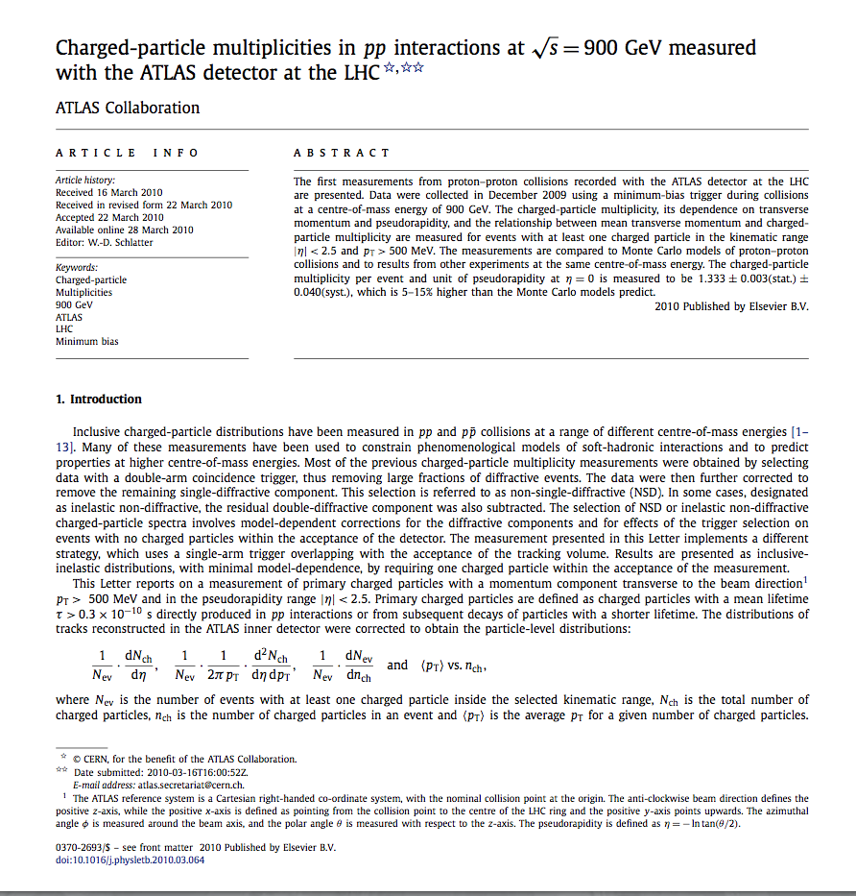
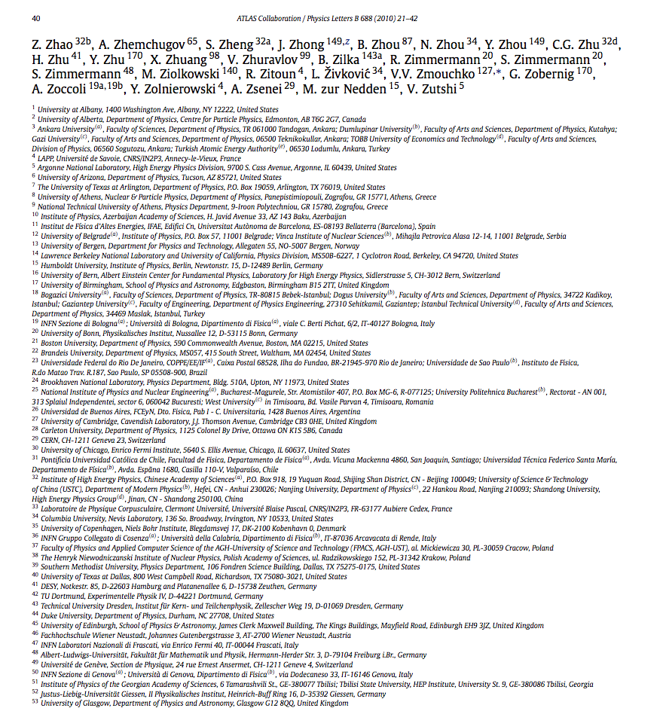
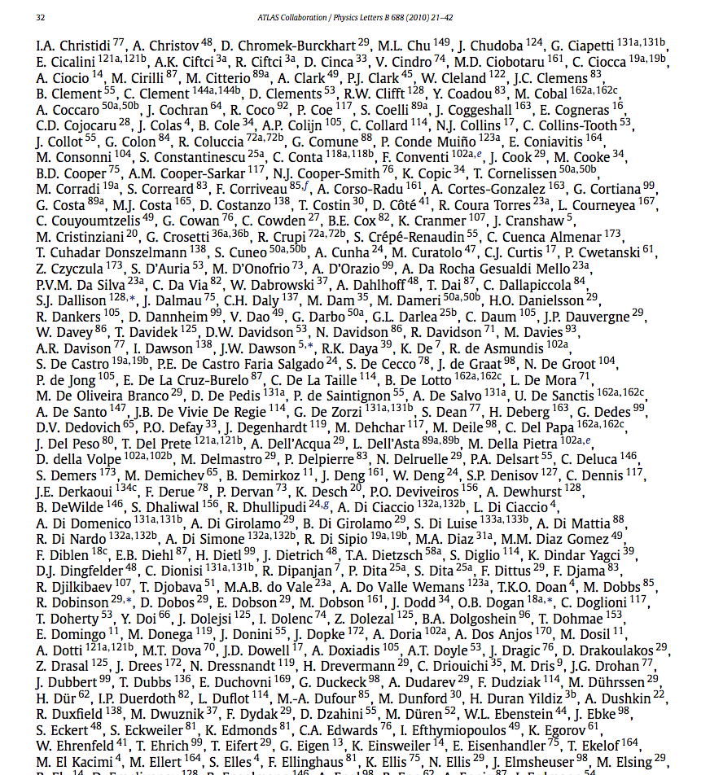
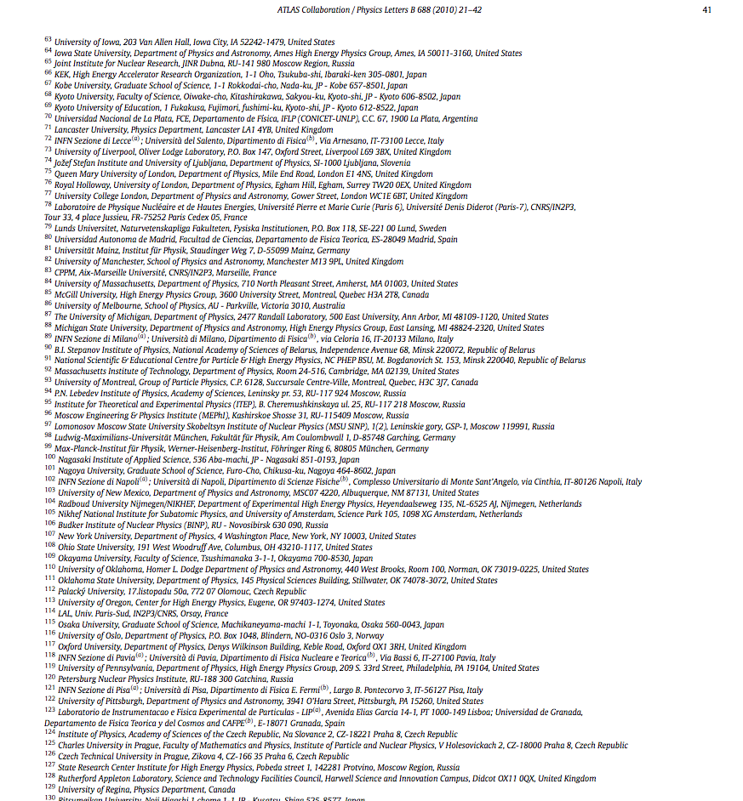
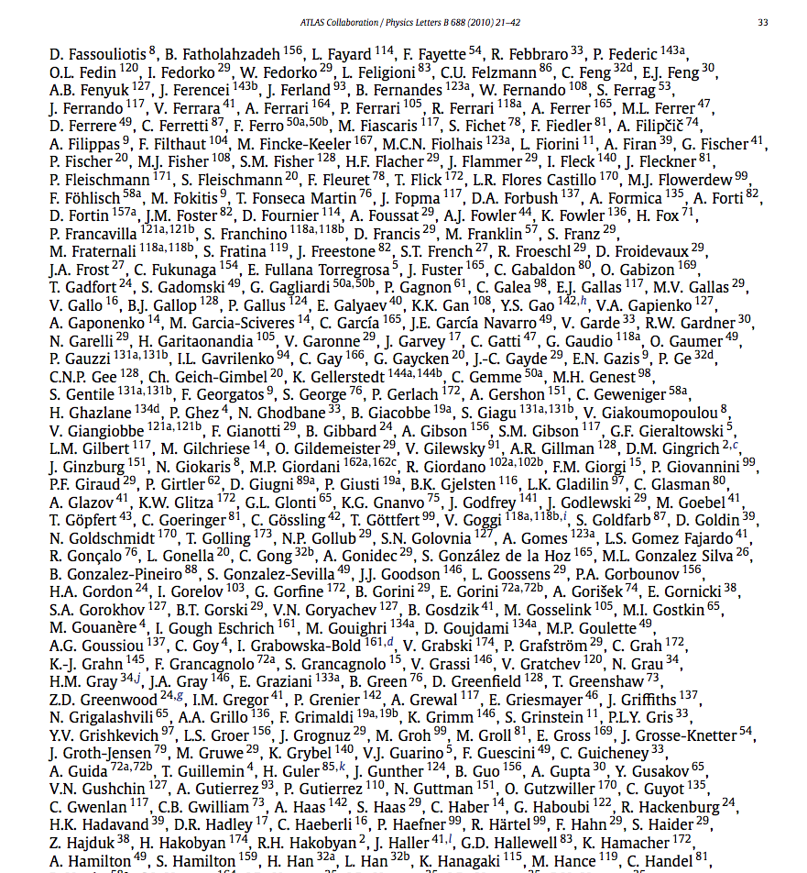
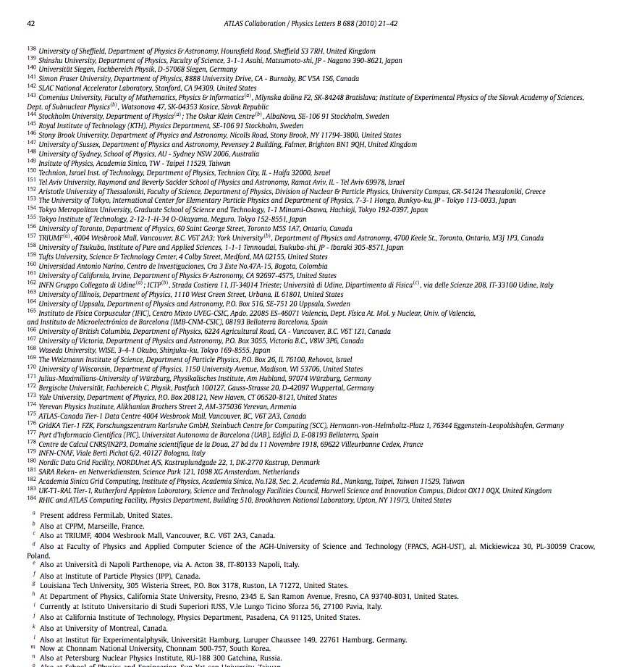
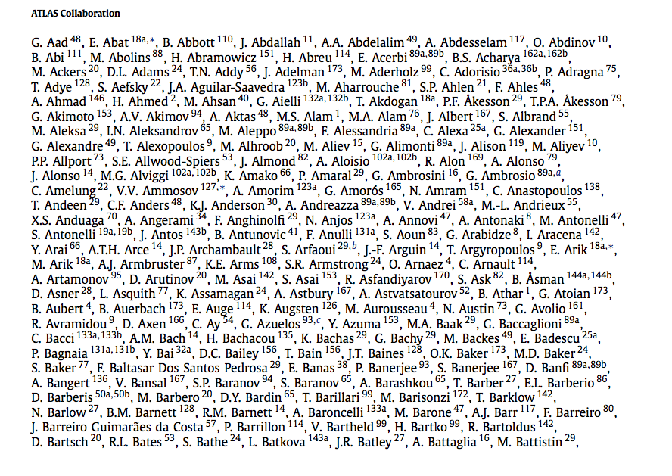
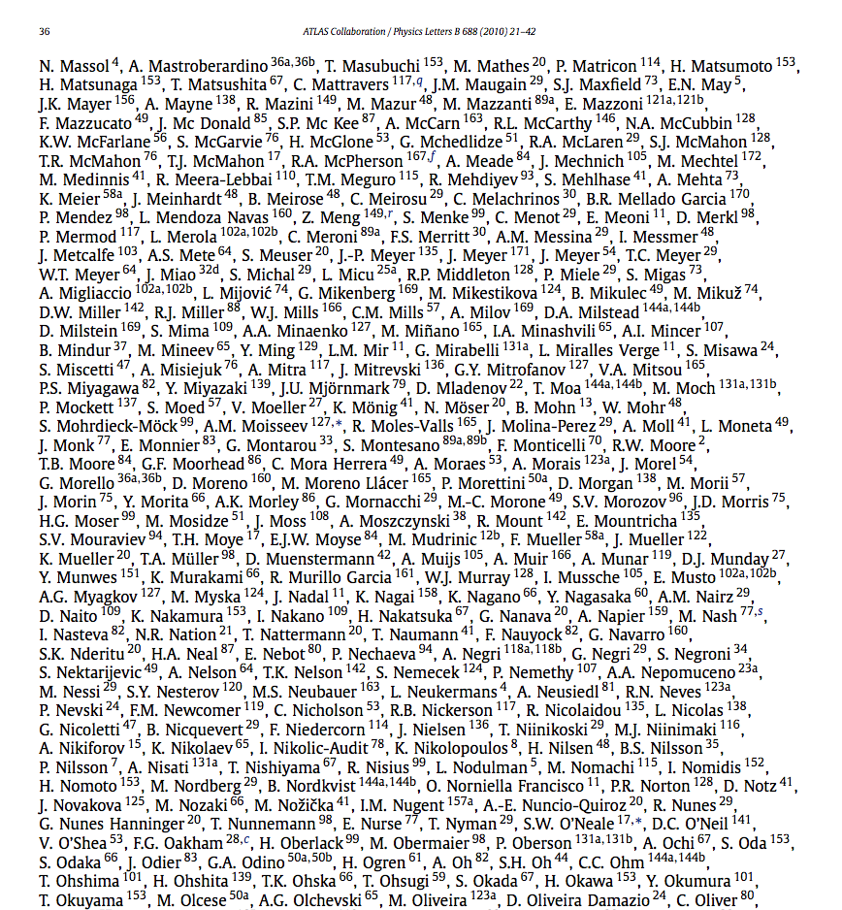

Slide 21
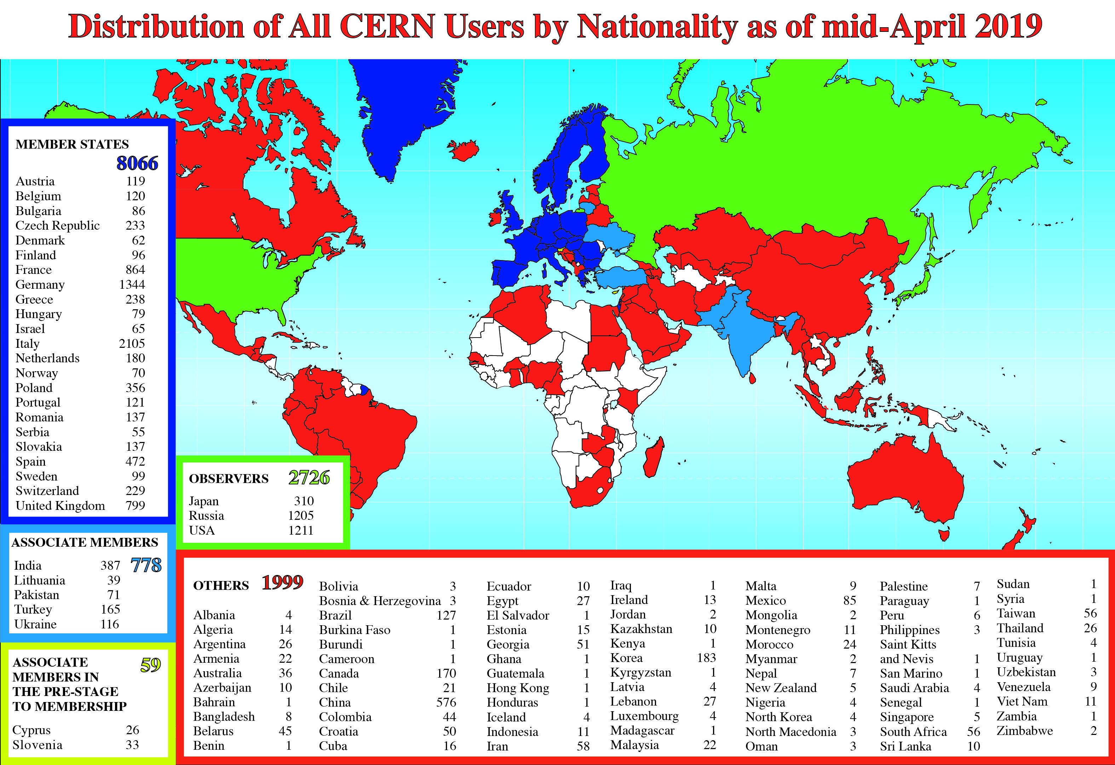
A Global Reach

Slide 22
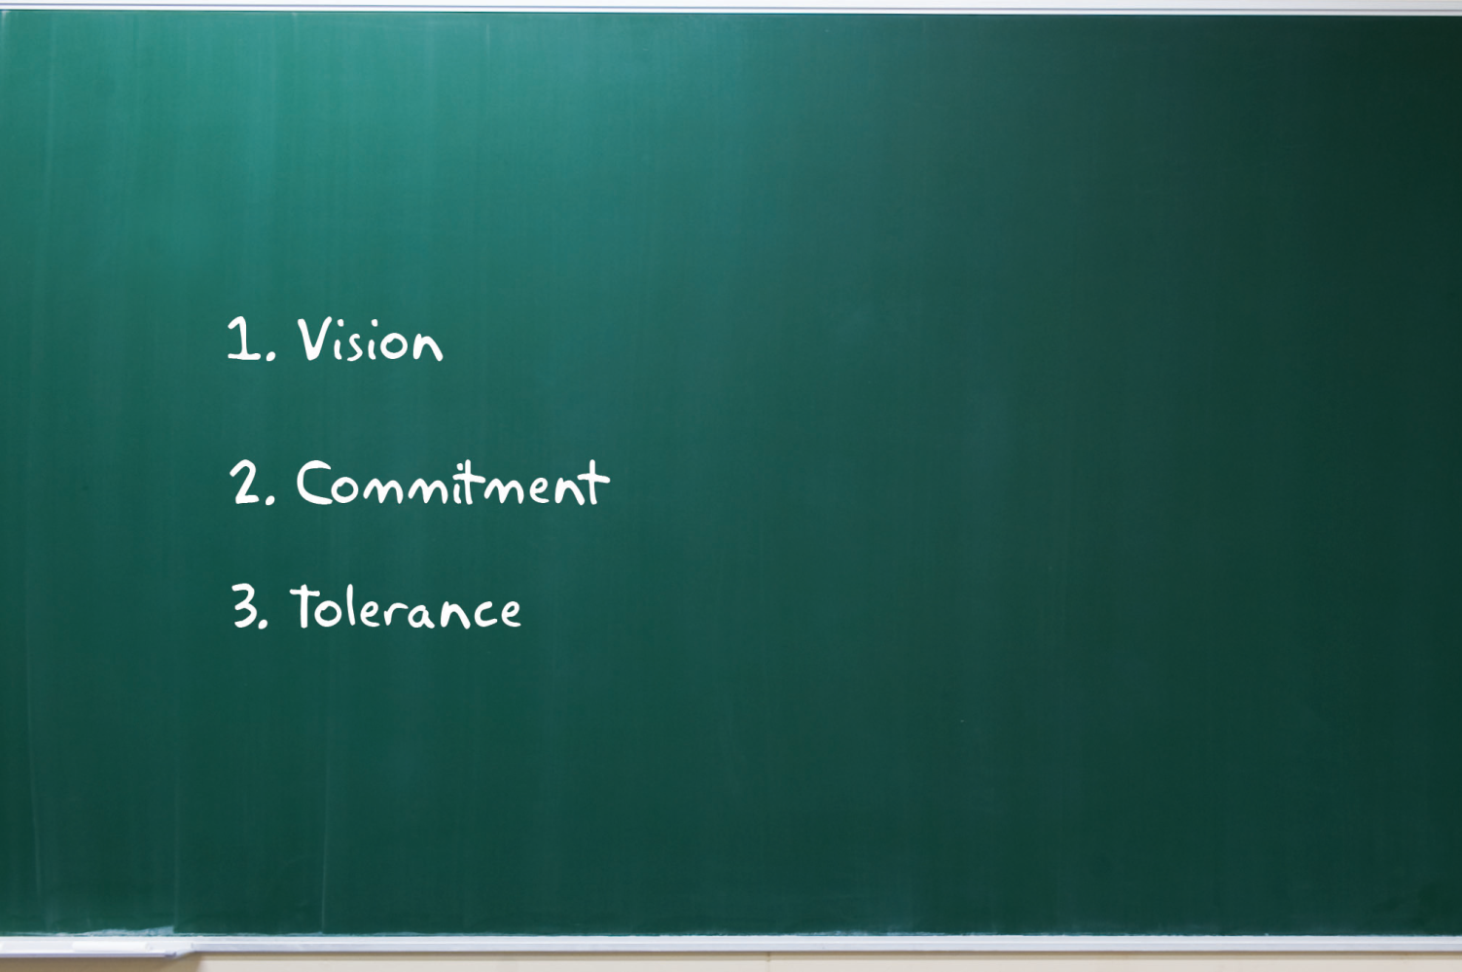
(How) Do We Manage This?

Slide 23
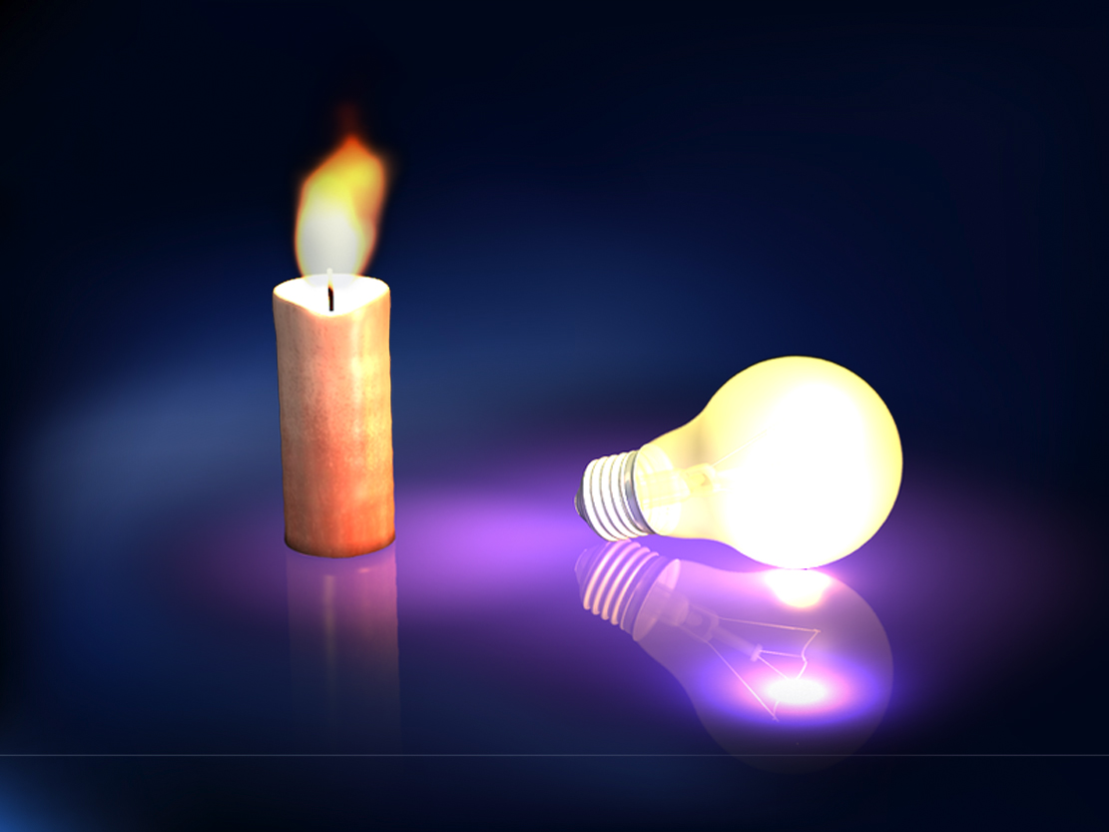

Slide 24
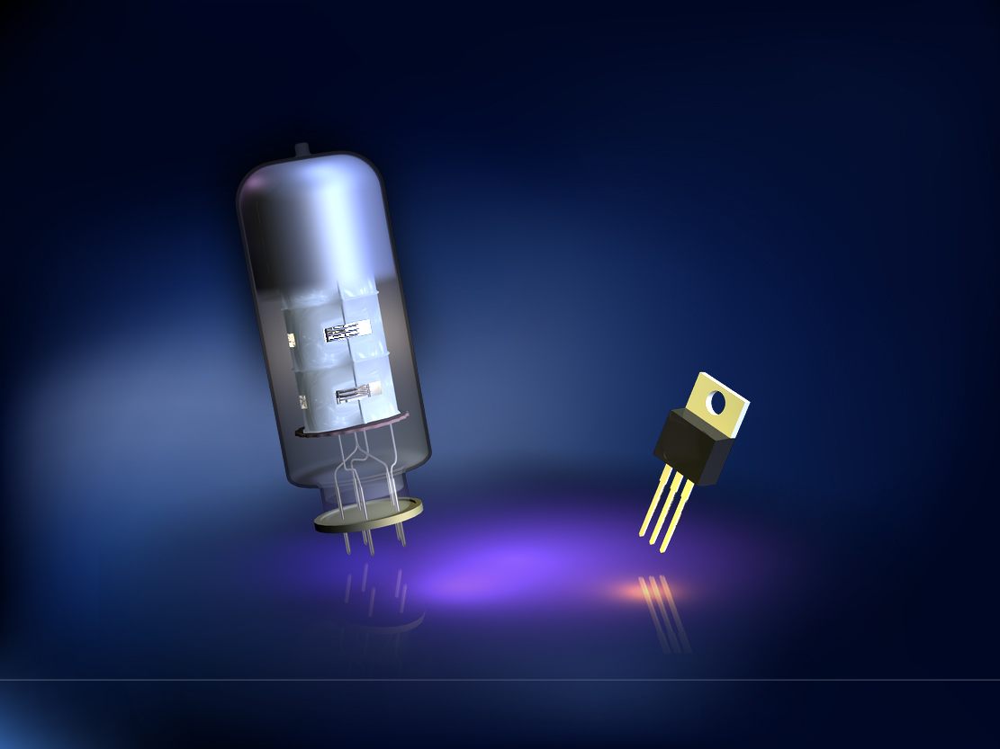

Slide 25
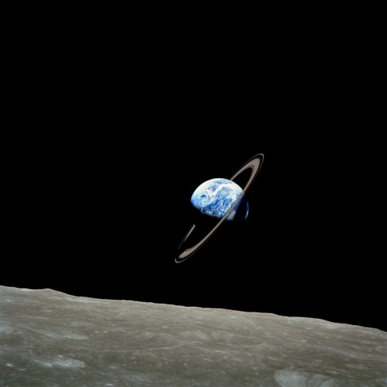

Slide 26
What do you see differently?

