Slide 1
Effective Field Theory for Extreme Mass Ratios
Nabha Shah
California Institute of Technology
QCD Meets Gravity 2023, CERN
11 December 2023
Based on 2308.14832, 23xx.xxxxx
(with C. Cheung, J. Wilson-Gerow, J. Parra-Martinez, I. Rothstein)
Part 1

Slide 2
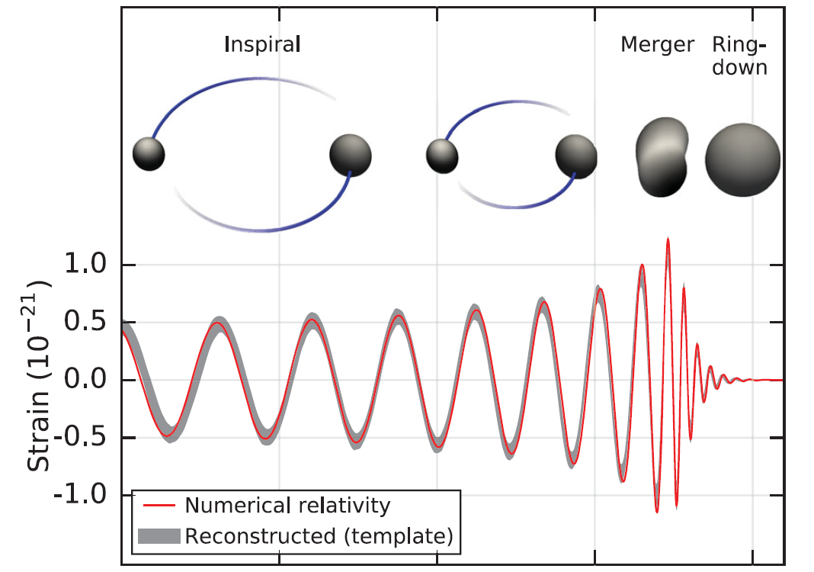
Motivation: gravitational wave physics
Perturbation theory:
Post-Newtonian
Post-Minkowskian
Self-force
LIGO Scientific Collaboration and Virgo Collaboration (2016)

Slide 3
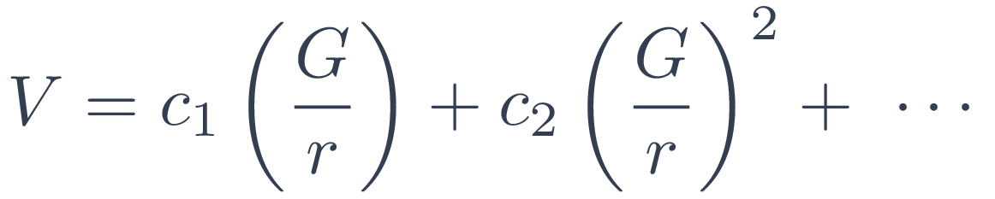
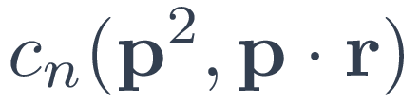
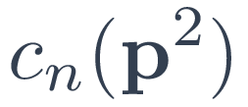


Post-Minkowskian (PM) perturbation theory
Generically:
Isotropic:
Relativistic scattering
Classical bound state dynamics
New results have been obtained for conservative and radiative dynamics,
non-spinning and spinning blackholes, finite size effects, etc.

Slide 4








Post-Minkowskian (PM) perturbation theory
Generically:
Isotropic:
An expansion in loops with all orders in velocity at each loop order

Slide 5
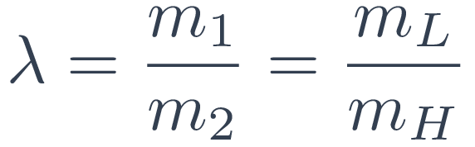

Expansion in mass ratio or the self-force (SF) expansion
Interplays with the post-Minkowskian expansion
Vines, Steinhoff, Buonanno (2019), Siemonsen, Vines (2019); Bini, Damour, Geralico (2019, 2020), Damour (2020), Antonelli, Kavanagh, Khalil, Steinhoff, Vines (2020)
0SF
1SF
0SF
1SF
2SF
3SF
4SF

Slide 6


Expansion in mass ratio or the self-force (SF) expansion
single interaction with the light particle
one light particle propagator
Are there ways to maximize data extraction?

Slide 7
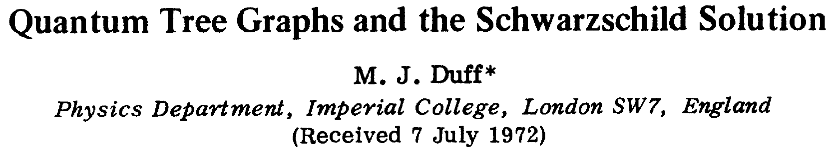
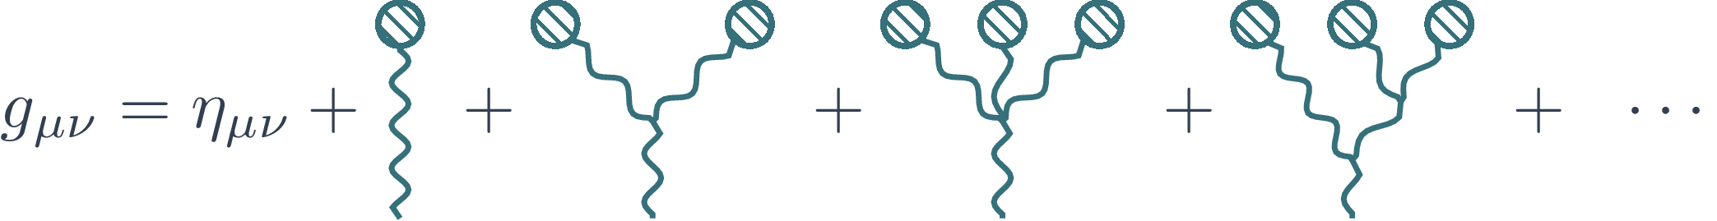



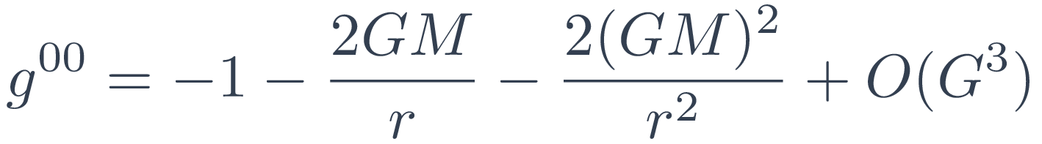
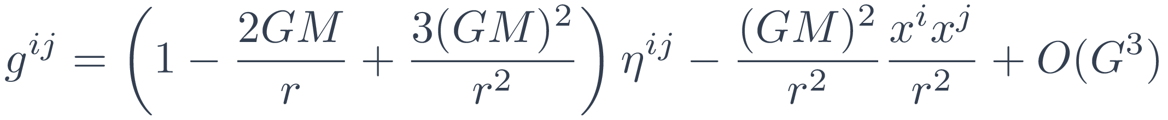
The metric encodes all order PM data
and can be interpreted as a sum of infinite flat-space diagrams
Expand known solutions

Slide 8

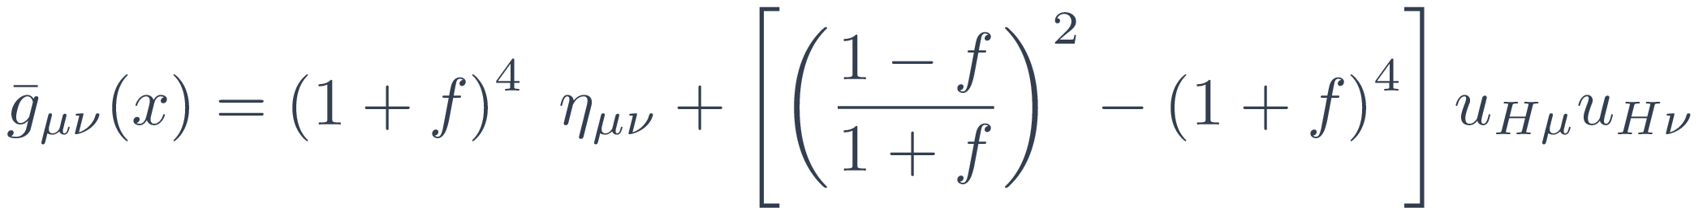
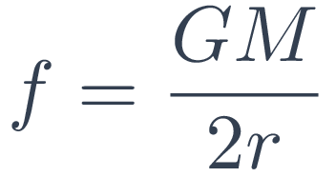
Probe dynamics from the geodesic equation
The geodesic equation encodes perturbative scattering information
for a test particle in a background at all orders in the PM expansion
Convenient coordinates can be chosen
where

Slide 9
Perturbations away from a probe in Schwarzschild
At 0SF:
perturbative corrections away from a non-spinning black hole binary system
Examples:
tidal distortions
higher derivative corrections to general relativity
interactions with a charged body
Cheung, Shah, Solon (arXiv:2010.08568)
2. Beyond 0SF:
Effective field theory in a mass ratio expansion

Slide 10
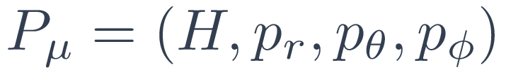
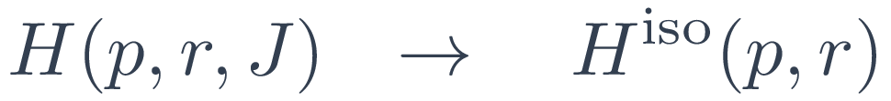
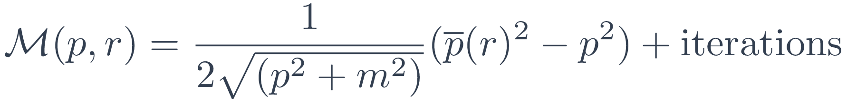
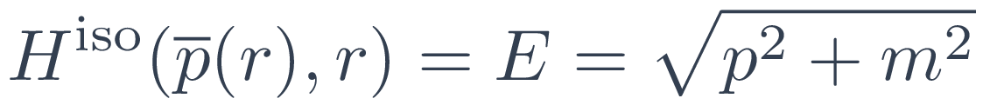
Schematic procedure at 0SF
Geodesic equation, Hamiltonian
,
Amplitude
The extraction procedure is purely algebraic thanks to the impetus formula
Bern, Cheung, Roiban, Shen, Solon, Zeng (2018, 2019);
Kӓlin, Porto (2020); Bjerrum-Bohr, Cristofoli, Damgaard (2020)

Slide 11

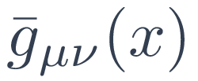

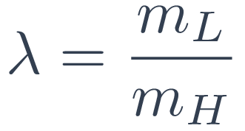


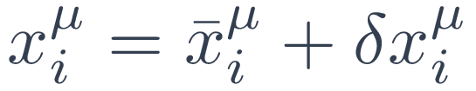

An EFT formalism for extreme mass ratios
1. Starting point: probe motion in curved spacetime, and
2. Accounting for heavy particle motion with
3. A systematic expansion in :
4. Integrate out the heavy particle fluctuation,
5. Use resulting effective action:
background field + corrective operators
to calculate quantities of interest (e.g. on-shell radial action)

Slide 12
Electromagnetism

Slide 13
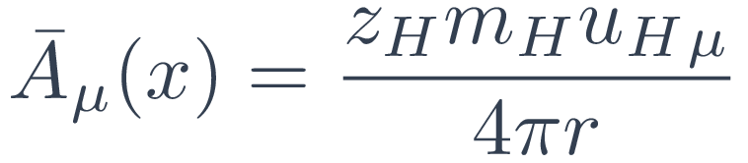
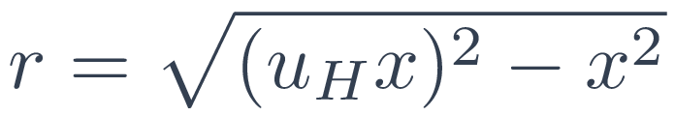
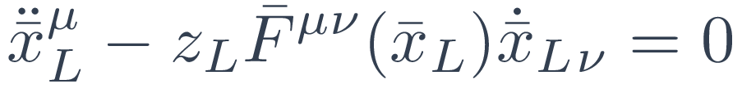
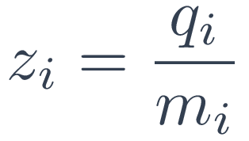
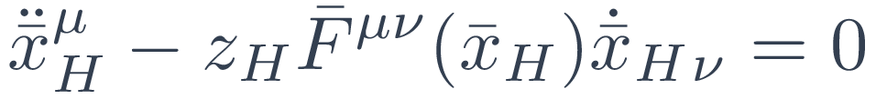

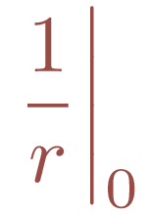
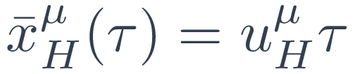
Background configuration: test particle in an electromagnetic field
Coulomb potential:
where
and is the light particle equation of motion
Assume of equal size so that forces scale with mass
For the heavy particle:
vanish in dimensional regularization
Divergence!
Background motion of the heavy particle is simply

Slide 14
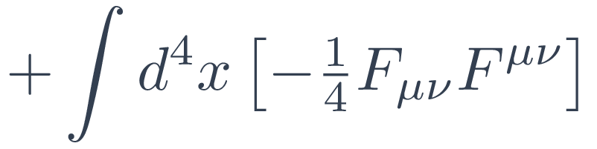




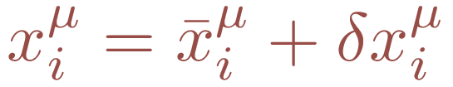
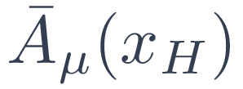

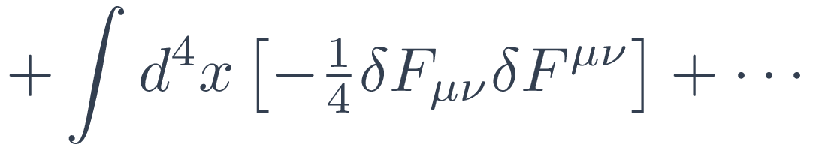
Expanding the action in orders of the mass ratio
light particle action is suppressed by
terms linear in and vanish
dimensional regularization sets terms
with to zero

Slide 15
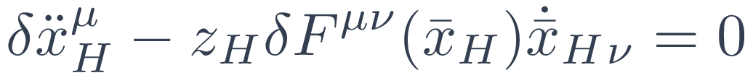
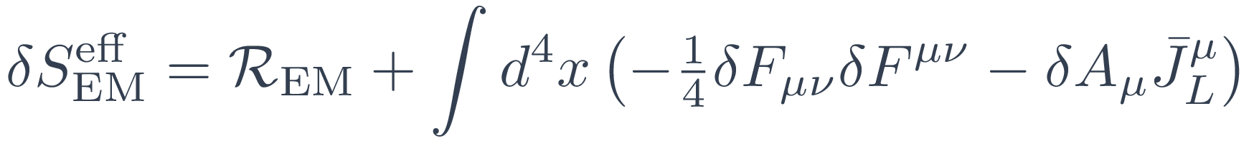
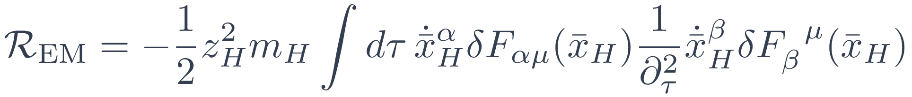

Effective action and recoil operator at 1SF
Integrate out
using
The non-local in time recoil operator
accounts for the wobble of the heavy particle

Slide 16
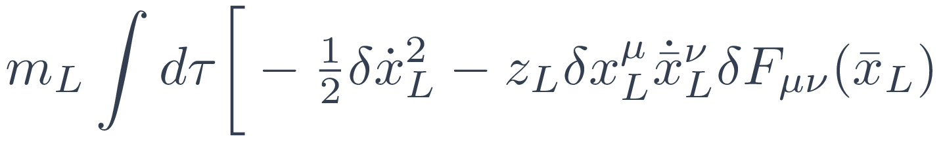
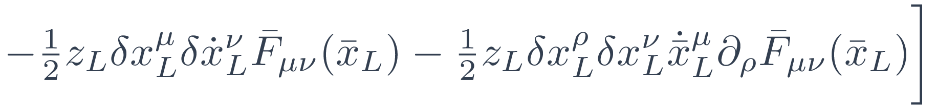
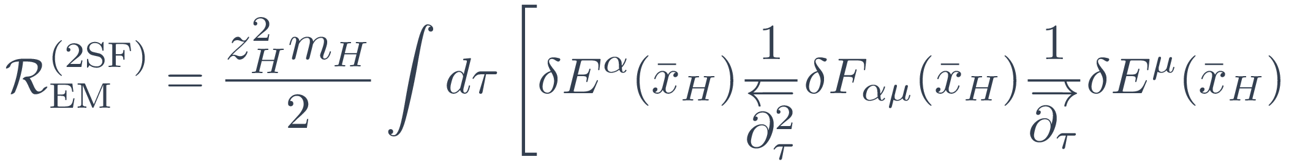
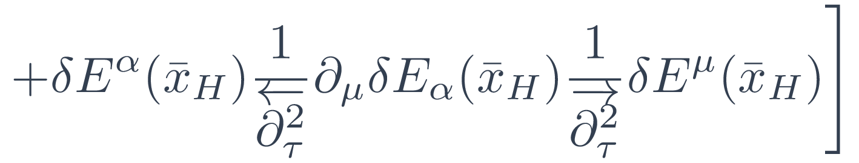

Effective action and recoil operator at 2SF
For light particle fluctuation:
The light particle experiences recoil and deviation from its trajectory
but continues to propagate in the background
Heavy particle recoil:
(where )

Slide 17




Types of interactions
1SF:
background
trajectory source
Heavy particle
recoil operator
2SF:
Deviation and propagation
Heavy particle
recoil operator

Slide 18
Gravity

Slide 19
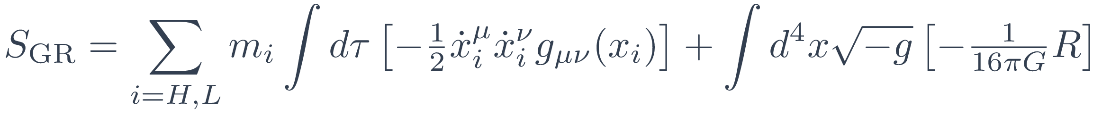
Effective action at 1SF
Self-energy contributions are dropped and the action at 1SF is
The action describes interactions of a probe particle with fluctuations of the background, heavy particle recoil encoded in a nonlocal operator
Expanding known curved spacetime solutions provides simplification

Slide 20





Types of interactions
1SF:
Geodesic source
Recoil operator
2SF:
Geodesic deviation
Recoil operator
Self-interactions

Slide 21
The interplay between PM and SF expansions provides an avenue for furthering calculations for the gravitational two-body problem
At 0SF, the Schwarzschild metric and geodesic motion carry all order perturbative information
EFT setup systematically describes perturbative corrections beyond test-particle dynamics needed at higher SF orders while leveraging the resummation provided by the background configurations

Slide 22
Thank You!

