Slide 1


Suppression of Particle Production at High p_{T} in ALICE
Philipp Lüttig
for the ALICE-Collaboration
High p_{T} @ LHC, Utrecht
April 2011

Slide 2

High p_{T} Particle Production
Hard partons are created at the early stage of the nuclear collision
Partons are believed to loose energy in a color charged medium
Fragmentation of the partons
Good probe of the medium
q
q
q
q

Slide 3
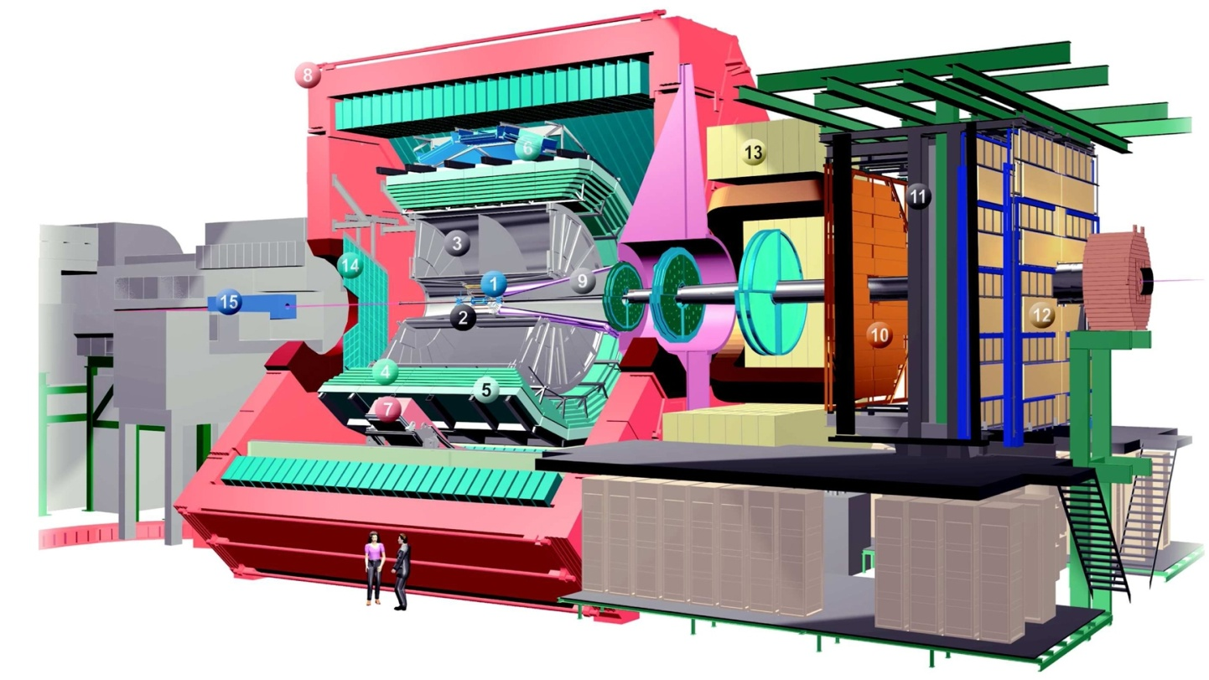
ALICE
In this analysis:
Tracking: ITS, TPC
Centrality: ZDC, VZERO

Slide 4
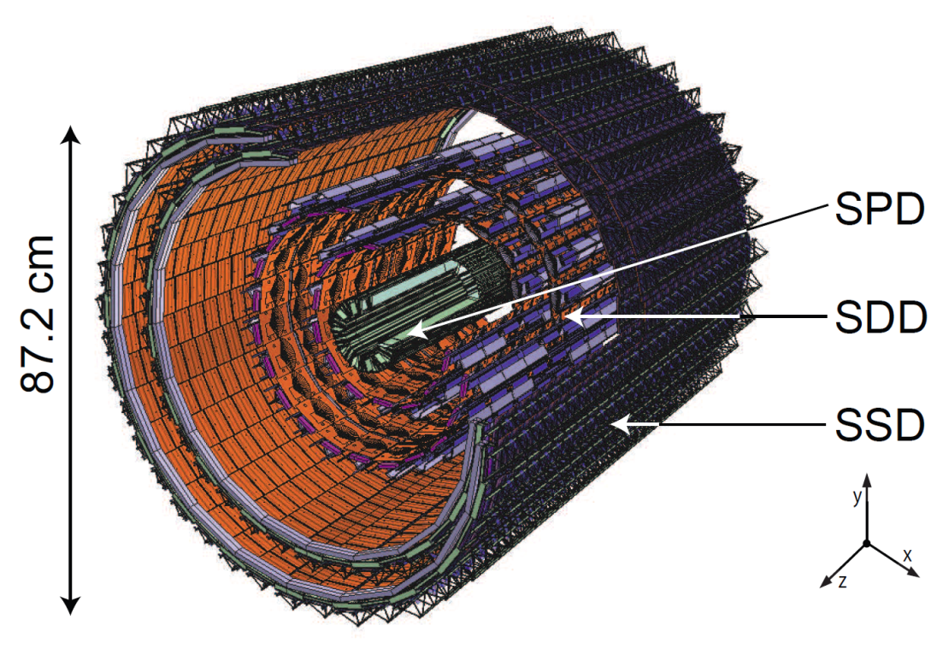
ALICE-ITS
Inner Tracking to reconstruct primary vertex with high precision
∼ 12.7 M channels
Three different techniques:
SPD, SDD, SSD

Slide 5
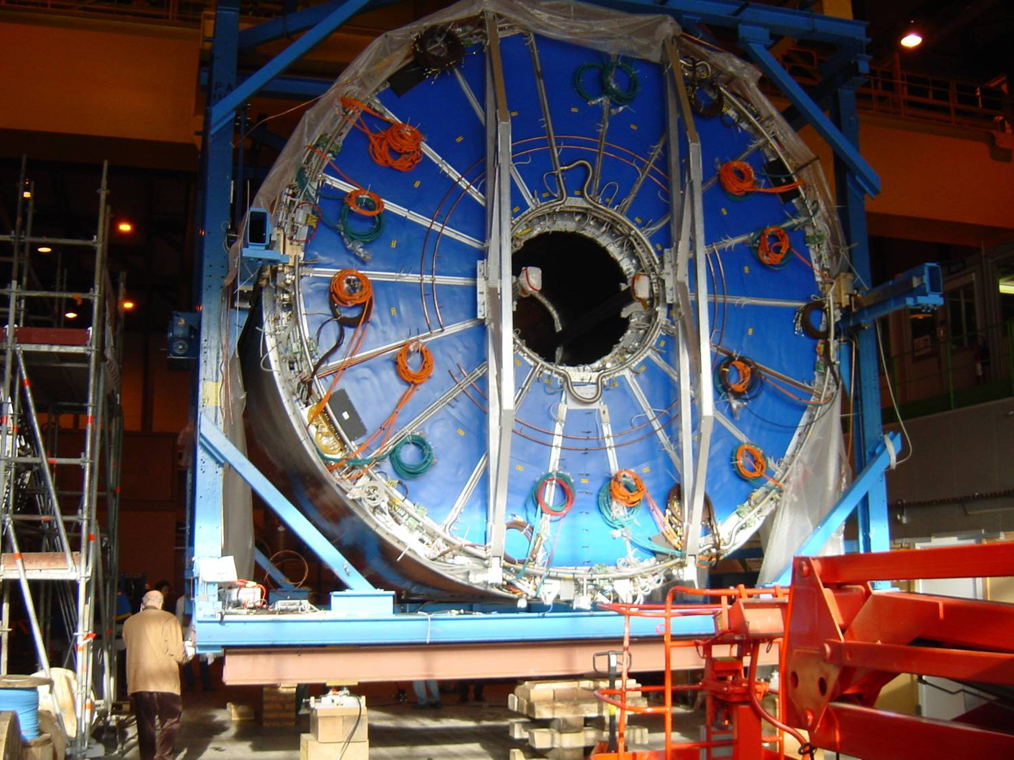
ALICE-TPC
Main Tracking Device
85 m³ NeCO₂N₂
∼ 560.000 channels
92 µs max. drift time
|η| < 0.9
p_{T} > 0.15 GeV/c

Slide 6
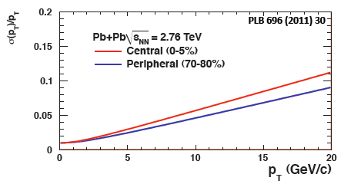
ALICE-TPC (II)
Combined ITS+TPC tracking
  TPC only tracks for crosschecks
Good resolution with early calibration
Background / weak decays excluded via DCA cut to primary vertex
Only tracks with |η| < 0.8

Slide 7
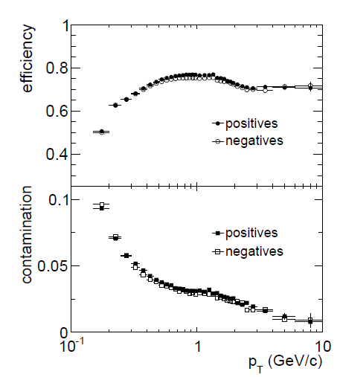
ALICE-TPC (III)
PLB 693 (2010) 53–68
Require at least 70 / 159 clusters in the TPC
χ² per fit < 4
Use only tracks with at least two hits in the ITS, one of them in the SPD
Strange particles used to determine resolution

Slide 8
Centrality: VZERO and ZDC
VZERO:
  on both sides of the ITS
  2.8 < η < 5.1 and -3.7 < η < -1.7
  scintillators
ZDC
  located +/- 116 m of the interaction point
  consists of p-, n- and EM calorimeters

Slide 9
The pp Reference

Slide 10
pp at 2.76 TeV
No previous measurements from other experiments
  just measured at LHC (end of March)
For this talk: interpolation of 900 GeV and 7 TeV data as in
Phys.Lett. B696 (2011) 30-39
ALICE data only
Parametrization to avoid statistical fluctuations:
  Intermediate p_{T}:
  High p_{T}:

Slide 11
Interpolation
Compare measured yield at a fixed p_{T} for different √s
Use powerlaw to interpolate between energies
Alternative approaches have been used for crosschecks:
  replace ALICE data at 900 GeV with data from CDF at 1.96 TeV
  scale measured data with NLO
yield
p_{T}=3.7 GeV/c

Slide 12
NLO Scaling
Use NLO Calculations to scale measured data (NLO performed by M. Stratmann, with CTEQ6.6M, DSS, µ = p_{T}):

Slide 13
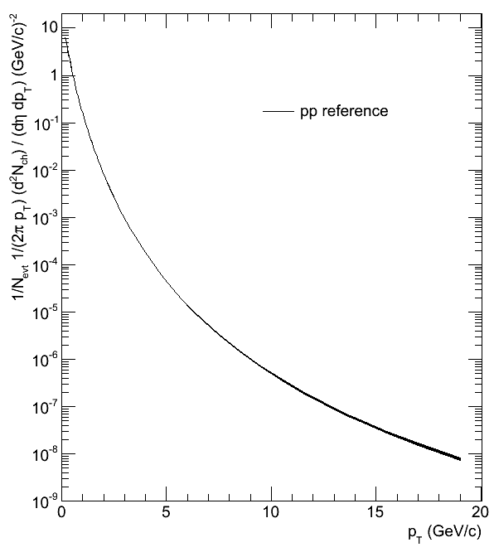
pp Reference
n = 6.5 for
p_{T} > 10 GeV/c

Slide 14
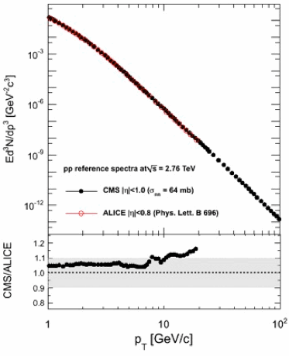
Comparison to CMS
C. Roland, HI at the LHC, 04.03.2011
CMS:
  < 5 GeV/c: linear interpolation
  5 – 20 GeV/c: linear interpolation + x_{T}-scaling
  > 20 GeV/c: x_{T}-scaling + NLO correction
Good agreement with ALICE

Slide 15
The Pb-Pb Spectra

Slide 16
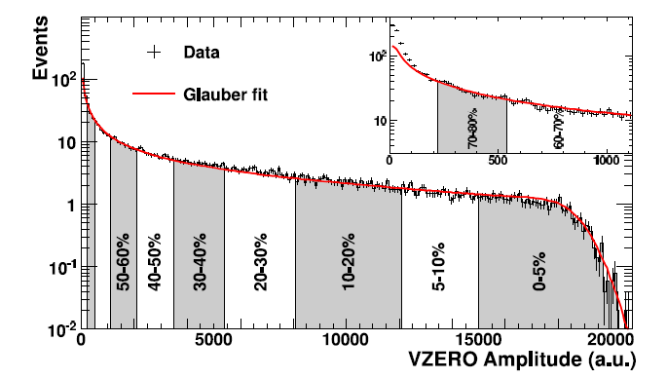
Centrality Selection
Phys. Rev. Lett. 106, 032301 (2011)
Compare VZERO amplitude to Glauber MC
Determine percentage intervals
Fit amplitude below 87% to avoid contamination from ultra-peripheral collisions
Produce N_{PART}, N_{COLL} using Glauber

Slide 17
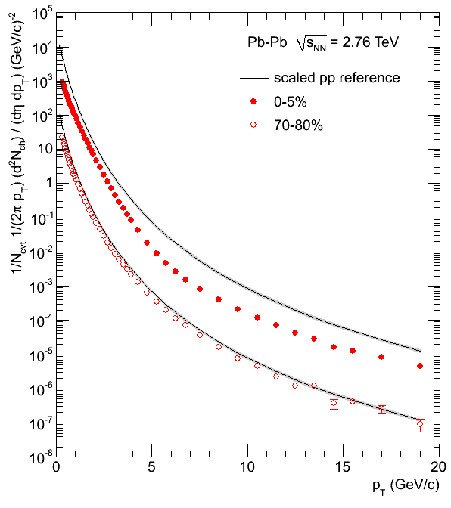
Transverse Momentum Spectra
Phys. Lett. B969 (2011) 30-39
Peripheral:
  Pb-Pb and scaled pp similar
  Power law at high p_{T}
  n = 6.2 for p_{T} > 10 GeV/c
Central:
  Pb-Pb and scaled pp different
  Up to 5 GeV/c exponential shape
  Power law at high p_{T}
  n = 5.7 for p_{T} > 10 GeV/c

Slide 18
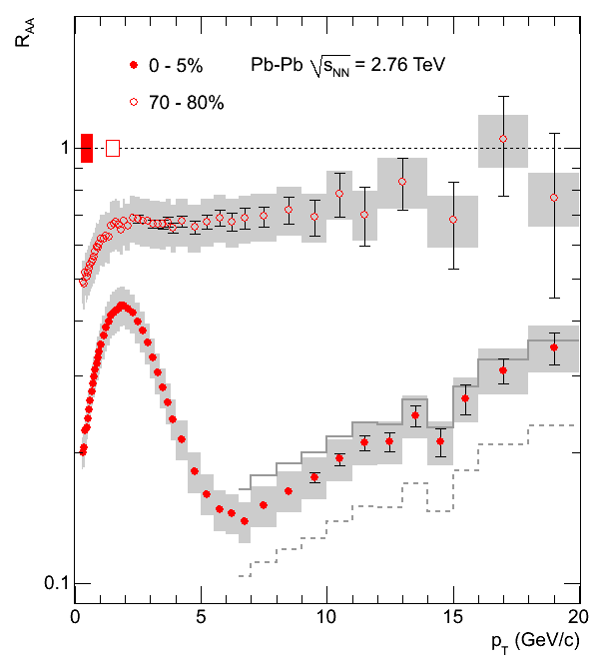
R_{AA}
Phys. Lett. B969 (2011) 30-39
Peripheral:
  Slight p_{T} dependence in peripheral collisions
Central:
  Large p_{T} dependence in central collisions
  Minimum at p_{T} ∼ 6-7 GeV/c
  Reflects change of shape (exponential/powerlaw)
Interpolation with CDF
Scaling with NLO

Slide 19
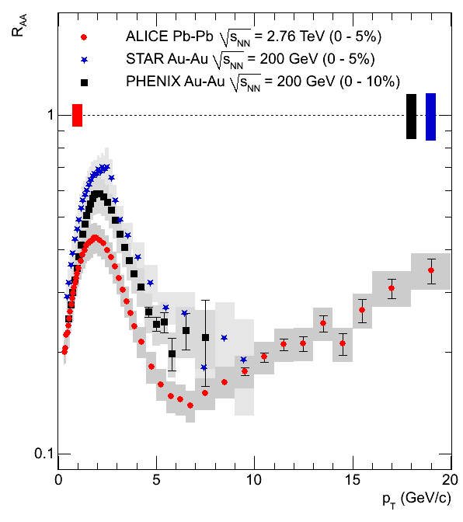
Comparison to RHIC
Phys. Lett. B969 (2011) 30-39
Low p_{T} ( < 5 GeV/c):
  Similar structures
Intermediate p_{T} ( 5 – 8 GeV/c):
  Stronger suppression at LHC
High p_{T} ( > 8 GeV/c):
  No direct comparison possible
  Only: π⁰ measured at PHENIX in 200 GeV Au+Au

Slide 20
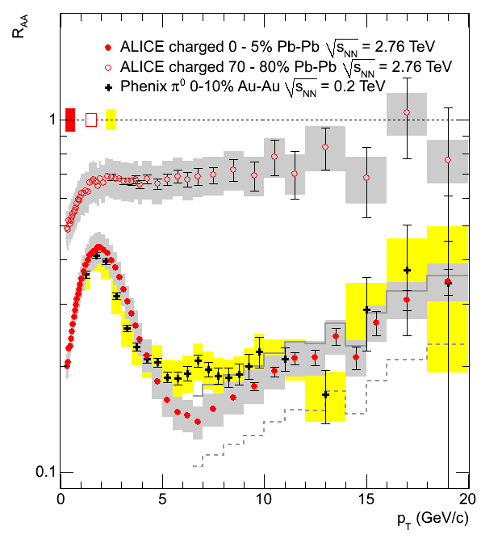
Comparison to RHIC
Low p_{T} ( < 5 GeV/c):
  Similar structures
Intermediate p_{T} ( 5 – 8 GeV/c):
  Stronger suppression at LHC
High p_{T} ( > 8 GeV/c):
  No direct comparison possible
  Only: π⁰ measured at PHENIX in 200 GeV Au+Au
Surprising coincidence between π⁰ @ RHIC and charged hadrons @ LHC
Phys. Lett. B969 (2011) 30-39, PHENIX PRL 101 (2008) 232301

Slide 21
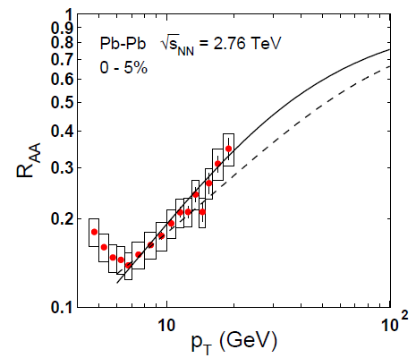
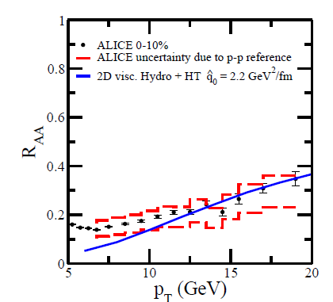
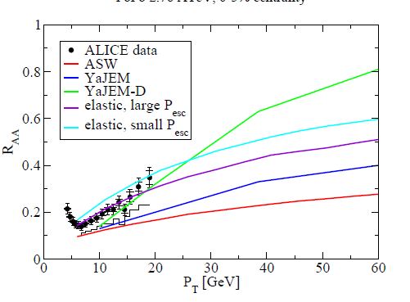
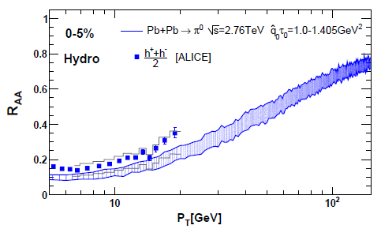
Comparison to theory
arXiv:1103.0809v1
Majumder and Shen
arXiv:1012.2854v3
Kopeliovich et al.
arXiv:1012.2854v3
arXiv:1103.5308v1
Renk, Holopainen, Paatelainen, Eskola
arXiv:1102.5614v2
Chen, Hirano, Wang, Wang, Zhang

Slide 22
Summary and Outlook
Inclusive charged particle spectra in Pb-Pb collisions at 2.76 TeV have been presented up to 20 GeV/c
R_{AA}:
  peripheral: slight p_{T} dependence
  central: R_{AA} ~ 0.14 for p_{T} = 6 – 7 GeV/c
Higher p_{T} reach with full year-1 Pb-Pb statistics
Reference just measured (currently being analyzed)
Investigation on particle production at low p_{T}:
  Identified particles

Slide 23
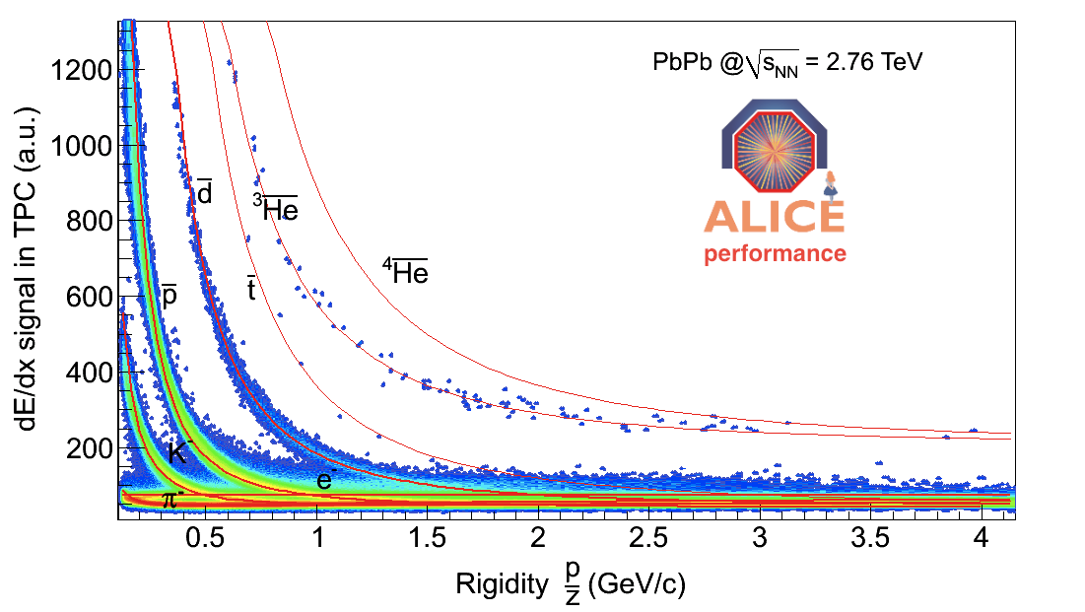
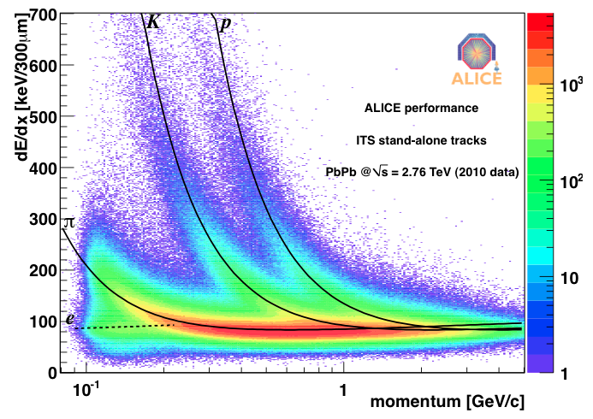
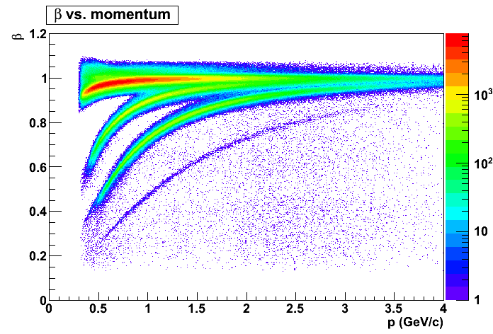
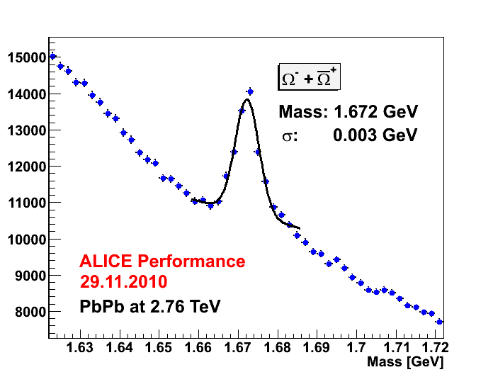
Outlook (II)
ITS
TPC
TOF
TOF
Notes:
200 gev AuAu, central peripheral

