Slide 1
Measurement of the magnetic properties of materials at high dB/dt
M. Buzio, M Pentella TE-MSC
22.08.2034
State of the art: B(H) measurements at CERN
Proposal for preliminary tests up to 6 kT/s

Slide 2
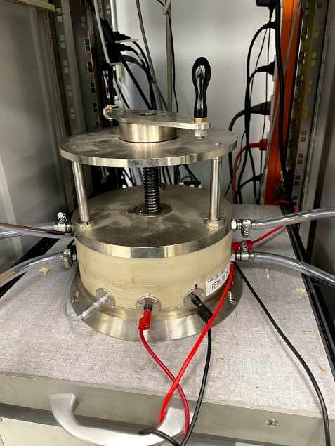
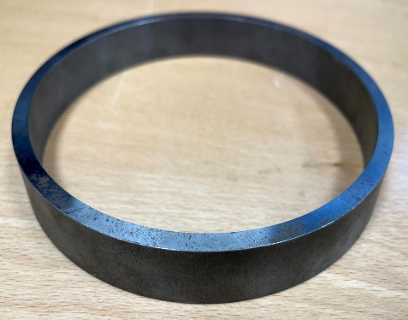
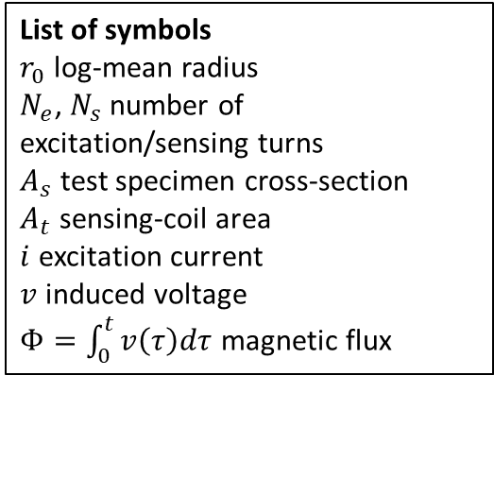
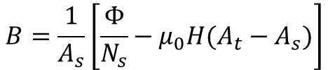
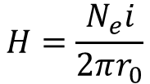


Toroidal ring permeameter (1/2)
List of symbols
$r_{0}$ log-mean radius
$N_{e}$, $N_{s}$ number of excitation/sensing turns
$A_{s}$ test specimen cross-section
$A_{t}$ sensing-coil area
$i$ excitation current
$v$ induced voltage
$Φ=\int_{0}^{t}{v\left(τ\right)dτ}$ magnetic flux
$$H=\frac{N_{e}i}{2πr_{0}}$$
Toroidal ring test method for soft ferromagnetic materials DC characterization, based on the fluxmetric method (transformer configuration).
Split-coil permeameter [2,3]
$$B=\frac{1}{A_{s}}\left[\frac{Φ}{N_{s}}−μ_{0}H{(A_{t}−A}_{s})\right]$$
Implemented at CERN by split-coil permeameter [1,2], where a mechanism allows to split the coils and place the specimen within them
$$u\left(H\right)/H≤1 \%$$
$$u\left(B\right)/B≤1 \%$$
[1] K.N. Henrichsen, “Permeameter”, Proceedings of the Second International Conference on Magnet Technology, 1967
[2] P. Arpaia, M. Buzio, L. Fiscarelli, G. Montenero, L. Walckiers, 2010 IEEE Instrumentation & Measurement Technology Conference Proceedings, 2010
[3] IEC 60404-4, “Magnetic materials - Part 4: Methods of measurement of DC magnetic properties of magnetically soft materials”, International Electrotechnical Commission, 2000
The standard IEC 60404-4 [3] provides guidelines for the characterization at room temperature and the operational procedures
IEC-compliant test specimen. 114 mm De, 105 mm Di, 15 mm H
Notes:
Let’s focus on two particular test methods, which will be used as a reference in this presentation.
The first one is the toroidal ring permeameter, working on the fluxmetric method and with toroidal test specimens. The field H is generated by injecting current in a excitation coil and is measured indirectly by measuring the excitation current. The flux density is measured by integrating the voltage at a sensing coil terminals and by dividing the magnetic flux by the cross-section of the specimen. This term here (point on the formula) is necessary to compensate the air-flux, because the total flux is the sum of a flux circulating inside the specimen and the air-flux in the space between the sensing coil and the specimen.
The method is implemented at CERN by split-coil permeameter, shown in this photo here, a particular test bench where we a mechanism to open and close the coils, so we can avoid to manually wind them.
The test methods are performed according to the IEC norm, providing the guidelines for the characterization at room temperature and the operational procedures.

Slide 3
Toroidal ring permeameter (2/2)
Two types of test cycles can be applied to the specimen for DC characterization
Continuous recording method
Initial magnetization curve
Hysteresis loop
Point-by-point (ballistic) method
Initial magnetization curve
Hysteresis loop

Slide 4
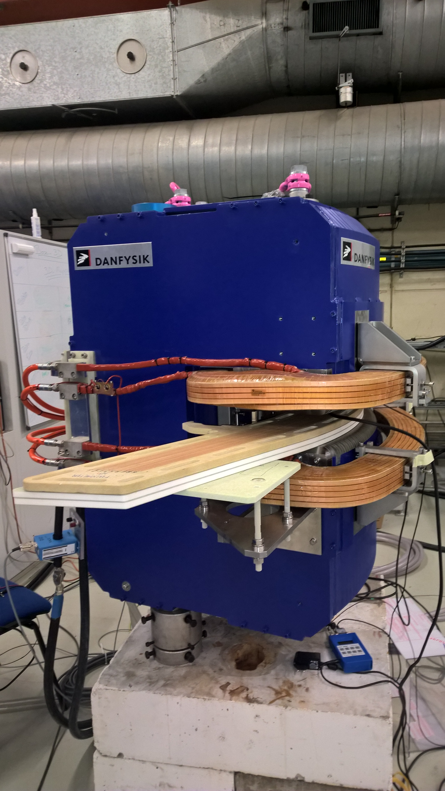
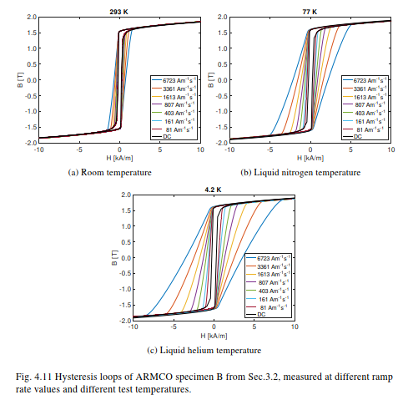
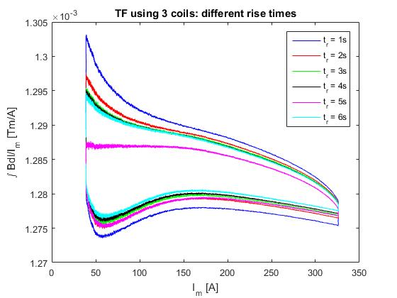
Examples of dynamic measurements (1/2)
ELENA main dipole

Slide 5
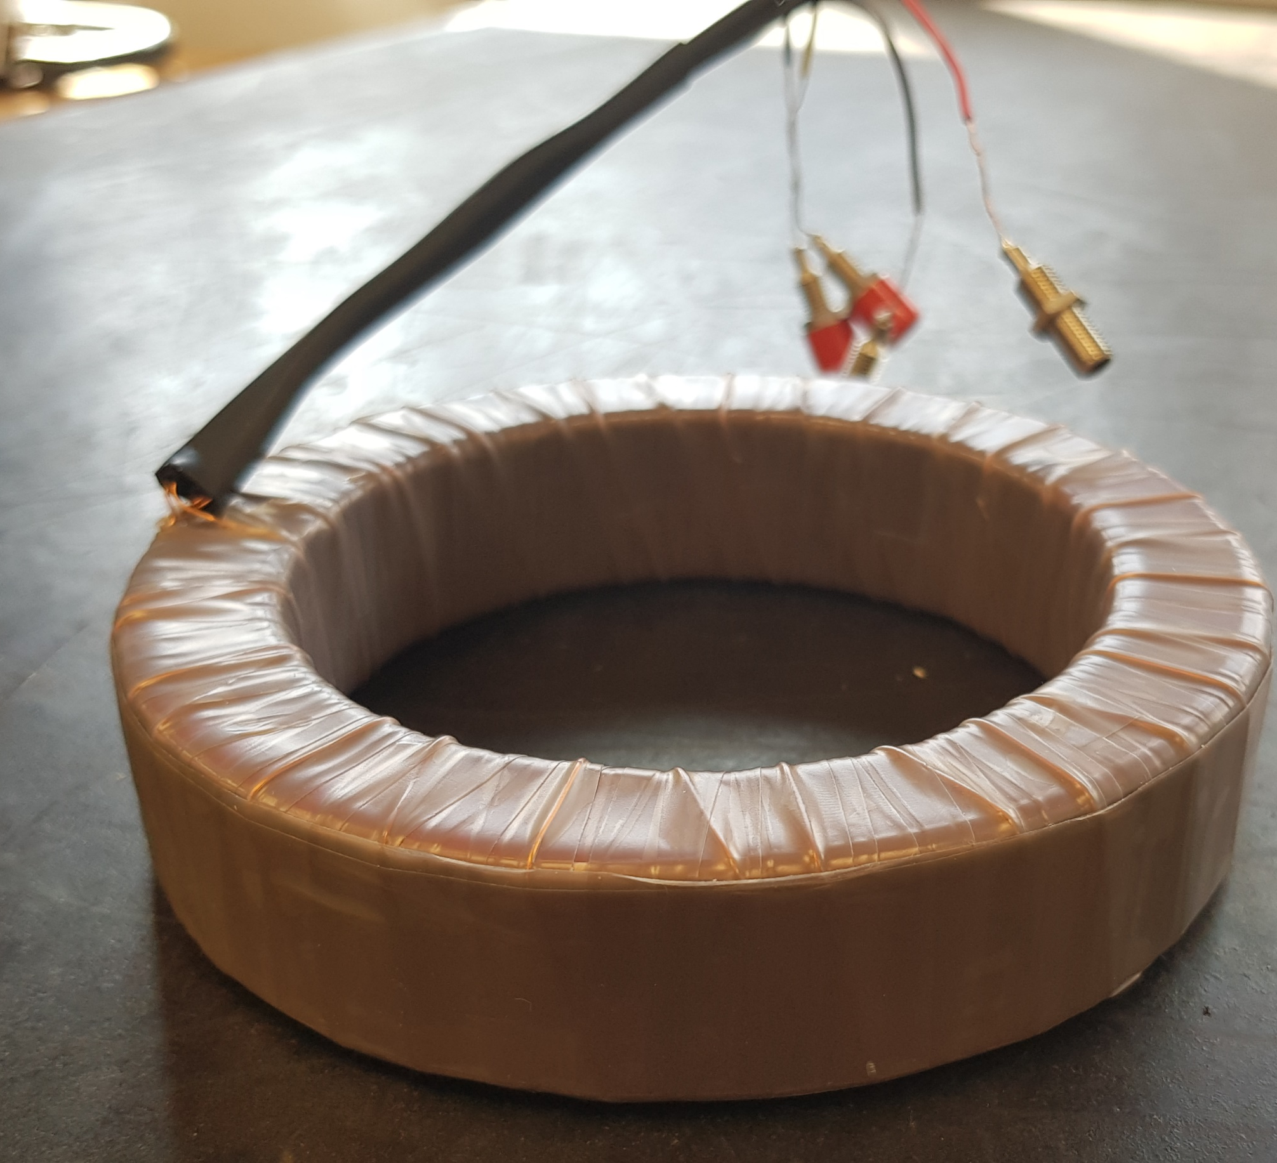
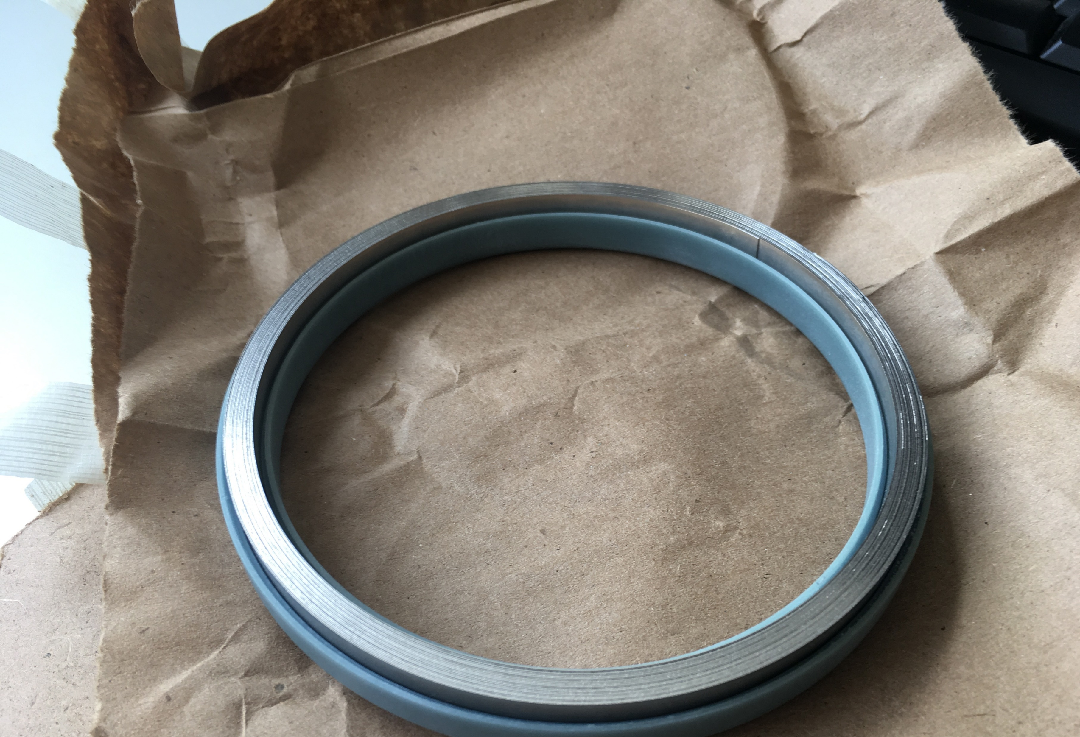
Examples of dynamic measurements (2/2)
Custom-winding permeameter
Manual winding of the coils allows to cover what the split-coil permemeter can’t do
Very-high permeability materials (i.e. mu-metals)
Fewer excitation turns can be used to measure low magnetic fields (<10 A/m) by using conveniently high currents.
Vitroperm500F. Non-standard dimensions and very-high permeability (about 80,000)
Dynamic characterization possible up to 1 kHz for some materials
Non-standard sized toroids
Maximum field limited to 6 kA/m at RT for thermal reasons and to limit the coil resistance.
It works at cryogenic temperatures!
Mu-metal sample in the holder

Slide 6
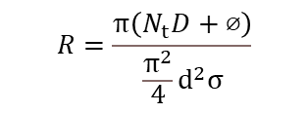








Magnetic permeability measurement of ring sample
$$d≤\frac{π⁢⌀}{Ν_{t}}−δ$$
Ø
Assumptions:
Thin ring
Laminated sample (no eddy currents)
Flux in air ignored
Round coil loops, normal to ring axis
δ
d
δ
N_{t}
$$H=\frac{Ν_{t}⁢Ι}{π⁢⌀}$$
b
Ø
I
$$B=μ_{0}⁢μ_{r}⁢HI$$
N_{out}
a
$$R=\frac{π\left(Ν_{t}D+⌀\right)}{\frac{π^{2}}{4}⁢d^{2}⁢σ}$$
D
$$D=d+\sqrt{a^{2}+b^{2}}+2⁢δ$$
$$L=\frac{∂Φ}{∂I}=\frac{μ_{0}⁢μ_{r}⁢{Ν_{t}}^{2}⁢a⁢b}{π⁢⌀}$$
$$L_{d}=L⁢\left(1+\frac{H}{μ_{r}}\frac{{ ∂μ}_{r}}{∂H}\right)$$
$$V=\frac{∂Φ}{∂t}=⁢L_{d}\frac{dI}{dt}+RI$$
$$V_{out}=⁢N_{out}ab\frac{dB}{dt}$$

Slide 7




ARMCO B(H) – 1st magnetization curve
Measurement data
$$\log_{10}{μ_{r}}=ηf_{1}+\left(1−η\right)f_{2}$$
$$f_{1}=A\left(1+Be^{C\log_{10}{H}}\right)$$
$$η=\frac{1−\tanh{α\left(\log_{10}{H}−β\right)}}{2}$$
$$f_{2}=\left(D−E\log_{10}{H}\right)\left(1−e^{F(\log_{10}{H−G)}}\right)$$

Slide 8
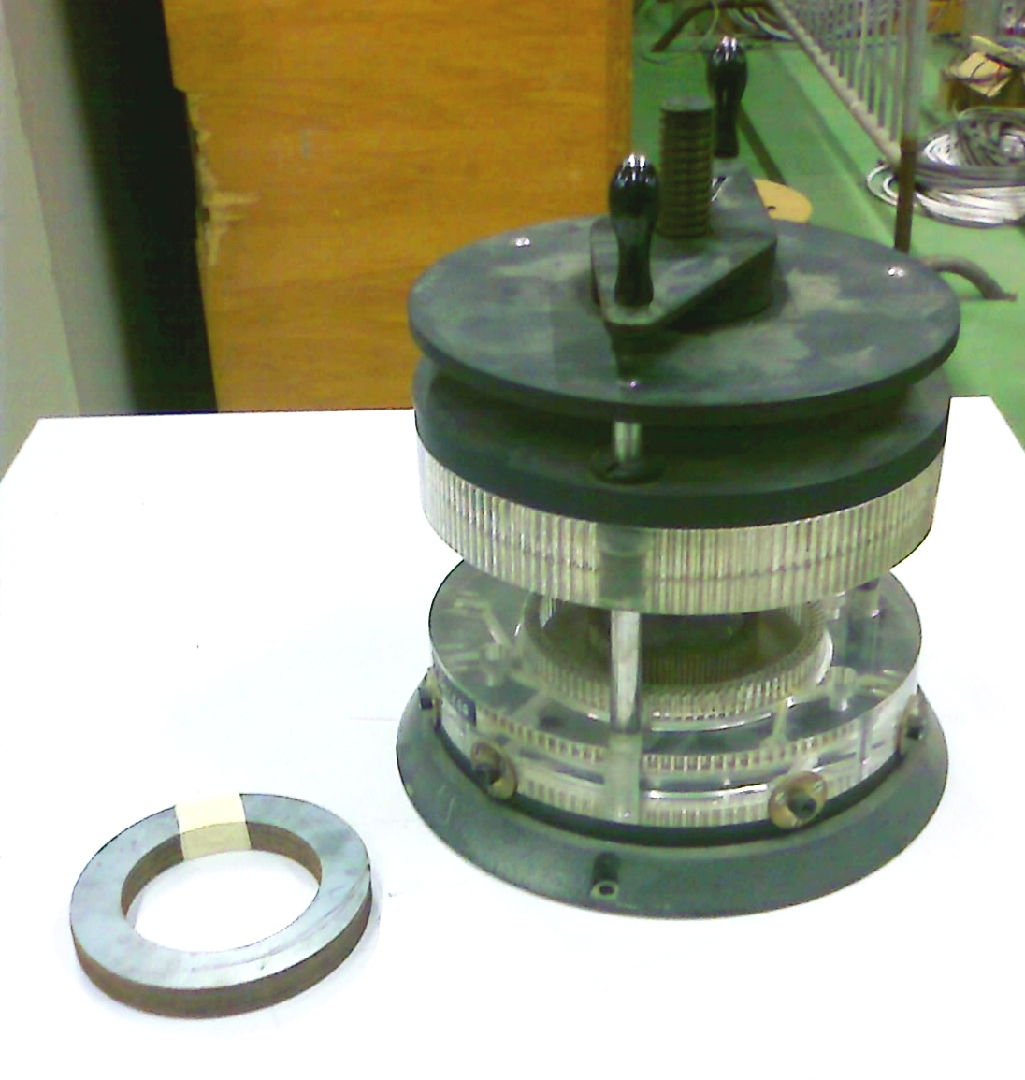
IEC standard sample in existing split-coil permeameter
Ø = 95 mm, a=38 mm, b=15 mm
N_{t} = N_{out} = 90
I_{max}=40 A
H_{max}=12 kA/m
dH/dt max = 450 MA/ms
V_{max}= V_{out}= 4 kV !!
B_{max}=1.8 T
dB/dt avg. =6 kT/s

Slide 9
Individually wound 10x10 mm ring sample – low voltage
Ø = 100 mm, a=b=10 mm
d = 3 mm
N_{t} = 10
R = 0.7 mΩ
L_{d,max} = 230 μH
N_{out} = 1
I_{max}=300 A
H_{max}=9.5 kA/m
dH/dt max=50 MA/ms
V_{max}= 70 V
P_{max}=2.5 kW
V_{out}= 7.5 V
B_{max}=1.8 T
dB/dt avg. = 6 kT/s
dB/dt peak = 70 kT/s
ΔT = 0.3 °C/cycle

Slide 10
Individually wound 10x10 mm ring sample – low current
Ø = 100 mm, a=b=10 mm
d = 1 mm
N_{t} = 60
R = 25 mΩ
L_{d,max}= 7.5 mH
N_{out} = 1
I_{max}=50 A
H_{max}=9.5 kA/m
dH/dt max=50 MA/ms
V_{max}= 420 V
P_{max}=2.5 kW
V_{out}= 7.5 V
B_{max}=1.8 T
dB/dt avg. =6 kT/s
dB/dt peak = 70 kT/s
ΔT = 0.7°C/cycle

