Slide 1
Probing the high scale seesaw at a natural cosmological Higgs collider
Chengcheng Han
Sun Yat-sen University
With Hongjian He, Linghao Song, Jintao You, arXiv: 2412.XXXXX
The International Joint Workshop on the Standard Model and Beyond
&& 2024/3rd Gordon Godfrey Workshop on Astroparticle Physics
2024.12.12

Slide 2
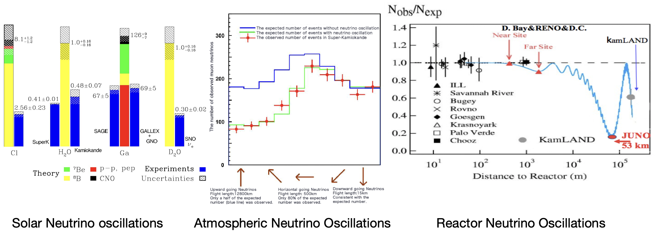
Neutrino masses
Neutrino oscillation indicates massive neutrinos
At least one neutrino mass (0.05-0.1) eV

Slide 3
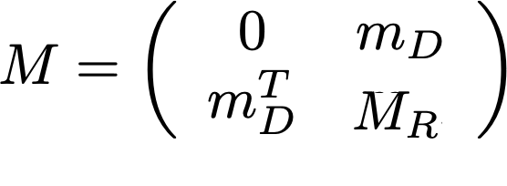
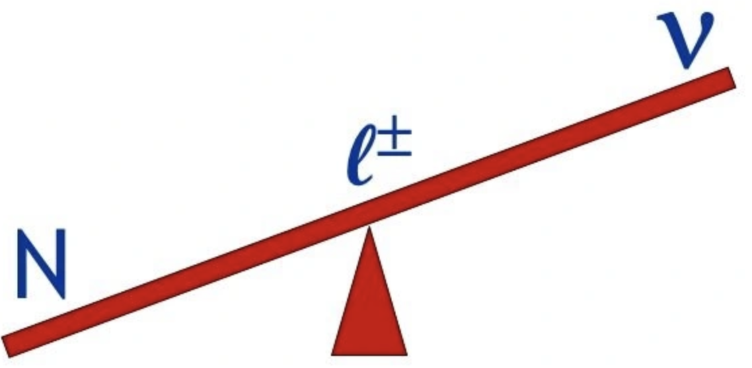
Seesaw mechanism
Origin of neutrino masses: seesaw mechanism
P. Minkowski ；T. Yanagida； S. L. Glashow；
M. Gell-Mann, P. Ramond and R. Slansky
Natural prediction of small neutrino masses
Explain the baryon asymmetry of the universe: leptogenesis
Baryogenesis Without Grand Unification, Fukugita and Yanagida, 1986’

Slide 4
Seesaw mechanism
If the Yukawa coupling is O(1)(as predicted by the GUT), the scale of M_{R} should be around 10¹³⁻¹⁴ GeV, which is much beyond the reach of particle experiments.
How to test such high scale seesaw?

Slide 5
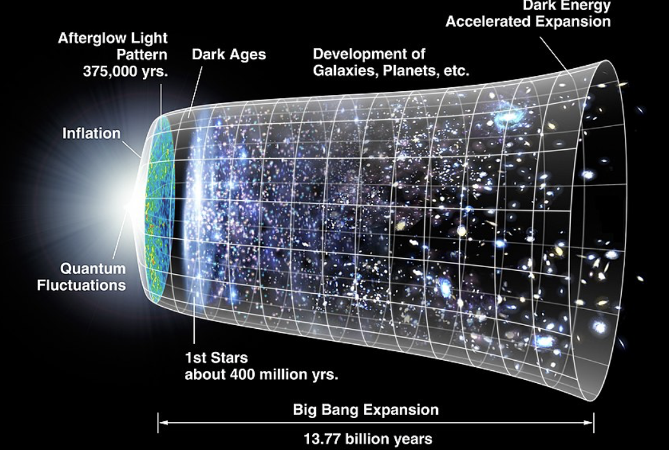
Inflation
Rapid expansion of the universe in the early time
Flatness problem
Horizon problem
Seeding the primordial anisotropies in CMB, finally develop into the large scale structure of our universe

Slide 6
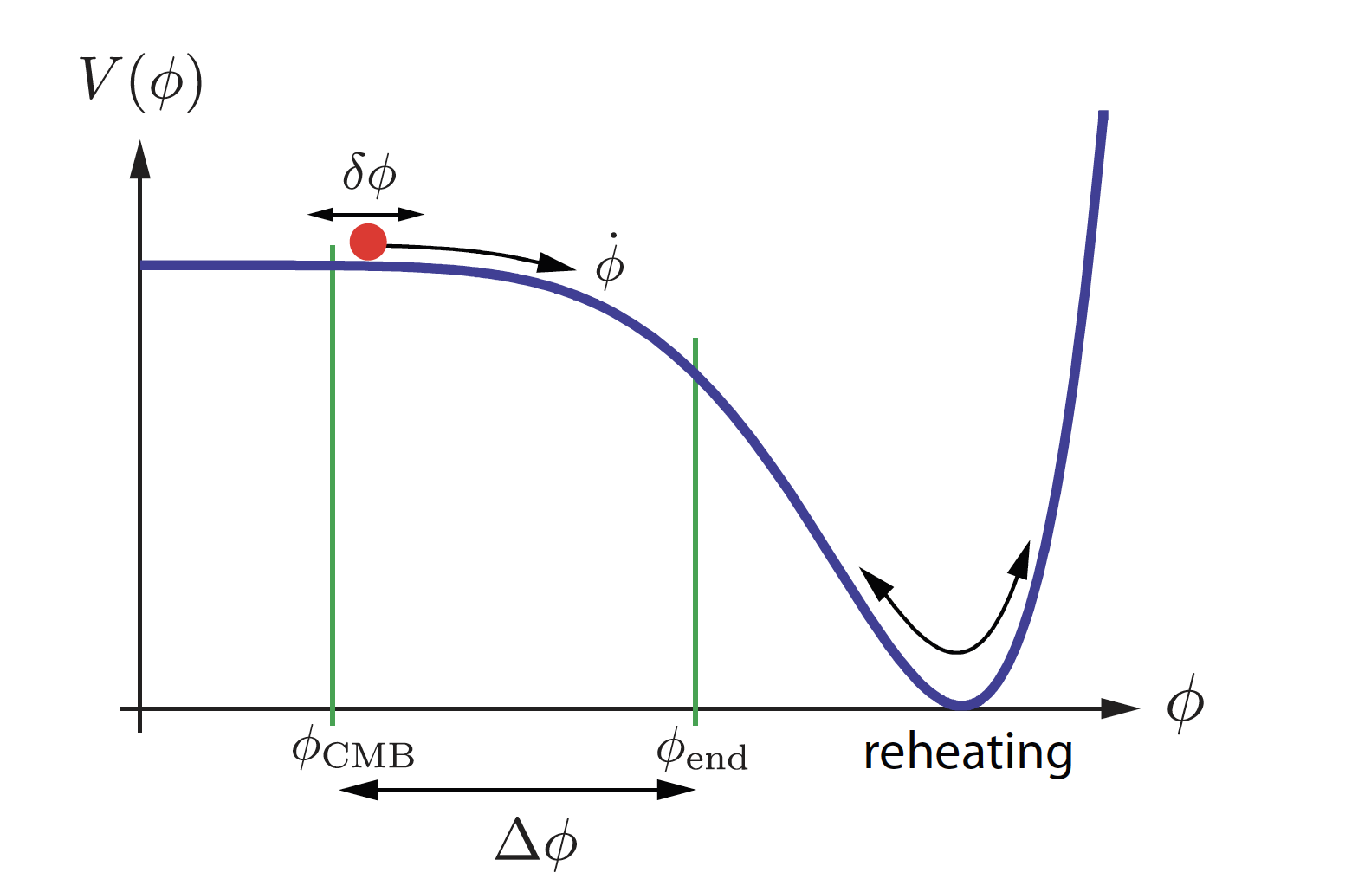
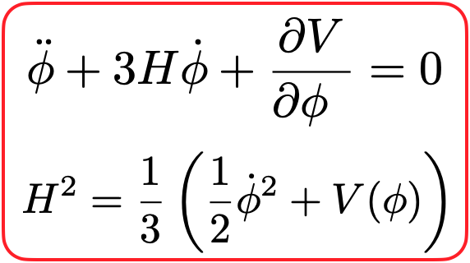
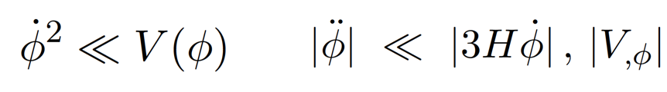
Slow-roll Inflation
Inflation is driven by a scalar field (inflaton)
Slow roll condition
Hubble parameter is nearly constant(de Sitter universe)
After inflation, inflaton oscillates at the bottom of the potential and finally decays, then reheats the universe(still no clear how it happens)

Slide 7
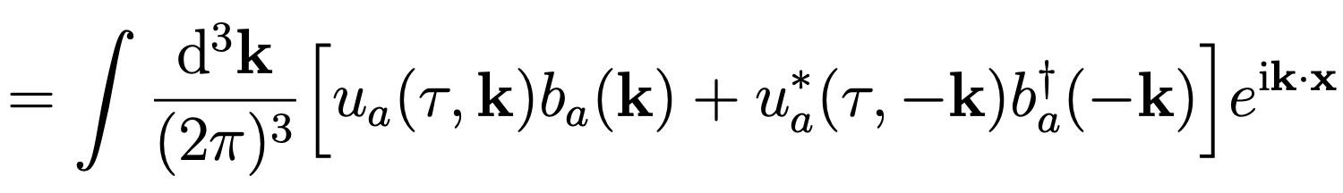
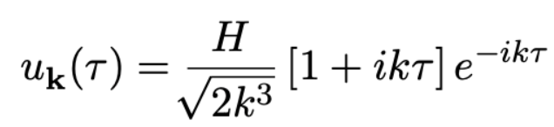
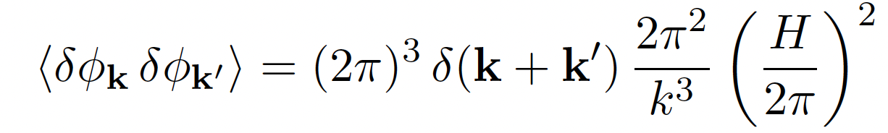
Slow-roll Inflation
In a de Sitter universe, scalar fields get quantum fluctuation
Massless limit
Quantum fluctuation of inflaton induces CMB anisotropies(or curvature perturbations)
In the single field inflation, the fluctuations should be nearly gaussian and adiabatic, close to scale invariant

Slide 8
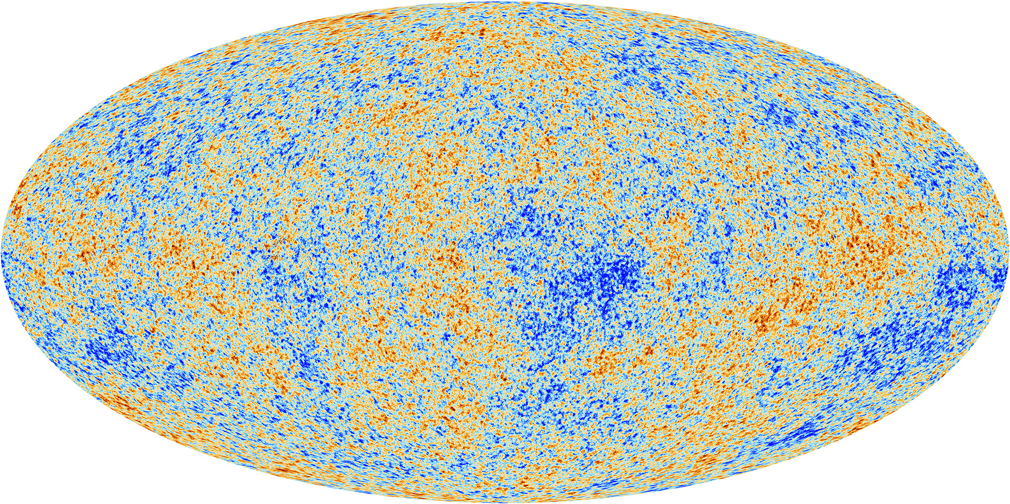
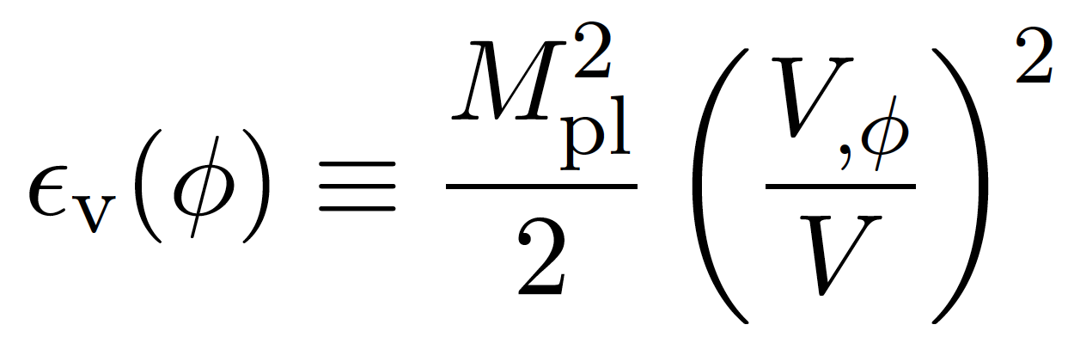
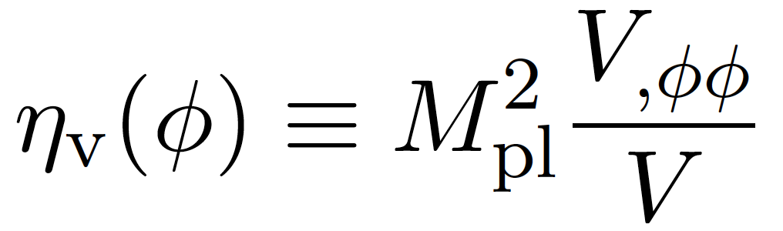
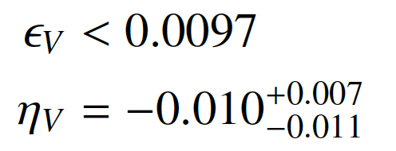
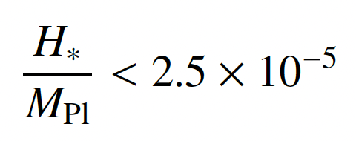
Measurements from Planck
Inflaton potential should be flat enough(shift-symmetry?)
Hubble scale could be as high as 10¹⁴ GeV(close to seesaw scale), providing a circumstance to interplay with high scale physics

Slide 9
Non-Gaussianity
Non-Gaussianity is sensitive to new physics
New physics could induce large non-Gaussianity : multi-field inflation models, modulated reheating, curvaton scenario…
Current limit from Planck on local type f_{NL}~ O(10), future CMB observations, LiteBIRD O(1), large scale structure observations DESI O(1), SKA O(0.1), 21 cm tomography O(0.01-0.1)
Non-Gaussianity could provide information to the new particle mass, spin, interactions: cosmological collider signals
Nima Arkani-Hamed, Juan Maldacena, arXiv:1503.08043
Xingang Chen, Yi Wang, JCAP 04 (2010) 027

Slide 10
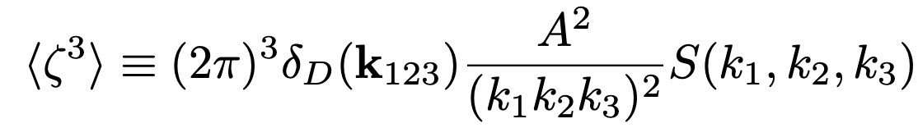

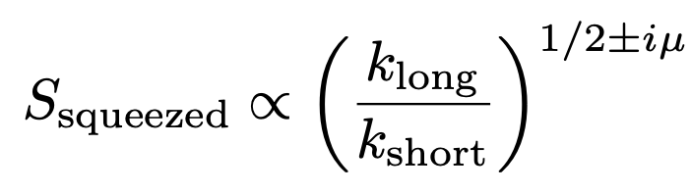
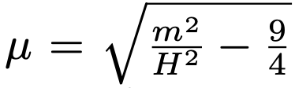
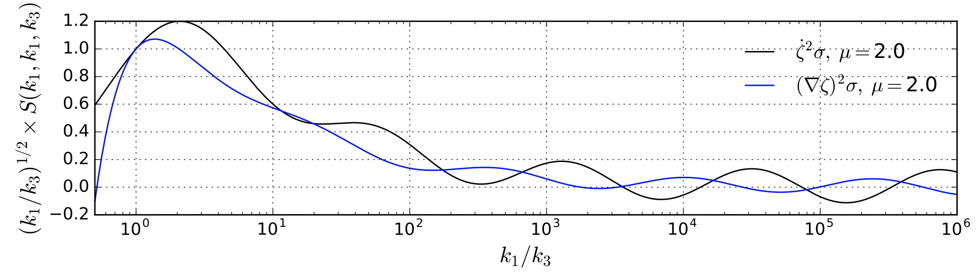
Cosmological collider signals
Bispectrum
Massive particle coupling to the inflaton could induce
P. Daniel Meerburg, Moritz Münchmeyer, Julian B. Muñoz, Xingang Chen, JCAP 03 (2017) 050
Probing new particles with mass around Hubble scale
Signature would be highly suppressed when mass is large

Slide 11
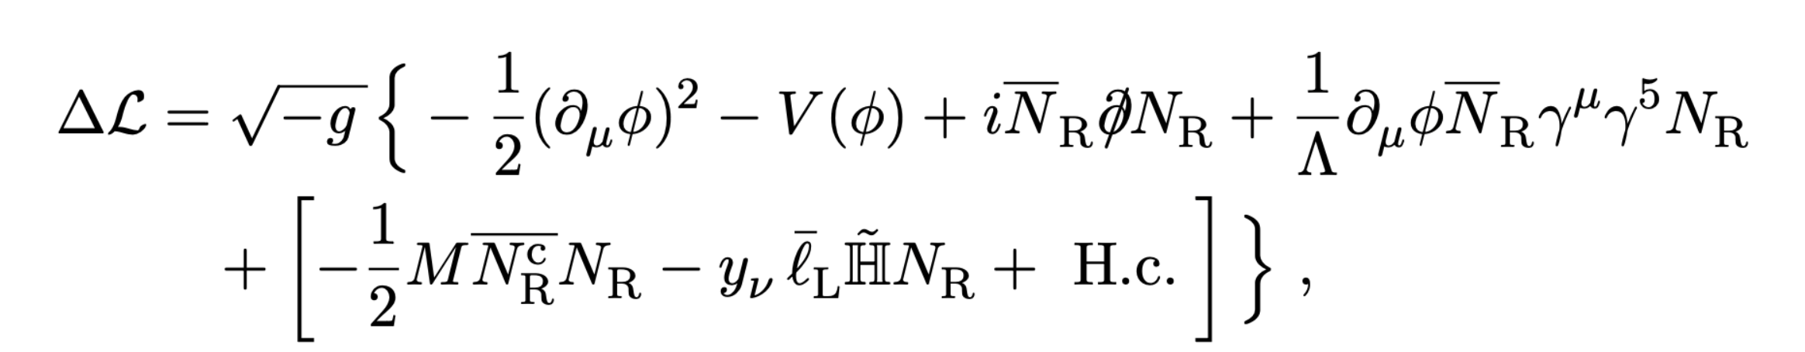
The model
Minimal model incorporates inflation and seesaw
Derivative coupling to keep the flatness of the inflaton potential(shift-symmetry)
Lambda > 60 Hubble to keep unitarity
Inflaton coupling with SM fermions does not change the following discussions
After inflation, inflaton oscillates at the bottom of the potential until decays into heavy neutrinos( mphi > 2 mN). The heavy neutrinos quickly decay into SM particles and reheat the universe

Slide 12
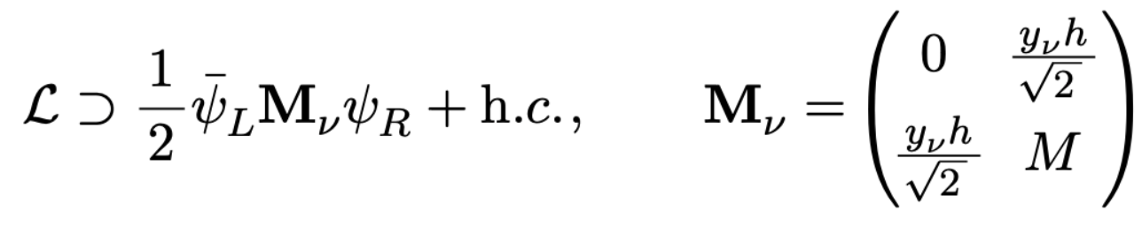
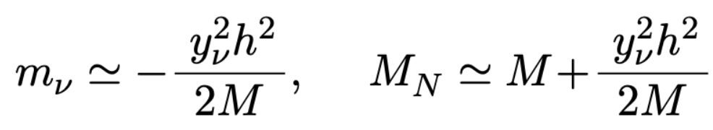
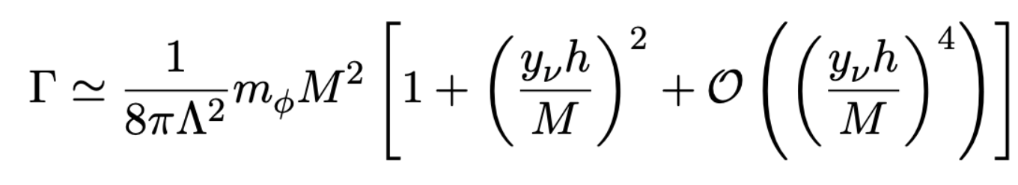
The model
Consequence of the seesaw mechanism
Light neutrino gets a mass
Heavy neutrino mass are get lifted (h dependent)
Decay rate of the inflaton:
What happens to h in the early universe?

Slide 13
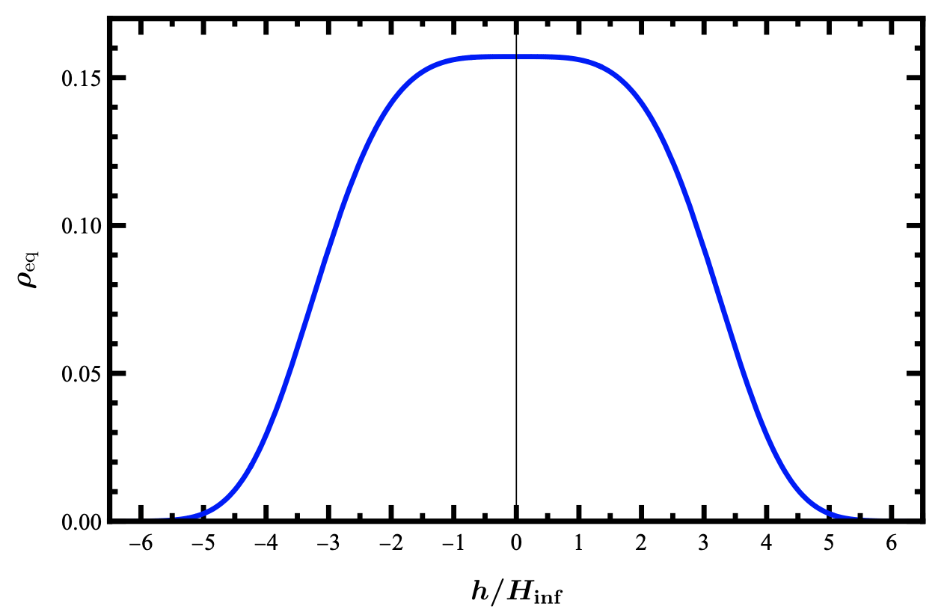
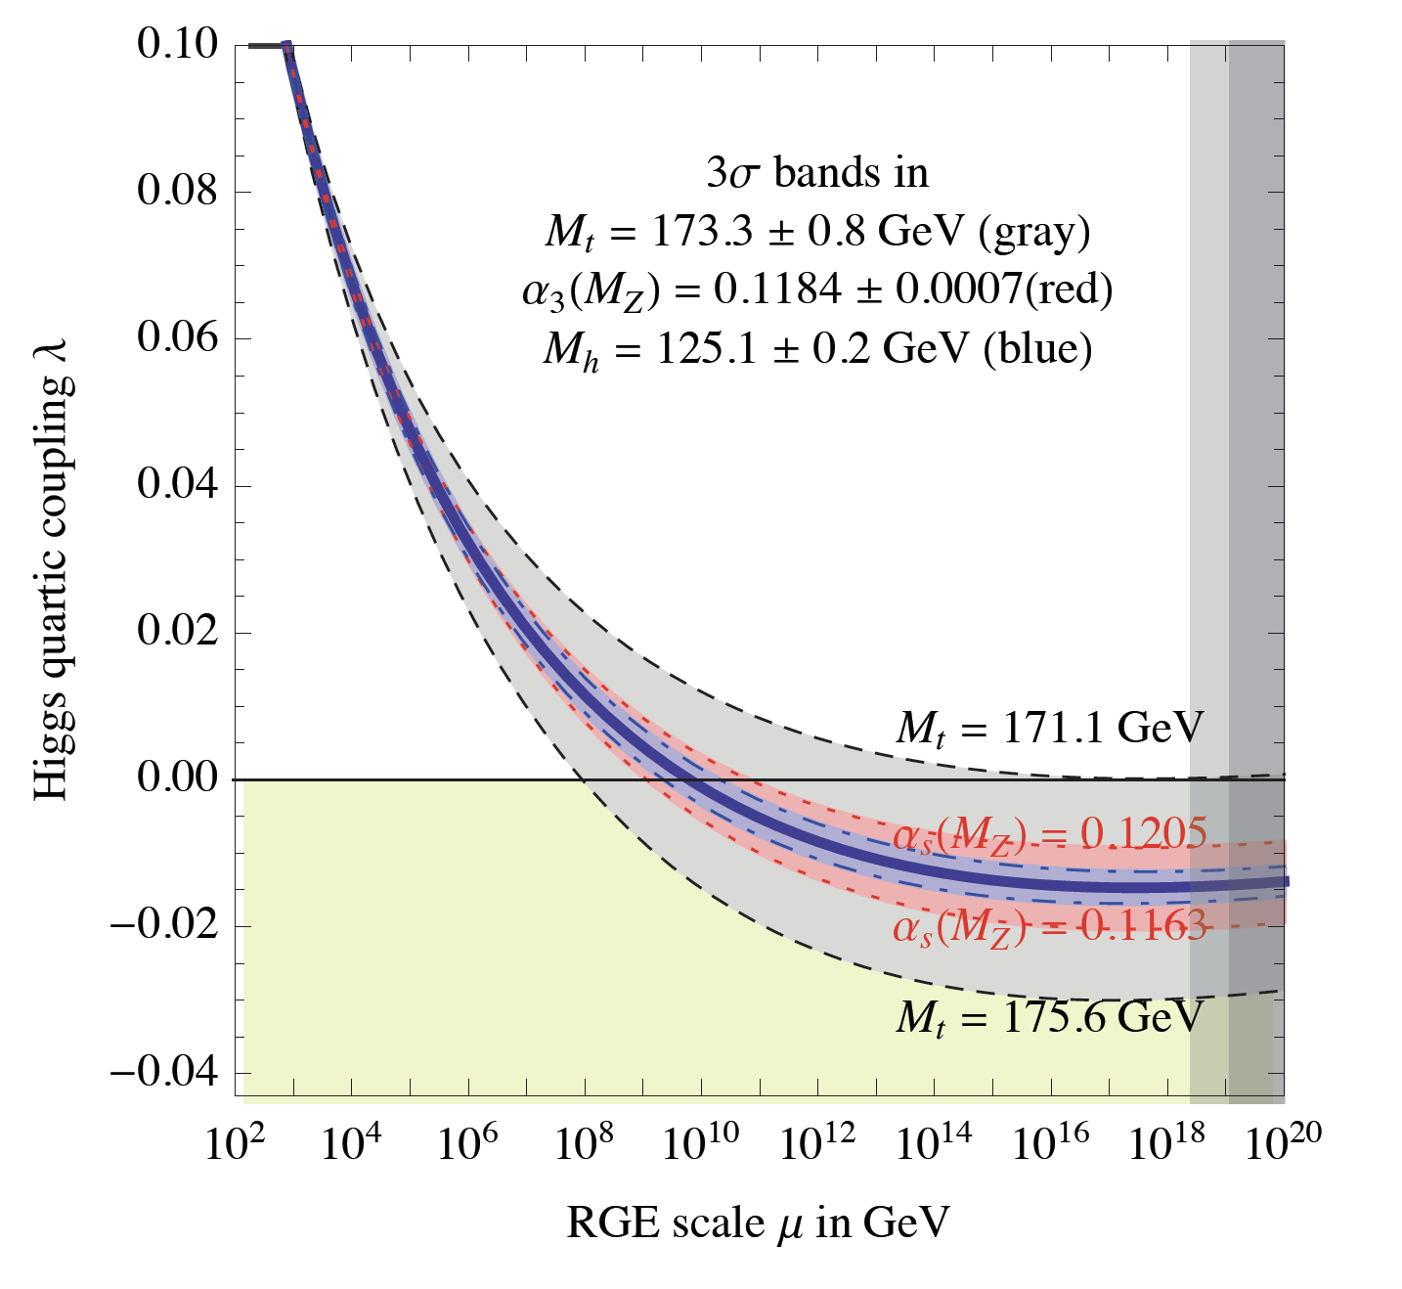
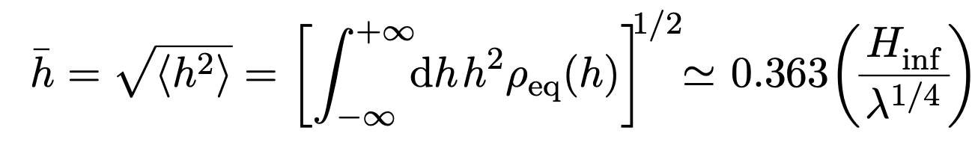
Higgs during inflation
During inflation(de-Sitter universe), Higgs also gets quantum fluctuations
If inflation lasts long enough, these fluctuations reach a equilibrium state
Different part of universe Higgs field takes different value
Alexei A. Starobinsky, Jun'ichi Yokoyama,
Phys.Rev.D 50 (1994) 6357-6368
D. Buttazzo, et al arXiv:1307.3536

Slide 14
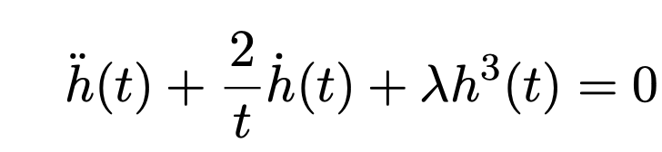
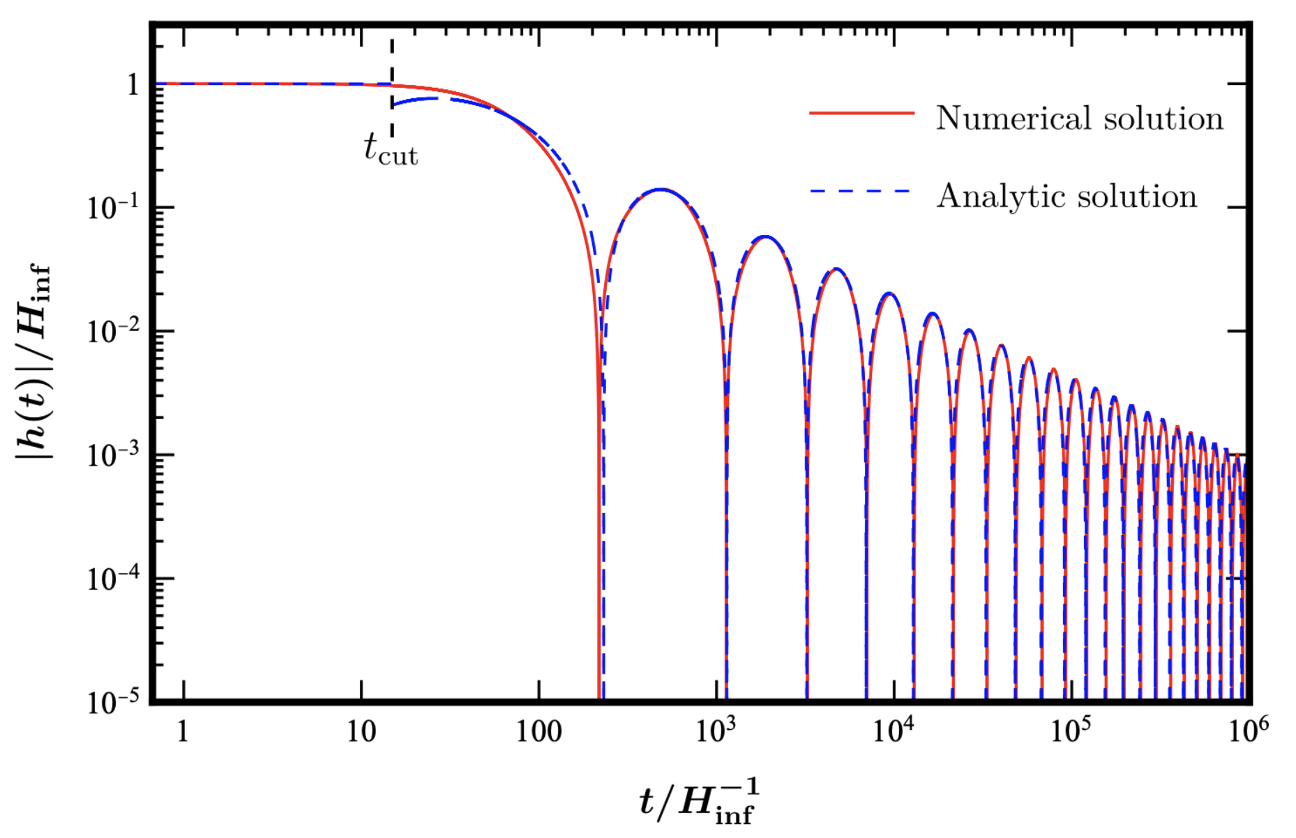
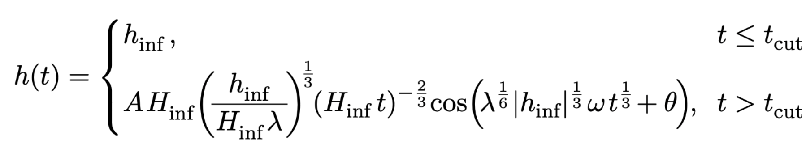
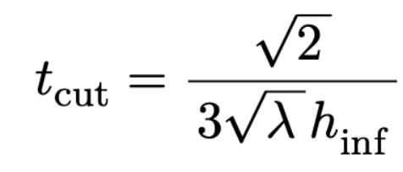
Higgs after inflation
Inflaton oscillates at the bottom potential. If the potential is dominated by the mass term, the Universe is matter-dominated

Slide 15
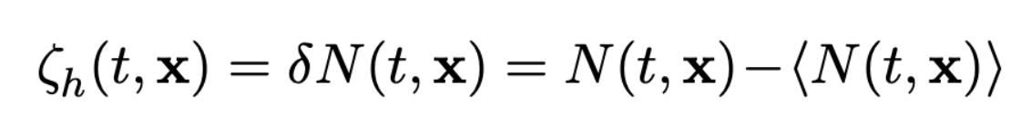
Higgs modulated reheating
Decay rate of the inflaton is h dependent
Gia Dvali, Andrei Gruzinov, Matias Zaldarriaga,
Phys.Rev. D69 (2004) 023505
Different patches of the universe reheat differently (modulated reheating)
The curvature perturbation is generated by Higgs field
Delta N formalism (from the end of inflation to the time after reheating completed)

Slide 16
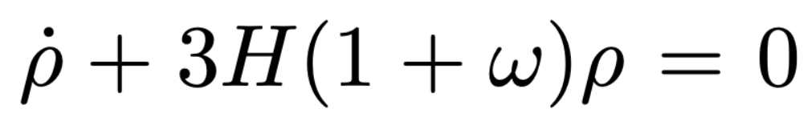
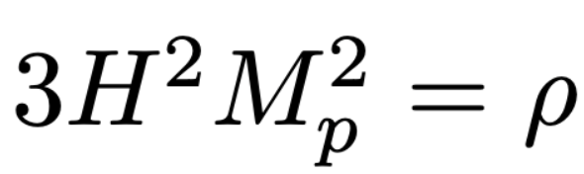
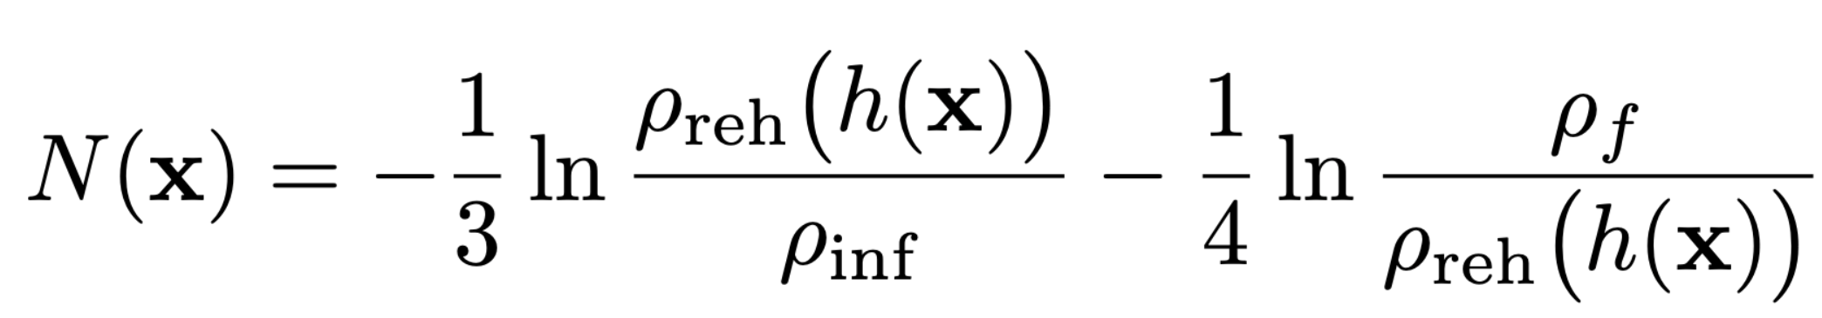
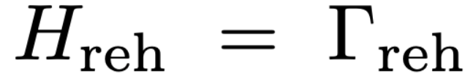
Higgs modulated reheating
Equation of state:
From matter-dominated universe to radiation dominated universe
Reheating occurs
Curvature perturbation in terms of the decay rate

Slide 17
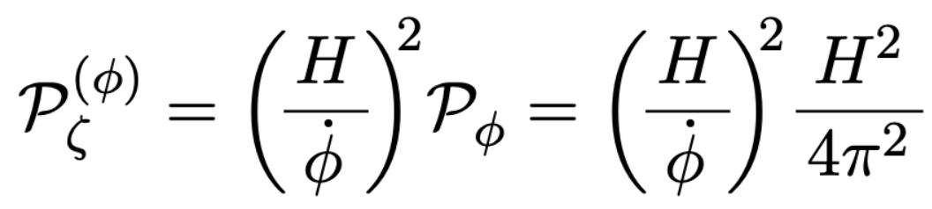
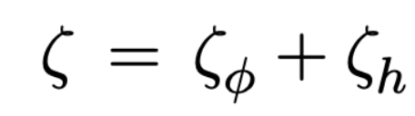
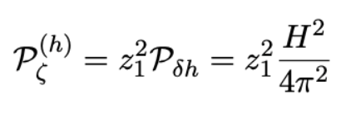
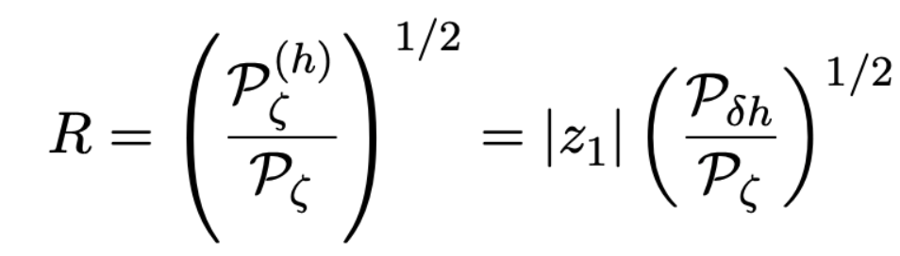
Higgs modulated reheating
Curvature perturbation contains two parts
Taylor expansion of the curvature perturbations
R should be less than 1

Slide 18
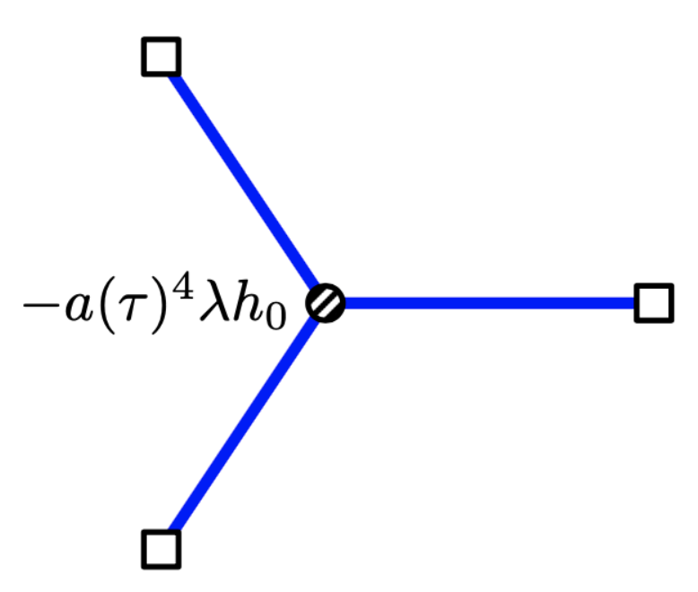
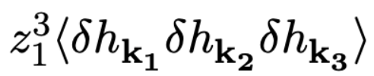
Bispectrum
Considering the three point correlation function
First term is from Higgs self-coupling
Calculated by in-in formalism/Schwinger-Keldysh formalism
Xingang Chen, Yi Wang, Zhong-Zhi Xianyu, JCAP 1712 (2017) 006

Slide 19
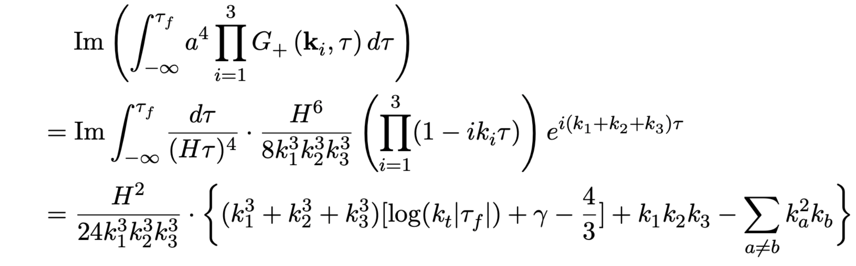
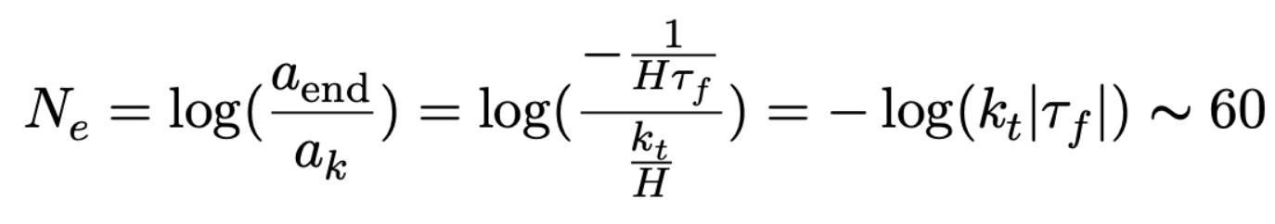
Bispectrum

Slide 20
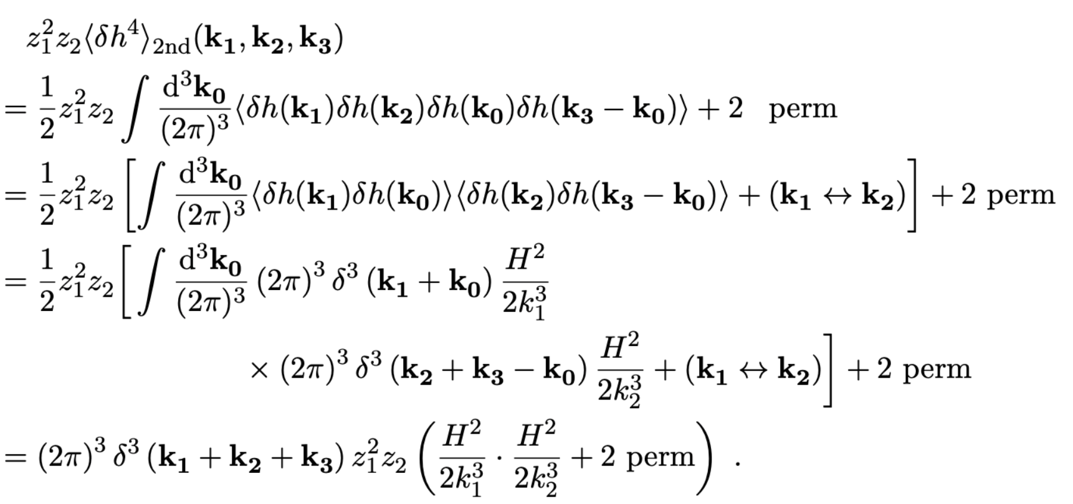
Bispectrum
Second term is from non-linear evolution of the Higgs

Slide 21
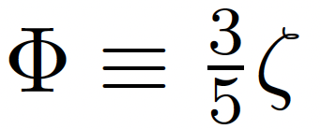
Local type non-gaussianity
The local type non-gaussianity which is defined by Bardeen Potential
In the limit k₁~k₂ >> k₃, we find

Slide 22
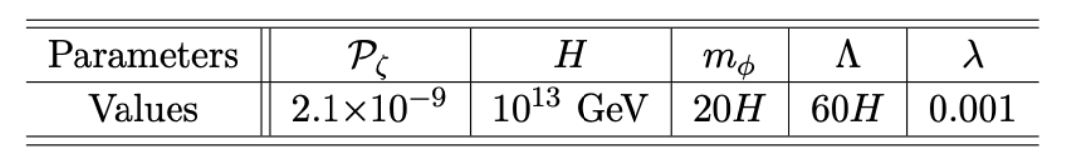
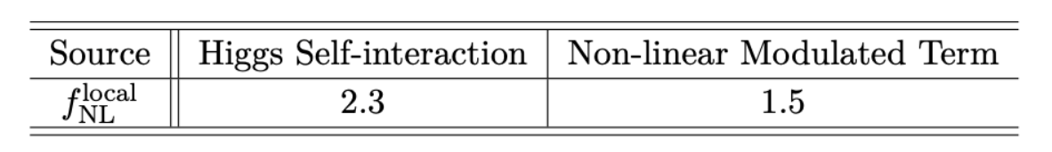
Local type non-gaussianity
R=0.1
Parameter space with Yukawa O(1) could be probed by future observations
The contribution from self-interaction and non-linear term are comparable
Interplaying with neutrino experiments

Slide 23
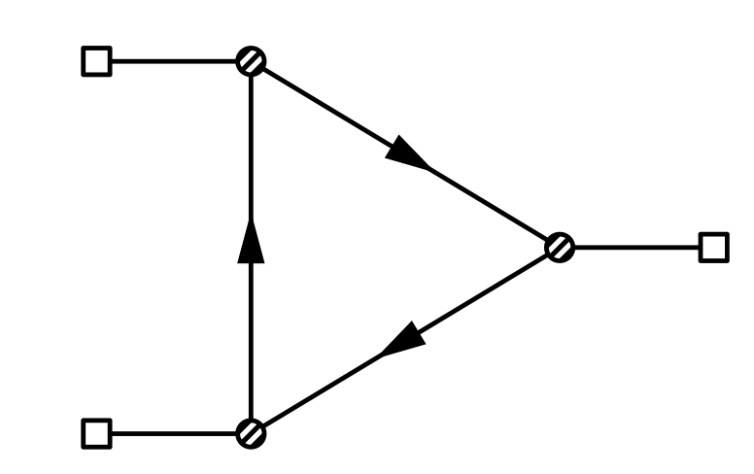
A cosmological Higgs collider
Any particles coupling to Higgs would induce cosmological collider signals ,
W，Z, top quark… (mass around H during inflation)
A (Natural) cosmological Higgs collider, signals need to be studied…

Slide 24
Summary
We propose a minimal model incorporating inflation and seesaw
The predicted local non-Gaussianity could be probed in near future CMB or large-scale structure observations
It also provides a framework of cosmological Higgs collider (particles coupling to Higgs boson could be detected)

Slide 25
Thanks!

Slide 26
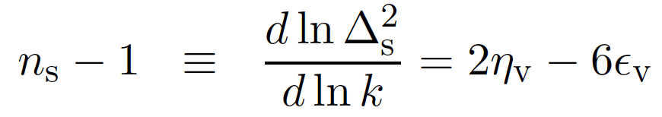
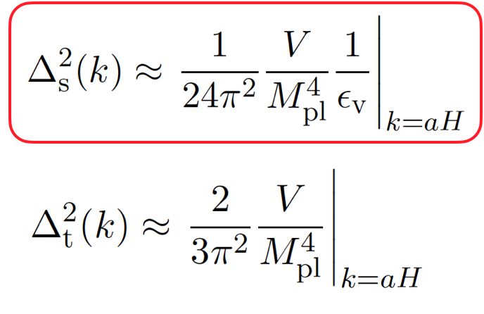

Slow-roll Inflation

Slide 27


Leptogenesis
Baryogenesis Without Grand Unification, Fukugita and Yanagida, 1986’
G.F. Giudice, et al,
Nucl.Phys.B 685 (2004) 89-149
Mass of the right-handed neutrino should heavier than 10⁷ GeV

Slide 28



S-K formalism

Slide 29





S-K formalism
Bulk-to-Boundary propagator

