Slide 1
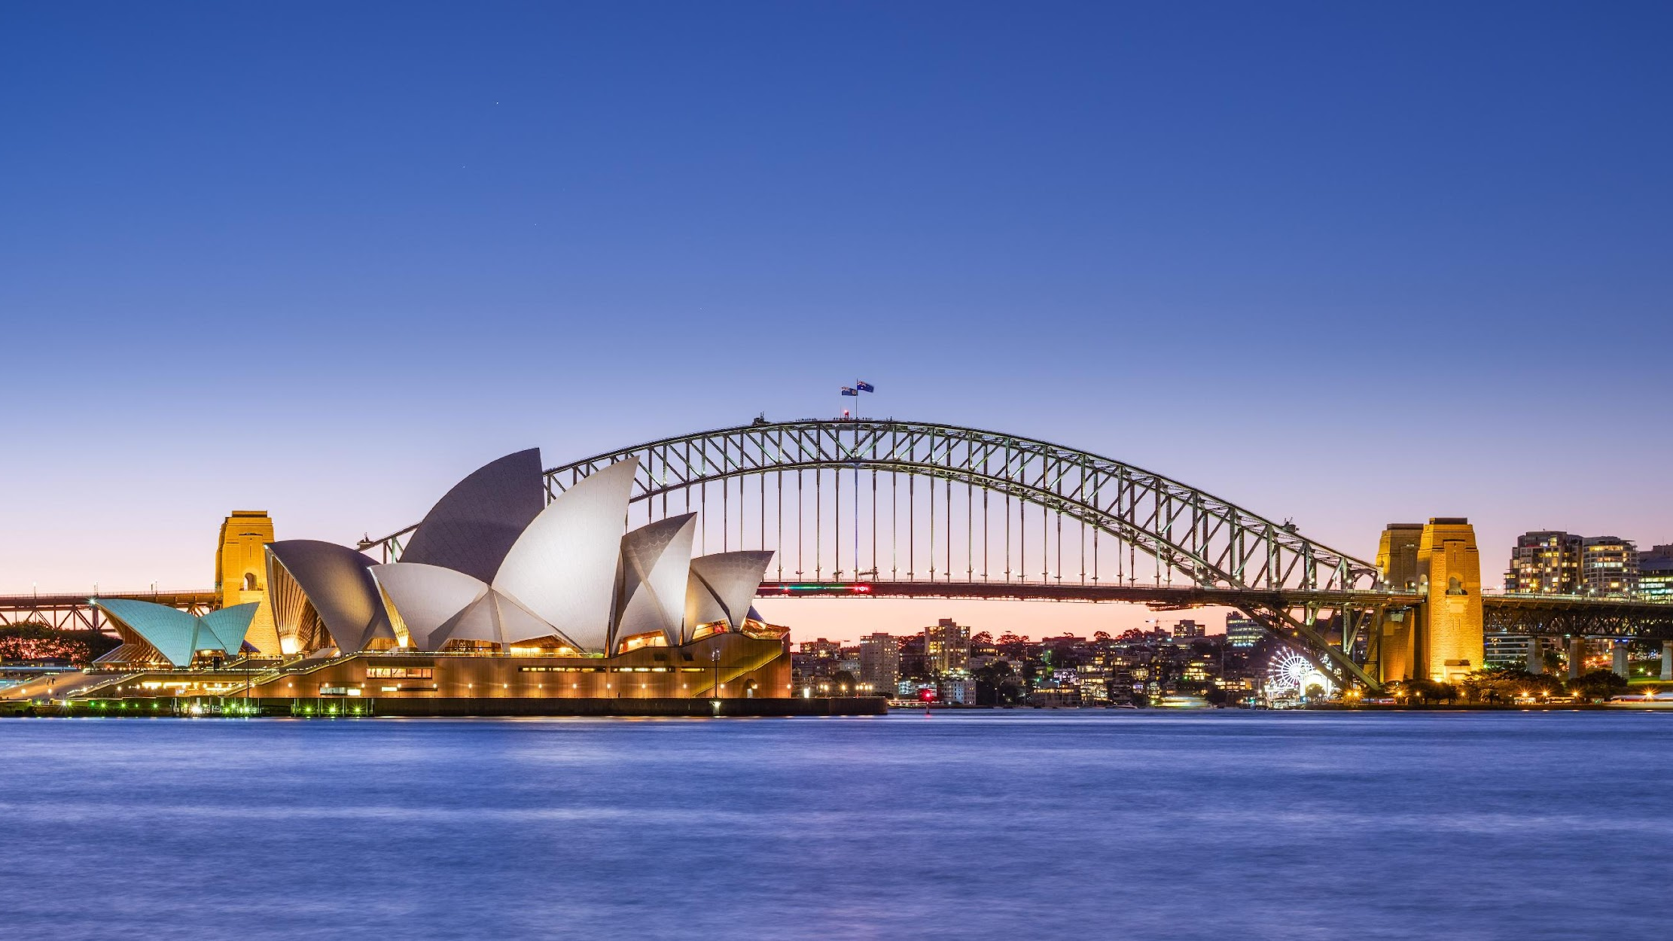
5th International Joint Workshop on the Standard Model and Beyond
3rd Gordon Godfrey Workshop on Astroparticle Physics
UNSW Sydney, December 9-13, 2024

Slide 2


Sponsors
We are grateful to the financial support of
School of Physics

Slide 3
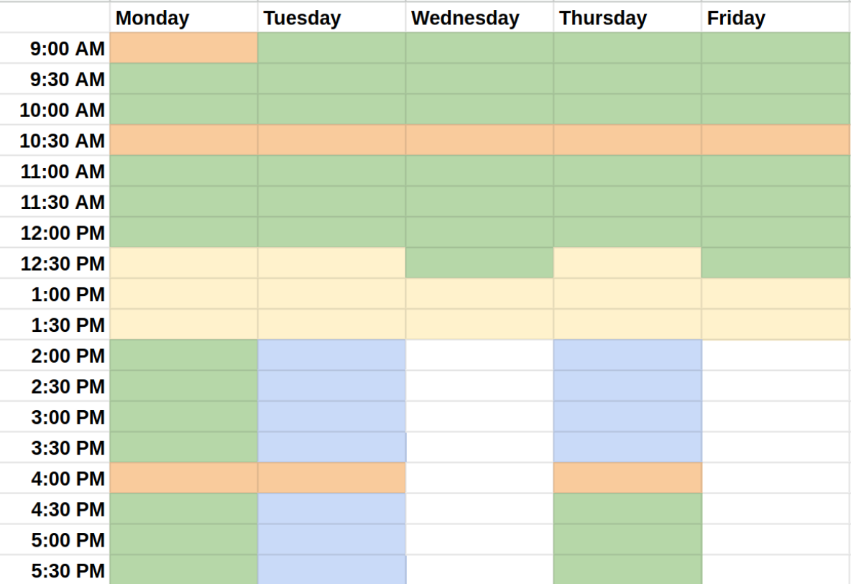
Scientific program
All sessions are in the
Ainsworth Building
All plenary sessions
are in G03
Parallel sessions are in
G02, G03, 102, 202
(just outside this room)
G01 is available for discussions.

Slide 4
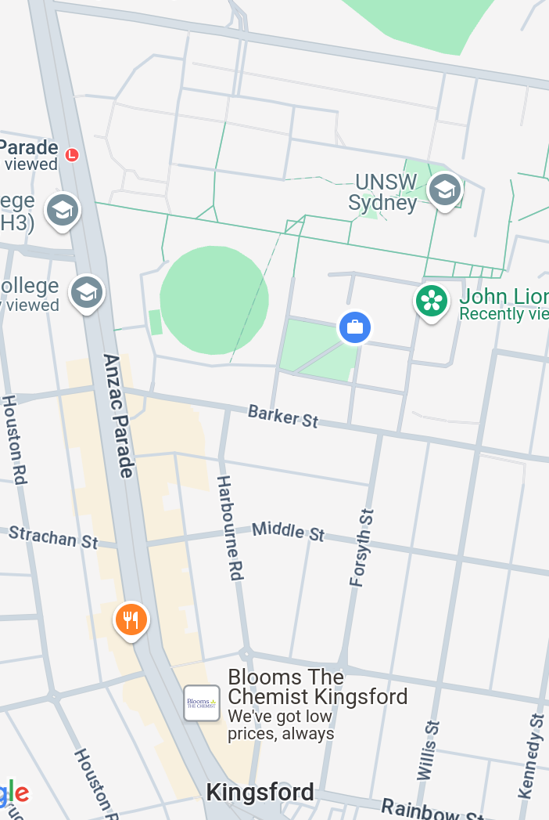
Coffee breaks are in Ainsworth foyer.
A selection of “standard” coffees are provided by Coffee on Campus.
Lunch breaks
Coffee on Campus
UNSW food court
Mostly Asian eateries on Anzac Parade
food court
IGA

Slide 5
WIFI access…
Eduroam is available for registered users.
UNSW Guest network.
  Choose “UNSW Guest” on your device.
  Follow the instructions to complete and activate your registration.

Slide 6
Instructions for speakers…
Please upload and make public slides to Indico by
  08:00 on day of presentation (plenary)
  13:00 on day of presentation (parallel)
If you can’t upload, email to m.schmidt@unsw.edu.au by the indicated time; we’ll upload for you.
Preferred format is PDF. If you choose to use a non-PDF format, please always submit a PDF as well as a backup.
Let us know well in advance if you wish to use your own computer.

Slide 7
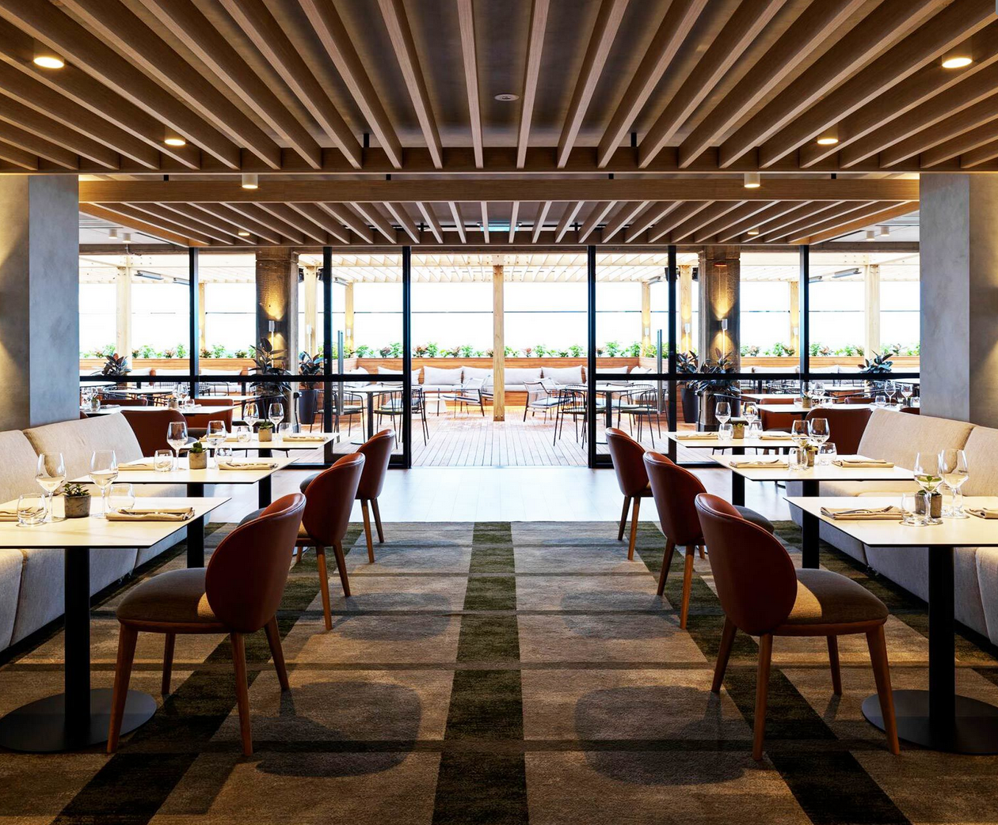
Social events…
Reception:
Today after the last session in the Ainsworth foyer and John Lion’s garden in front of Ainsworth depending on weather.
Conference dinner:
Thursday from 18:30 at The Lounge,
level 11 of the library building

Slide 8
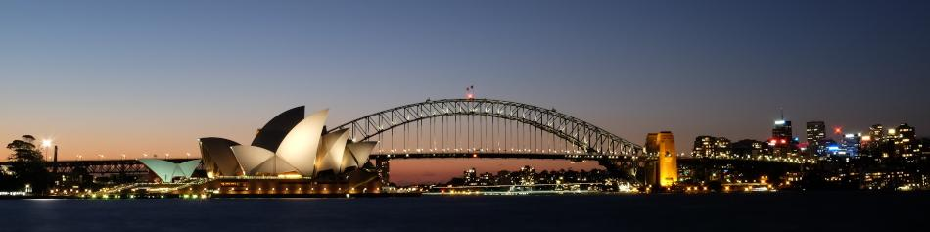
Enjoy the conference
and your stay in Sydney!

