Slide 1

Going back to move forward
Beyond the Standard Model with geometric quantization
Tom McClain
Washington and Lee University
International Joint Workshop on the Standard Model and Beyond 2024
UNSW Sydney, 10 December 2024

Slide 2
Synopsis
General relativity cannot be quantized with canonical or path integral methods
Neither can anything else!
Can we build a better “machine” to quantize classical fields?
Maybe! If so, GR may quantize without issue
Guiding idea: geometry leads the way

Slide 3
Outline
Review (?) of Hamiltonian particle theory
Geometric quantization: a “better” way to quantize particle theories
Geometric quantization for classical fields?
Polysymplectic (Hamiltonian) field theory
Geometric quantization for classical fields! (Sort of.)
Directions for future research

Slide 4


Hamiltonian particle theory
Configuration space $Q$(space; $x^{i}$)
Phase space $T^{∗}Q$(space + momentum; $x^{i},p_{i}$)
Tautological one-form $θ=p_{i}{dq}^{i}$
Symplectic form $ω=dθ=$ ${dp}_{i}{∧dq}^{i}$
Poisson structure ${Π=ω}^{−1}=$ $−$ $\frac{∂}{∂q^{i}}∧\frac{∂}{∂p_{i}}$
Physically realizable trajectories $γ=x^{i}\left(t\right),p_{i}\left(t\right)$ must satisfy Hamilton’s equations $Tγ=Π(dH,−)$
Note: Time dependence is brought in “after-the-fact”

Slide 5


Hamiltonian particle theory highlights
Equivalent to Newton’s laws/Euler Lagrange-equations
Coordinate independent
Tautological one-form $θ$, Poisson structure $Π$: ingredients for geometric quantization!

Slide 6
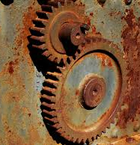


Geometric quantization
Canonical quantization: $x^{i},p_{i}↦x^{i}\text{,}\text{−}iℏ\frac{∂}{∂x^{i}}$
Geometric quantization: $f↦f+Π$(df, $θ$) $+$ $iℏ$ $Π$(df, $−$)

Slide 7
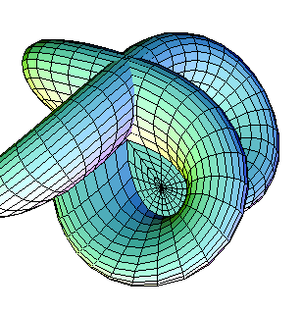
Geometric quantization highlights
Coordinate invariant
Works for all possible configuration spaces (e.g., 2-sphere)
Traditionally has a hard time handling quadratic-in-momentum Hamiltonians (can be fixed; TM, in progress)

Slide 8

Geometric quantization for classical fields?
Hamiltonian field theory singles out time for special treatment
Treats instantaneous field configurations rather than coordinate functions
No tautological one-form
Poisson bracket is variational
Makes geometric quantization very difficult to reproduce

Slide 9

Introducing polysymplectic field theory
Pioneered by Christian Gunther in the 1980s
Incorporates the parameter space (spacetime) from the beginning
Natural tautological (vector-valued) one-form
Natural Poisson structure (one-form valued)
Only worked for flat spacetimes (fixed; TM 2021)

Slide 10
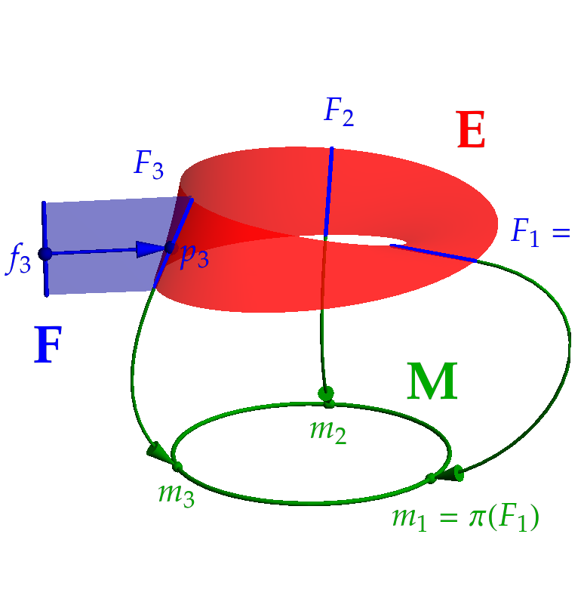

Polysymplectic field theory
Spacetime $M$;${ x}^{i}$
Extended configuration space $E→M;{ x}^{μ}$, $φ^{I}$
Extended phase space $P=V^{∗}E⨂TM; { x}^{μ}$, $φ^{I}$, $π_{I}^{μ}$
Tautological one-form $θ=$ $π_{I}^{μ}$ d$φ^{I}⨂\frac{∂}{∂x^{μ}}$
Polysymplectic form $ω=$ d$π_{I}^{μ}$ $∧$ d$φ^{I}⨂\frac{∂}{∂x^{μ}}$
Poisson structure $Π =$ $−\frac{∂}{∂φ^{I}}∧\frac{∂}{∂π_{I}^{μ}}$ $⨂dx^{μ}$
Physically realizable fields $γ=φ^{I}\left(x^{μ}\right),π_{I}^{μ}\left(x^{μ}\right)$ must satisfy Hamilton’s field equations $Π$($dH,−,−)=$ T$γ−Tγ_{0}$

Slide 11

Polysymplectic field theory highlights
Fully covariant
Incorporates spacetime from the beginning without space-time splitting
Natural tautological one-form and Poisson structure: the right ingredients for geometric quantization!

Slide 12
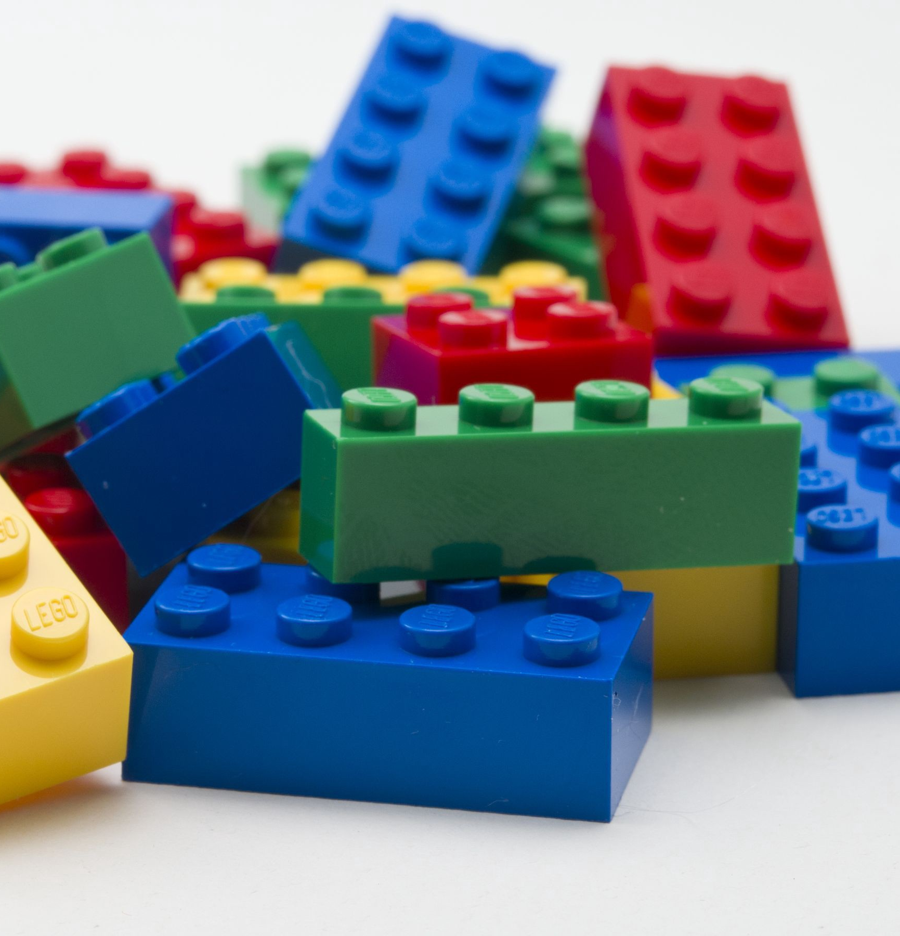

Geometric quantization for polysymplectic fields I
Quantization map (TM, 2024):
$f↦f+Π$($α(θ$), df, v) $+$ $κ Π$($−$, df, v)
New ingredients: vector field v, one-form $α, α(v)=1$
Dimensional considerations: $κ=\frac{iℏc}{V_{4}}$
Resulting operators for scalar field theory:
$φ↦φ$, $π^{i}↦$ $π^{i}$, $π^{0}$ $↦$ $−$ $\frac{iℏc}{V_{3}}\frac{∂}{∂φ}$

Slide 13


Geometric quantization for polysymplectic fields II
Where is the physics?!
Where is the space-time dependence?!
Total momentum operators for scalar field theory:
$P^{i}↦$ ${− iℏπ}^{i}\frac{∂}{∂φ}$
Naturally act on extended phase space “meta-state” $Ψ(x^{μ}$, $φ$, $π^{i}$)
Pullback by classical (complex) KG solution section
$γ\left(x^{μ}\right)=Ae^{ig_{μν}k^{μ}x^{ν}}$ to get Q($P^{i})$($Ψ$) = $ℏk^{i}γ{ γ}^{∗}(\frac{∂Ψ}{∂φ})$

Slide 14


Geometric quantization for polysymplectic fields III
Eigenvalue equation?
Yes! When $Ψ∝ e^{\frac{φ\overline{φ}}{{\left|A\right|}^{2}}}$
And the same process works for the total energy operator with massless fields!

Slide 15

Geometric quantization for polysymplectic fields highlights
Fully covariant
No need for renormalization
No obvious “red flags” to prevent it from working with GR!

Slide 16
Future work
Better understand the physical meaning of the meta-states
Energy eigenstates for massive particles (TM, in progress)
Spin ½ particles
Spin 1 particles
GR?

Slide 17
Conclusions
Geometric quantization of classical fields is hard, but can be done for free scalar fields
The resulting quantum field theory looks quite different from canonical QFT, with some tantalizing benefits
Future work will tell if we really can move forward by going back

