Slide 1







WG 7-1
Data density and power efficiency
S. Michelis on behalf of WG7.1.b collaboration:
M. Karagounis, FH-Dortmund, Germany
K. Klein, L. Feld RWTH Aachen, Germany
A. Michalowska-Forsyth, TU Graz, Austria
S. Saggini, UNIUD University of Udine, Italy
F. Arteche, Itainnova, Spain
S. Michelis, G. Ripamonti CERN, Switzerland
M.Lazzaroni and A. Andreazza, UNIMI University of Milan+INFN

Slide 2
WP 7.1b: power efficiency
Next-generation, large-area, high-granularity particle detectors consume significantly more power at reduced voltages compared to current systems.
This project aims to improve power efficiency of detector systems at reduced material budget.
For this purpose, two powering options will be investigated:
The project is a joint effort of experts in power electronics, IC and PCB design, thermal management, EMC, reliability and particle detector systems.
Parallel
Powering (DCDC)
Serial
Powering
Contribution from:
CERN
FH Dortmund
RWTH Aachen
TU Graz
UNIUD
UNIMI+INFN
Contribution from:
FH Dortmund
ITAINNOVA
UNIMI+INFN

Slide 3
Available and requested funds
 | Granted Funds |  | Requested funds
Institute | FTE / Monetary funds | Funds granted by | FTE / Monetary funds | note
CERN | 2.5 / 270kCHF (over 5 years) | Granted by CERN EP-RD WP2 and EP-RD WP5.4
FH Dortmund | 1.33 / 110 kCHF (over 3 years) | BMBF as part of two projects (05H21PRCA9 & 05H21PRRD1) | 1 | Submitted to transnational funding agencies.
ITAINNOVA | 1.5 /100 kCHF (over 3 years) | GanCAP4CMS, PC Fisica-MMR and AIDAinnova
RWTH Aachen | 0.4 |  | 0.67 / 35 kCHF | Submitted to the BMBF on June 30th 2023
TU Graz | 0.33 |  | 1 / 50 kCHF | Submitted the Austrian Science Fund FWF
UNIUD | 0.7 |  | 1 | Request will be done to INFN if DRD approved
INFN and UNIMI | 0.5 |  | 0.5 | Request will be done to INFN if DRD approved

Slide 4
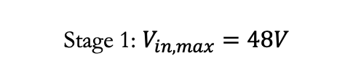
WP 7.1b: parallel power (DCDC)
Stage 1: $V_{in,max}=48V$
Stage 2: Smart powering in front-end ASICs
Gen2 GaN-based 48V DC-DC
Input, output voltage and load current range are being defined
1.2V
1.8V and/or 5V
Stage 2
On-chip stage +line regulators
0.9V
0.8V
Front-end ASIC /
Optical link /
Concentrators etc.
28nm ASIC
Stage 1 based on HV CMOS technology and GaN power stage
Stage 2 is a fully integrated solution with all components inside the 28nm ASIC

Slide 5
WP 7.1b: parallel power (DCDC)
Stage 1: $V_{in,max}=48V$
Stage2: Smart power in front-end ASICs
Gen2 GaN-based 48V DC-DC
Input, output voltage and load current range are being defined
iPOL5V
resonant
DCDC-Converter
5V
1-1.2V
LDO
LDO
LDO
0.9V
1V
0.8V
1.8V
28nm ASIC
3 level buck
DCDC-converter
0.9V
Developed by:
CERN + UNIUD
TU Graz
FH Dortmund
Front-end ASIC /
Optical link /
Concentrators etc.

Slide 6
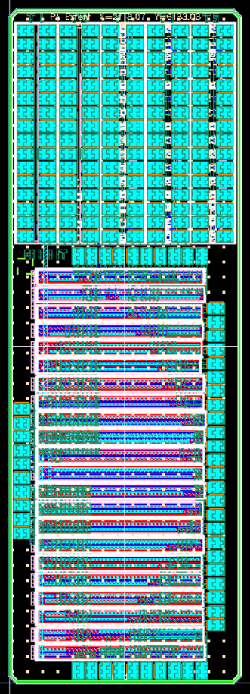
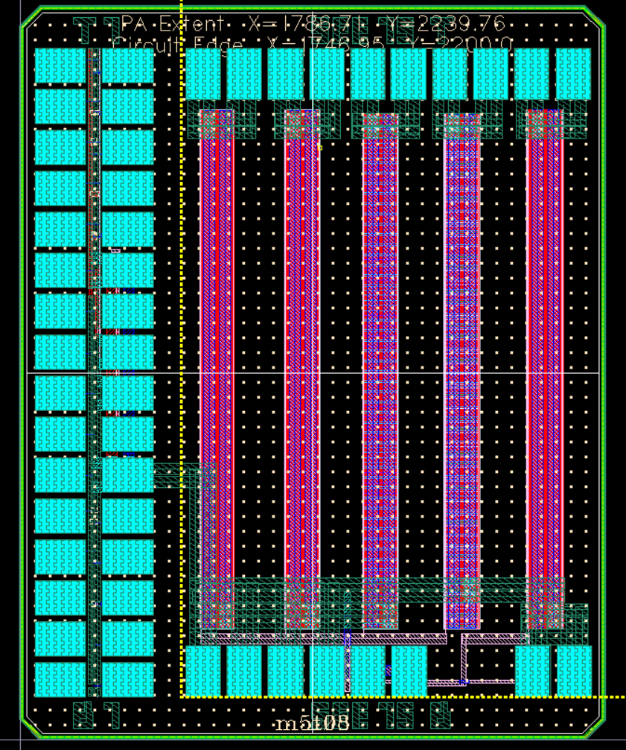
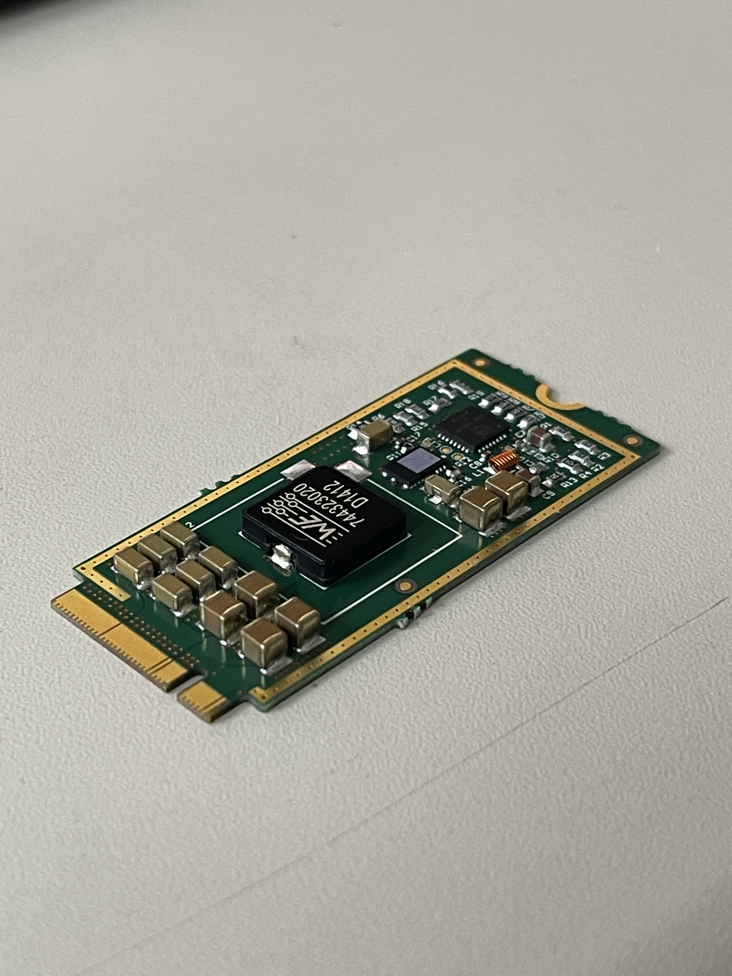
Stage1: high voltage technologies and 48V DCDC
  We need to find suitable technologies (both High Voltage CMOS and GaN) which are available in long term
  HV CMOS technology must be found:
  The radiation characterization of the OnSemi I4T is being finalized. (Test chips
  designed in 2020).
  As an alternative solution, the ST 0.16 BCD SOI will be tested.
  Future HV technologies must be tested
  GaN
  Survey of commercial components (EPC, Infineon, ST, GaN System)
  Test of accessible GaN process for radiation (IMEC GaN technology)
  Low mass, high efficiency and high conversion ratio DCDC converter are in development
  Example bPOL48V from 48V to 5V
OnSemi I4T test chips
5cmx2.5cmx3mm 48Vto5V 6A 85% eff

Slide 7
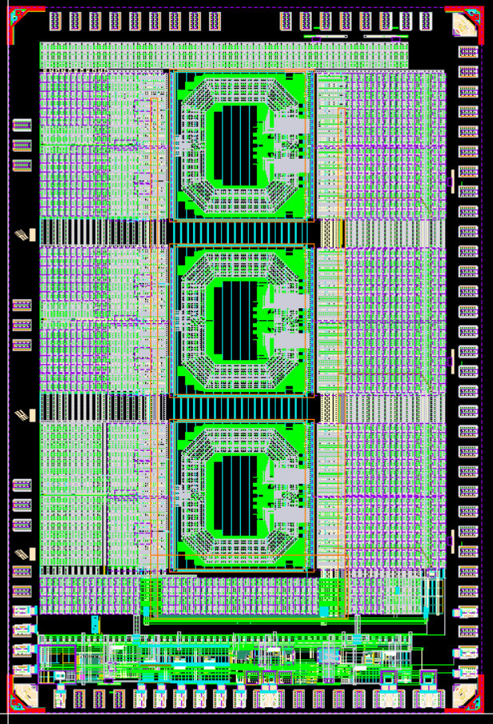
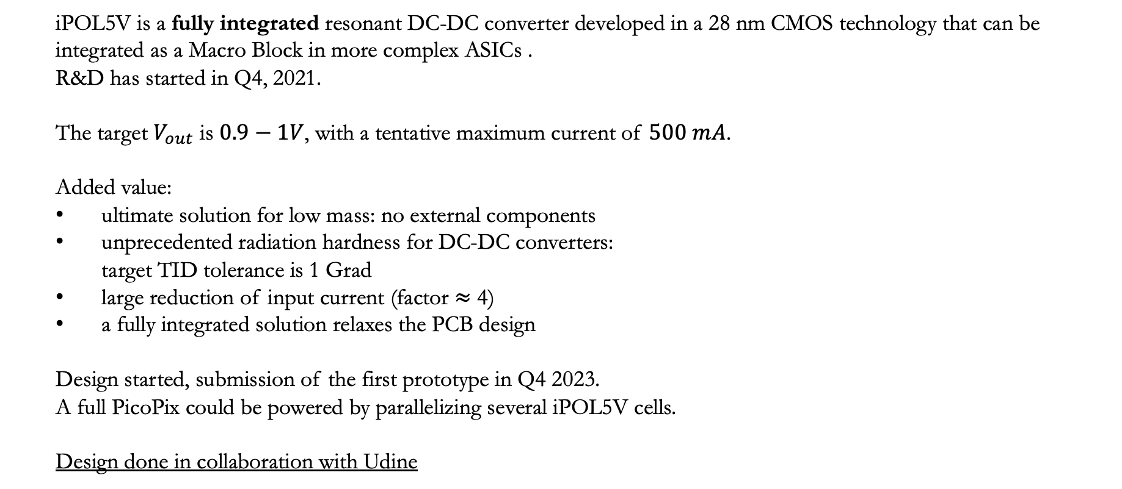
Stage2 iPOL5V: 5V-input resonant DC-DC converter
  iPOL5V is a fully integrated resonant DC-DC converter developed in a 28 nm CMOS technology that can be integrated as a Macro Block in more complex ASICs .
  R&D has started in Q4, 2021.
  The target $V_{out}$ is $0.9−1V$, with a tentative maximum current of $500 mA$.
  Added value:
  ultimate solution for low mass: no external components
  unprecedented radiation hardness for DC-DC converters:
    target TID tolerance is 1 Grad
  large reduction of input current (factor $≈$ 4)
  a fully integrated solution relaxes the PCB design
  Design started, submission of the first prototype in Q4 2023.
  A full PicoPix could be powered by parallelizing several iPOL5V cells.
  Design done in collaboration with Udine
3.2 x 2.1 mm

Slide 8
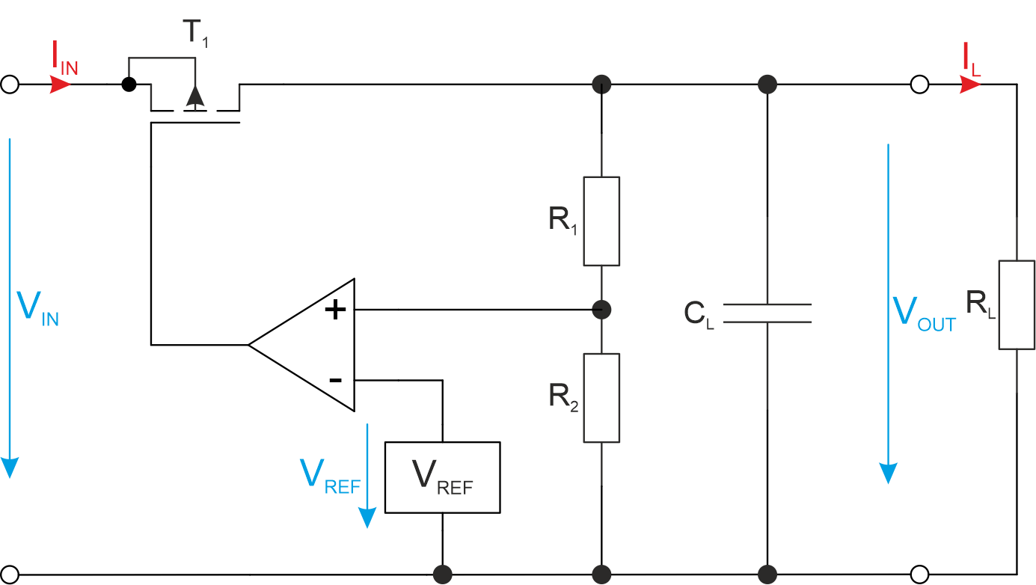
Stage2 : LDO low drop-out linear regulator
  A fully integrated linear regulator (capless) is under design in TU Graz with these specifications
    Input Voltage V_{IN} = 0.9V – 1.2V
    Output Current I_{L} =150mA
    PSRR >10dB @ 1Hz < f_{ripple} < 1GHz)
    Minimum Drop Voltage V_{drop,min} = 50mV
    Max. TID 1 Grad
    Mainly using core transistors
  First prototype Q4 2023

Slide 9
Stage2 3-Level FCML DC-DC converter
Advantages:
  High power density because of better utilization of passive components
  Multimode operation (resonant, quasi resonant, inductive) Enables soft switching which reduces switching losses and device stress
  Smaller output voltage ripple compared to a conventional (2 level) buck converter
Challenges:
  Reliable startup is necessary to precharge the flying capacitor(s) and ensure that the switches operate within their voltage limits until steady state is reached
  Voltage imbalance across flying capacitors due to various disturbances (input impedance, switching delays in driver network) Requires additional circuitry to maintain voltage balance
Cfly stores Vin/2 (Gate driver necessary)
For D < 0.5:Vx switches between Vin/2 and GND)
For D > 0.5:Vx switches between Vin and Vin/2
4 Switching Phases
Resonant mode possible

Slide 10
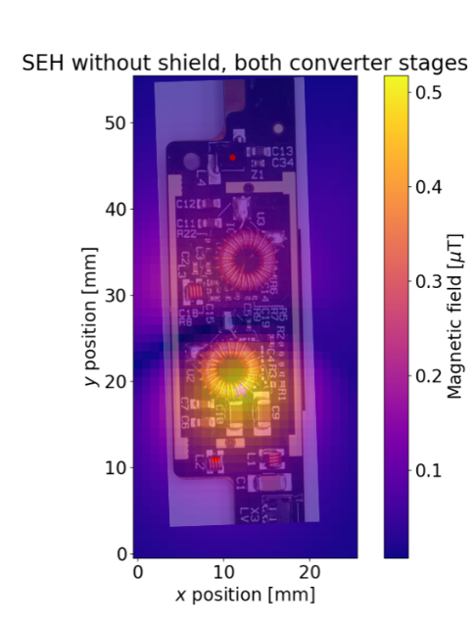
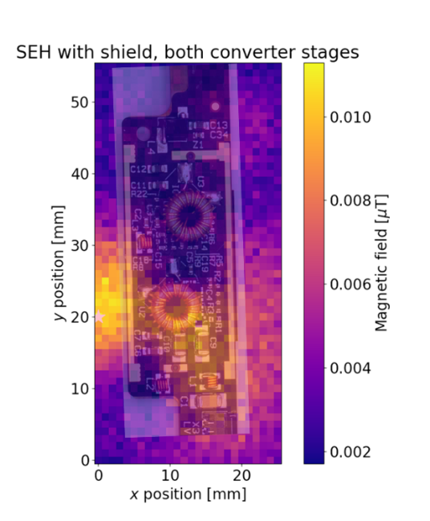
Testing of the DCDC converter
Objective is the characterization of novel DC-DC converters, both standalone and in-system
    Efficiency, line and load regulation (RWTH)
    conducted and radiated noise, thermal aspects, module noise performance (RWTH)
    Radiation testing (TU Graz)
    electromagnetic compatibility testing (immunity - EMI and emissions - EME) at PCB and IC level (TU Graz)
    Reliability and aging testing (TU Graz)
Example:
Radiated noise without (left)
and with (right) shield –
reduction by factor 50
Example:
Common Mode output noise spectrum
of a prototype hybrid without shield

Slide 11
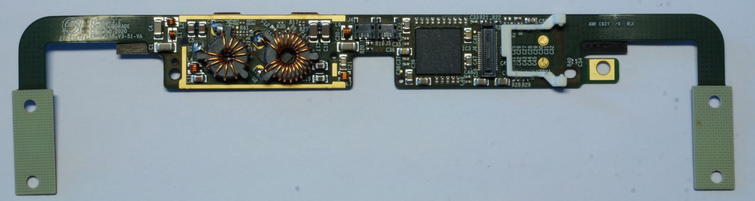
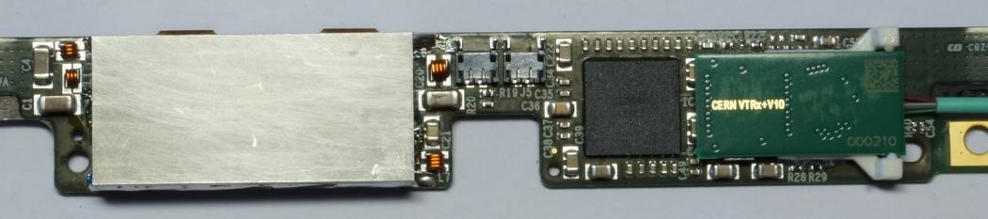
Plans of RWTH Aachen University
Tentative workplan:
  Using the bPOL48V DC-DC converter:
    Step 1: Characterization of the CERN bPOL48V board, standalone and with a CMS module (replacing the bPOL12V)
    Step 2: Development of a small, lightweight optimized board that can be integrated into the CMS module
    Step 3: Integration of the bPOL48V directly into the CMS tracker hybrids
  Characterization of an on-chip DC-DC converter, designed by Fachhochschule Dortmund
bPOL12V and bPOL2V5
El.-magn. shield
CMS Phase-2 strip module featuring a 2-step DC-DC scheme

Slide 12
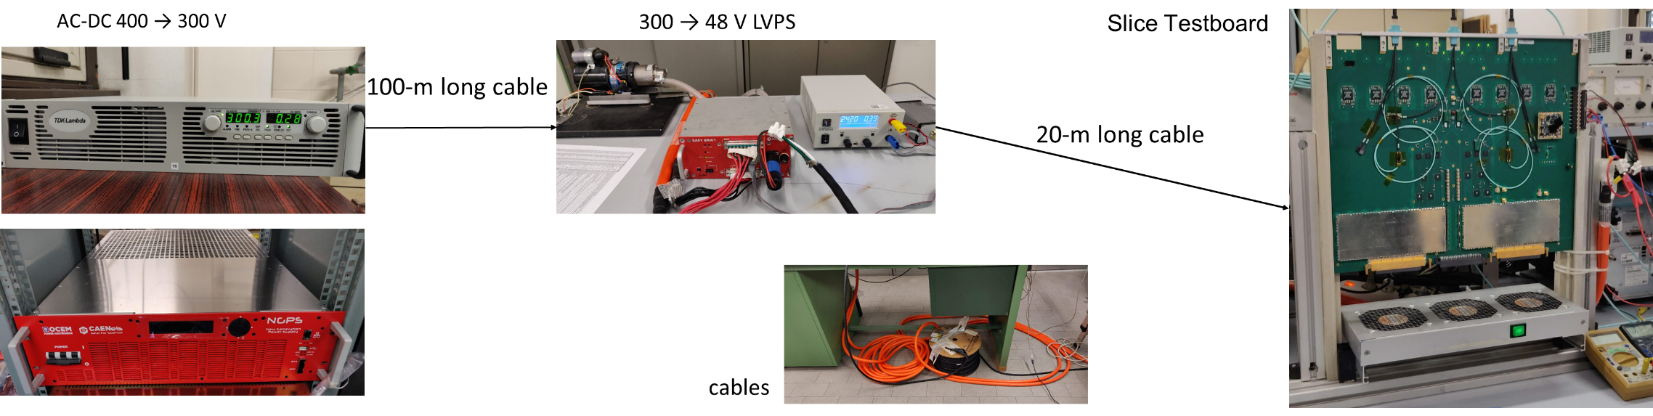
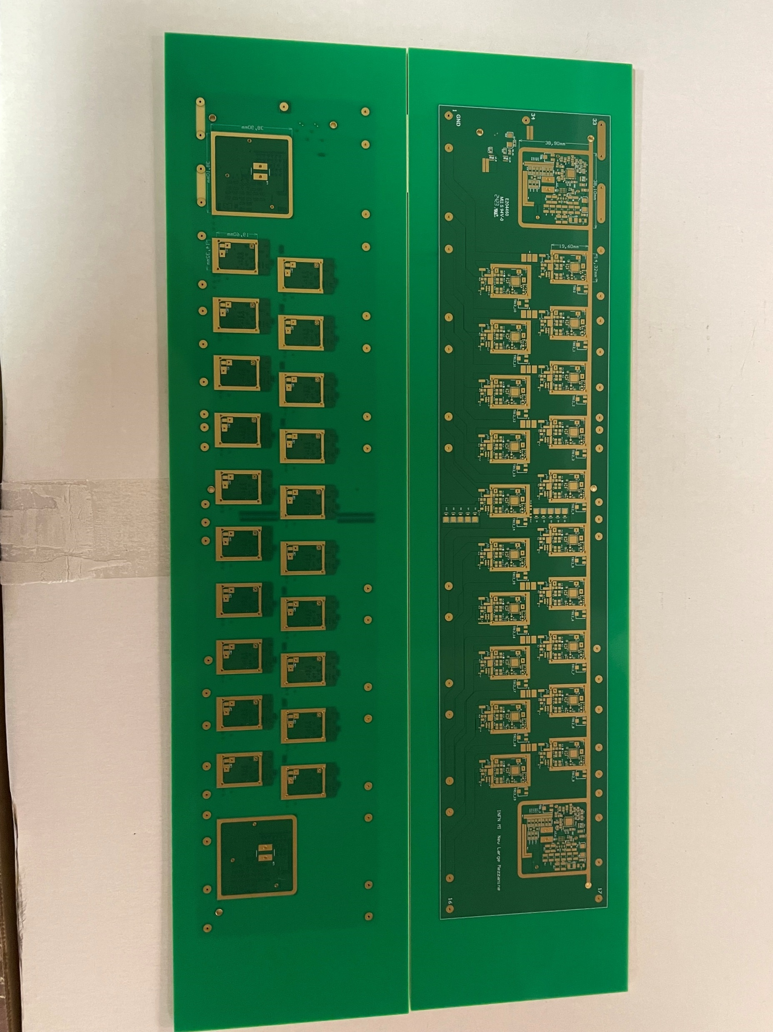
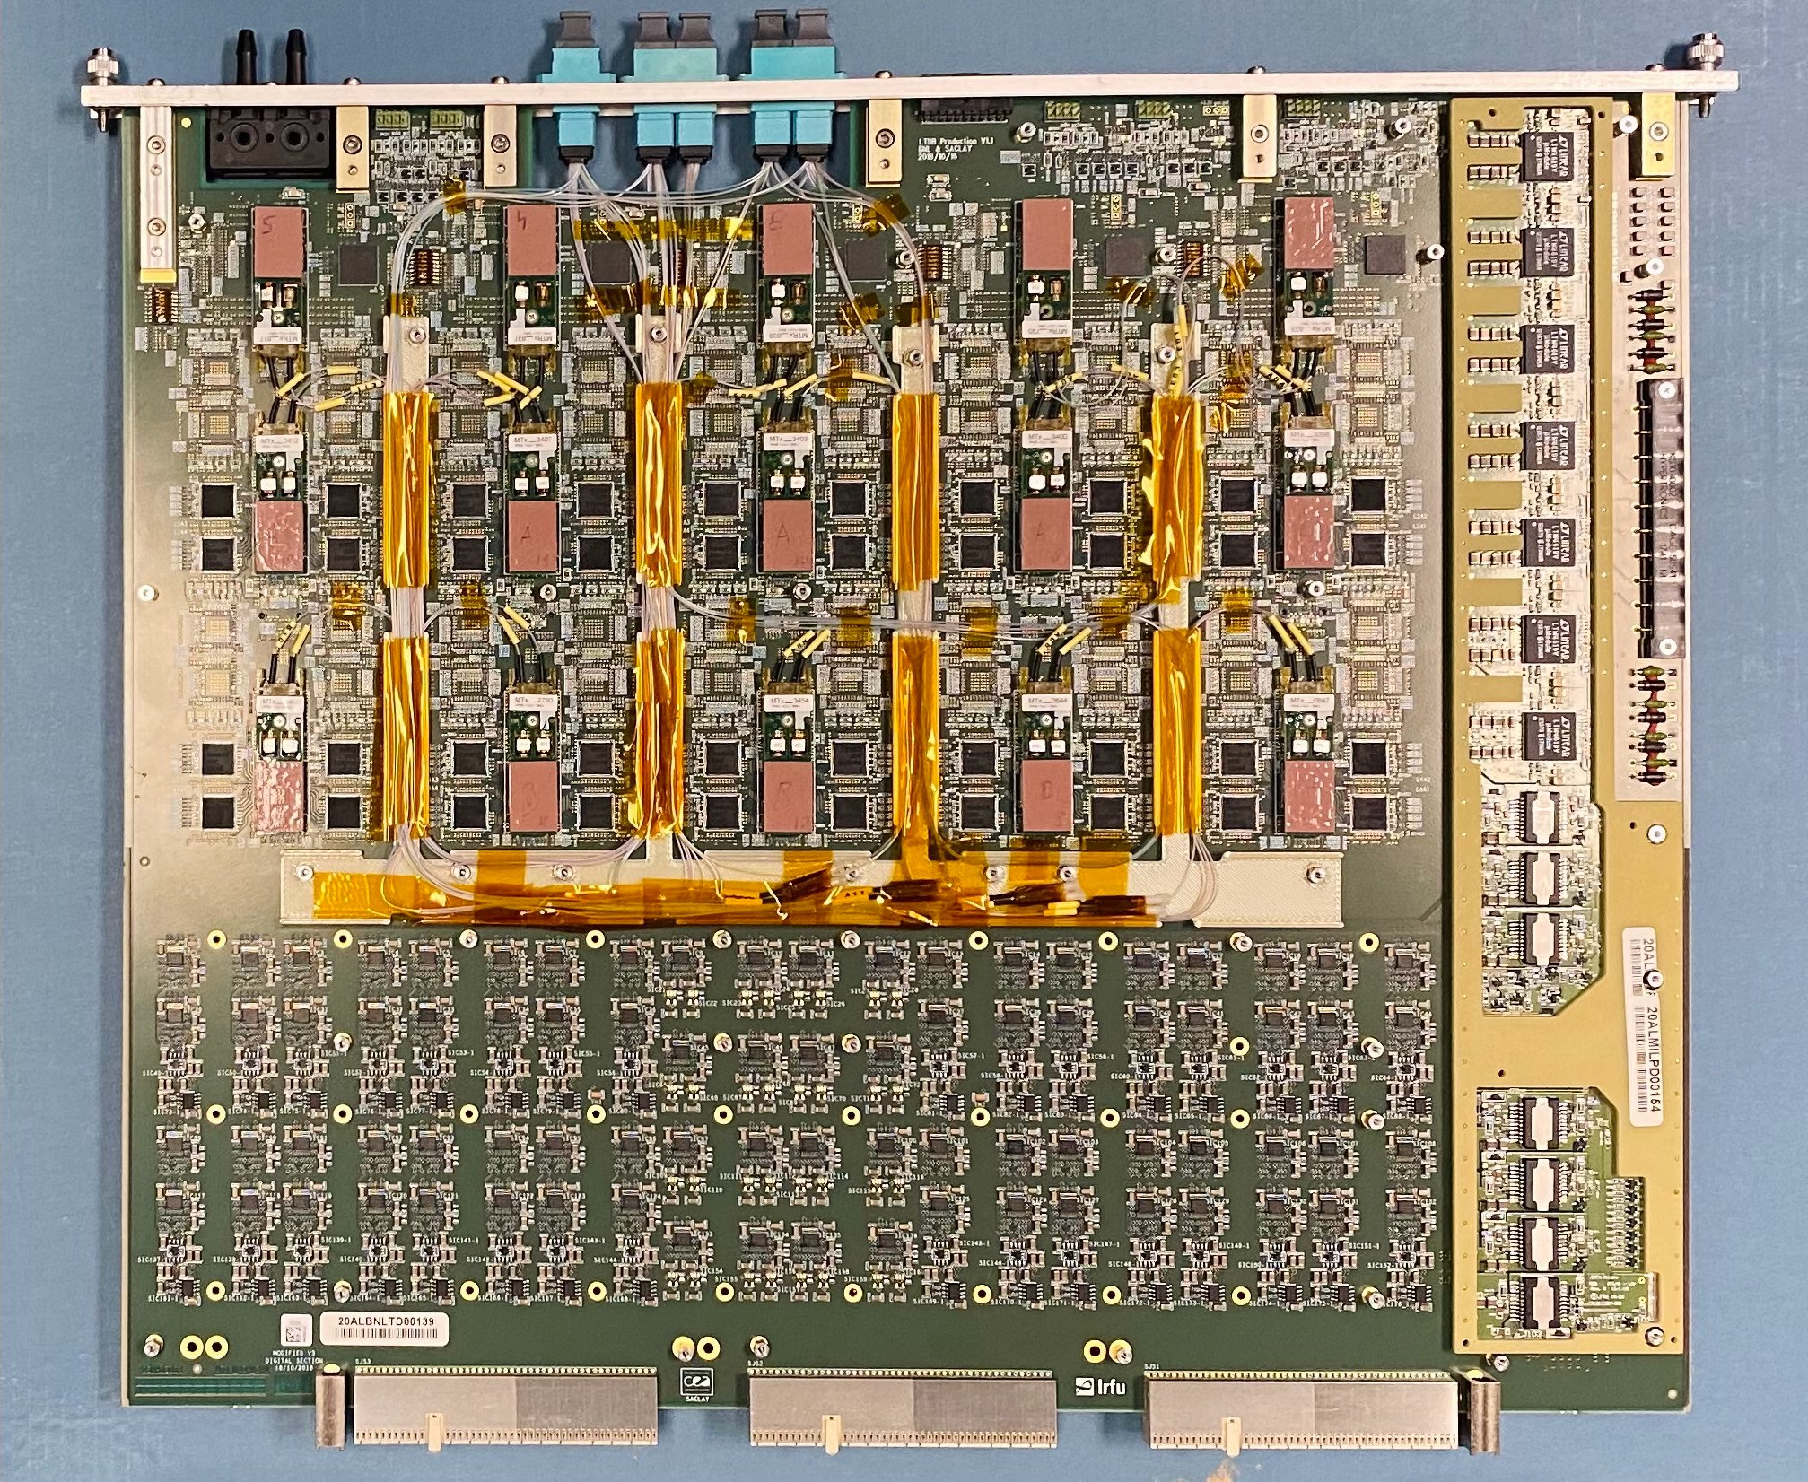
Plans of UNIMI and INFN Milan
Activity on Power Distribution Systems from ~300V to 24 – 48V with MainConverters
Final/local DC-DC conversion 24 – 48 V → 1 – 5 V with DC-DC and PoL (solutions using CERN devices and commercial devices)
Issues:
  Mechanical: Devices integrated on-board or Mezzanine.
  Reliability (long term operations)
  ATLAS: Magnetic Field, Radiation, Temperature (Device → Room)
  Other experiments: cryogenic temperature (LAr and N₂), Room → Device
  Test
Interesting results on ATLAS – LAr Calorimeter (see pictures, research and commissioning) and in DUNE experiment (more recently, research)
Investigation about ASIC devices and Power over Fiber (PoF).
Interest for different technologies
PDB mounted on the trigger board
Power supply mezzanine for a board (FEB2 for Lar Calorimeter): on going
Power supply mezzanine for a board (LTDB for Lar Calorimeter): done

Slide 13
WP 7.1b: serial power
Vin_global up to 16-20V for 8-10 modules in series
Current source output filter
ChipN_1
SLDO
ChipN_2
SLDO
ChipN_3
SLDO
ChipN_N
SLDO
Current source
Chip2_1
SLDO
Chip2_2
SLDO
Chip2_3
SLDO
Chip2_N
SLDO
48V
Iin DC-DC
Vin
Vout
Chip1_1
SLDO
Chip1_2
SLDO
Chip1_3
SLDO
Chip1_N
SLDO

Slide 14
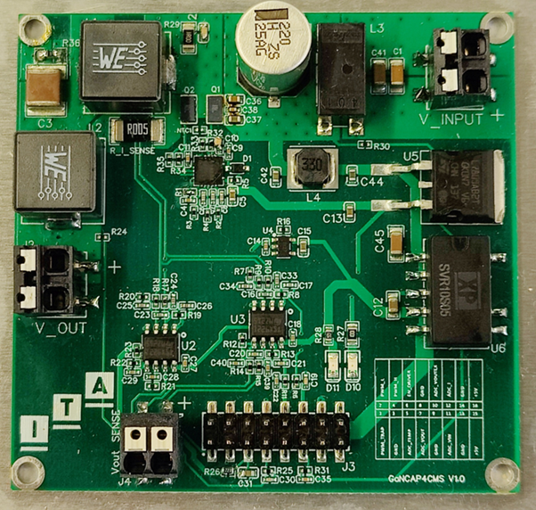
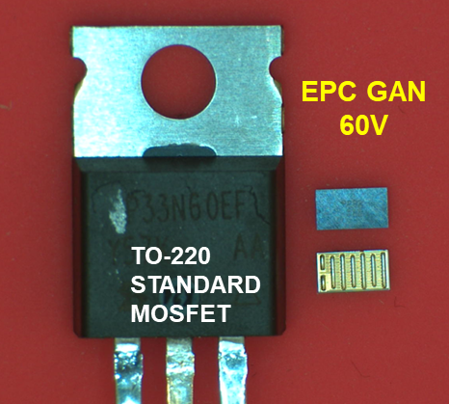
GaN based power converter for Serial Powering
The main goal of this task is to assess the feasibility of utilizing GaN- based DC-DC converters ( current source) for serial powering applications.
Several critical issues have been identified to optimized the design of these units
Design implications associated to GaN switching
High frequency (MHz) and short transition times (ns)
Control & deadtimes
EMI filter design : Filter embedded in the PCB
Magnetic components (air-core/other)
Power converter PCB layout
Radiation hardness
Explore Modular/Multiphase concept

Slide 15
GaN based power converter for Serial Powering
In order to analyze some of the critical issues mentioned above, several activities focused on the development of 200W / 2MHz GaN-based DC-DC have been planned
Design & Develop a preliminary prototype, which includes (2023):
  HF simulation models.
  HIL models to enhance control and protections.
Perform a performance evaluation, encompassing efficiency and EMI testing (2024)
  This evaluation will also involve combined EMI testing in radiation environments.
Design printed circuit boards (PCBs) that incorporate embedded filters and magnetic components.
Design & develop a new prototype based on a modular concept, incorporating identified improvements.(2025)
This activities are supported with projects and facilities:
  GanCAP4CMS: Design and development of a protection system based on GaN based DC-DC and integrated UCAPs for future detectors (Ref: LMP239_21). (2022-2023).
  Physics PC: Advanced technologies for the exploration of the universe and its components (2022-2025).
  AIDAINNOVA -Advancement and Innovation for Detectors at Accelerators (Ref: 101004761). (2021-2025).
  ITAINNOVA EMC & Power Lab

Slide 16
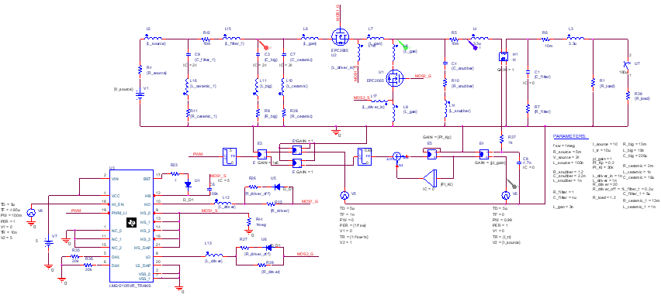
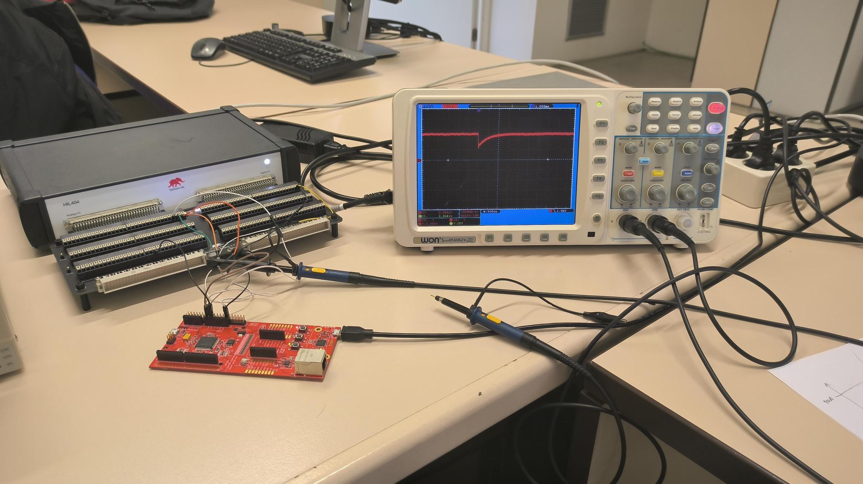
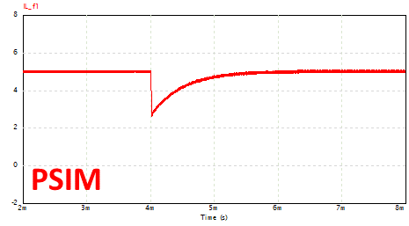
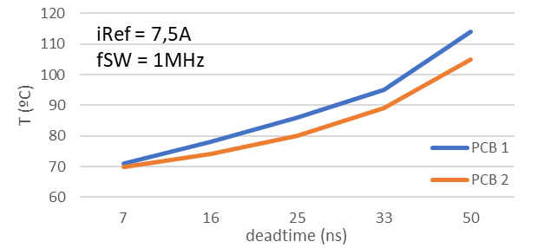
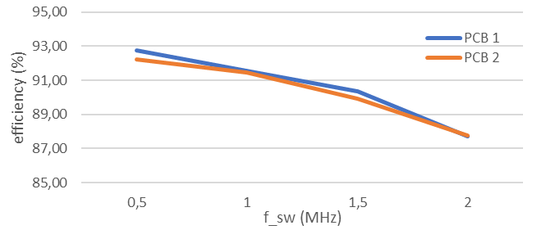
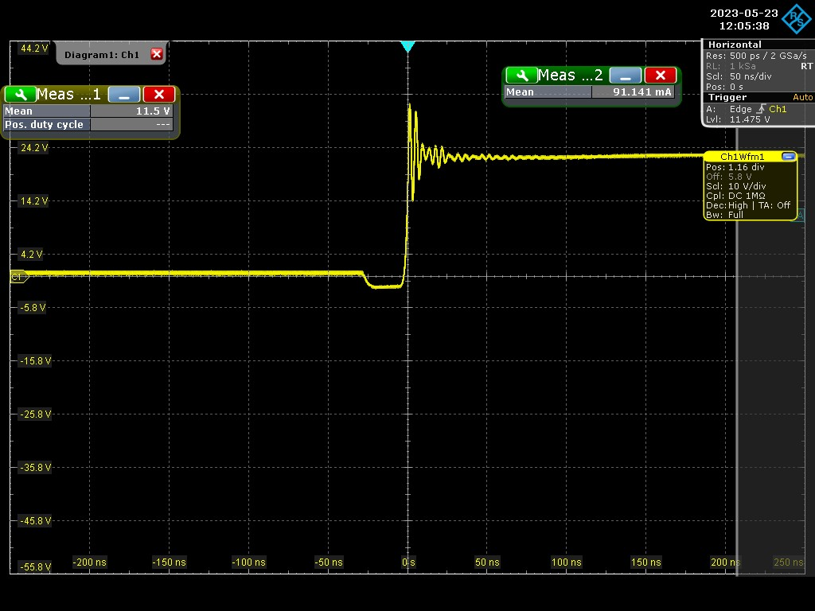
GaN based power converter for Serial Powering
HIL Models
Some activities have been already started
HIL
HF Models
Oscilloscope
Pspice Simulation
Prototype characterization

Slide 17
High-Efficiency Shunt-LDO Regulator
study of innovative architectures to increase efficiency on system and regulator level
regulator level efficiency can be increased by switch-mode shunt element
  Connected either at the output (see diagram) or the input of the regulator

Slide 18
High-Efficiency Shunt-LDO Regulator
system level efficiency can be increased by supply current reduction
combination of a fully integrated 2-4x step-down converter with SLDO regulator

Slide 19
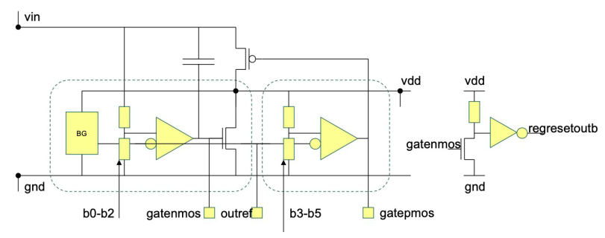
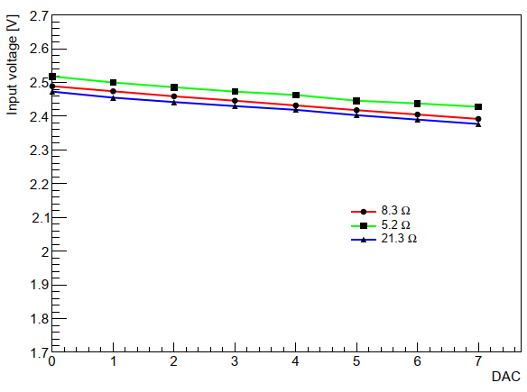
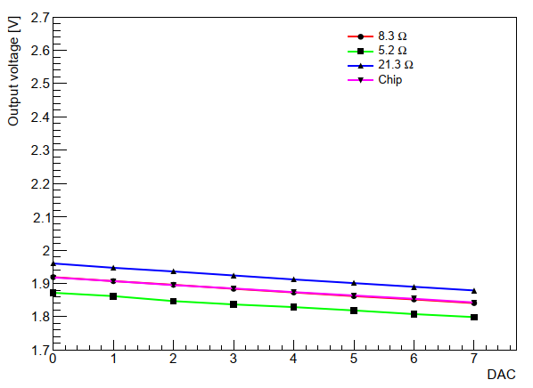
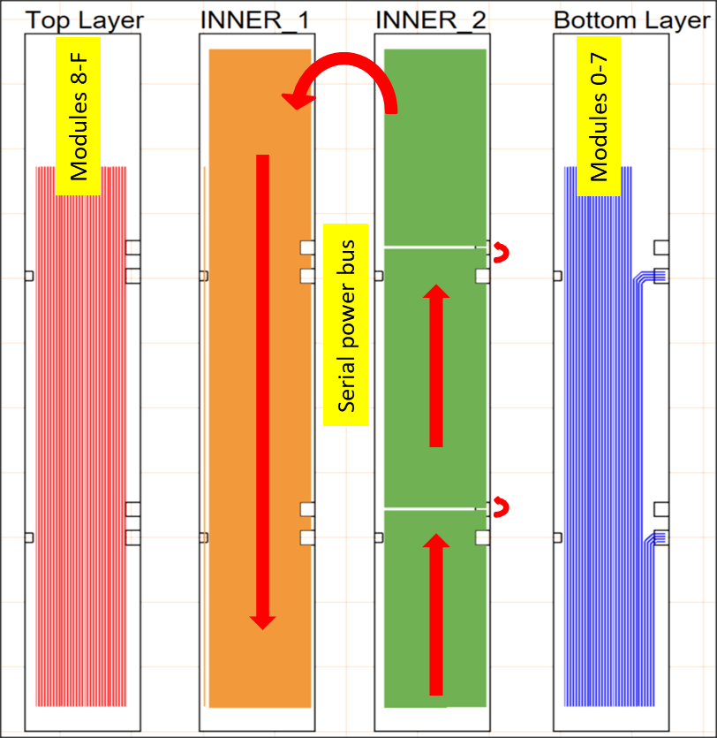
Serial Powering for FCCee
Minimize detector material and number of connections for future lepton colliders
DMAPS may be a suitable options for large area tracker
Serial powering accessible for HV-CMOS technologies
Some results on ATLASPIX3 chips with integrated SLDO:
  no degradation of noise and threshold performance
  tunable within some tens of mV range
Planning for multi-module chain with low-mass power buses
Interest for other technologies like the LF110nm platform (DRD7.6.1)
Vout DAC calibration
Vin DAC calibration

Slide 20
Summary
Large community is building up around powering solutions for HEP applications
Investigate both parallel and serial power distribution solution with low mass, radiation hardness and high efficiency specifications
Main building blocks are:
  GaN DC-DC Converter and GaN DC-DC Current Source, with use of high voltage CMOS and GaN technology up to 48V
  Resonant Converter, 3-level Buck Converter, Capless-LDO and SLDO designed in 28nm technology, aiming 1Grad
Full characterization of each block:
  Electrical and thermal performances
  Radiation hardness
  EMC and reliability assessment
Funding is granted already for CERN, FH Dortmund, Itainnova
Request for funds are pending or to be done for RWTH Aachen, TU Graz, UNIUD, UNIMI+INFN

