Slide 1
Radiation Tolerant RISC-V processor and SoC platform
Implementing DRD7: an R&D Collaboration on Electronics and On-detector Processing.
2nd workshop
25 September 2023
Kostas Kloukinas

Slide 2
Introduction
Project intentions
  Rad-Tol RISC-V based System-on-Chip design
Participating institues, as of today
(in order of presentations)
  CERN
  KU LEUVEN
  Fachhochschule Dortmund
  UK Consortium

Slide 3

CERN
EP-R&D WP5.2 Rad-Tol SoC Ecosystem activity
  Motivation
    Tackle design complexity in future experiments
    Control development cost on advanced nodes
    Facilitate on-detector “intelligence”
    Enable reconfigurable, retargetable FE ASICs
  Propose a SoC ASIC design methodology
    Introduce an abstract design methodology
    Develop reusable IP blocks
    Standardized interconnects for IP blocks
    Replace state machines with a control processor (RISC-V based)
    Programmable, flexible logic blocks (SoC Ecosystem, cores, eFPGA, NoCs)
    Enhance Hierarchical Digital Implementation and Verifications

Slide 4
SoC Radiation Tolerant Ecosystem
Conceptual Diagram
Analog functions
ADC
ADC
ADC
Slow Control Interfaces
ADC
DAC
JTAG
SPI
I²C
DAC
SPI
I²C
DAC
SPI
I²C
DAC
GPIO
SPI
I²C
Interconnect Bus
e-Links
FE channel
SRAM
RISC-V
e-Links
FE channel
micro-code
e-Links
any-Link
e-Link
any-Link
FE analog
blocks
eFPGA fabric
SRAM
High Speed Interfaces
data
Programmable Logic

Slide 5
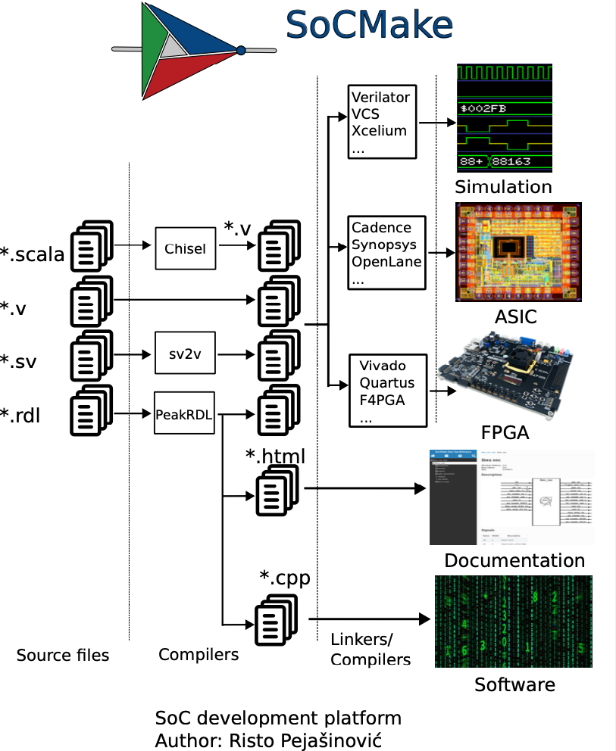
SoC Generator Tool
SoCMake
  SoC generator tool
  SystemRDL language to automatize the generation of:
    Hardware design
    Software toolchain
    Verification platform
    Documentation
  Generate custom SoCs
  Rapid SoC prototyping
  Work in progress

Slide 6
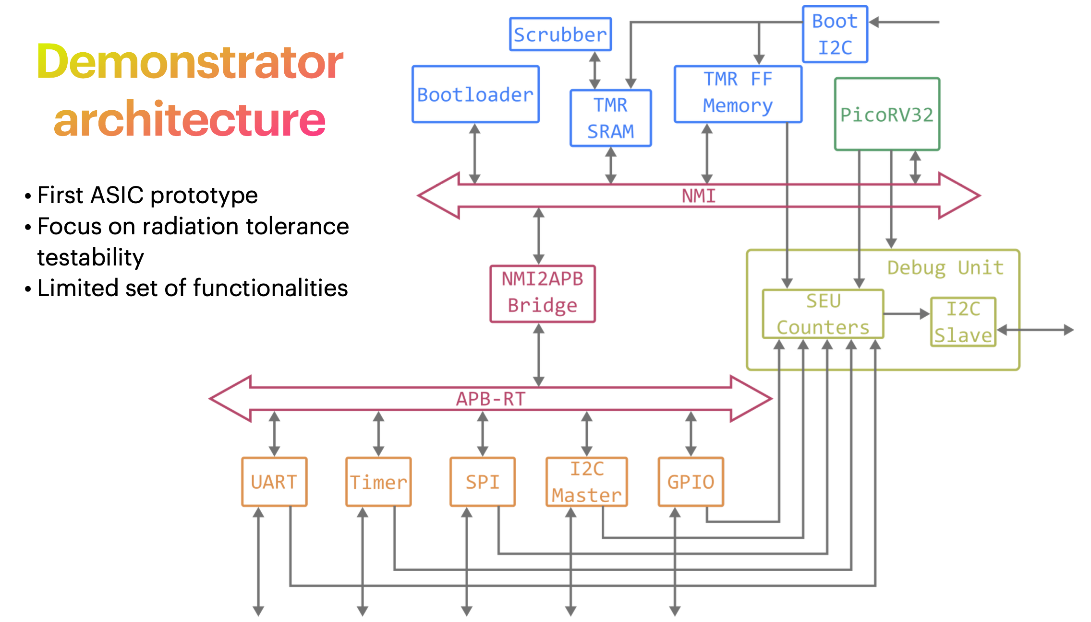
Demonstrator ASIC
Alessandro Caratelli
Marco Andorno
Anvesh Nookala
Davide Ceresa
Risto Pejasinovitc

Slide 7
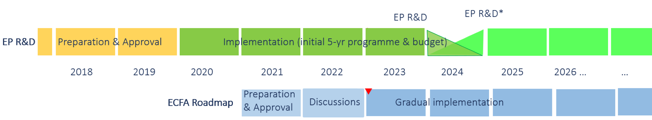
Plans & Resources
Timeline
  SoC activity started in 2021, during EP R&D phase I
  Approved to continue in phase II, for at least four more years
Scope
  Open platform for Rad-Tol SoC ASIC design
  SoC & core architecture, Verification, Implementation
Resources
  1 fellow, 2 students, 3 part-time staff
Start of SoC activity

Slide 8
DRD7 Workshop
Radiation Tolerant RISC-V Processors

Slide 9

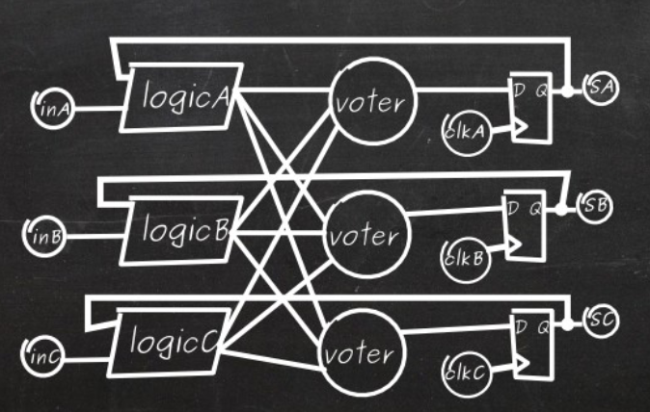

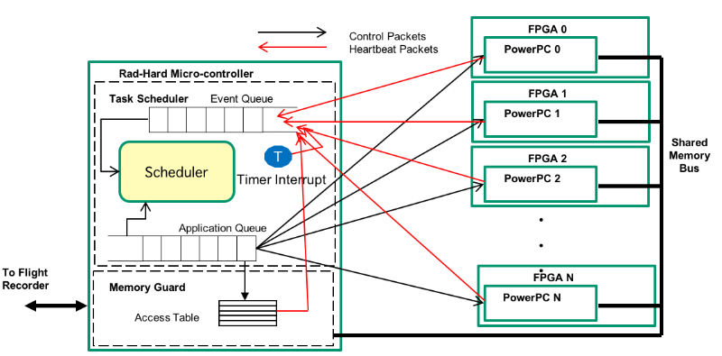
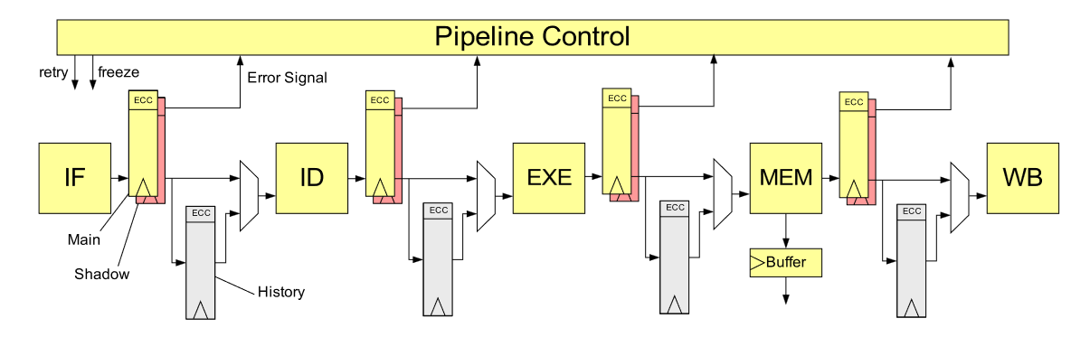
Motivation behind our research
Radiation hardening by software techniques
  Instruction replay or checkpoint recovery
Spatial redundancy techniques
  TMR, DMR, dual lockstep systems, ...
Pipeline rollback
  Register encoding/decoding
  Pipeline rollback when non-recoverable error occurs
Simple to understand
Reliability failure reduces by orders of magnitude
Can be automatized
Large area and power overhead (> 2x/3x)
difficult to implement (RTL and physical constraints)
Low area overhead
Low critical path delay overhead
Can be fully implemented in software
Significally complicates the
software stack
Performance loss (lost cycles)
Memory requirement for checkpoint recovery
Low area overhead
Can mitigate SETs and SEUs
Increases critical path delay
Latency penalty when rollback
Complex to implement

Slide 10
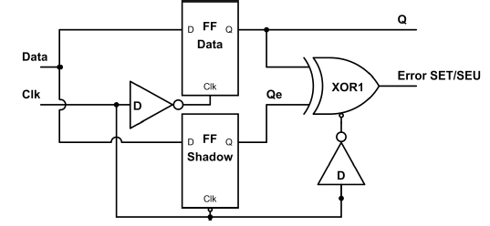
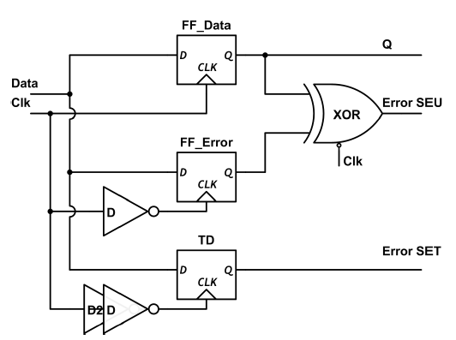
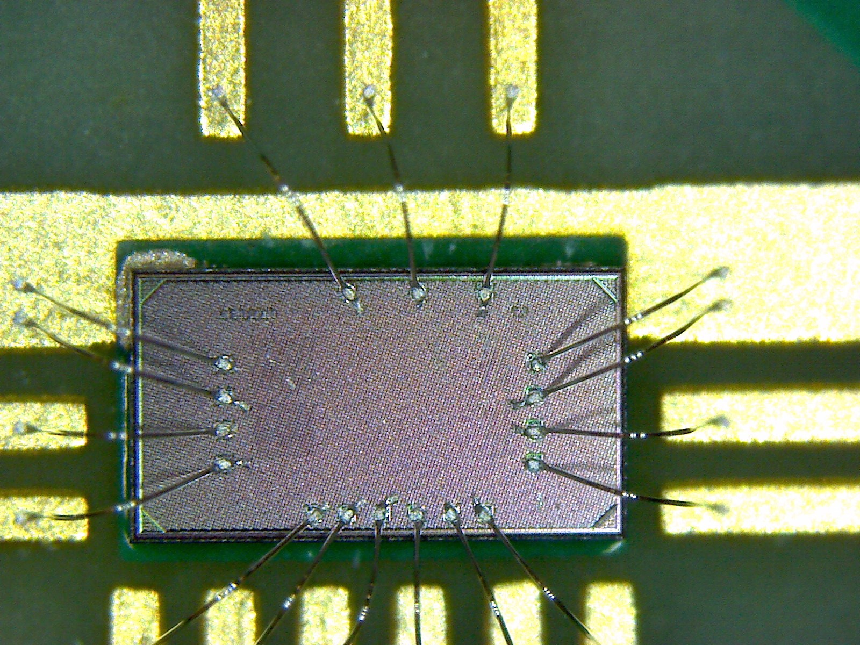
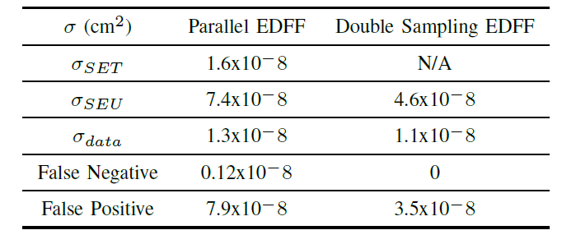
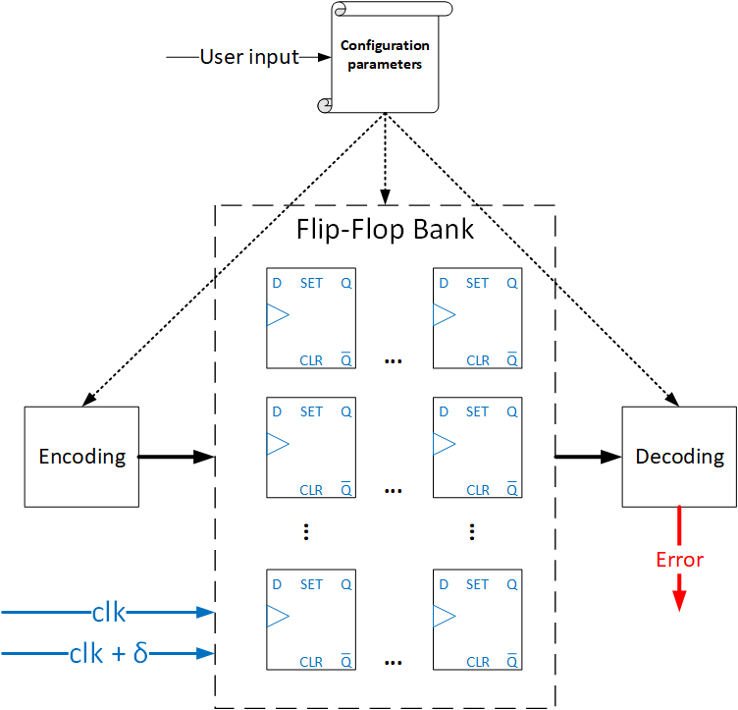
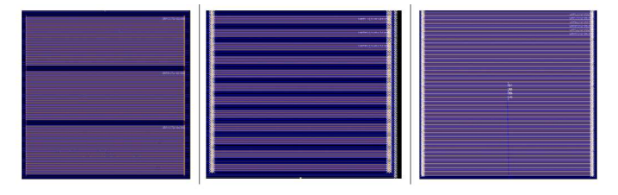
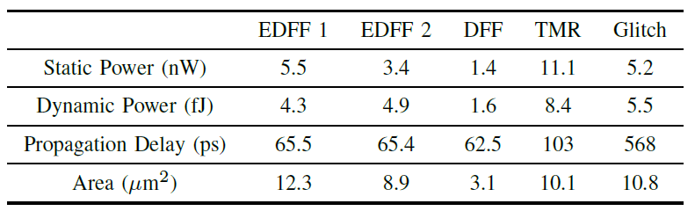
In-situ SEE error detection and correction
Single-Event Effect (SEE) error detection
  Double sampling error detection flip-flop
  Parallel error detection flip-flop
  Test chip created
Single-Event Effect (SEE) error correction
  Fully configurable
2023
Notes:
TD = transition tedection
Fully configurable
Different flavours of error correction code
Clock phase offset
Number of bits to target
Floorplanning methods to increase radiation hardening

Slide 11
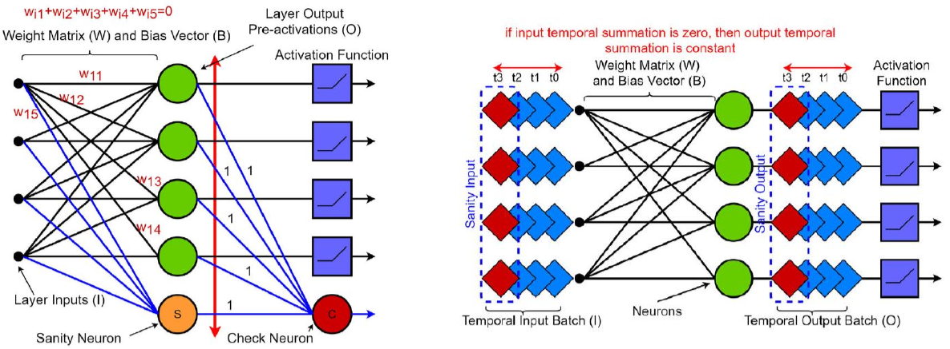
SEE mitigation in DNN accelerators
Memories: 50-70% area
  SEC-DED code to harden
Data path: 30-50% area
  Software/hardware mitigation
  Software-based DNN tolerance
  Hardware checker neurons
Control logic: 2-5% area
  TMR
DNN accelerator
Memories
Data path
Control logic

Slide 12
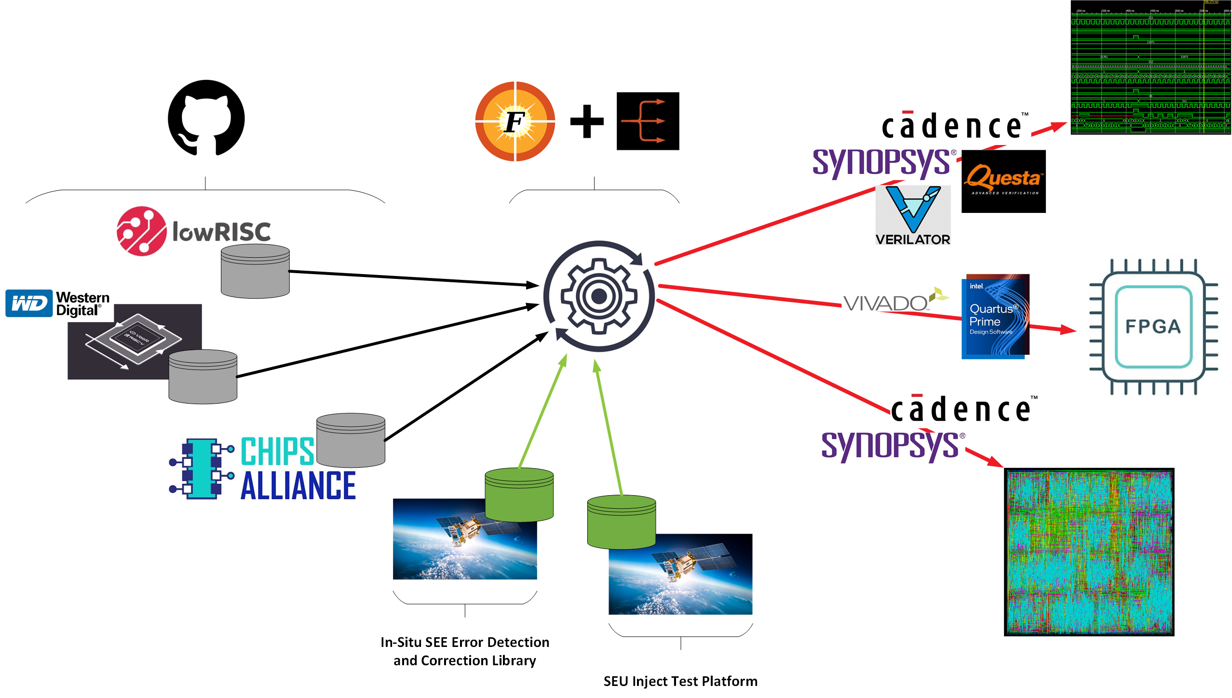
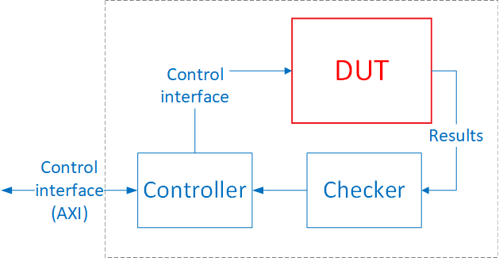
Long term goal
Any RISC-V core can be targeted
  Hell, any design for that matter
Fueled by FuseSoC and Edalize
  Achieving the power of vendor and tool independence
In-Situ SEE error detection and correction library
SEU inject test platform
  In simulation testing
  At runtime (FPGA) testing
  Formal verification?

Slide 13
Contributions and resources
Contributions
  Rad-hard RISC-V SoC development on TSMC 28nm HPC+ or 22nm FDSOI technology
Resources
  5 person team for 3 years
    3 persons already funded
      3 * 3FTE, resources already available
    2 persons to be funded
      2 * 3 FTE, resources considering asking

Slide 14
A radhard RISC-V micorocontroller implementation
25.09.2023
2nd DRD7 workshop
Michael Karagounis

Slide 15
Motivation
First thoughts about the usefulness of a radiation-hard µC arose during the development of the MOPS (Monitoring of Pixel) chip
  MOPS digitizes pixel module voltage and temperature and communicates via CANOpen
  CANOpen is usually implemented in software but was implemented in hardware for MOPS
Many custom ASICs have a similar structure:
Design of hardwired custom ASIC is complex and time consuming
  Big verification effort
  Bugfixes detected in silicon need redesign and new production cycle
Adaptation to new projects is difficult
  hardwired logic needs full redesign
Idea: replace internal data processing logic with radiation-hard RISC-V core
  Adaptation to new application and bugfixes via software updates
AD / DA Converter
Internal Logic
Communication Interface
Data Acquisition
Data Processing
Data Transfer

Slide 16
Design of TMR protected RISC-V microcontroller
Fully TMR protected RV32-IMC Core designed in TSMC 65nm
  3 stage pipeline with multiplication and compressed instruction set extension
1.2V Core & I/O supply and 50 MHz clock
three SRAM instances protected with scrubbing algorithm
SEU detection & counting logic
Read SRAM Row
Compare 3 Instances
Write SRAM Row
Increase SRAM Row
SRAM
SRAM
SRAM
Refresh
SRAM
SEU Register
Voter
SRAM Counter
1
≥1
Voter
2
Core Counter
Voter X
Periph Counter
Core Instances
Voter
1
≥1
Voter
2
Voter X
Periph Instances

Slide 17
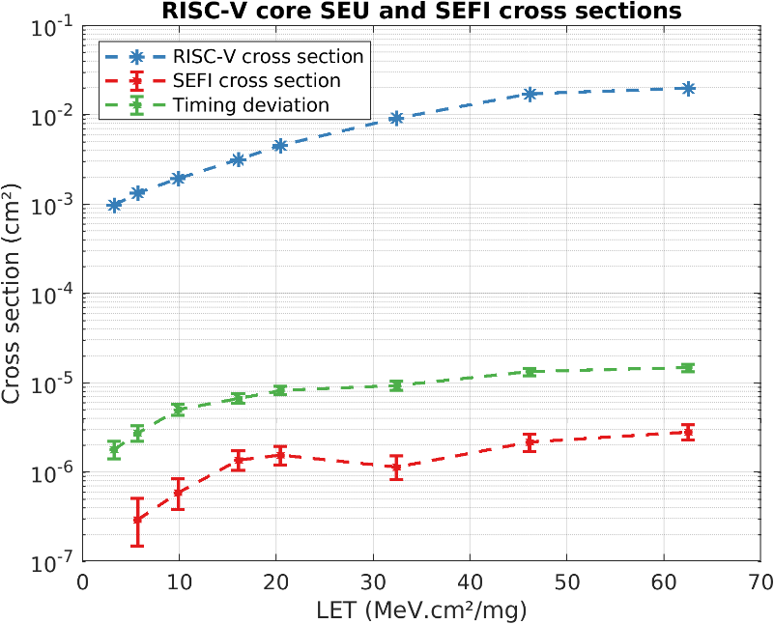
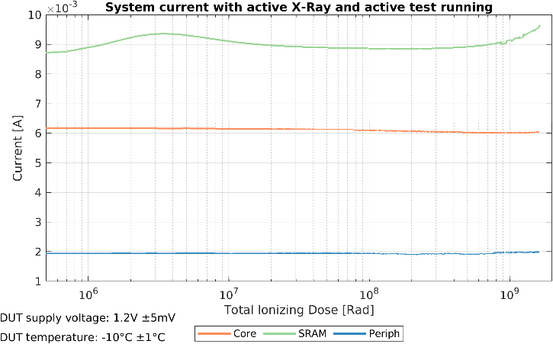
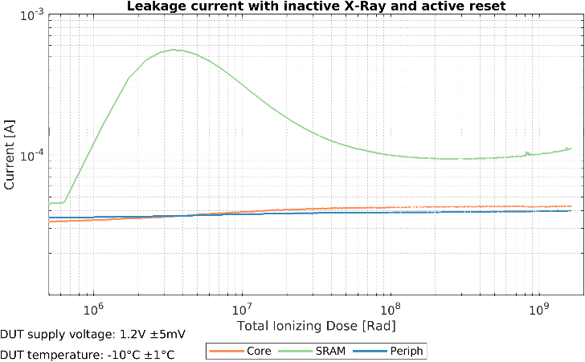
TID & SEE Characterization
X-ray irrdiation at -20°C
TID of 1 Grad reached
SRAM leakage current main driver
of increased current consumption
Heavy ion irradiation for study of SEE
cross section of corrected SEUs extracted by SEU counter circuit
SEFI cross section is three orders of magnitude smaller than SEU cross section
A. Walsemann, M. Karagounis, A. Stanitzki, D. Tutsch, A radiation hard RISC-V microprocessor for high-energy physics applications, Nuclear Instruments and Methods in Physics Research Section A, vol. 1056, p. 168633, 2023

Slide 18
Futur Plans & Resources
Overall project goal is an open-source Zero SEFI microcontroller at LHC inner layer SEE rates
  Are there additional architecture level protection measures necessary apart from TMR?
Development of a well-elaborated verification suite
  Verification of functionality and TMR implementation
  study of cycle accurate golden models and/or virtual prototypes
Improve diagnose capability during SEE radiation testing
  Not only detect SEFIs but also cause of SEFIs
Resources
  0.67 FTE (PhD student) for 1+3 years
  Funds for Submission of chip prototypes

Slide 19
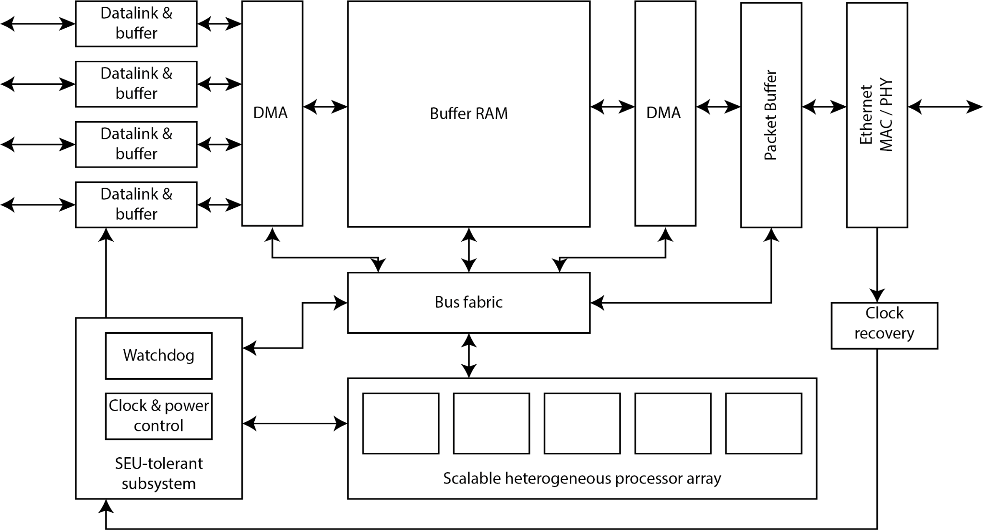






UK Consortium Contribution
UK (STFC) Consortia
  Royal Holloway, Birmingham, Warwick, Bristol, Manchester, RAL.
Motivation
  Develop common interface ASIC to couple a range of specialised FE ASICs to a common industry-standard off-detector interface.
Plans for DRD7.2.b
  Study/design of processor
  Verification/testing of cores
  Evaluate SoC platform
  Software Ecosystem
Contribution
  Q4 2023: requests for funds
  >1 FTE for 4 years
Proposed common interface ASIC for detector readout, timing, and control

Slide 20
Towards a Project Proposal
Develop a Rad-Tol RISC-V based SoC ASIC design platform
for HEP experiments
  Standardized Architectures
  Implementation Methodologies
  Verification Methodologies
  IP block Repository
  Propose standardized solutions to the HEP community
Establish regular meetings
  Kick-off meeting in late October 2023
  Identify areas of expertise
  Define fields of contribution
Finalize Project Proposal

Slide 21

Thank You

