Slide 1
DRD 7.6a – Common Access to Imaging Technologies

Slide 2
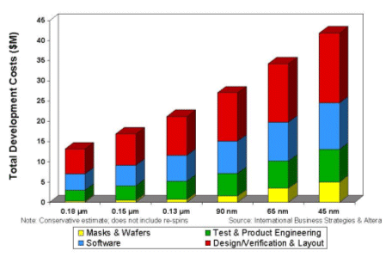
Strategic Goal
Provide efficient and affordable access to imaging technologies
Share and reduce development costs & time
Requires concentration of resources
}
Performance Targets
Shared PDKs, IPs and access to runs
Chip submissions and test results
DRD7.6a
}
DRD7.7
}
Supported Technologies
DRD7.6c
}
DRD7.6a
TPSCO 65nm (this talk)
Tower Semiconductor 180nm (this talk)
LFoundry 110nm (Manuel’s talk)
https://www.design-reuse.com/articles/12360/fpgas-and-structured-asics-low-risk-soc-for-the-masses.html

Slide 3
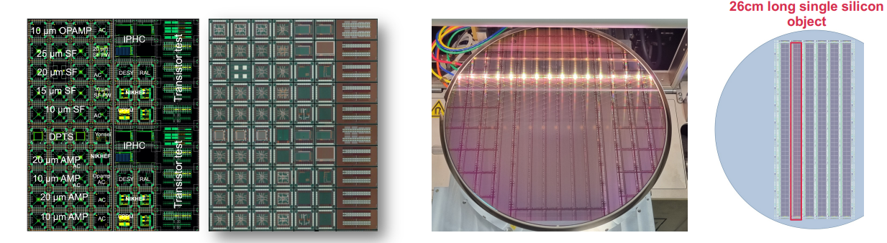
TPSCo 65nm
Currently in use for ALICE ITS3 and EP R&D WP1.2
Joint runs already carried out – MLR1, ER1
CERN, IPHC, CPPM, INFN, NIKHEF, STFC, SLAC, DESY, SLAC, Yonsei…
  MLR1 (December 2020): 1.5 x 1.5 mm² test chips
  ER1 (December 2022): stitching

Slide 4
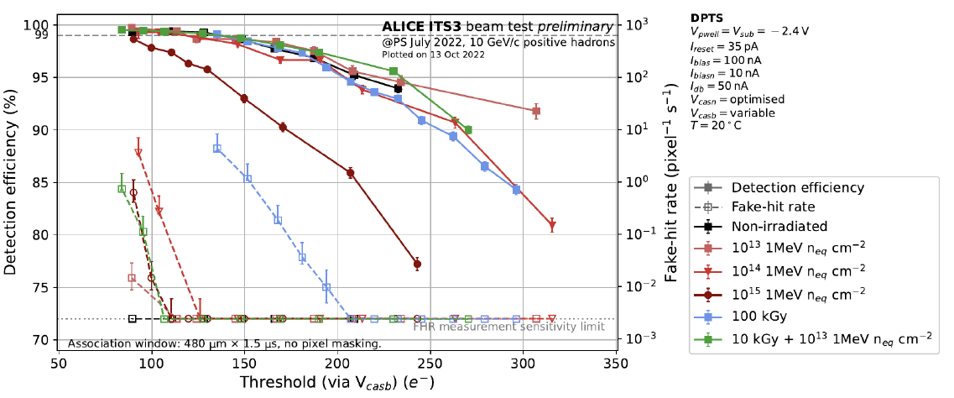
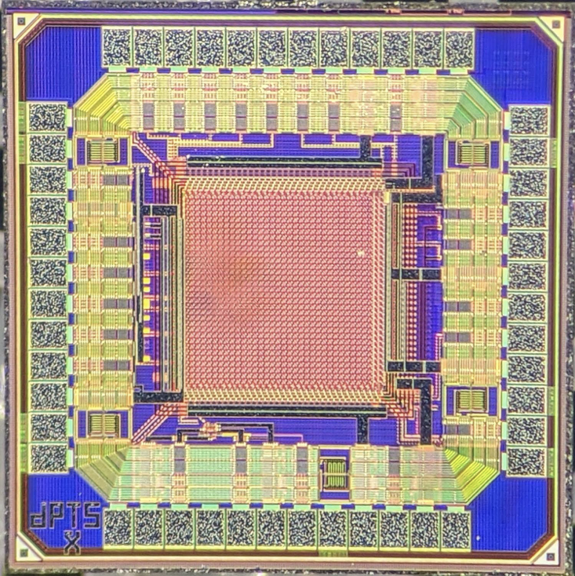
doi: 10.1016/j.nima.2023.168589
TPSCo 65nm : qualified for HEP
DPTS
15 x 15 μm² pixel
Fully efficient after 10¹⁵ 1MeV n_{eq} cm⁻²… at room temperature
Transistor total ionizing dose tolerance doi: 10.1088/1748-0221/18/02/C02036 and SEU in line with other 65 nm technologies
Many features not yet explored (wafer stacking, special imaging devices…)

Slide 5
TPSCo 65 nm
CERN engages to do the support and interface to the foundry
Common runs foreseen in Q4 2025, Q2 2027, Q4 2028 with financial support at 50 % (excluding wafer stacking)
Custom DRC rules, more automated reticle assembly and sign-off
Some IPs already developed, including digital library for DFM.
More are needed, with preparation for shared use

Slide 6
Tower Semiconductor 180nm
>10 years of experience in the community
Used for:
  ALPIDE in ALICE ITS2 (10m²), taking data in the experiment
  for STREAM, Belle II, GSI…
CERN has been interface to the foundry and carried out the support so far:
- intends to concentrate on TPSCo 65 nm
- discussions underway with IPHC and foundry for support
Custom DRC rules
Several IPs developed, need preparation for shared use
Common runs to be scheduled, could be foreseen in 2025, 2026 and 2028.

Slide 7
Access
Institute 1
Institute 2
CERN
Foundry
Institute 3

Slide 8
Access
Institute 1
Sign NDA (and Cadence Design Share Agreement if applicable). Permits:
  Sharing of Designs
  Access to PDK
Institute 2
CERN
Foundry
Institute 3

Slide 9
Access
Institute 1
Sign NDA (and Cadence Design Share Agreement if applicable). Permits:
  Sharing of Designs/Experience
  Access to PDK
Institutes submit to CERN
CERN assembles and submits GDSII
Institute 2
CERN
Foundry
Institute 3

Slide 10
Resources
Technology | Current Resources |  | Requested Resources
 | FTE/year | Recurrent/year (€) | FTE/year | Recurrent/year (€)
TPSCo 65 | 8 | 250k | 8 | 250k + stacking
Tower 180 | 0.5 | 20k | 4 | 150k
LF11is | See Manuel’s Presentation

Slide 11
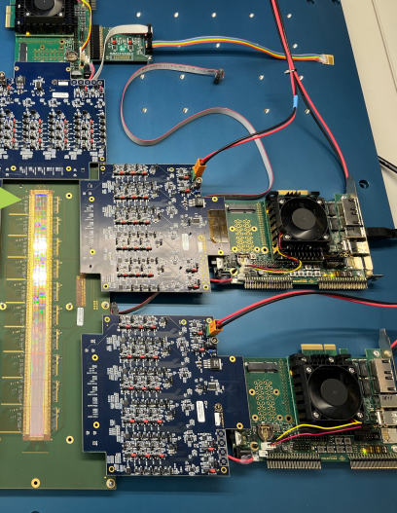
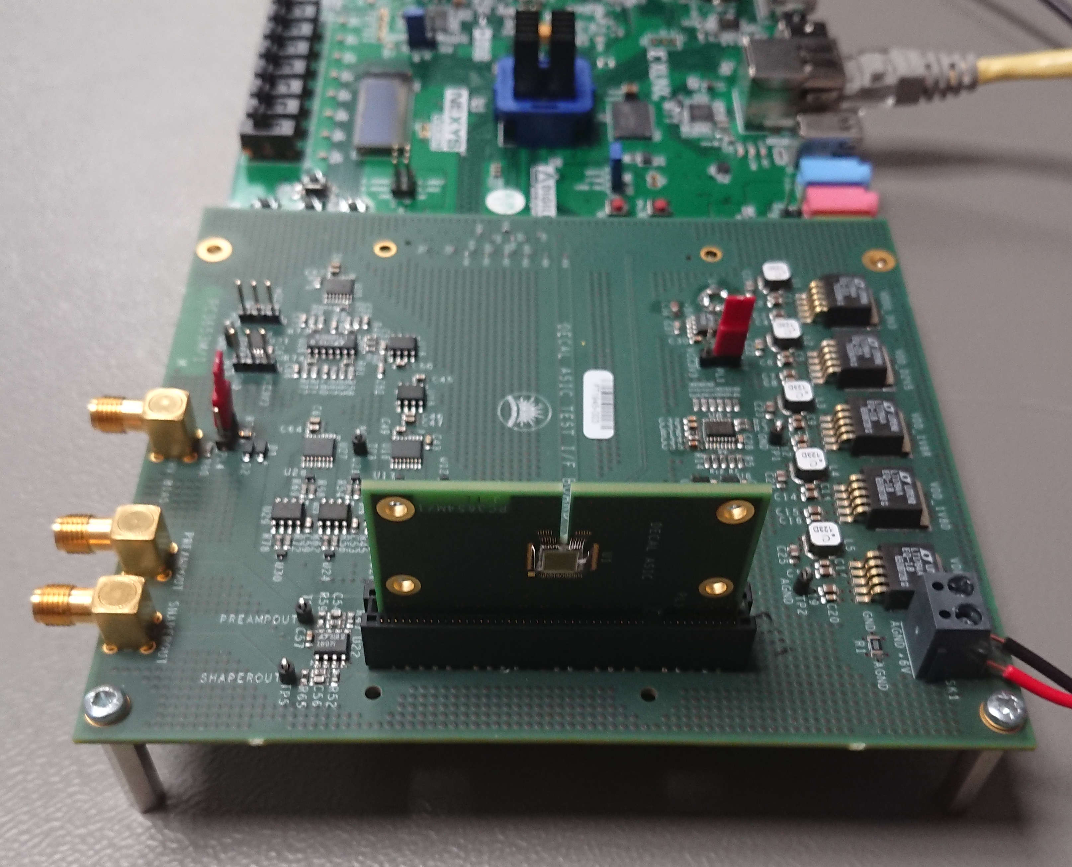
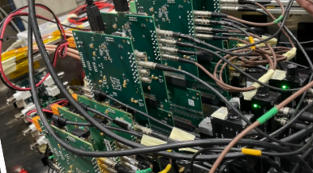
Shared Standardized Test Systems
Desire to reduce duplication and development time of many test systems
Render their support manageable (at present usually not sustainable)
Standardise on chip interfaces
Originally proposed as DRD7.6c
Much interest, but no driving institute came forward
If interested please get in touch – could include in future DRD7 calls

Slide 12
Questions?

