Slide 1


7.5.b
WG 7.5 Backend Systems & COTS
Full 100GbE Solutions from FE to DAQ
sophie.baron@cern.ch
On behalf of the 7.5.b contributors

Slide 2
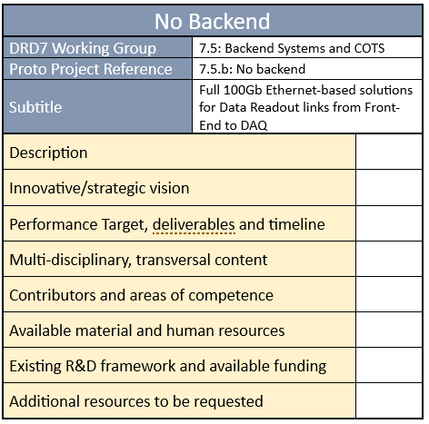
Proto Project ID Card
Represents a first «project Intention»
Written by the 7.5 conveners (Niko and Conor) with inputs from the initial contributors of the initiative
Still at the intention level: Will be extended and completed with additional contributions from incoming institutes

Slide 3
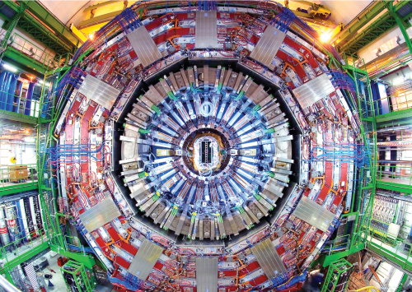
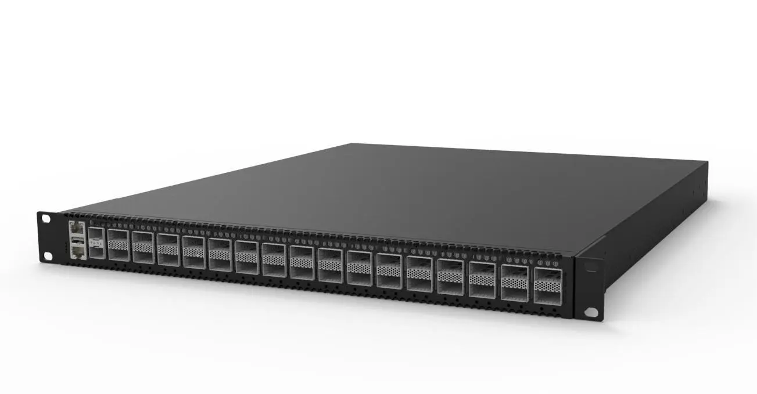

Innovative / Strategic Vision
Lower radiation levels opens the door to increasing the complexity of Front-End electronics (RISC-V based processors, RAMs and SoC in the Front-End)
COTS Switch
Data
Clock & Fast Control
?
A detector
Data Centre
NEW PARADIGM: high throughput 100GbE-based data readout link can reasonably be envisaged and shall be investigated
Many challenges ahead
Tightly linked to other WG like DRD7.2/RISC-V or DRD7.1/links activities.

Slide 4
Project Description
Streaming data directly from HEP detector front-end to the DAQ processing farm over Ethernet, with 2 (complementary) approaches:
  using COTS switches to handle data-streams from the Front-End to Network Interface Cards (NICs) or even DAQ processors (the “No backend” approach)
  design a COTS-based high-density switch bridging the detector environment to the COTS/DAQ world (the “Smart Switch” approach).
complemented with
  backend board adaptation to explored DAQ topologies (based on custom boards for DAQ, concentration and processing)
  study and design of the building blocks IPs necessary for 100Gb Ethernet cores implementation in future FE ASICs.

Slide 5
An Example: the No Backend Approach
Activity started in June 2023 within the CERN EP RnD Programme (Work Package 6: High speed links)
  CERN ESE and LBC groups
Protocol study/selection for 100GbE
  FEC for 100GbE (standards, complexity, correction capacity, latency, ..)
  Unidirectionality/asymmetric ethernet
  Optical transceiver compatibility (MSA, limitations, tuning)
  Commodity switches compatibility
Selection and configuration of commercial Ethernet Switches
  Testing with Front end, ethernet compliance testing
  Open-source switches evaluation
100 GbE software backend development
  Kernel bypass (DPDK), Queue based asynchronous I/O
System demonstration based on Xilinx Versal emulation of FE and BE + switch + software

Slide 6
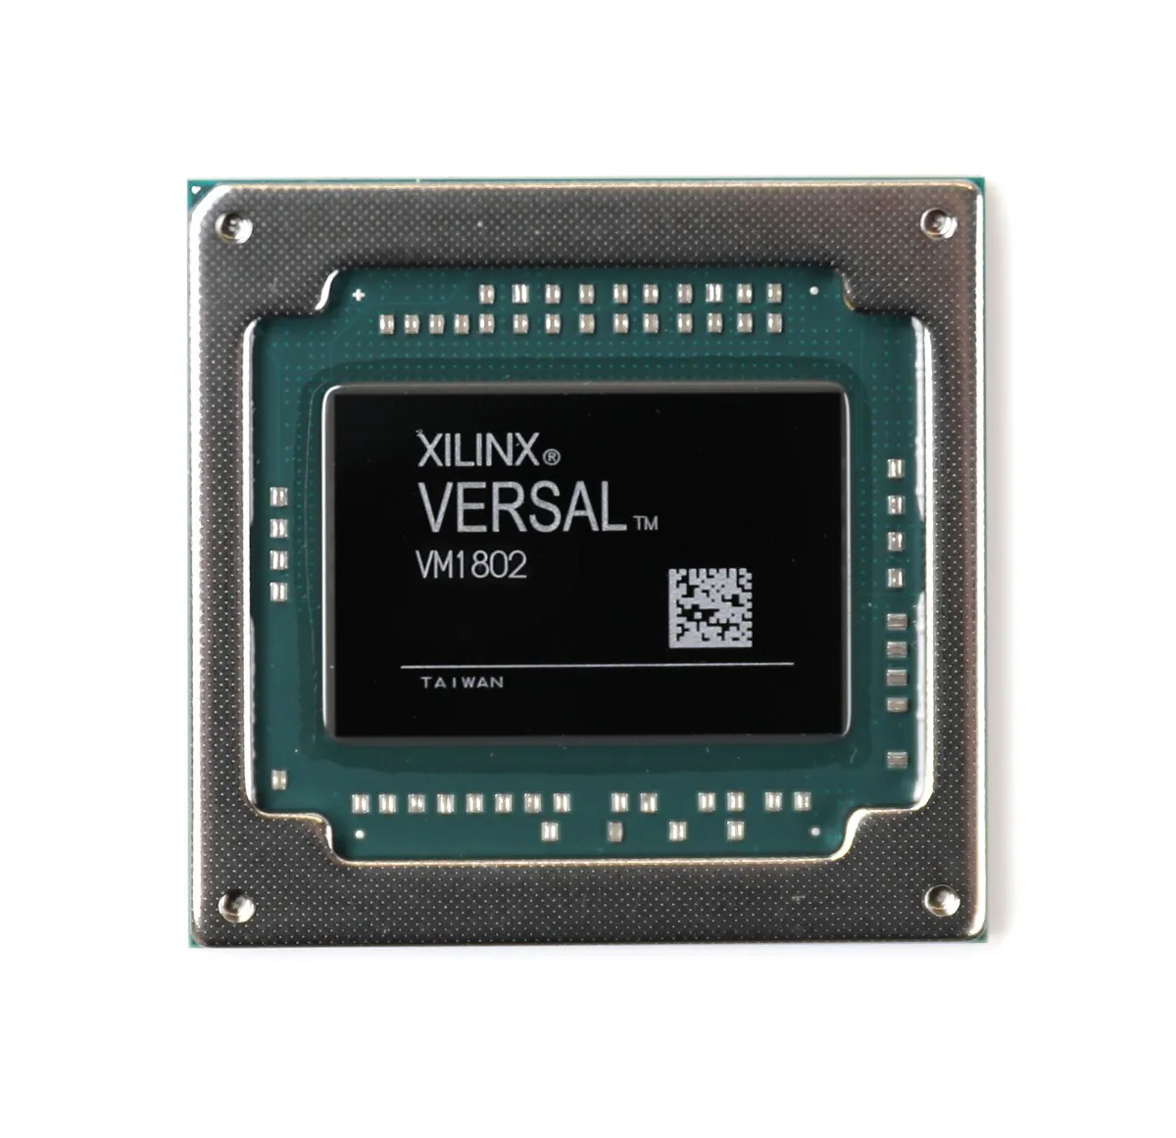
Another Example: the Smart Switch Approach
No back-end may be suitable for most applications
For applications needing something special make a small perturbation to no-backend
Keep same form factor for both switch & optics, aligning to industry standards
Should be a superset of no-backend design
Special applications:
Low latency,
Bridge from front-end to back-end
e.g. combined clock, fast control & data
Pre-processing of data from many sources
Smart Switch (same form-factor),
but likely FPGA inside

Slide 7
Performance Target, deliverables and timeline
Q4 2023:
  Standard FEC-based 100GbE evaluations and link implementation.
  COTS switch evaluation versus these protocols.
2024:
  FE ASIC emulator in an FPGA using open-source solutions (RAMs, RISC-V, SoC).
  Network/Transport/Application layer protocols selection/design
  100 GbE software backend development
  Smart-switch specifications and prototyping.
  BE boards adaptation
2025:
  Demonstrator implementation.
  System tests. Specifications & recommendation for potential IP blocks for FE ASICs.
universal across HEP for detectors requiring high/concentrated data readout bandwidth.

Slide 8











Contributors*
No Backend Approach
Backend board adaptation to explored DAQ topologies
Building blocks IPs necessary for 100Gb Ethernet cores implementation in future FE ASICs.
Smart Switch Approach
*Some other institutes communicated their interest to contribute via the survey and are being contacted for consolidation

Slide 9
Resources and Organization
Resources
  Manpower and Funding currently being consolidated
  «no backend» approach funded by CERN (EP RnD Programme WP6 & Gentner Grant)
  UK, US and NL requests for funds to be submitted end of 2023
Organized as
  A Forum
  Rotating Chair
Strong link with
  WG 7.2 and 7.1

