Slide 1
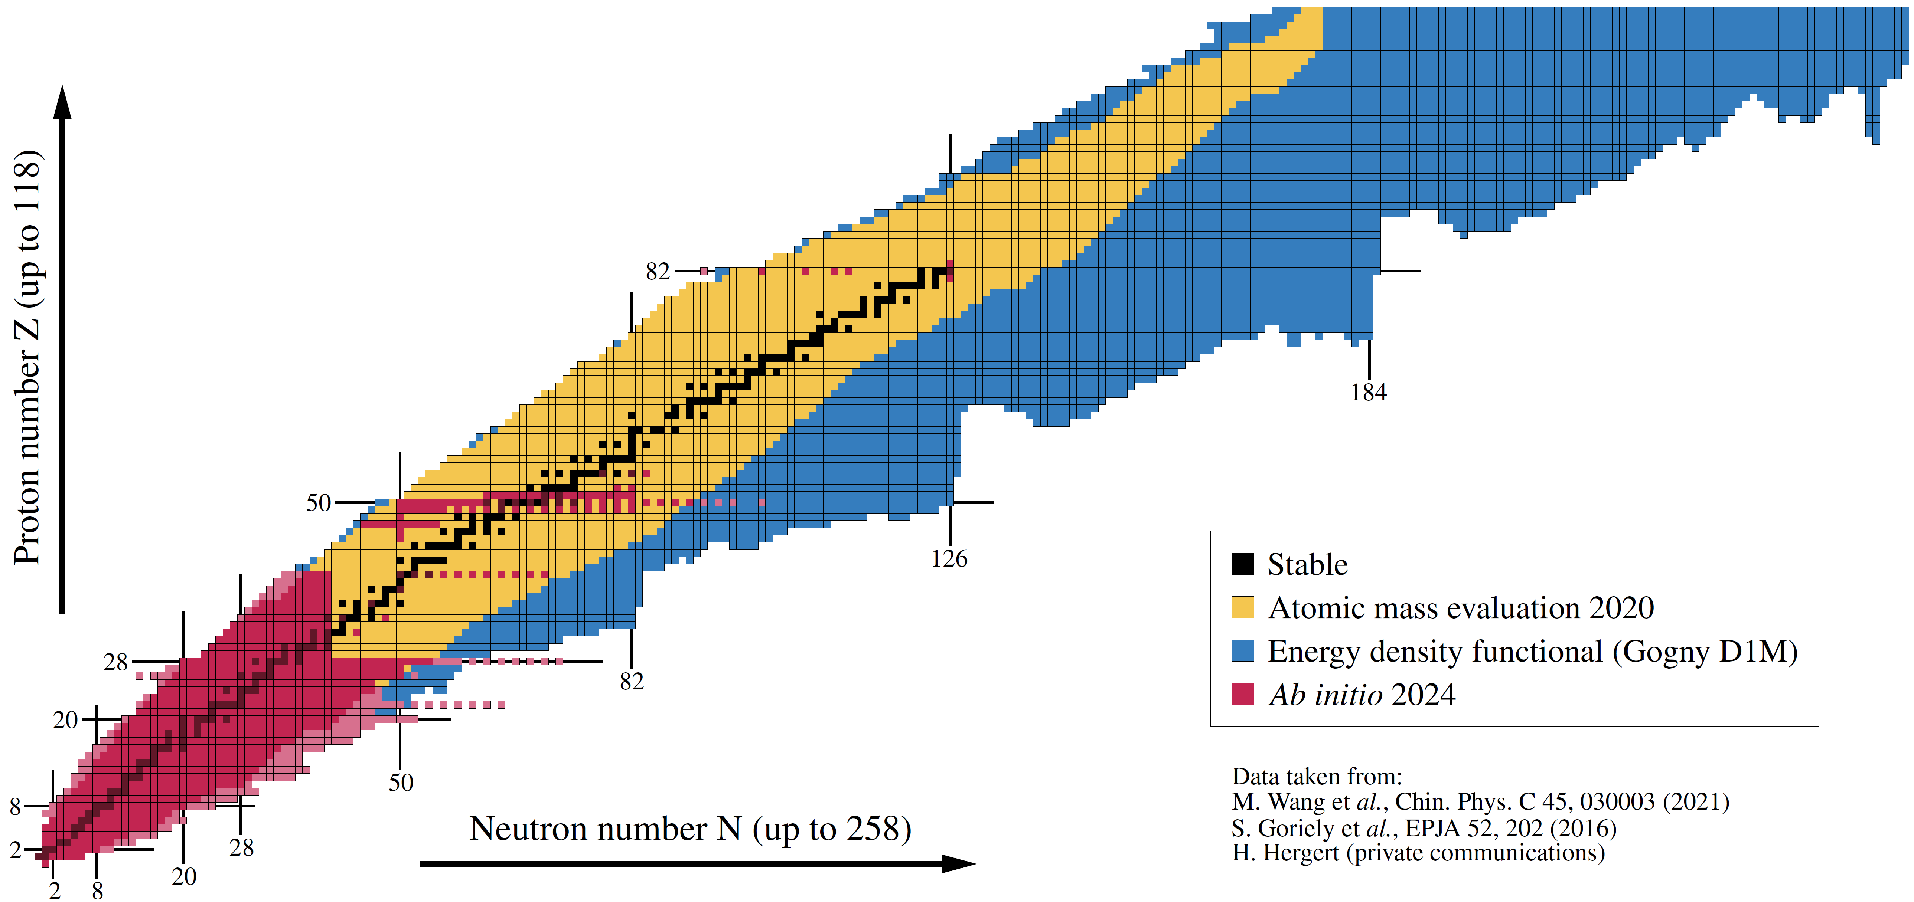


Ab initio description of singly and doubly open-shell nuclei at polynomial cost
Pairing and deformation versus dynamical correlations + going heavier and more neutron rich
²⁰⁸Pb
2024
Figure: B. Bally
HaloWeek'24 - Nuclei at and beyond the driplines
9–14 juin 2024 Chalmers University of Technology
Thomas DUGUET
DPhN, CEA-Saclay, France
IKS, KU Leuven, Belgium

Slide 2










Collaborators on ab initio many-body methods/calculations
B. Bally
J.-P. Ebran
M. Frosini
A. Porro
A. Roux
A. Scalesi
V. Somà
G. Stellin
L. Zurek
H. Hergert
P. Navratil
P. Demol
U. Vernik
A.Tichai
P. Arthuis
R. Roth
C. Barbieri
T. R. Rodriguez
G. Hagen
T. Papenbrock
J. M. Yao

Slide 3
Could have talked about halo…
I. Model-independent quantitative characterization method based on the matter density distribution
II. Lightest halo (the deuteron…) can be described ab initio exactly at mean-field (« on steroid ») level
Bally et al., unpublished
General Bogoliubov state
Breaking U(1)= np pairing
Breaking S(U2) = triax deformation
Breaking parity = Octupole
Break time reversal
+VAP on N=1 and Z=1
+PAV on N=1,Z=1,P=+,J=1
M. Drissi, T. Duguet, V. Somà, EPJA (2020)
Implications about many-body approx. on π-less EFT renormalizability

Slide 4
Contents
⦿ Ab initio expansion many-body methods for closed- and open-shell nuclei
⦿ How many-body correlations come in at polynomial cost = pedagogical account
⦿ Pushing to high accuracy and to heavier open-shell nuclei at polynomial cost

Slide 5
Contents
⦿ Ab initio expansion many-body methods for closed- and open-shell nuclei
⦿ How many-body correlations come in at polynomial cost = pedagogical account
⦿ Pushing to high accuracy and to heavier open-shell nuclei at polynomial cost

Slide 6




Ab initio approach at polynomial cost
“Ab initio” theoretical scheme
From point-like nucleons = In medias res
Inter-nucleon interactions rooted into QCD = via effective field theory
Currently best realized by chiral effective field theory (χEFT) in A-body sector
with
Exponential → Polynomial cost
Systematic expansion of H
Systematic expansion of | Ψ_{k} >
Approximate solution systematically improvable towards well-defined limit
Uncertainties evaluation, quantify what is missing

Slide 7
Expansion many-body methods
with
One-body Hilbert space
A-body Hilbert space
with
Expansion many-body methods
« The curse of dimensionality »
Hamiltonian partitioning
Unperturbed state
« Easy »
to solve
Mean-field-like =
Symmetry?
Nature of the state?

Slide 8
Expansion many-body methods
with
One-body Hilbert space
A-body Hilbert space
with
Expansion many-body methods
Hamiltonian partitioning
Unperturbed state
« Easy »
to solve
90% of the even-even nuclei
►Empirically key
►Impossible to grasp otherwise at polynomial cost

Slide 9
Expansion many-body methods
with
One-body Hilbert space
A-body Hilbert space
with
Expansion many-body methods
Hamiltonian partitioning
Unperturbed state
Fully correlated state
Wave operator
« Easy »
to solve
Expansion series
Dynamical correlations due to H₁
Wave-operator expansion
Nature of the expansion?
Cost?

Slide 10
Expansion many-body methods
with
One-body Hilbert space
A-body Hilbert space
with
Expansion many-body methods
Hamiltonian partitioning
Unperturbed state
Fully correlated state
Wave operator
« Easy »
to solve
Expansion series
Wave-operator expansion nature
q_{max}
q_{max}
►Tuncated expansion = n_{dim}^{p} cost
→ Systematically improvable
►Become quickly expansive as q ⸕
→ Typically q_{max} ≤ 3
Perturbative
q_{max}
with
Non-perturbative
Coefficients calculated at n_{dim}^{p} cost

Slide 11
Expansion many-body methods
with
One-body Hilbert space
A-body Hilbert space
with
Expansion many-body methods
Hamiltonian partitioning
Unperturbed state
Fully correlated state
« Easy »
to solve
Expansion series
Example: coupled cluster theories
with cluster excitation operator
singles
doubles
triples
Closed-shell (unpaired) nuclei: standard CC
Open-shell (paired) nuclei: Bogoliubov CC extension
Hagen et al., RPP (2014)
Signoracci et al., PRC (2015)
Slater determinant
Bogoliubov vacuum
np-nh excitations operator
2n quasi-particle excitations operator
Unknowns found via coupled algebraic non-linear equations
Unknowns found via coupled algebraic non-linear equations
→ Ex: CCSD = A²n_{dim}⁴ ; CCSDT = A³n_{dim}⁵
→ Ex: BCCSD = n_{dim}⁶ ; BCCSDT = n_{dim}⁸

Slide 12
Expansion many-body methods
with
One-body Hilbert space
A-body Hilbert space
with
Expansion many-body methods
Hamiltonian partitioning
Unperturbed state
Fully correlated state
« Easy »
to solve
Expansion series
►Numerical results shown in the below

Slide 13
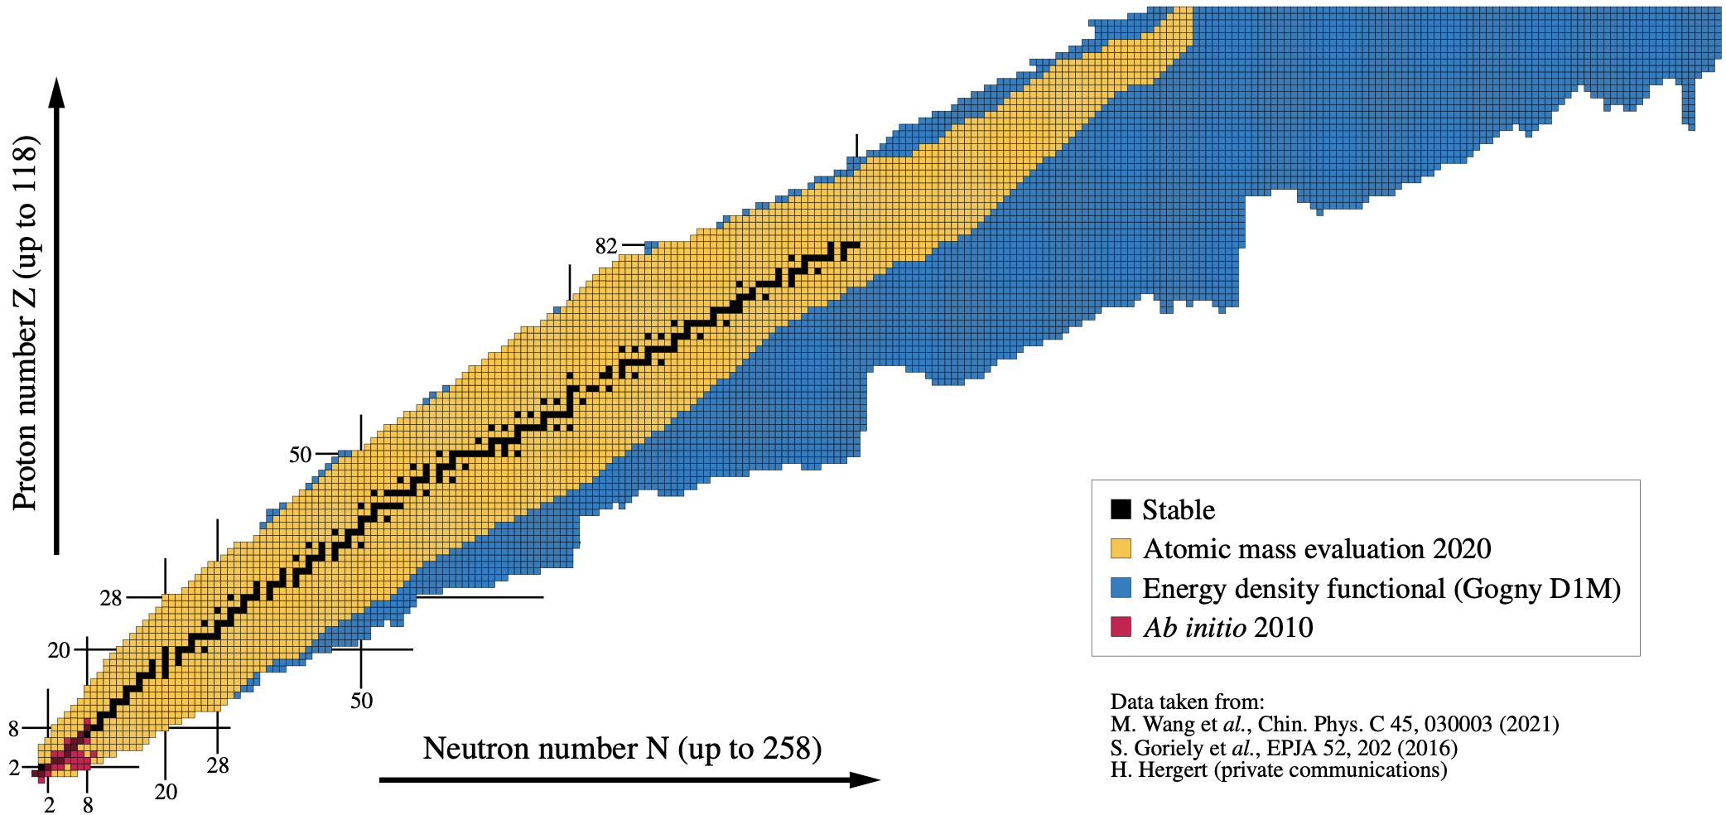
Ground-state ab initio nuclear chart… then
Quasi-exact methods (>1990)
Examples: No core shell-model (NCSM)
Green’s function monte carlo (GFMC)
2010
[Figure: B. Bally]

Slide 14
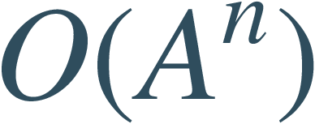

Ground-state ab initio nuclear chart… now!
Single-reference expansion methods (>2010)
Hybrid methods for open shell (>2015)
Scaling:
CPU scalable (memory limitations arise)
Examples: Valence-space in-medium similarity renormalization group (VS-IMSRG)
Multi-configuration perturbation theory (MCPT)
+
CPU not scalable
Scaling:
SC expansion methods for open shell (>2022)
Examples: Projected Bogoliubov coupled cluster theory (PdCC)
Projected generator coordinate method perturbation theory (PGCM-PT)
Scaling:
CPU scalable
Uncertainty quantification in ²⁰⁸Pb
Hu et al., Nature Physics (2022)
Charge radii in ¹³⁸Xe
Arthuis et al., PRL (2020)
Detailed structure of ¹⁰⁰Sn
Morris et al., PRL (2018)
Binding energy of ¹⁰⁰⁻¹⁷⁰Sn
Tichai, Demol, Duguet, PLB (2024)
Mass and spectroscopy ~¹³²Sn
Miyagi et al., PRC (2022)
Global mass predictions of ~700 nuclei
Stroberg et al., PRL (2021)
Rotational excitations in ²⁰Ne
Novario et al., PRC (2021)
Hagen et al., PRC (2022)
Frosini et al., EPJA (2022)
2024
[Figure: B. Bally]

Slide 15
Contents
⦿ Ab initio expansion many-body methods for closed- and open-shell nuclei
⦿ How many-body correlations come in at polynomial cost = pedagogical account
⦿ Pushing to high accuracy and to heavier open-shell nuclei at polynomial cost

Slide 16
Numerical applications
Empirically optimal for ground-state energies
Not optimal for radii → Use also of ΔNNLO_{GO}(394) Hamiltonian
Stroberg et al., PRL (2021)
Hamiltonian
Jiang et al., PRC (2020)
⦿ Chiral-based Hamiltonian EM 1.8/2.0
⦿ Three-nucleon interaction rank-reduced to effective two-body interaction
Hebeler et al., PRC (2011)
Frosini et al., EPJA (2021)
Systems
Heaviest open-shell nuclei ever computed ab initio so far
Tichai, Demol; Duguet., PLB (2024)
⦿ Ca (Z=20) and Sn (Z=50) even-even singly open-shell isotopes
⦿ Cr (Z=24) and Ne (Z=10) even-even doubly open-shell isotopes
Model-space parameters
⦿ Spherical harmonic oscillator basis (hw= 12)
⦿ e_{max} ≡ max(2n + l) = 12 and e_{3max} = 18 (24) in Ca and Cr (Sn) isotopes
Miyagi et al., PRC (2022)
Many-body methods
Observables
⦿ sBMBPT(2)
⦿ sBCCSD[T]
⦿ dBMBPT(2)
⦿ dDSCGF[2]
⦿ Absolute binding energy
⦿ Two-neutron separation energy
⦿ Two-neutron shell gap
⦿ Neutron three-point mass difference
⦿ Charge radius
⦿ Neutron skin
Tichai et al., PLB (2018)
Tichai et al., PLB (2024)
Frosini et al., EPJA (2021)
Scalesi et al., unpublished
►against sVS-IMSRG(2)
Stroberg et al., PRL (2021)

Slide 17
Contents
⦿ Ab initio expansion many-body methods for closed- and open-shell nuclei
⦿ How many-body correlations come in at polynomial cost = pedagogical account
How does the ab initio spherical mean-field looks like along the Ca chain?
How dynamical correlations improve the ab initio spherical mean-field?
What happens to the ab initio mean-field when going to the Cr chain?
Where is the pairing gone?
⦿ Pushing to high accuracy and to heavier open-shell nuclei at polynomial cost

Slide 18
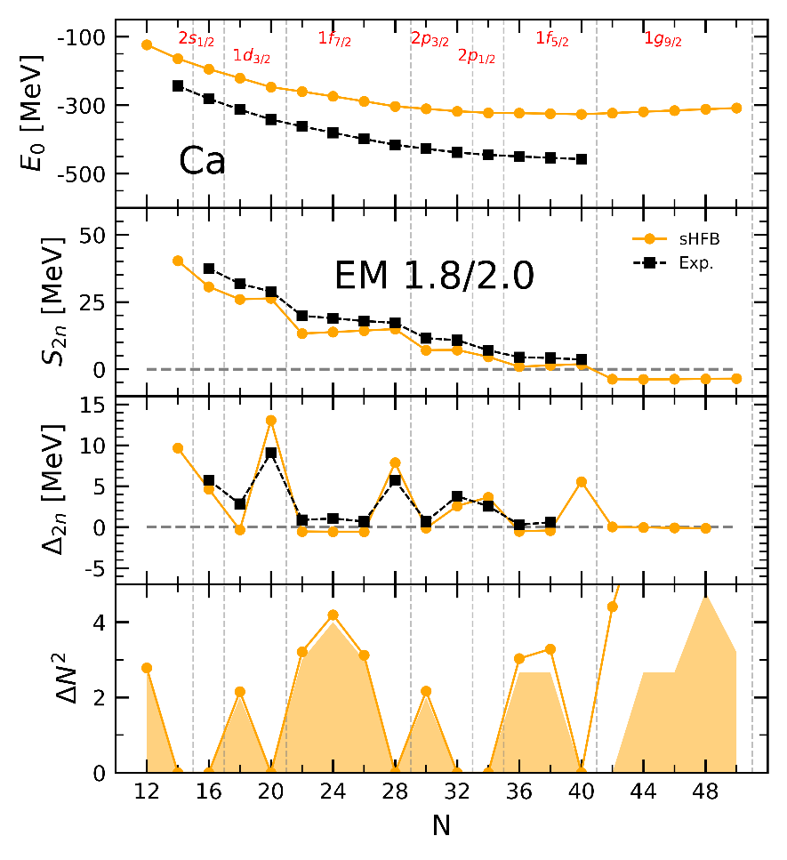
How does the spherical ab initio mean-field looks like?
Scalesi et al., arXiv:2406.03545
sHFB unbound by [80,130] MeV (account for ~70% of BE)
→ Expected due to missing dynamical correlations
→ Would be more pronounced with a “harder” Hamiltonian
→ Deficit increases with neutron excess
sHFB E(N,Z) wrongly concave throughout open-shells
→ Systematic with (soften) χEFT Hamiltonians
Positive slope
sHFB S_{2n}(N,Z)
→ Too low at the beginning of the shells
→ Exaggerated jumps/magicity at N=20,28
Negative value
Pairing gap ~20% of exp Δ⁽³⁾ at sHFB level
→ Systematic with (soften) χEFT Hamiltonians
→ Despite large ¹S₀ a_{nn} inducing Cooper pair instability
→ Pairing strictly zero in doubly open-shell mid-mass nuclei
Very different picture from empirical EDF effective sHFB
→ m* fitted to be close to empirical value
→ Interaction fitted to match experimental Δ⁽³⁾(N,Z)
ΔN² close to « zero-pairing limit of HFB (HFB-ZP) »
Duguet, Bally, Tichai, PRC (2020)
Superfluidity “fine-tuned” from a many-body standpoint = description at polynomial cost challenging^{*see back up slides}

Slide 19
Contents
⦿ Ab initio expansion many-body methods for closed- and open-shell nuclei
⦿ How many-body correlations come in at polynomial cost = pedagogical account
How does the ab initio spherical mean-field looks like along the Ca chain?
How dynamical correlations improve the ab initio spherical mean-field?
What happens to the ab initio mean-field when going to the Cr chain?
Where is the pairing gone?
⦿ Pushing to high accuracy and to heavier open-shell nuclei at polynomial cost

Slide 20
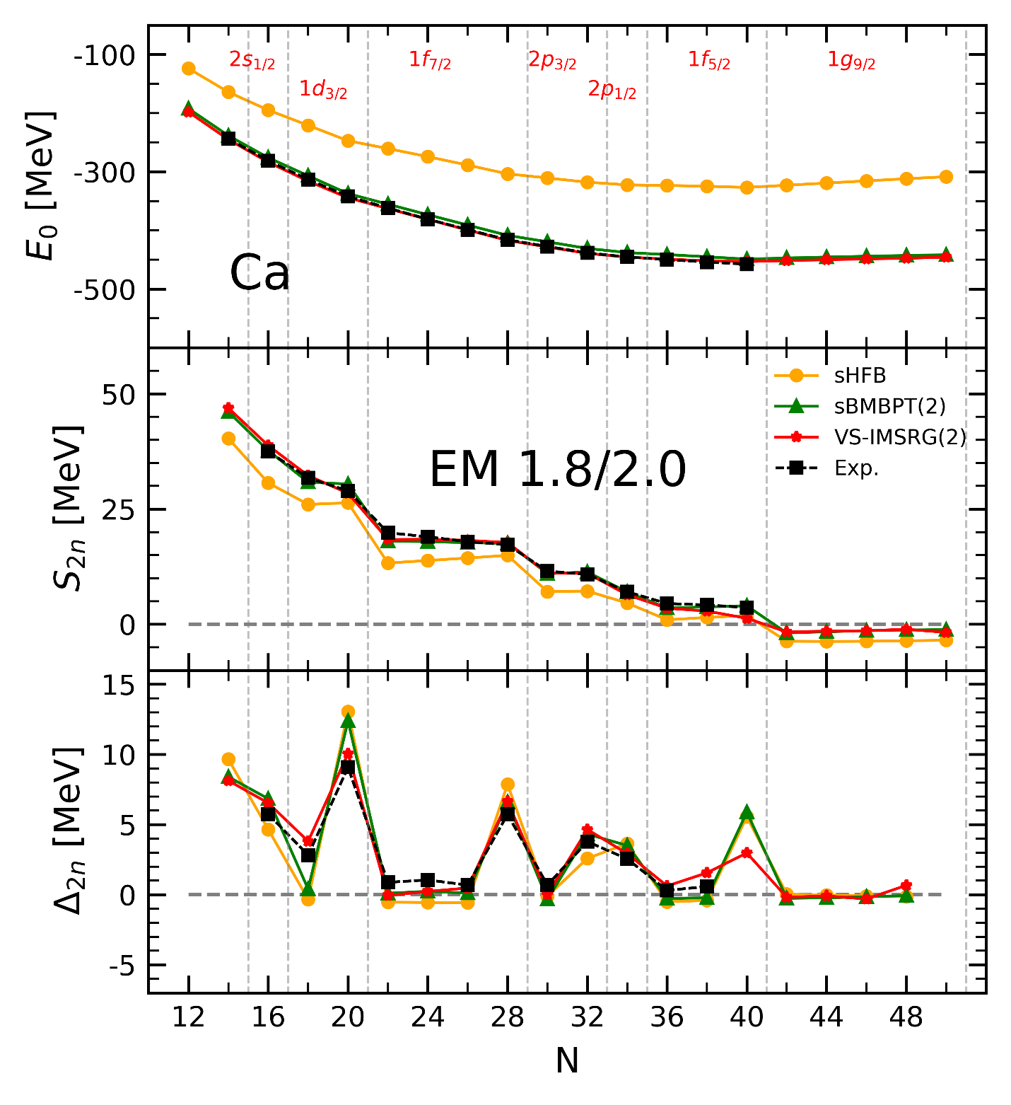
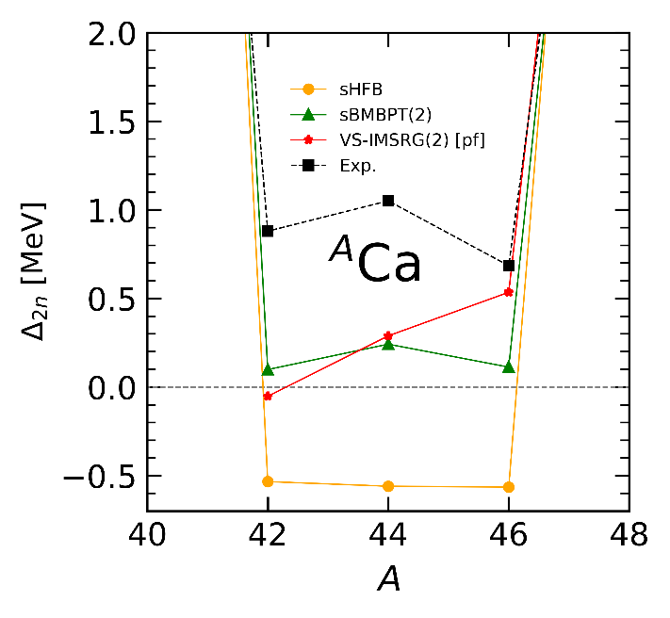
Effect of dynamical correlations in semi-magic nuclei
Scalesi et al., arXiv:2406.03545
sBMBPT(2) adds [80,130] MeV correlation energy
→ Compensates deficit with neutron excess (a_{sym})
→ rms error to sVS-IMSRG(2) (exp) = 6.9 (7.3) MeV
sBMBPT(2) E(N,Z) correctly convex in open-shells
→ Curvature has correct sign but too small
→ Similar for sVS-IMSRG(2) with ⁴⁰Ca core

Slide 21
Effect of dynamical correlations in semi-magic nuclei
Scalesi et al., arXiv:2406.03545
sBMBPT(2) adds [80,130] MeV correlation energy
→ Compensates deficit with neutron excess (a_{sym})
→ rms error to sVS-IMSRG(2) (exp) = 6.9 (7.3) MeV
sBMBPT(2) E(N,Z) correctly convex in open-shells
→ Curvature has correct sign but too small
→ Similar for sVS-IMSRG(2) with ⁴⁰Ca core
Curvature in sBMBPT(2)
sHFB (EFA)
Monopole valence-shell 2-body matrix element
sBMBPT(2) (EFA)
2nd order effective valence-shell monopole 2-body matrix element due to 2p and 2h excitations

Slide 22
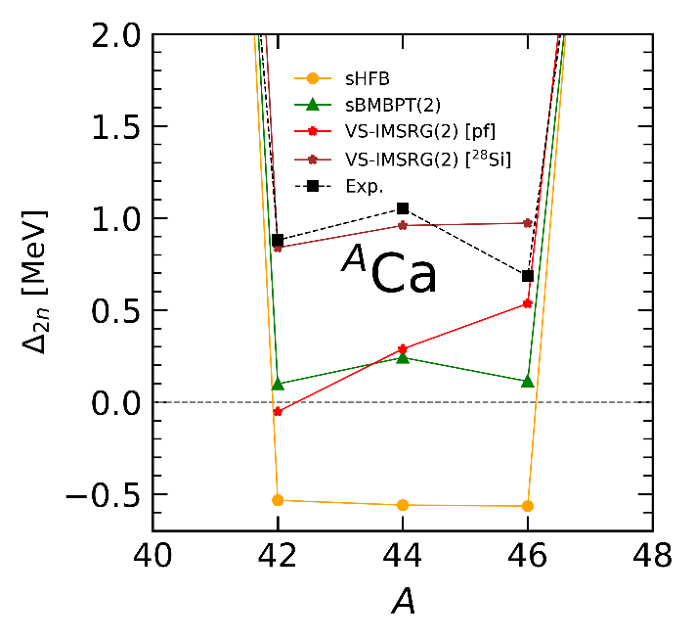
Effect of dynamical correlations in semi-magic nuclei
Scalesi et al., arXiv:2406.03545
sBMBPT(2) adds [80,130] MeV correlation energy
→ Compensates deficit with neutron excess (a_{sym})
→ rms error to sVS-IMSRG(2) (exp) = 6.9 (7.3) MeV
sBMBPT(2) E(N,Z) correctly convex in open-shells
→ Curvature has correct sign but too small
→ Similar for sVS-IMSRG(2) with ⁴⁰Ca core
Full diago via sVS-IMSRG(2) not better
Miyagi, Priv. Comm.
sVS-IMSRG(2) with ²⁸Si core gets it right
→ Collective fluctuations of ⁴⁰Ca core key
Curvature improved by low-order dynamical correlations
Collective fluctuations needed to be quantitative
►At least third order in non-perturbative expansion methods…
Infamous charge radius problem not solved
→ At variance with
Caurier et al., PLB (2001)

Slide 23
Effect of dynamical correlations in semi-magic nuclei
Scalesi et al., arXiv:2406.03545
sBMBPT(2) adds [80,130] MeV correlation energy
→ Compensates deficit with neutron excess (a_{sym})
→ rms error to sVS-IMSRG(2) (exp) = 6.9 (7.3) MeV
sBMBPT(2) E(N,Z) correctly convex in open-shells
→ Curvature has correct sign but too small
→ Similar for sVS-IMSRG(2) with ⁴⁰Ca core
sBMBPT(2) S_{2n}(N,Z)
→ Increases at the beginning of the open shells
→ Exaggerated jump/magicity at N=20 remains
S_{2n} entering open shell in sBMBPT(2)
HF-EFA
Mean-field valence shell single-particle energy
2nd order self-energy correction due to 2h-1p and 1h-2p excitations
MBPT(2)-EFA
Starting S_{2n} ok with low-order dynamical correlations
Not sufficient for Δ_{2n} at N=20
Σ⁽²⁾_{f7/2} = -5 MeV

Slide 24
Contents
⦿ Ab initio expansion many-body methods for closed- and open-shell nuclei
⦿ How many-body correlations come in at polynomial cost = pedagogical account
How does the ab initio spherical mean-field looks like along the Ca chain?
How dynamical correlations improve the ab initio spherical mean-field?
What happens to the ab initio mean-field when going to the Cr chain?
Where is the pairing gone?
⦿ Pushing to high accuracy and to heavier open-shell nuclei at polynomial cost

Slide 25
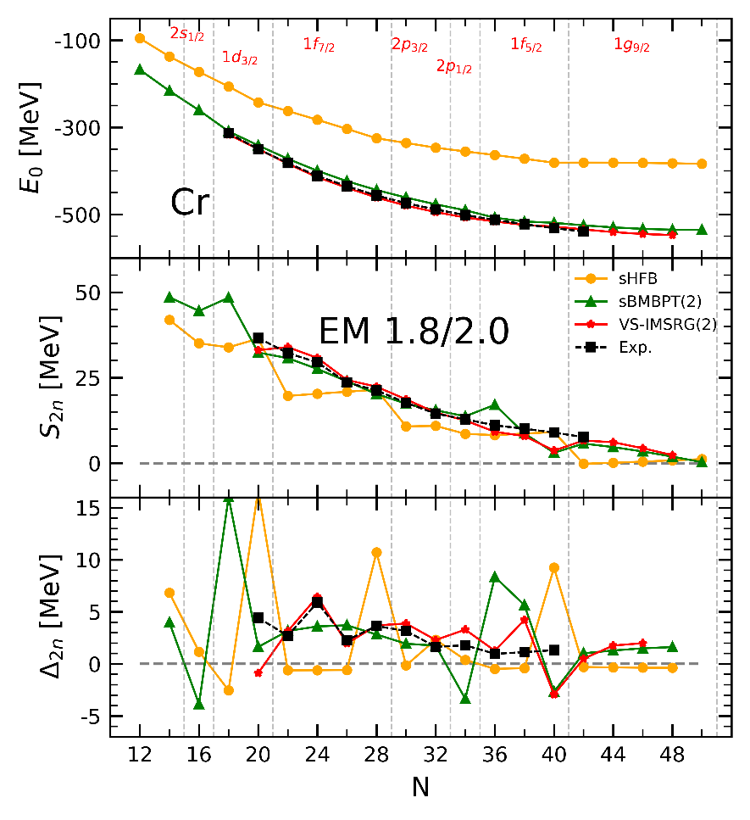
What about doubly open-shell nuclei?
Scalesi et al., arXiv:2406.03545
sHFB displays same wrong features
→ Concavity and exaggerated magicity at N=20,28
→ Magicity signature has disappeared from data
Dynamical correlations
→ sBMBPT(2) remains qualitatively wrong
→ sVS-IMSRG(2) correct via full diagonalization in VS
How to do the same at polynomial cost?

Slide 26
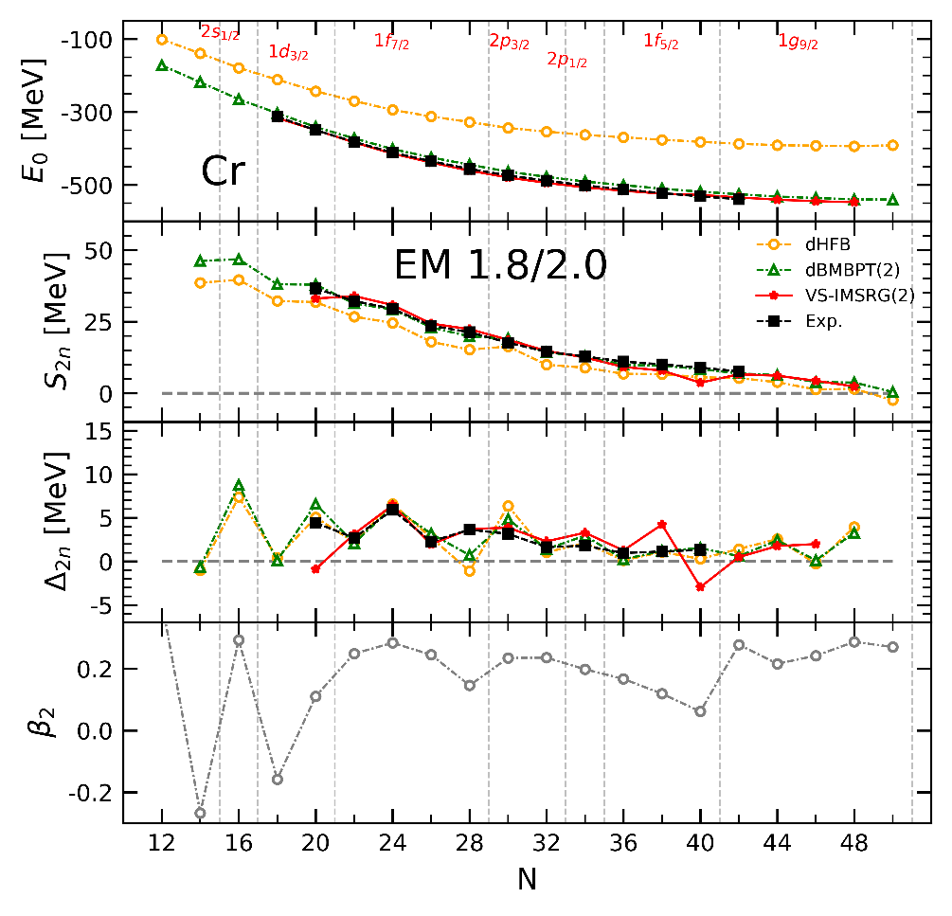
What about doubly open-shell nuclei?
Scalesi et al., arXiv:2406.03545
sHFB displays same wrong features
→ Concavity and exaggerated magicity at N=20,28
→ Magicity signature has disappeared from data
Dynamical correlations
→ sBMBPT(2) remains qualitatively wrong
→ sVS-IMSRG(2) correct via full diagonalization in VS
Allowing for static deformation via breaking SU(2)
→ dHFB qualitatively correct thanks to static correlations
→ Missing dynamical correlations ok via dBMBPT(2)

Slide 27
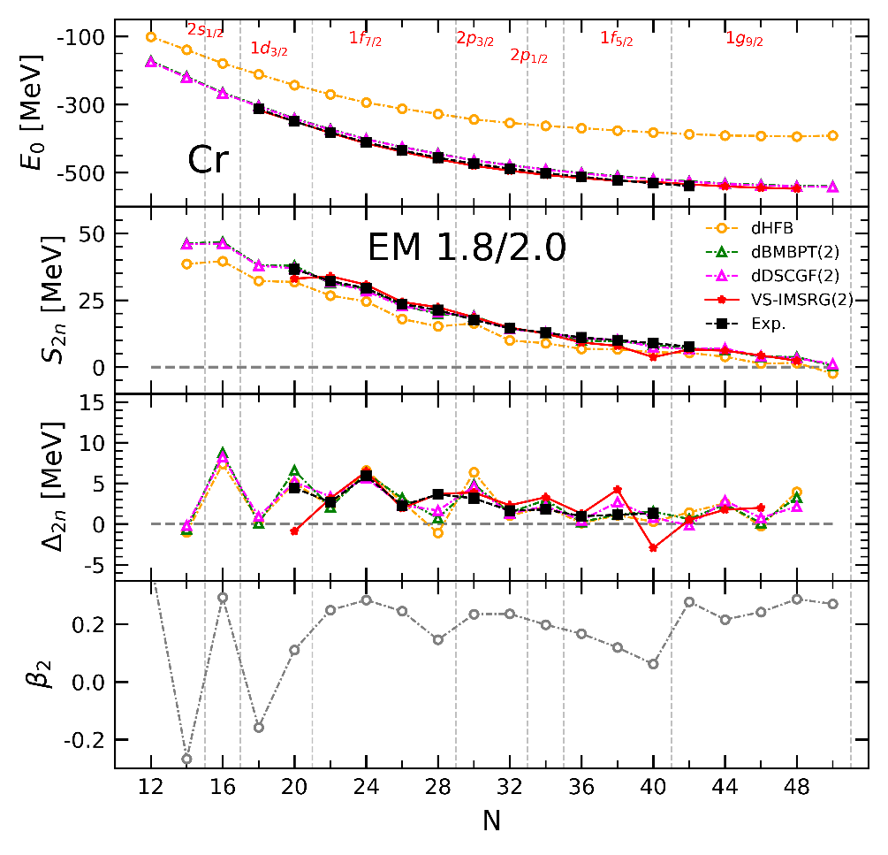
What about doubly open-shell nuclei?
Scalesi et al., unpublished
sHFB displays same wrong features
→ Concavity and exaggerated magicity at N=20,28
→ Magicity signature has disappeared from data
Dynamical correlations
→ sBMBPT(2) remains qualitatively wrong
→ sVS-IMSRG(2) correct via full diagonalization in VS
Allowing for static deformation via breaking SU(2)
→ dHFB qualitatively correct thanks to static correlations
→ Missing dynamical correlations ok via dBMBPT(2)
Go non-perturbative to be fully quantitative: dDSCGF[2]
→ Consistent with dBMBPT(2) soft Hamiltonian employed

Slide 28
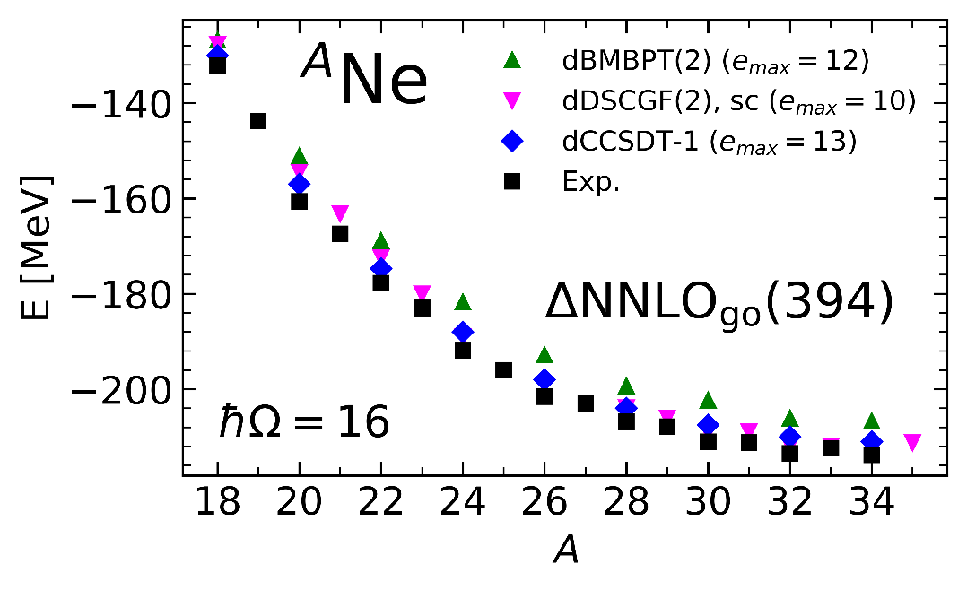
What about doubly open-shell nuclei?
Scalesi et al., unpublished
Novario et al., PRC (2020)
Very recent design of non-perturbative dDSCGF[2] expansion method
→ +4.2 MeV binding on average compared to dBMBPT(2)
→ Very consistent with dCCSDT-1 but slight trend with neutron excess
→ Access to odd nuclei on the same footing
Allowing for deformation is the key feature to describe doubly open-shell nuclei at polynomial cost

Slide 29
Contents
⦿ Ab initio expansion many-body methods for closed- and open-shell nuclei
⦿ How many-body correlations come in at polynomial cost = pedagogical account
How does the ab initio spherical mean-field looks like along the Ca chain?
How dynamical correlations improve the ab initio spherical mean-field?
What happens to the ab initio mean-field when going to the Cr chain?
Where is the pairing gone?
⦿ Pushing to high accuracy and to heavier open-shell nuclei at polynomial cost

Slide 30
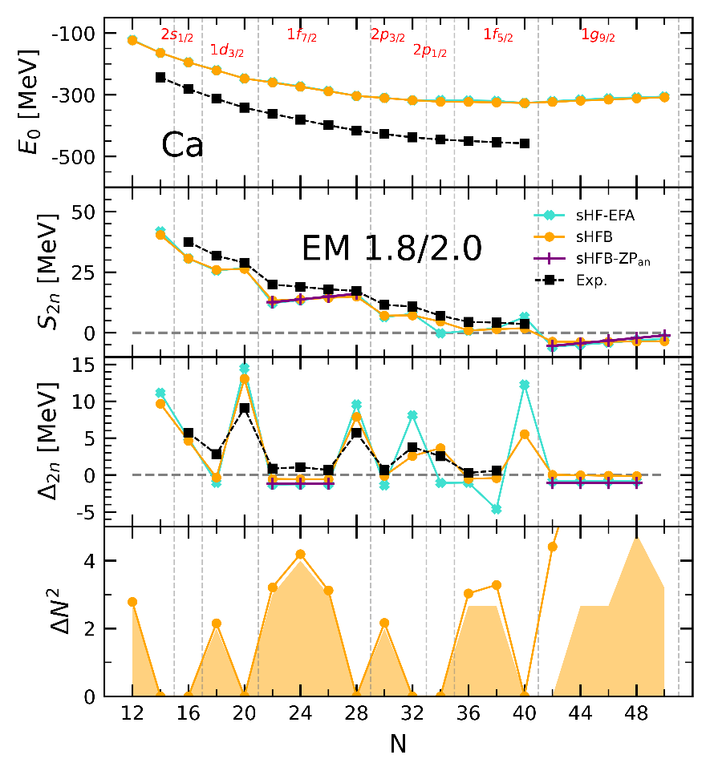
Where is the pairing gone?^{© G. Hagen, T. Duguet}
Scalesi et al., arXiv:2406.03545
sHFB displays weak pairing
→ S_{2n} and Δ_{2n} very close with HF-EFA and HFB-ZP
→ Gives ~20% of exp Δ⁽³⁾
→ Too-low effective mass m*
→ Too weak pairing kernel = bare nn vertex

Slide 31
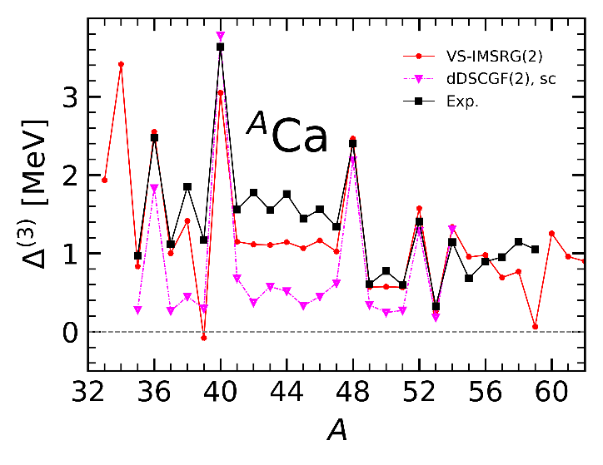
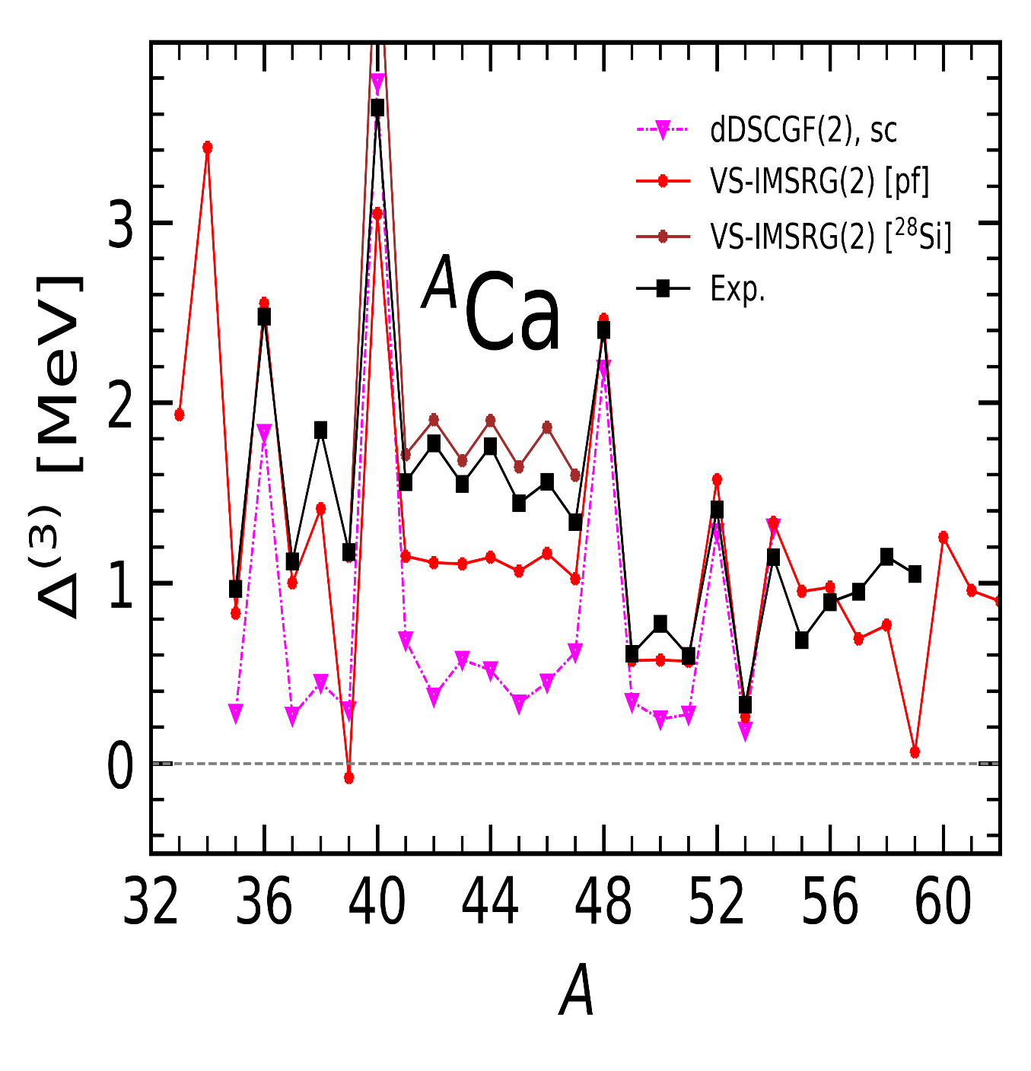
Where is the pairing gone?^{© G. Hagen, T. Duguet}
Scalesi et al., unpublished
sHFB displays weak pairing
→ S_{2n} and Δ_{2n} very close with HF-EFA and HFB-ZP
→ Gives ~20% of exp Δ⁽³⁾
→ Too-low effective mass m*
→ Too weak pairing kernel = bare nn vertex
Dynamical correlations
→ Low-order via sDSCGF(2) ≈ 30% of exp Δ⁽³⁾
→ sVS-IMSRG(2) with ⁴⁰Ca core ≈ 70% of exp Δ⁽³⁾
→ Higher-order collective process = exchange of vibrations
EM 1.8/2.0
Barranco et al., JPCS (2011)
Miyagi, Priv. Comm.
sVS-IMSRG(2) with ²⁸Si core = 100% of exp Δ⁽³⁾!
→ Collective fluctuations of ⁴⁰Ca core does it
At what polynomial cost can this be captured?

Slide 32
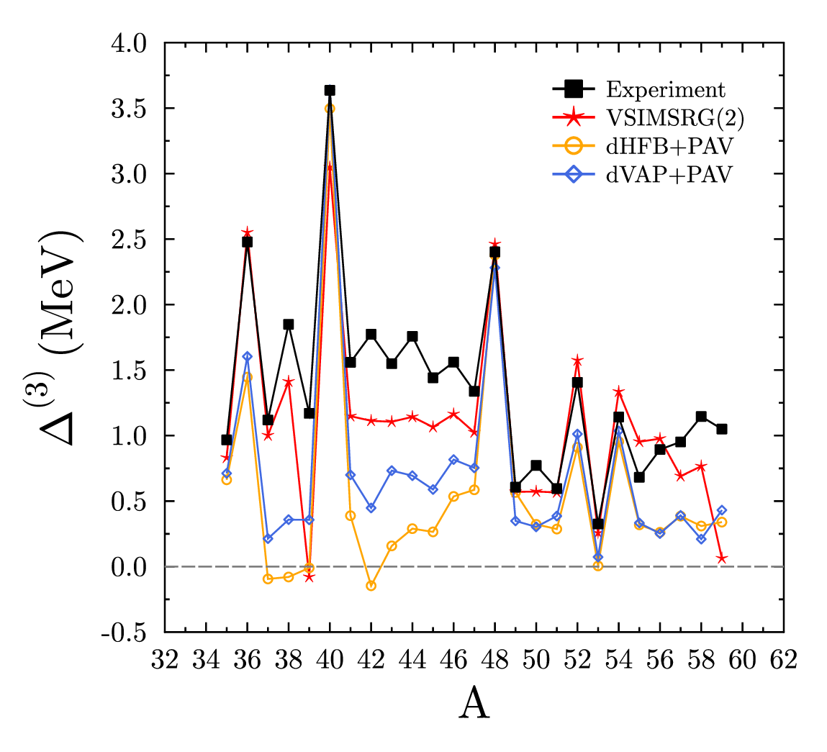
Where is the pairing gone?^{© G. Hagen, T. Duguet}
Bally et al., unpublished
sHFB displays weak pairing
→ S_{2n} and Δ_{2n} very close with HF-EFA and HFB-ZP
→ Gives ~20% of exp Δ⁽³⁾
→ Too-low effective mass m*
→ Too weak pairing kernel = bare nn vertex
Dynamical correlations
→ Low-order via sDSCGF(2) ≈ 30% of exp Δ⁽³⁾
→ sVS-IMSRG(2) with ⁴⁰Ca core ≈ 70% of exp Δ⁽³⁾
→ Higher-order collective process = exchange of vibrations
EM 1.8/2.0
Use richer unperturbed state (first step here)
Deformed Bogoliubov with full blocking in odd isotopes
+VAP on N&Z
+PAV on J^{π}
→ 40% of exp Δ⁽³⁾: not enough as expected
Collective vibrations of ⁴⁰Ca « core » adding GCM
Dynamical correlations on top via PGCM-PT
Frosini et al., EPJA (2022)
Superfluidity “fine-tuned” from a many-body standpoint
►A quantitative ab initio description at polynomial cost is a challenge for the future

Slide 33
Contents
⦿ Ab initio expansion many-body methods for closed- and open-shell nuclei
⦿ How many-body correlations come in at polynomial cost = pedagogical account
⦿ Pushing to high accuracy and to heavier open-shell nuclei at polynomial cost
BCCSD and BCCSD[T] ground-state energies in Ca and Sn isotopes
BCCSD ground-state charge radii and neutron skins in Sn isotopes

Slide 34
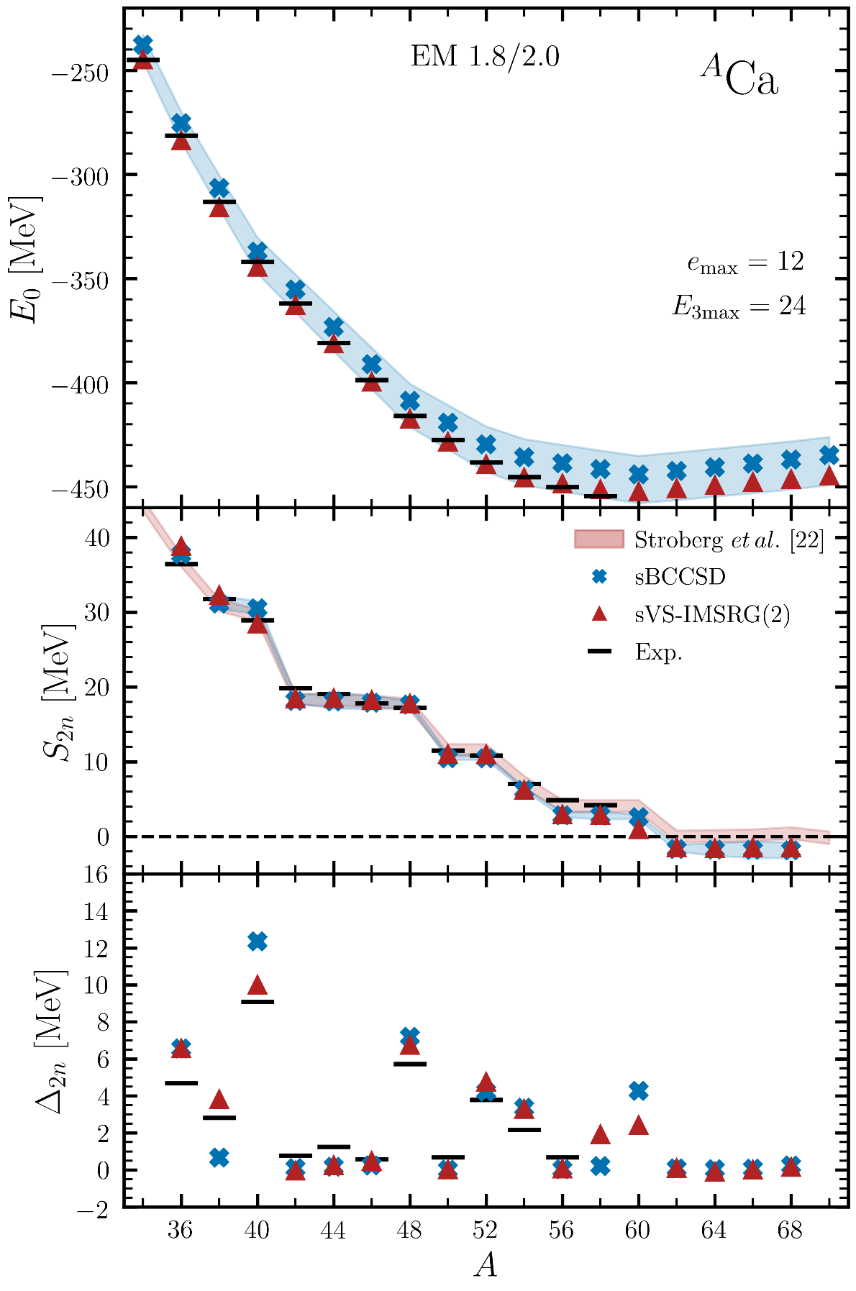
Pushing to greater accuracy in open-shell nuclei…
Tichai et al., PLB (2024)
Novel non-perturbative sBCCSD (sBMBPT(3) complete)
σ_{th-exp}(E) = 9 MeV (2.3%)
→ 2 MeV for sVS-IMSRG(2)
Exaggerated N=20 magicity / N=28,32,34 magicity ok
Predicted magicity at N=40
  → Exaggerated compared to sVS-IMSRG(2)
  Neutron drip-line predicted in ⁶⁰Ca (closing of 1f_{5/2})
  → Consistent with sVS-IMSRG(2)
Dominating many-body uncertainty
Many-body uncertainties
Can it be removed?

Slide 35
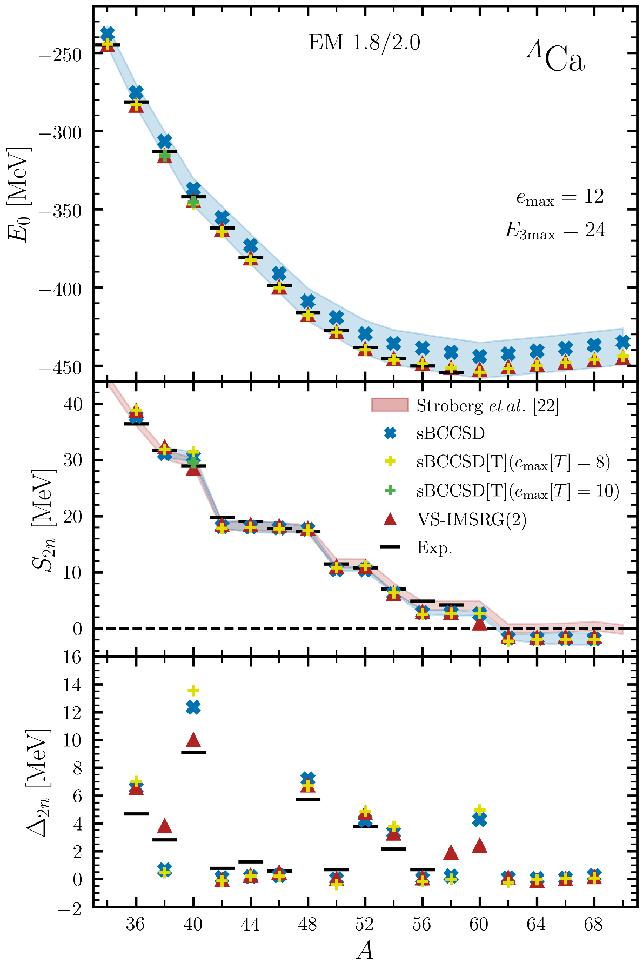
Pushing to greater accuracy in open-shell nuclei…
Vernik et al., unpublished
sBCCSD[T] = adding perturbative triples correction
Challenging n_{dim}⁷ process
σ_{th-exp}(E) = 9 MeV (2.3%) ► 2.1 MeV (0.5%)
→ 2 MeV for sVS-IMSRG(2)
Magicity&drip-line essentially unchanged
→ Relative energies not much affected
→ But [T] still moving from e_{max}=8 to e_{max}=10
→ Do we need feedback onto BCCSD (i.e. T₁&T₂) part?
→ Would naively be a n_{dim}⁸ process…
Consistent with triples in closed-shell
→ [8.6,10.6]% of ΔE_{BCCSD} along chain
1.8 MeV
Many-body uncertainties

Slide 36
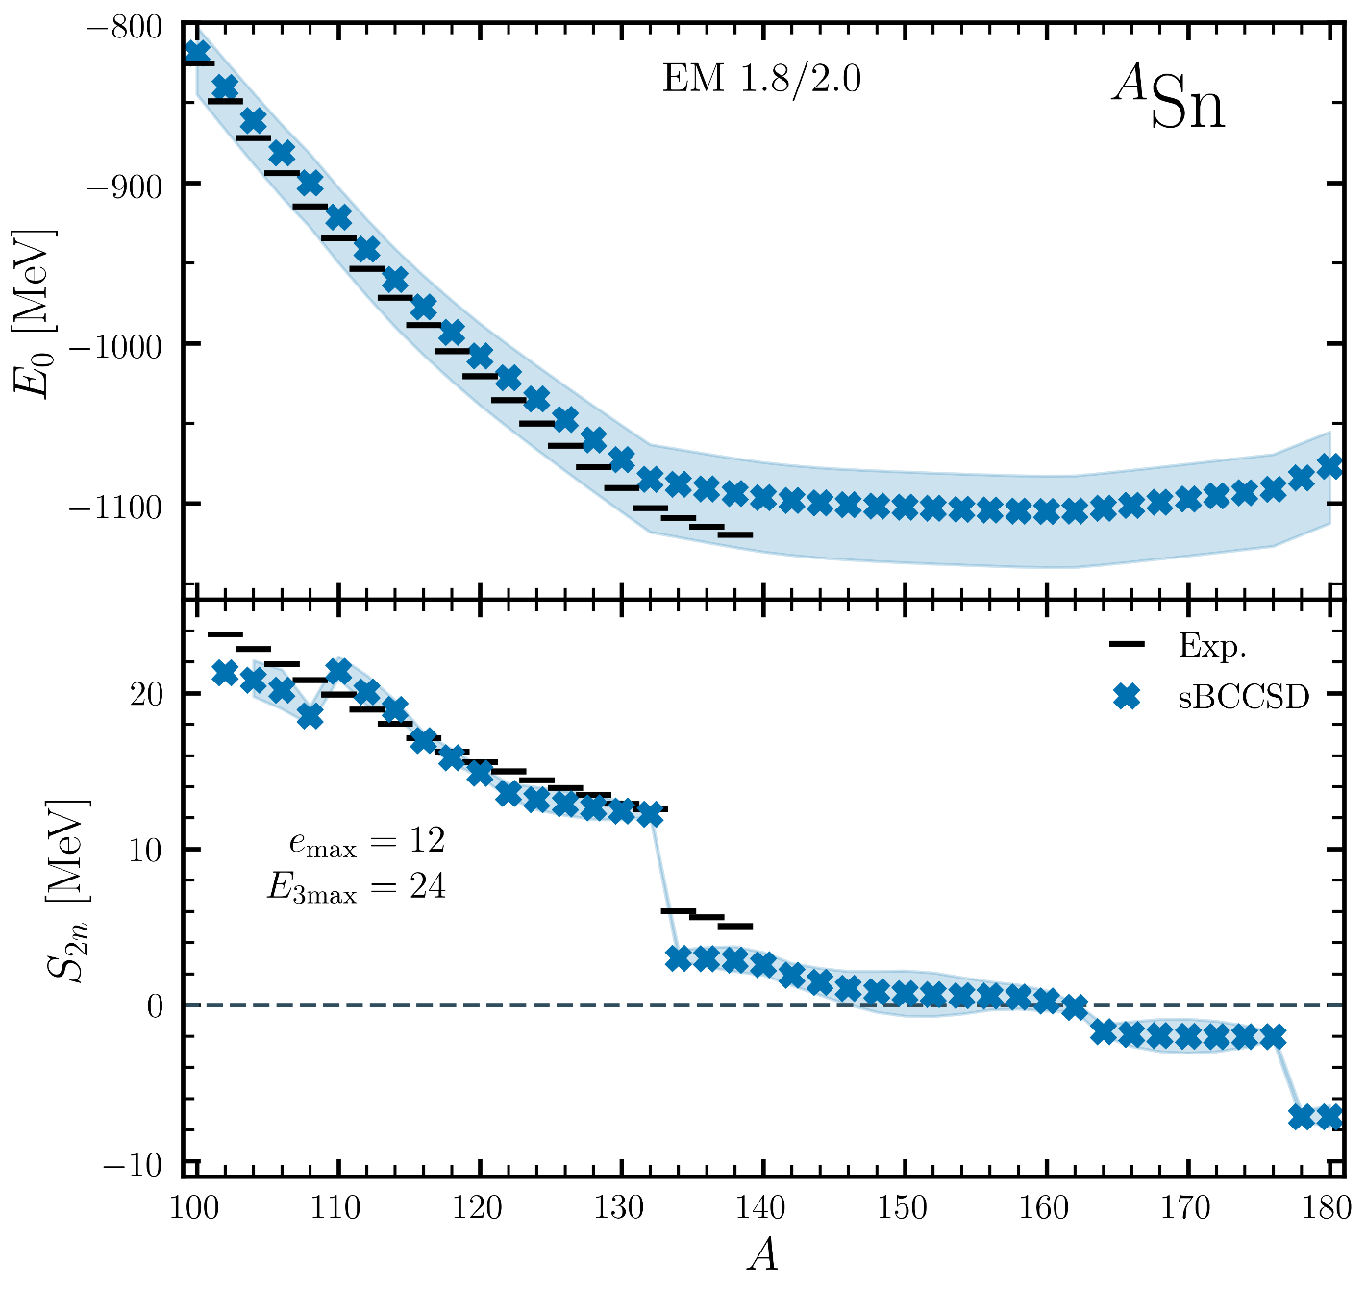
…before pushing to heavier open-shell nuclei
Tichai et al., PLB (2024)
Heaviest open-shell ab initio calculation
¹⁸⁰Sn
sBCCSD calculations of ^{A}Sn isotopes
Polynomial scaling makes possible to go beyond ¹³²Sn
σ_{th-exp} (E) = 15.4 MeV ~ 1.5%
Exaggerated N=82 magicity
→ Significant lack of binding in ¹³²⁻¹³⁸Sn
→ Outside many-body uncertainty estimate
→ Attributable to interaction uncertainty

Slide 37
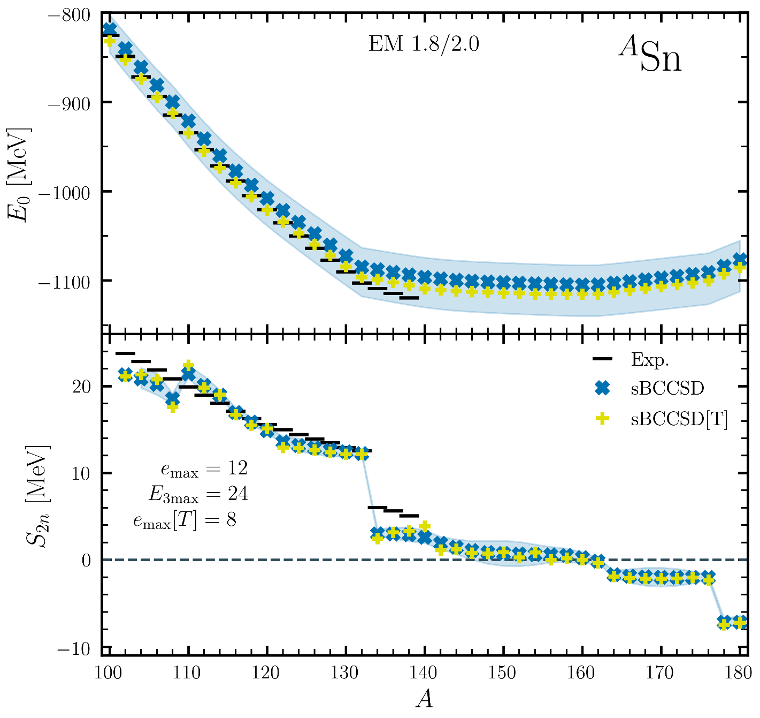
…before pushing to heavier open-shell nuclei
Vernik et al., unpublished
Heaviest open-shell ab initio calculation
¹⁸⁰Sn
sBCCSD calculations of ^{A}Sn isotopes
Polynomial scaling makes possible to go beyond ¹³²Sn
σ_{th-exp} (E) = 15.4 MeV ~ 1.5%
Exaggerated N=82 magicity
→ Significant lack of binding in ¹³²⁻¹³⁸Sn
→ Outside many-body uncertainty estimate
→ Attributable to interaction uncertainty
sBCCSD[T]
σ_{th-exp} (E) = 5.8 MeV ~ 0.5%
Exaggerated N=82 magicity remains
→ Little effect on relative energies as in ^{A}ca
→ Need to push to e_{max}=10

Slide 38
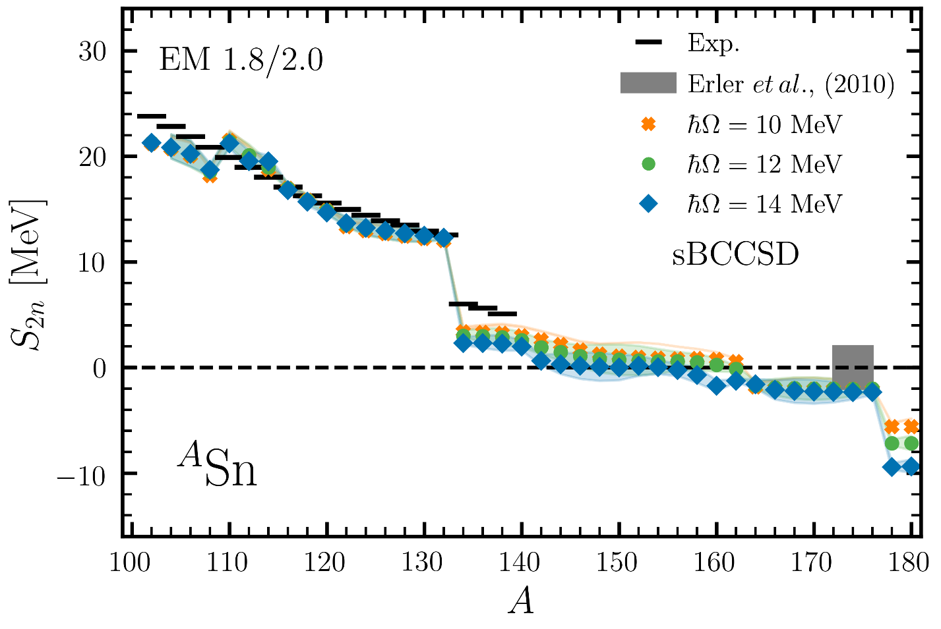
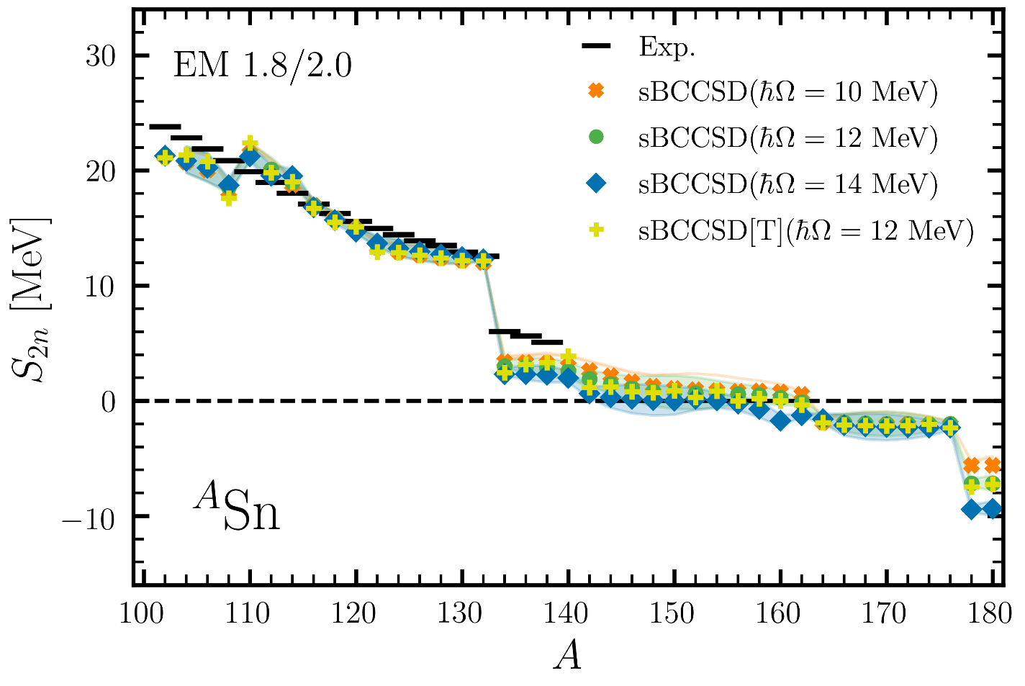
…before pushing to heavier open-shell nuclei
Vernik et al., unpublished
¹⁸⁰Sn
Tichai et al., PLB (2024)
Heaviest open-shell ab initio calculation
sBCCSD calculations of ^{A}Sn isotopes
Polynomial scaling makes possible to go beyond ¹³²Sn
σ_{th-exp} (E) = 15.4 MeV ~ 1.5%
Exaggerated N=82 magicity
→ Significant lack of binding in ¹³²⁻¹³⁸Sn
→ Outside many-body uncertainty estimate
→ Attributable to interaction uncertainty
sBCCSD[T]
σ_{th-exp} (E) = 5.8 MeV ~ 0.5%
Exaggerated N=82 magicity remains
→ Little effect on relative energies as in ^{A}ca
→ Need to push [T] to e_{max}=10
Very neutron-rich Sn isotopes
Significant sensitivity to hw value at e_{max} = 12
→ 1BB size uncertainty larger than estimated
Predicted drip-line location [¹⁴⁰Sn,¹⁶²Sn]
→ Much affected by 1BB size uncertainty: δN = 22!
→ Possibly equally affected by interaction uncertainty
→ Not affected by (perturbative) [T] at e_{max}=8
Could be compatible with EDF prediction
Need to push beyond e_{max} = 12 in heavy neutron-rich open-shell nuclei

Slide 39
Contents
⦿ Ab initio expansion many-body methods for closed- and open-shell nuclei
⦿ How many-body correlations come in at polynomial cost = pedagogical account
⦿ Pushing to high accuracy and to heavier open-shell nuclei at polynomial cost
BCCSD and BCCSD[T] ground-state energies in Ca and Sn isotopes
BCCSD ground-state charge radii and neutron skins in Sn isotopes

Slide 40
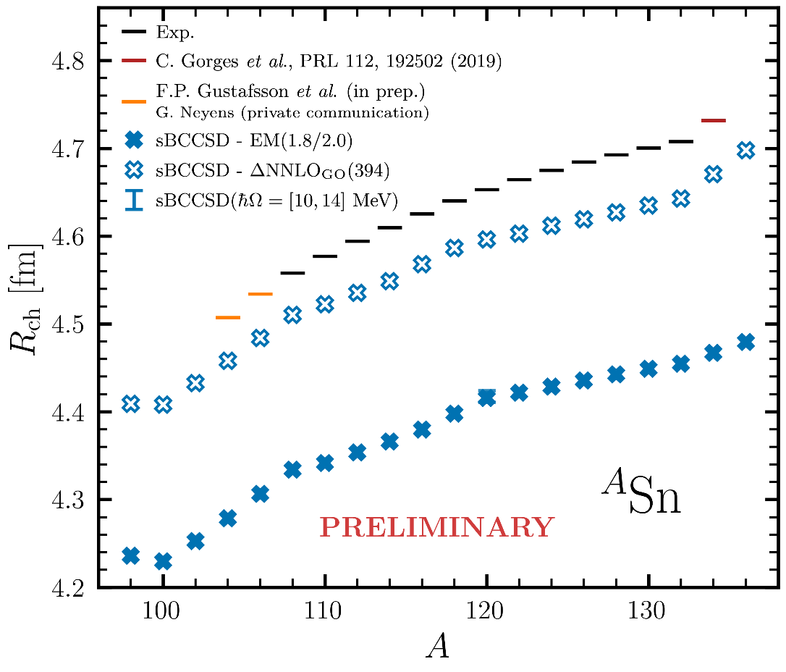
…and beyond energies: charge radii in Sn
Demol et al., unpublished
Absolute radii from sBCCSD
Recent/unpublished new data in ¹³⁴Sn/¹⁰⁴⁻¹⁰⁶Sn
Results depend strongly on χEFT-based interaction
→ EM 1.8/2.0 radii too small by 5%
→ ΔNNLOGo underestimates by 1%
→ Variants to be tested
Arthuis et al., arXiv:2401.06675

Slide 41
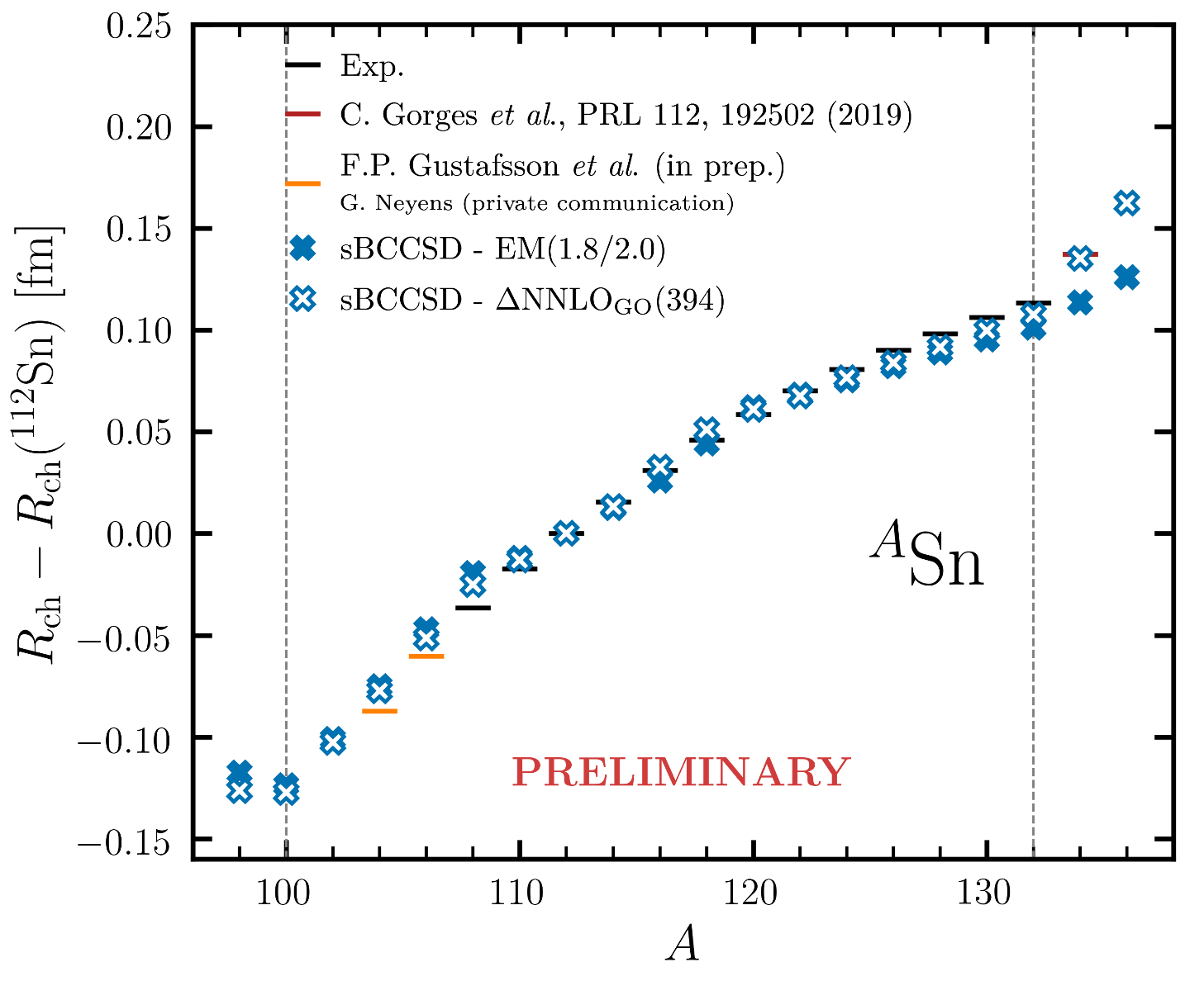
…and beyond energies: charge radii in Sn
Demol et al., unpublished
Absolute radii from sBCCSD
Recent/unpublished new data in ¹³⁴Sn/¹⁰⁴⁻¹⁰⁶Sn
Results depend strongly on χEFT-based interaction
→ EM 1.8/2.0 radii too small by 5%
→ ΔNNLOGo underestimates by 1%
→ Variant to be tested
Arthuis et al., arXiv:2401.06675
Isotope shifts
sBCCSD in great agreement with data (linear&quad)
Kink at N=82 thanks to recent data in ¹³⁴Sn
→ EM 1.8/2.0 underestimates it (too large S_{2n} drop)
→ ΔNNLOGo reproduces it (way too large S_{2n} drop) → Can variant capture it all?
Arthuis et al., arXiv:2401.06675
Going below ¹⁰⁴Sn and beyond ¹³⁴Sn
→ Possible at CRIS@ISOLDE in future with MR-TOF

Slide 42
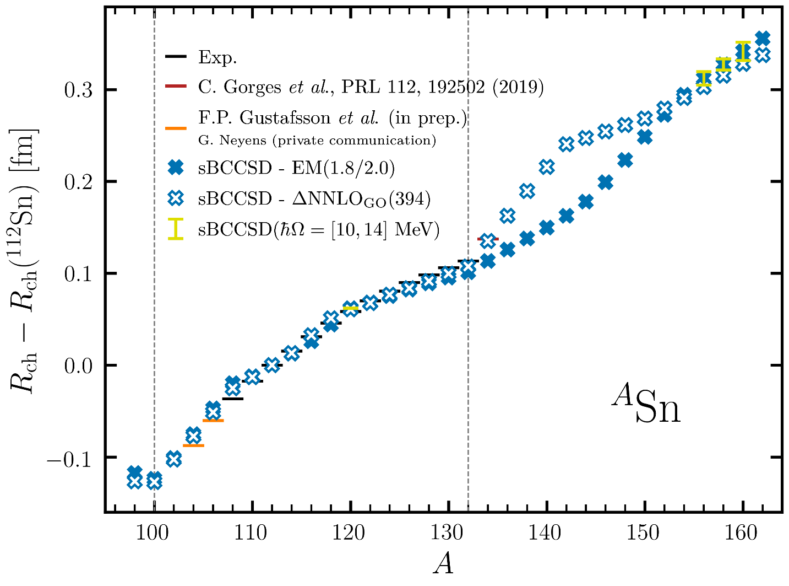
…and beyond energies: charge radii in Sn
Demol et al., unpublished
Absolute radii from sBCCSD
Recent/unpublished new data in ¹³⁴Sn/¹⁰⁴⁻¹⁰⁶Sn
Results depend strongly on χEFT-based interaction
→ EM 1.8/2.0 radii too small by 5%
→ ΔNNLOGo underestimates by 1%
→ Variants to be tested
Arthuis et al., arXiv:2401.06675
Isotope shifts
sBCCSD in great agreement with data (linear&quad)
Kink at N=82 thanks to recent data in ¹³⁴Sn
→ EM 1.8/2.0 underestimates it (too large S_{2n} drop)
→ ΔNNLOGo reproduces it (way too large S2n drop) → Can variant capture it all?
Arthuis et al., arXiv:2401.06675
Extension to very neutron rich isotopes
→ Possible thanks to polynomial scaling
→ Increased hw sensitivity at emax=12 with N-Z
→ Need thorough uncertainty quantification

Slide 43
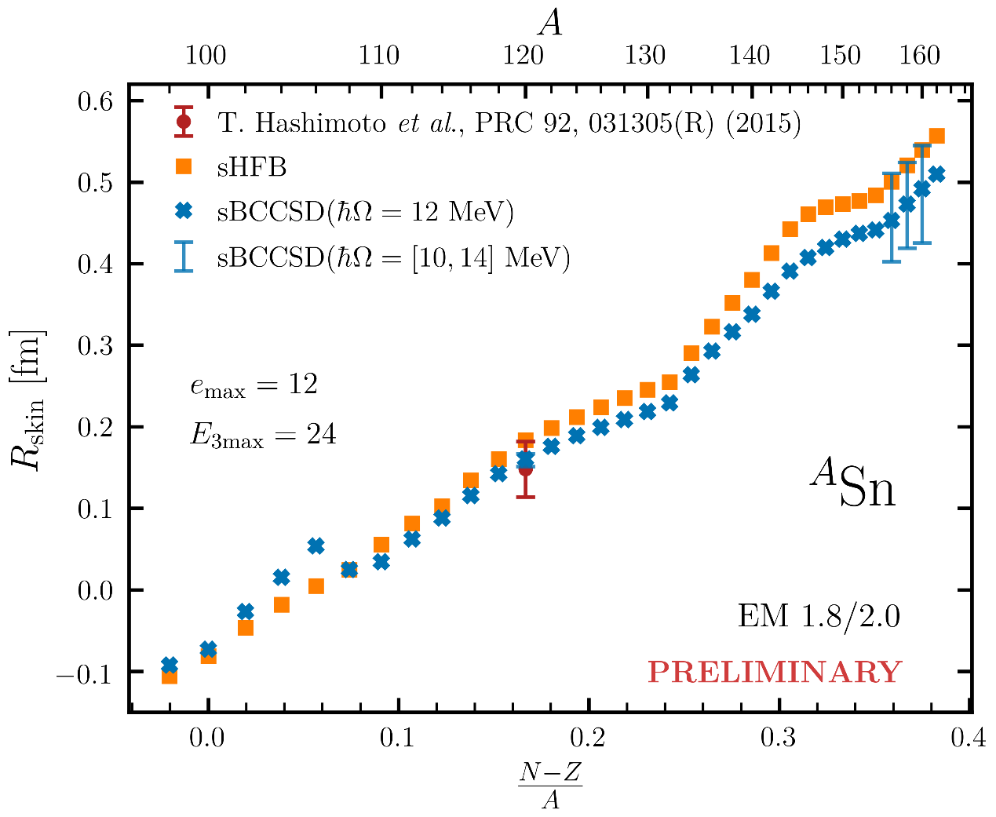

…and beyond energies: neutron skin in Sn
Demol et al., unpublished
Neutron skin thickness
Correlated to the symmetry energy slope L
→ Key information about the nuclear EOS
Extracted value in ¹²⁰Sn from α_{D} well reproduced
Very neutron rich isotopes
Sensitive to H in CS nuclei
→ Can be studied systematically here (to be done)
Linear with I=(N-Z)/A in CS nuclei
→ Kinks at N=82 and N=104
→ Driven by neutrons (but underestimated for protons!)
Impact of dynamical correlations (up to 0.05 fm)
→ Triples correction to be evaluated soon
More sensitive to hw value at e_{max} = 12
→ Uncertainty estimation (to be done)
Novario et al., PRL (2023)

Slide 44
Conclusions
►Ask me if not clear

