Slide 1
MWPC Spare Status
Inaki Ortega, Jean Cenede, Christophe Vuitton (SY-BI)
Jan Buesa (BE-EA)
Bertrand Mehl, Rui de Oliveira (EP-DT)
158th EATM

Slide 2
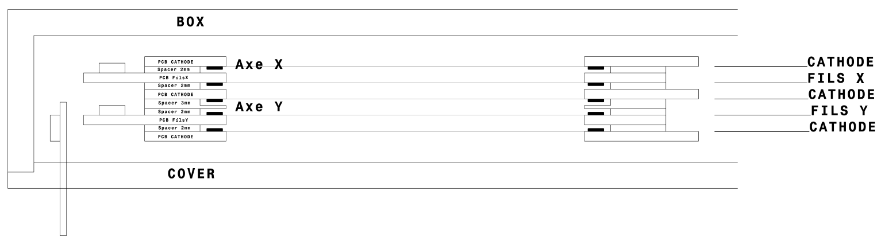
Quick update since the last EATM
We have a clear idea of how to produce a prototype of a wire chamber
The wires are welded on Printed Circuit Boards (PCB)
Two types of PCBs:
  Cathode for the HV
  Anode to recover the signal
We make a stack of Anodes and Cathodes following the same design as the old chambers
  Same stack (see image below)
  Same type of wires (cathode -> 100um Cu/Be; anode -> 20 um W/Au)
  Same pitch (cathode -> 2mm; anode -> 1mm)
  Same distance between planes -> we ensure the same electric field!
We enclose the stack in a hermetic box
  We abandon the idea of the original XWCAs -> unnecessarily complicated!
  We follow the principle of the DWC

Slide 3
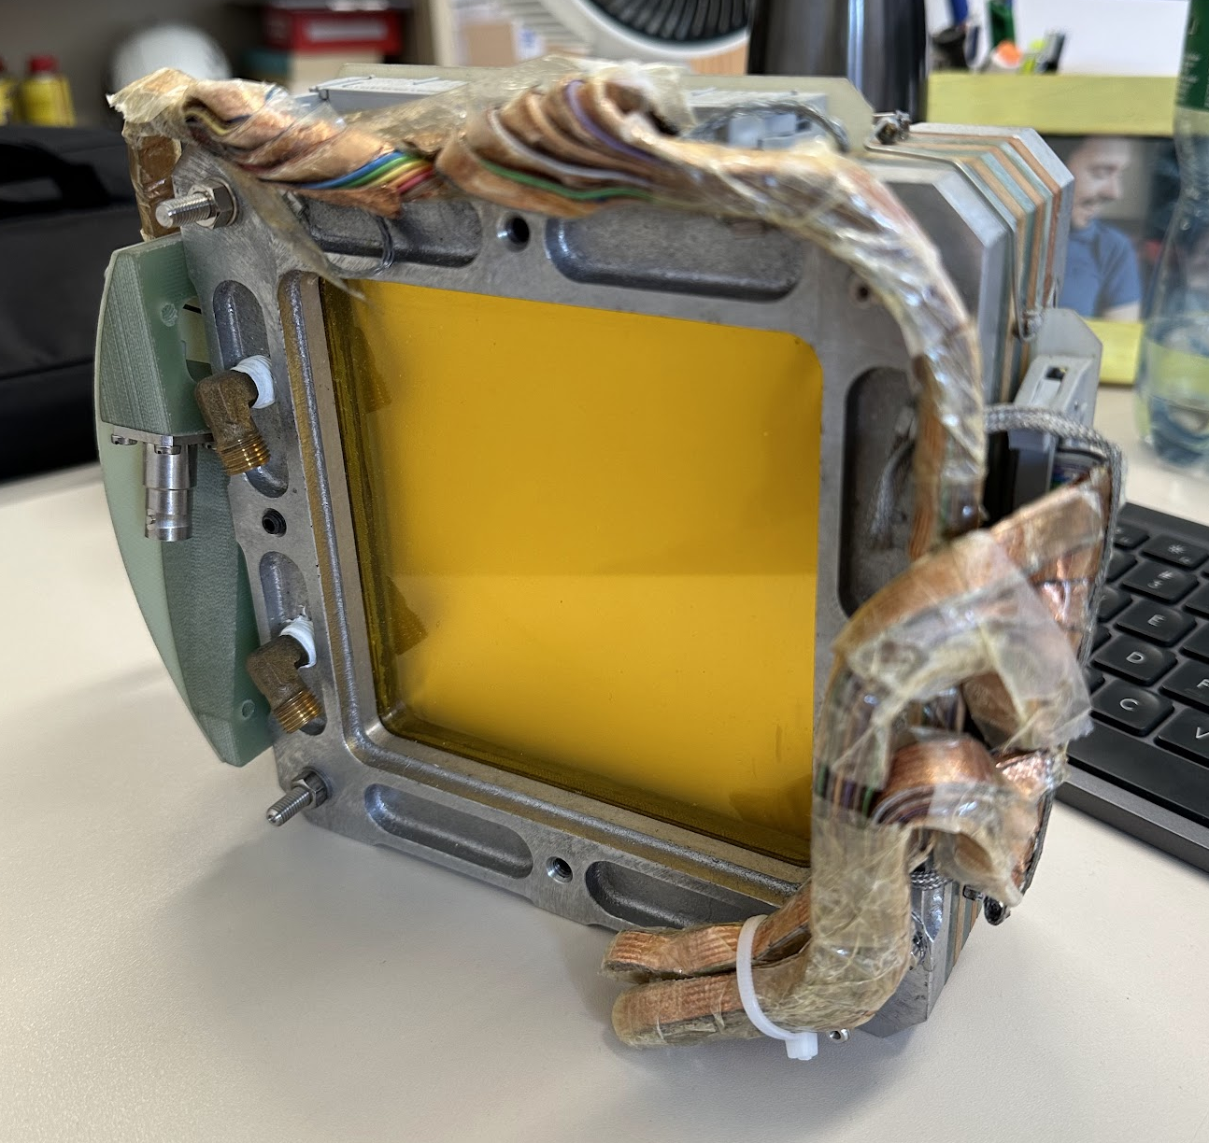
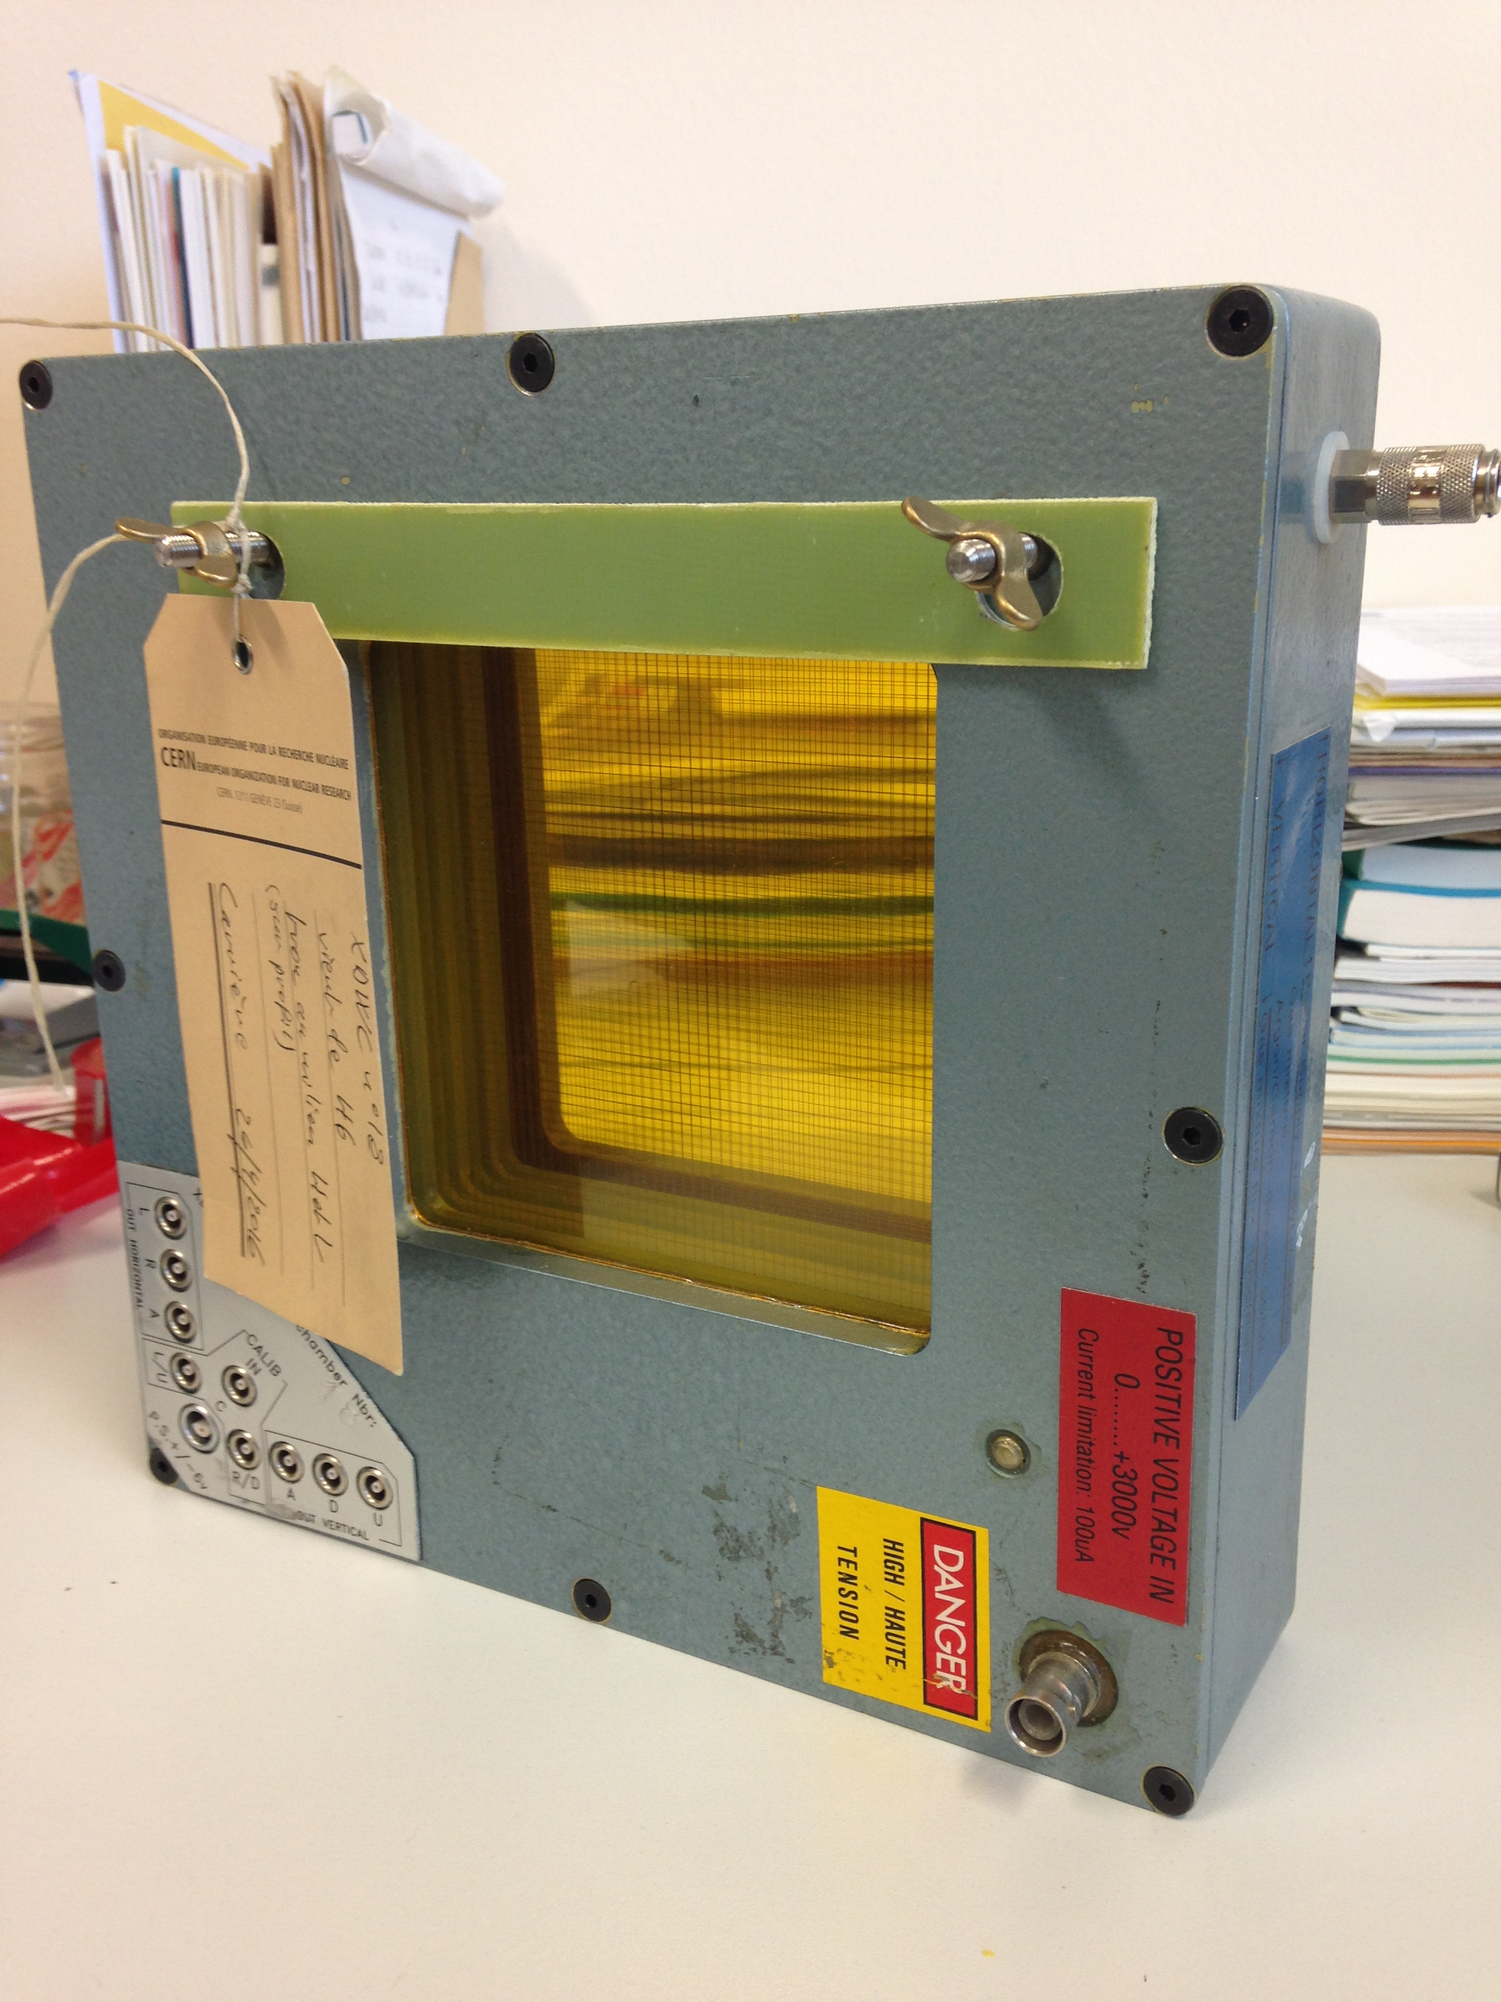
XWCA
DWC

Slide 4
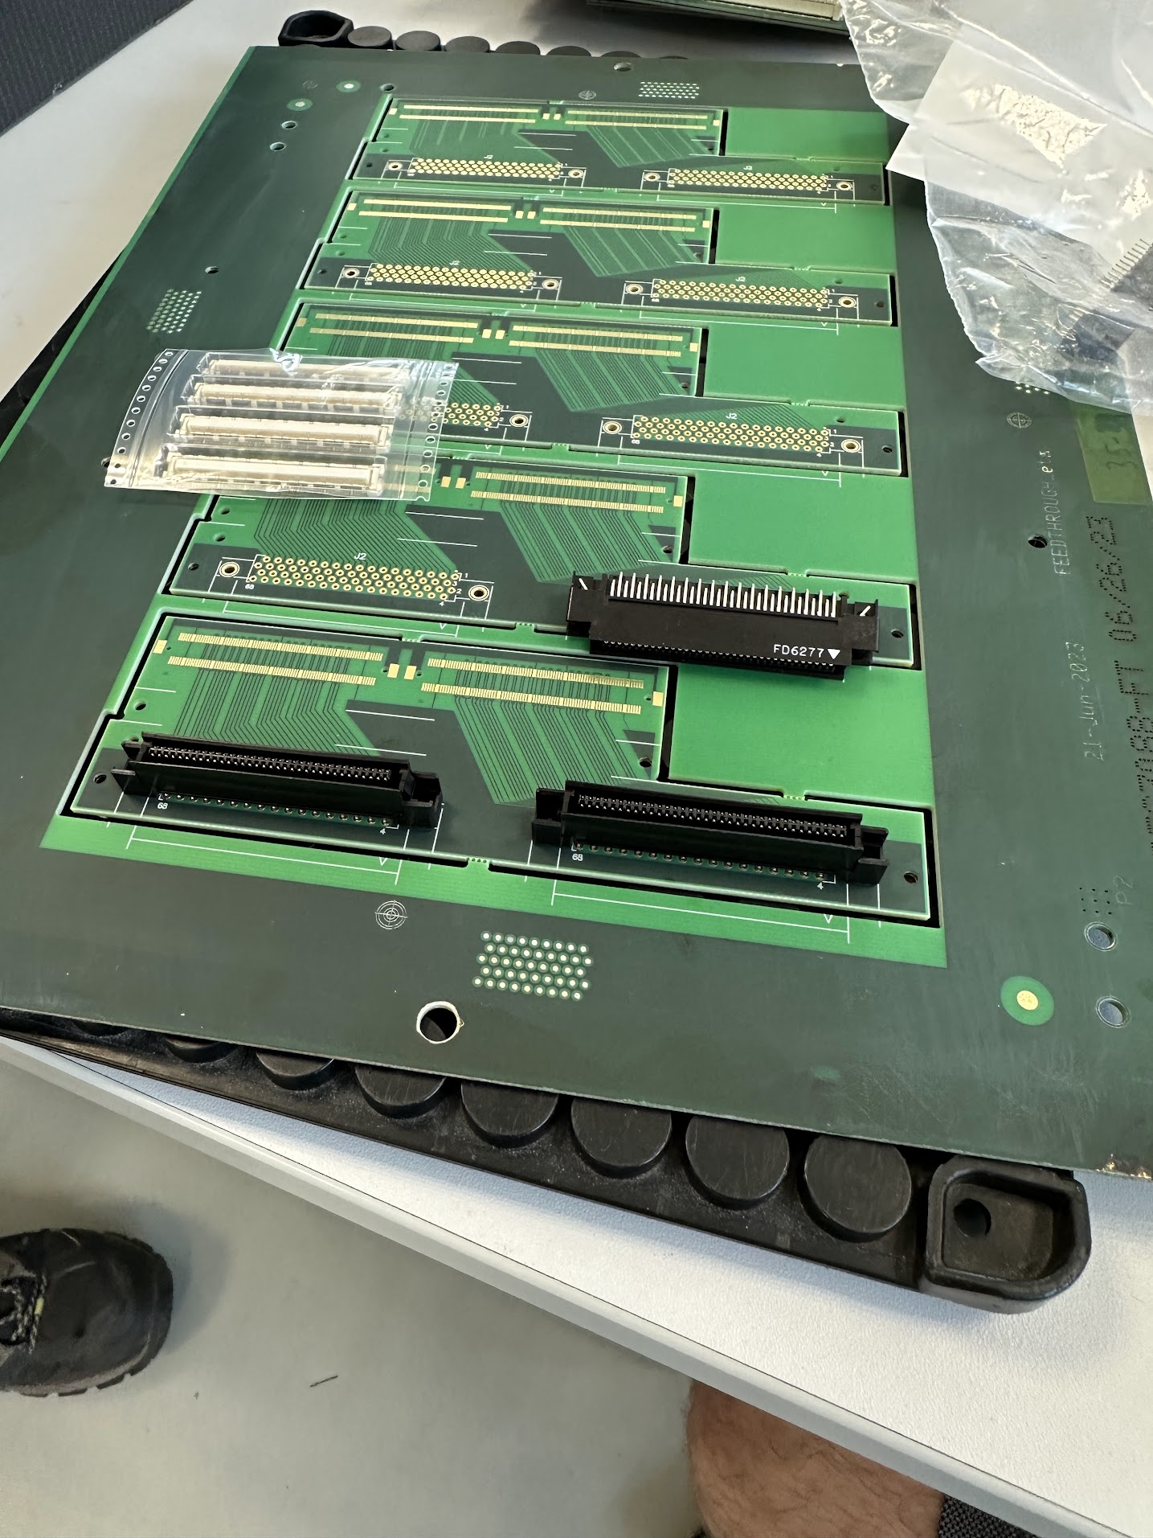
We have established a collaboration with EP-DT (Rui de Oliveira)
They design, produce and assemble the PCBs where the wires are welded
All necessary PCBs have been produced
  We are focusing on the small XWCA for a first prototype

Slide 5
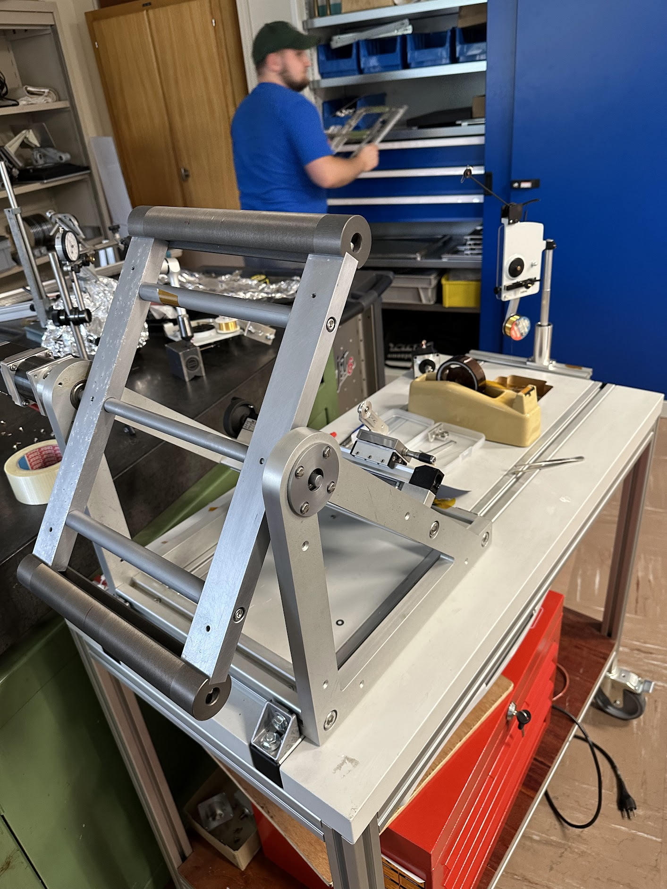
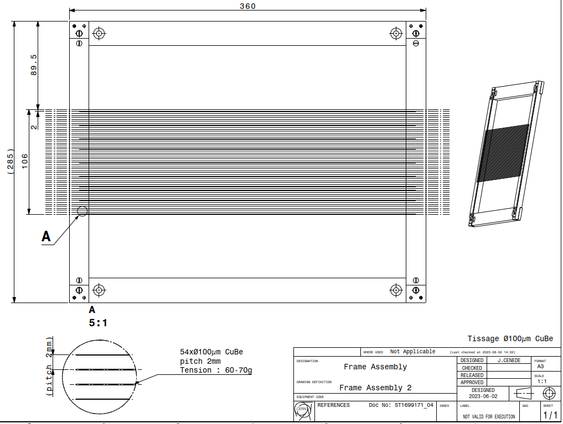
We are recovering the know-how on fibre winding in SY-BI
It has many things in common with SEM Grid production
EN-MME has performed measurements of failure stress on wires
We have already weaved 4 fibre planes (anodes) -> lengthy and delicate procedure
  3 fibre planes remaining (cathodes)
  Series production of 30 chambers will need some reflection…

Slide 6
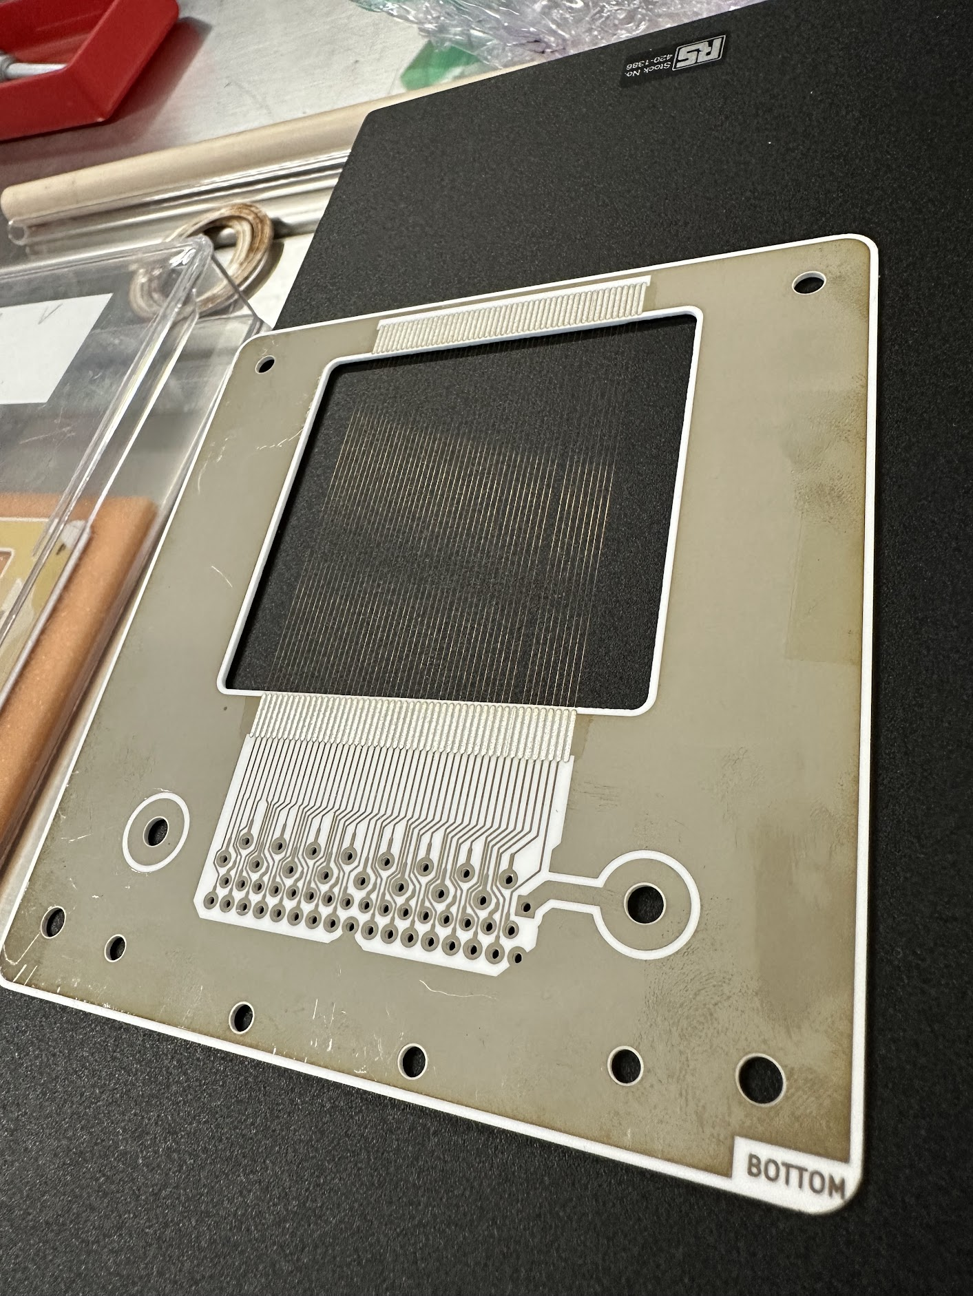
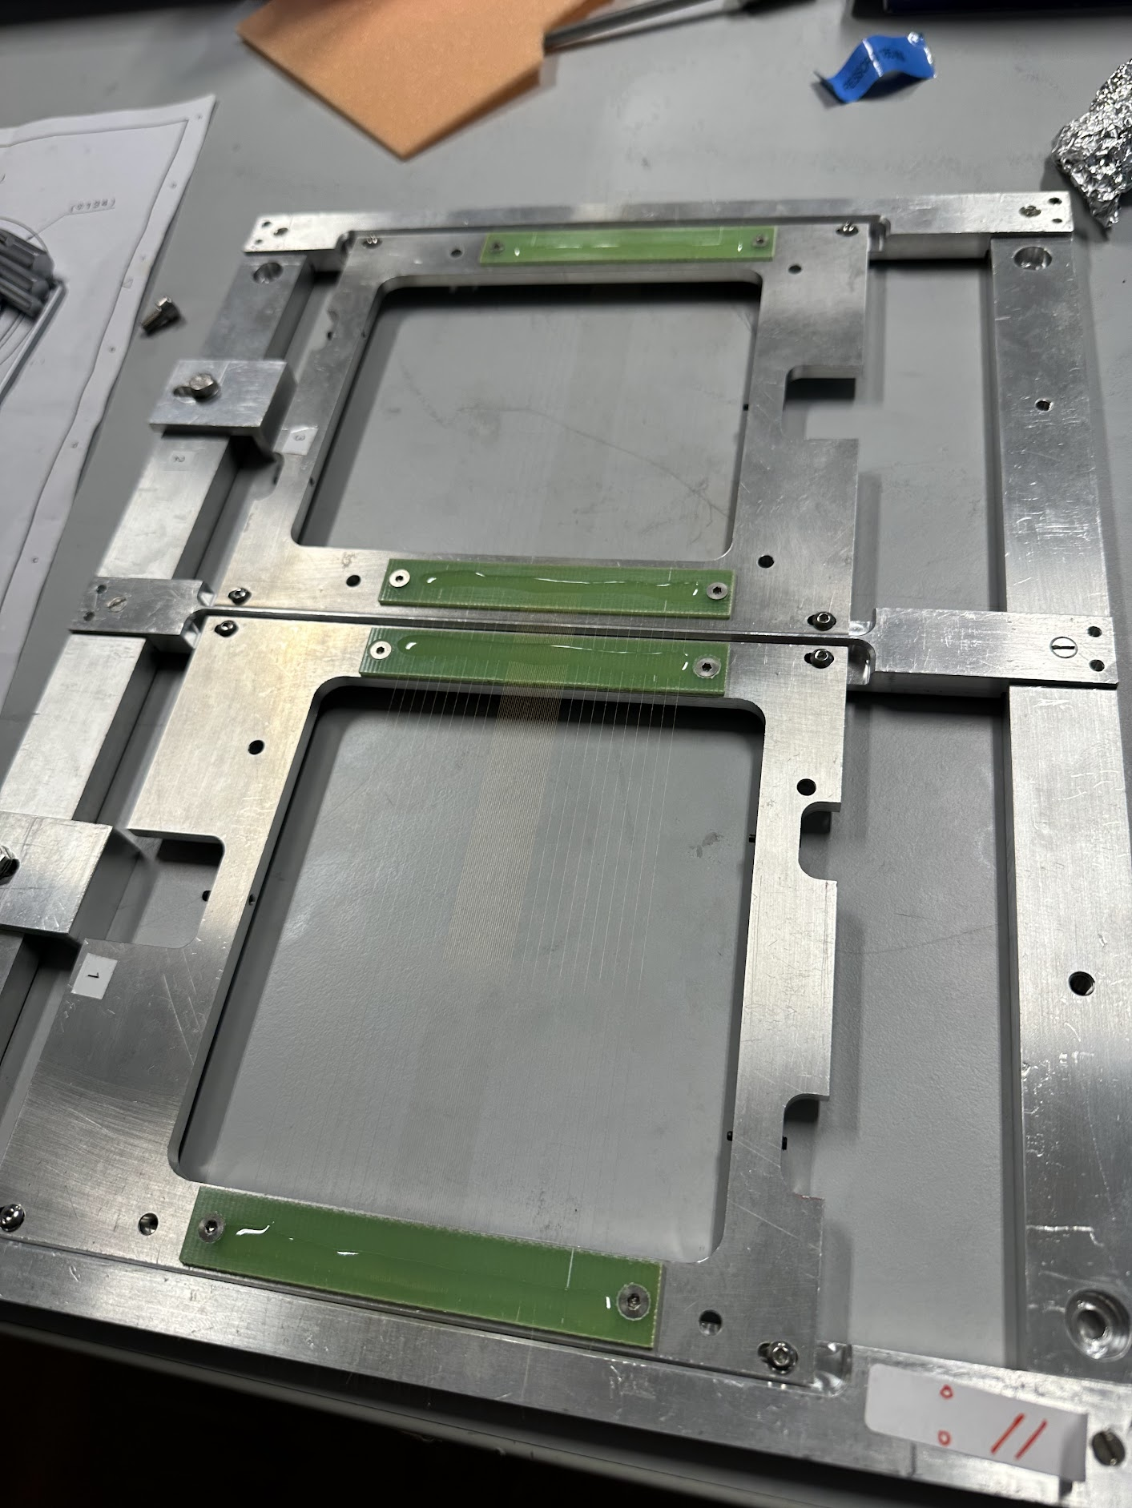

Slide 7
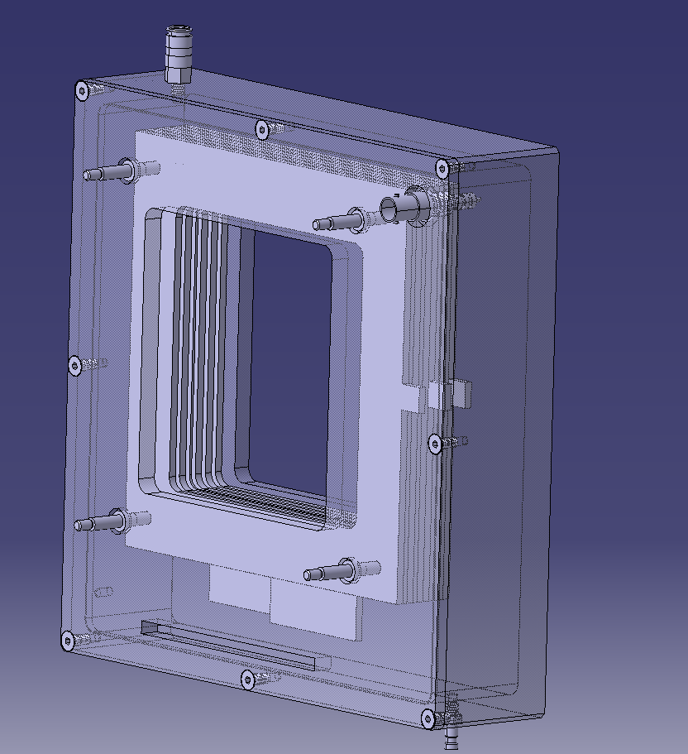
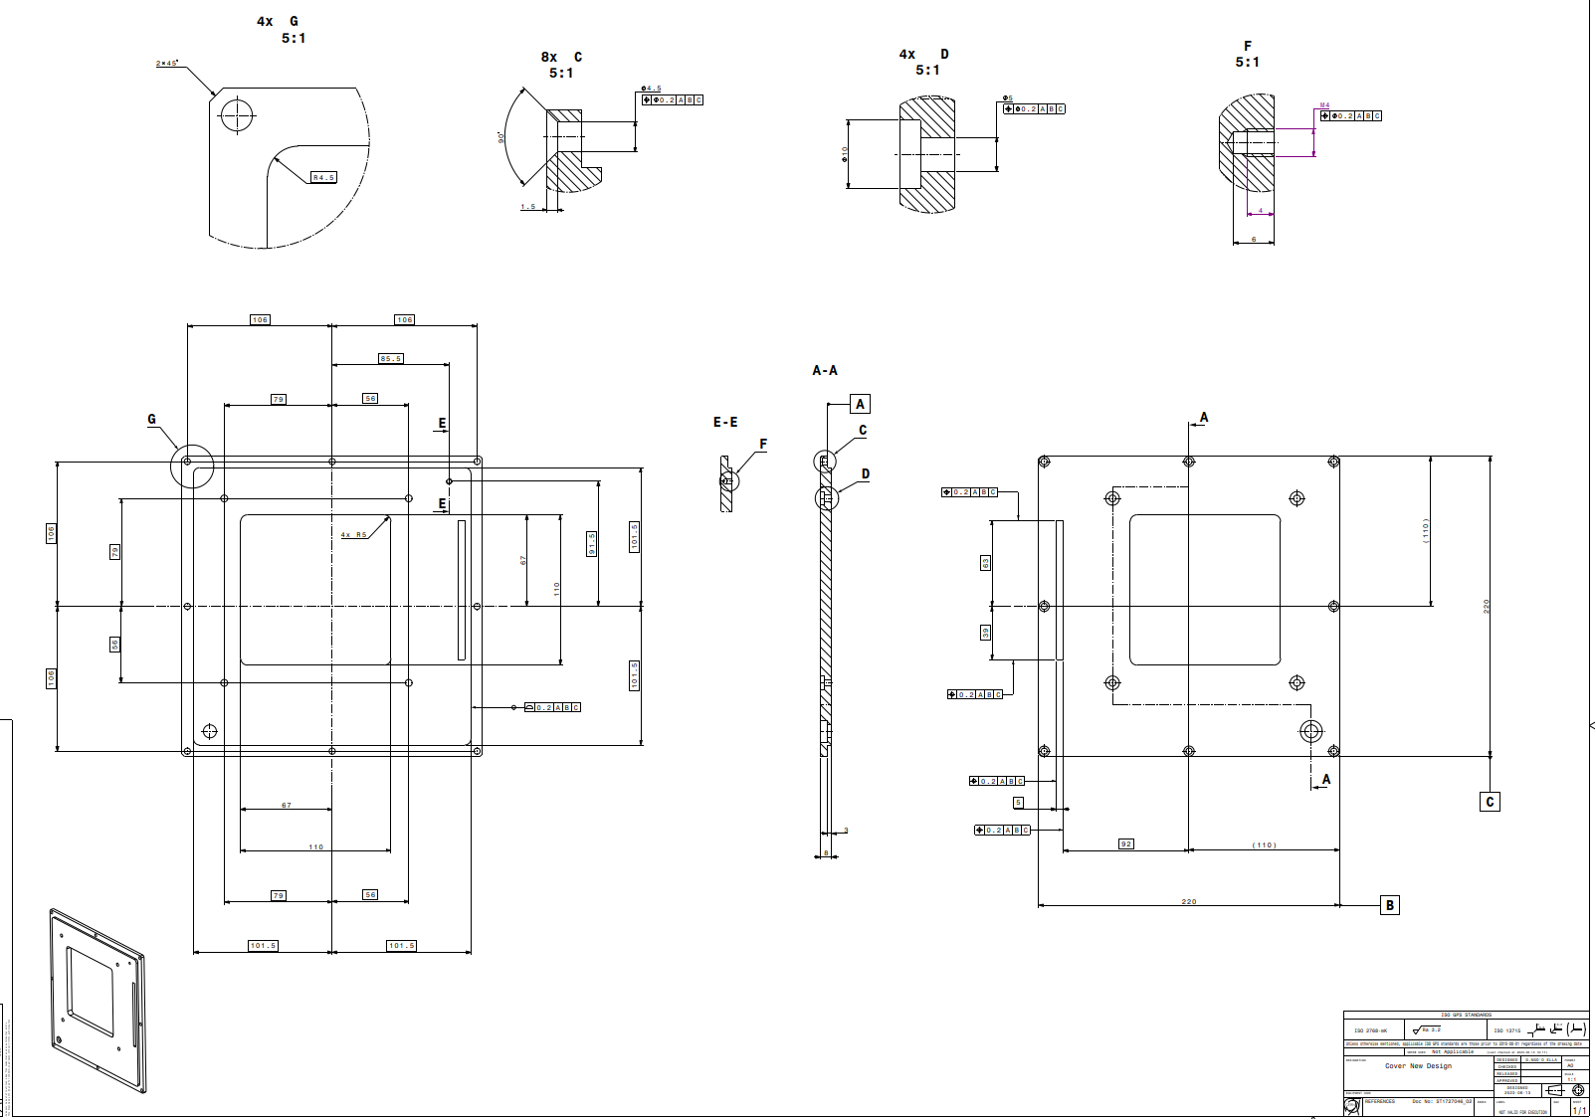
We are modifying the DWC box for the first prototype
Straightforward integration in the beamline
We have solved the issue of how to take the signals out -> must be gas-tight!
  64 channels for the read-out wires
  1 high-voltage connector
We are producing 1 box with our modified design
We are implementing radiation-resistant materials

Slide 8
We were aiming for the prototype to be ready in September.
We hope we’ll be able to test it with beam in 2023!!

Slide 9
Mitigation of radiation issues in TT83
Local electronics die every few months due to radiation damage
  In 2023, they have survived only 4 months!
We have asked for help from the Radiation to Electronics Working Group (R2E) -> they have provided valuable advice
  R2E has tested similar components to ours -> their measurements of lifetime vs total absorbed dose match with our observations
  Apparently, our chips will suffer more damage when biased
    We are implementing a system to stop the voltage to the local electronics when the detectors are OUT of the beamline

