Slide 1
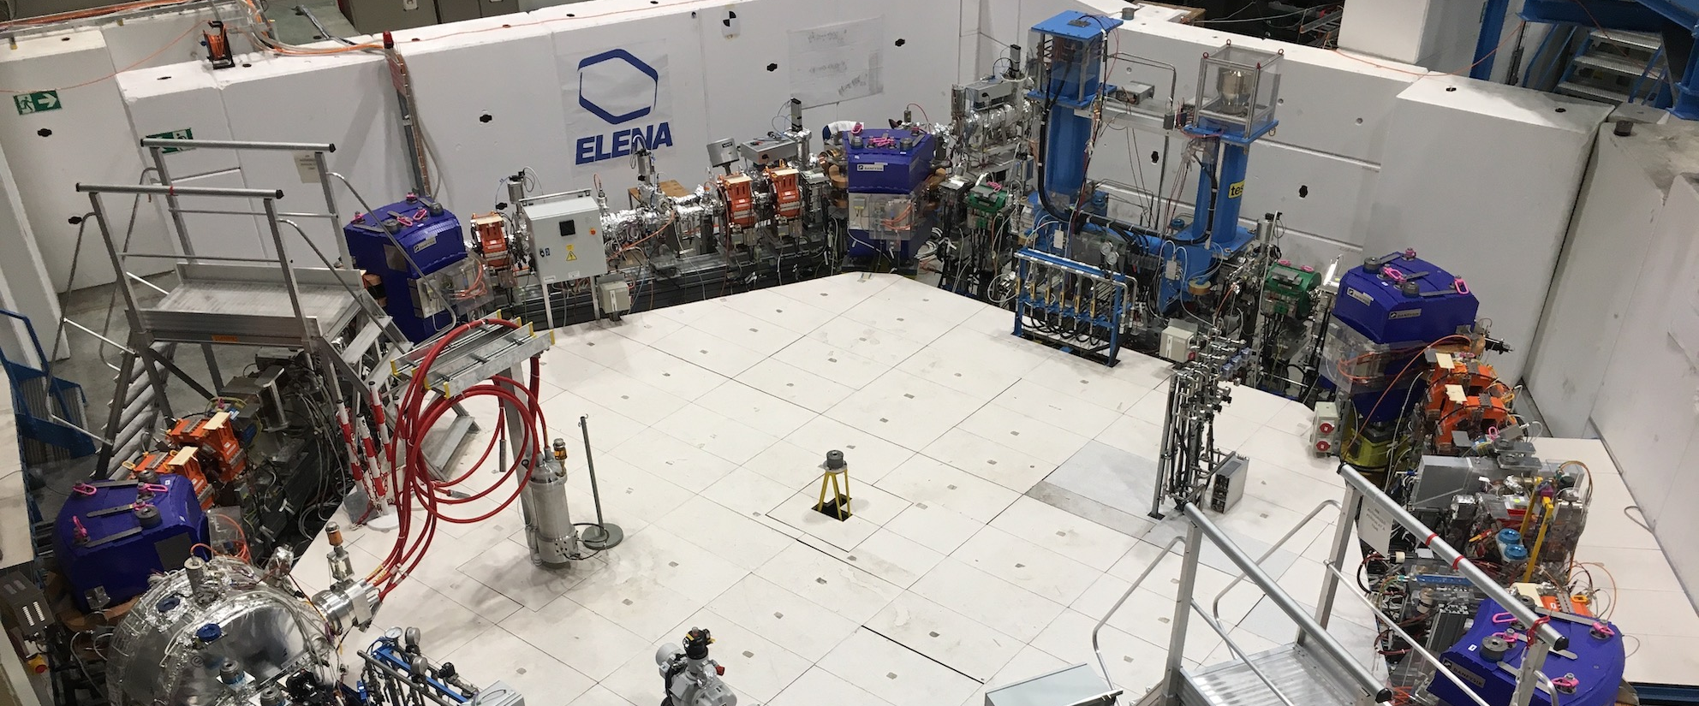
IPM for AD: shall we replace the MCPs during this YETS?
5th BIFT – 4/09/2023 D. Gamba for the AD/ELENA team

Slide 2
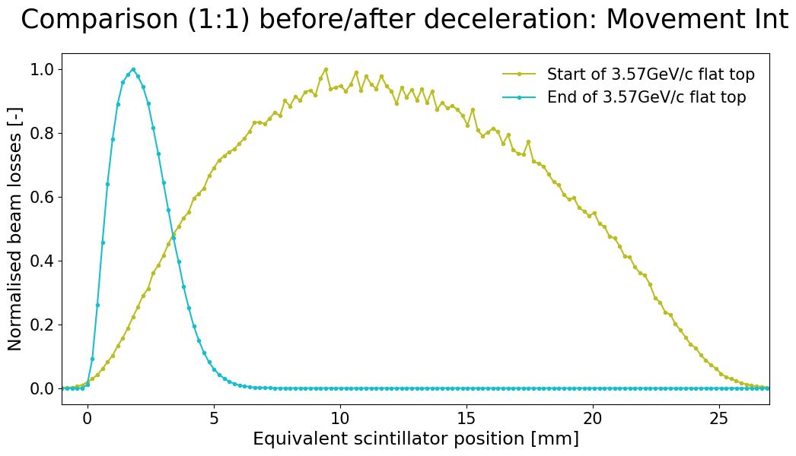
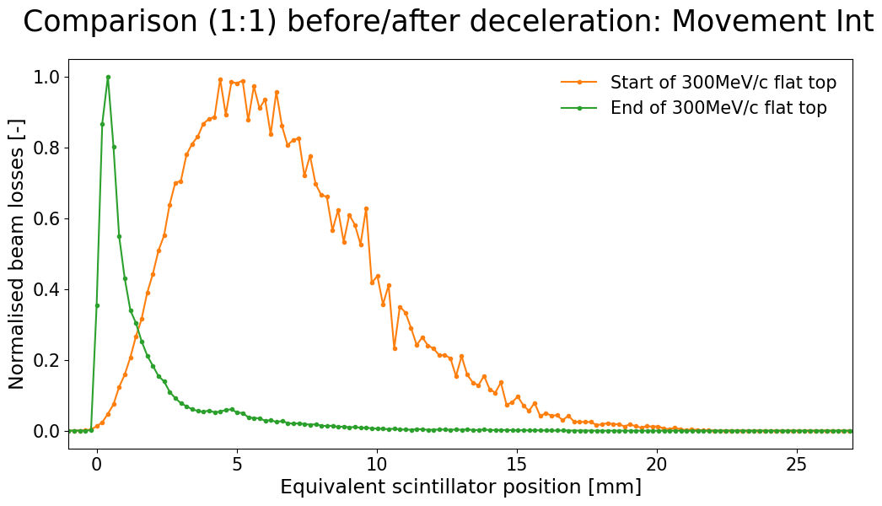
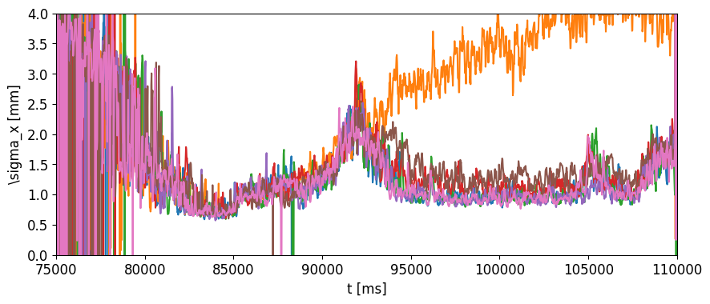
IPM: the missing tool for AD Transverse Cooling Characterisation and Optimisation
Today, we mainly use punctual/desctructive scraper measurements
Core about
8 times smaller
after cooling
~10 mm rms
begin 3.57GeV/c
~ 5 mm rms
begin 300 MeV/c
~1.7 mm rms
end 3.57 GeV/c
~0.5 mm rms
end 300 MeV/c
Clearly interested in having the IPM-like instrument operational!
300 MeV/c
ramp
100 MeV/c
RF ON
Bad settings!
OK-ish settings
???
Best setup
  If running live as the Schottky, it will be a breakthrough in AD setup/control
  Long term alternative: what about wire scanners? Medipix based detectors?

Slide 3
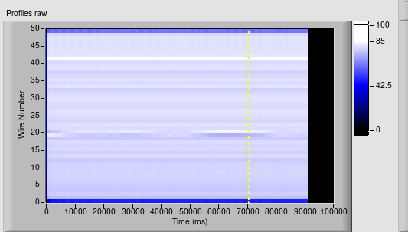
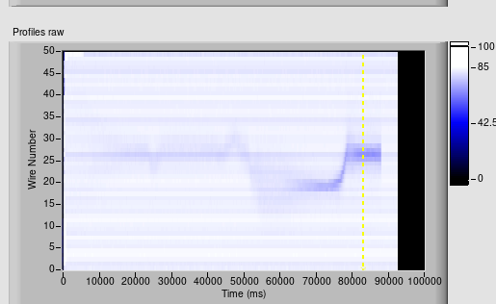
Present Status/Discussion
Two independent monitors, one for H and one for V
  using a “double MCP” configuration
V: not operational ☹
broken MCP?
H: almost all cycle visible,
even without gas injection
Vacuum sector hosting the IPM will be vented during YETS 23/24
  Venting end of November 2023, closing during first week of February 2024
  Unique opportunity to replace MCPs (assuming we can procure them in time)
    Suggested to replace both H and V detectors
It might be helpful to rework the FESA class: e.g. allow live acquisition of profiles
Long term strategy: different monitor compatible with other machines?

