Slide 1

Updates on IR7 design
B. Lindström, R. Bruce, X. Buffat, R. de Maria, L. Giacomel,
N. Mounet, S. Redaelli
Many thanks to S. Fartoukh, G. Iadarola, R. Tomas
6th September 2023 – Special Joint HiLumi WP2/WP5 meeting

Slide 2
Introduction and Motivation
HL-LHC beam intensity and brightness produces significant challenges:
  Beam losses in IR7 DS could cause quenches
  Impedance can cause instabilities
Beam losses:
  Mitigate them using TCLDs installed between two 11T dipoles
  → Alternative strategy must be devised
Impedance:
  Low-impedance collimators introduced (LS2, LS3),
  Relaxed collimator settings
  Further reduction of impedance helps ensure beam stability
Redesign the IR7 optics to mitigate both issues!

Slide 3
New optics – requirements
Increase collimator beta functions
  Larger normalized kicks → larger fraction absorbed by TCS / TCLAs
  Larger physical gaps → lower impedance
Increase single pass dispersion at TCS / TCLAs
  Off-momentum particles from TCP more likely intercepted by collimators
  Must be balanced – too large dispersion decreases performance!
Small beta functions at TCS/TCLAs:
  Increase of beta function compensates an increase of dispersion
Phase advances:
  Should not be reduced within IR7
  Strongly impacts the leakage to the TCTs

Slide 4
Current status
Two candidate optics available:
  reMD5 – similar to optics used for the MD
  reV10 – further improved optics
    matched using new optimizer object in XSuite!
R. de Maria is implementing both in HLLHCv1.6
  Focus on keeping IR7 single pass optics constant, but periodic can change
    effect on cleaning performance with this approach to be seen
  Combined ramp and squeeze
  Must be compatible with other phase constraints
  TCP → TCT phase constraint is considered for collimation purposes

Slide 5
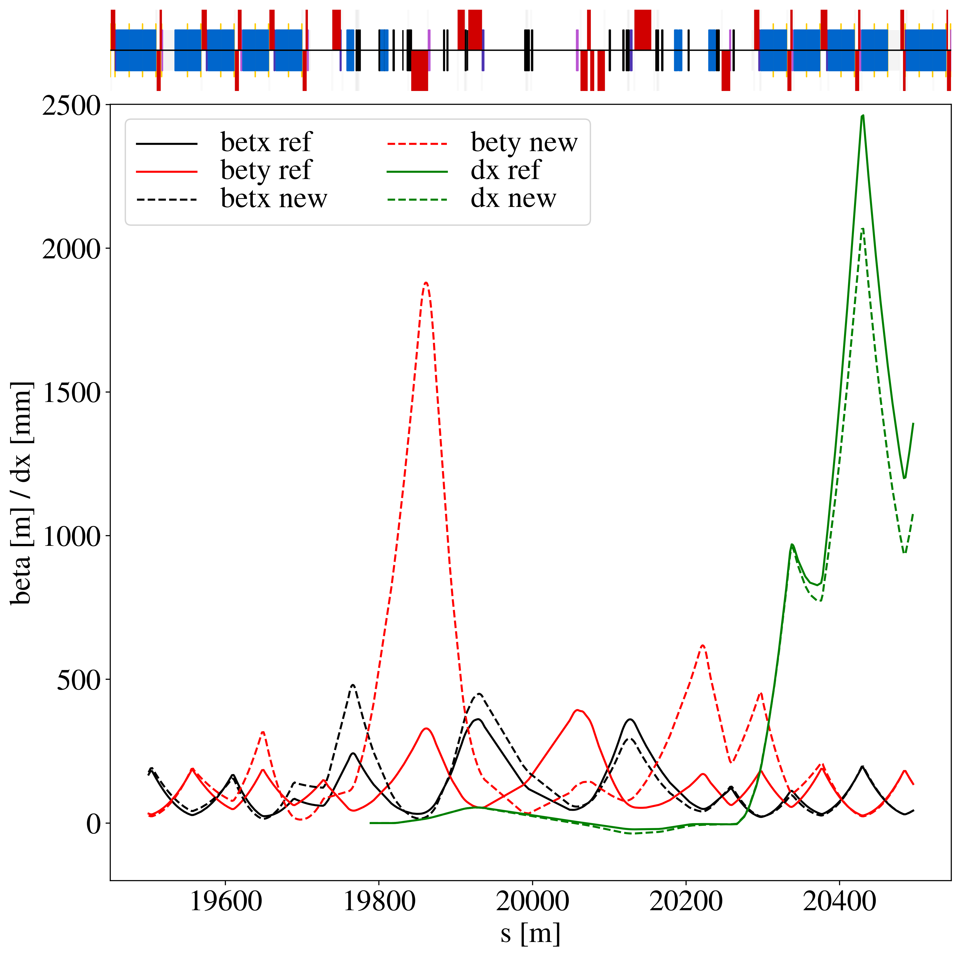
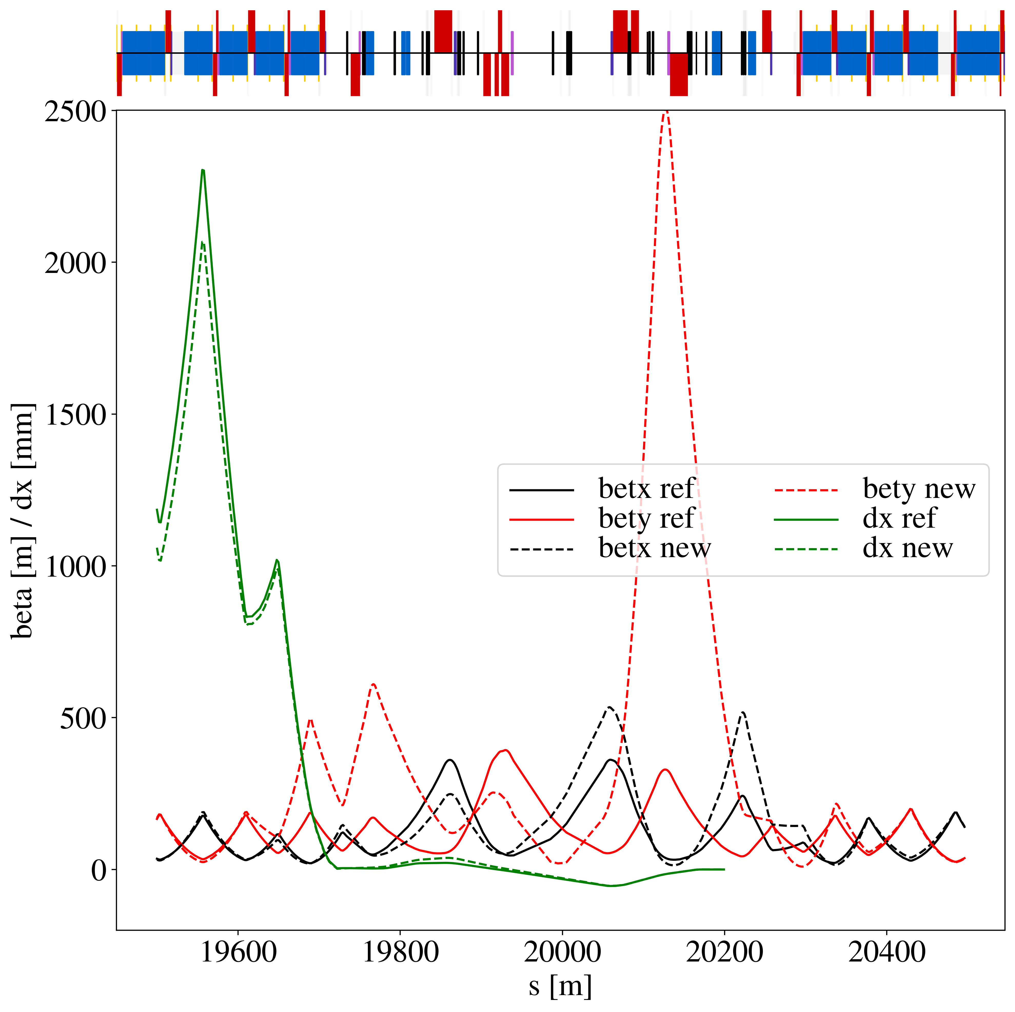
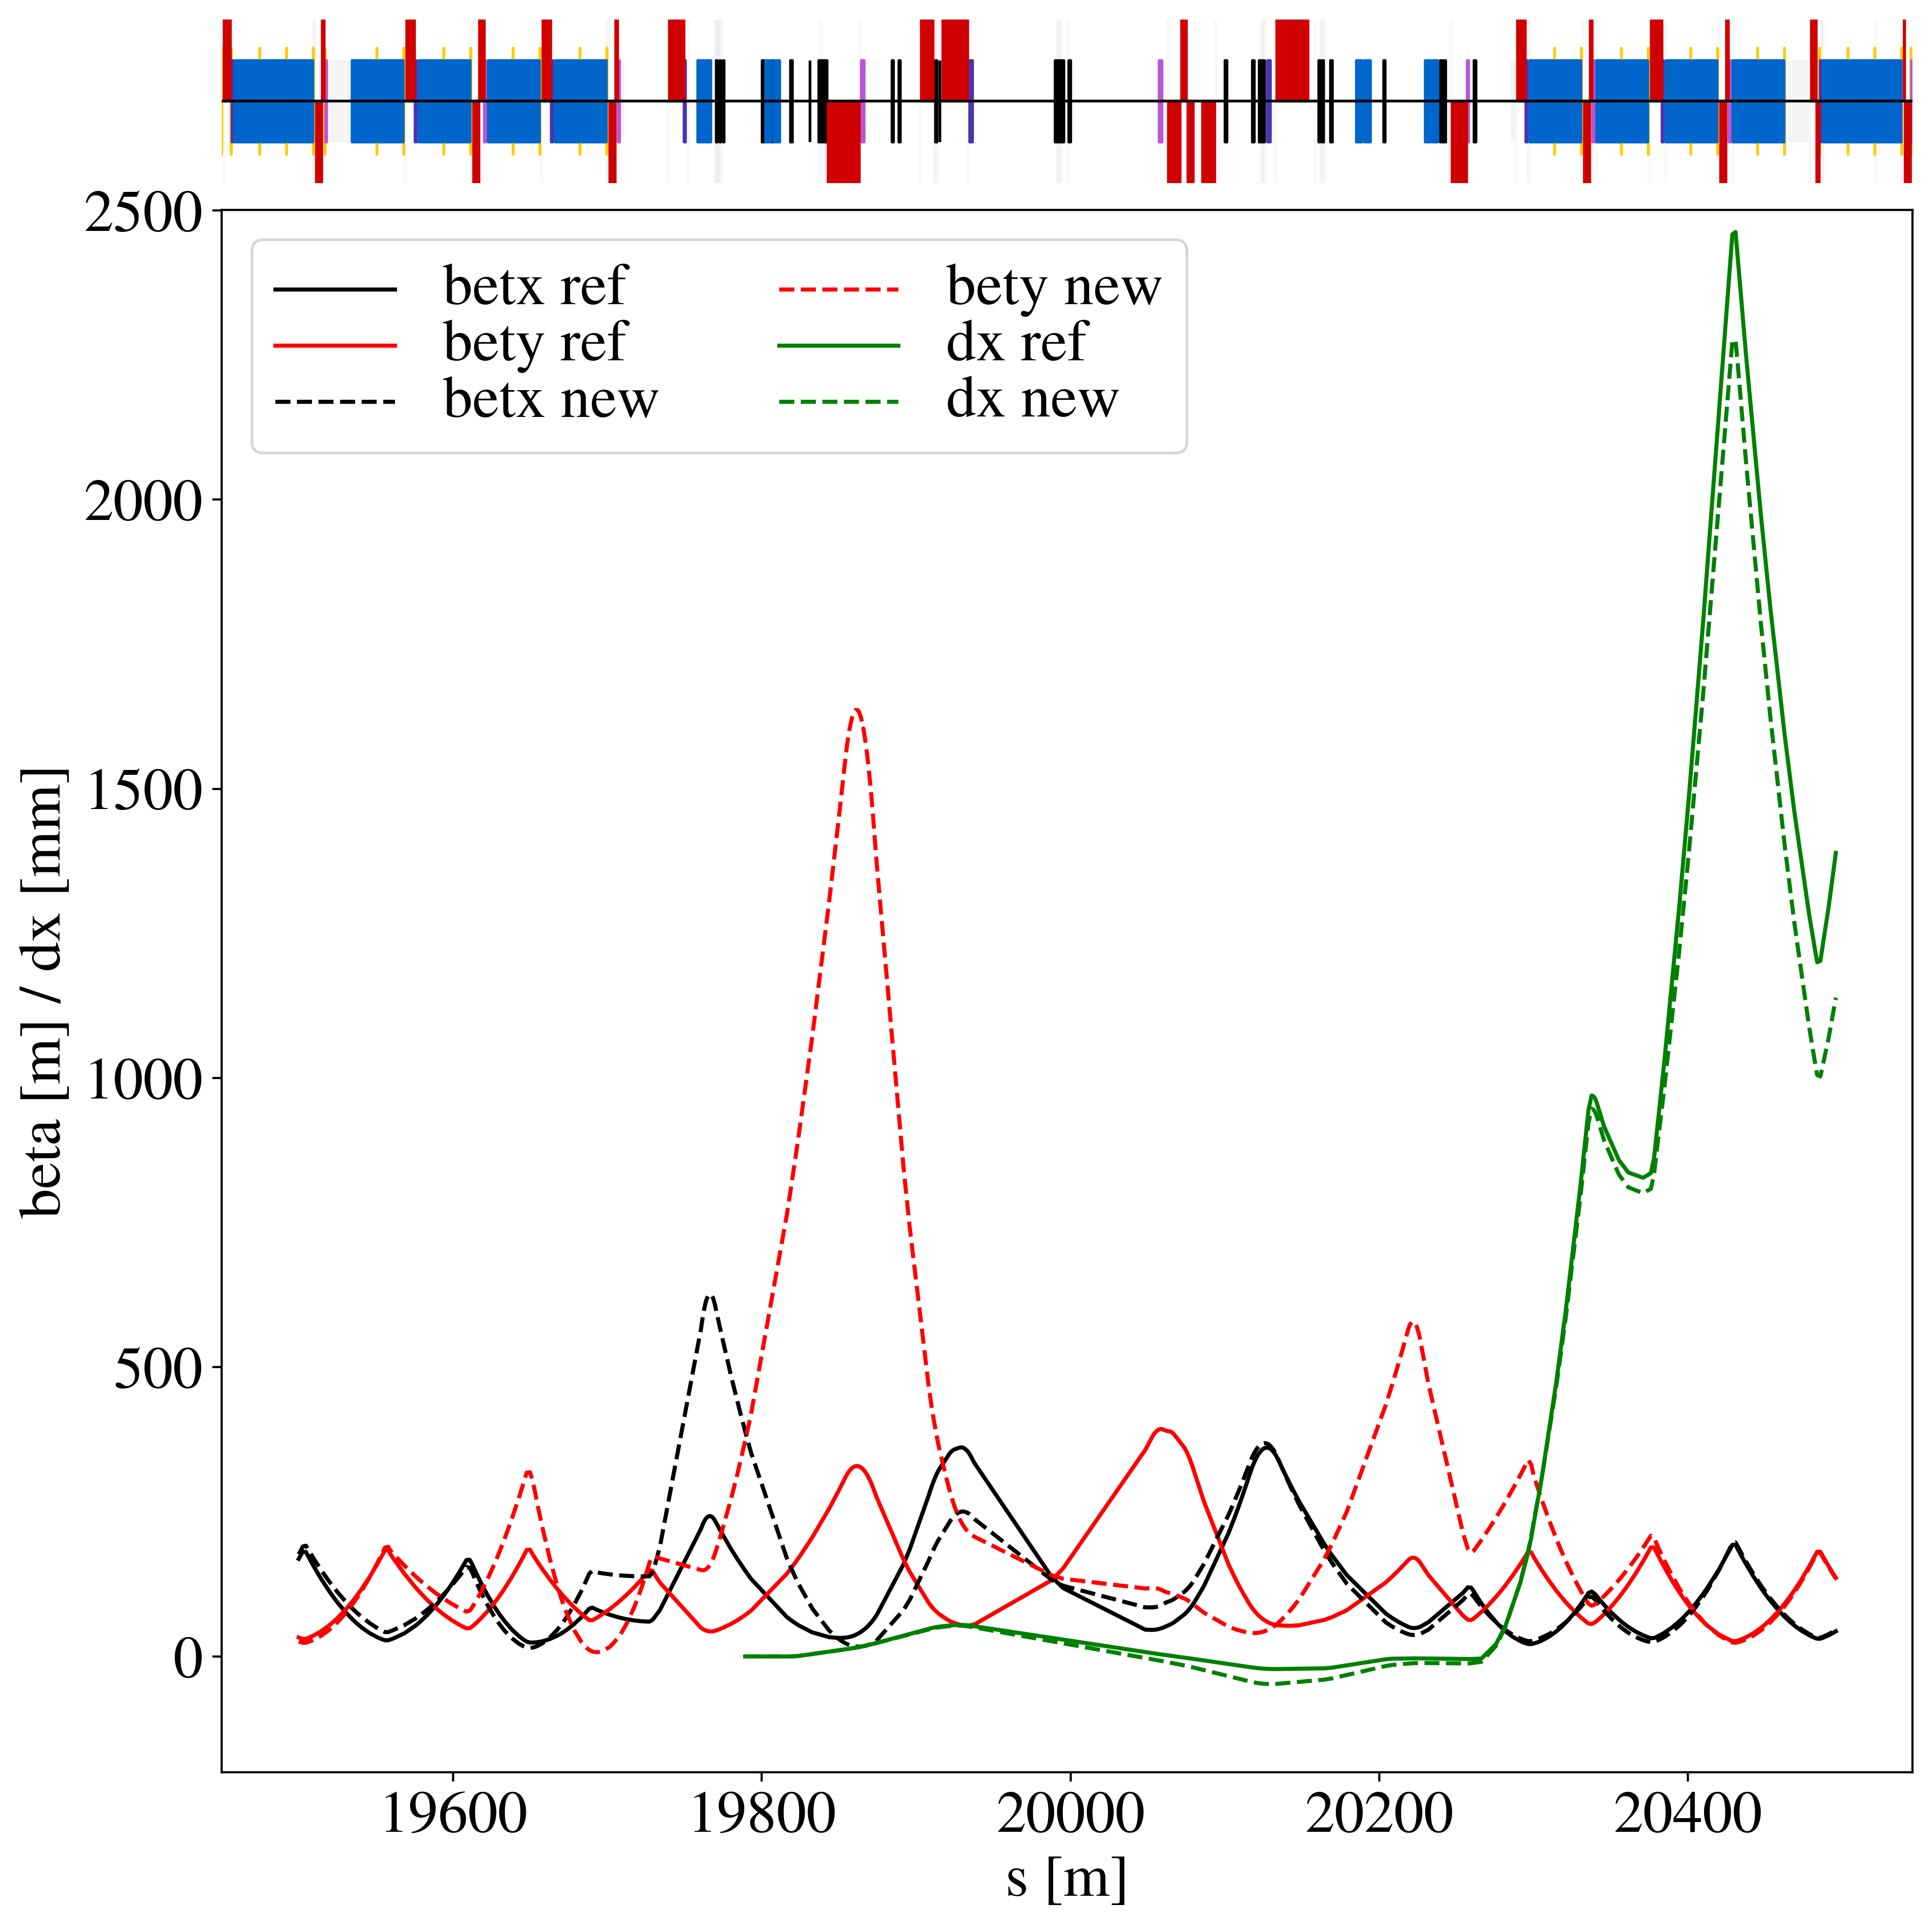
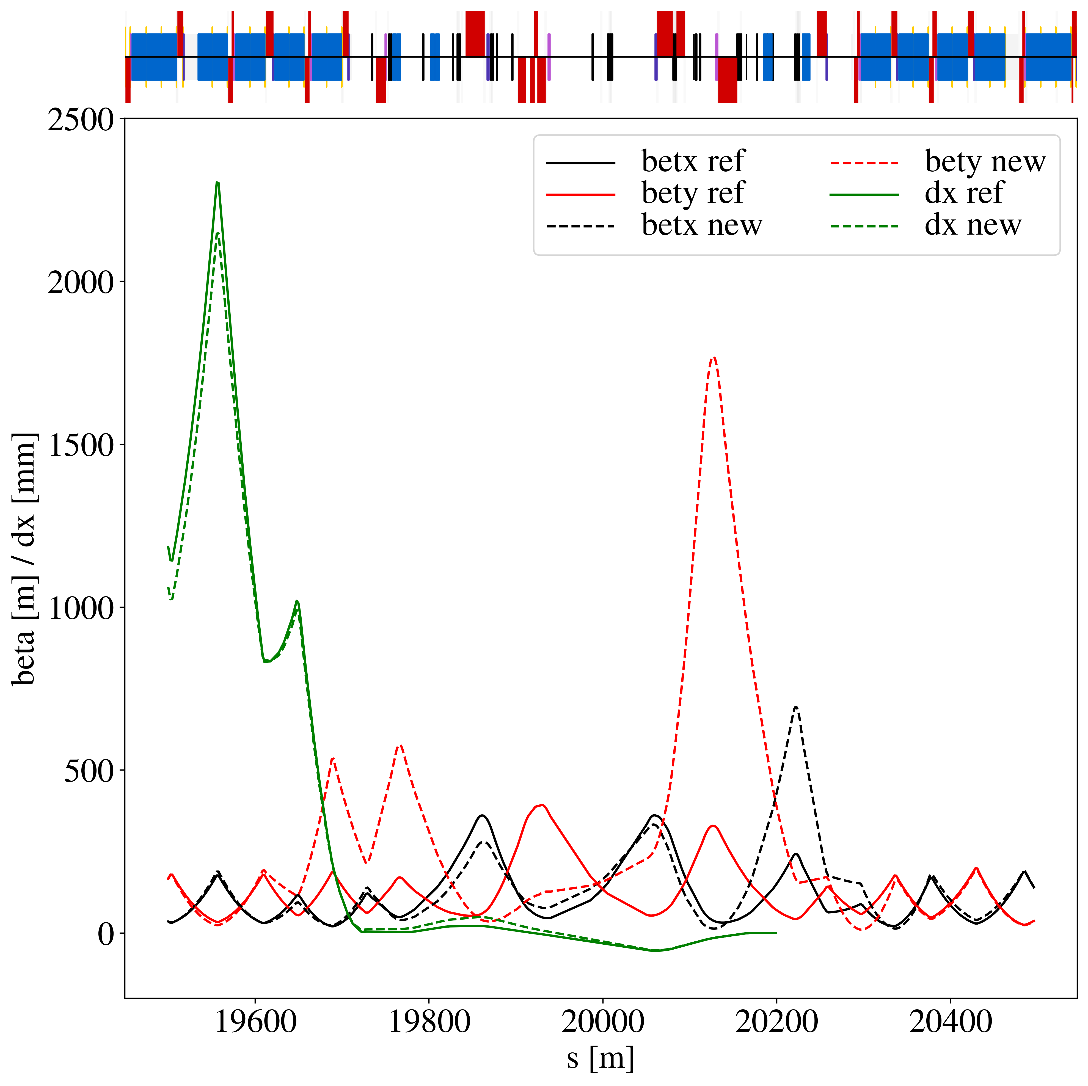
Optics comparison
Smaller peak beta functions
→ less aperture constraints
→ easier to fit in ramp
→ less risk of issues with MQW field errors
Phase not matched (up to 0.06 change in muy)
→ must be compensated elsewhere
kqtl9.l7.b1 current limit breached (300 A vs 200 A)
→ requires quench training (n.b. design current is 550 A)
reMD5
reV10

Slide 6
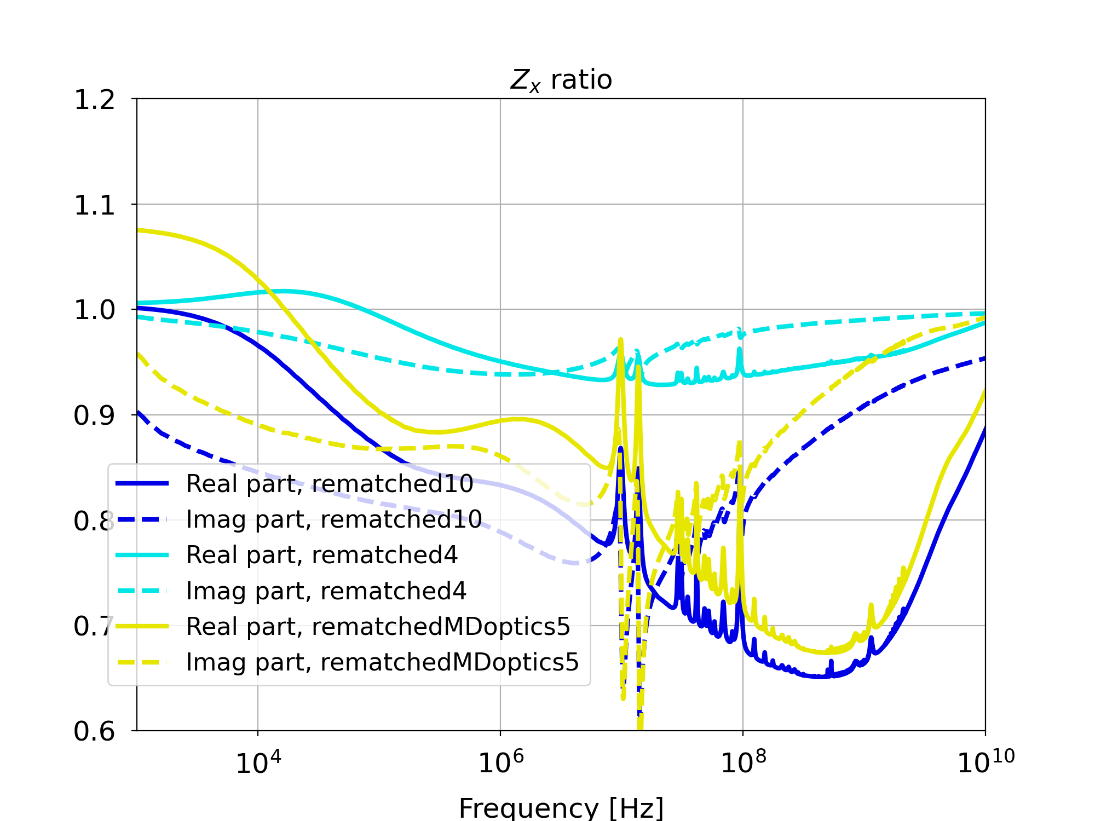
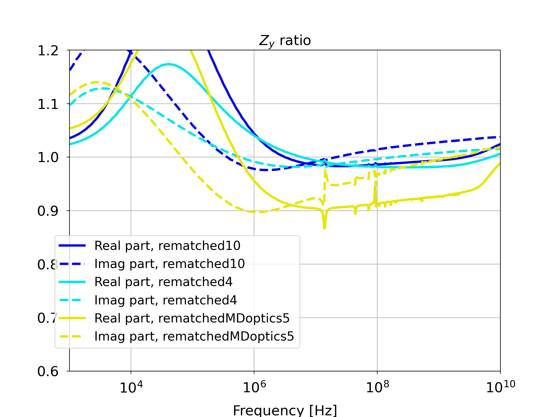
Impedance comparison
Expected to be similar between the two candidates based on scaling formulae
  Detailed calculations seem to prefer reMD5
Clear reduction in x, no clear benefit in y, reason not currently understood
3.5 µm emittance used for calculations, correcting this should provide better improvement
L. Giacomel

Slide 7
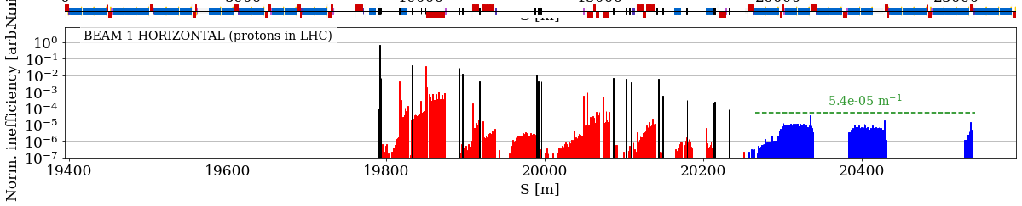
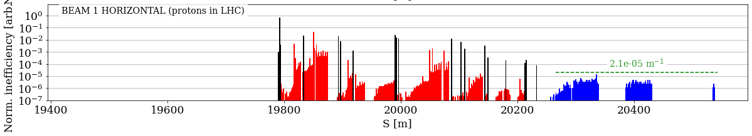
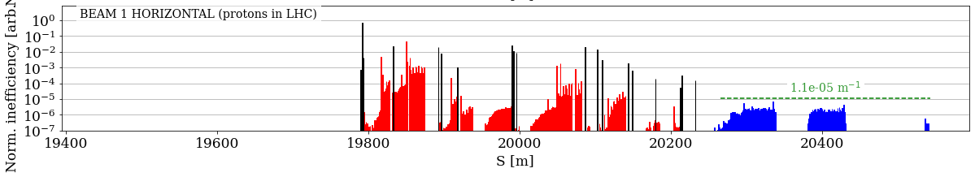
Loss Maps
reference
reMD5
reV10

Slide 8
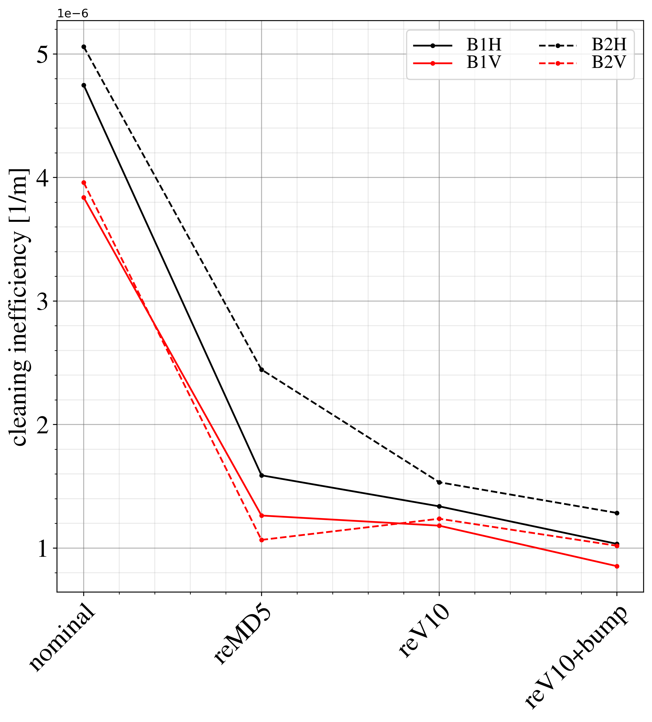
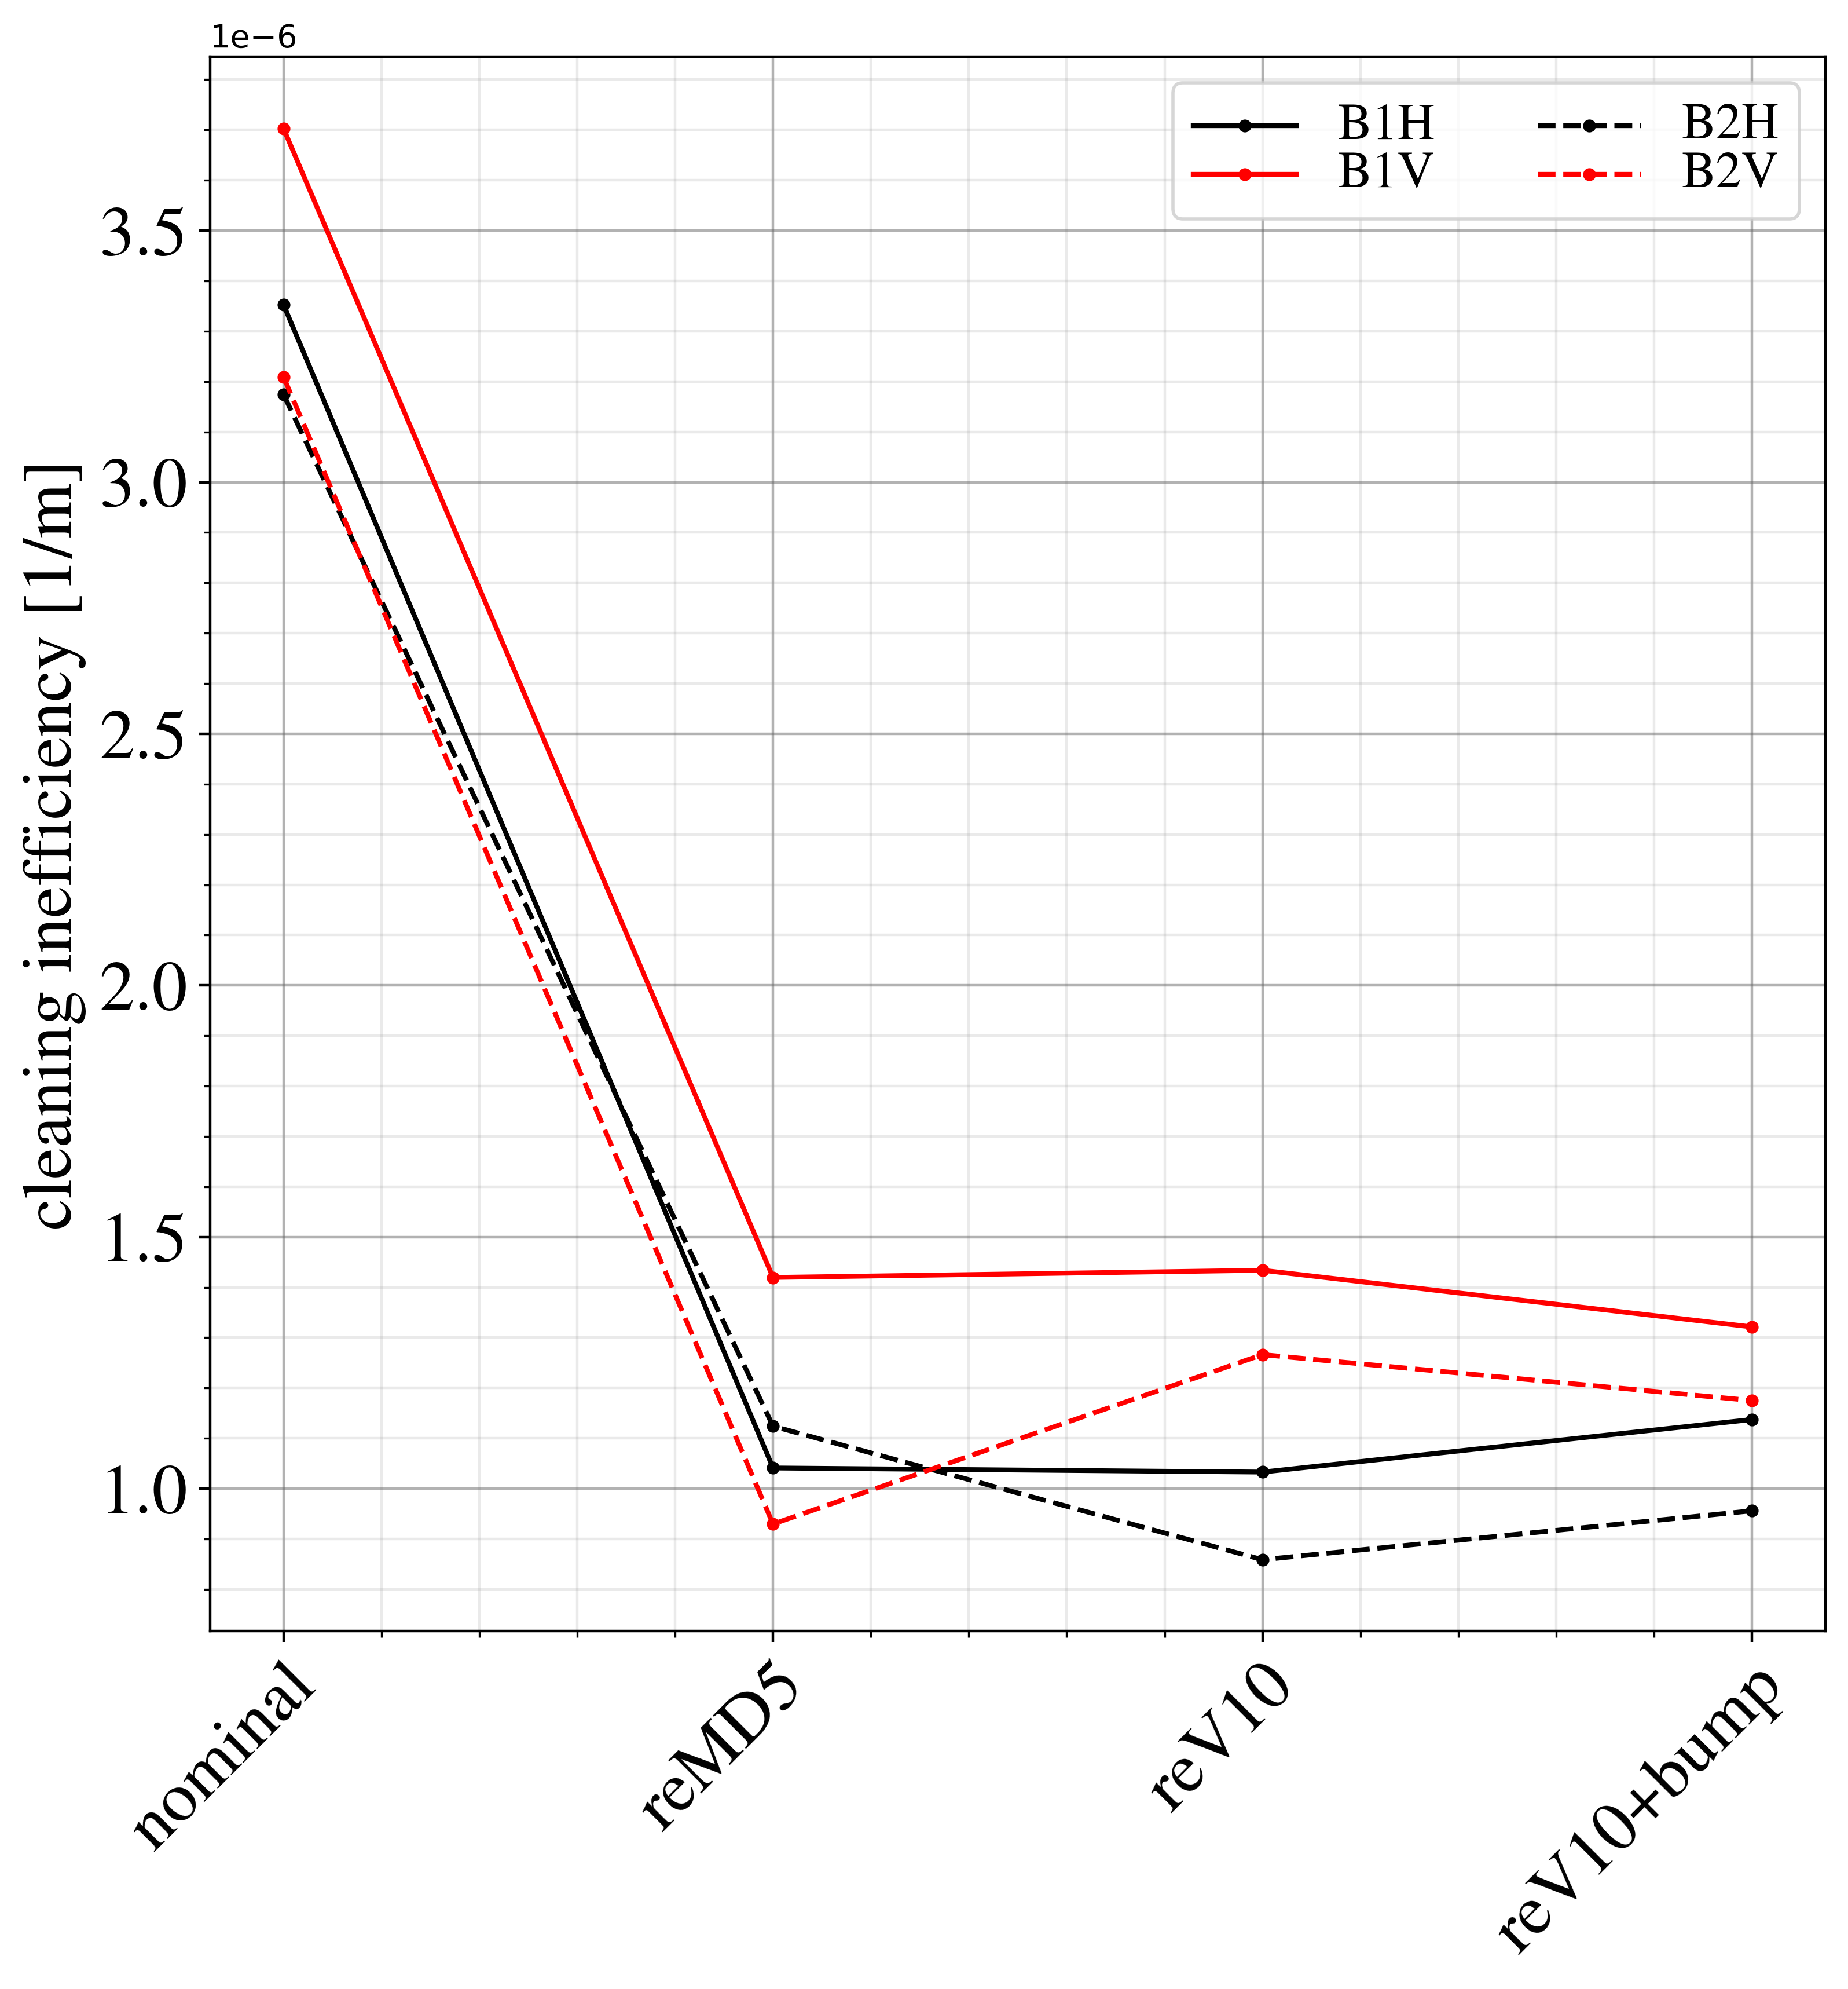
DS cluster losses
reV10 as good as reMD5+bump+asymmetric TCLA
Leakage more symmetric betweeen H/V
DS1
DS2

Slide 9
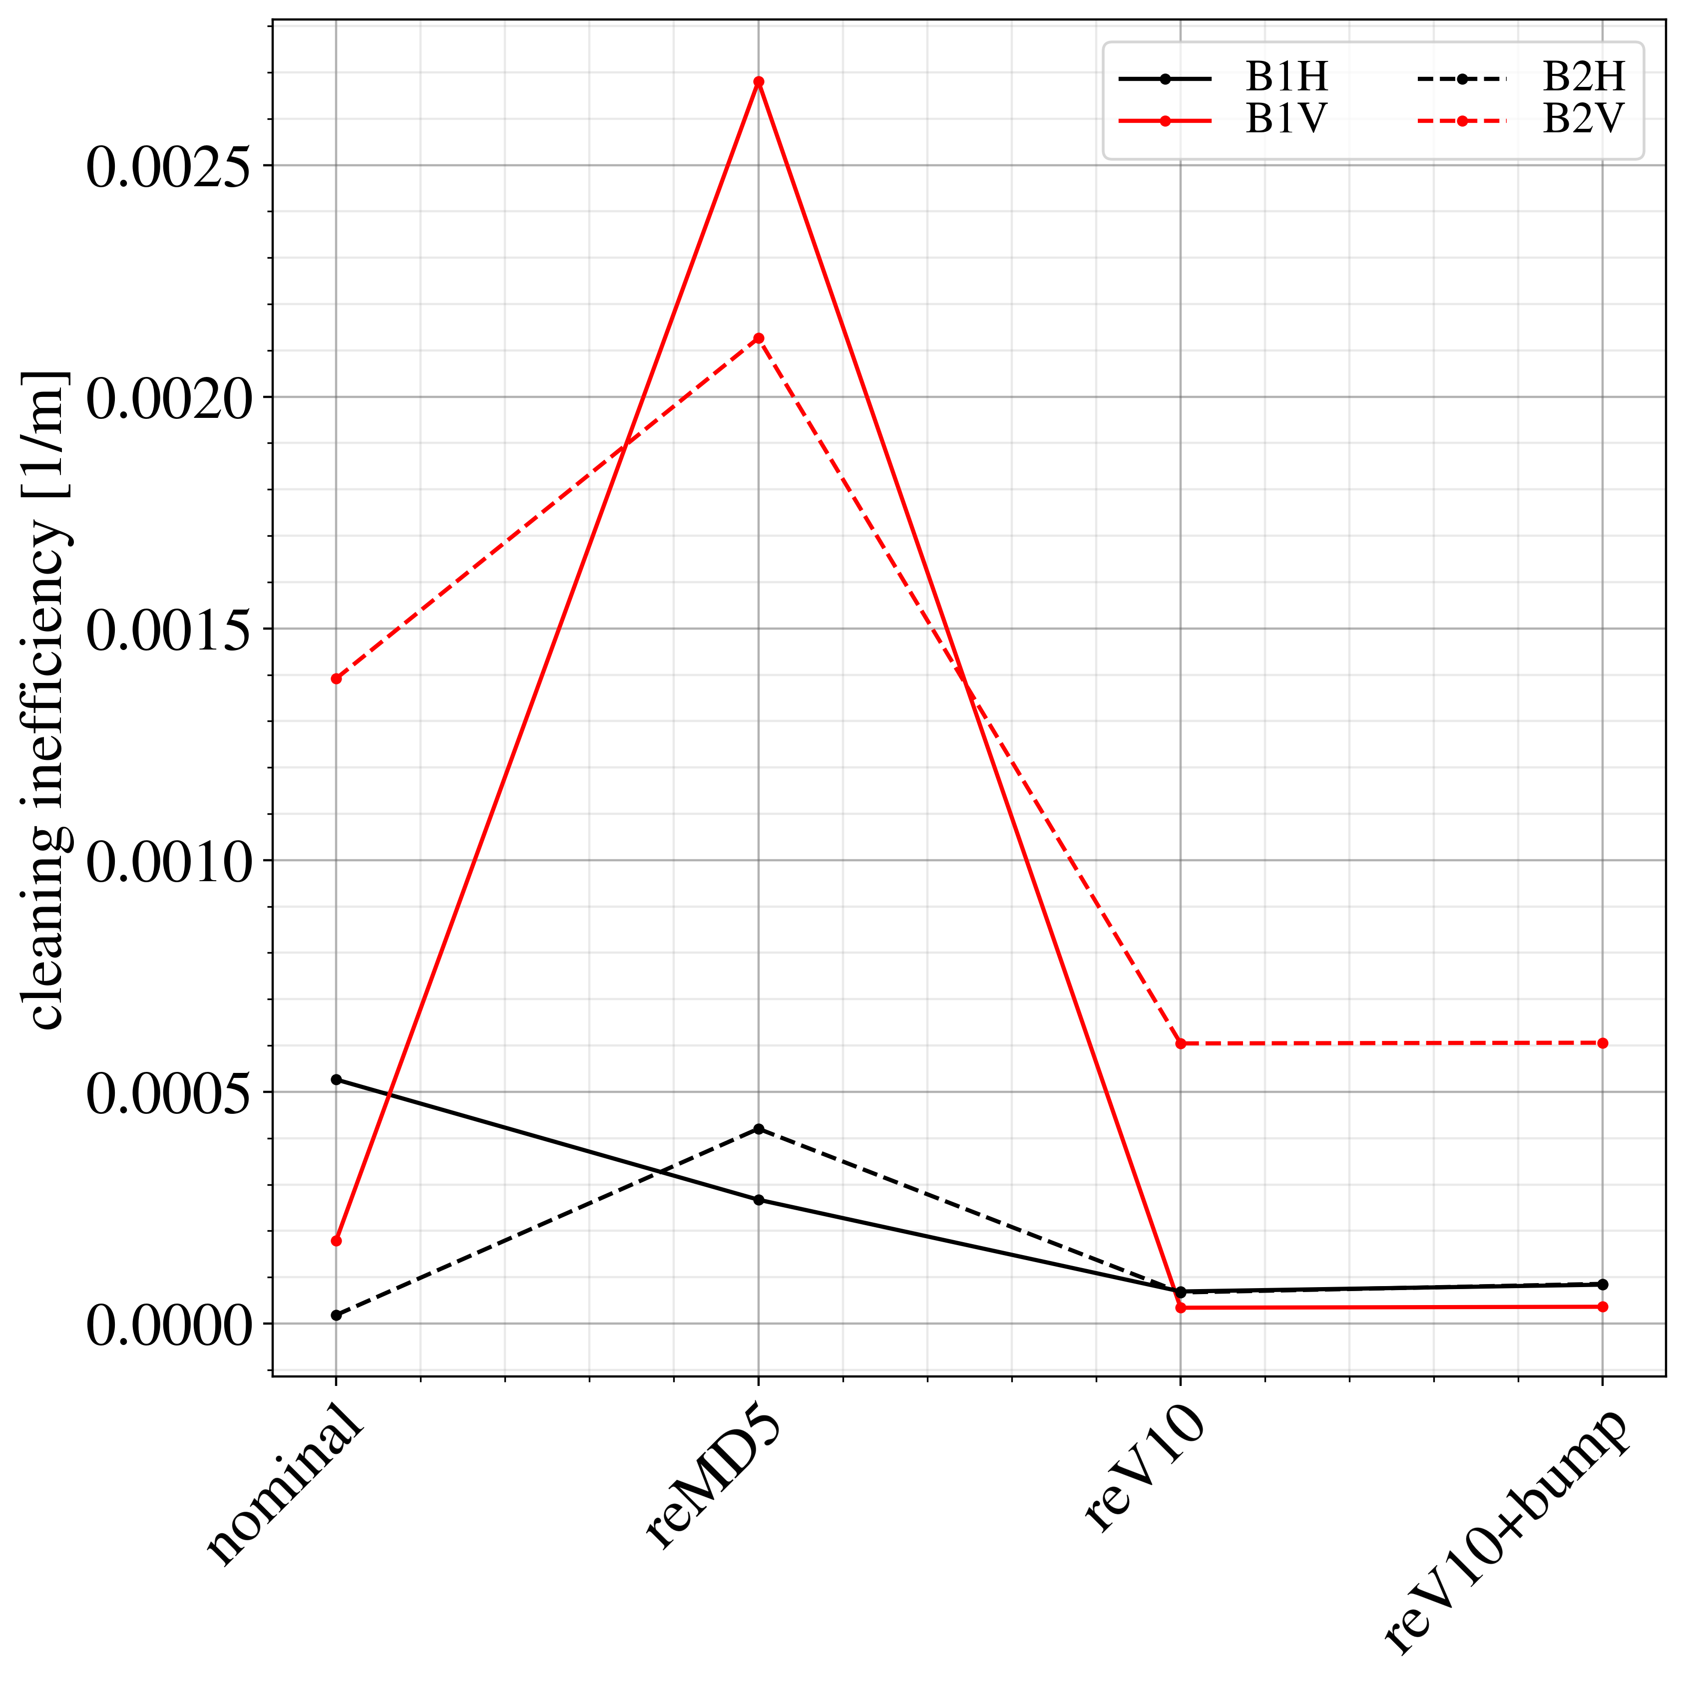
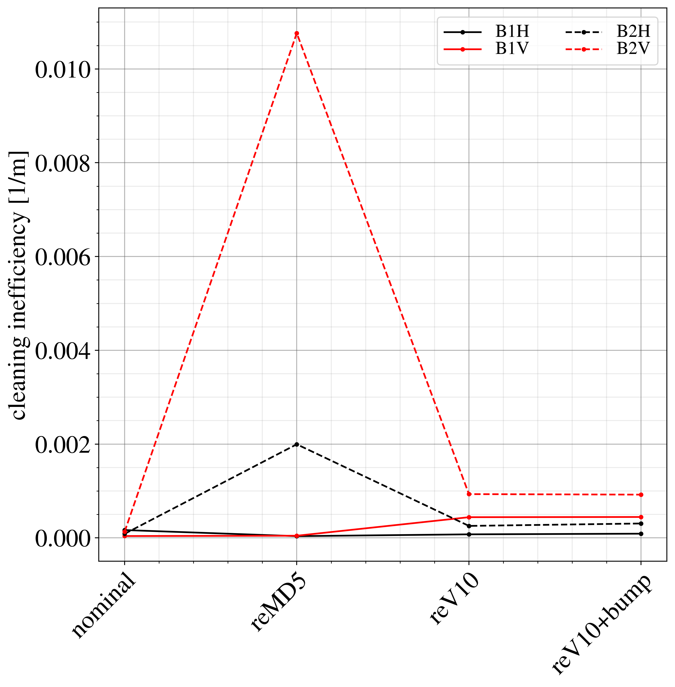
TCT losses
Large increase for reMD5
TCT losses depend strongly on TCP – TCT phase advance
IP1
IP5

Slide 10
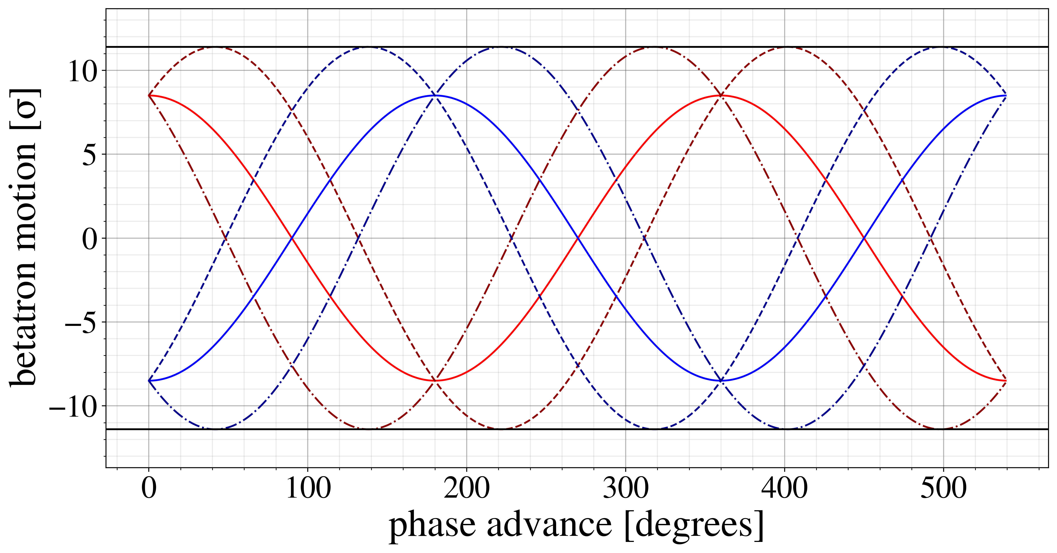
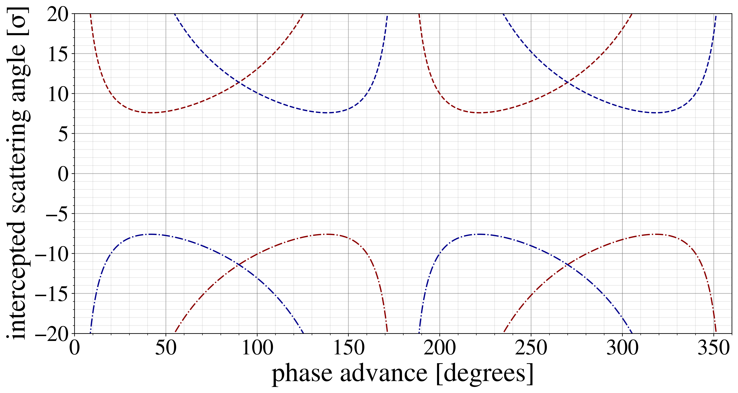
Collimator Cut
Betatron motion following TCP scatter combination of normal motion + kick
Min. kick needed to hit secondary collimator depends on:
  relative coll. settings
  phase advance
  starting jaw (pos. or neg.)
  sign of kick
TCT losses mainly leakage from TCP → TCT
  keep phase away from
  ~40 / ~140 deg (mod 180)
Phase constraint CC → TCP < 30 deg
  TCP → TCT phase
  90 →120 / 260→290
  These regions are good and should automatically limit TCT losses

Slide 11
Further improvements
Estimate single-pass coll. performance by minimizing cuts (black absorbers)
Can be done in XSuite
  Very flexible and fast, easy to implement complicated matching functions
Several challenges:
  Skew collimators introduce x-y dependence
  Single pass dispersion causes asymmetric cuts (pos. / neg. jaw, pos. / neg. kicks)
  → can both improve and worsen leakage!
  Third order dispersion (dp up to 15 % for particles leaking from TCP to DS without being intercepted by TCS/TCLA)
  Appropriate weighting of cuts at different dp
Initial results show promise, but still a work in progress

Slide 12
Conclusions
Improved IR7 optics important for HL due to missing 11T
Two candidate optics with improved cleaning and impedance have been developed
  reMD5 optics to be tested in MD block 2 in September
  reV10 best in terms of DS leakage, TCT losses and peak beta functions
  – requires 300 A in kqtl9.l7.b1 which is currently limited to 200 A
  Impedance comparison will be followed up
Work has started to implement new optics in HLLHCV1.6
(R. de Maria)
  Should decide which optics to implement for now
  Future iterations on optics are foreseen
Directly minimizing collimator cuts in XSuite matching function could provide further improvements

