Slide 1


TCLPX4 settings effect on the matching section of IR1/5
M. Sabaté-Gilarte, F. Cerutti
WP10 Energy deposition & R2E
Special Joint HiLumi WP2/WP5 meeting 5th September 2023

Slide 2
Context
TCLPX4 aperture needs to be modified to allocate the flat optics.
Furthermore, it is important for PPS2 configuration in IR5.
Study the impact of the TCLPX4 settings by looking at:
  Peak dose on D2 and Q4 assemblies.
  Loads on D2, Q4, TCLPX4 and TCLMB.
  Radiation levels.
Settings to be considered:
Half-gap | 11.6 mm | 14.2 mm | 21.1 mm | 24.7 mm | 28 mm
IR1 - HC | x | x | ref
IR5 - VC | x | x | ref | x | x

Slide 3
FLUKA simulations
HL-LHC optics version 1.5 (Nov. 2019 released).
Right side of the IP1/5.
p-p collisions at 7 TeV.
IR1: 250 μrad crossing angle in the horizontal plane.
IR5:
  +250 μrad crossing angle in the vertical plane.
  Mix polarity up/down combination.
Normalization factor:
  4000 fb⁻¹ integrated luminosity.
  7.5 L0 instantaneous luminosity.
Special Joint HiLumi WP2/WP5 meeting M. Sabaté-Gilarte 5th September 2023

Slide 4
IR1
Horizontal crossing
Special Joint HiLumi WP2/WP5 meeting M. Sabaté-Gilarte 5th September 2023

Slide 5
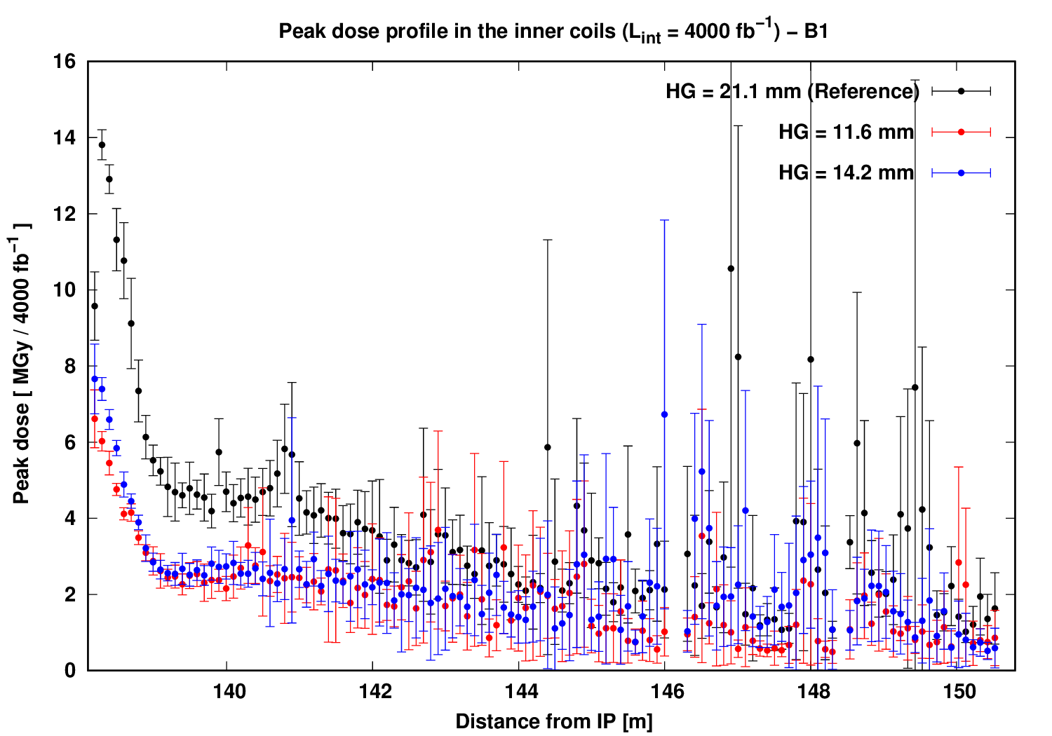
HC: peak dose distribution in D2 assembly
Decreased from 14 MGy down to 7 - 7.5 MGy at peak
Special Joint HiLumi WP2/WP5 meeting M. Sabaté-Gilarte 5th September 2023

Slide 6
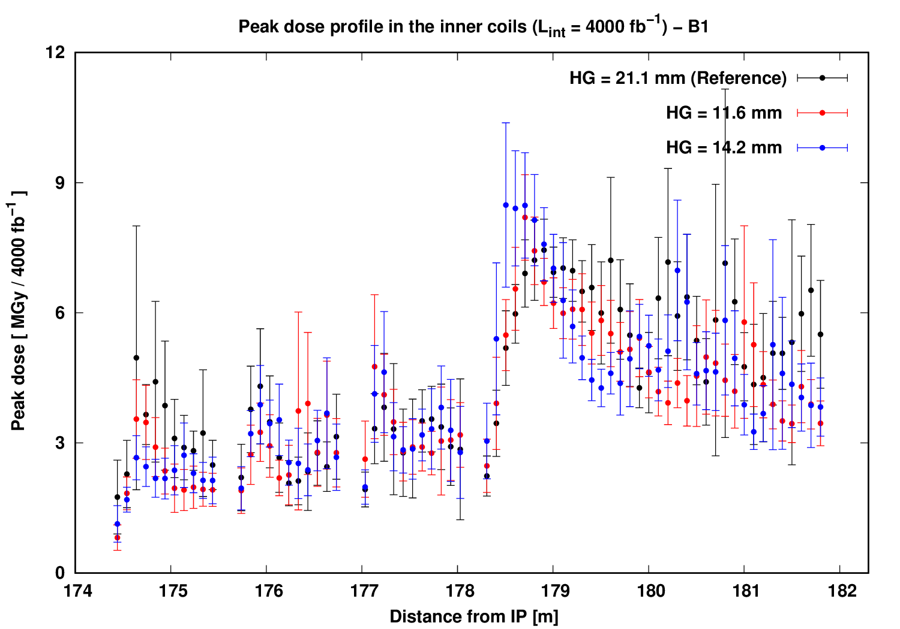
HC: peak dose distribution in Q4 assembly
Decreased in the front MCBY
Special Joint HiLumi WP2/WP5 meeting M. Sabaté-Gilarte 5th September 2023

Slide 7
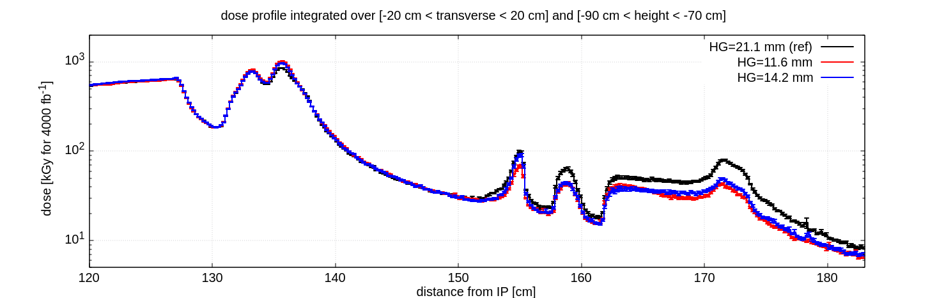
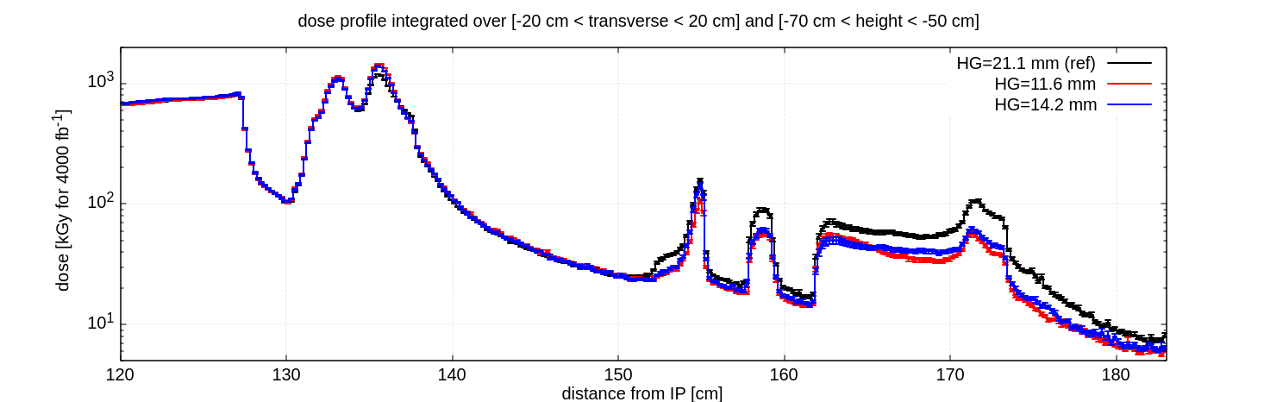
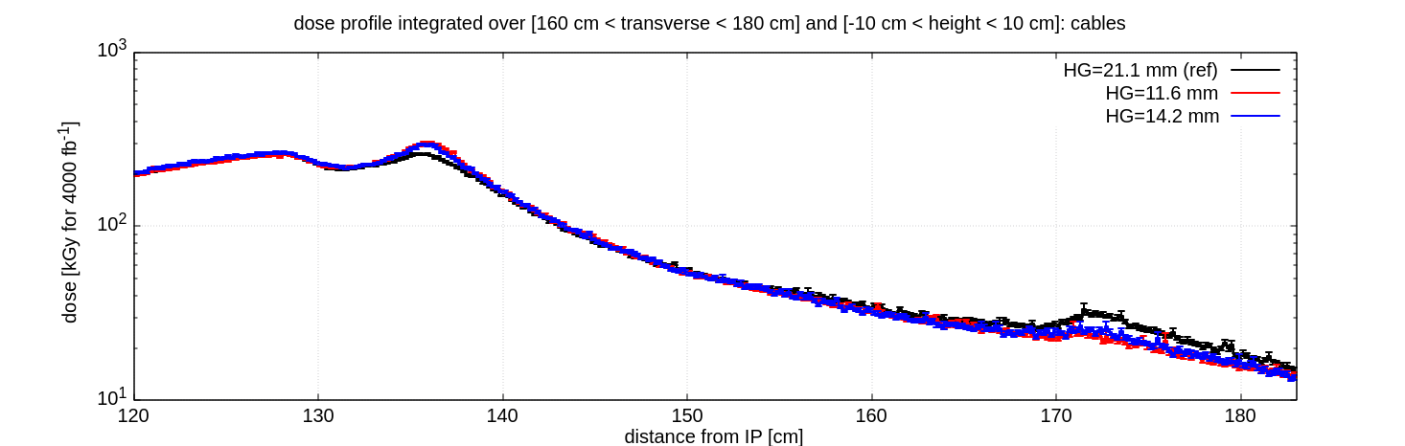
Horizontal Crossing: dose levels
TCLPX4
Around TCPLX4
11.6 / 14.2 mm: increased by a factor 1.2
CC1 CC2
TCLMB
Around Q4-assembly:
11.6 / 14.2 mm: decreased by a factor 0.6
TCLPX4
CC1 CC2
TCLMB
TCLPX4
TCLMB
Special Joint HiLumi WP2/WP5 meeting M. Sabaté-Gilarte 5th September 2023

Slide 8
Horizontal Crossing: Total power (W) for 7.5 L0
Half gap (mm) | D2 | D2 Hcorr | D2 Vcorr | Q4 - CM MCBYs | Q4 - CM | TCLPX inner | TCLPX outer | TCLMB B1
11.6 | 24.2 | 0.9 | 0.8 | 3.3 | 3.7 | 303.5 | 288.2 | 13.7
Ratio wrt ref | 0.9 | 0.5 | 0.5 | 0.6 | 0.8 | 1.3 | 1.8 | 0.5
14.2 | 26.7 | 1.05 | 1.04 | 3.6 | 3.9 | 277.8 | 256 | 15.7
Ratio wrt ref | 0.9 | 0.6 | 0.7 | 0.7 | 0.8 | 1.2 | 1.6 | 0.5
21.1 - ref | 28.3 | 1.8 | 1.5 | 5.3 | 4.8 | 230.1 | 162.4 | 29.1
The collimator design, including the thermomechanical studies, is based on the loads corresponding to the reference settings.
corr = corrector
CM = cold mass
Special Joint HiLumi WP2/WP5 meeting M. Sabaté-Gilarte 5th September 2023

Slide 9
IR5
Vertical crossing
Special Joint HiLumi WP2/WP5 meeting M. Sabaté-Gilarte 5th September 2023

Slide 10
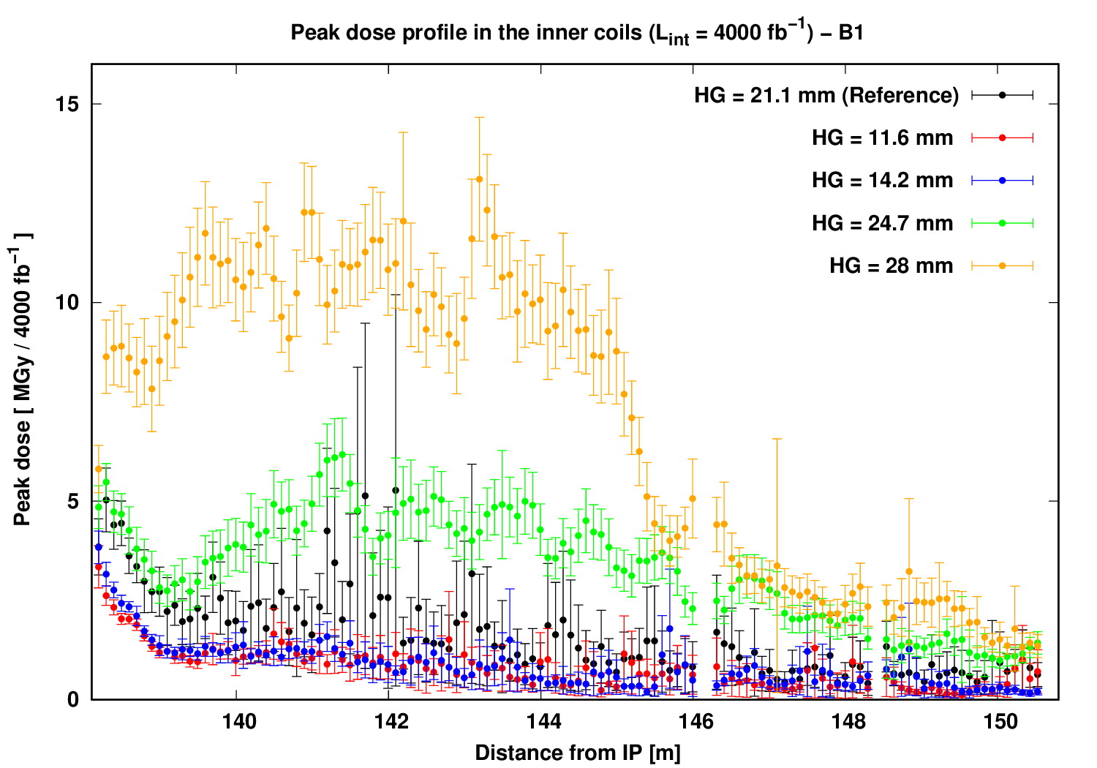
VC: peak dose distribution in D2 assembly
VC-up/down
Half gap (mm) | Peak dose (MGy)
21.1 - ref | 5
11.6 | 3.3
ratio | 0.7
14.2 | 3.8
ratio | 0.8
24.7 | 6
ratio | 1.2
28 | 12
ratio | 2.4
!
Special Joint HiLumi WP2/WP5 meeting M. Sabaté-Gilarte 5th September 2023

Slide 11
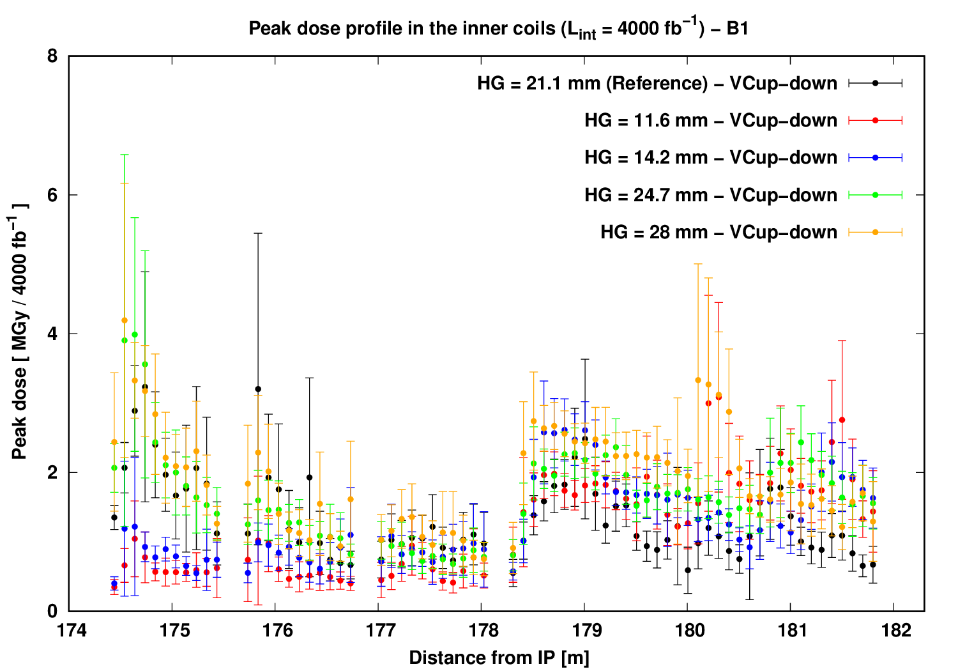
VC: peak dose distribution in Q4 assembly
VC-up/down
Half gap (mm) | Peak dose (MGy)
21.1 - ref | 3.2
11.6 | 1
ratio | 0.3
14.2 | 1.2
ratio | 0.4
24.7 | 4
ratio | 1.3
28 | 4.2
ratio | 1.3
Special Joint HiLumi WP2/WP5 meeting M. Sabaté-Gilarte 5th September 2023

Slide 12
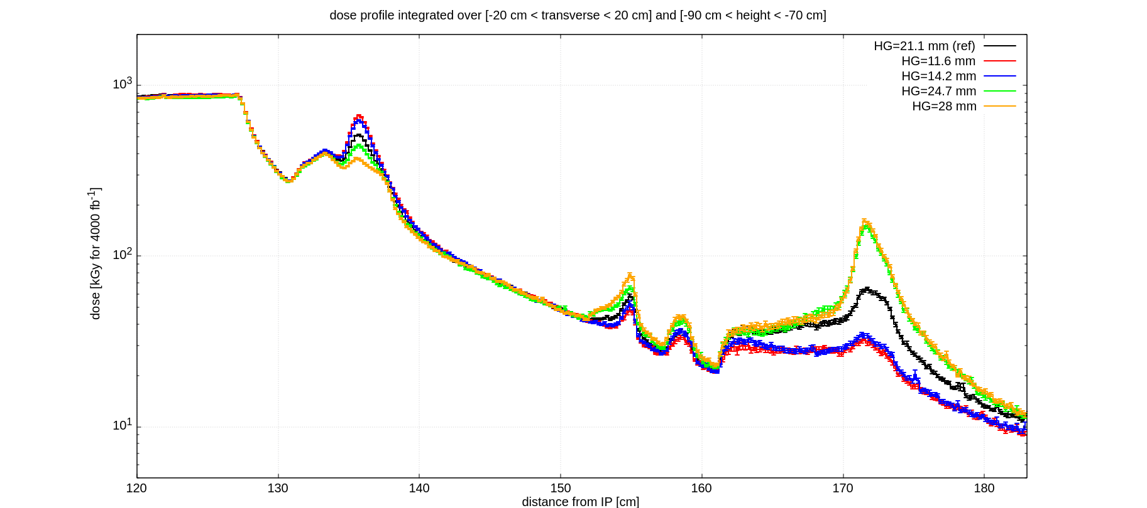
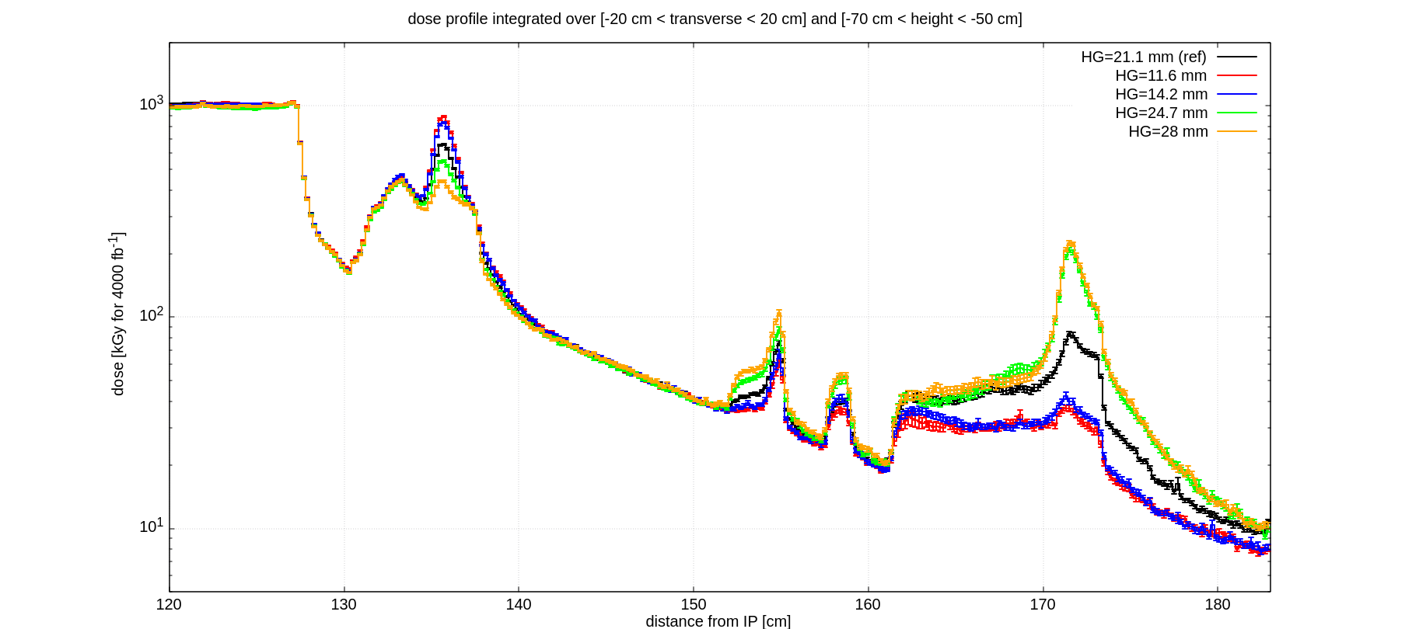
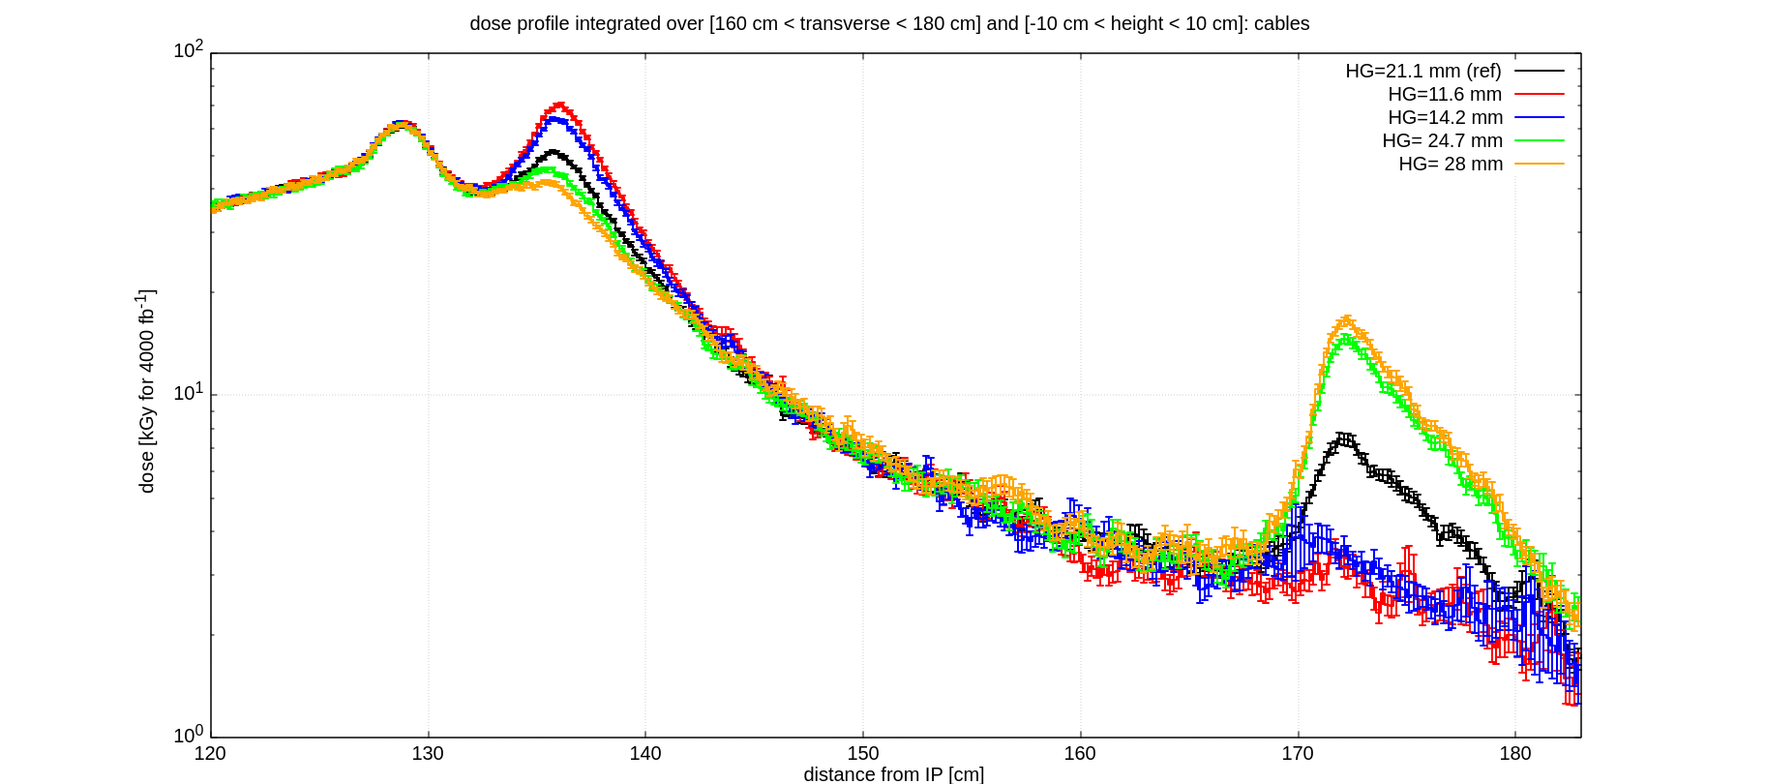
VC dose levels
TCLPX4
TCLMB
CC1 CC2
Around TCPLX4:
24.7 / 28 mm: decreased by a factor 0.7-0.8
11.6 / 14.2 mm: increased by a factor 1.3
TCLPX4
TCLMB
CC1 CC2
Around Q4-assembly:
24.7 / 28 mm: increased by a factor 2.5
11.6 / 14.2 mm: decreased by a factor 0.5
VC-up
TCLPX4
TCLMB

Slide 13
Vertical crossing: Total power (W) for 7.5 Lo
Half gap (mm) | D2 | D2 Hcorr | D2 Vcorr | Q4 - CM MCBYs | Q4 - CM | TCLPX inner | TCLPX outer | TCLMB B1 | TCLMB B2
11.6 | 13.7 | 0.4 | 0.5 | 1.8 | 1.8 | 58.3 | 170 | 5 | 0.63
Ratio | 0.7 | 0.4 | 0.4 | 0.4 | 0.7 | 1.5 | 2 | 0.1 | 0.6
14.2 | 14.6 | 0.4 | 0.6 | 2.2 | 1.8 | 52.6 | 144.7 | 6.1 | 0.79
Ratio | 0.8 | 0.5 | 0.5 | 0.5 | 0.8 | 1.4 | 1.7 | 0.2 | 0.8
21.1 - ref | 18.8 | 1 | 1.2 | 4.6 | 2.4 | 38.7 | 85.5 | 35.7 | 0.98
24.7 | 31.8 | 2.1 | 3.3 | 5.3 | 2.3 | 30.8 | 59.3 | 44.7 | 0.9
Ratio | 1.7 | 2.2 | 2.7 | 1.2 | 1 | 0.8 | 0.7 | 1.3 | 0.9
28 | 54 | 3 | 4.6 | 5.6 | 2.6 | 23.2 | 37.3 | 51.9 | 0.9
Ratio | 2.9 | 3.1 | 3.8 | 1.2 | 1.1 | 0.6 | 0.4 | 1.5 | 0.9
!
TCLPX is designed to stand the maximum heat in IR1, > 200 W for a single jaw.
corr = corrector
CM = cold mass
Special Joint HiLumi WP2/WP5 meeting M. Sabaté-Gilarte 5th September 2023

Slide 14
Conclusions
The effect of bigger and smaller aperture of the TCLPX collimator was explored for HC/VC.
Peak dose in D2/Q4 assemblies:
  A reduction in the aperture of the TCLPX4 implies a decrease in the peak dose in D2 and Q4-assembly.
  A larger opening leads to a non-negligible increase in D2 (up to a factor 2) and Q4-assembly.
Total power:
  The impact of the TCLPX4 settings highly depends on the half gap and the crossing plane.
  For horizontal crossing, an aperture of 11.6 mm half-gap implies that the loads in the inner jaw of the TCLPX4 will be ~304 W, 70 W above the values considered in the design.
  In vertical crossing when opening the TCLPX4 to 28 mm half-gap, the loads in the D2, Q4 and TCLMB increase by a factor 2.9 (up to 54 W), 1.2 (5.6 W) and 1.5 (52 W) respectively.
Radiation levels:
  When opening the collimator there is a decrease by a factor ~0.8 in the surrounding of TCLPX4 and an increase by a factor 2.5 around Q4-assembly.
  When closing the collimator there is an increase by a factor ~1.3 in the surrounding of TCLPX4 and a decrease by a factor ~0.5 around Q4-assembly.
Special Joint HiLumi WP2/WP5 meeting M. Sabaté-Gilarte 5th September 2023

