Slide 1
HL-LHC: Towards updated baseline for Run4
R. De Maria
Thanks to B. Lindstrom, Y. Angelis, G. Sterbini,
C. Droin, L. Giacomelli, N. Mounet, X. Buffat, R. Tomas

Slide 2
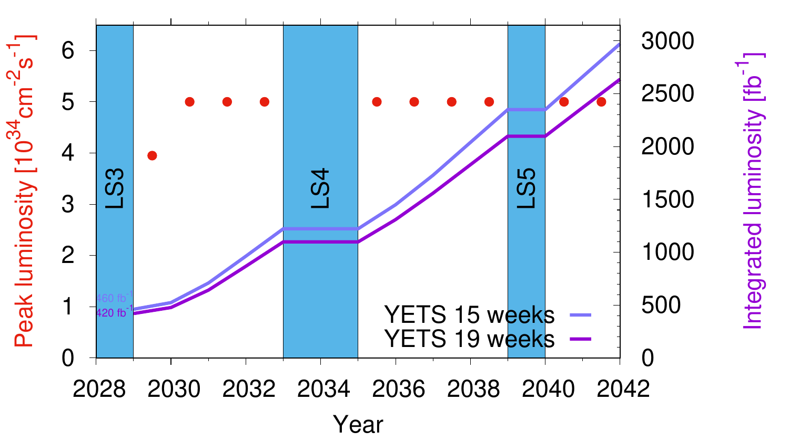

Baseline HL-LHC schedule and Run 4 ramp-up
Baseline HL-LHC schedule and performance for ATLAS/CMS. Heavy ion runs are considered at the end of each year.
Assuming 2748 bunches, 2.3 10¹¹ ppb, 2.5h turn-around time, 50% operational efficiency* (or 40% stable-beam efficiency for 7h stable beam duration).
Run 4 aims at approaching 250 fb⁻¹ in the last year after ramping up phase for a total of 750 fb⁻¹.
15 Weeks EYETS | pp | Yets | Commissioning | Scrubbing | Ion + comm. | Op. efficiency | ∫ L dt | Pile-up
 | [days] |  |  |  |  |  | [fb⁻¹]
2029 | 90 | 105 | 80 | 10 | 34 | 0.4 | 64 | 120
2030 | 120 | 105 | 60 | 2 | 34 | 0.5 | 185 | 140
2031 | 160 | 105 | 25 | 2 | 34 | 0.5 | 254 | 132
2032 | 160 | 105 | 25 | 2 | 34 | 0.5 | 260 | 132
Run 5 avg | 172 | 105 | 27 | 2.5 | 34 | 0.5 | 280 | 132
Run 6 avg | 190 | 105 | 25 | 2.5 | 34 | 0.5 | 309 | 132
This table is being reviewed by taking into account the new schedule!
*Op. efficiency = ideal stable beam duration + turn-around/allocated time;
SB efficiency = ideal stable beam duration/allocated time

Slide 3
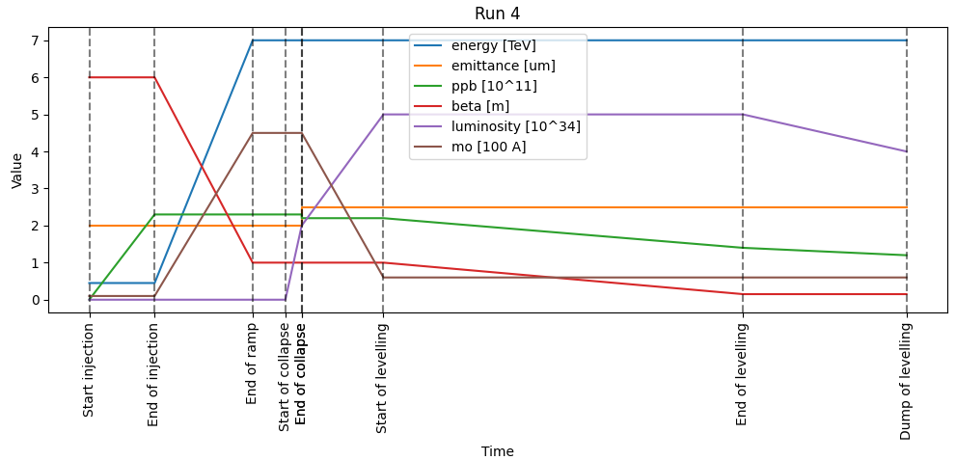
Run 4 scenarios
News from previous baseline:
No e-lens:
  Point 4 optics not optimal anymore
  Improve Crab TCP phase advance
  Better tails for impedance
BETS upgrade:
  TCDQ gaps can change at flat top (like TCTs), no more tight constraints in TCDQ beta
Impedance unknowns: crab needs a comb filter (~+20 A) and if does not work (~+100A) to stabilize beam during collapse
  Need to use improved IR7 optics
  Need to decrease beta at crabs
  Be compatible with relaxed TCPs
MS10 in allows to consider larger ATS factor and flat optics to increase performance:
  Increase virtual lumi with flat beta* at the end of levelling
Proven effectiveness of phase advance optimization:
  Factor in lessons learned at injection and flat top.
Example cycle evolution (not to scale).
The collapse process has a lot of uncertainties, therefore assume an unrealistic step function for ε and ppb to study a pessimistic collapse scenarios. At the same time we should also qualify the optimistic and middle case, to understand the extent of the margins.

Slide 4
Phase advance constraints
B1-> IP1 CCR CCL TCT IP5 CCR MKD IP6 TCP IP7 TCT IP8 CCL TCT IP1
B2<- IP1 CCR CCL IP5 TCT CCR IP6 MKD IP7 TCP IP8 TCT CCL IP1
15 cm baseline [ unit 2 pi]
Constraints
CC-TCP | B1 Left | B1 Right | B2 Left | B2 Right
CC1 H | 46.25 | 45.74 | 15.58 | 16.08
CC5 V | 14.56 | 14.05 | 44.85 | 45.4
MKD-TCT | B1 MKD.A | B1 MKD.0 | B2 MKD.A | B2 MKD.0
TCTH1 | 23.49 | 23.5 | 38.45 | 38.46
TCTH5 | 54.42 | 54.43 | 7.41 | 7.42
TCTH8 | 15.51 | 15.53 | 46.66 | 46.67
TCP-TCT | B1 H | B1 V | B2 H | B2 V
TCT1 | 16.07 | 15.77 | 46.23 | 44.91
TCT5 | 47 | 45.76 | 15.19 | 14.96
TCT8 | 8.09 | 7.72 | 54.44 | 52.77
CC-TCP
Below 30° mod 180°
Particularly needed for tight settings
MKD-TCT
Below 20° mod 180°
Particularly needed for relaxed settings
TCP-TCT
Below 25° or in
70°-110° mod 180°

Slide 5
Phase advance constraints
B1-> IP1 CCR CCL TCT IP5 CCR MKD IP6 TCP IP7 TCT IP8 CCL TCT IP1
B2<- IP1 CCR TCT CCL IP5 TCT CCR IP6 MKD IP7 TCP IP8 TCT CCL IP1
15 cm baseline [unit degree]
Constraints
CC-TCP | B1 Left | B1 Right | B2 Left | B2 Right
CC1 H | 88.21 | 86.76 | 28.77 | 29.93
CC5 V | 21.19 | 19.74 | -52.65 | -36.87
MKD-TCT | B1 MKD.A | B1 MKD.0 | B2 MKD.A | B2 MKD.0
TCTH1 | -4.85 | 1.35 | -18.7 | -14.74
TCTH5 | -29.87 | -23.67 | -30.97 | -27
TCTH8 | 3.55 | 9.74 | 57.16 | 61.12
TCP-TCT | B1 H | B1 V | B2 H | B2 V
TCT1 | 23.75 | -81.71 | 81.78 | -31.38
TCT5 | -1.27 | -85.69 | 69.52 | -13.25
TCT8 | 32.14 | 77.75 | -22.36 | -82.54
CC-TCP
Below 30° mod 180°
Freedom
- Arc 23,34, 67, 78
- IR 2, 8, 3, 4
MKD-TCT
Below 20° mod 180°
TCP-TCT
Below 25° or in
70°-110° mod 180°

Slide 6
Phase advance constraints
B1-> IP1 CCR CCL TCT IP5 CCR MKD IP6 TCP IP7 TCT IP8 CCL TCT IP1
B2<- IP1 CCR CCL IP5 TCT CCR IP6 MKD IP7 TCP IP8 TCT CCL IP1
15 cm optimized [unit degree]
Constraints
Freedom
- Arc 23, 34, 67, 78
- IR 2, 8, 3, 4
CC-TCP | B1 Left | B1 Right | B2 Left | B2 Right
CC1 H | 16.21 | 14.76 | 13.87 | 15.02
CC5 V | 21.19 | 19.74 | 6.16 | 7.55
MKD-TCT | B1 MKD.A | B1 MKD.0 | B2 MKD.A | B2 MKD.0
TCTH1 | -4.75 | 1.45 | -18.67 | -14.71
TCTH5 | -29.77 | -23.57 | -30.94 | -26.97
TCTH8 | 4.27 | 10.47 | 48.58 | 52.54
TCP-TCT | B1 H | B1 V | B2 H | B2 V
TCT1 | -84.25 | -81.71 | -83.31 | -75.79
TCT5 | 70.73 | -85.69 | 84.42 | -72.06
TCT8 | -75.23 | 77.45 | -16.07 | 50.96
CC-TCP
Below 30° mod 180°
Using MQTF/D at <95 T/m
But without IR8, IR4, etc…
MKD-TCT
Below 20° mod 180°
TCP-TCT
Below 25° or in
70°-110° mod 180°

Slide 7
Beta* options
 | Point 1 and 5 βx/βy* [m] |  |  | Point 8
Optics case | Flat Option 1 | Flat Option 2 | Back-up
Injection | 6 | 6 | 6 | 10
Collapse | 0.7/2.8 | 0.9/1.8 | 1.1 | 1.5
End of levelling 2029 | 0.15/0.60 | 0.25/0.50 | 0.3 | 1.5
End of levelling 2030 | 0.10/0.40 | 0.15/0.30 | 0.2 | 1.5
End of levelling 2031-32 | 0.09/0.18 | 0.09/0.18 | 0.15 | 1.5
MD 2029-2030 | 0.075/0.18 | 0.075/0.18 | 0.15 | 0.5/1.5*
MD 2024-2025 | 0.3/0.72** | 0.3/0.72** | 0.6** | 1.5
MD 2024-2025 | 2 | 2 | 2 | 0.5/1.5
*if LHCb upgrade approved for Tun ** same ATS factor as 0.075/0.18 cm (pre-squeeze 2m)
Flat ratio and ATS factors choice pending DA results.
Anti-ATS for the collapse is better to forward physics, but relies more on BETS upgrade.
Further reduction of beta at the crab at collapse could be envisaged at the cost of initial changes of transport for forward physics. New IR7 optics to be added in the ramp.
Tight settings probably needed for most pushed beta*, new aperture estimates on-going, ideally waiting from b.s. Production.
Optics to be compatible both 6.8 TeV and 7 TeV (although we may miss some optimizations)

Slide 8
Back-up

Slide 9
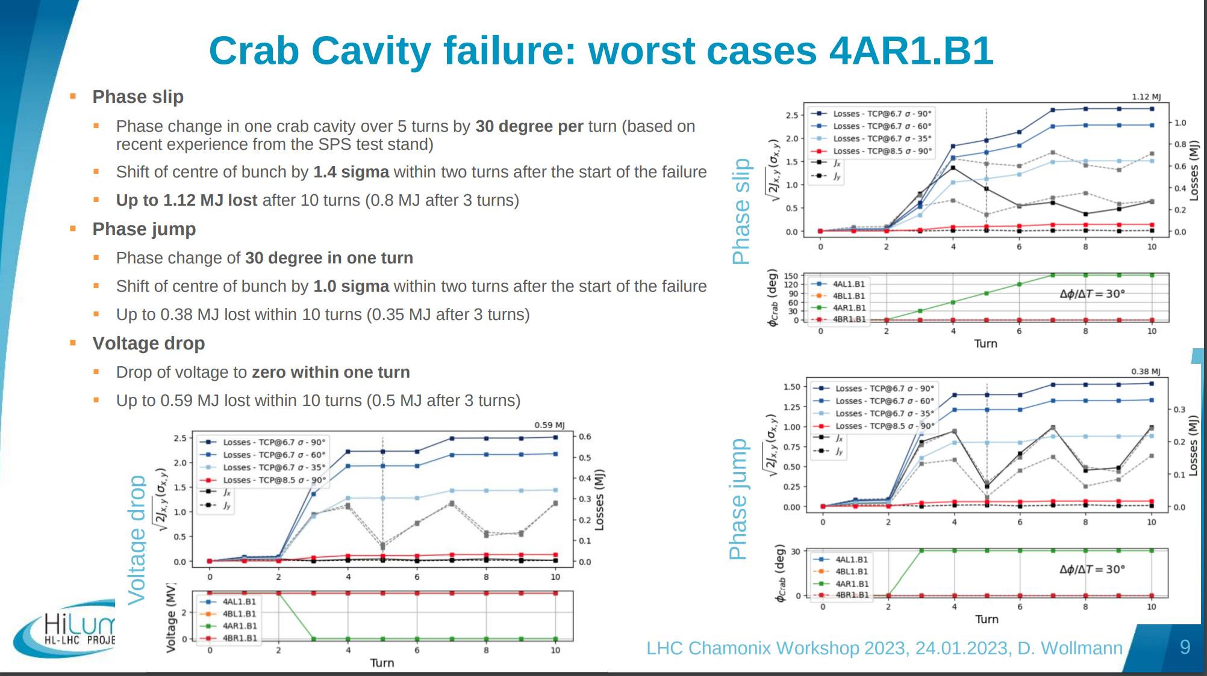

Slide 10
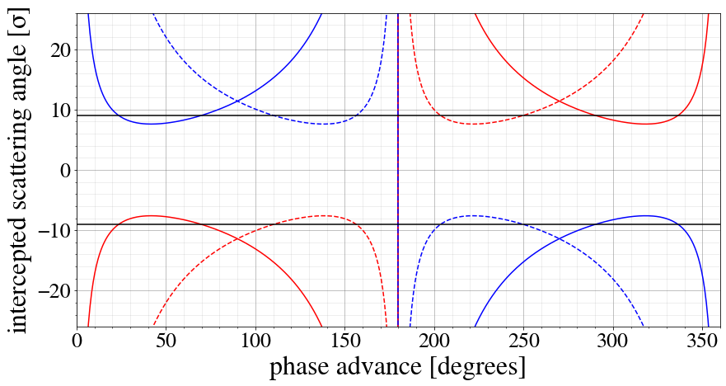

Slide 11
