Slide 1
MD # 9545 preliminary results
Nabil El-Kassem
05.09.2023

Slide 2
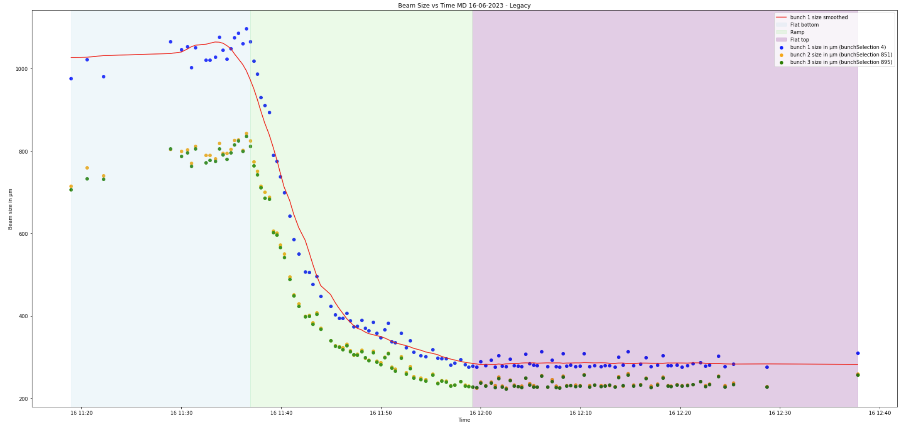
Beam size vs Time (Legacy)
Points deviating from the mean, caused by non-linearity of the position readings (known issue)
Source: FESA

Slide 3
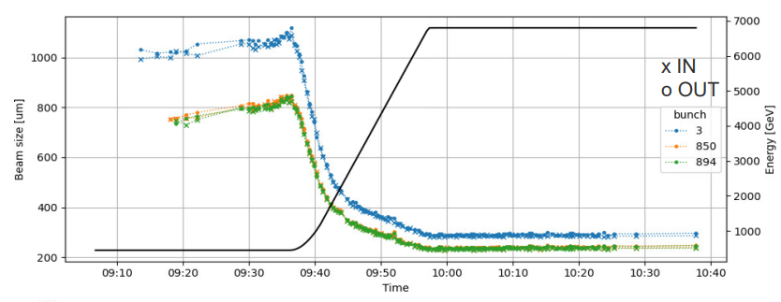
Beam size vs Time (Legacy)
Solved by assuming a constant speed of the WS and linearizing its position.
Credit: Daniele
Source: FESA

Slide 4
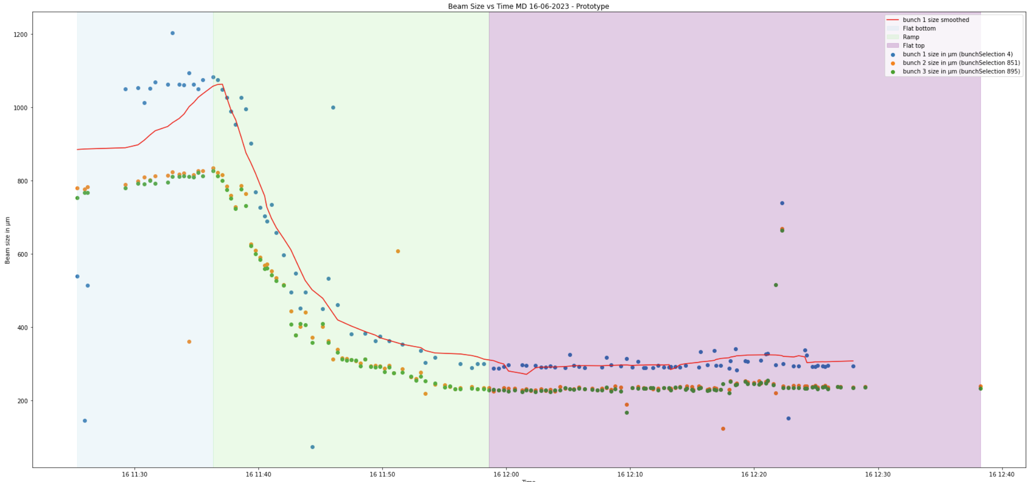
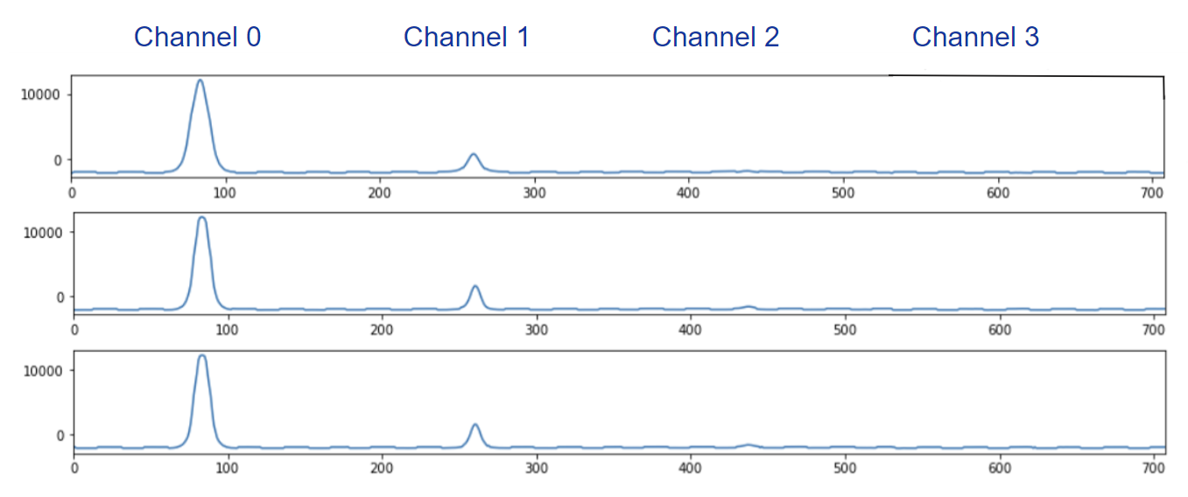
Beam size vs Time (Prototype)
Bunch 1
ProjDataSet1
Bunch 2
Bunch 3
Array index
Wrong channel?
Points deviating from the mean, caused by non-linearity of the position readings?
Source: FESA fit

Slide 5
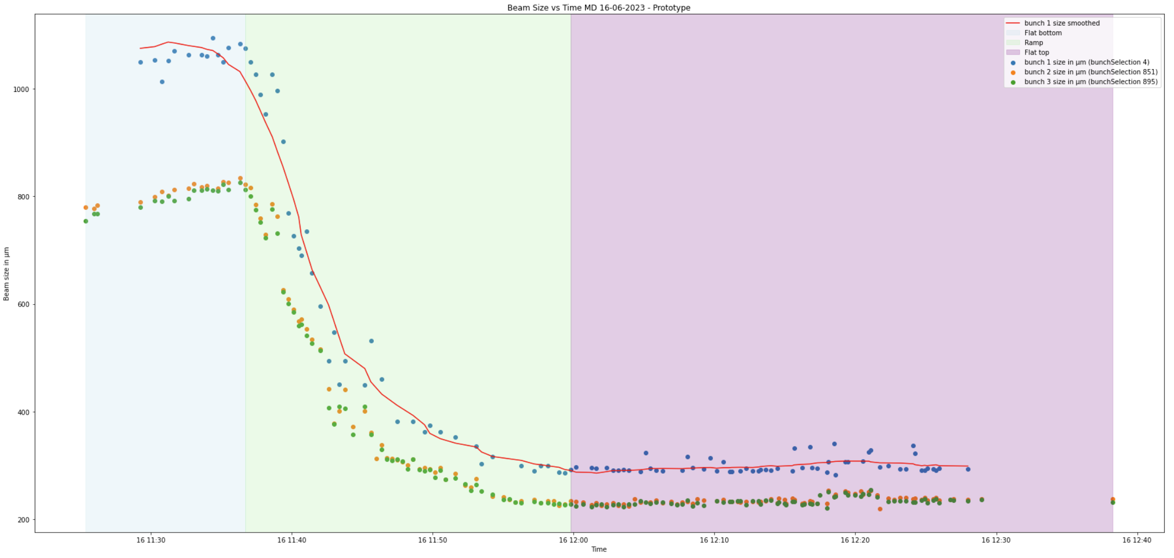
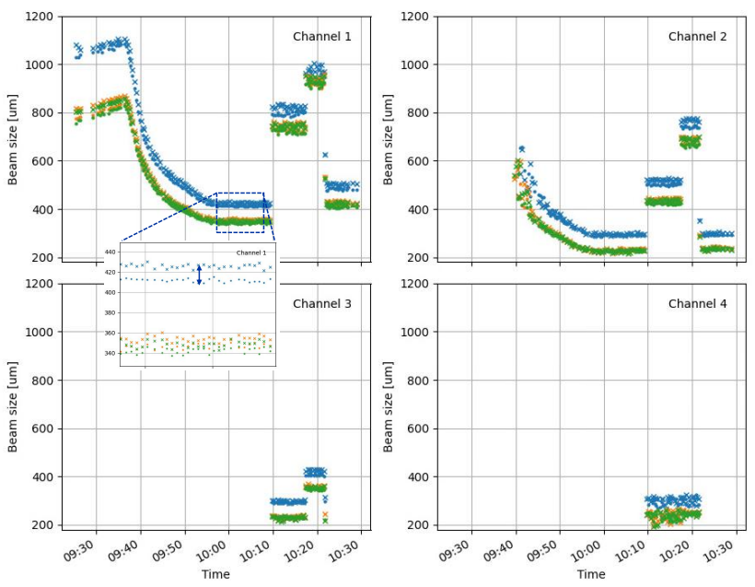
Beam size vs Time (Prototype - Filtered)
Source: Daniele
Channel switching needs to get smoother
Source: FESA

Slide 6
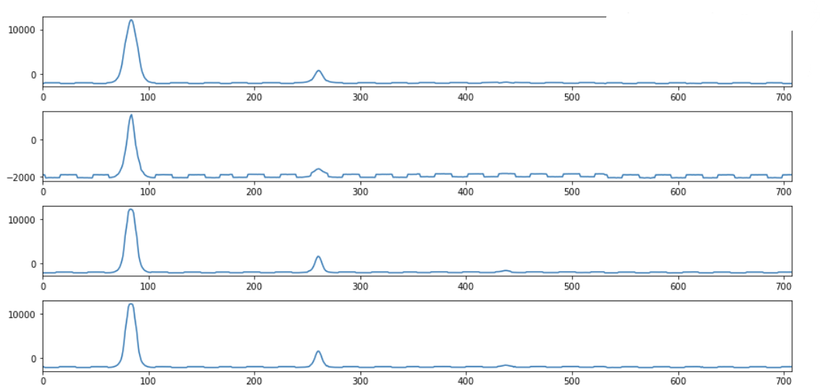
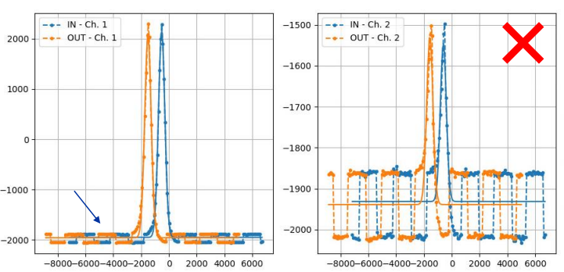
Previously unknown noise (Prototype)
Uniform noise also causing disturbances in the measurements of the beam size – Major issue
Source: FESA
Source: Daniele

Slide 7
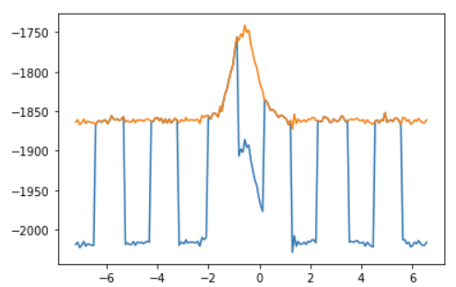
Previously unknown noise solved (Prototype) credit: David and Daniele
Noise removed
Raw data from FESA
ProjDataSet1
Source: FESA
Position

Slide 8
Standard deviation of Beam size in % and Sigma in µm at Flat top (Sigma calculated by FESA)
Bunch | Sigma in µm (FT) | std deviation at FT in % (Legacy) | std deviation at FT in % (Prototype) | std deviation at FT in % (Prototype filtered)
1 (bunchSelection 4) | 285 | 4 | 32.4 | 5.1
2 (bunchSelection 851) | 236 | 4.1 | 30.8 | 2.9
3 (bunchSelection 895) | 234 | 4 | 32.7 | 2.9

Slide 9
Next Steps 1/2
Beam size calculated from the projected data (the PMT data) and projected position (optical encoder simulated).
Beam size calculated from the PMT bunch-by-bunch data and position reconstructed with a constant speed using 2 resolver position (the method I used for the first prototype MD, the file you have).
Beam size calculated from the raw PMT data on HDF5 file (needs digital integration see P.6) and with a constant speed using 2 resolver position.
PMT Cross-talk study: Using the BWSACQ class data which contains all the bunches already integrated using the delay setting we gave during the MD, to evaluate the cross-talk between adjacent bunch slots.
PMT data integration study: PMT data integration reconstruction based on HDF5 file on disk. This is the 2ns acquisition of the photomultipliers. With this we can evaluate the limit of the system’s performance, evaluate the best crass-talk we can obtain, verify the phasing between this data and the digital integration, etc…

Slide 10
Next Steps 2/2
Optical encoder simulation study: Verification of optical encoder simulation: compare the optical disk data against the resolver and see if the SW provides the best estimate possible of the wire position.
Best PMT high voltage study: Since we will have calculated the beam size for each of the 4 channels, this study should find which is the best channel to use. The SW does this by looking how saturated is the ADC samples.
Best high voltage setting for the PMT: Study how the secondary particle shower is affecting the proportionality between the 4 PMT channels. The Legacy systems are using the PMT without any direct light from the scintillators at high energy. How better is the 4 channels PMT system we have on the prototype?

Slide 12
Beam size vs Time (Prototype)
Channel 0
Channel 1
Channel 2
Channel 3

