Slide 1
Linear LHC-BWS Mechanics
LHC BWS CONS project team meeting
05/09/2023

Slide 2
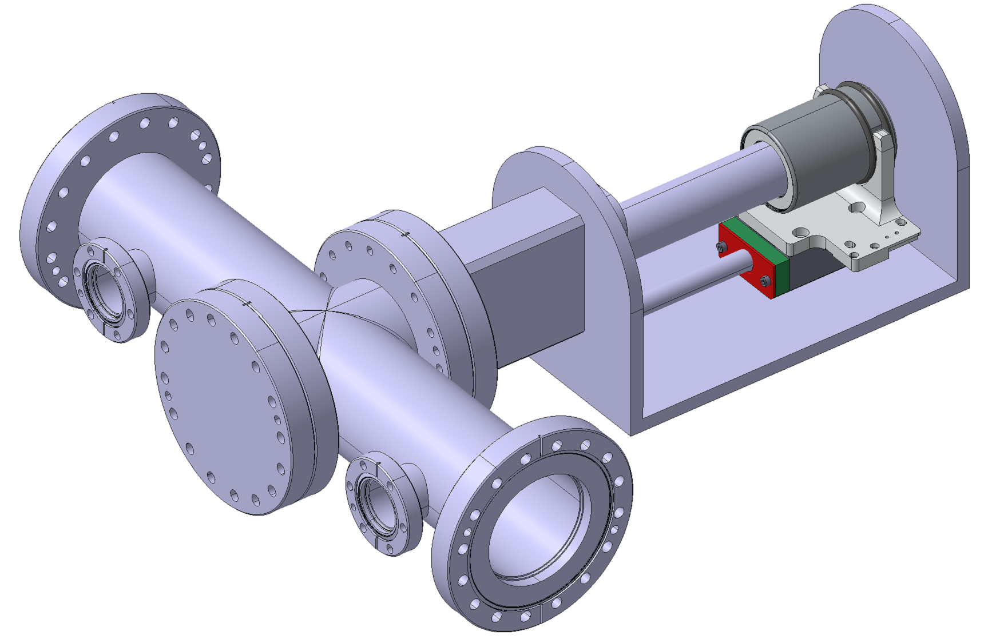
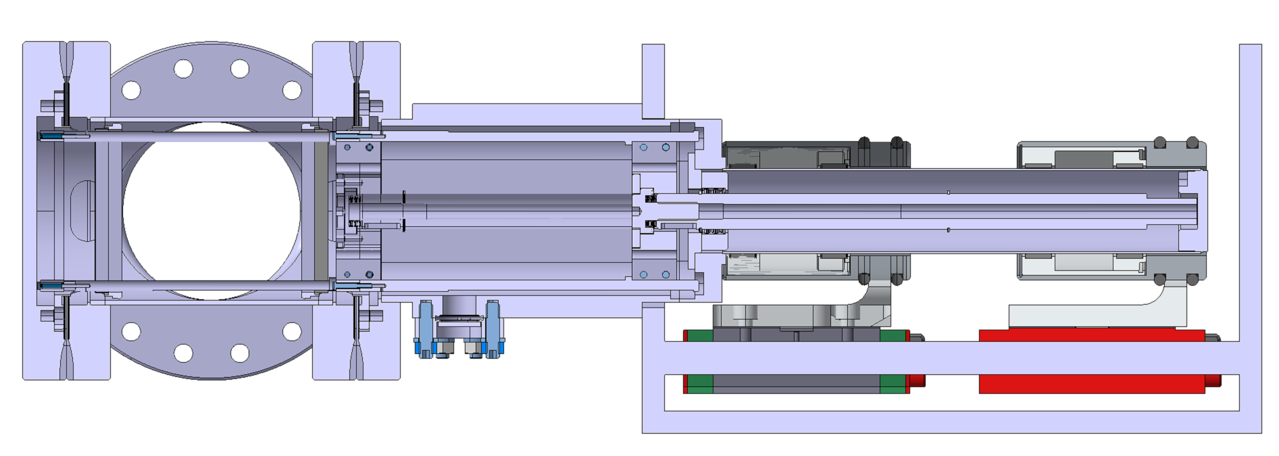
Radio-Frequency Studies
Design Tips
Magnetically Coupled Design
The BWS Vacuum Chamber is the main resonator component, in addition to the Line Vacuum Chamber
The Ferrite Windows reduce the coupling thanks to the ferrites (that absorb some resonances depending on the ferrite properties) and the small aperture (calculated, documentation being found by RF team)
Line Vacuum Chamber
BWS Vacuum Chamber
Ferrite Window

Slide 3
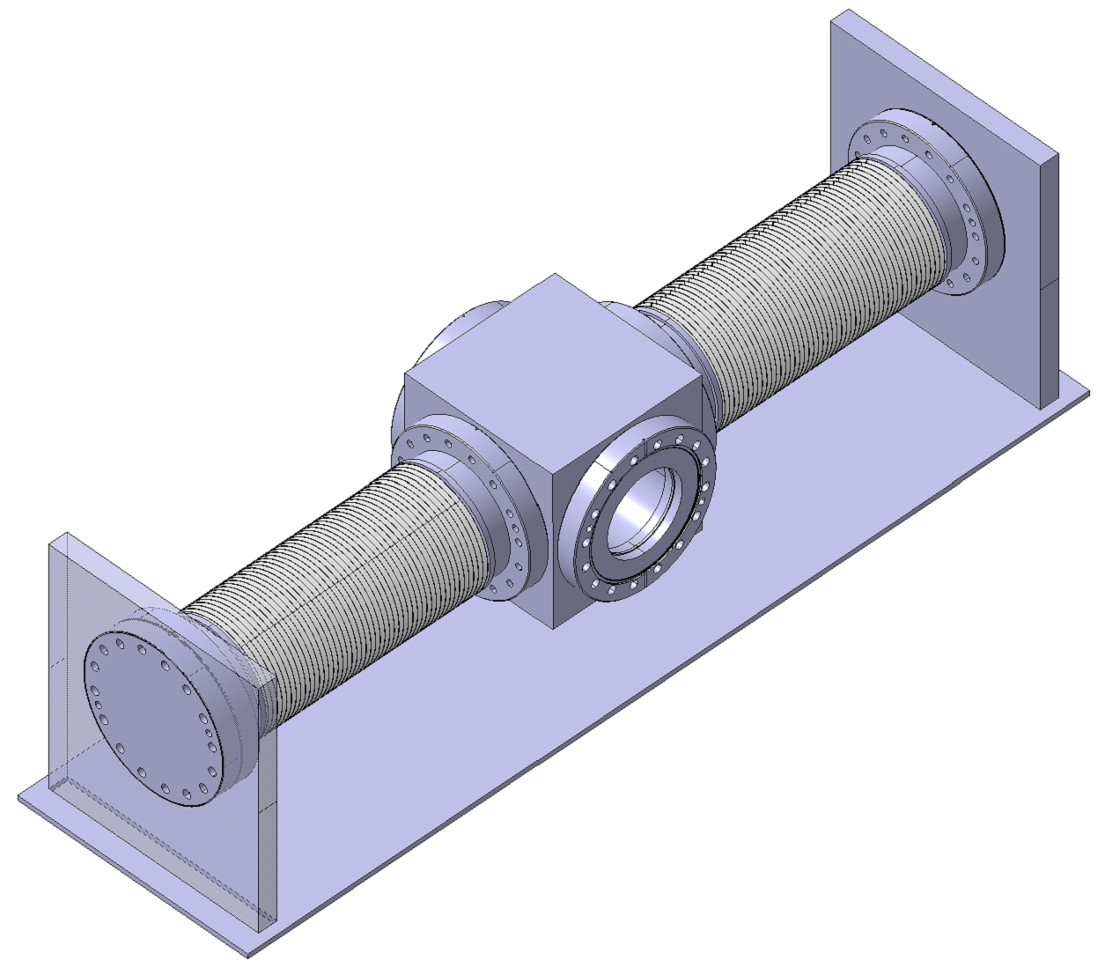
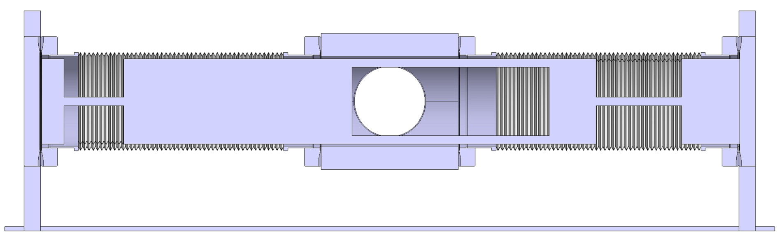
Radio-Frequency Studies
Design Tips
Double Bellow Design
The symmetric design creates a half wavelength resonator. The shorter the instrument, the better. A solution to attenuate it could be implementing two ferrite windows
To make the card transparent to the beam, a ceramic material could be used. In addition, some mechanical solutions (slot) could be implemented
Slot
Ferrite Window

Slide 4
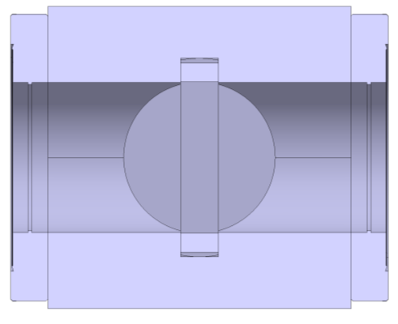
Radio-Frequency Studies
Design Tips
Aperture Reduction
Could we reduce the aperture of the instrument?
  → ABP (Riccardo De Maria): min aperture → RF (Hikmet Bursali): impedance study
Ø 80
Ø min aperture

Slide 5
SPS Prototype
YETS 24/25: install a vacuum chamber in SPS for a new prototype
During 2025: Install the new prototype and make it operational

