Slide 1
Title: A dielectric pickup for short bunches
Abstract: Novel acceleration schemes pose new challenges to the beam instrumentation required. This contribution presents a novel device to measure the beam position, enabling the discrimination of different co-propagating beams. The method leverages the characteristic properties of the Coherent Cherenkov-Diffraction Radiation (ChDR) emitted from dielectric inserts in the beampipe. The beam discrimination is performed in the frequency domain, exploiting the bunch length difference of the two beams. This device was developed for the AWAKE experiment, where not only an electron beam co-propagates with a more intense proton beam, but also traditional pickups are impacted by the environment polluted with spurious charges from the plasma. The electron beam discrimination takes place in a narrow band around 30 GHz. The overall design and results from the AWAKE experiment are presented. The utilisation of coherent ChDR to distinguish different co-propagating beams is a substantial novelty in the field, pushing the instruments capabilities for novel accelerating technologies, such as plasma-based accelerators.

Slide 2
A dielectric pickup for short bunches
Eugenio Senes, V. Bencini, C. Davut, W. Farabolini, P. Karataev, P. Korysko,
M. Krupa, K. Lasocha, S. Liu, T. Lefevre, T. Manson, S. Mazzoni, B. Moser,
C. Pakuza, E. Poimenidou, A. Schloegelhofer, A. Topaloudis, B. Spear,
L. Verra, V. Verzilov, M. Wendt, G. Zevi Della Porta
International Beam Instrumentation Conference IBIC 2023, Saskatoon, Canada
11 September 2023

Slide 3
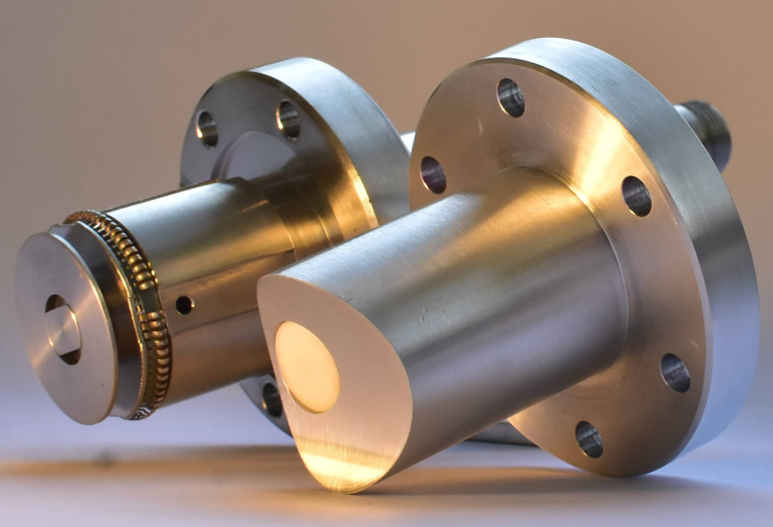

Slide 4
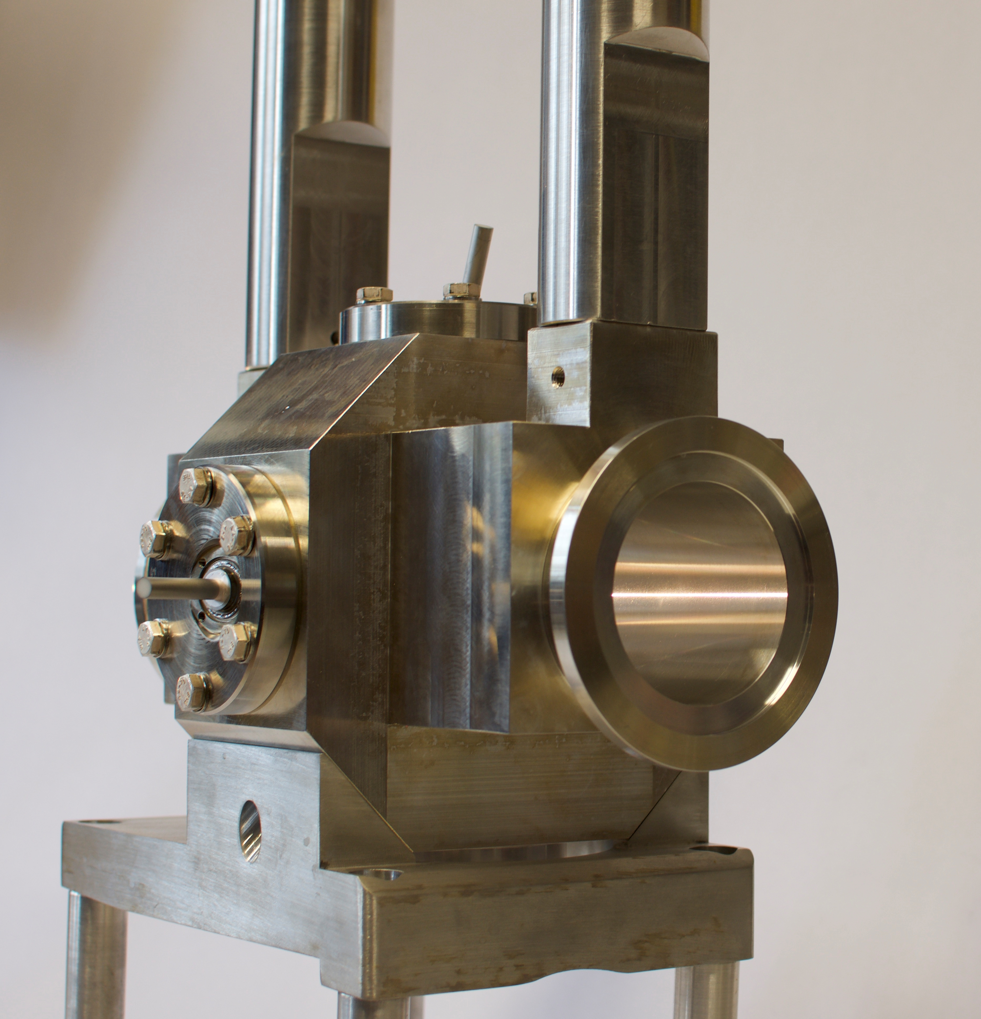
Outline
Motivation
The AWAKE experiment
Co-propagating beams diagnostics
Coherent Cherenkov diffraction radiation
Pickup design
Test results
Operational electronics
Future outlook

Slide 5
Motivation – AWAKE Experiment
AWAKE: Proton-driven plasma acceleration
SPECTROMETER
ELECTRON
LINAC
Electron BPMs
LASER
PULSE
DUMP
Plasma cell
Accelerated Beam
diagnostics
SPS
protons
Proton BPMs

Slide 6
Motivation – AWAKE Experiment
1
INJECTORS
The AWAKE ingredients
SPECTROMETER
SPECTROMETER
ELECTRON
LINAC
ELECTRON
LINAC
Electron BPMs
Proton beam 48 nC, 250 ps-σ
Electron BPMs
LASER
PULSE
LASER
PULSE
Electron beam 600 pC, 4 ps-σ
DUMP
DUMP
Laser beam 120 fs, 450 mJ
Plasma cell
Plasma cell
Accelerated Beam
diagnostics
Accelerated Beam
diagnostics
SPS
protons
SPS
protons
Proton BPMs
Proton BPMs
Rb vapour (later)

Slide 7
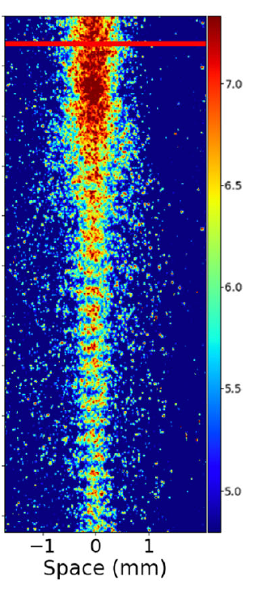
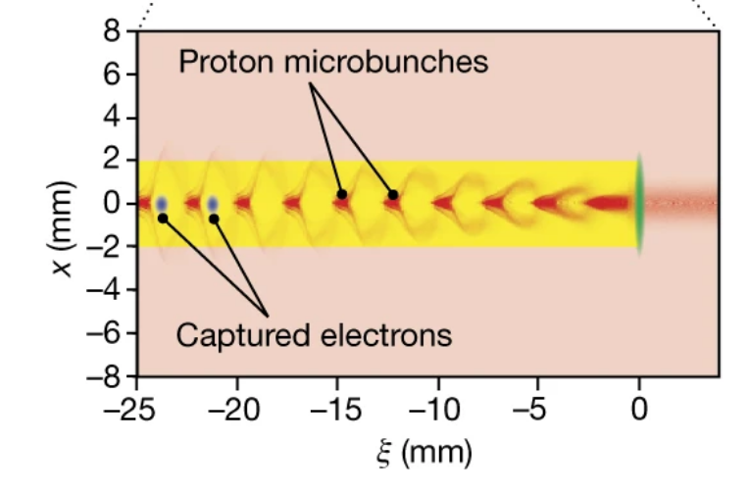
Motivation – AWAKE Experiment
2
PROTON MICROBUNCHING AND ELECTRON ACCELERATION
The proton bunch is broken into a train of microbunches via the self modulation process in the plasma.
Captured electrons in the plasma wakefields are accelerated.
See AWAKE Collab., Phys. Rev. Lett. 122, 054802 (2019)
See AWAKE Collab., Nature 561, 363-367 (2018)

Slide 8
Motivation – Multiple beams
The trajectory control of the laser, electron and proton beam is essential to avoid instabilities and study reproducibility !
SPECTROMETER
ELECTRON
LINAC
Electron BPMs
LASER
PULSE
DUMP
Due to the larger intensity, the proton beam saturates all the other diagnostics when present.
Need for an electron position measurement in the common beamline.
Plasma cell
Accelerated Beam
diagnostics
SPS
protons
Proton BPMs
Common
beamline

Slide 9
Cherenkov Diffraction radiation
Cherenkov Diffraction Radiation is a type of polarization radiation induced in dielectrics when a charged particle passes in proximity to the surface
ChDR
emission
ε_{r} (ω)
Very well-defined properties, including the radiation front direction at the Cherenkov angle θ_{Ch}
θ_{Ch}
See: M. V. Shevelev and A. S. Konkov, JETP 118, 501-511 (2014)
h
Beam
Recent interest to realise non-intercepting diagnostics
See:
A. Curcio et al., Phys. Rev. Accel. Beams 23 (2020) 022802
R. Kieffer et al., Phys. Rev. Lett. 121 (2018) 0548802
T. Lefevre et al., Cherenkov Diffraction Radiation as a tool for beam diagnostics, Conf. Proc. IBIC 2019 (2019), Malmo, Sweden
K. Lasocha et al., Experimental Verification of Several Theoretical Models for ChDR Description, Conf. Proc. IPAC’22 (2022), Bangkok, Thailand

Slide 10
Kacper test slide
Show linearity

Slide 11
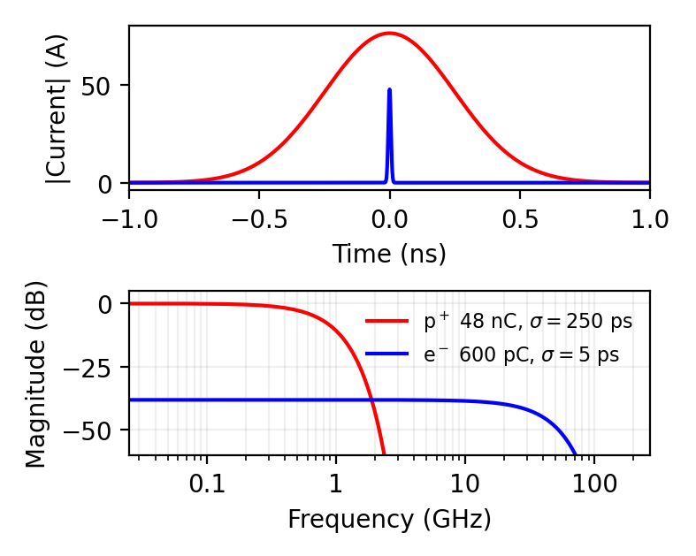
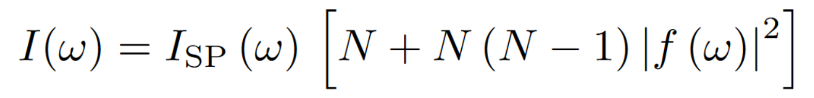
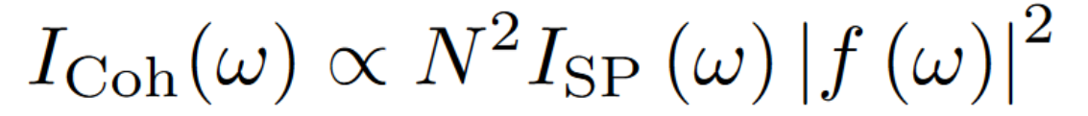
Coherent Radiation
For any radiation mechanism, we know that the radiation intensity spectrum is
At low frequencies, in the coherent region of the spectrum, one can assume the single particle emission in quasi-phase, hence:
Bunch intensity
Single
particle
term
Bunch form factor
(here Gaussian)

Slide 12
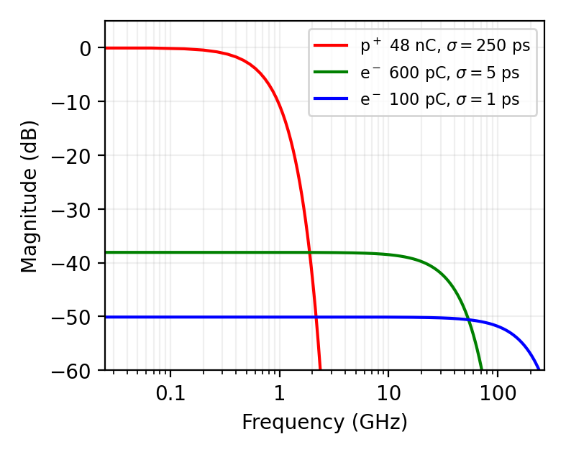
Coherent Radiation
Protons
Different beams feature different bunch form factors. For the AWAKE case:
Gaussian beams assumed here !
Real life is not that simple !
!
Electrons

Slide 13
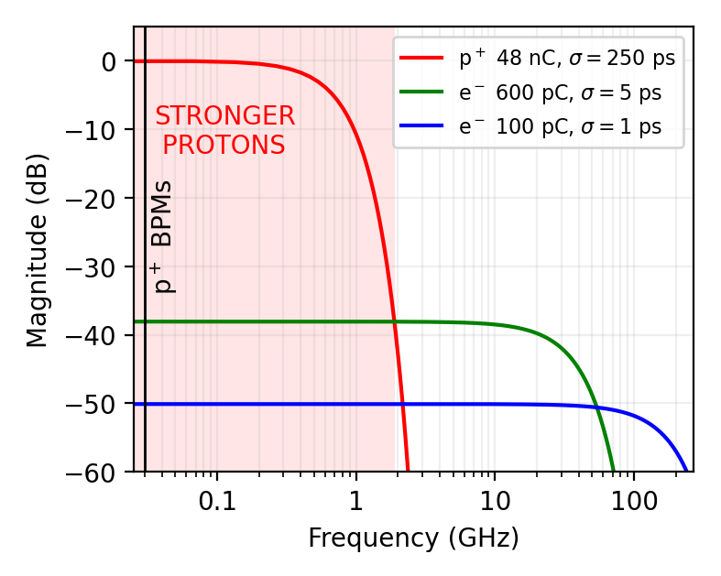
Coherent Radiation
DOMINANT PROTON AREA < 2 GHz
BPMs for p⁺ detect at 20 MHz
Gaussian beams assumed here !
Real life is not that simple !
!

Slide 14
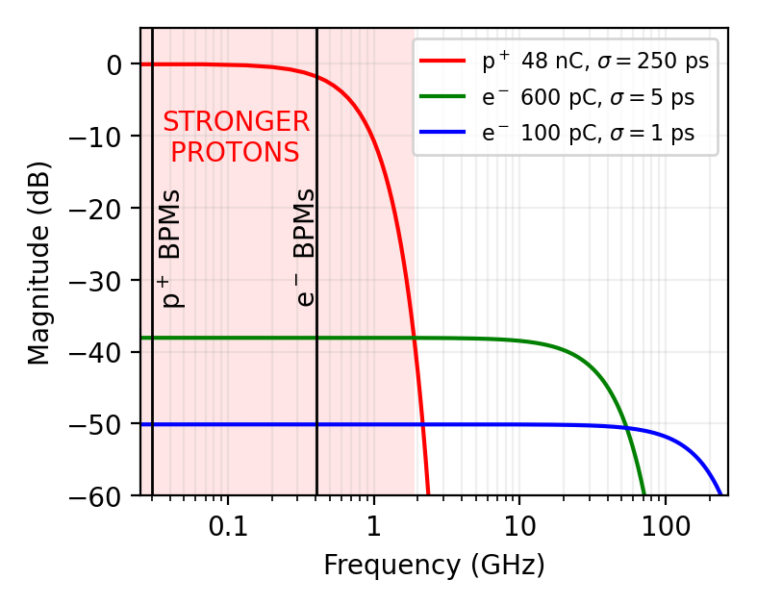
Coherent Radiation
DOMINANT PROTON AREA < 2 GHz
BPMs for p⁺ detect at 20 MHz
BPMs for e⁻ detect at 434 MHz
Gaussian beams assumed here !
Real life is not that simple !
!

Slide 15
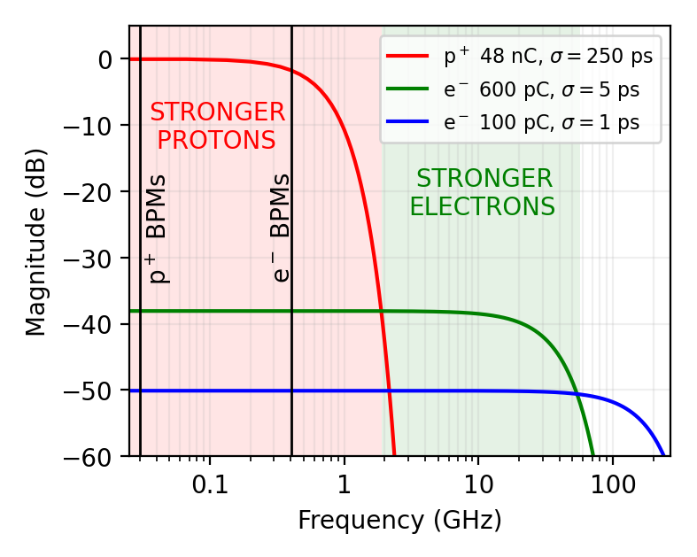
Coherent Radiation
DOMINANT PROTON AREA < 2 GHz
BPMs for p⁺ detect at 20 MHz
BPMs for e⁻ detect at 434 MHz
DOMINANT ELECTRON AREA > 2 GHz
Gaussian beams assumed here !
Real life is not that simple !
!

Slide 16
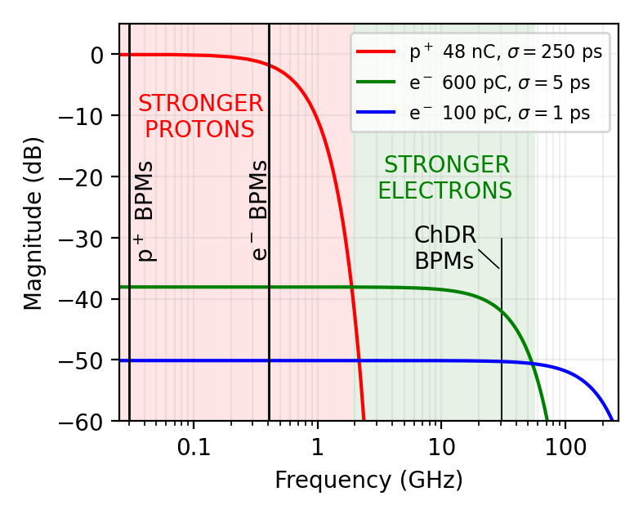
Coherent Radiation
DOMINANT PROTON AREA < 2 GHz
BPMs for p⁺ detect at 20 MHz
BPMs for e⁻ detect at 434 MHz
DOMINANT ELECTRON AREA > 2 GHz
Ideal BPMs for e⁻ detect at 20-30 GHz
Gaussian beams assumed here !
Real life is not that simple !
!

Slide 17
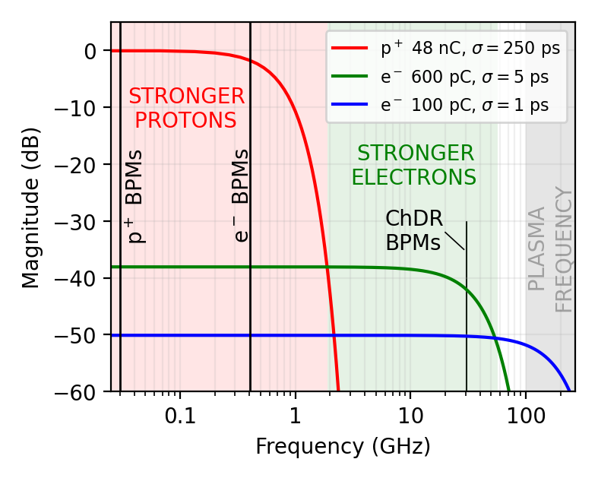
Coherent Radiation
DOMINANT PROTON AREA < 2 GHz
BPMs for p⁺ detect at 20 MHz
BPMs for e⁻ detect at 434 MHz
DOMINANT ELECTRON AREA > 2 GHz
Ideal BPMs for e⁻ detect at 20-30 GHz
PLASMA FREQUENCY > 100 GHz
Gaussian beams assumed here !
Real life is not that simple !
!

Slide 18
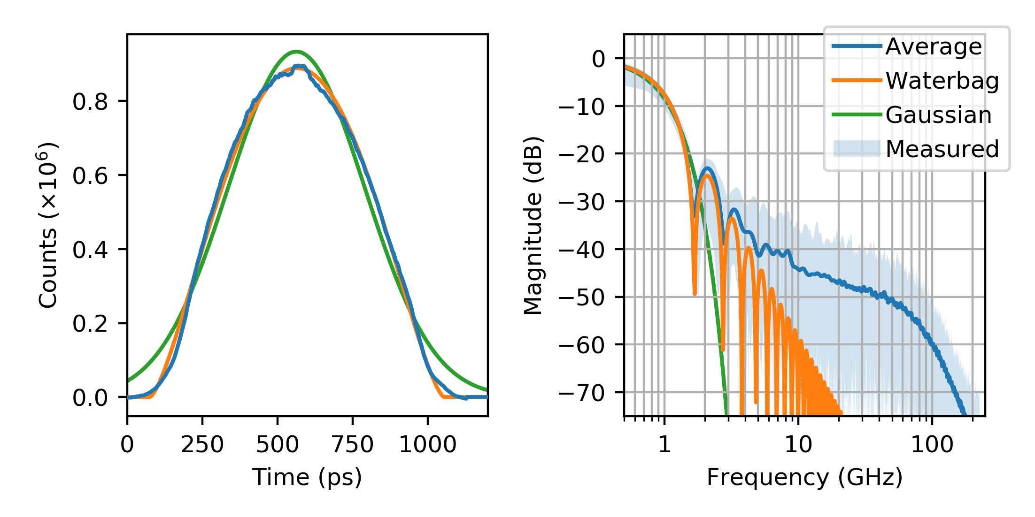
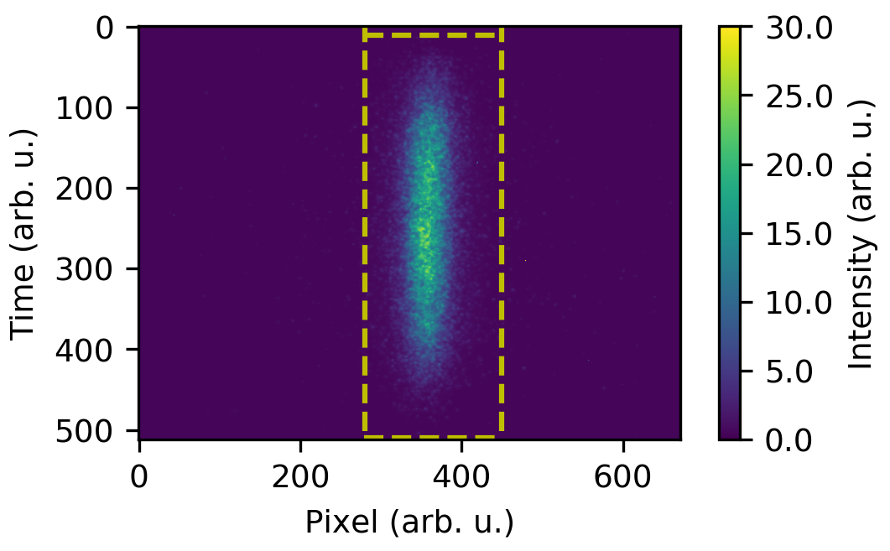
Coherent Radiation – Non Gaussian Beams
ToDO

Slide 19
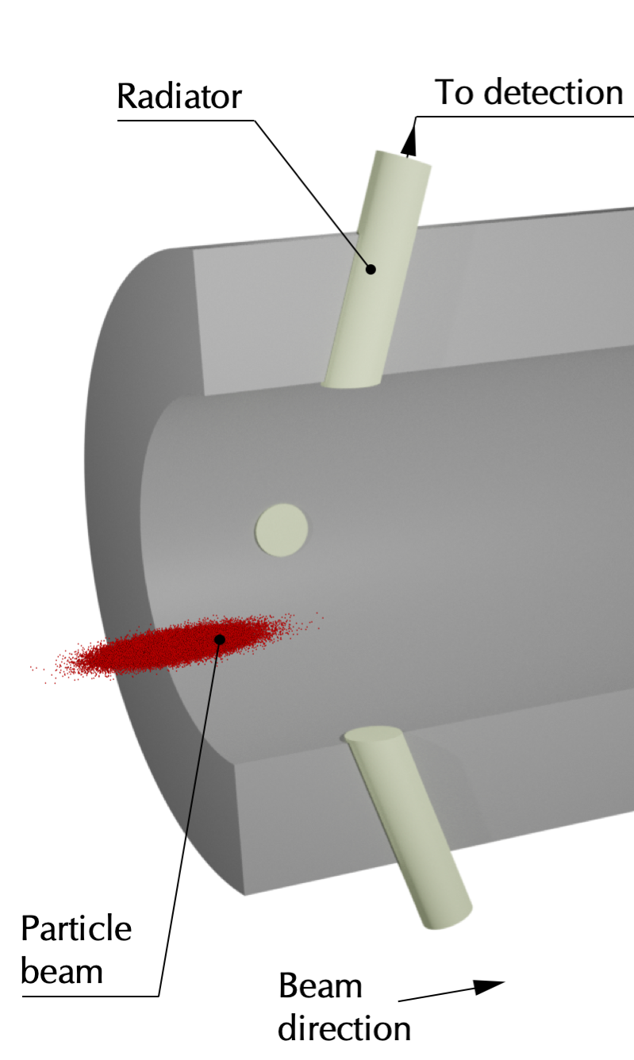
Pickup design – Mechanical description
Cylindrical Radiators are inserted in a vacuum chamber.
A brazed collar assure them to be vacuum tight.
The dielectric bar is left protruding outside, to ease the transition into waveguides.

Slide 20
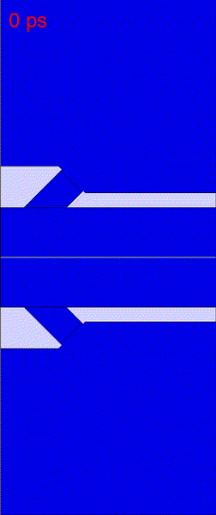
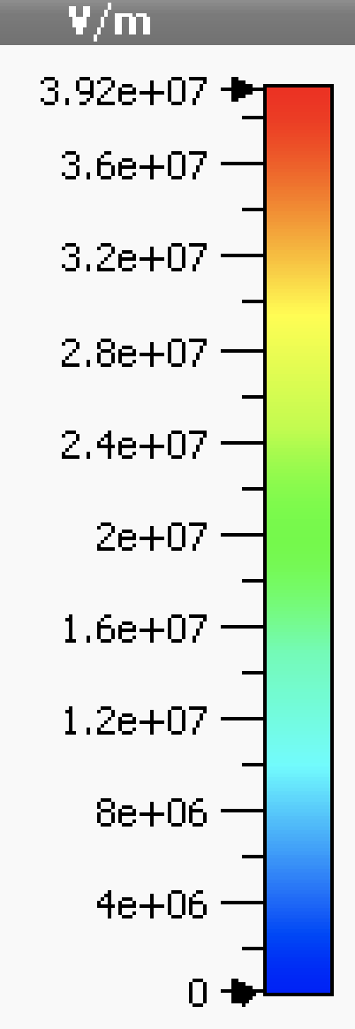
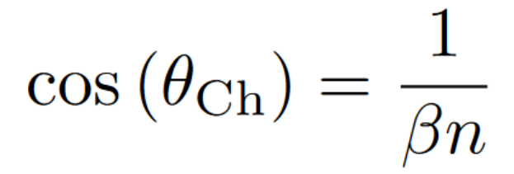
Pickup design – Radiation generation
Cherenkov Diffraction Radiation is generated at the dielectric surface exposed to the direct beam field.
The radiator must be oriented at the Cherenkov angle to limit internal reflections.
Dielectric
insert
CST Studio 2018
e⁻ beam, σ = 5ps
50 GHz simul. BW
20 cells/λ mesh
Beam
axis
Other minor diffraction radiation wavefronts are generated due to the interaction with the radiator edges.

Slide 21
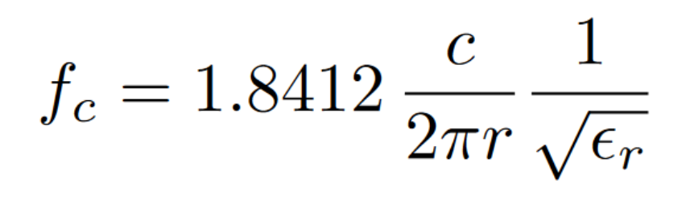
Pickup design – Radiation propagation
Although broadband radiation is generated at the surface, the radiator dimensions determine the output radiation properties.
For cylindrical radiators surrounded by metallic walls, the base mode cutoff frequency is
Radiator
radius
Material selection
Below cutoff, the electric field propagation is exponentially damped.

Slide 22
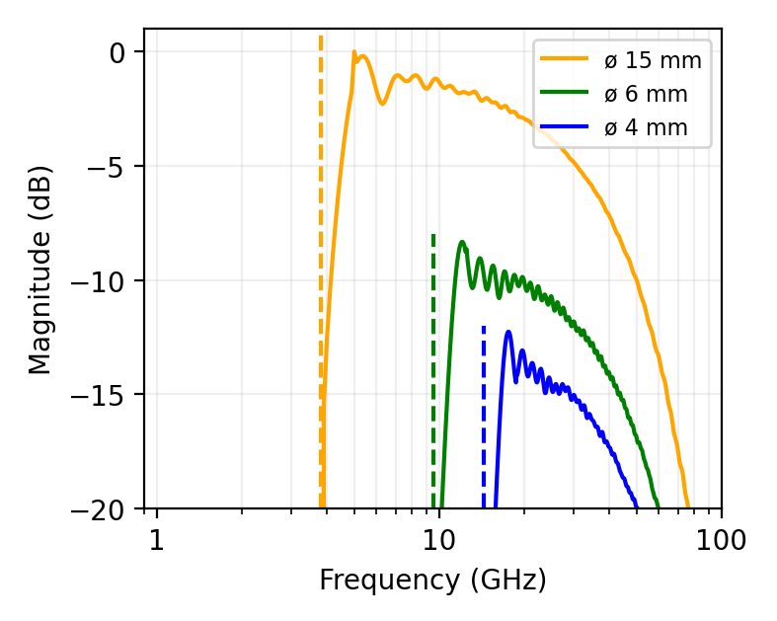
Pickup design – Radiation propagation simulation
Analytical formula
CST simulation
CST Studio

Slide 23
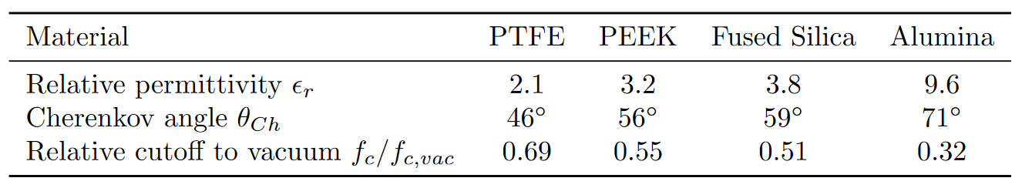
Pickup design – Material selection
A large choice of dielectric materials can be used as radiators, such as PTFE, PEEK, Fused silica, Alumina, …
PTFE
ε_{r} = 2.1
PEEK
ε_{r} = 3.2
SiO₂
ε_{r} = 3.8
Al₂O₃
ε_{r} = 9.6
As ε_{r} increases:
Larger Cherenkov angles
The low cutoff frequency decreases
θ_{Ch}=56⁰
θ_{Ch}=59⁰
θ_{Ch}=71⁰
θ_{Ch}=46⁰
Beam
Comparison of different dielectric materials for cylindrical ChDR radiators. The radiator radius is scaled to maintain the same
cutoff frequency.

Slide 24
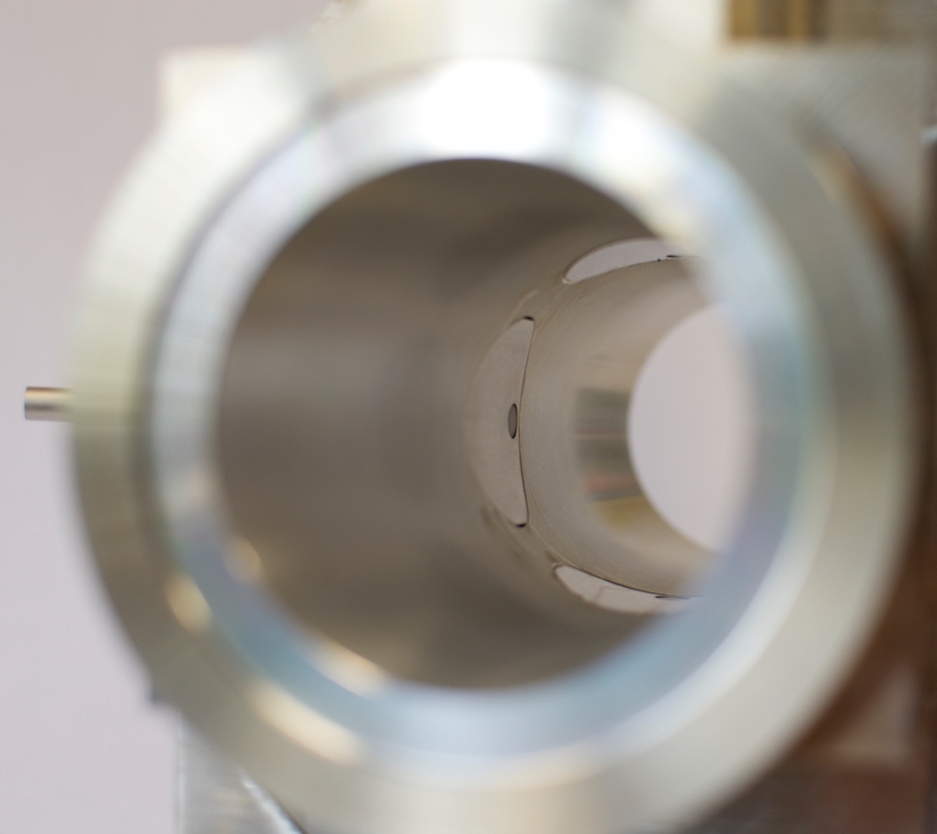
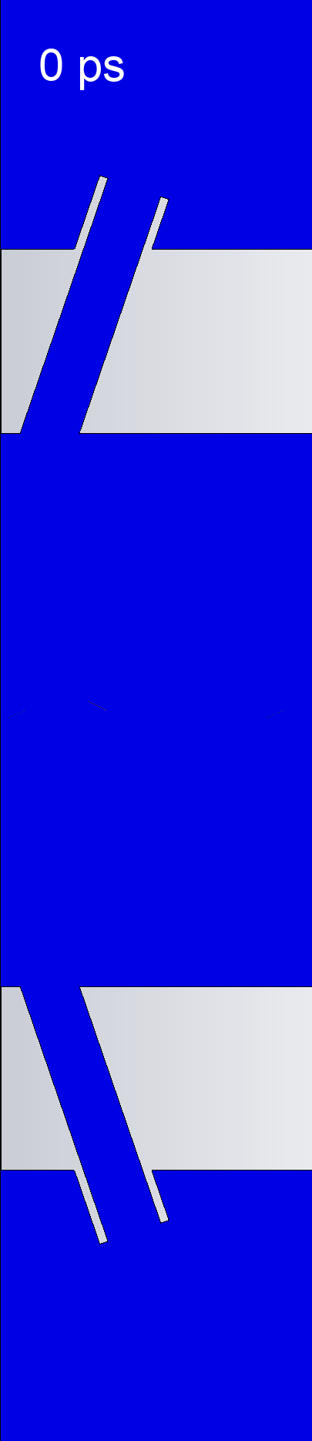
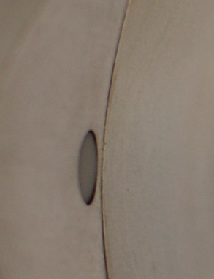
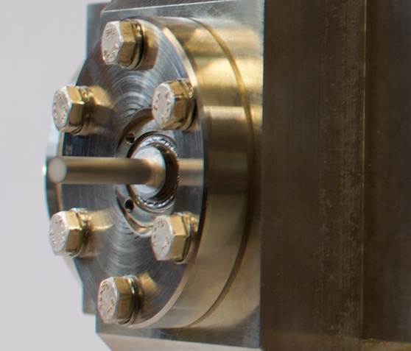
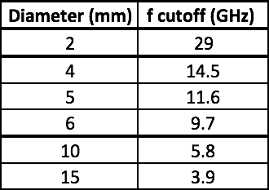
Pickup design – Real case
Alumina 99.5% pure (ε_{r} = 9.4)
Cylindrical rods 90 mm x Ø 6 mm
Metallic coating ~10 µm thick
Cutoff frequency choice
f_{c} = 9.7 GHz

Slide 25
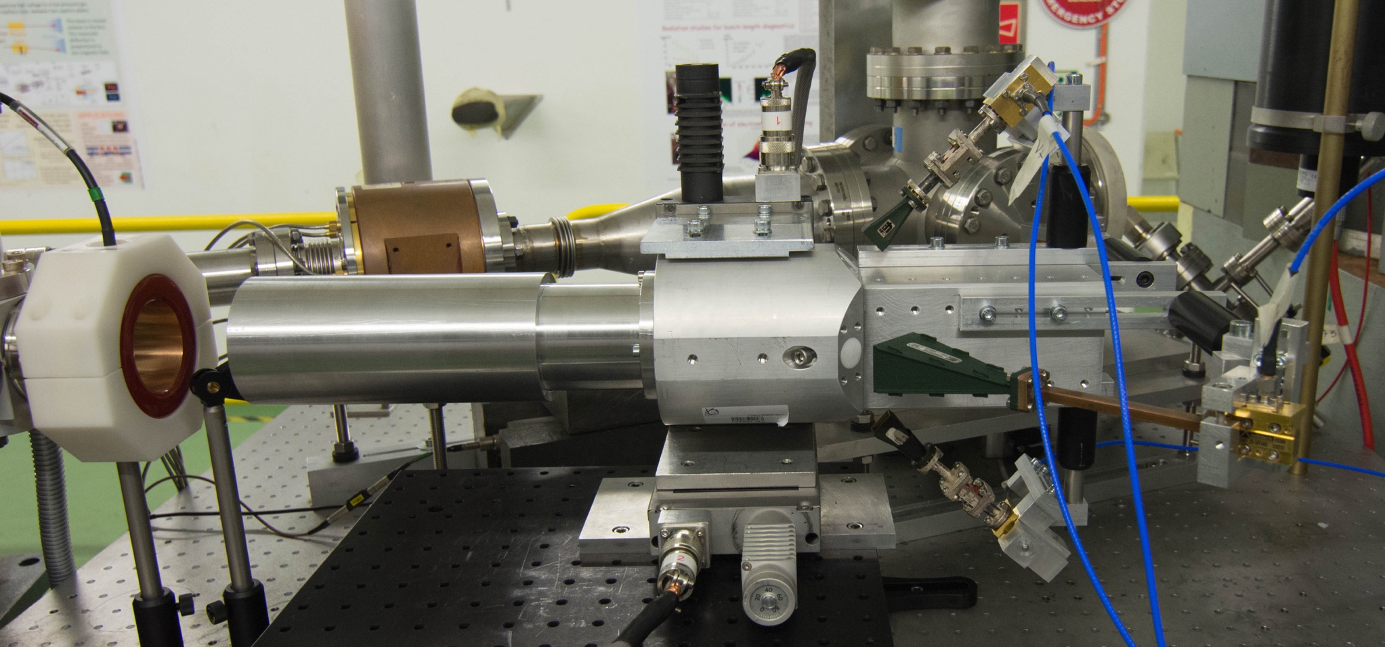
2019 – PTFE Proof of Principle

Slide 26
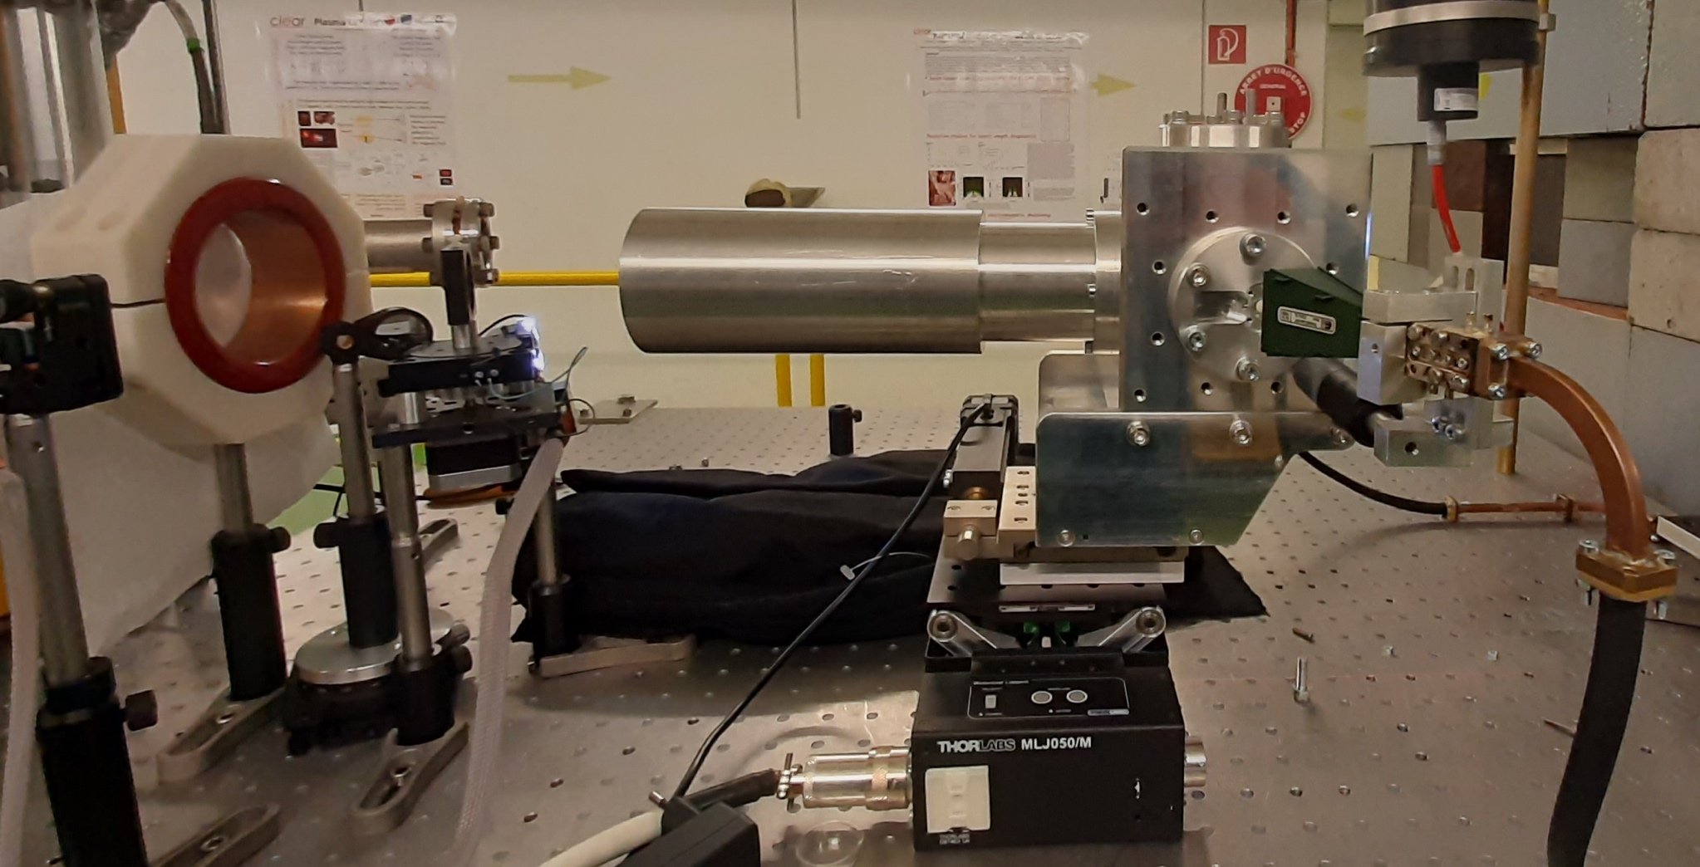
2019 – PTFE Proof of Principle
2020/21 – In-air alumina prototype

Slide 27
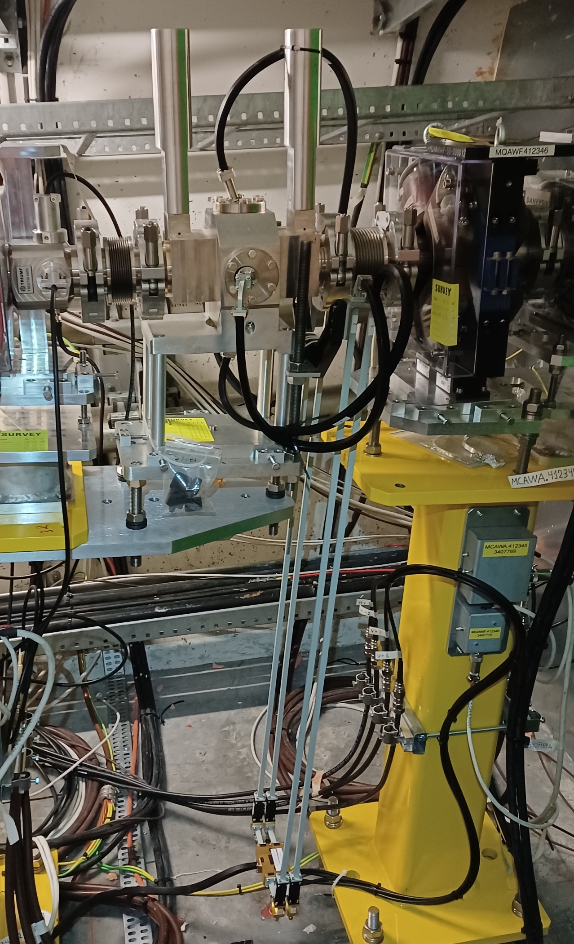
2019 – PTFE Proof of Principle
2020/21 – In-air alumina prototype
2022 – Vacuum version

Slide 28
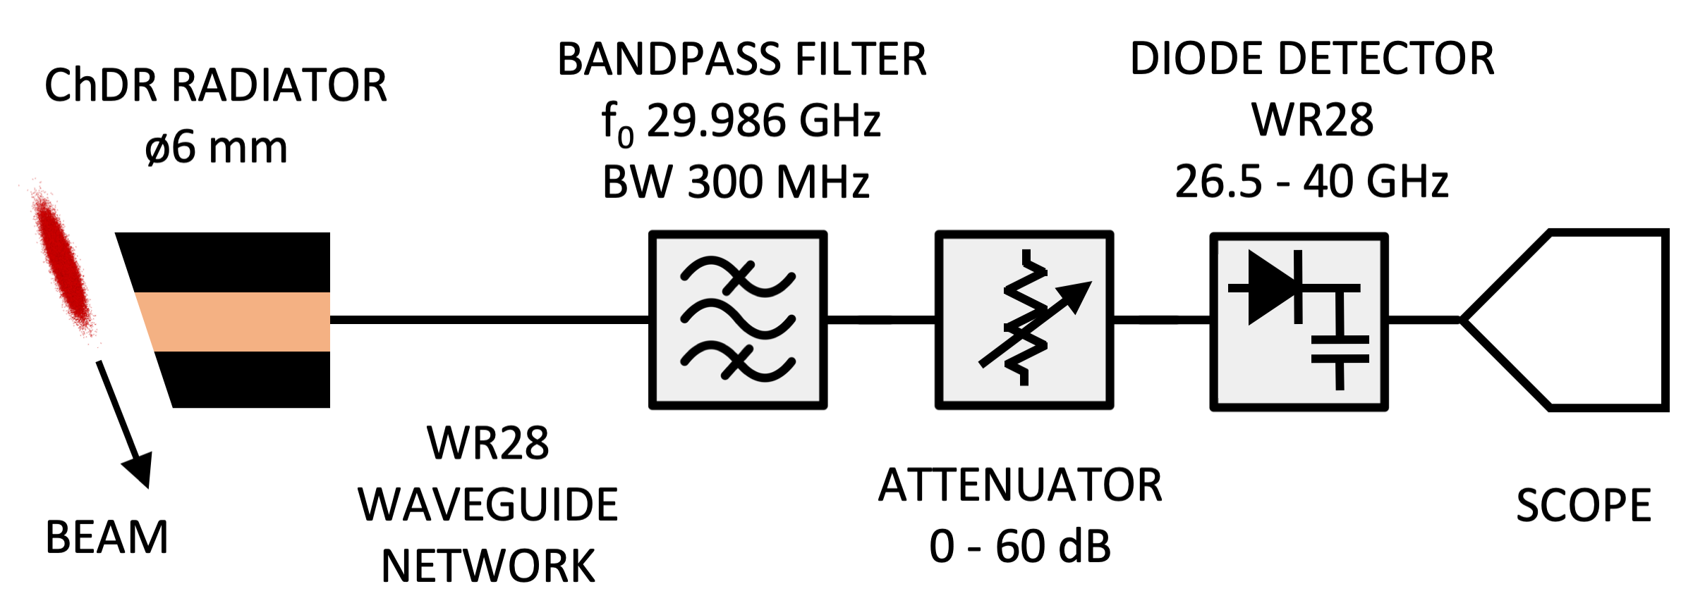
Test setup
Beam-based test with 100-600 pC single-bunch electron.
Multi-shot measurement, using the remote-controlled attenuator to keep a constant diode input power and limit non-linear response effects.
Data recorded with a 6 GHz scope in the alcove ~20 m away.

Slide 29
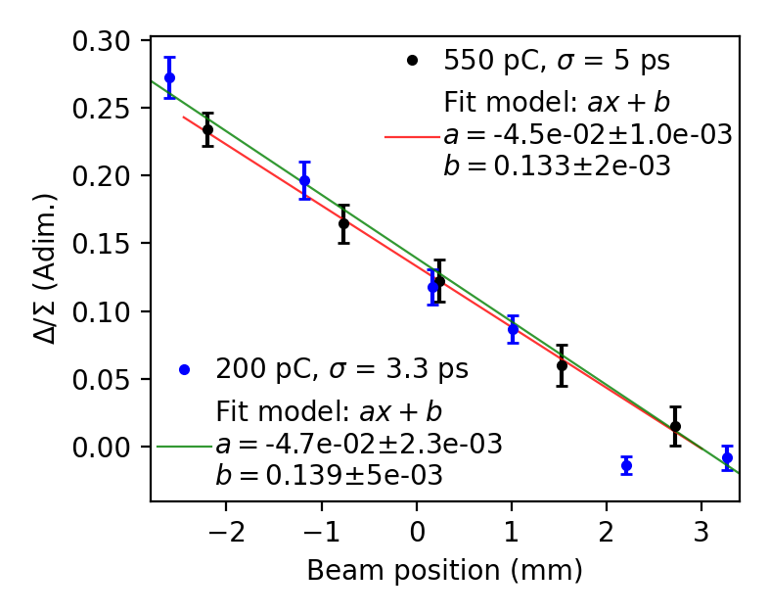
Test results (1)
Sensitivity to electrons only
Similar response to high and low charge with AWAKE parameters
Linear response in a 5 mm range
Limited test time in AWAKE, preliminary test for the operational electronics

Slide 30
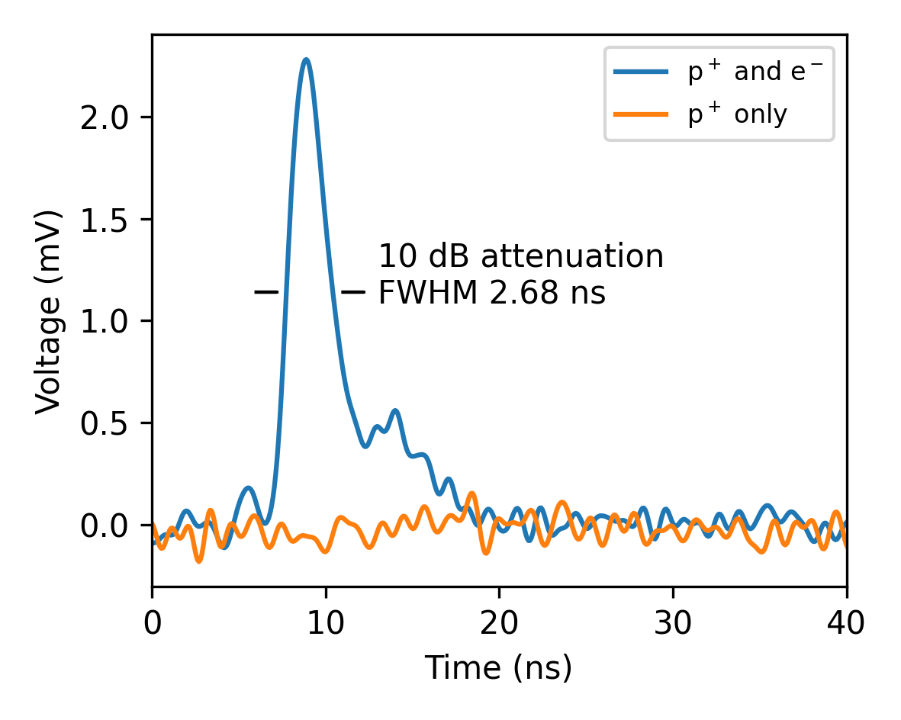
Test results (2)
Proton signal rejection
Proton-only signals below noise level for 1e11 protons per bunch
No signal shape change for simultaneous protons + electrons
Some signal with 3e11 protons per bunch, however depressed with respect to the electrons. Under investigation.

Slide 31
Operational electronics
A collaboration with TRIUMF was started to realise high-frequency BPM electronics
The elected operation frequency is 30.5 GHz with a bandwidth of 1 GHz.
The system was realised on the model of the existing electron BPMs, to ease integration.
First module installed for tests in 2022.

Slide 32
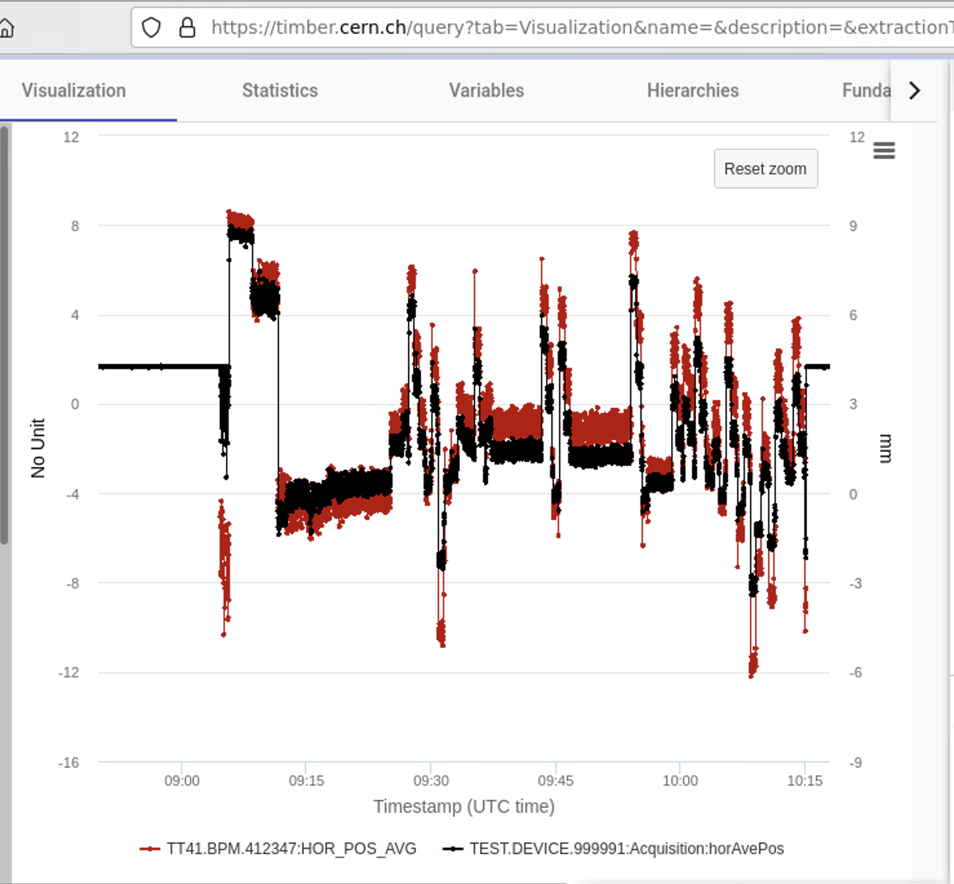

Operational electronics
Initial tests in 2022 currently ongoing.
Need for a better plot than that.
RED = eBPM
BLACK = ChDR BPM
TUNNEL SIDE
ALCOVE
BP FILTER
f₀ 30.5 GHz
BW 1 GHz
ChDR
BPM
Pickup
BEAM
RF
IF
2.5 GHz
Analog Front-end
Digitiser
LO
28 GHz
28 GHz
Generator
10 MHz
REF
WR28 WAVEGUIDE
COAXIAL CABLE

Slide 33
Future outlook
ChDR pickups are a promising but young technology !
PROs:
CONs:
Large signal output. Can measure charges as low as few pC.
Difficult to test in the GHz regime. Quality control of the pickups is complicated.
High cutoff frequency defined only by the bunch length. Potential for optical techniques with short bunches.
See poster TUP022.
Broadband emission at high frequency, needs careful control when using waveguide hardware.
Requires the difficult design of a broadband transition between the radiator and the waveguides to the detection.
Low cutoff frequency decided by construction.
Allow for beam distinction based on frequency discrimination.
Large impedance, so far tests in single bunch single pass beamlines. Not suitable for counter-rotating beams.

Slide 34
Potential impact
The impact of ChDR techniques go well beyond AWAKE !
Potential use for PWFA, LWFA, xFELs, …

Slide 35
Thanks for your attention
Acknowledgements: V. Bencini, P. Bestmann, P. Burrows, A. Cherif, N. Chritin, V. Clerc,
C. Davut, W. Farabolini, F. Galleazzi, E. Gschwendtner, E. Guran, P. Karataev, J. Kortesmaa, P. Korysko, M. Krupa, K. Lasocha, S. Liu, T. Lefevre, T. Manson, S. Mazzoni, B. Moser,
C. Pakuza, E. Poimenidou, P. Muggli, A. Pardons, C. Pasquino, C. Saury, A. Schloegelhofer,
P. Schwartz, E. Senes, A. Topaloudis, B. Spear, L. Verra, F. M. Velotti, C. Vendeuvre,
V. Verzilov, M. Wendt, B. Woolley, G. Zevi Della Porta
Questions ? eugenio.senes@cern.ch

