Slide 1
Safety System Engineering, Alarm and Access EN-AA
EN Einstein Telescope day– P. Ninin - CERN
18 October 2023
Reference (EDMS, Indico…)

Slide 2
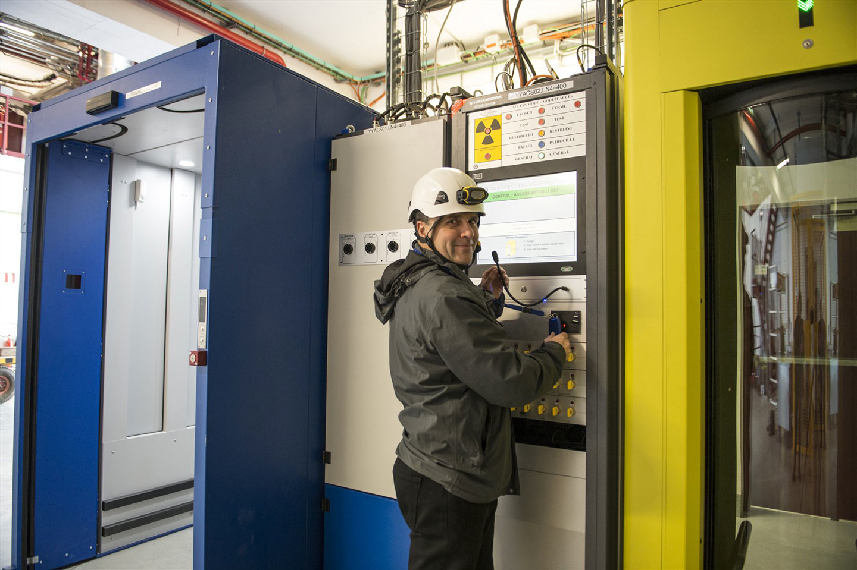
AA : Access and Alarm Group
The AA group is in charge of the specification, engineering, installation, monitoring and maintenance of the systems that ensures the Safety of the CERN Personnel, Users and Visitors, on all CERN sites and facility.
The safety systems concerned are:
Fire, Gas and ODH detection, emergency phones, evacuation, alarm transmission and monitoring,
Interlocks to protect people against radioactivity, X rays, lasers, electricity and cryogenics hazards,
Access control to all CERN conventional or nuclear facilities and sites,
Video: surveillance, protection and intrusion detection,
Access data management applications
Not covered by AA: Electrical Safety, Radiation Monitoring, Detector Safety System
Notes:
Machines & Experimental Facilities: is responsible for planning and coordinating all maintenance and installation activities in the CERN Accelerator Complex, providing support to the experiments using the CERN accelerators.

Slide 3
AA group figures
Organisation - 3 sections: 31 staffs, 16 contracts ( 60 people),
Critical Systems Engineering: to deal with large scale projects
Alarm System Section: maintenance and operation, 150 new projects/ year
> 20 000 equipment.
approximately 700 fixed gas detectors and 500 portable detectors.
Access Control Section: maintenance and operation, 100 new installation projects/year
custom-built systems based on industrial safety PLCs, and include access control and biometrics, customised doors, locks and position switches.
approximately 150 industrial airlocks for personnel and material, 600 doors, 200 PLCs and 50’000 PLC input/output signals.
Site Security systems for the CERN site: physical access control systems, road gates and barriers, turnstiles and other physical access control devices, approximately 1500 badge readers, 30 pedestrian and bicycle turnstiles, 40 road gates and 50 road barriers.
Video surveillance and audio intercom, composed of approximately 1’500 video cameras and 150 intercoms.

Slide 4
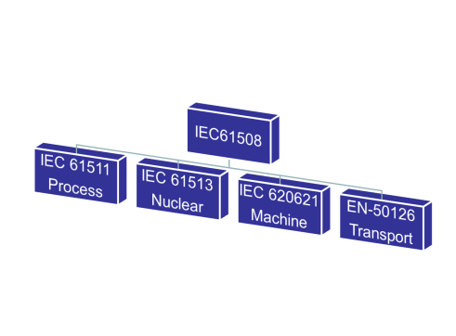
Critical System Engineering
It concerns any system whose 'failure' could threaten human life, the environment or the image & existence of the organization, as well as beam time.
The engineering of a critical system is particularly focused on:
Reliability: measures of the ability to deliver a specified service;
Availability: quantifies the alternation between deliveries of proper and improper service;
Maintainability: concerns its ability to evolve and to be restored after failures;
Safety: concerns the system behavior, directly or indirectly threatening human life;
Security: concerned with the ability of the system to protect itself.

Slide 5
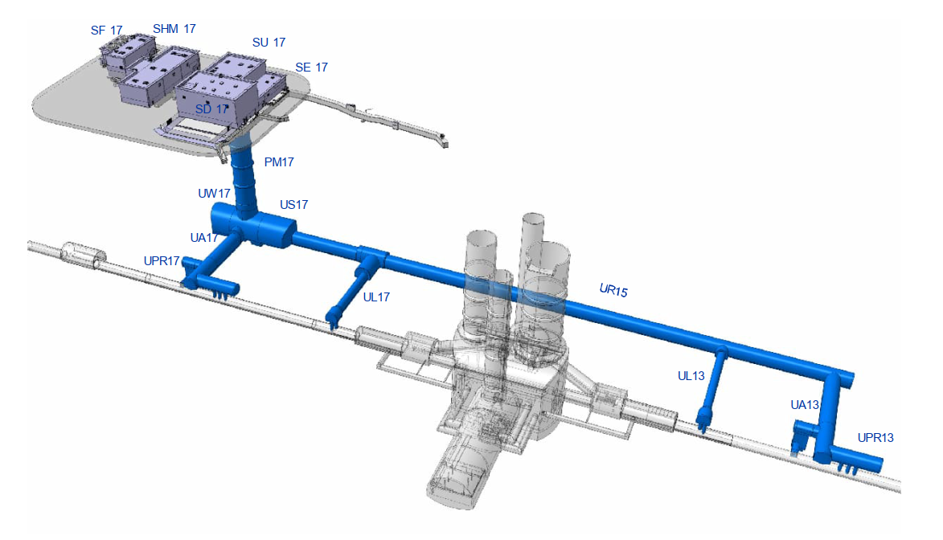
Safety Alarms and Access Infrastructure for HL-LHC
Surface & underground Fire Safety System
Smoke Extraction
Evacuation System
ODH Detection
Emergency Telephones
Emergency call buttons
Site Access
Video Surveillance
Access Control to radiological areas
Access Safety System (Beams interlock)

Slide 6
Engineering of Personnel Safety Systems - sharing our return of experience

Slide 7
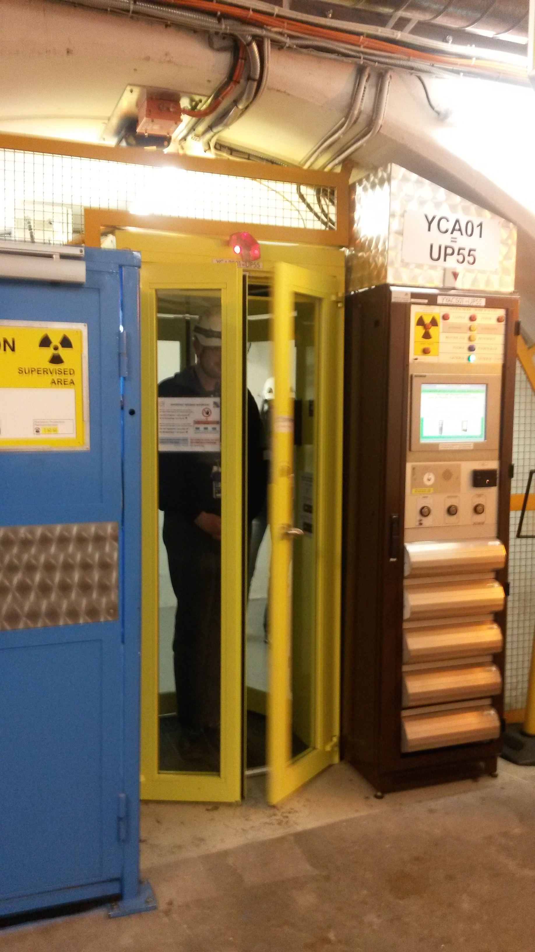




The factors influencing the performance of safety systems over time
MAINTENANCE
OPERATION
ENVIRONMENT
ENGINEERING
P. Ninin, Einstein Telescope Day, 18 October 2023, edms: 1562467

Slide 8
Realisation
Risk analysis, FIS definition, functional and technical specification done by CERN
Outsourcing of the system realisation carefully followed by CERN
Safety lifecycle followed by a CERN Safety Engineer
Extensive testing done by contractor and CERN
Project monitored by the Nuclear French and Swiss Regulatory body
Phase 1:
Design & Test Platform
Phase 2:
Implementation
Phase 3:
Maintenance
P. Ninin, Einstein Telescope Day, 18 October 2023, edms: 1562467

Slide 9
Functional Safety Methodology
1
Preliminary Risks and Hazards Analysis
2
Protection barriers definition and allocation of their respective safety functions
3
Specification of the safety functions
7
4
Design and realisation
5
Installation, commissioning, validation
6
Operation and maintenance
8
Modification
Dismantling
Sectorisation, Operation modes
Equipment Integration in 3D Model
Cabling
P. Ninin, Einstein Telescope Day, 18 October 2023, edms: 1562467

Slide 10
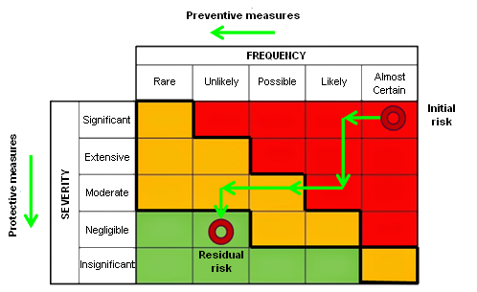
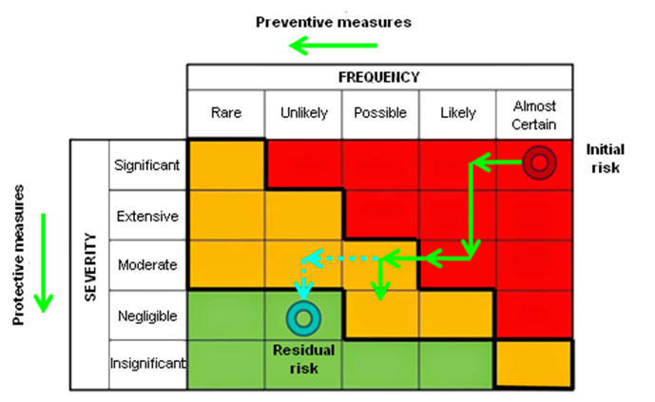
Risk Reduction strategy
P. Ninin, Einstein Telescope Day, 18 October 2023, edms: 1562467

Slide 11
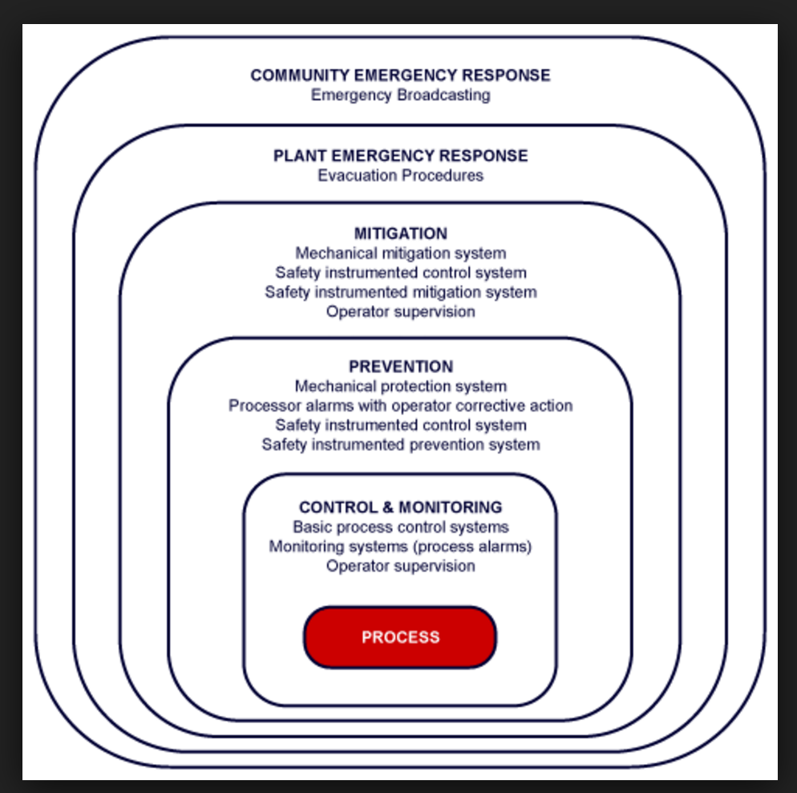
Layer of Protection
P. Ninin, Einstein Telescope Day, 18 October 2023, edms: 1562467

Slide 12
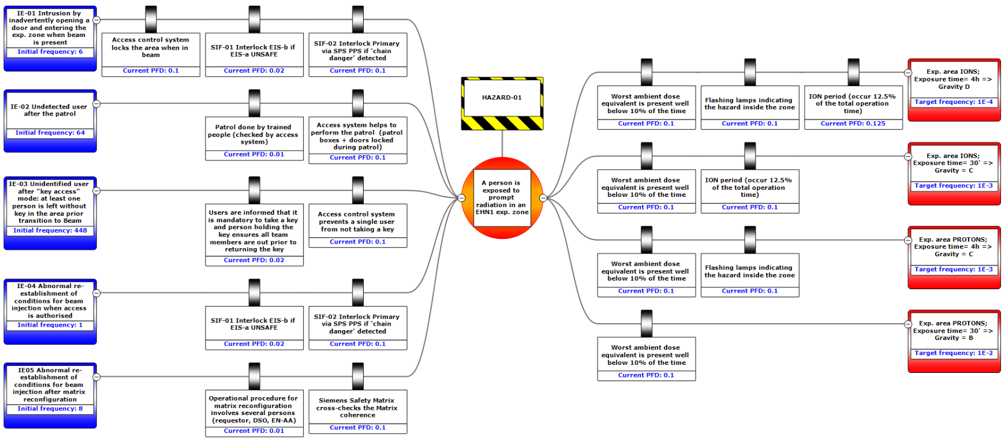
Modelling of preventive and protective barriers using bowtie diagram
* PFDs are estimated according to the guidelines of IEC61511
Initiating events
&
associated frequency
Identify preventive barriers
&
their Probability of Failure on Demand (PFD)
1 central event
per hazard
Identify protective barriers
&
their Probability of Failure on Demand (PFD)
Severity classification
&
target frequency

Slide 13

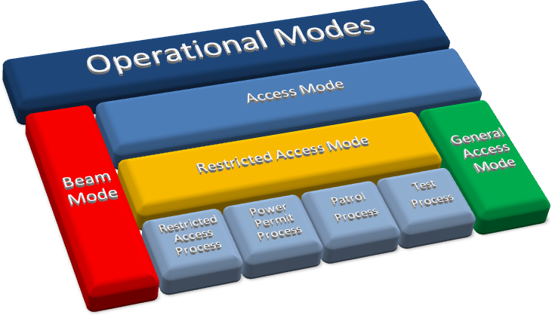
Definition of Operation mode
P. Ninin, Einstein Telescope Day, 18 October 2023, edms: 1562467

Slide 14
Sectorisation
Define how the facility will be used,
by whom
NEW
NEW
NEW

Slide 15
Mandatory Tools
Ticketing (SNOW) : to manage maintenance request and new projects
Maintenance Management System (EAM)
3D Modelling for integration, laser scan
Electrical and mechanical design tool
Document Management systems : EDMS

Slide 16



Tunnel incident : worker perspective
Worker is alone, can rely on:
- Training
- PPE : self rescue mask
- Detection (sensors or human)
- Alert means (full duplex)
- Evacuation system
- Emergency lighting, evacuation route
- Safe areas, Compartimentalisation
- Extinguishing systems
Fire Brigade Response after alarm reception
- Intervention preparation and transport
- Site securisation
- Intervention starts
- Local and truck Fire-fighting gear
- Dry riser
- Local control such as Smoke extraction
- Safe evacuation route up to the surface
Worker is alone 30’
Fire Brigade intervention
P. Ninin, Einstein Telescope Day, 18 October 2023, edms: 1562467

Slide 17
Alarm Systems
Monitoring and diagnostic
Redundant Alarm Transmission
(Safety Dedicated)
FB
Alarm System
Sonorisation, Video
Local Interlocks & Man Machine Interfaces
Fire
Smoke Detection
Fire Protection
Gas & ODH Detection
Emergency call
Button
Evacuation
SSS
Alert
Intercom
Flashing lights
Compart.
doors
P. Ninin, Einstein Telescope Day, 18 October 2023, edms: 1562467

Slide 18
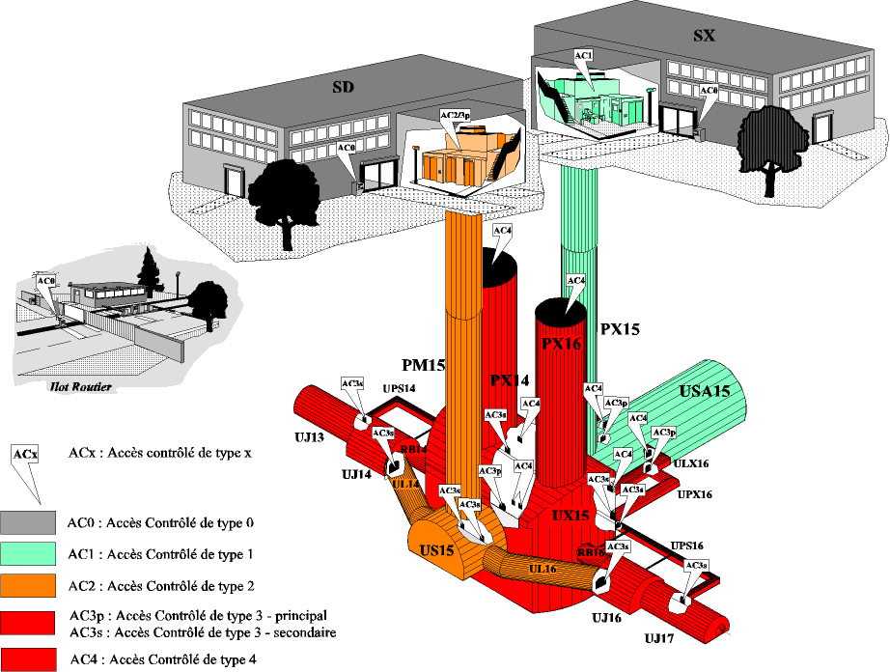
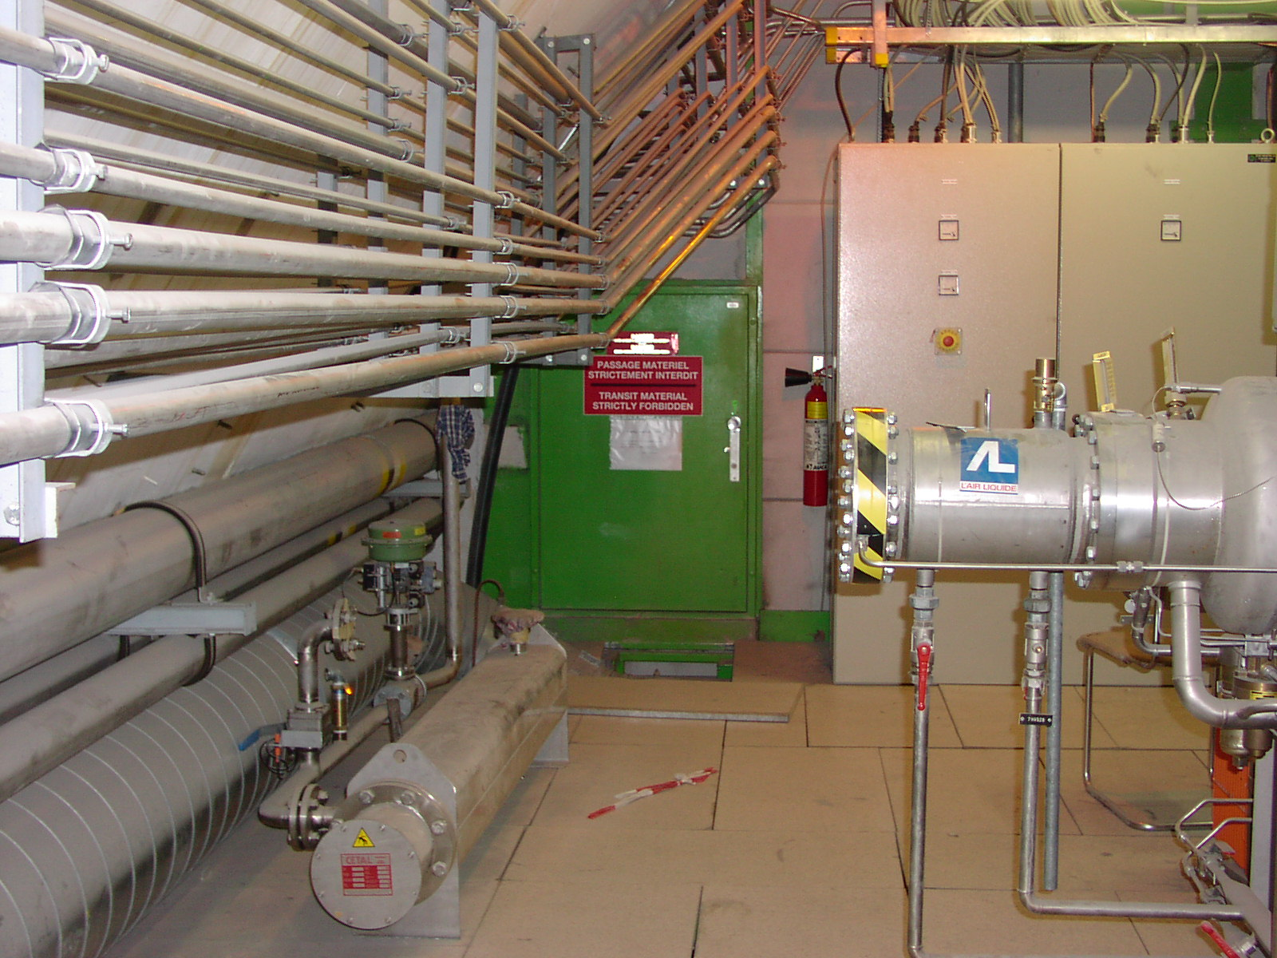

Buildings access
Experimental services areas access * ACCESSIBLE during beam operation
Sites access
Video Surveillance
Video protection
Access to Accelerator and experiment
Access Service
Access Tunnel
Access Experiment
NON ACCESSIBLE during beam operation

Slide 19
Regulatory bodies and other stakeholders
CERN HSE
For CERN : “Autorité de Sûreté Nucléaire (ASN) and Office Fédéral de la Santé Publique (OFSP).”
“Show us what you do and we will tell you …”
Dedicated general document demonstrating the safety
Access at any time to project documentation
Specific questions
All accelerator complex
National Labor Inspection Office: could close a facility
Facility Insurance company: The better is the PPS, the Lowest is the Premium
-
P. Ninin, Einstein Telescope Day, 18 October 2023, edms: 1562467

Slide 20
Einstein Telescope Use Case

Slide 21
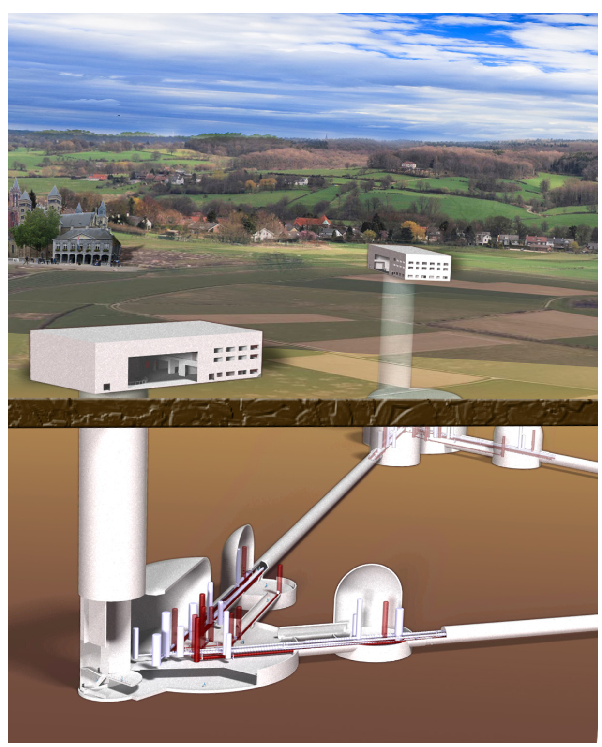
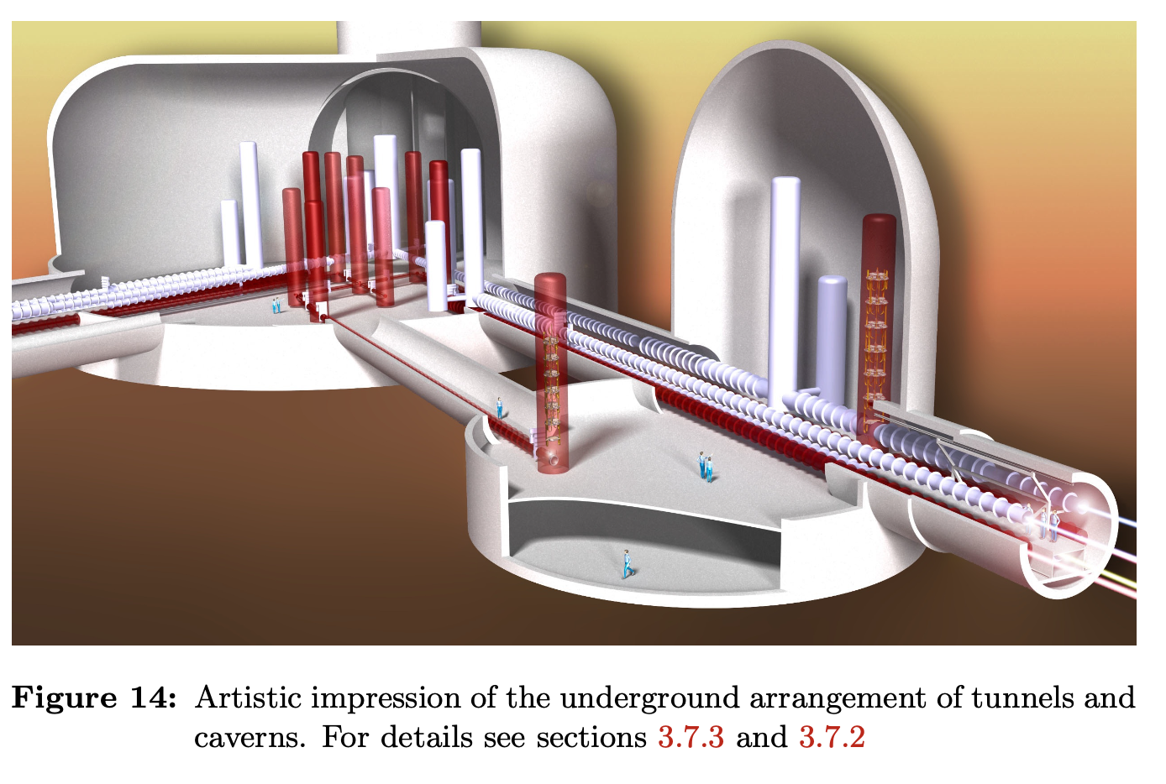
Quick Glance
Risk Analysis: adapted to Cavern and Tunnel
“deep” underground facility,
isolated worker protection
Evacuation routes
Fire & smoke : cables, electrical cabinet, battery vehicles, work
Laser
Flooding by underground water
Gas & Oxygen Deficiency
Security: vandalism, theft, terrorism, cybersecurity
Operation modes requirements :
Access: where, when, How
Measurement Mode
Facility sectorization: Experimental caverns, Tunnel,

Slide 22
Summary
Methodology
Global approach looking at all the prevention and mitigation barriers
APR -> Safety functions definition-> …-> verification of the achieved SIL
Definition of Operation modes and Sectorisation
Keep it as simple as possible
Emphasis on functional and dysfunctional testing
Most of the foreseen incidents happened
Right Balance
Understanding expectations and documentation for the Regulatory Bodies
PSS design is complex and usually specific
Happy to collaborate, as we do with ITER to promote common solution
P. Ninin, Einstein Telescope Day, 18 October 2023, edms: 1562467

Slide 23
Thank you for your attention

Slide 24
Spare slides

Slide 25
Standards
Gas/ODH | ATEX directive | CH & F applications
Fire Detection | Code E, CNPP
Fire Protection |  | French american
Smoke Removal
Personnel Protection | IEC 61508 – IEC 61511

Slide 26
Numbers
Personnel safety interlock systems for CERN’s accelerator areas. These are custom-built systems based on industrial safety PLCs, and include access control and biometrics, customised doors, locks and position switches. The include approximately 150 industrial airlocks for personnel and material, 600 doors, 200 PLCs and 50’000 PLC input/output signals.
Gas detection systems, in particular Oxygen Deficiency Hazard (ODH) for CERN’s accelerator and experimental areas. Flammable and toxic gas detection also included in an overall total of approximately 700 fixed gas detectors and 500 portable detectors.
Site Security systems for the CERN site. These include physical access control systems, road gates and barriers, pedestrian and bicycle turnstiles and other physical access control devices, composed of approximately 1500 badge readers, 30 pedestrian and bicycle turnstiles, 40 road gates and 50 road barriers.
Video surveillance and audio intercom, composed of approximately 1’500 video cameras and 150 intercoms.
Other alarm systems connected to CERN’s fire brigade, representing approximately 20’000 signals

Slide 27
Prevention and Mitigation Barriers
Identification of any existing protection barrier that may contribute to the reduction of every risk previously identified. (LOPA)
Prevention Barriers (extra SIS)
Presence of shielding blocks.
Frequency Reduction
Presence of basic access control to dangerous area.
Presence of operational procedures (Beam Permit).
Presence of Hazard signalization systems.
Mitigation Barriers (extra SIS)
Evacuation alarms.
Damage Reduction
Control room alarms.
Automatic shutdown mechanism (Interlock).
Evacuation plan.

Slide 28
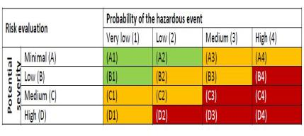
Identified Hazards
Hazard | Description
H1 | Electrical. Exposition to uncovered powered parts.
H2 | Exposition to radiations prompted by beam accelerated inside the bunker.
H3 | Exposition to radiations prompted by the proton source.
H4 | Exposition to X-rays emitted by the RF cavities.
H5 | Exposition to radiations from activated material.
FIS 1: In case of Intrusion beam shall be stopped
SIL 3

Slide 29
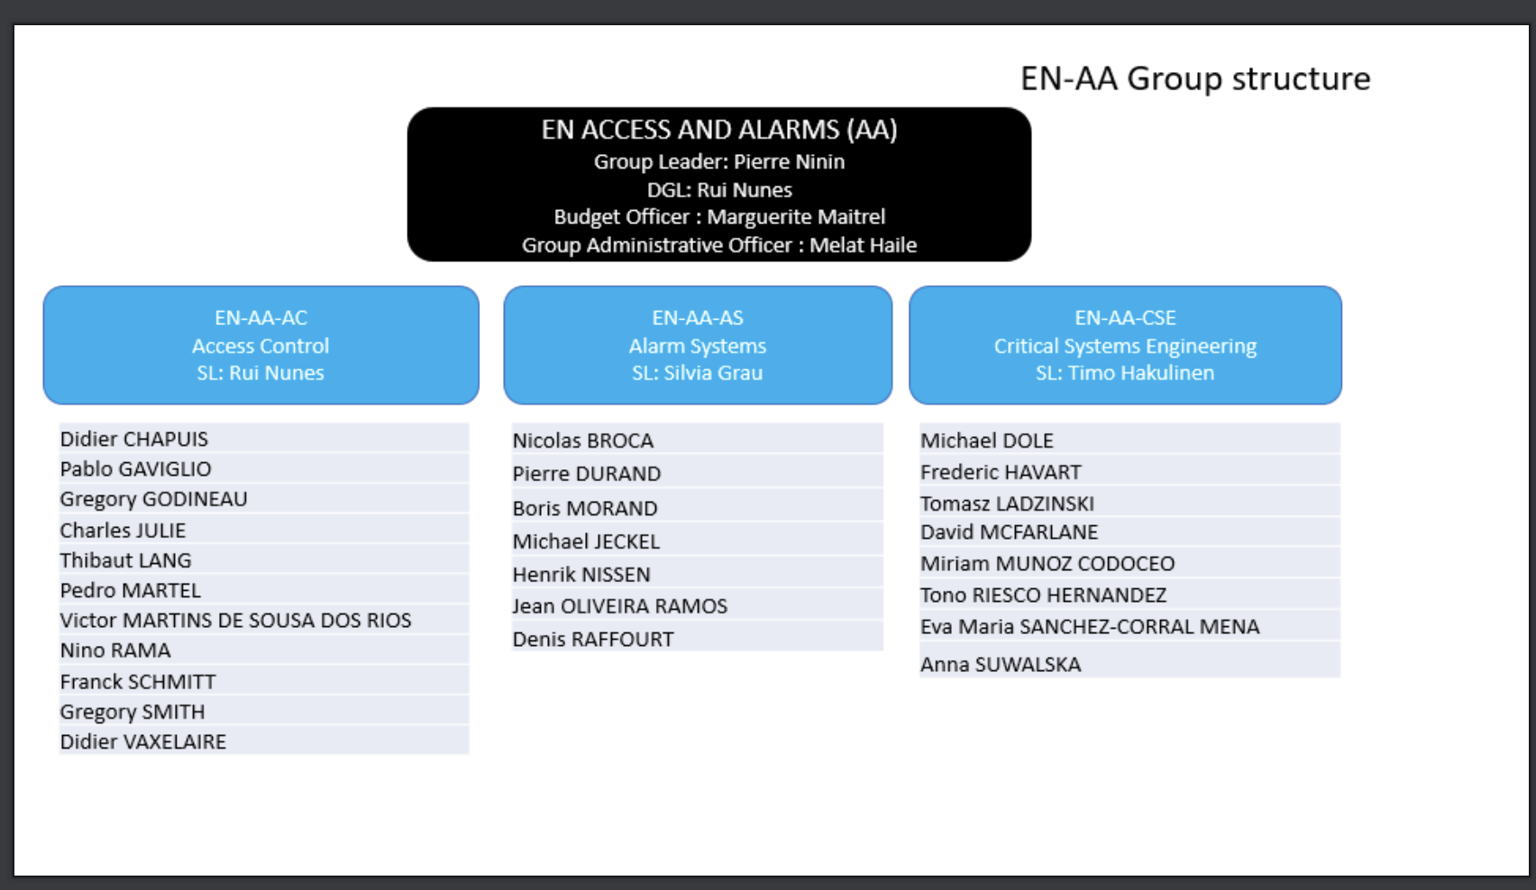

Slide 30
Projects characteristics
Small size: 10KCHF - 100 KCHF: Laser rooms, ECR
Mid size : 100 KCHF – 500 KCHF: SM18 RF test stand, Medicis, Adam Light
Large scale : 0.5 MCHF – 20 MCHF: LHC Access, PS Access, LHC Gas and ODH,
Insourced
Risk Analysis
Specification, Preliminary Design
Planning, coordination, integration
Testing
Outsourced
Equipment purchasing, specific design, installation works
We do not have all the necessary resources neither all the competence,
Competitive tendering procedure, lowest conforming bid

