Slide 1
EN/CV – Cooling and Ventilation of Large-scale Projects & Sustainability
Francesco Dragoni, Ingo Ruehl
Einstein Telescope Meeting - 18.10.2023

Slide 2
Cooling & Ventilation (CV) Installations

Slide 3
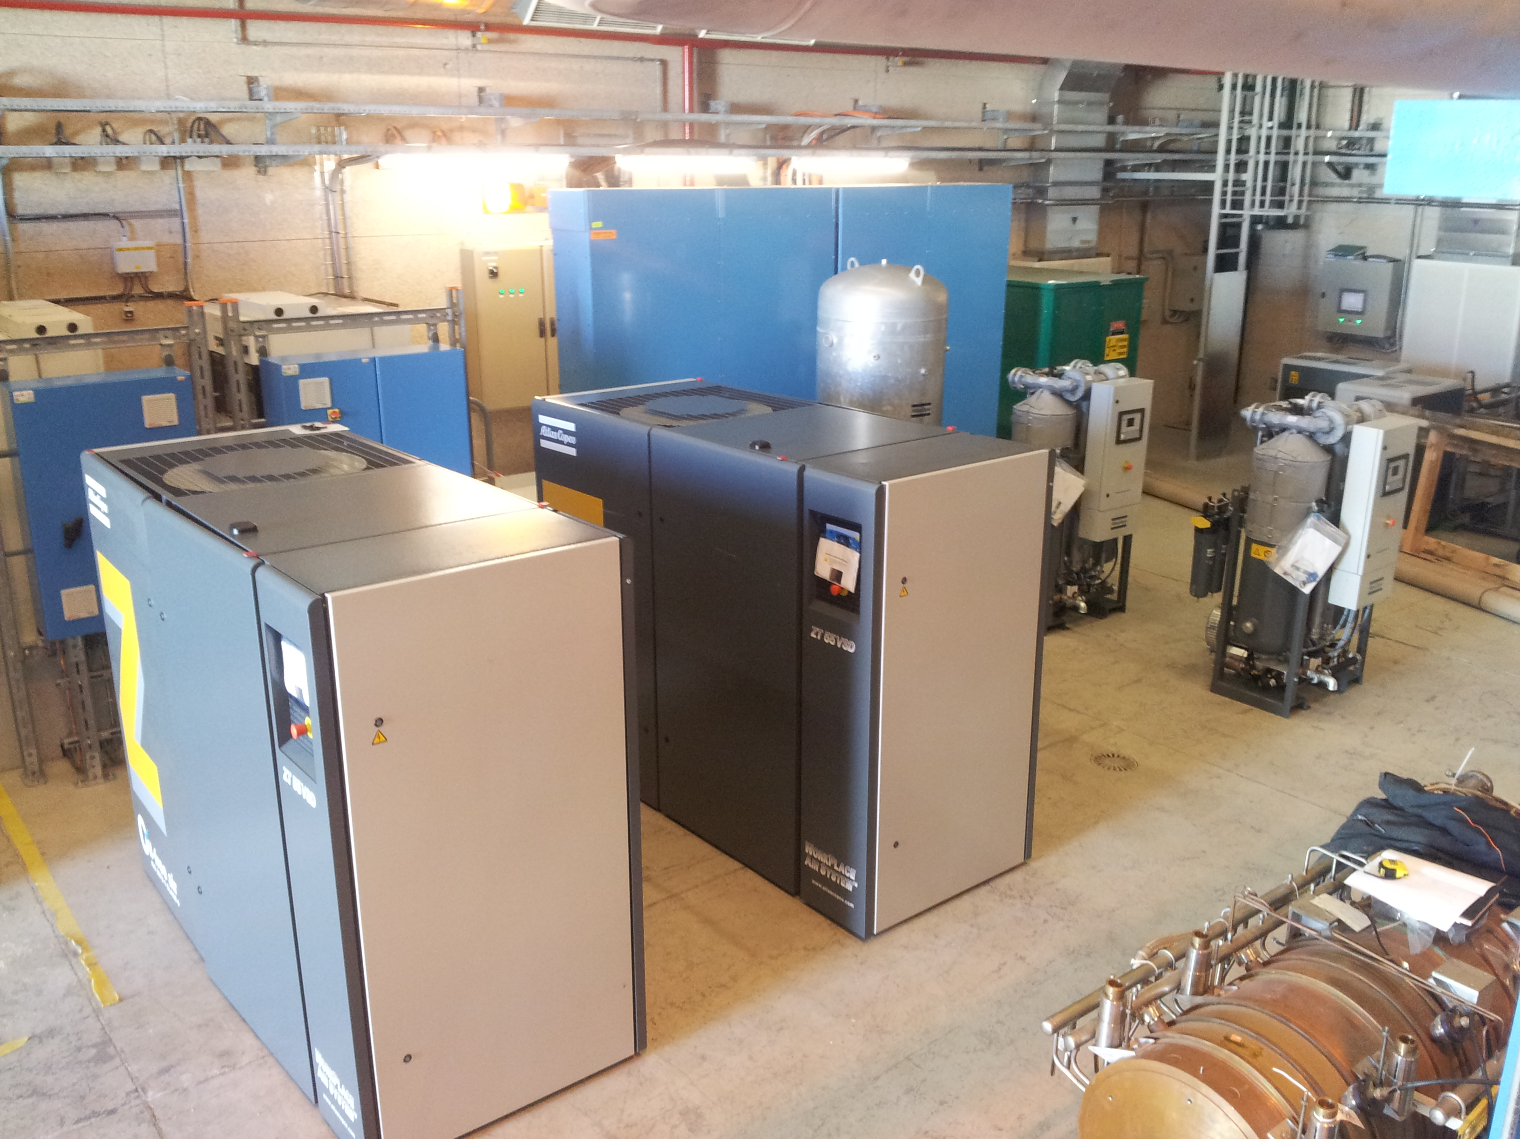
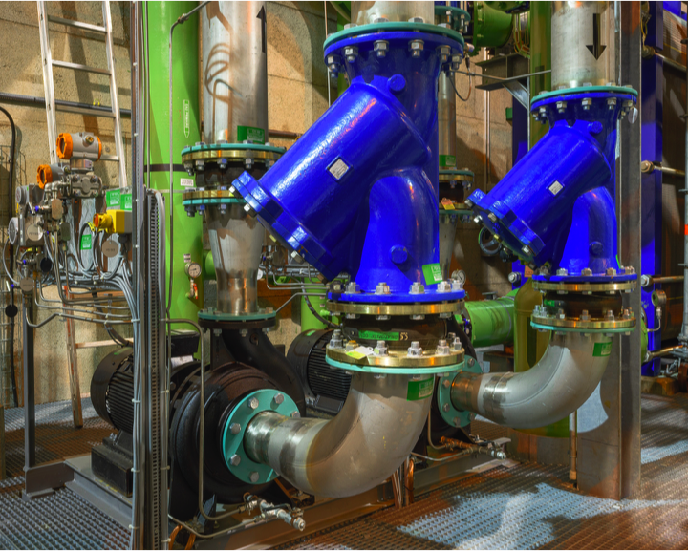
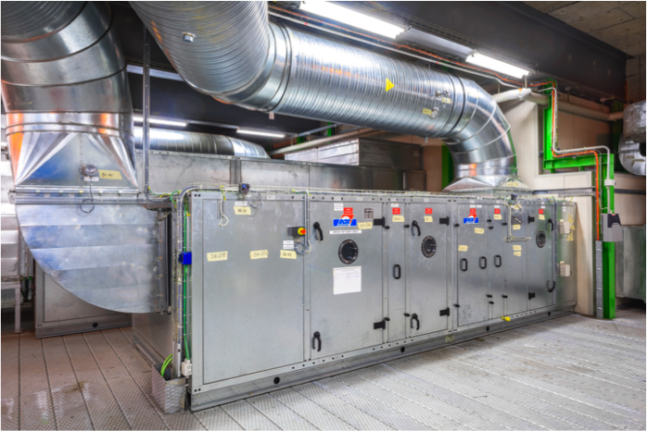
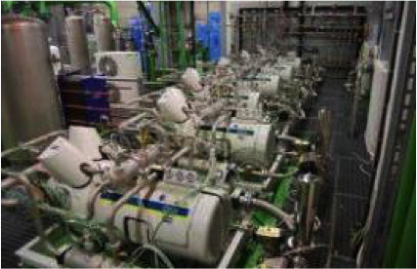
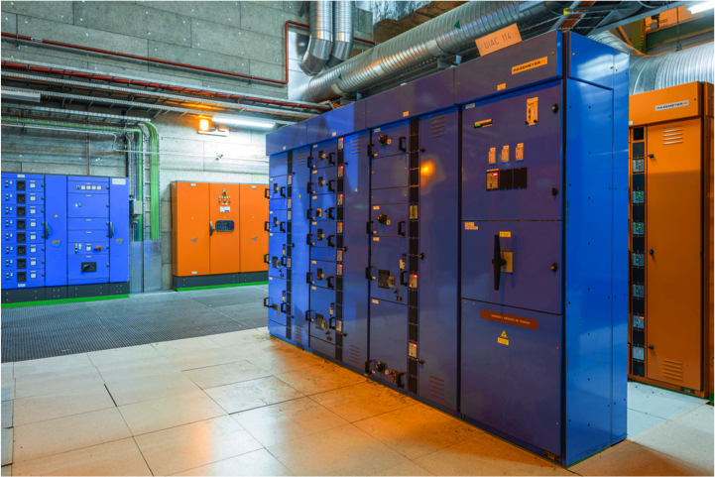
CV Systems Overview
    Water cooling systems sump pumps and firefighting network for technical buildings and underground areas
    Ventilation and air conditioning for technical buildings and underground areas
    Compressed air production and distribution
    Power and control cubicles for CV Systems
    Detector cooling

Slide 4
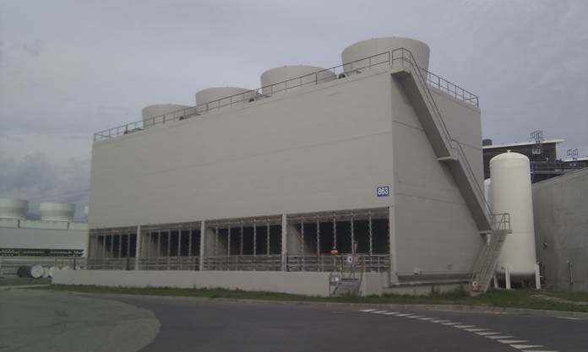
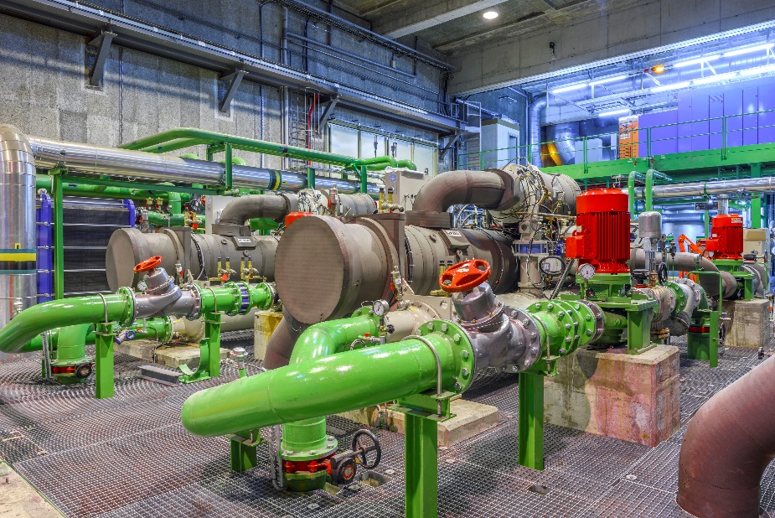
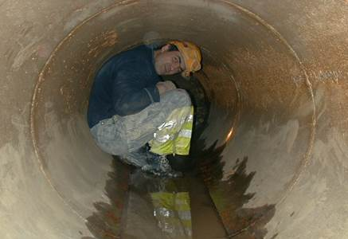
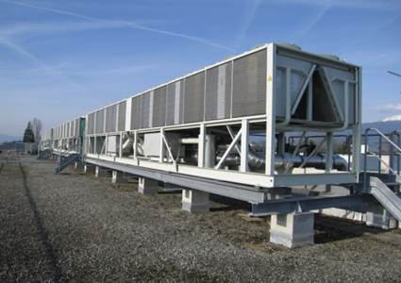
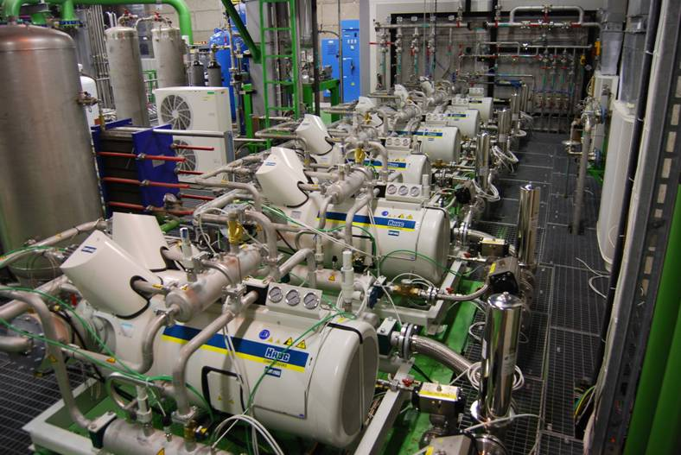
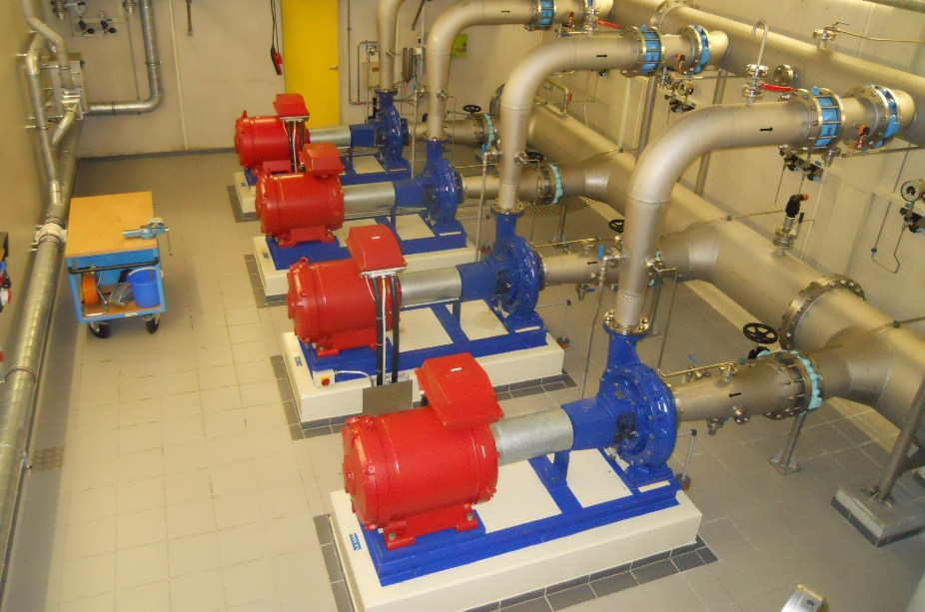
CV Systems – Cooling Plants
30 Cooling towers (Total: 470 MW)
160+ Cooling Stations: raw & demi water, C₃F₈, C₆F₁₄, CO₂, N₂
Raw water distribution network: 3 station @ 5,400 m3/h
40+ Chilled Water Stations 6-12 °C
800+ km pipework
1,260 m3/h peak water consumption

Slide 5
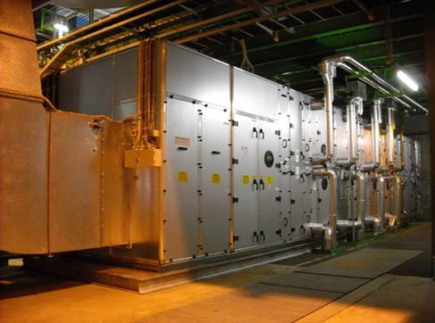
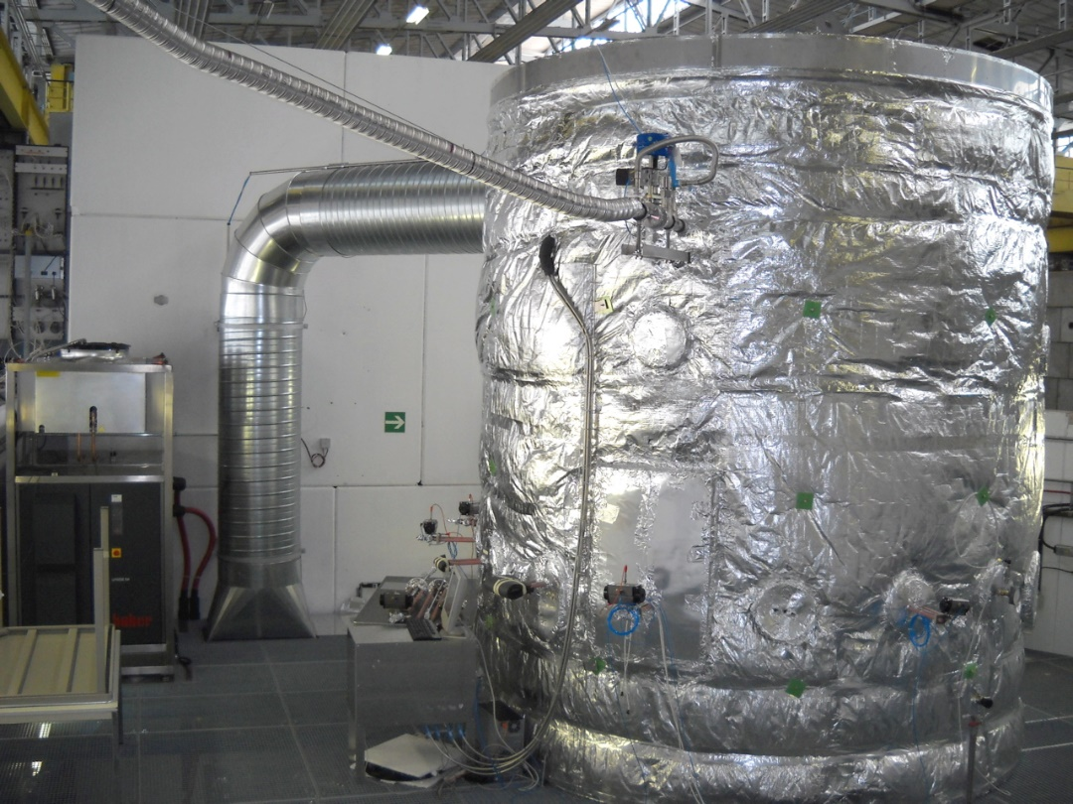
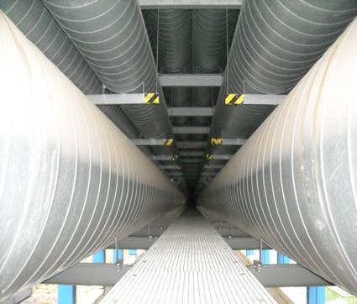
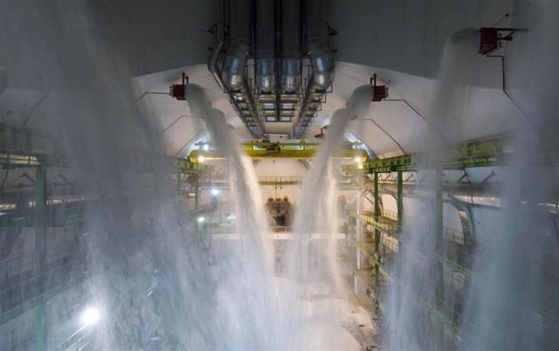
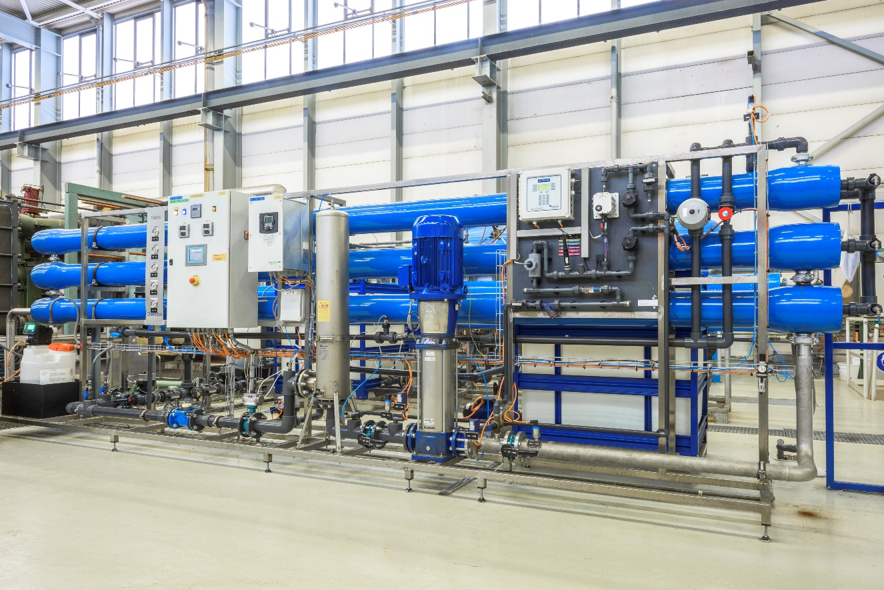
CV Systems – Ventilation and networks
1,500 + Air Handling Units
2,000 to 120,000 m³/h
14 compressed air stations 200+ km distribution network
800+ firefighting hydrants/valves
Demineralised water production: 20 m³/h at 0.1 uS/cm

Slide 6
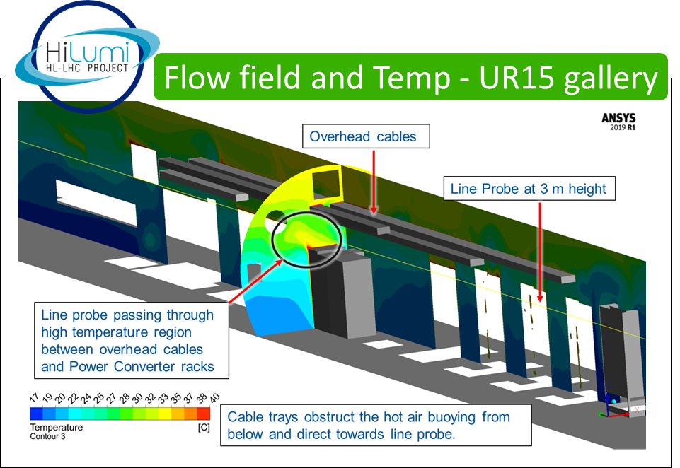
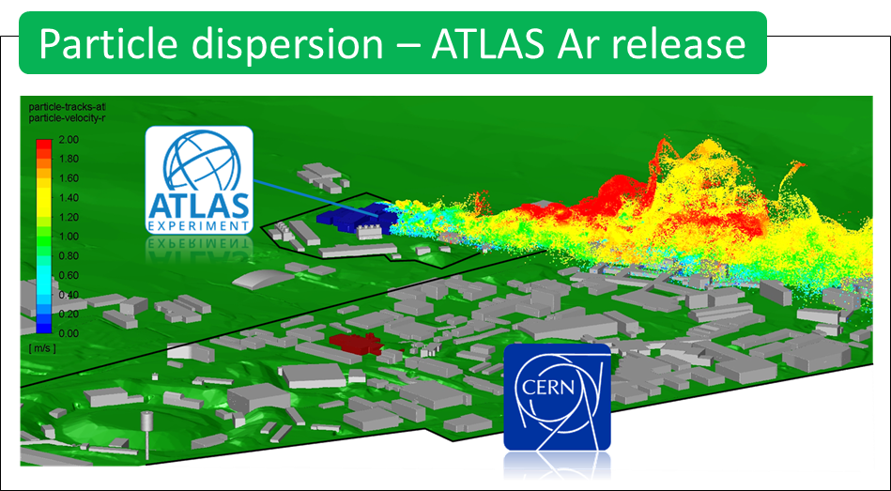

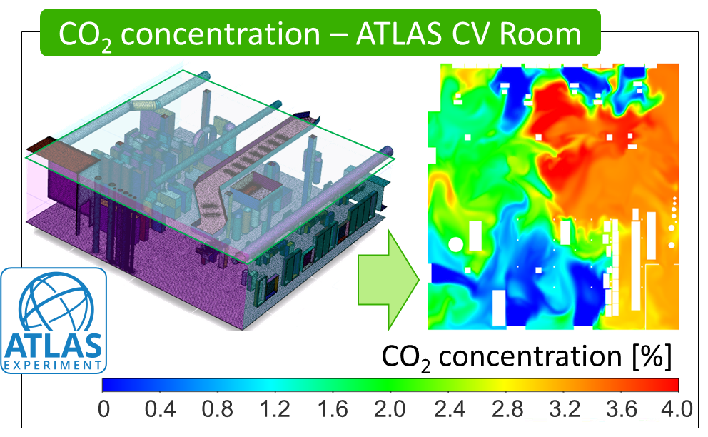
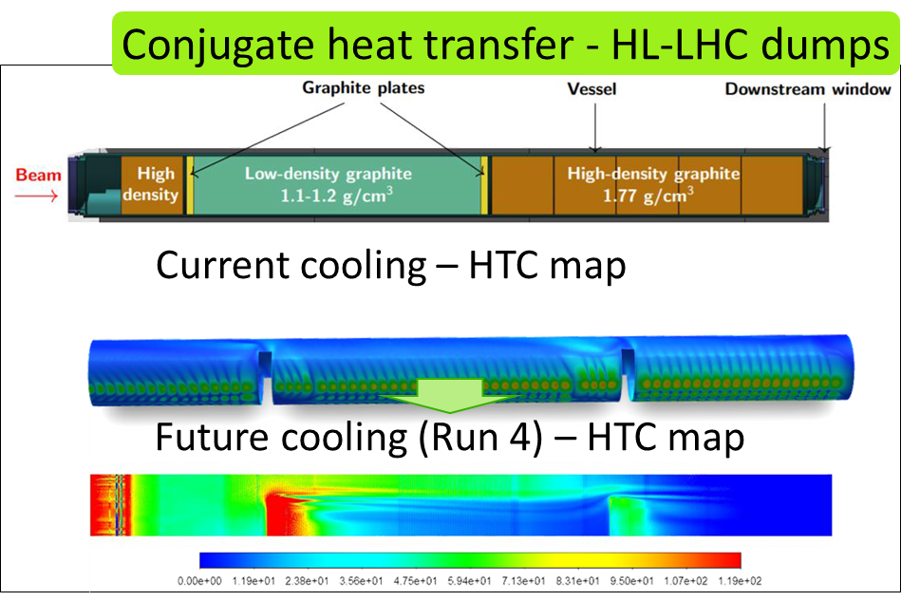
Computational Fluid Dynamics (CFD) Team

Slide 7
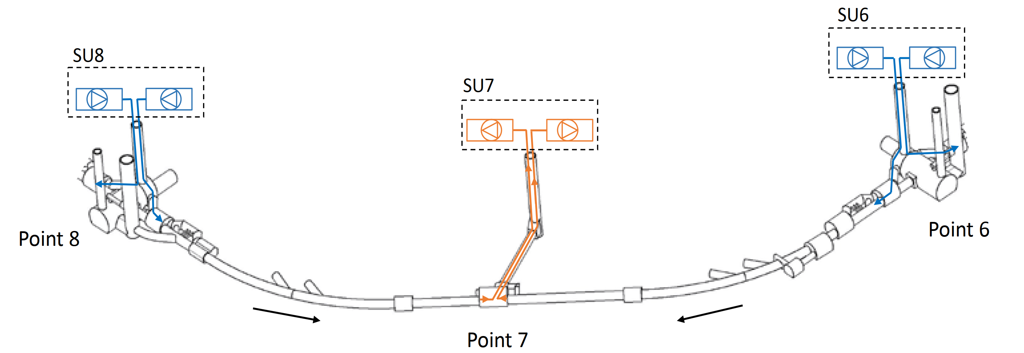
I. Underground Ventilation - Sizing
Dimensioning Criteria
LHC ventilation scheme
Minimum flow
Operational modes
Heat loads/humidity control
Air speed
Operating mode | Design flow rate [m³/h] | Current supply flow rate [m³/h] | Current return flow rate [m³/h]
Tunnel Accessible | 18,000 | 18,000 | 23,000
Tunnel not accessible | 36,000 | 18,000 | 23,000
Emergency mode | 64,000 | 36,000 | 64,000
Reduced consumption | 9,000 | 9,000 | 10,000

Slide 8

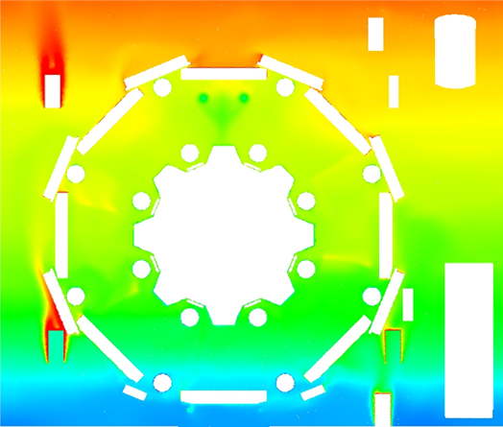

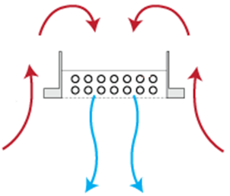
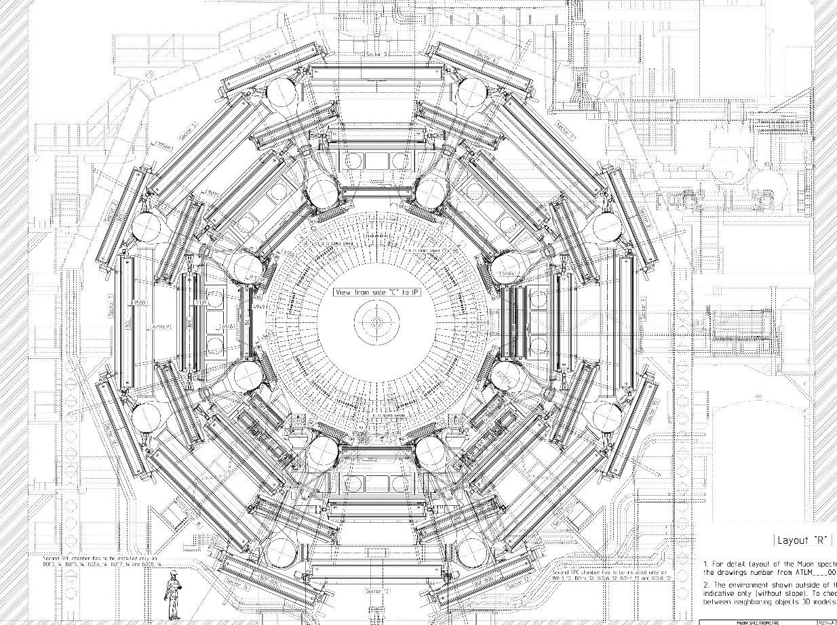
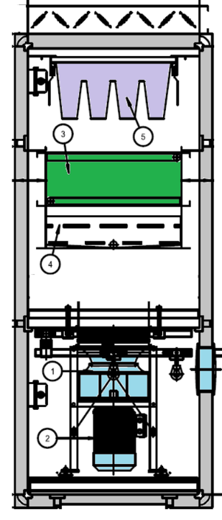

II. ATLAS UX15 Cavern - Destratification
Muon chambers target temperature range: 18-25 °C
2 Possible Solutions
1 - Natural convective cooling
2 - Active
mechanical cooling
ATLAS UX15 Cavern
Air Temperature [°C]
Cold beams
8 Air Handlers
33
29
25
21
17

Slide 9
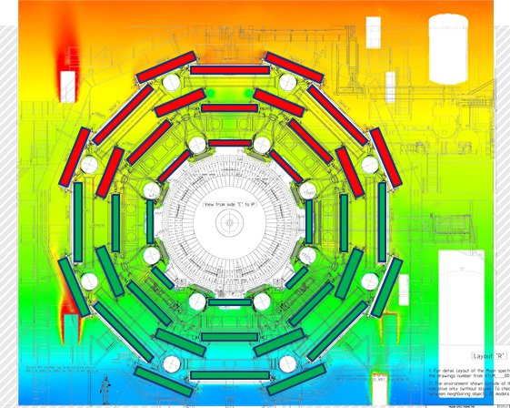
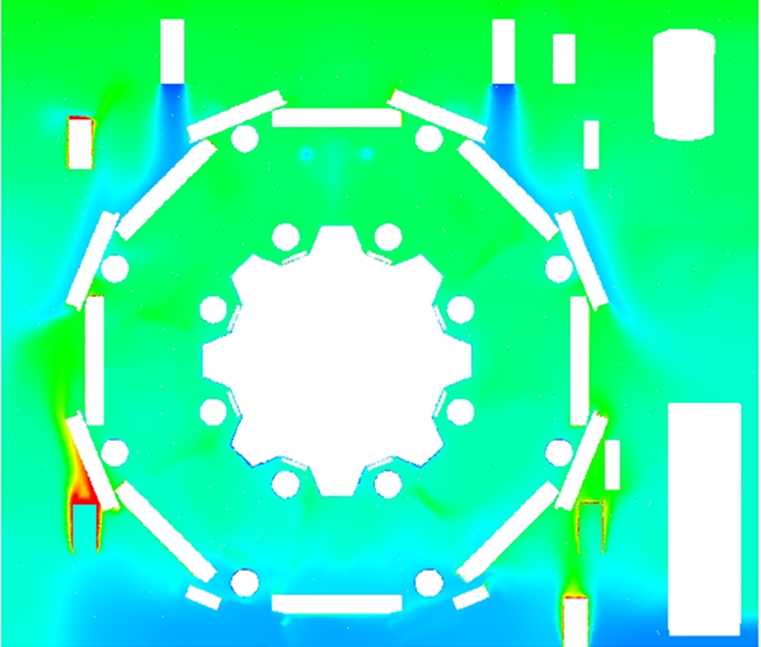
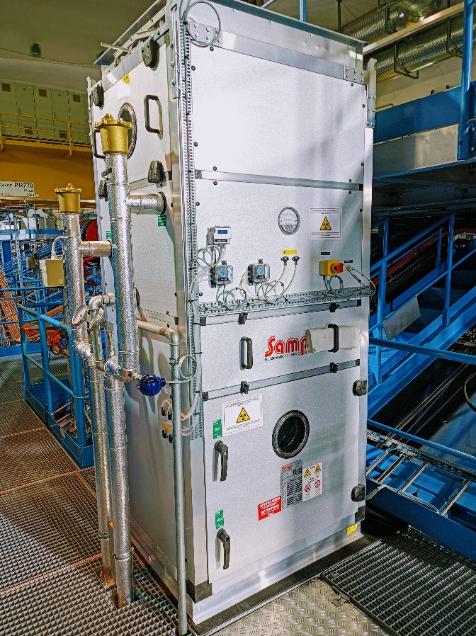
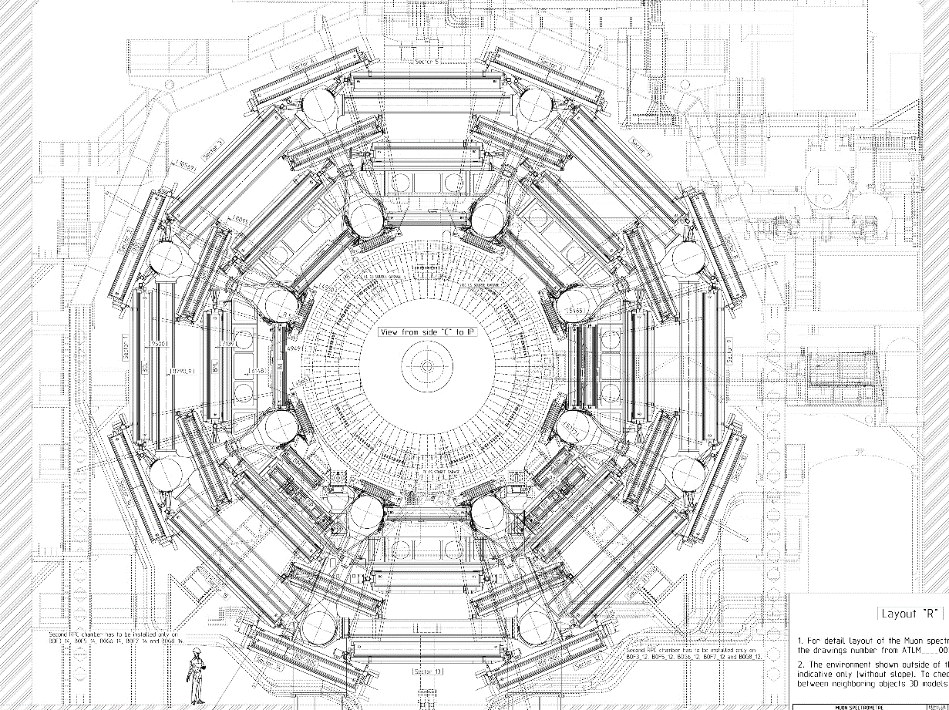
II. ATLAS UX15 Cavern - Destratification
Muon chambers target temperature range: 18-25 °C
2 - Active
mechanical cooling
ATLAS UX15 Cavern
Air Temperature [°C]
UX15 Air Temperature
with Air Handlers [°C]
8 Air Handlers
33
29
25
21
17

Slide 10
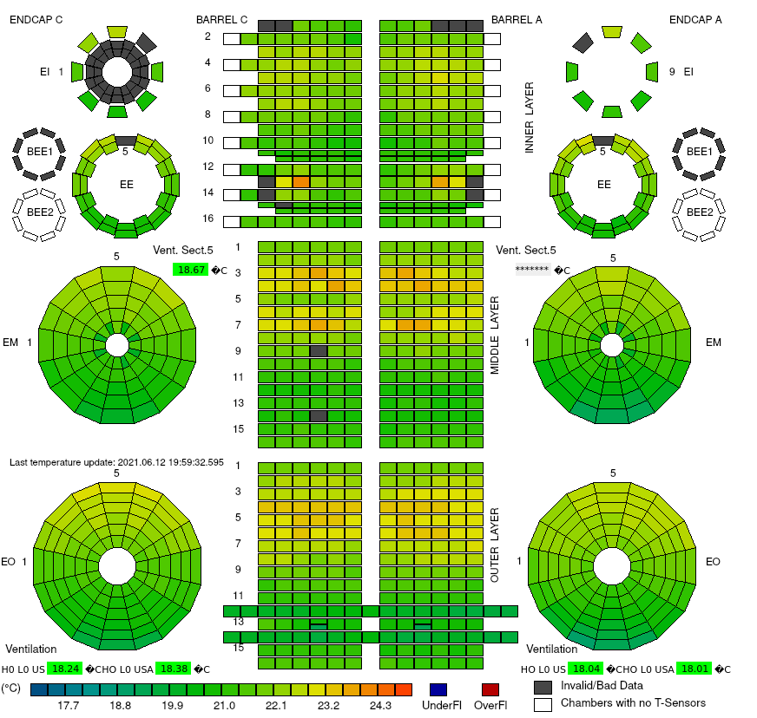
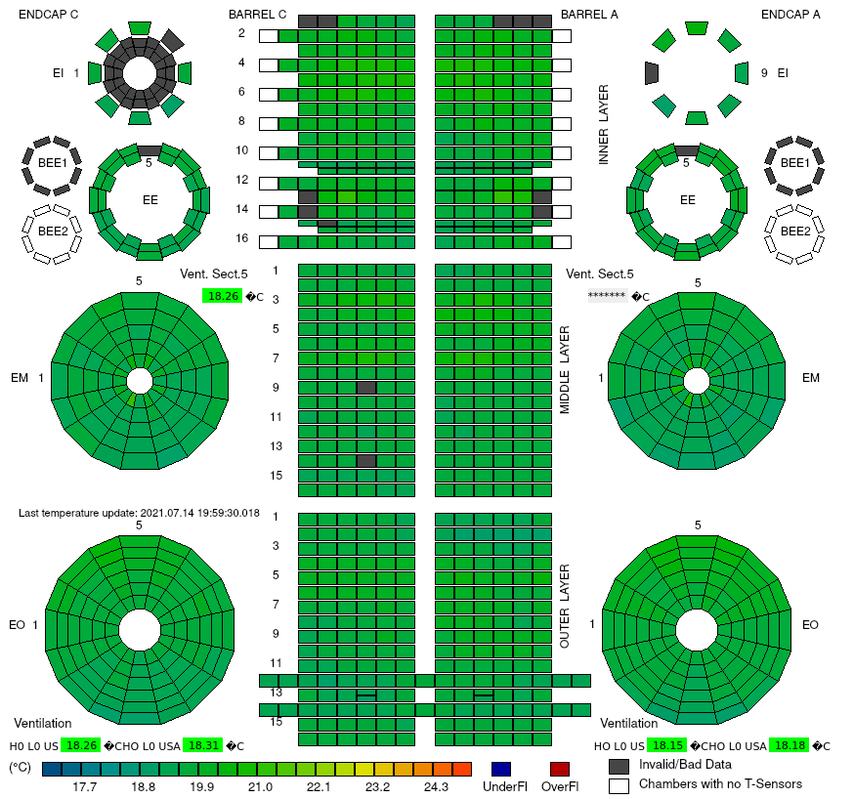
II. ATLAS UX15 Cavern - Destratification
Muon Chambers Temperature Measurements
Destratification OFF
Destratification ON

Slide 11

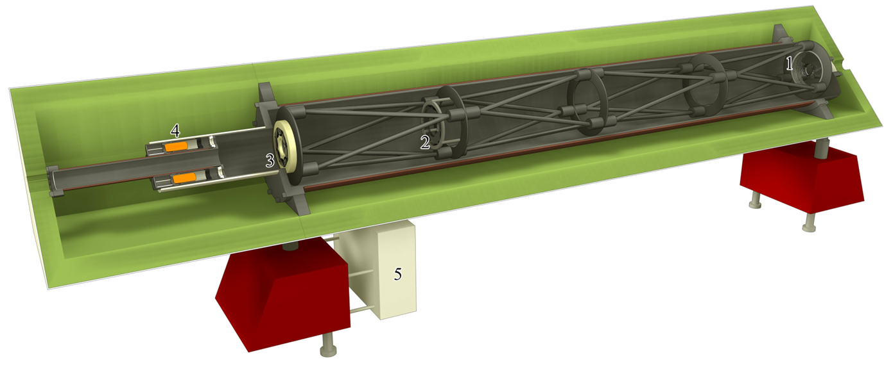
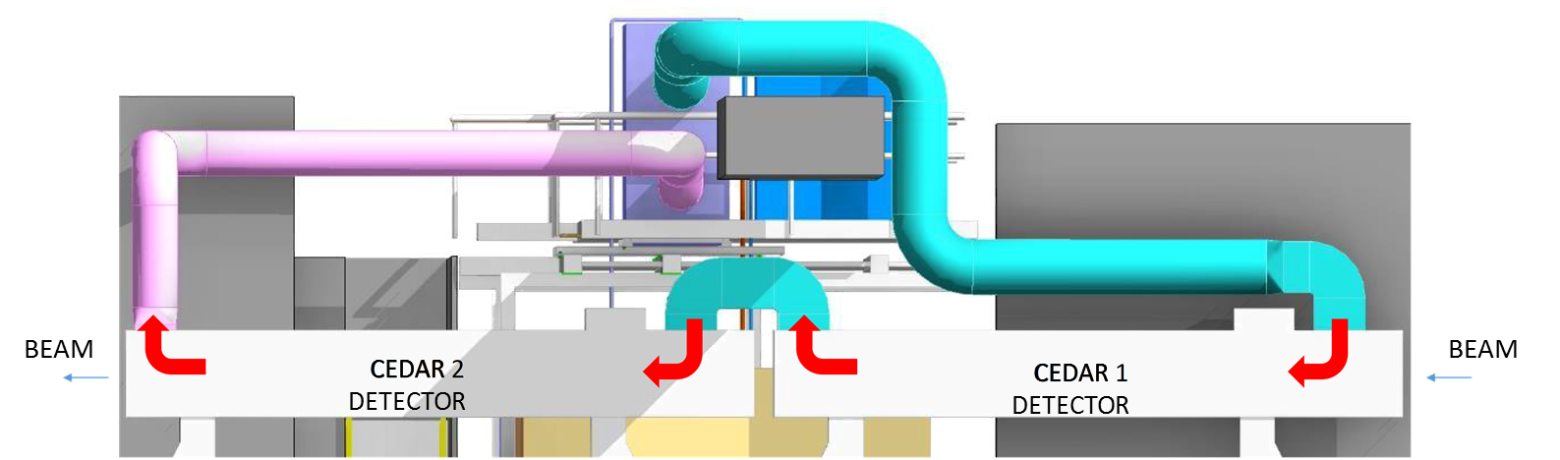
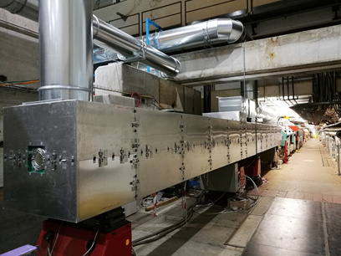
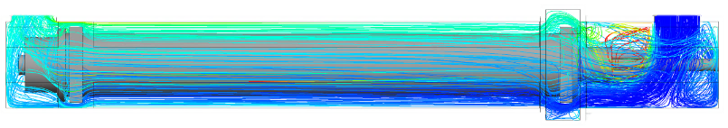
III. CEDAR Detector – Temperature stability
Requirement
T_{IN} = 23.0 °C ± 0.1 K
Standard system: ± 1 K
CEDAR Detector

Slide 12
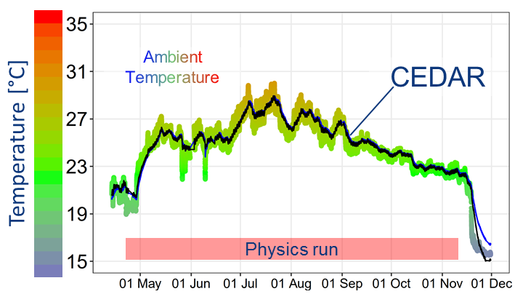
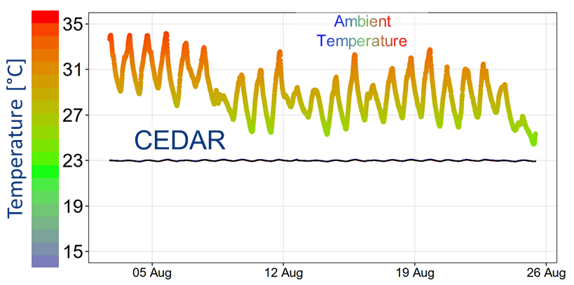
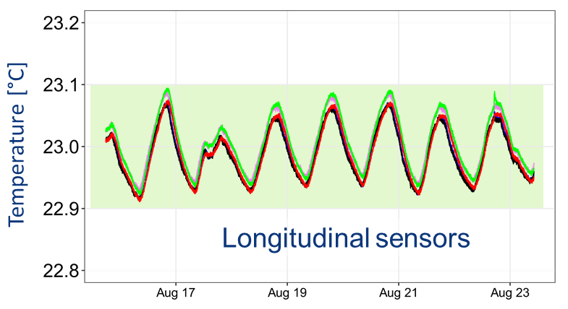
III. CEDAR Detector - Ventilation System
Run 2015
Run 2018
Temperature Stability
± 0.1 K
vs
± 1.0 K
± 0.08 K
Required
Standard solution
Achieved

Slide 13
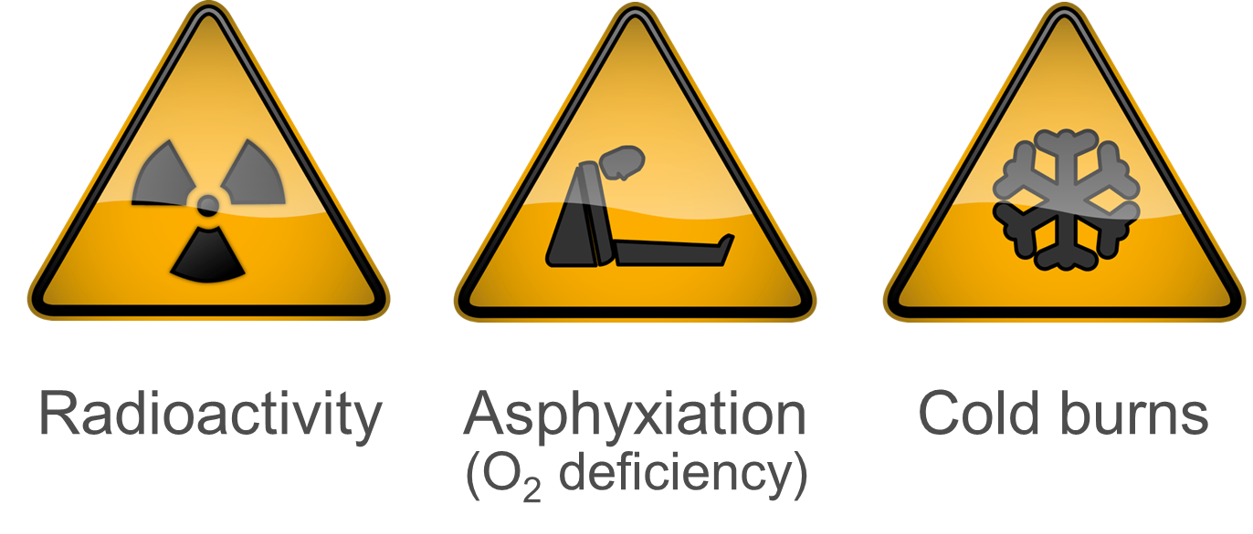
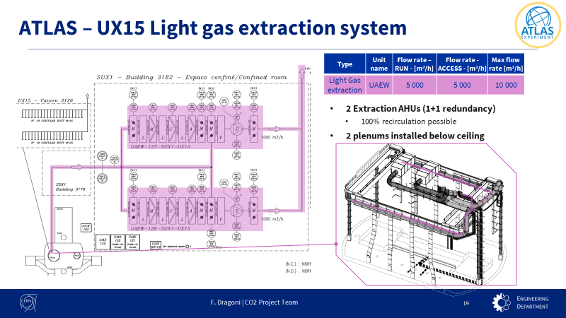
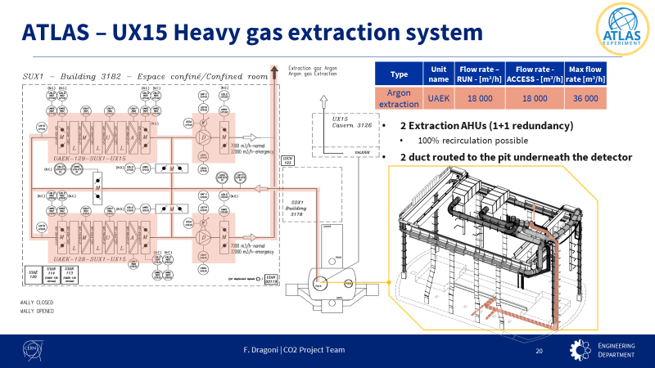
IV. Gas management in underground
Ventilation systems
CFD Analysis

Slide 14
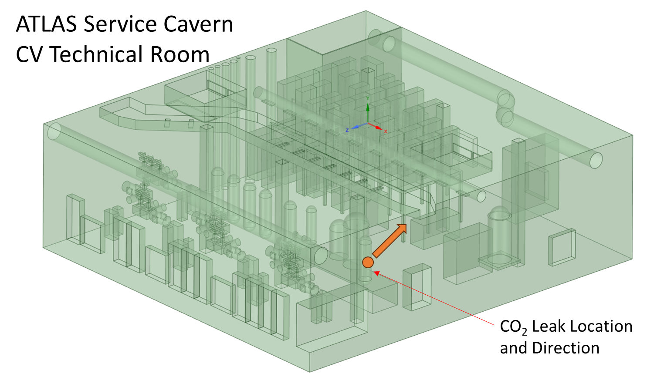
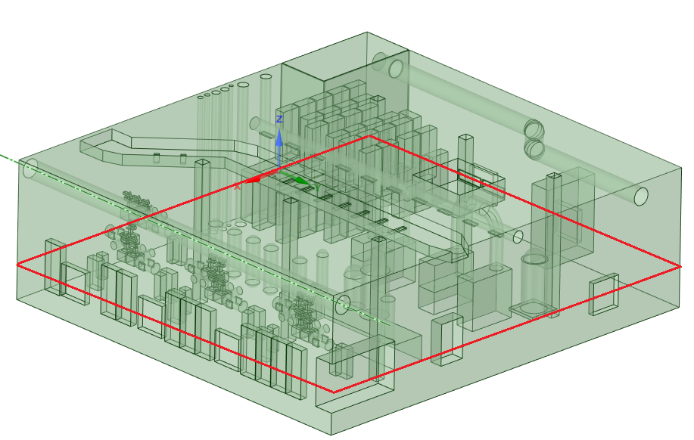

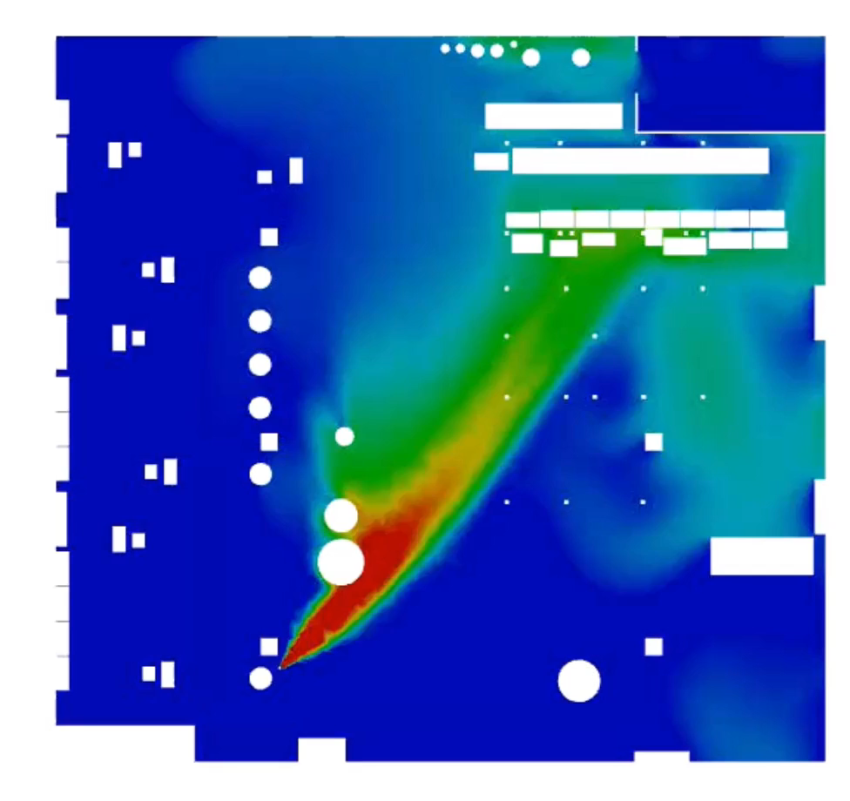
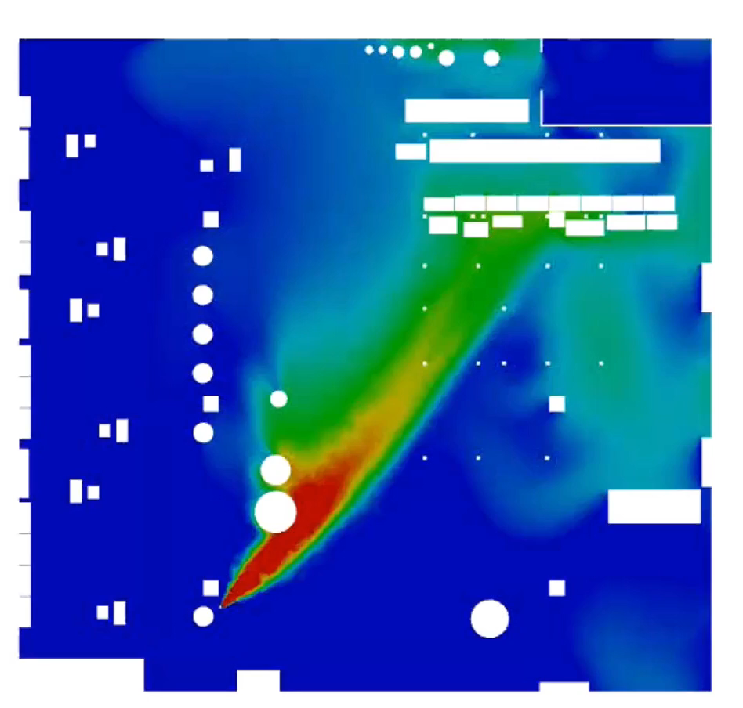
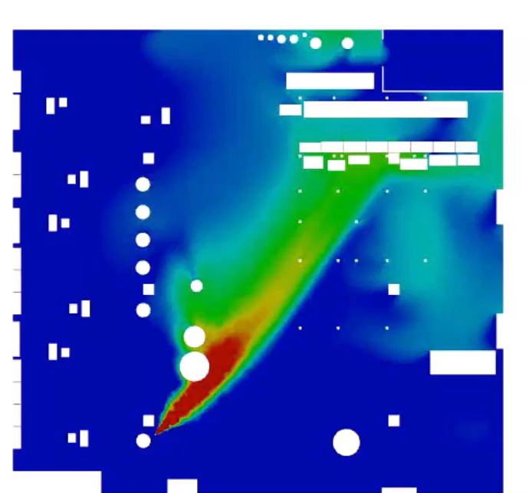
IV. Gas management in underground
Ventilation systems
CFD Analysis
TWA
STEL INRS
STEL Suva
IDTL
Y = 1 m from false floor
10.000 m³/h
10.000 + 3.750 m³/h
10.000 + 7.500 m³/h

Slide 15
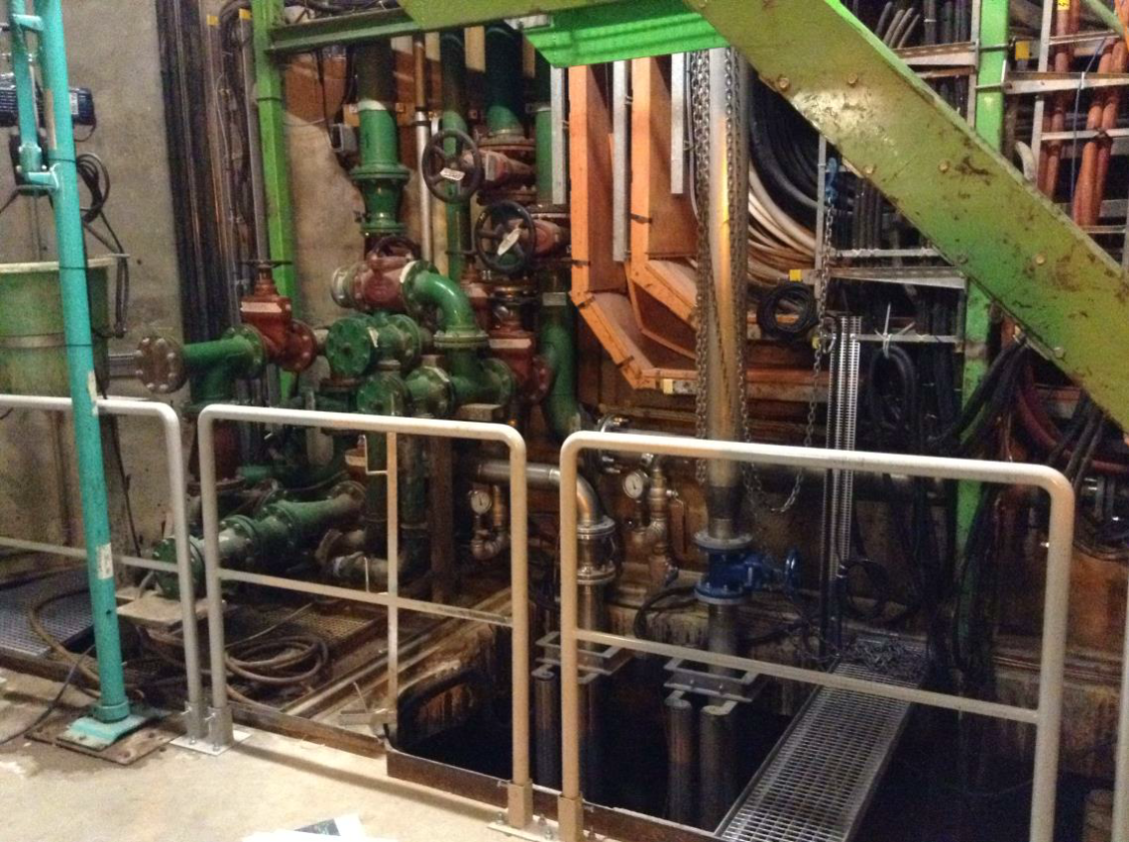
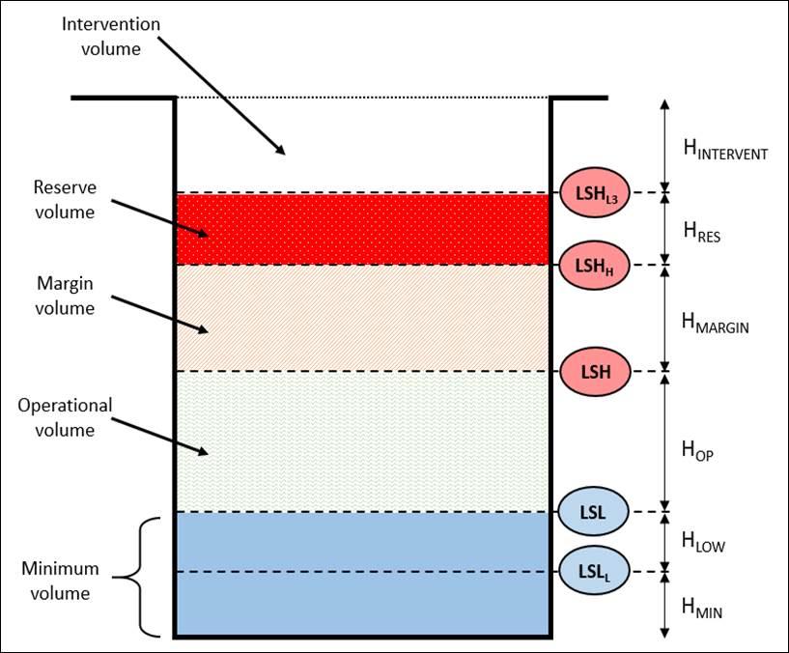
V. Water rising systems
Requirements
PM32 water rising system
Underground drain water
80 m3/h underground water infiltration
Critical system
Cooling circuits drains
Underground toilets
Potential issues
Water treatment
Backup sump
2 pumps (1+1)
Main sump
3 pumps
Suspension particles
Hydrocarbon presence
Contaminated water
High pH

Slide 16
Cooling and Refrigerant

Slide 17
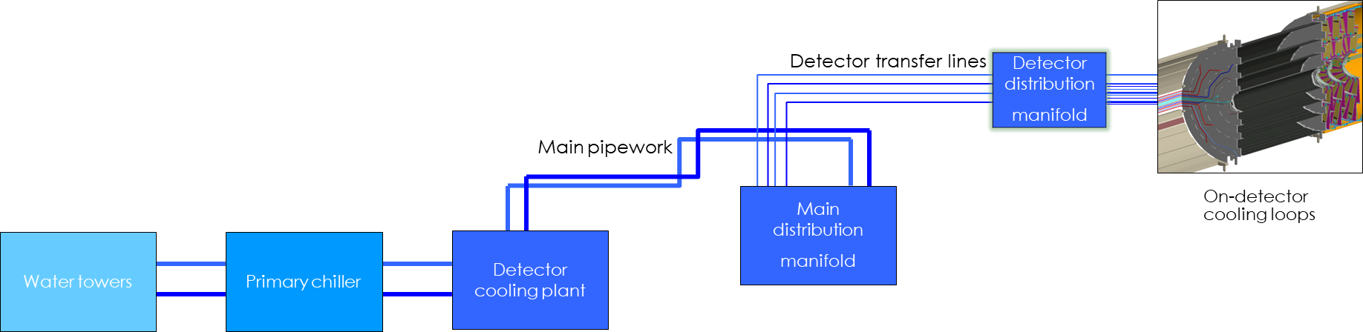
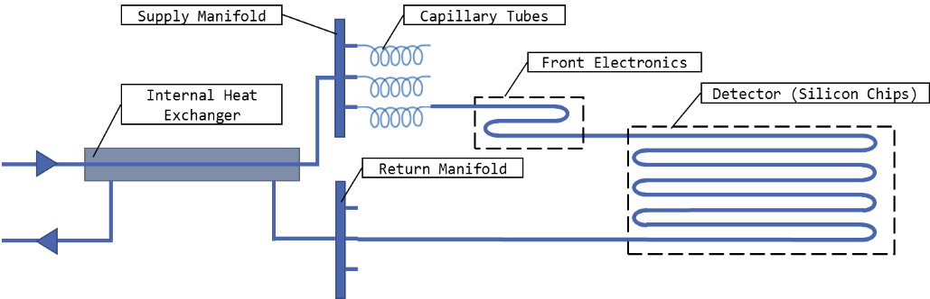



ATLAS/CMS - Si detector cooling chain
cooling towers
primary chiller plant
detector cooling plant
transfer lines
distribution
heat sink
EN-CV
EN-CV
(NTNU + EP-DT)
EP-DT
EXP-TC
(EP-DT)
Experiment
(EP-DT)
Experiment
Courtesy P. Hanf

Slide 18

ATLAS/CMS - R744 Cooling Systems
ATLAS and CMS cooling: same concept, same hardware & different distribution
A Primary lubricated loop (purple lines)
A Secondary Oil free distribution loop (red lines)
Courtesy P. Hanf

Slide 19

ATLAS/CMS – Detector cooling timeline
Secondary circuit "coolant” technologies
Today
CO2 -2PACL technology 1kW @-30°C, 2Plants
CO2 -2PACL technology 17.5 kW below -25°C, 6Plants
CO2 -2PACL technology 23.5 kW below -30°C, 6Plants
CO2 -2PACL technology 1 130 kW @ -53°C, 2Plants
*C3F8 62 kW@-25°C, 1 Plant
*C6F14 101 kW below -20°C, 5 Plants
*C3F8 62kW@-25°C, 1 Plant
*C6F14 91 kW below -20°C, 4 Plants
RUN 1
RUN 2
RUN 3
RUN 4
2008
2029
Primary circuit “Refrigerant” technologies
*R404a/R507a
*R404a/R507a & R448a
R744 (CO2)
June 2023 - Update the F-gas regulation (EU 517/2014) prohibiting or controlling the use of chemical refrigerant
*Chemical products damaging environment and contributing to the Global warming
Courtesy P. Hanf

Slide 20





ATLAS/CMS - R744 Cooling Systems
Aircoolers part
of the compressor slice
Common module
Production
module
Control
&
Power supply
R744 Cooling Slice
Control & Power supply
Common module
Production
module
ATLAS SXSN1 Building – Final system with 7 slices

Slide 21
Future Circular Collider (FCC)

Slide 22






FCC layout
FCC-ee underground structure
FCC-ee machine elements
Pipework
Fresh air passage
No return duct
AC terminals
Smoke/He extraction plenum
Courtesy A. Navascues Cornago

Slide 23



FCC Ventilation Principle
Smoke/He extraction plenum
AC terminals
FCC sector ventilation
Thermal aspects in FCC sector
Operation modes
Courtesy G. Peon

Slide 24
Q&A?

