Slide 1
PU chemical compatibility test plan
R. Piccin, C. Scheuerlein, S. Clement, J.S. Rigaud
Polymer Lab (TE-MSC-SMT)

Slide 2
Scope
Asses the compatibility of the different PU grades with Molykote BR2 and understand the failure mechanism
Investigate and test compatibility of alternative lubricants
Support the identification and test of alternative materials for the pads

Slide 3
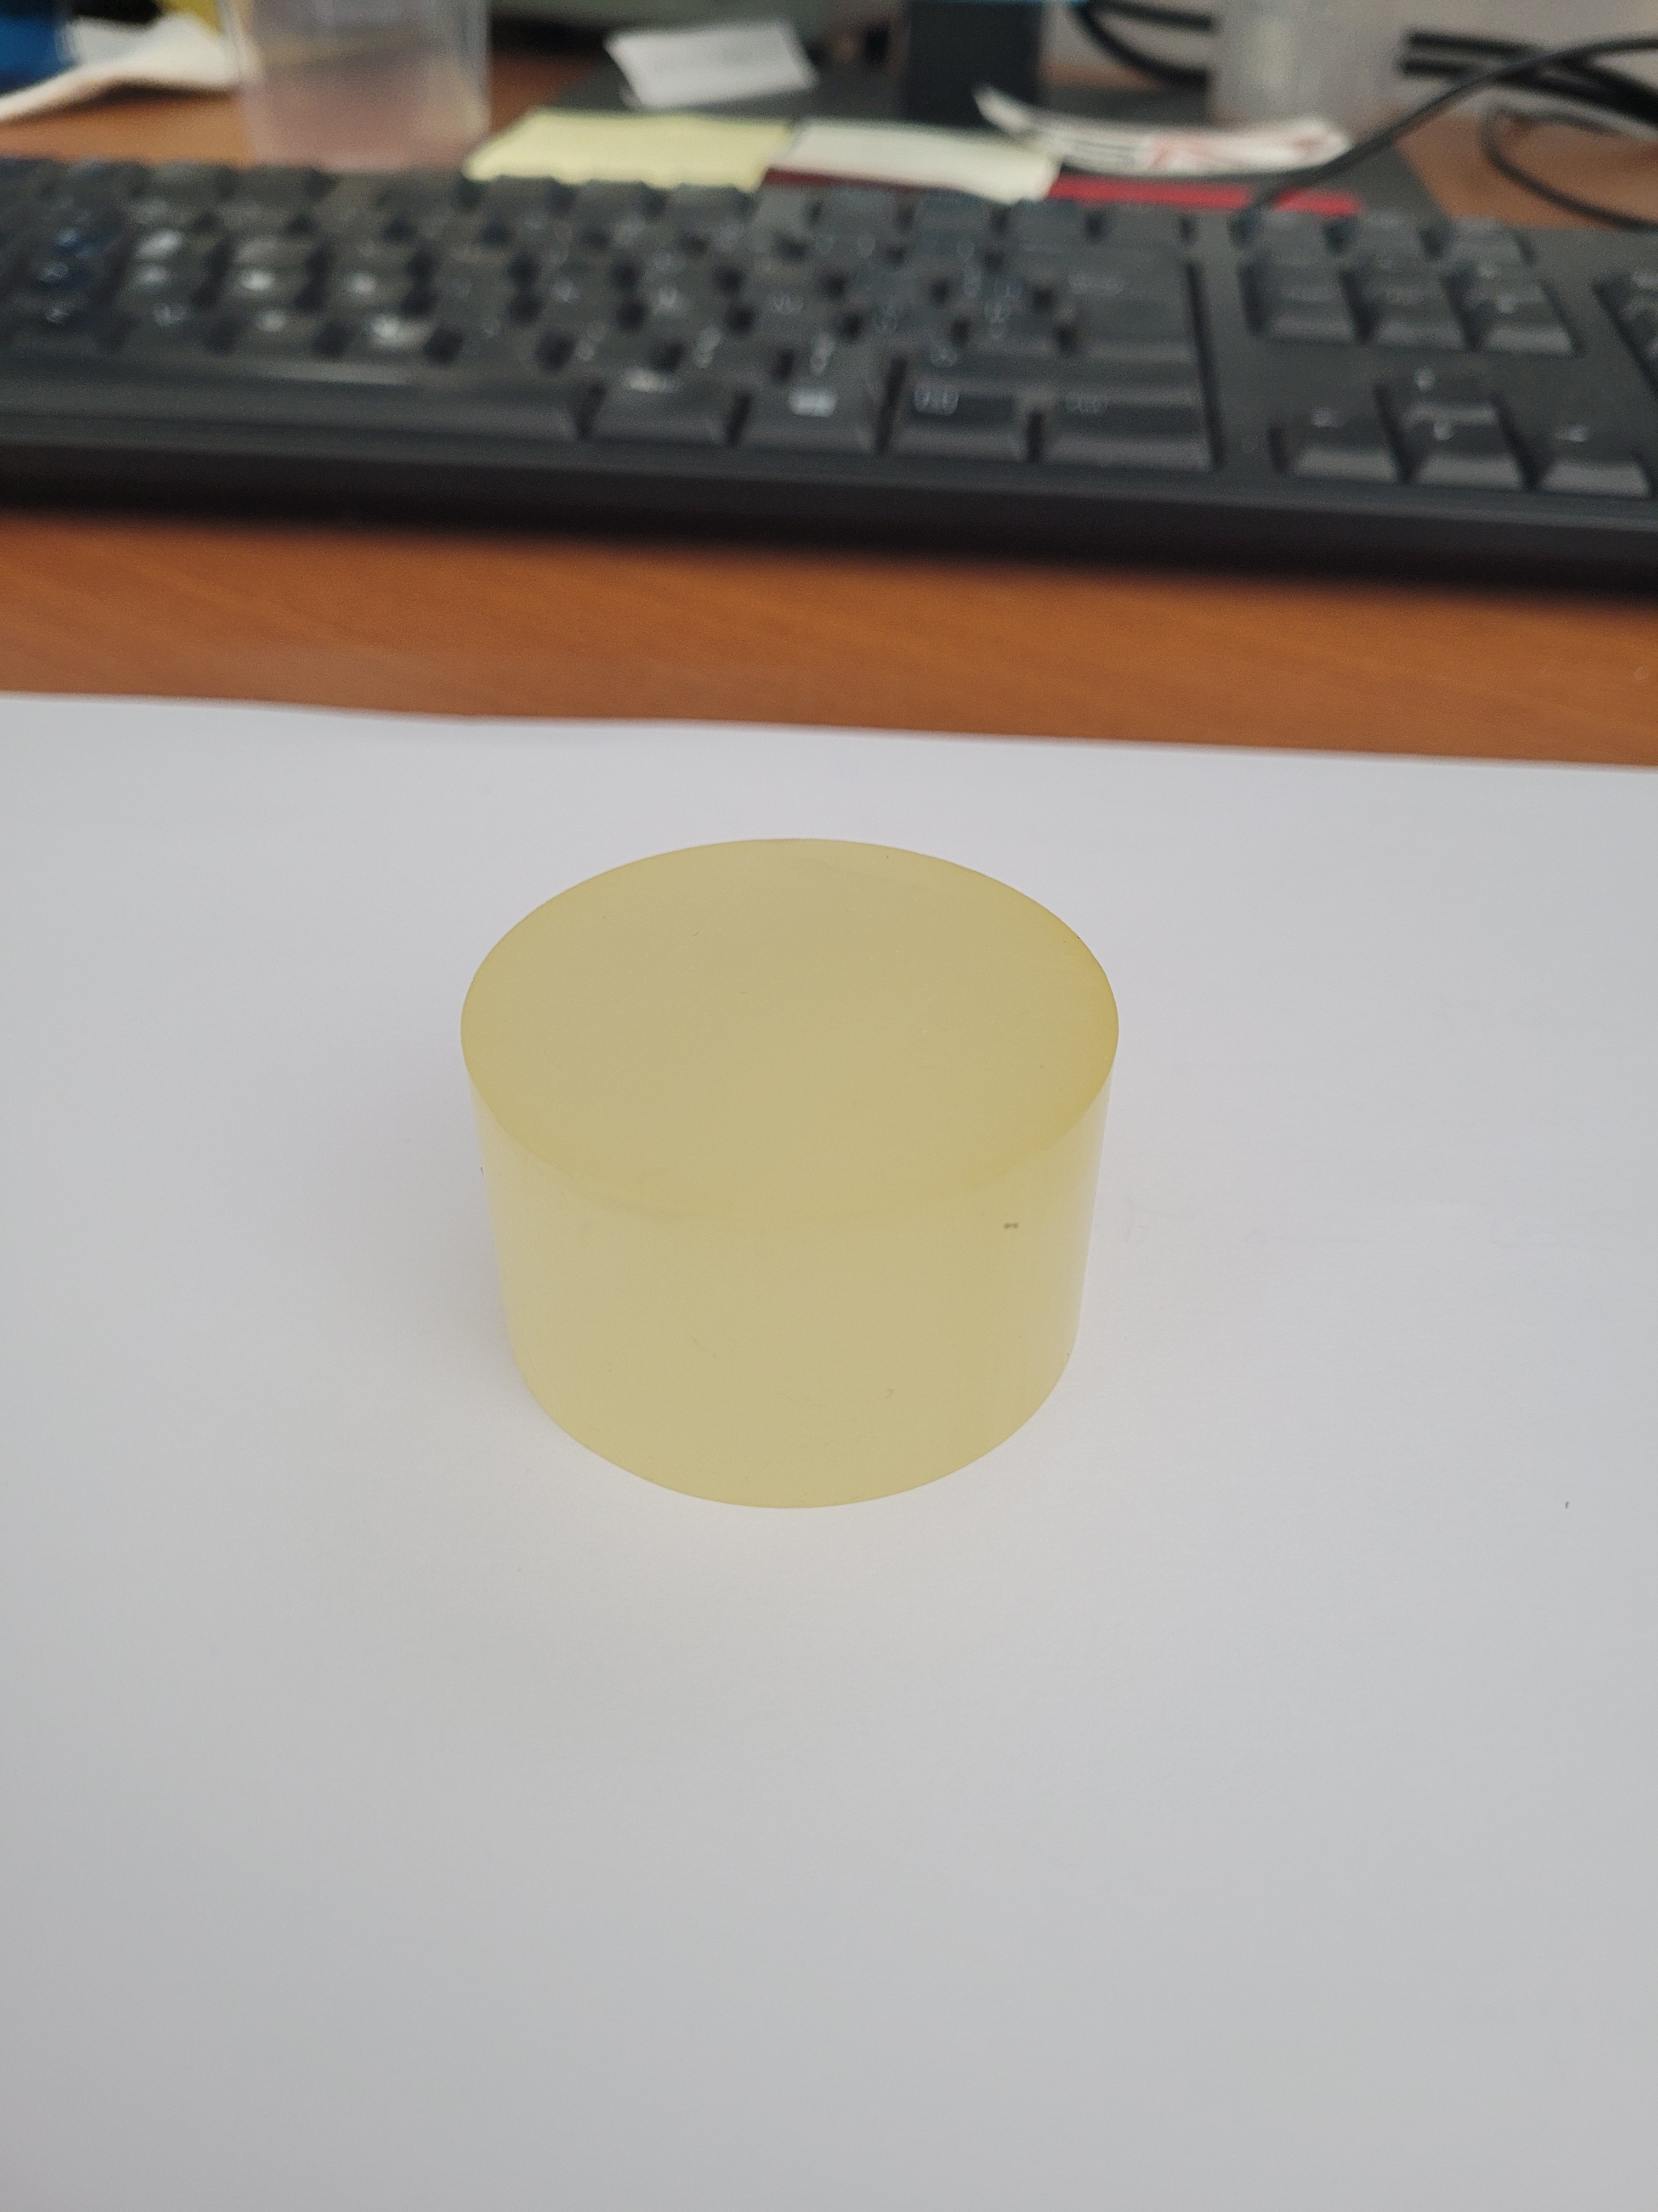
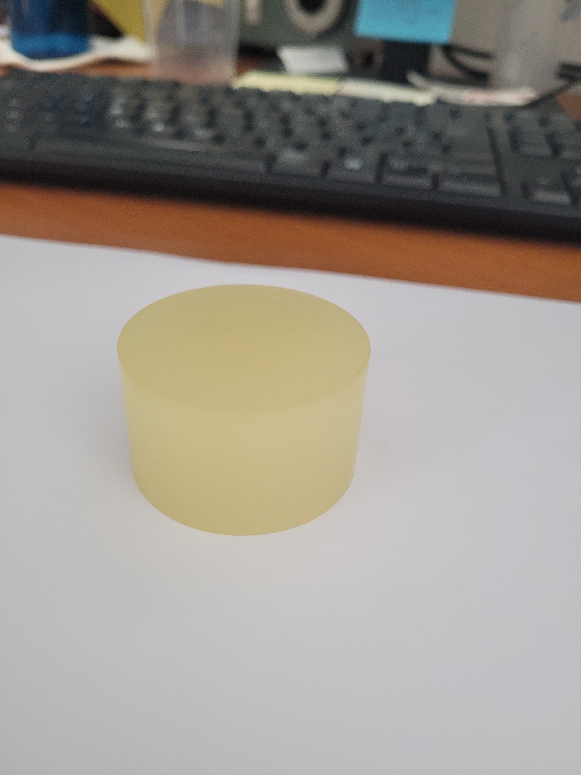
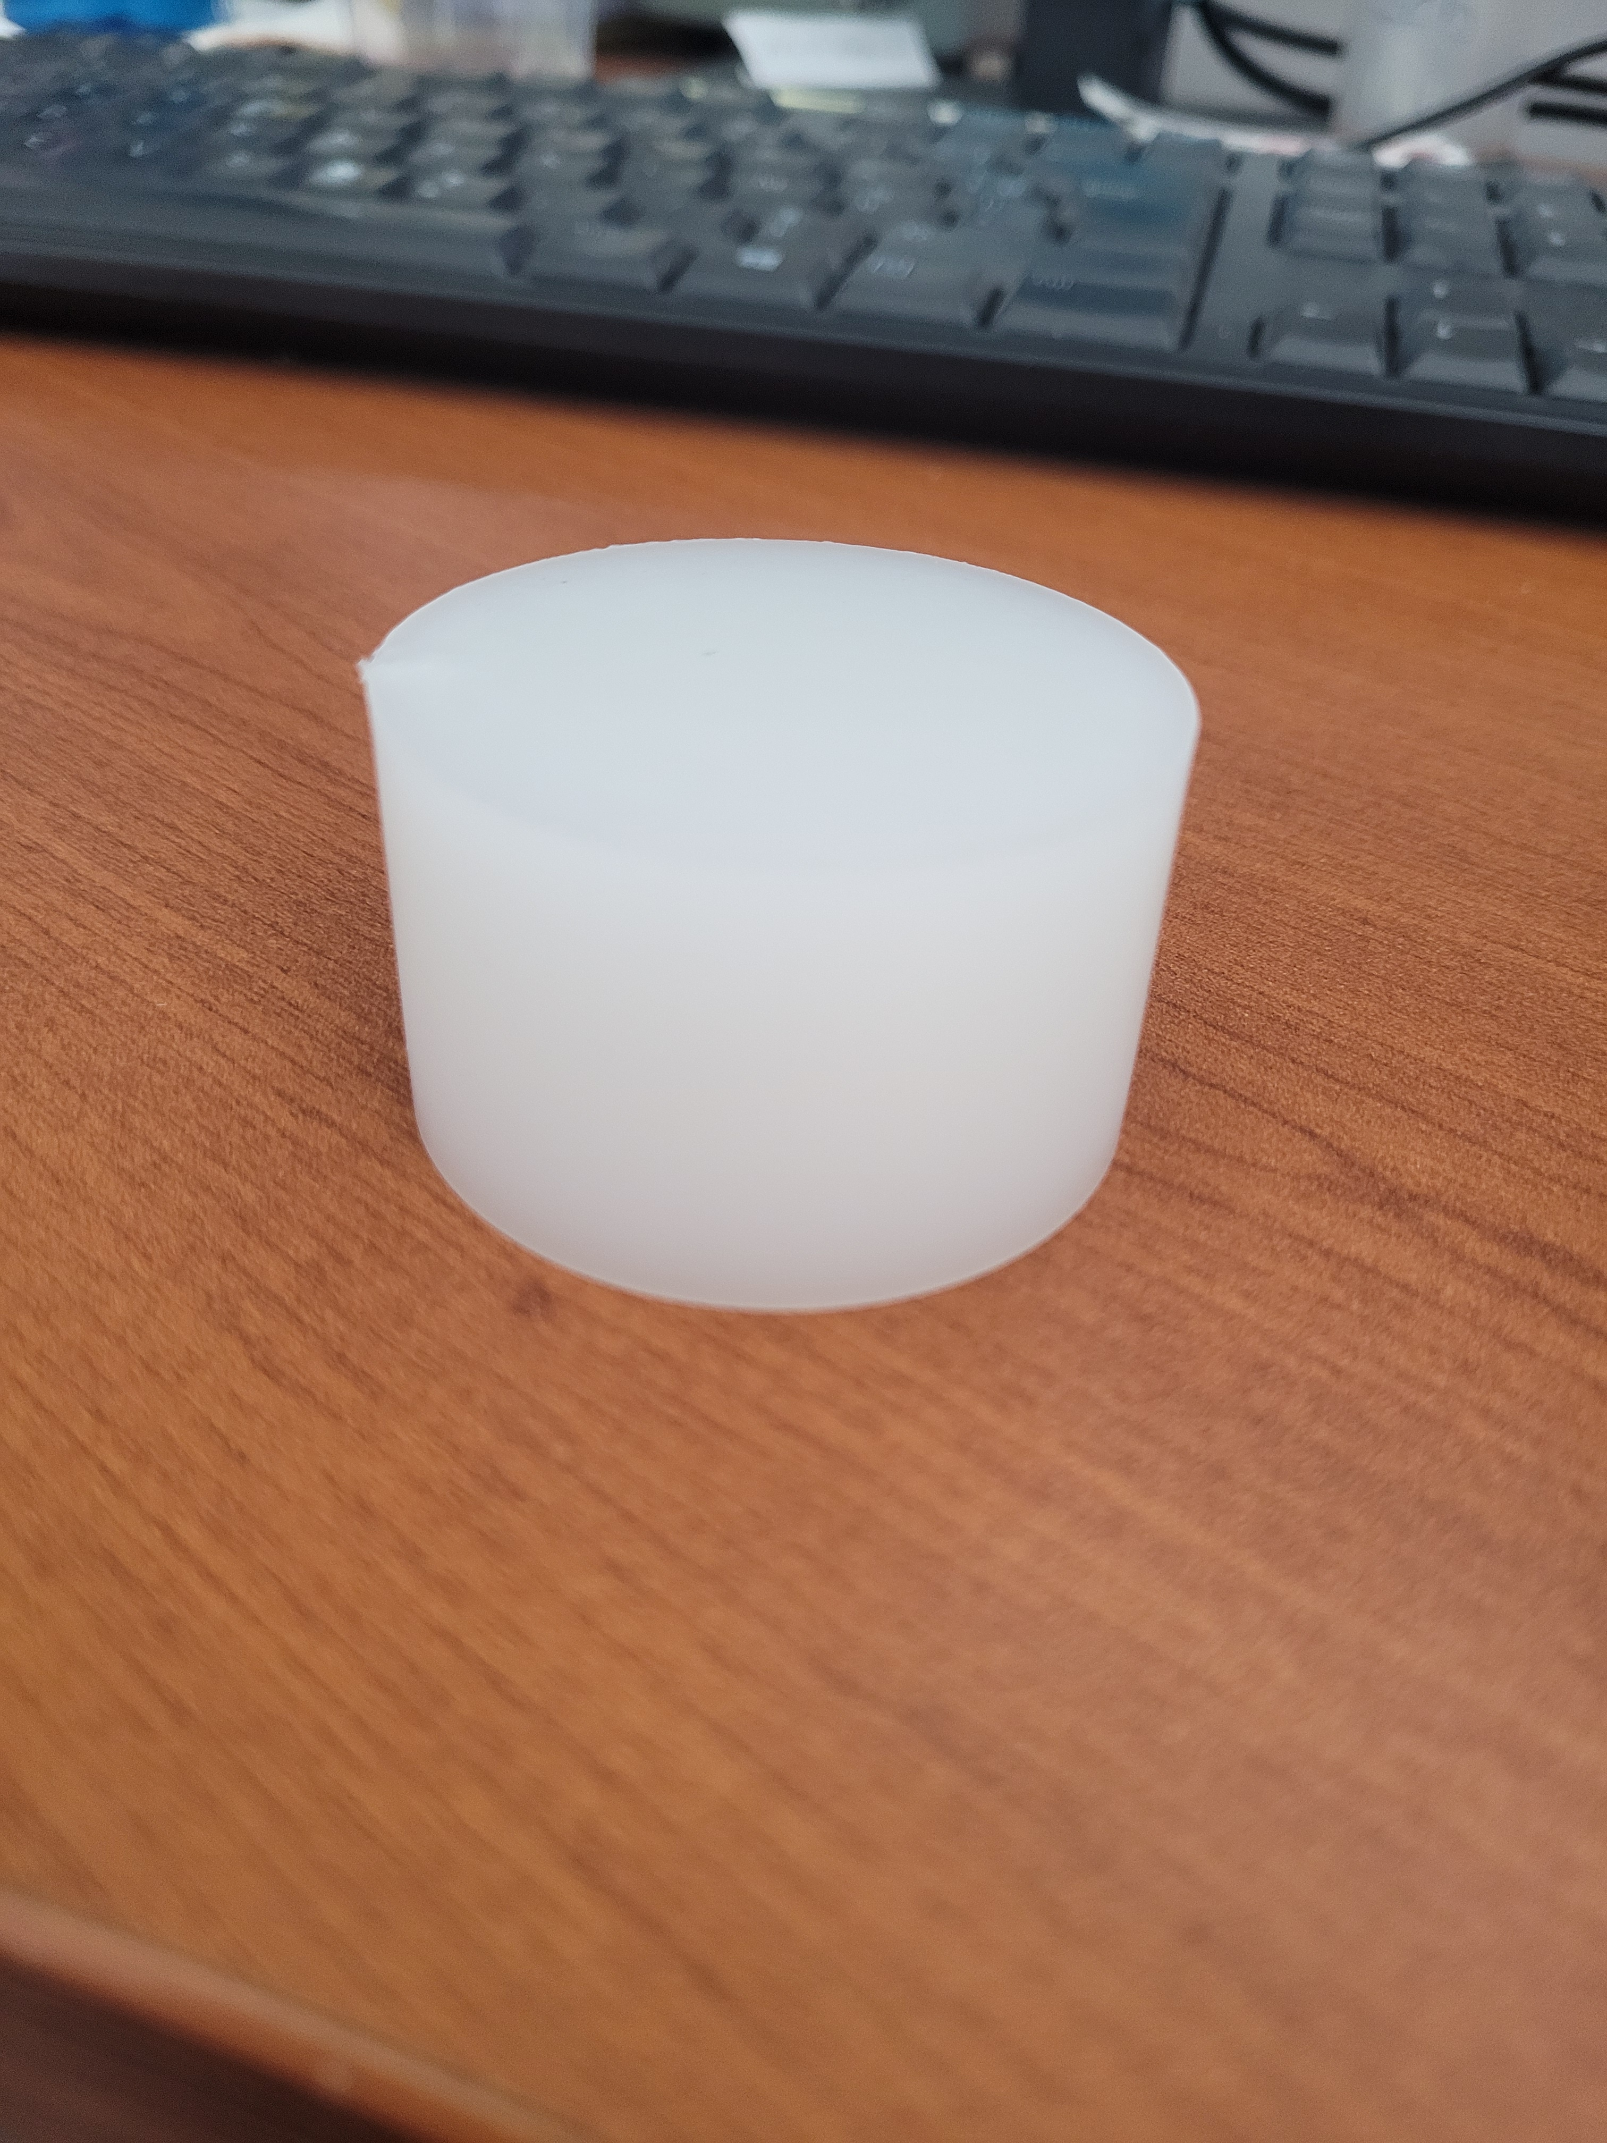
Pads delivered at Polymer lab
Pads year | Hardness (Shore A) | Number of pads
2005 (PU-E-EMD 135N DAI n°9835980) | 75 | 3
 | 90 | 0
2017 (PUE-53hc, DAI n°6853867) | 75 | 8
 | 90 | 6
2023 (PUE-53hc, DAI n°1907270) | 75 | 3
 | 90 | 3
Missing inputs, if known:
Composition of pads (ether, esther, etc.). TDS/MSDS available?
Which are exposed to Molykote BR2

Slide 4
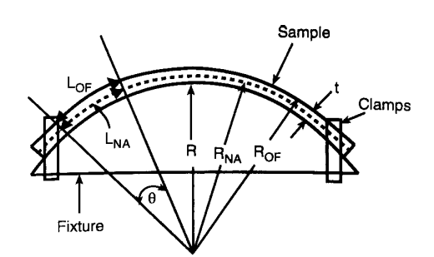
Chemical compatibility test (1)
Test as per ASTM D543 - Evaluation of resistance of plastics to chemical reagents. Bent strip at constant strain.
TEST CONDITIONS
Temperature:
Standard room temperature
60 ℃ (below the onset temperature of undetermined thermal phenomenon detected by DSC at chemical lab)
Strain:
0%
1 – 5% depending on final design of test jig
Chemical:
Molykote BR2
One from alternatives (see annex)
Wet patch of Molykote
Limitations: test conditions may vary depending on the dimension and shape of the specimens that we extract from the pads. Not easy to cut proper specimens.
Possibly get more pads and a plate from PUE-53hc, DAI n°1907270.

Slide 5
Chemical compatibility test (2)
Properties change shall be measured on not-exposed and exposed specimens. Exposure time shall be minimum 120 h.
Mechanical properties change:
  Tensile test
  Hardness
2) Weight change
Other possible measurements:
Physicochemical changes with DSC and FTIR
To be discussed with chemical lab if meaningful results can be obtained from these measurements (see next presentation Chemical analysis)

Slide 6
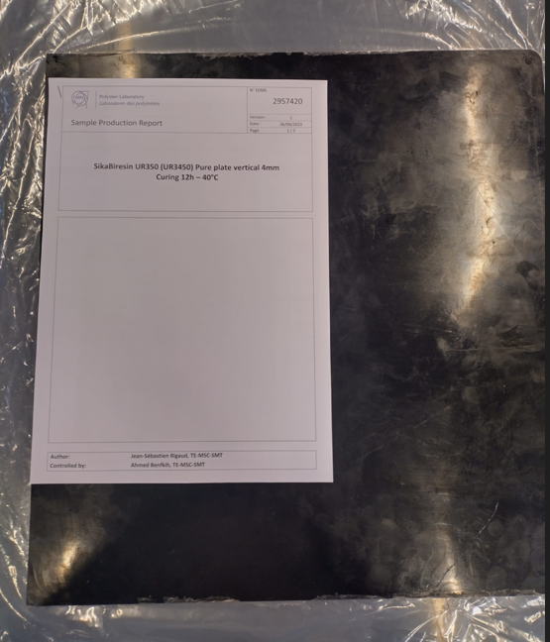
Alternative PU in use at Polymer lab
Under preparation plates with alternative PUs for mechanical and chemical compatibility test
We can target more precisely alternative materials upon definition of the detailed technical specifications of the pads.
Some of our suppliers can develop tailor formulations to costumer specifications
Plates of PU SikaBiresin and sample production report

Slide 7
Outlook
Extraction of specimens from pads and construction of the strain jig for compatibility test
Get DuPont feedback on compatibility of Molykote with PU and propose alternative lubricants
Screening of alternative PUs

Slide 8
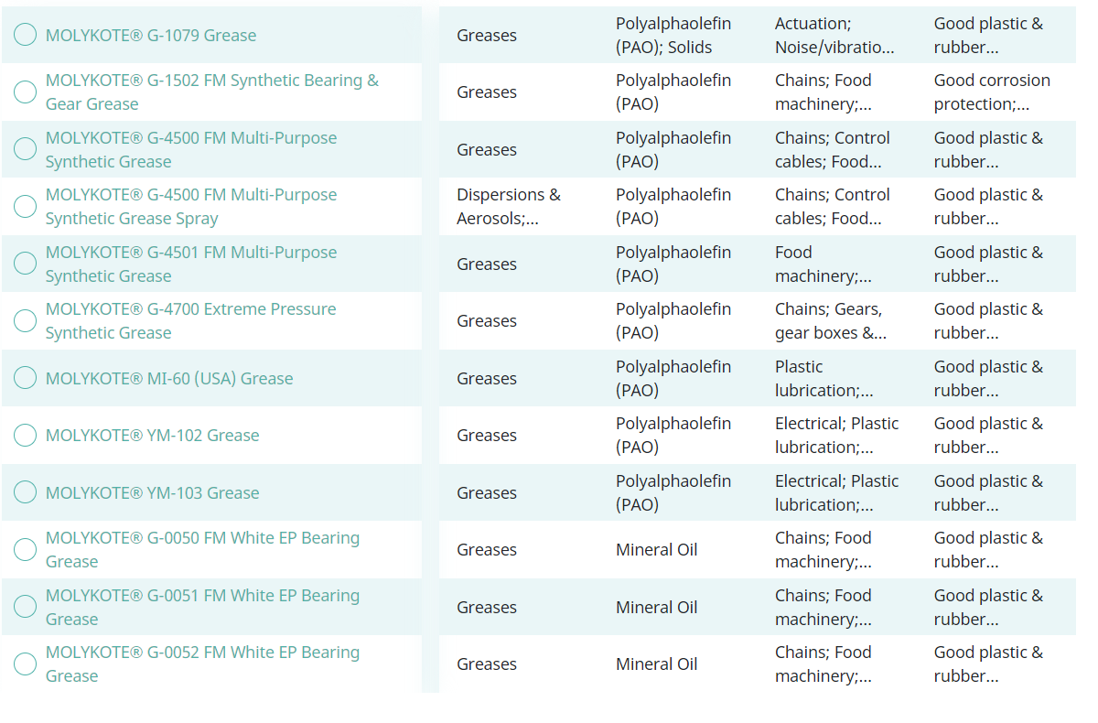
Annex – plastic lubricants

