Slide 1
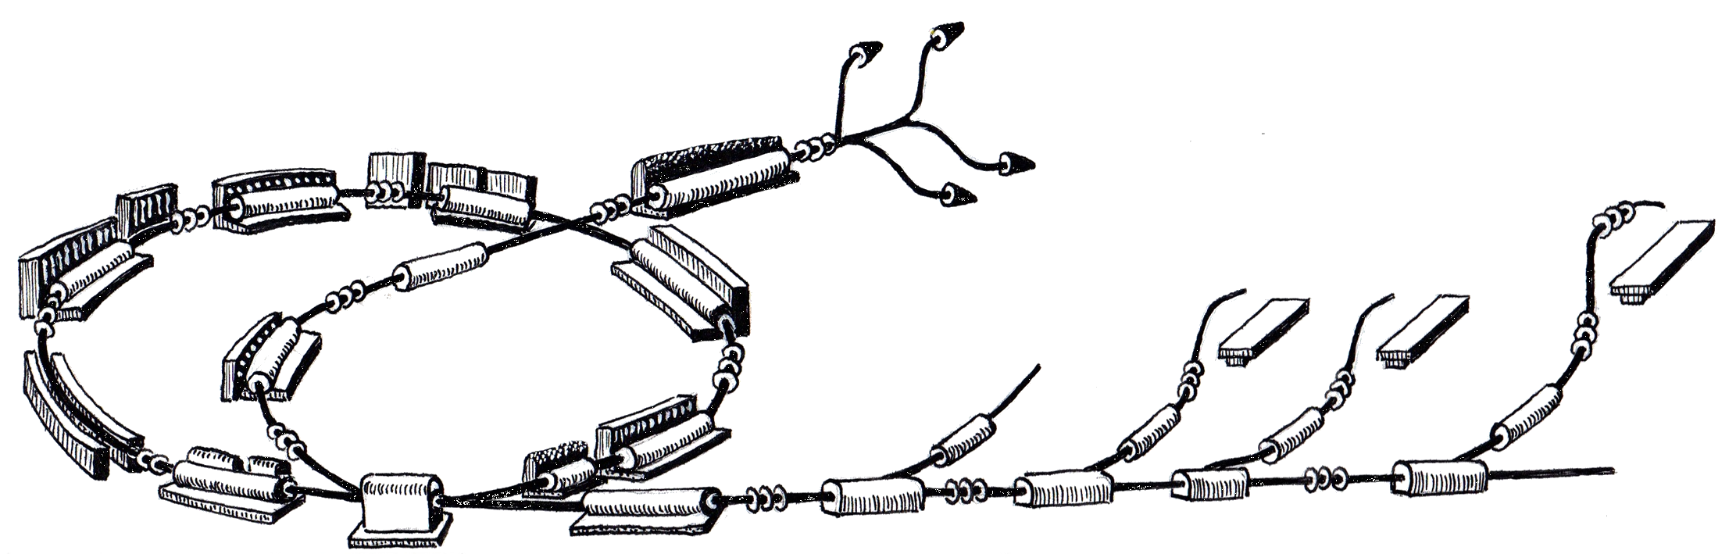
ProShell Procedure Framework Status
MedAustron Control System Week 1
March 28th, 2011
Roland Moser
R. Gutleber

Slide 2
Scope
Overview of ProShell Procedure Framework
  „Beam Spectrum“ Procedure Example
Current status
  What was achieved since December2010
  Plan till June 2011
Summary

Slide 3
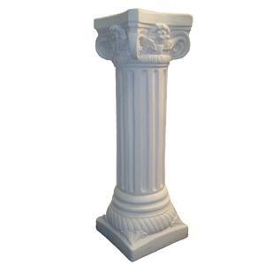
OVERVIEW

Slide 4
ProShell Procedure Framework
provides a graphical user interface that
dynamically loads procedures,
Manages procedures‘ lifecycles,
provides APIs to interact with control system components
  Allocate resources through VAA
  Communicate with resources for control and monitoring purposes

Slide 5
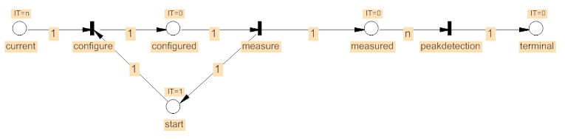
„Beam Spectrum“ Procedure Example
Move Faraday Cup into the beam line
For a list of currents perform the following actions
  Set a current on a power converter
  Wait until the current is reached on the power converter output
  Readout value from Faraday cup and add to plot
Perform a peak detection on the plot

Slide 6
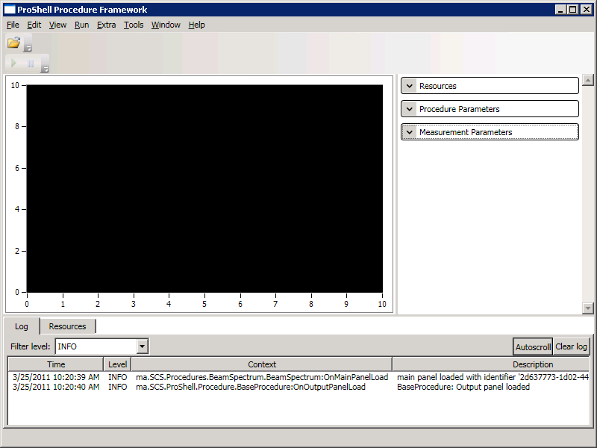
Screenshot

Slide 7
Screenshot
MenuBar
ToolBar
Main Panel
Input Panel
Output Panel
(Logger, Resource Allocation)
Status Bar

Slide 8
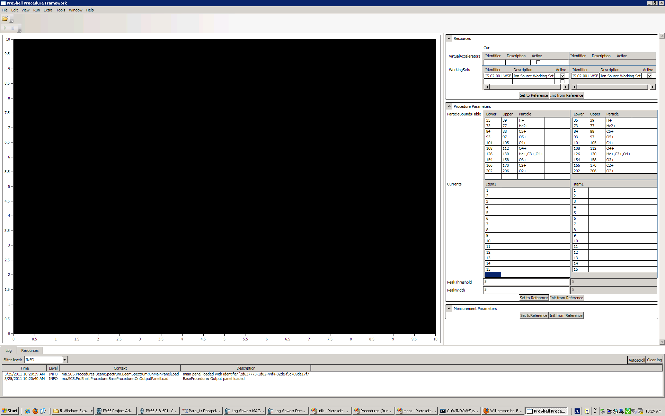
Input Panel (Resources)
List of Virtual Accelerators and Working Sets
that are allocated by ProShell on behalf of the procedure

Slide 9
Input Panel (Procedure Parameters)

Slide 10
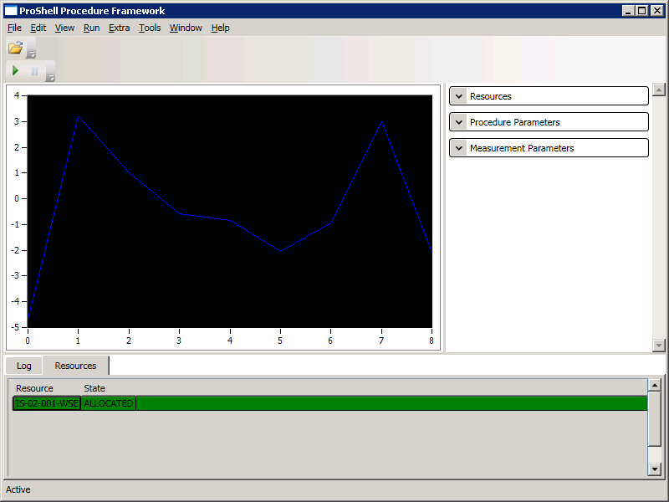
Executing Procedure

Slide 11
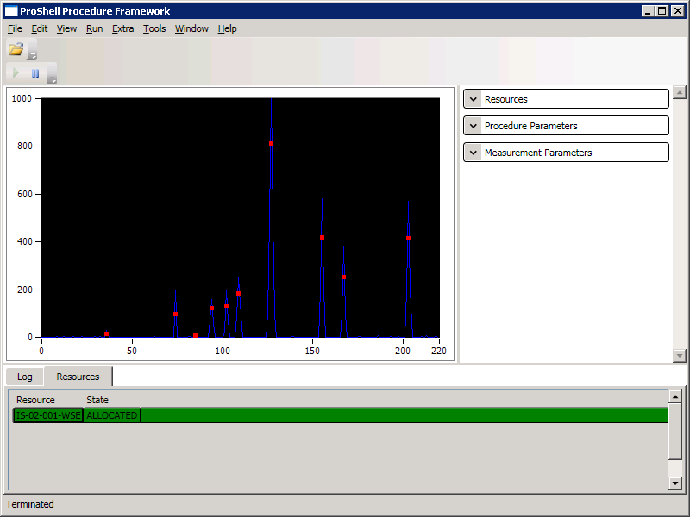
Procedure Finished

Slide 12
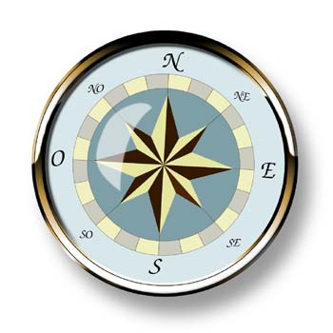
STATUS

Slide 13
Plan since December 2010
Enterprise Architect Model
  Requirements
Implementation
  Complete resource hierarchy
  Dynamic loading of procedures (Cosylab, Sunil Sah)
  Petri Net Editor (Cosylab, Sunil Sah)
  (Eventually Integration PetriNet Visualization)
Procedure example
  e.g. Dummy emittance measurement

Slide 14
Documentation Progress
ProShell Enterprise Architect Model
  Requirements
    Added for external developed components
  Architecture and Design
    Added for external developed components
    Very High level architecture is aligned to implementation

Slide 15
Implementation Progress
ProShell
  Beam spectrum measurement example procedure
  Application configuration
  PetriNet improvements (run, pause, restart, etc.)
  Provide a log4net logging widget (SSA)
Device Hierarchy
  DeviceFactory creates device proxies by name
  Implement PVSS data acquisition interface
  Revised commanding interface
  Implement (basic) device proxies for Power Converter and Faraday cup
  Feedback and stabilization of PVSSProxy

Slide 16
Plan since December 2010
Enterprise Architect Model
  Requirements
Implementation
  Complete resource hierarchy
  Dynamic loading of procedures (Cosylab, Sunil Sah)
  Petri Net Editor (Cosylab, Sunil Sah)
  (Eventually Integration PetriNet Visualization)
Procedure example
  e.g. Dummy beam spectrum measurement
    Slow progress
    Good progress
    Done
    No changes
    Not started
    Basic Example
Notes:
Ahead of Time
- None
In-Time
- Architecture and Design
Behind schedule
Requirements
Implementation

Slide 17
Plan till June 2011
Documentation
  Improve Requirements
  Improve Architecture & Design
  Procedure Developer Manual
  API documentation
Implementation
  Freeze resource hierarchy API
  Complete Petri Net Editor (Cosylab, Sunil Sah)
  PetriNet Loading and Visualization (Cosylab, Sunil Sah)
  Publisher/Subscriber integration
    Main Timing System non-realtime network
    High-bandwidth data acquisition
  Implement Main Timing System device proxy in C#
Notes:
New developer (Mr. Hager) from 1st April onwards

Slide 18
Questions?

Slide 19

ADDITIONAL
SLIDES

