Slide 1
Introduction
Components
Status
Details
AOB
Special Magnets Controls
Status
Tobias Stadlbauer
Special Magnets
MedAustron
30 March 2011

Slide 2

Introduction
Components
Status
Details
AOB
Content
Our components which need to be controlled
What has been done since last MACS Week
What items need to be done until completion
Interesting Details
AOB

Slide 3
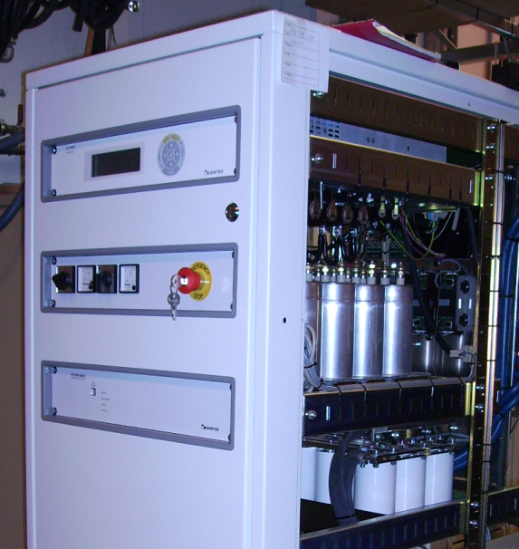
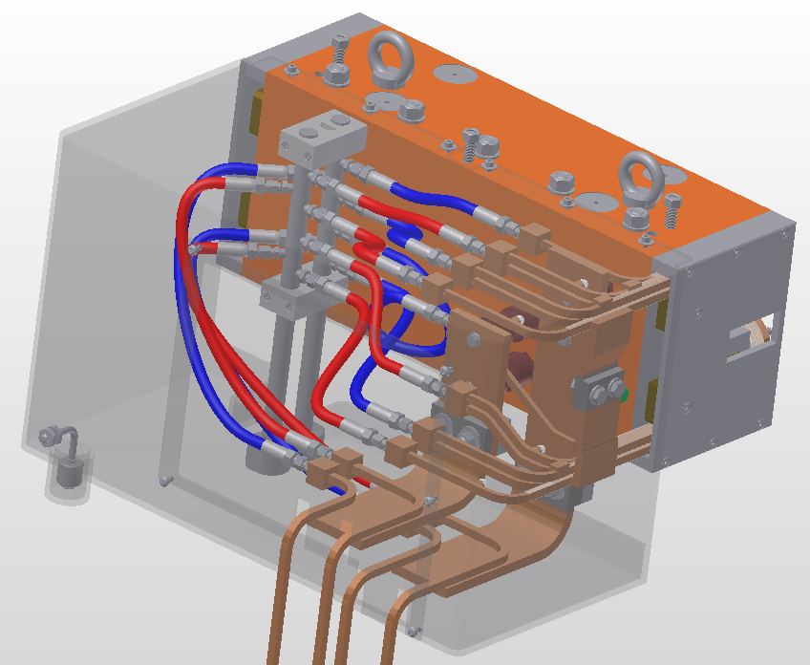
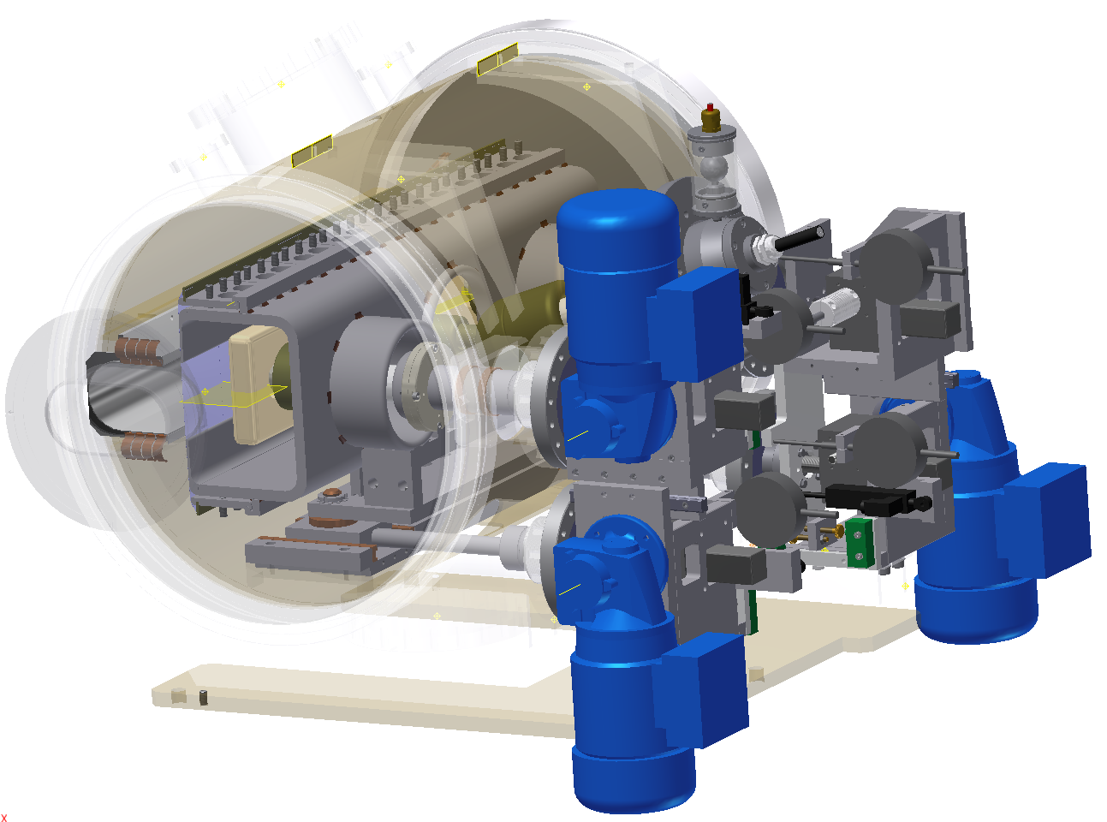
Introduction
Components
Status
Details
AOB
Controlled Components
CNAO model
Power supplies (9):
Set points,
trigger,
state control,
timing
Magnetic Septa and Chopper Dipole (10):
water flow,
water leakage,
coil temperature
Electrostatic Septa (2):
remote displacement system

Slide 4
Introduction
Components
Status
Details
AOB
What has been done since last MACS Week
Common STATUS word between special magnet and normal power supplies and individual FAULT words
State diagram modified to incorporate new BIS interlock transition conditions
Decision for optical triggers to avoid EMI problems of electrical triggers
No PCO FED card tests from WP BTS:
use of direct trigger from MTS over optical fiber thus
no electrical PCO FED trigger used thus no reason for tests
BIS inputs and outputs for our systems are defined and fixed
Tune Kicker Controls defined
Updated Special Magnets Controls Compendium with latest information and comments

Slide 5
Introduction
Components
Status
Details
AOB
What items need to be done until completion (rough)
MKC risk assessment – impact on controls interfaces
Displacement System for electrostatic Septa (PLC)
PLC-System for Water, Temperature Control/Interlock
Fast Deflector power supply controls
RS422 error detection implementation
Upcoming task during production like verification, validation, contract follow up

Slide 6
Introduction
Components
Status
Details
AOB
What items need to be done until completion (detail)
Displacement System for electrostatic Septa (PLC) (0.5 FTE)
  Priority: intermediate
  Manpower: partly covered
PLC-System for Water, Temperature Control/Interlock (0.25 FTE)
  Manpower: partly covered
Fast Deflector Power Supply Controls (0.8 FTE)
  Priority: intermediate
  Manpower: arranged but not delivered yet
RS422 error detection implementation
  Requirements for manufacturer only
  Priority: high
  Manpower: covered
Upcoming task during production like verification, validation, contract follow up (0.2 FTE)
  Priority: currently low, situation will change in summer 2011
  Manpower: partly available
MKC Systems (> 0.5FTE):
  Definition if medical device
Priority: Very high
Manpower: not available
  risk assessment – impact on controls interfaces
Priority: Ultra high
Manpower: not assigned
  Definition of Safety level status
Priority: High
Manpower: only partly covered
  Definition of BDS and MACS interface
Priority: High
Manpower: partly covered

Slide 7
Introduction
Components
Status
Details
AOB
What items need to be done until completion (detail)
Already the listed tasks are not covered by manpower. Any Additional task has to be postponed or postpones scheduled tasks until further resources are committed.
Committed Resources available for Controls Issues 2011:
Tony (CERN): 0.2 FTE (Consultancy, Planning, Management of CERN Resources)
Christoph (CERN): 0.2 FTE (Remote displacement systems only )
Tobias (MA): 0.7 FTE (Development, Planning )
Thomas (MA): overhead
Asked for (but not approved):
0.3 FTE Student
0.5 FTE MA Staff

Slide 8
Introduction
Components
Status
Details
AOB
Universal State Machine for Power Supplies
New transition conditions for BIS inputs

Slide 9
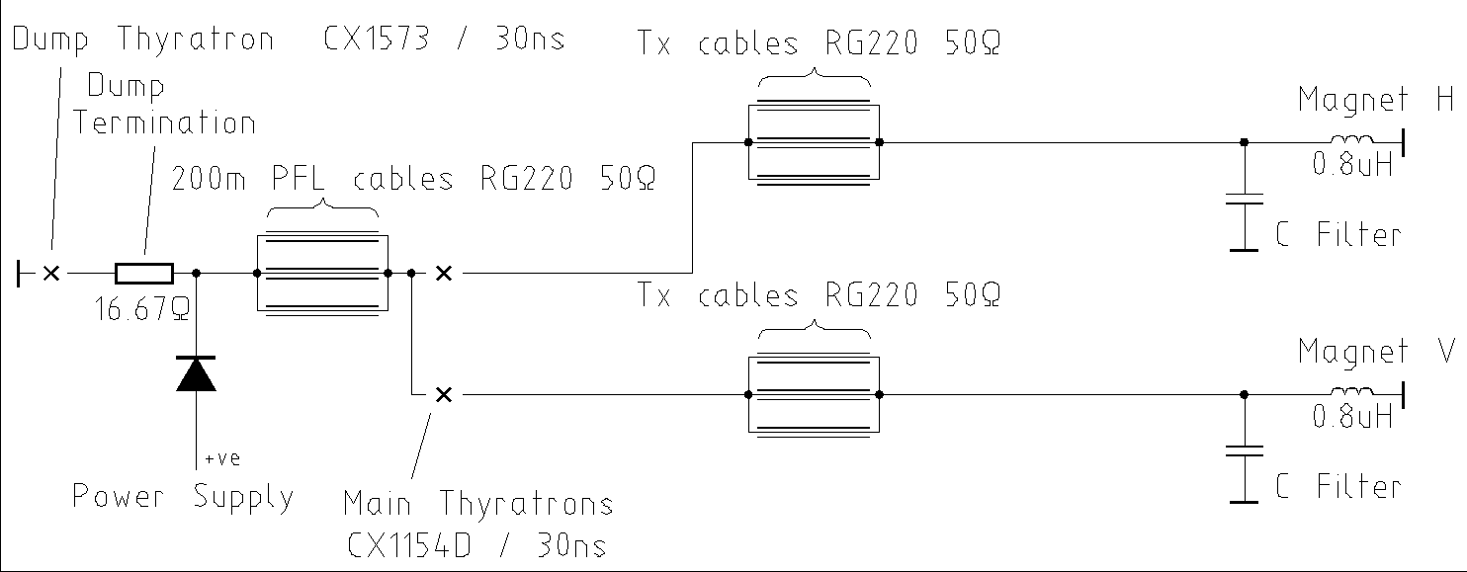
Introduction
Components
Status
Details
AOB
Tune Kicker Power Supply (PKT)
MTR
RF
Control architecture for the Tune Kicker Power Supply (PKT)
Start-Trigger
Stop-Trigger
Pre-Trigger
PKT
Simplified pulse generator circuit
OFF | ? | ?
Selection Horizontal, Vertical
FED
(PCO FED)
Current over Time for the Tune Kicker Magnet
MTV
MTH
Current
Time

Slide 10
Introduction
Components
Status
Details
AOB
Tune Kicker Power Supply (PKT)
MTR
RF
Command STANDBY
Start-Trigger
Stop-Trigger
Pre-Trigger
PKT
STBY | ? | ?
Selection Horizontal, Vertical
FED
(PCO FED)
MTV
MTH
Current
Time

Slide 11
Introduction
Components
Status
Details
AOB
Tune Kicker Power Supply (PKT)
MTR
RF
Command STANDBY
Command Horizontal
Start-Trigger
Stop-Trigger
Pre-Trigger
PKT
STBY | H | ?
Selection Horizontal, Vertical
FED
(PCO FED)
MTV
MTH
Current
Time

Slide 12
Introduction
Components
Status
Details
AOB
Tune Kicker Power Supply (PKT)
MTR
RF
Command STANDBY
Command Horizontal
Download Set point: Current
Start-Trigger
Stop-Trigger
Pre-Trigger
PKT
STBY | H | 2100A
Selection Horizontal, Vertical
FED
(PCO FED)
MTV
MTH
Current
Time

Slide 13
Introduction
Components
Status
Details
AOB
Tune Kicker Power Supply (PKT)
MTR
RF
Command STANDBY
Command Horizontal
Download Set point: Current
Command ON
Start-Trigger
Stop-Trigger
Pre-Trigger
PKT
ON | H | 2100A
Selection Horizontal, Vertical
FED
(PCO FED)
MTV
MTH
Current
Time

Slide 14
Introduction
Components
Status
Details
AOB
Tune Kicker Power Supply (PKT)
MTR
RF
Command STANDBY
Command Horizontal
Download Set point: Current
Command ON
Pre-Trigger
Start-Trigger
Stop-Trigger
Pre-Trigger
PKT
ON | H | 2100A
Selection Horizontal, Vertical
FED
(PCO FED)
MTV
MTH
Current
Time

Slide 15
Introduction
Components
Status
Details
AOB
Tune Kicker Power Supply (PKT)
MTR
RF
Command STANDBY
Command Horizontal
Download Set point: Current
Command ON
Pre-Trigger
Start-Trigger
Start-Trigger
Stop-Trigger
Pre-Trigger
PKT
ON | H | 2100A
Selection Horizontal, Vertical
FED
(PCO FED)
MTV
MTH
Current MTH
Time

Slide 16
Introduction
Components
Status
Details
AOB
Tune Kicker Power Supply (PKT)
MTR
RF
Command STANDBY
Command Horizontal
Download Set point: Current
Command ON
Pre-Trigger
Start-Trigger
Stop-Trigger
Start-Trigger
Stop-Trigger
Pre-Trigger
PKT
ON | H | 2100A
Selection Horizontal, Vertical
FED
(PCO FED)
MTV
MTH
Current MTH
Time

Slide 17
Introduction
Components
Status
Details
AOB
Tendering
Tendering documents for Magnets and Power supplies will be released end March 2011
MKC power supply thereby also the MKC controls are excluded from this tender
Tendering for electrostatic septa power supplies second half of 2011

Slide 18
Introduction
Components
Status
Details
AOB
References
[1] J. Borburgh, M. Barnes, T. Fowler, M. Hourican, T. Kramer. T. Stadlbauer, Special Magnets - Final Design Report, CERN, 2010 (unpublished).
[2] J. Gutleber, R. Moser, MedAustron Control System Architecture and Design Document, MedAustron, ES-1000406-a-JGU.
[3] J. Gutleber, R. Moser, Main Timing System and Signal Distribution Services, MedAustron, unpublished.
[4] J. Borburgh, et al., “MedAustron Special Magnets - WP description”, CERN, Geneva, 2009
[5] M. Marchhart, T.Glatzl “Magnet Slow Control - Requirements”,
MedAustron
[6] T. Fowler, T.Stadlbauer “Special Magnets Controls Compendium”,
ES-110114-a-TST-V0.91

