Slide 1
Injector RF and Synchrotron RF
Present Status, Activities, Plans

Slide 2
Contents
Recap: RF System components
Injector RF System
  Status, Plans, Actions
Synchrotron RF System
  Status, Plans, Actions

Slide 3
Introduction

Slide 4
Recap: Main components of an RF System
cavity
Resonant structure = cavity
  To store energy (in form of EM-field)
  To apply E-field component in beam direction
RF amplifier
  To build up EM-field, i.e. to power the cavity
RF signal generation = LLRF
  Drives the RF amplifier
→ LLRF (Low Level RF; means: low signal level)
Consists of closed loop controls,
to ensure HW performance
and beam stability/reproduceability
1
2
LLRF
3

Slide 5
Work package RF
Resonant Structures
RF Amplifier
Injector RF
MACS
RF Feedback Loops
Accelerator
Resonant Structures
Synchrotron RF
RF Amplifier
MACS
RF Feedback Loops

Slide 6
Injector RF

Slide 7
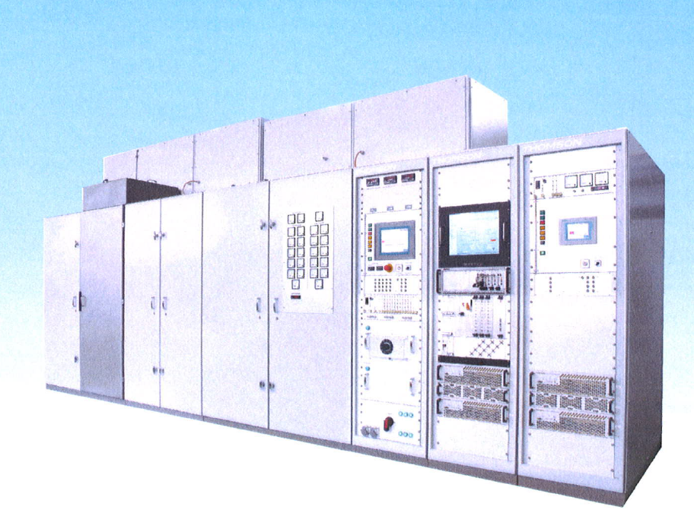
1500 kW RF amplifier (pulsed)

Slide 8
Injector RF – Present Status
Two-stage negotiated tendering procedure completed:
  Thomson Broadcast AG, Turgi (CH)
Thomson implementation of Tube amplifiers & LLRF started:
  1500 kW pulsed RF, PLC Simatic S7-400 (IH)
  250 kW pulsed RF amplifier, PLC Simatic S7-400(RFQ)
  digital LLRF regulation sets consisting of
    single board computer (access via Tine Framework)
    RF front-end electronics
    digital signal processing (FPGA)

Slide 9
Injector RF – Plans
Complete requirements document (these days)
On-site tests (~1-2 weeks, close to Zürich)
Install and run LLRF “CERN” – Mid 2011
Delivery of RFQ amplifier for ITS – November 30th, 2011
  Run ITS at CERN (LLRF “CERN”)
Delivery of IH amplifier to Wiener Neustadt – August 31st, 2012 (at the earliest)
  RF conditioning of IH tank (LLRF “WN”)
Ship CERN equipment to Wiener Neustadt - End 2012
  Merge LLRF “CERN” and LLRF “WN”,
  Run Injector for RF conditioning/commissioning

Slide 10
Injector RF – Actions (since last MACS week)
Contract Signature with Supplier Thomson
CS Requirements Document, WP CO
Ordering of Solid-State amplifiers (2x10 kW) with a dedicated tendering procedure:
Control System-Integration
Define on-site tests (Proposals by CERN, supplier, WP-CO)
Prepare LLRF “CERN” (37-R-023, ITS)
Prepare ITS (acceptance tests, terminated/resonant load, RF conditioning, operation with beam)
DONE
Short term
Mid term
Long term
Color Coding used: DONE, PENDING, URGENT/DELAYED, Unknown

Slide 11
Synchrotron RF

Slide 12
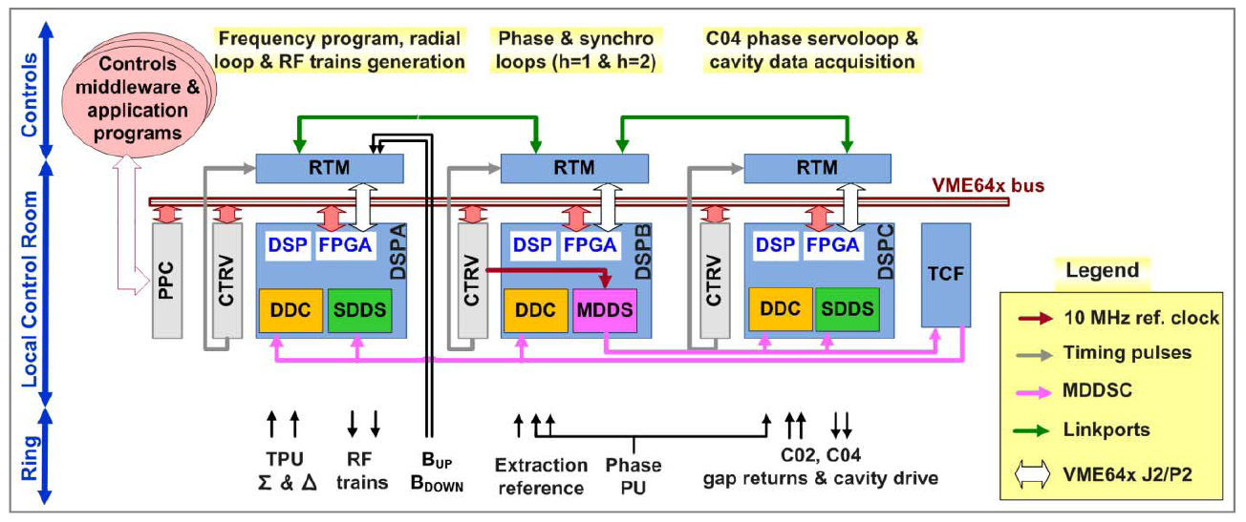
PSB-LLRF: System Overview
Taken from: Maria Elena Angoletta, CERN’S PS BOOSTER LLRF RENOVATION PLANS AND INITIAL BEAM TESTS, CERN-ATS-2010-198,

Slide 13
Synchrotron RF – Present Status
Collaboration Agreement between CERN RF-group and MedAustron finalized
  Sychrotron LLRF (fully digital)
  RF cavity (newly developed)
  RF amplifier (1kW, existing design)
Re-Evaluation of schedule required:
  HW development
  Firmware implementation
  LLRF tests with beam in the CERN PS-Booster

Slide 14
Synchrotron RF – Plans
Requirements Document
  Fall 2011
  WP-RF (possibly with help of WP-CO?)
Develop LLRF prototype
  Fall 2011 Now: End 2011
  For beam tests @CERN using CERN infrastructure Spring 2012
LLRF series production
  Spring 2012 Now: Summer 2012
  MACS integration – 2012 (TBD)
Overall system tests
  LLRF+cavity+amplifer – Fall 2012

Slide 15
Synchrotron RF – Actions
Finalize Collaboration Agreement (RF group)
Agree on schedule (with RF-group)
Requirements Document, WP CO
Prepare LLRF tests for spring 2012, CERN
System integration tests (LLRF)
DONE
Short term
Mid term
Long term
Color Coding used: DONE, PENDING, URGENT/DELAYED, Unknown

Slide 16
THank you!

