Slide 1
SIMATIC WinCC OA Developments
Synoptics EWO and ftp control extention

Slide 2


SIMATIC WinCC OA?
WinCC OA is our SCADA tool
I thought they are using PVSS as SCADA tool.
Why are they jumping now to a different product?
WinCC OA is the new name for PVSS

Slide 3
3D Synoptics Widget
External Widget Object (EWO) to load and render 3D models in WinCC OA panels using Qt and Open Cascade libraries
Loading of STEP files (.stp)
Interact with the EWO through:
  Mouse (select, rotate, zoom, pan, etc…)
  API (set colors, zoom to element, get all element IDs, get selected element ID, select 2D/3D view, etc…)

Slide 4
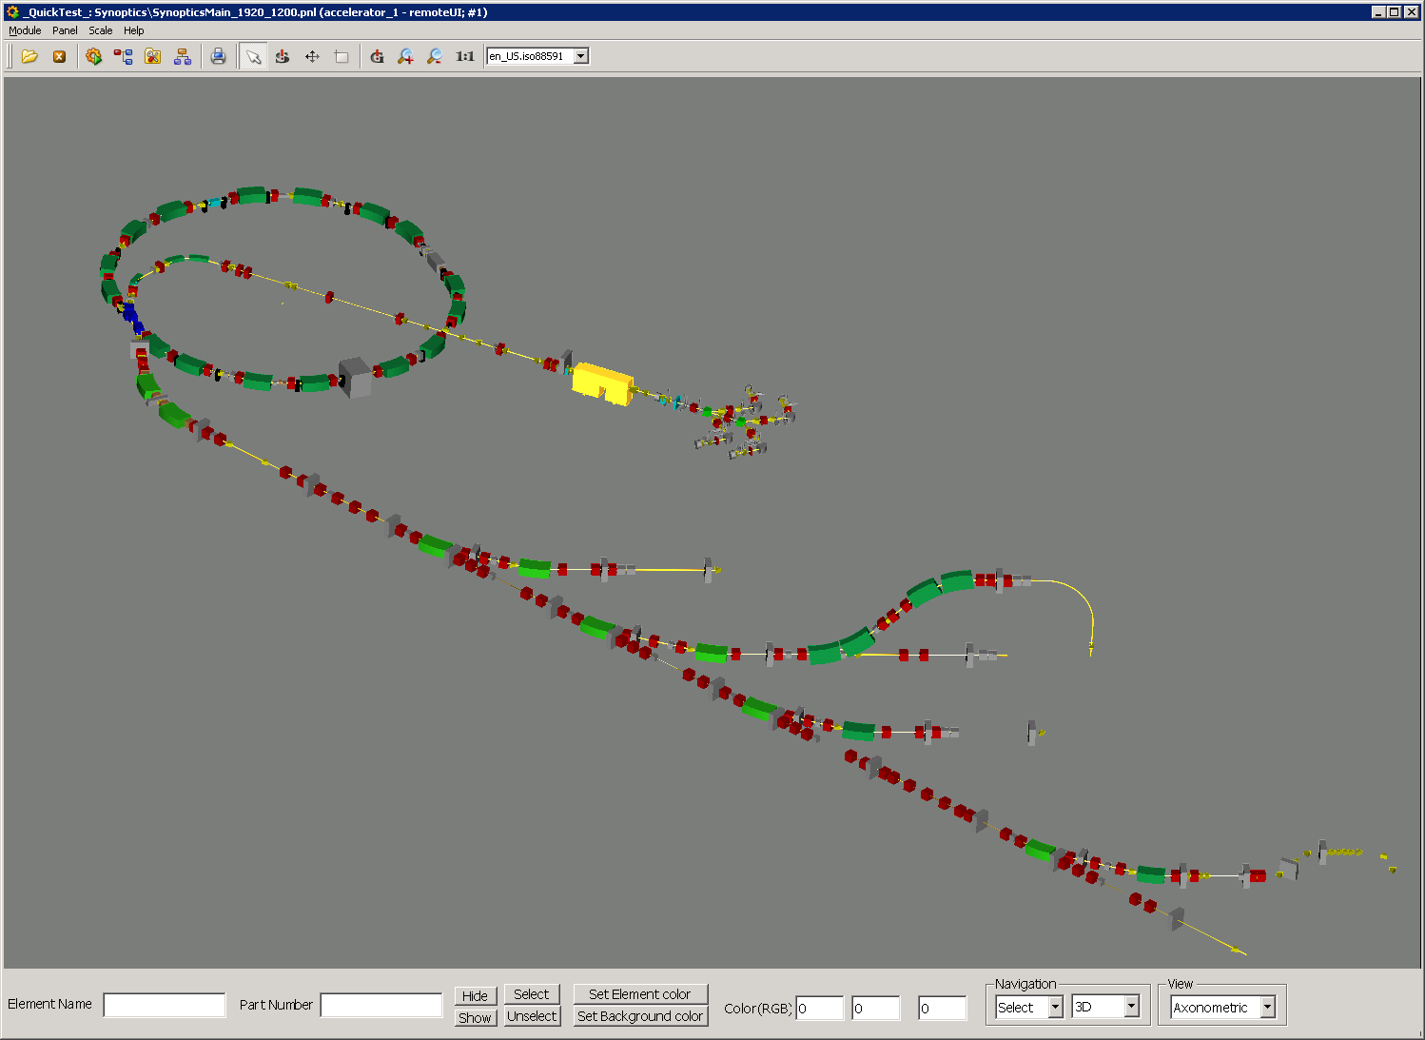
Example Panel

Slide 5
FTP extension
Dynamic Link Library to extend WinCC OA with ftp functionality
Provides high level APIs
  ftpUpload()
  ftpDownload()
  downloadFromURL()
Low level APIs
  ftpSessionStart() / ftpSessionClose()
  ftpSessionUpLoad / ftpSessionDowload()
  Etc…

Slide 6
Planned developments
Synoptic panel for the Navigator using the synoptic EWO
Panel for working sets and virtual accelerators
Panel for ftp file up and download using the control extension library

