Slide 1

XML Device Description

Slide 2

MACS configuration chain
XML documents for device definition
Database filled from XML documents
Configuration created in RMS
Configuration exported to configuration files
Configuration files are read by the individual systems
MACS
XML
File
RMS
DB
config
files
Importer
Exporter

Slide 3
Device Description Documents
Word Document
  Purpose
  Interfaces
  Operations model (how to operate the device)
  etc…
XML Document
  Device class definition
  Attribute definition
  Definition of instances
  Default value definition
  etc…

Slide 4
XML Document
Document header
  Document title
  Document number
  Author
  Data of creation
  Abstract
  Document dependency (optional)
Document body
  Device class definition
  Device instantiation
  Instance value definition

Slide 5
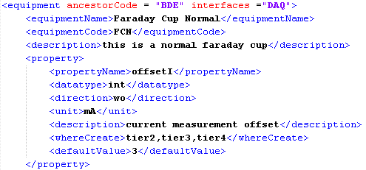
Device class definition
Inheritance and interfaces
Class name and three letter code
Description
Properties

Slide 6
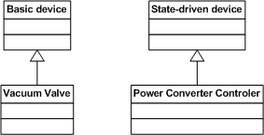
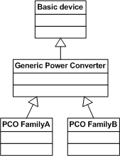
Inheritance
Device class can inherit directly from basic device or state-driven device
Device class can inherit from a intermediate class

Slide 7
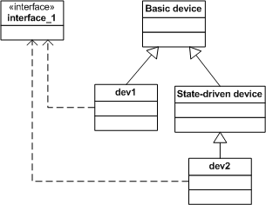
Interfaces
Devices can implement interfaces

Slide 8
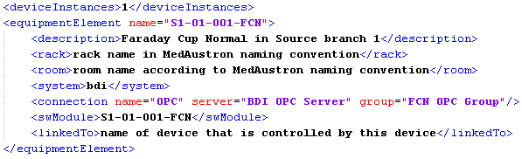
Device instantiation
Number of instances
Instance name and description
Rack and Room (optional)
WinCC OA system and connection
Software Module and controlled devices (optional)

Slide 9
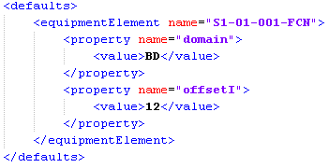
  Instance value definition
Define property values for each particular instance

Slide 10
Status
Description and template documents are available under:
https://svn.cern.ch/reps/macs/trunk/sdp/documents/Deployment/Configuration/ControlSystem/GenericDevice/doc
A workshop on how to write device description documents is scheduled on 30.03.2011

