Slide 1
RMS Status
What we can do and what is missing

Slide 2
Definition of general system information
Machines / Rooms / Racks
CPUs
Crates / Interface cards
PLCs / Interface modules / Polling groups
Software modules
OPC Server / OPC groups
WinCC OA Systems
Panels
Cycle Codes (Masks&Filters)

Slide 3
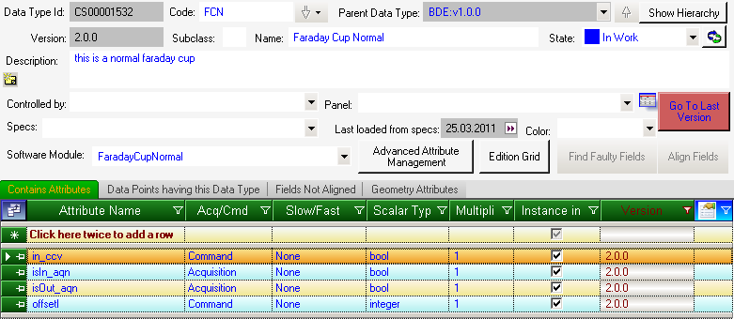
Definition of data types
Device class definition

Slide 4
Versions and States
Each data type/data point/Working Set/Virtual Accelerator can exist in multiple versions
Each version can be in one out of three states:
  In work (one version at a time, modifiable)
  Released (one version at a time, not modifiable)
  Deprecated (multiple versions at a time, not modifiable)
in work
released
deprecated

Slide 5
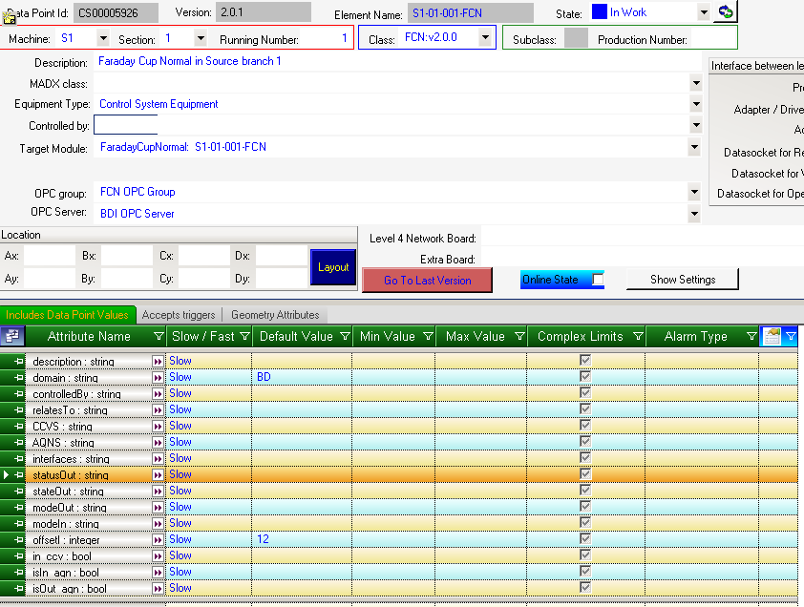
Definition of data points
Device class instantiation

Slide 6
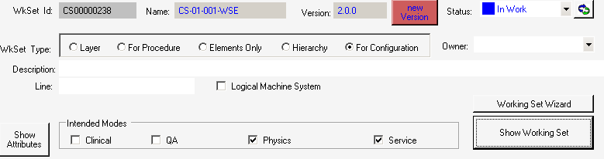
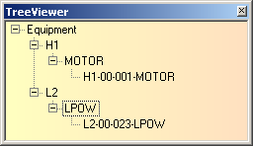
Definition of working sets
Set of devices

Slide 7
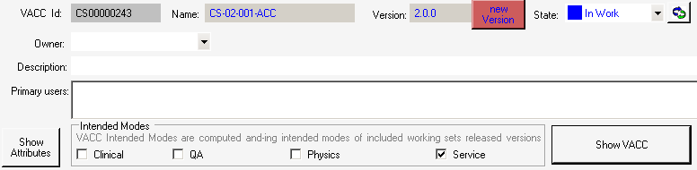

Definition of virtual accelerators
Set of working sets

Slide 8
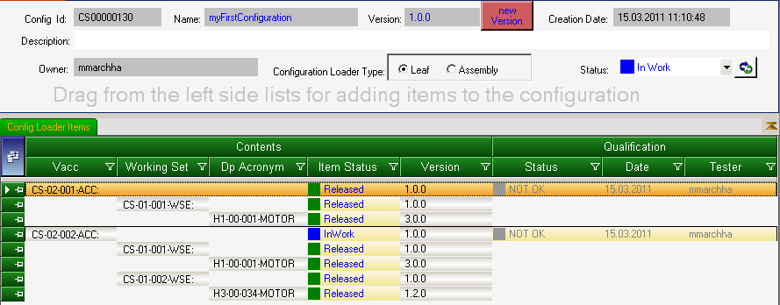
Definition of configuration
Virtual Accelerators
Working Sets
Devices

Slide 9
Steps to do from 0→Configuration
Definition of the general system Information
Definition of device classes
Definition of device instances
Working Set definition
Virtual Accelerator definition
Create configuration

Slide 10
What is missing
Navigator Panel Manager
  Define available panels
  Define panel tree
Wave form builder (first version delivered)
Sequence builder (for building timing sequences)

