Slide 1
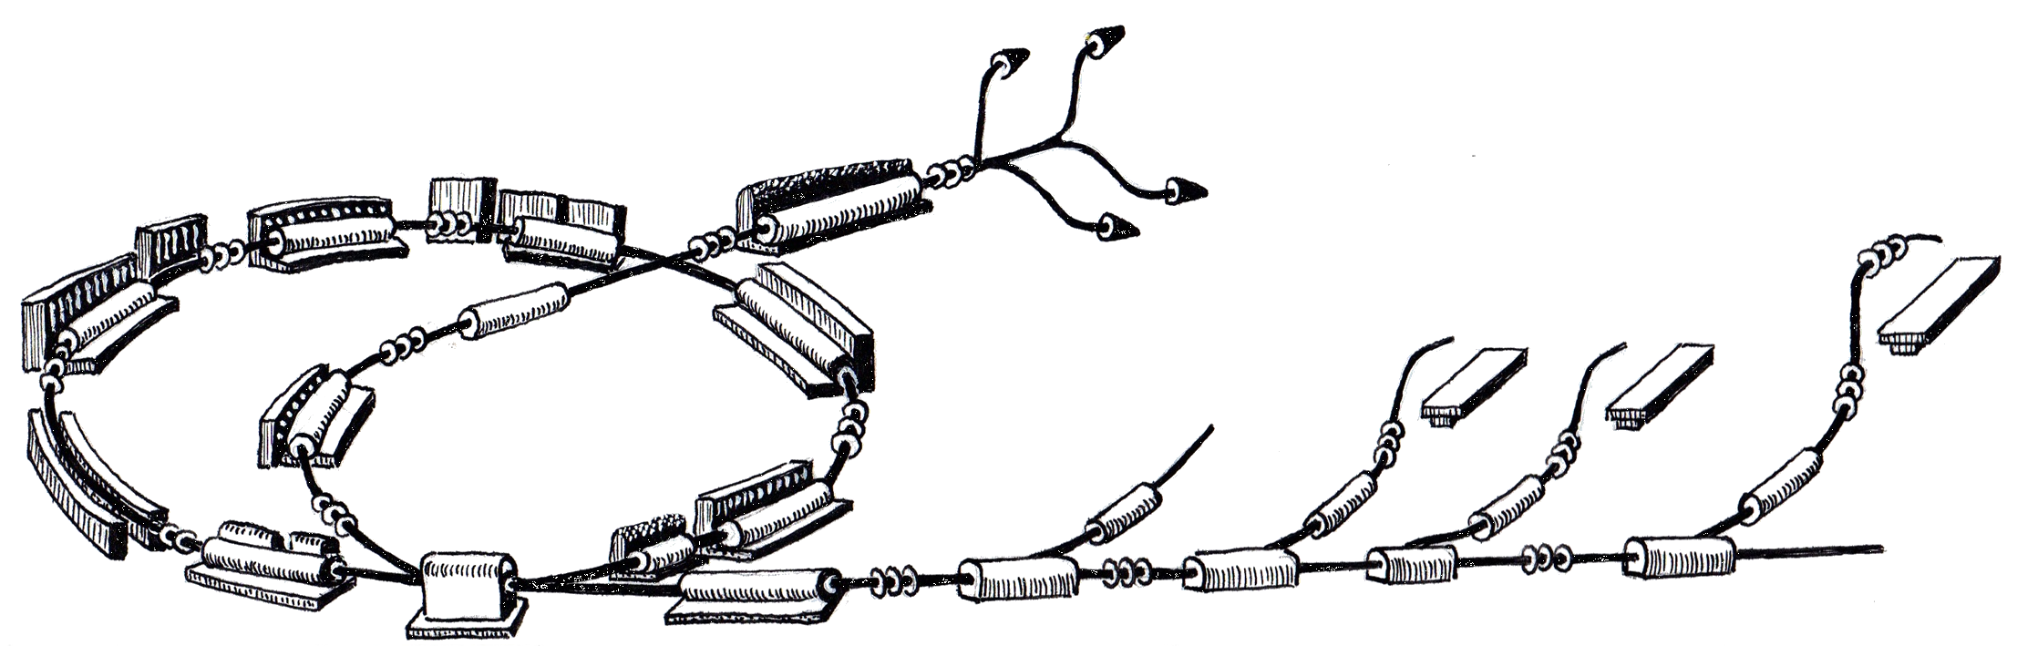
Injector RF Control System Status
MedAustron Control System Week 1
March 28th, 2011
Roland Moser
R. Gutleber

Slide 2
Scope
Architecture Overview
Current status
  What was achieved since December 2010
  Plan till June 2011
Summary

Slide 3

OVERVIEW

Slide 4
Injector RF Integration
Configure the Injector RF system remotely
Trigger pulses via the Main Timing System
Report status information
Provide detailed error information
Configure, retrieve and display measurements

Slide 5
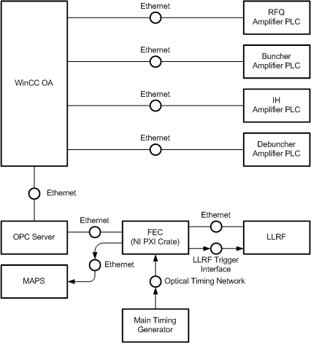
Deployment View

Slide 6
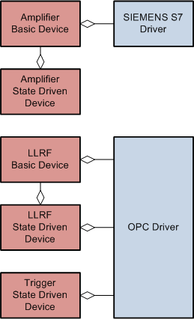
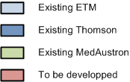
WinCC OA Data Point Representation
For each amplifier (RFQ, BU, IH, Debuncher)
  Basic device mirroring the PLC memory map
  State driven device providing the uniform commanding interface
For each LLRF subsystem (RFQ, BU, IH, Debuncher)
  Basic device mirroring the LLRF memory map
  State driven device providing the uniform commanding and measurement interface
A single Trigger State driven device
  configure the main timing receiver card to forward LINAC Duty and Stability to the LLRF trigger interface.

Slide 7
Software Integration
Amplifier State Driven Devices will be implemented as WinCC OA scripts
LLRF Basic and State Driven Devices will be implemented as FECOS components
Trigger State Driven Device will be implemented as FECOS component
All FECOS components
  run on National Instruments Labview (Realtime) 2010
  are installed on National Instruments PXI crate

Slide 8
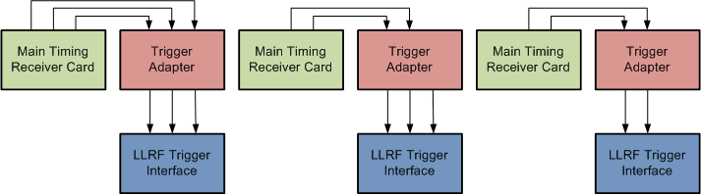
Hardware Integration
LLRF Trigger interface expects 3 signals
  LINAC Duty pulse
  Stability pulse
  1 MHz pulse (detect if trigger interface works as expected)
Trigger adapter converts trigger signals to the LLRF trigger interface
  Option 1 – MTR generates 1 MHz signal
  Option 2 – Trigger adapter generates 1 MHz signal
  Option 3 – Ask Thomson to disable trigger interface failure detection

Slide 9

STATUS

Slide 10
Plan since December 2010
Enterprise Architect Model
  Requirements
  Architecture and Design
Implementation
  Start Implementation in beginning of March
    Finished, not approved
    Initial draft
    Delayed
Notes:
Ahead of Time
- None
In-Time
- Requirements
Behind schedule
Architecture and Design
Implementation

Slide 11
Plan till June 2011
Documentation
  Formally approve Requirements
  Finish and review Architecture & Design
Implementation
  Agree on a timeplan with CSL and WP:RF
    Planned meeting Tuesday, 29th March 2011 with CSL and WP:RF
Notes:
Prototype of Trigger Adapter
LLRF integration through FECOS component

Slide 12
Open Issues
Which option to choose for trigger interface integration?
Does the existing TINE library work on Labview Realtime?
  Fallback solution: Labview on Non-realtime target
Who will do the Amplifier PLC integration?
Who will define acceptance tests for the Injector RF Control System integration?
Follow-up LLRF Extensions to be implemented by Thomson
  Stepping motor interface must be disabled when in remote mode
  Measurement extensions for tagging (RF-A-13)
    Current LLRF does not allow to tag measurements based on STAB pulses
  PLC Summary field organization (RF-A-8)
  (disable RF trigger interface watchdog functionality)

Slide 13
Questions?

Slide 14

ADDITIONAL
SLIDES

