Slide 1
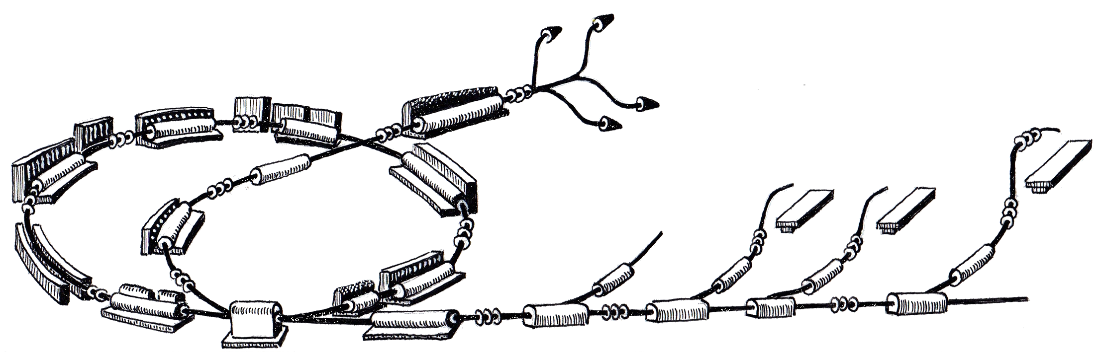
WP CO
Status and Schedule for 2011
March 28th, 2011
Johannes Gutleber
R. Gutleber

Slide 2
Summary
Development is advancing well with resources
No contingency in schedule
Continuous integration has highest priority

Slide 3

Brainpower
February, Mr. Pavetits
  Safety related automation technology (BIS)
April: Mr. Hager
  software development ProShell, integration physics code
January, Mr. Mindaugas (consultancy)
  Qt C++ developments for WinCC OA
May: Mr. Schokker and Mr. Olaf (both PSI)
  Coordination of beam delivery system

Slide 4
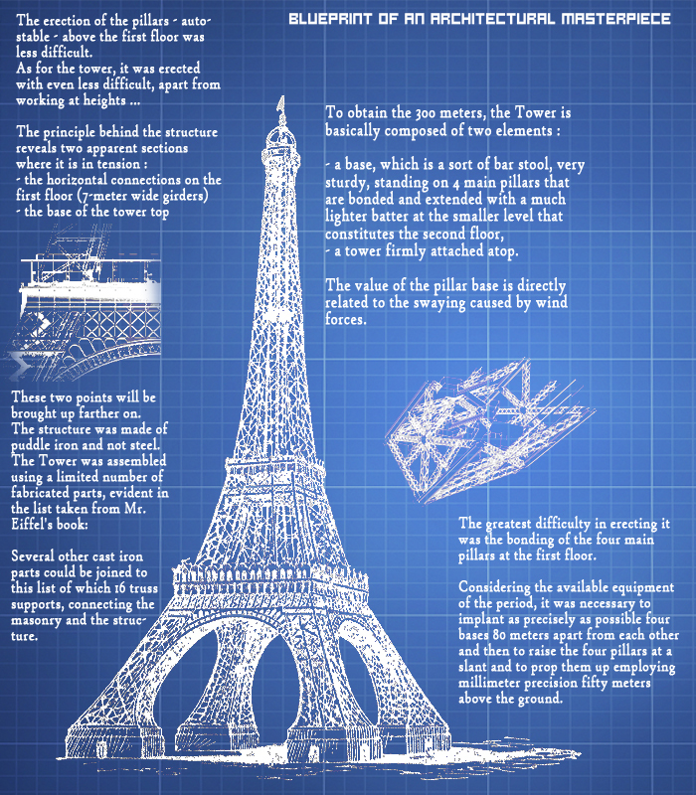
Architecture

Slide 5
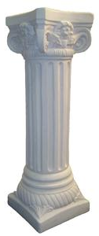
Architecture
Presentation tier (1)
Processing tier (2)
Equipment tier (3)
Frontend tier (4)

Slide 6
Architecture
Presentation tier (1)
WinCC OA
  Panels, Qt plugins, NI DataStudio widgets (Active X or Qt)
C# Applications
  WPF, NI DataStudio widgets (WinForms)
Web
  HTML pages with forms
  Adobe Flash (Flex, AIR) or Labview in future
Processing tier (2)
Equipment tier (3)
Frontend tier (4)

Slide 7
Architecture
Presentation tier (1)
RDP with seamless windows
WinCC proprietary (TCP/IP)
HTTP
Processing tier (2)
Equipment tier (3)
Frontend tier (4)

Slide 8
Architecture
Presentation tier (1)
VWWare
WinCC OA,
  Ctrl state-machines,
  VAC, beam stopper, special magnet device components
MAPS, VAA, ProShell,
RMS, RMS importer/exporter,
Web server, configuration files
NI and Matrikon OPC
Processing tier (2)
Equipment tier (3)
Frontend tier (4)

Slide 9
Architecture
Presentation tier (1)
OPC
HTTP
FTP
NI/STM based SIM and MAPS
Tine TCP/IP for iLLRF
S7 over TCP/IP for SafetyMatrix and iAmplifiers
Processing tier (2)
Equipment tier (3)
Frontend tier (4)

Slide 10
Architecture
Presentation tier (1)
FECOS
FECOS based applications
  PCC, MTG, MTR, iLLRF, sLLRF, SRC,
REDNet
SafetyMatrix
SADS
Processing tier (2)
Equipment tier (3)
Frontend tier (4)

Slide 11
Architecture
Presentation tier (1)
PCC FlexRIO – SFP – FED with UHPI bus protocol vs. CRB
Profibus,
RS422,
Ethernet,
HFBR trigger lines,
custom electrical trigger lines
Processing tier (2)
Equipment tier (3)
Frontend tier (4)

Slide 12
Architecture
Presentation tier (1)
Sources,
Power converters,
injector LLRF and amplifiers,
Synchrotron LLRF,
Special mag. power converters,
Special mag. slow control
Conventional magnets,
Beam stoppers,
Beam diagnostics devices,
Vacuum devices
Processing tier (2)
Equipment tier (3)
Frontend tier (4)

Slide 13

Status

Slide 14
What we have
Completed and frozen frozen architecture
MTS real-time event distribution transport layer
PCC real-time links, custom hardware
FECOS core and documentation (RT programming framework)
PVSS/C# integrated
Virtual Accelerator Allocator implemented to large extent
Generic GUIs (FrontPanel, ScratchPad, Synoptics) core
PVSS script libraries for state-driven devices
ProShell architecture and code skeleton
RMS adapted 60% - to be finished by summer 2011
RMS exporter for PVSS, XML importer minimal functionality

Slide 15
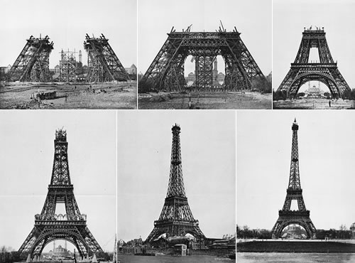
Project
Schedule

Slide 16
Roadmap Towards Commissioning
12/2010
Column demo
09/2011 ITS intermediary release
12/2011 Continuous integration
06/2012 Pre-release
07/2012 Start IT installation
12/2012 Functional release
10/2012 Start CO installation
03/2013 Commissioning
2010
2011
2012
2013
2014

Slide 17
Planning 2011
Cosylab
  CWO-3 running until July 2011
  Planning for CWO-4 (12/2011) must be concluded by June 2011!
Working sessions on schedule with WPs for 2011
  SRC, VAC, PO, INJ/RF done
  Building infrastructure, IT done
  Agreement on principle of development with BD
Remain to be defined for 2012
  BTS, Sync/RF, BD, BID, RP, operations, integration
  Interface medical systems
  what else? – please get in contact!

Slide 18
Cosylab Coverage 2011
Finalize MTS including peripherals (e.g. GPS, LLRF)
Finalize PCC, family A and CRB integration
Develop Ion Source control system
Integrate Injector LLRF
Revise all in-house hardware, production and test
Design SADS
Develop communication libraries
Develop isolated C# components for ProShell
Develop crate bootstrapping and deployment mechanisms
Carry out performance studies
Prepare Bills of Materials required for procurement

Slide 19
Primary Goals 2011
Continuous integration of column
Main Timing System fully operational
PCC fully operational with family A
FED revised and ready for production
Ion source control system operational
Injector LLRF & amplifiers integrated
Vacuum control system operational and integrated
ProShell core complete
BIS design & technology evaluation finished
BIS first set of chains implemented
RMS importer/exporter complete and in use
Dummy BDS and VAA operation chain implemented

Slide 20
Secondary Goals 2011
Graphical user interfaces
BDS interface specification
RMS device specifications
BIS interlock chain identification and specification
Integration of vacuum control
Integration of CRB
Special magnets interface specifications
Definition of configuration scheme
Implementation of configuration scheme
XML + Word device specifications

Slide 21
Support Work
Configuration Management
  Improvement of infrastructure
  Automated documentation tree
ITS assistance
  Provision of virtual machine, WinCC OA ensured
  Provision of FECOS ensured
IT infrastructure finalization and tendering
  Tendering starts May 13, 2011
  Contract award by december 2011
Risk analysis concerning particle accelerator
  Limited to what is required for BIS design and definition
  Safety requirements with respect to building integration

Slide 22

Summary and outlook

Slide 23
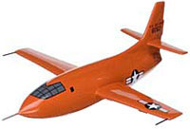
Integration Weeks (iWeek)
Validate components and concepts continuously!
Learn using our system!
Identify gaps!
Run the system!
Test Pilot
Accelerator and its control
system are like a new plane…
… we have to learn to fly it!

Slide 24
Organization of iWeeks
One week at distance of about five weeks
  Step-by-step integrate all available components
  Operate vertical column (tier 1 to tier 3)
Planning and Execution
  Plan prepared and communicated to entire team
  Integration carried out by core team at CERN
  Results are documented in a record and communicated
  Results must be be taken into consideration for developments

Slide 25
iWeeks 2011
7
4
2
5
1
3
6
25

Slide 26
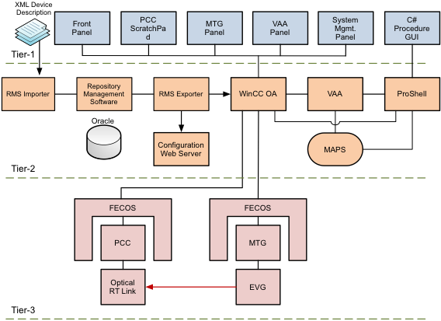
Column

