Slide 1
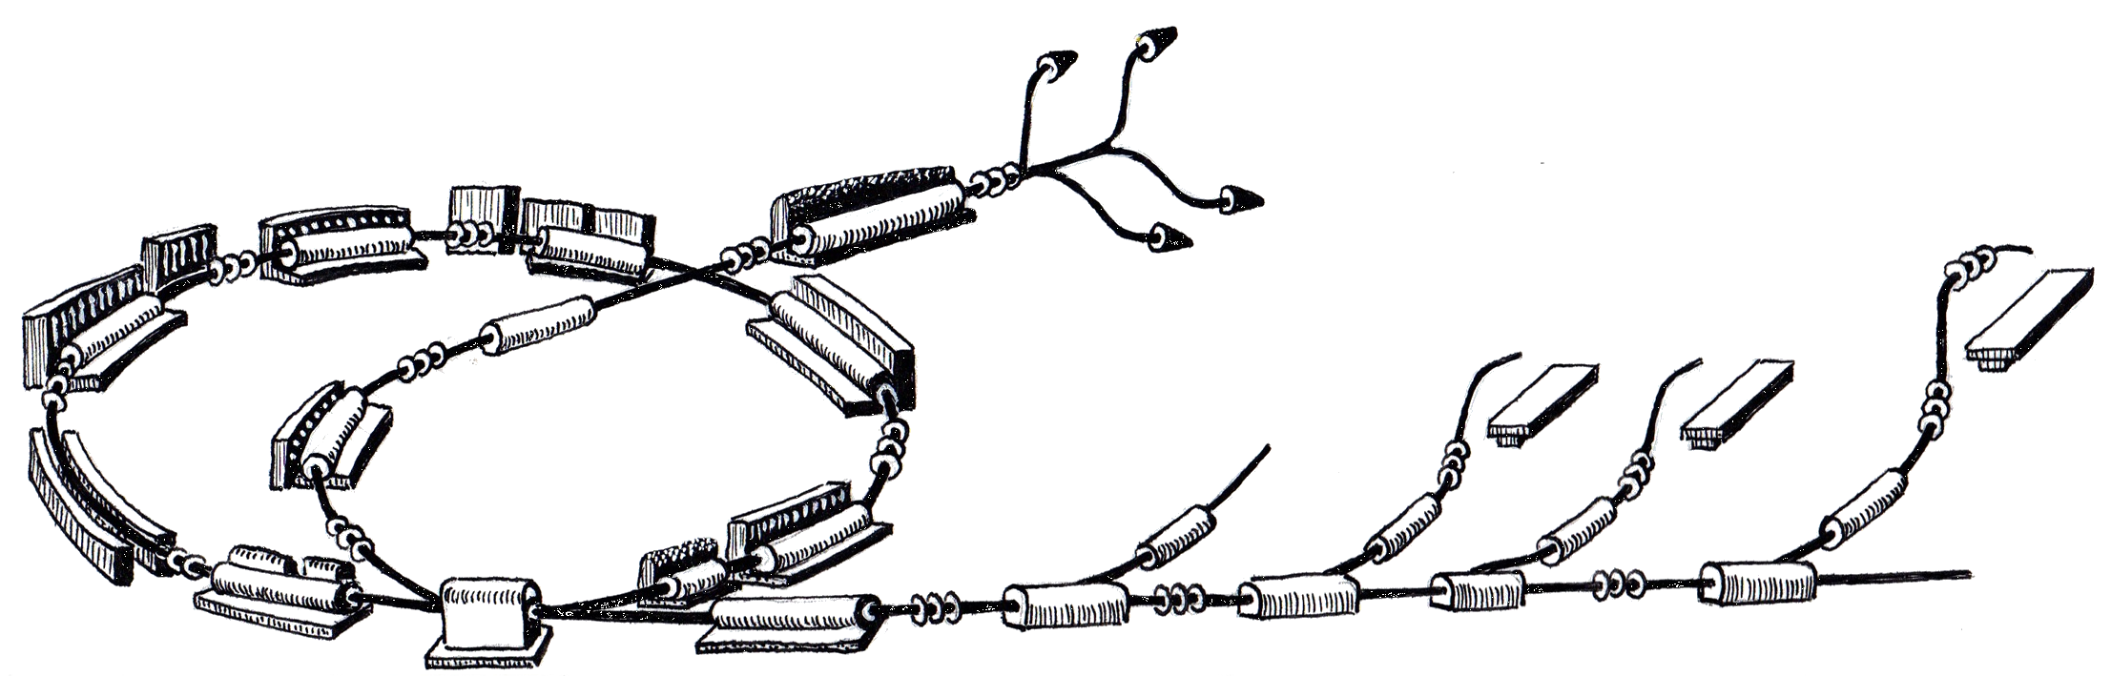
Beam Interlock System
Technology Evaluation and Design
MACS Week 1, 2011
Hannes Pavetits
R. Gutleber

Slide 2
Overview
Concepts
  Risk Management
  From FMEA to interlockchains
Design
  Purpose of the BIS
  Scope of the BIS
  Hardware / Software
  Safety-Matrix tool
  Defined Safety-Matrices
Status

Slide 3
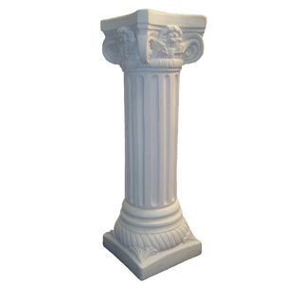
CONCEPTS

Slide 4


Risk Management
Identify, characterize, and assess threats
Assess the vulnerability to the specific threats and determine the risk
Identify ways to reduce those risks
Prioritize and apply risk reduction measures based on a strategy
! The BIS is the LAST resort !

Slide 5
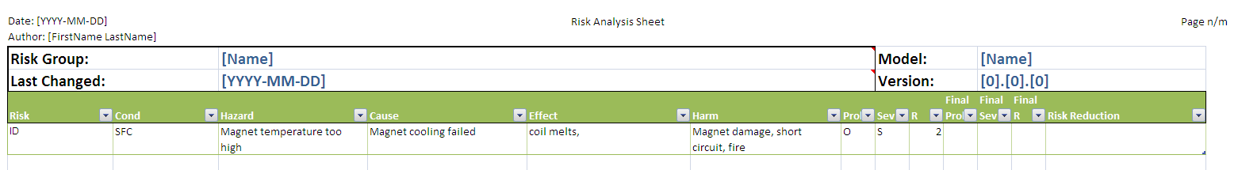
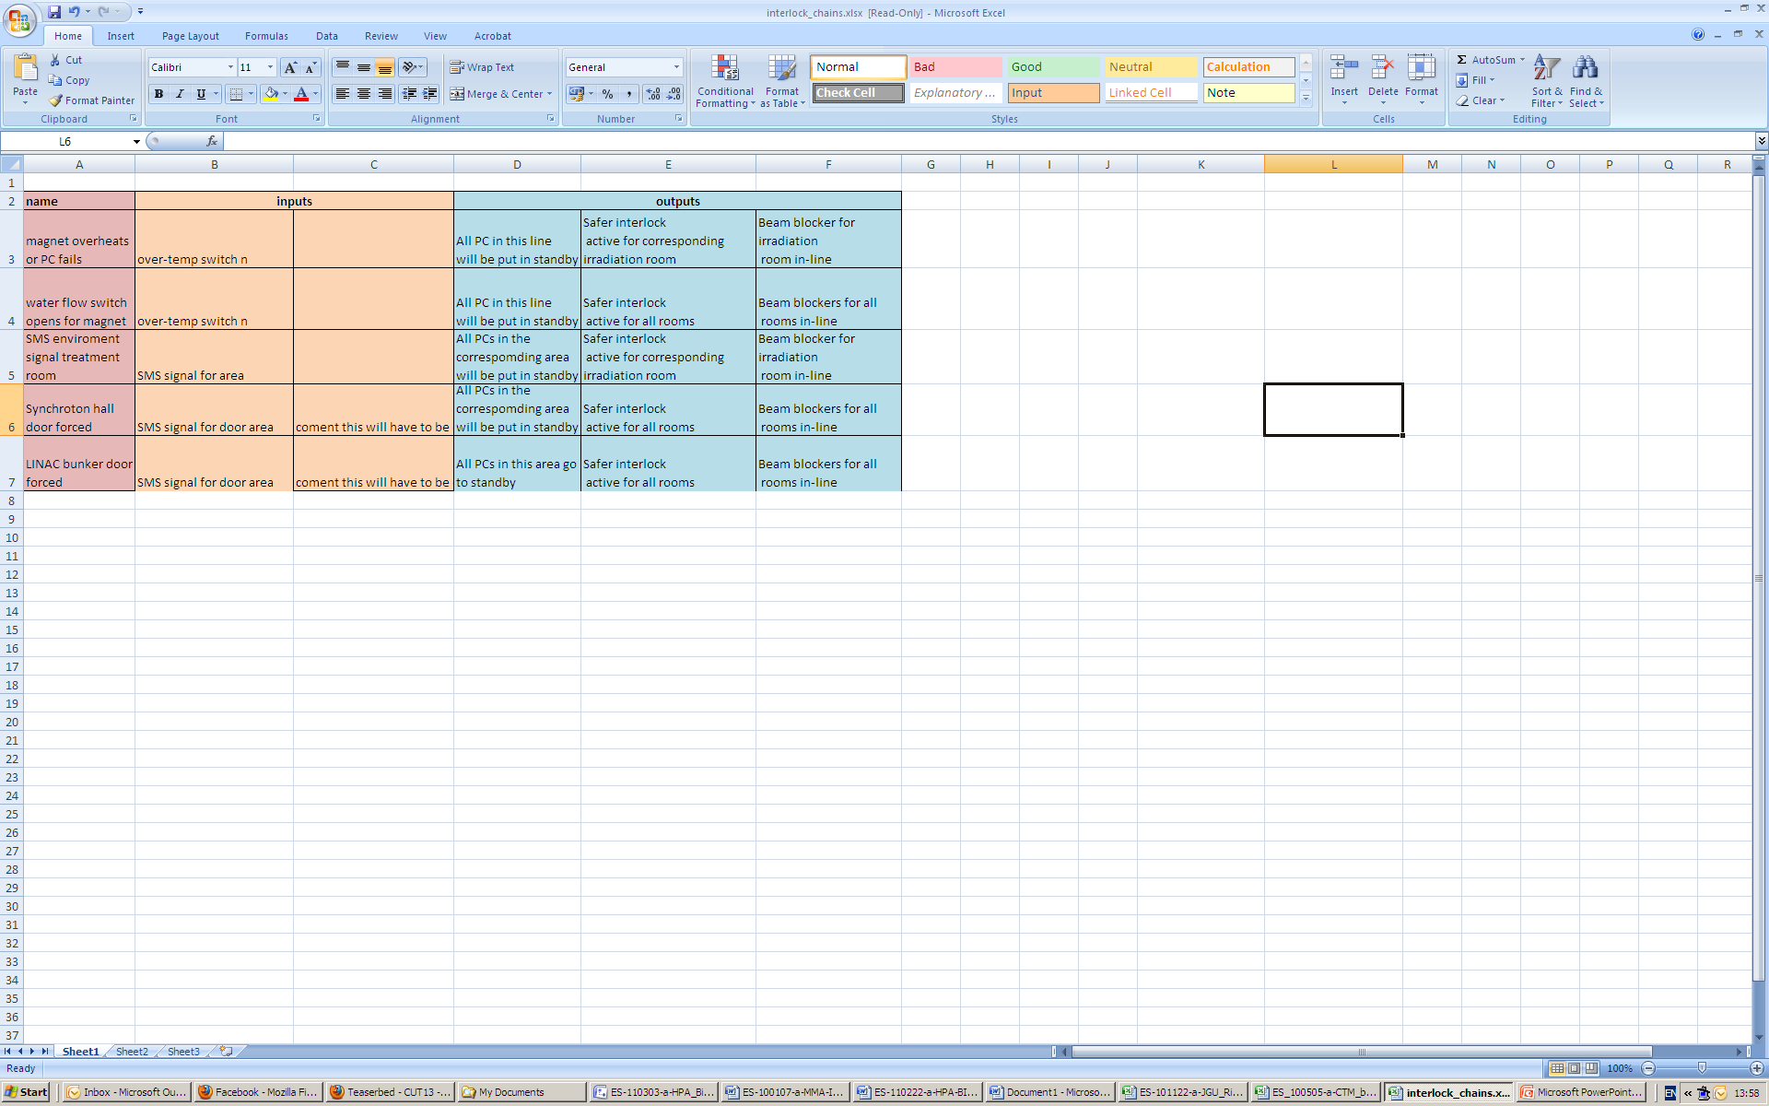
From FMEA to Interlockchains

Slide 6

Beam Interlock System Design

Slide 7
Goals of the BIS
Protect machine components from damage
  Due to conflicting commands
Reduce risk for persons to be harmed
  Due to conflicting commands intended for beam generation
The scope of the BIS is to act as a
functional safety mechanism
for the particle accelerator

Slide 8
What it is not
Protect patients from beams that deviate from expected characteristics
Protect people from hazards that do not originate from the particle accelerator

Slide 9
Sensors and Actuators

Slide 10

Characteristics
Reaction time
  Order of “cycle” times
  Faster than human
  Slower than dedicated safety systems
Orthogonal to the other systems
Interconnects subsystems to achieve safety behaviour
Prevention of the next beam cycle

Slide 11
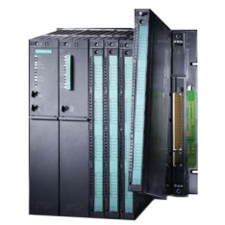
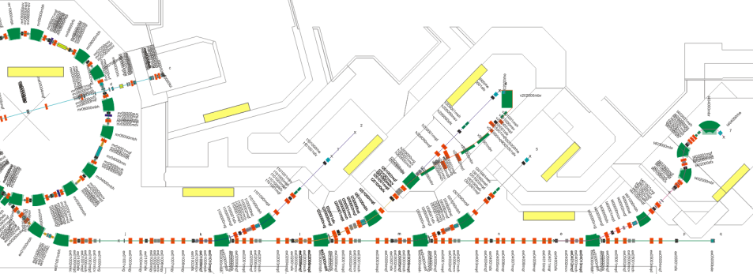
Hardware / Software
Siemens PLCs And Safety I/O Modules
  Reliable, flexible and scalable
Profibus I/O network
Distributed I/O Modules
to interconnect racks
Siemens Simatic Safety Matrix
Table based interface
Cause & effect method

Slide 12
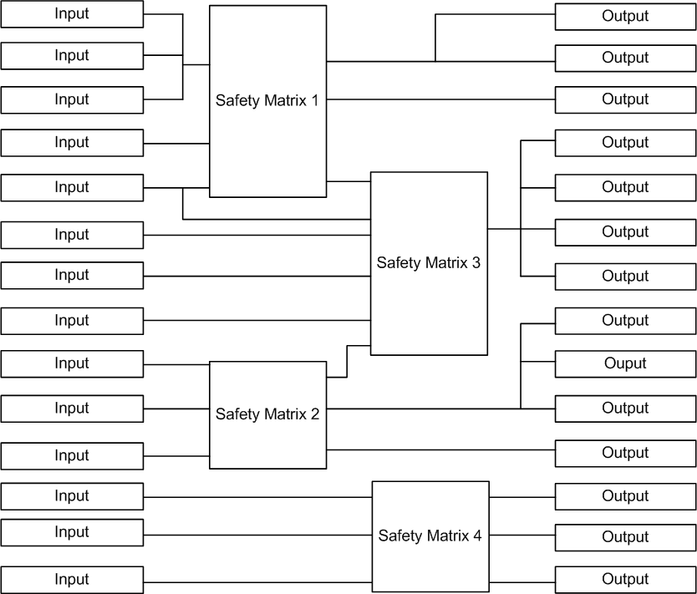
Safety-Matrix Tool
Multiple matrices possible
At most 128 causes and 128 effects per Matrix
Outputs cannot be shared by matrices

Slide 13
Defined Matrices
Emergency Inputs
Emergency buttons
SMS
PCS
RP
...
PCO / Magnets
Srcs + LEBT
Shared Inputs
Other matrices
RF
Vacuum
Beam stoppers
PCO / Magnets
LINAC + MEBT
PCO / Magnets
MR + EX
Emergency
devices
Shared
Outputs
Emergency Outputs
“Hard interlock” PCO’s
Other matrices
PCO / Magnets
EX
Shared Outputs
Beam stoppers
Srcs
RF
...
PCO / Magnets + MTE
IR1 + IR2
PCO / Magnets + MTE
IR3 + IR4

Slide 14

Status

Slide 15
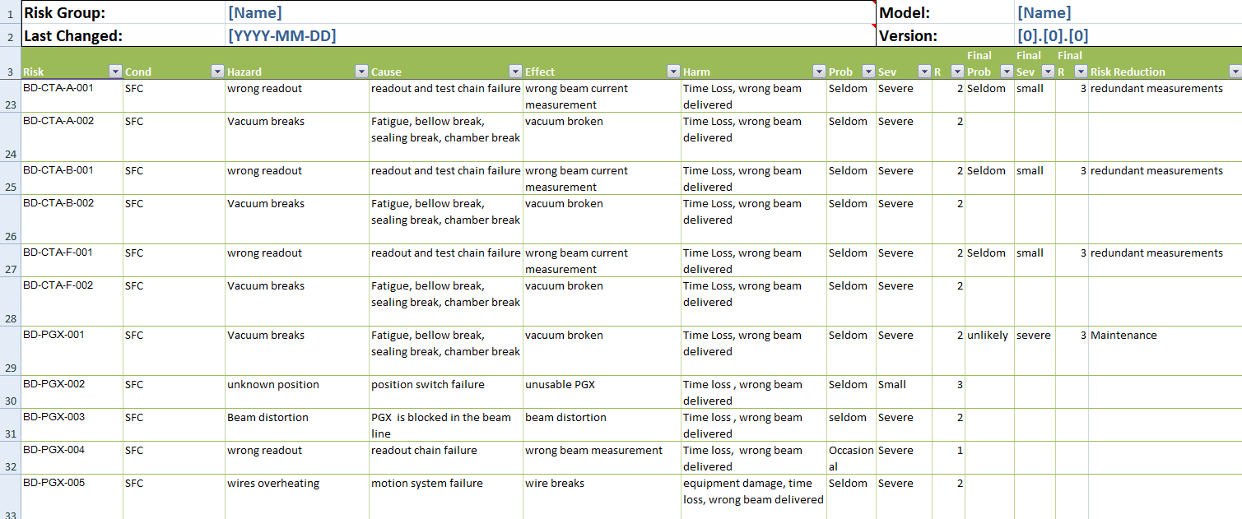
BIS Workshop BD
Snipped from FMECA BD risk sheet
55 hazards found in total

Slide 16
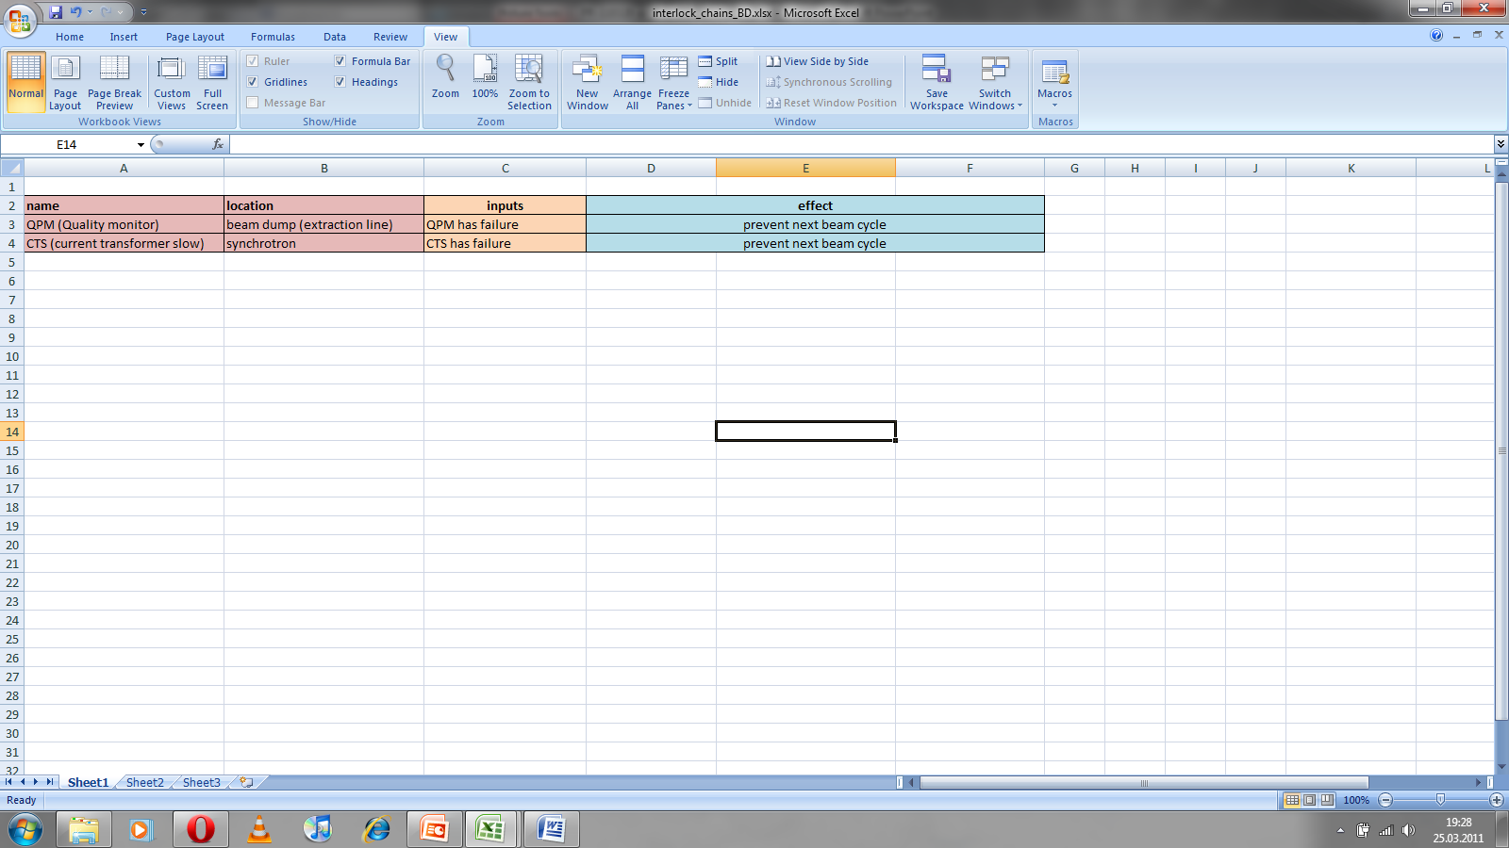
BD Interlock Chains
Other hazards defined
No risk reduction measure because of risk level 3
Hardware safety system of BD
Redundant measurements
Example of interlock chain
QPM
Beam blocker LINAC bunker
CTS
Beam blocker LINAC bunker

Slide 17

BD Open Questions
Devices which need to be in and out of the beam due to the different modes of the accelerator
  BIS has no modes!
On-Delay in the Safety-Matrix
Devices up to one day in the beam
Time period is too long
No interlock chains for that devices
Other safety measures have to be taken
BIS does not know the position of the devices
Resulting interlock of another device (e.g. BDS) because of wrong or no beam

Slide 18
Summary
Achievements since last MACS week
Evaluation of the Siemens hardware and software performed
Concept of the program structure in the Safety-Matrix tool with the I/O’s
  Draft of the BIS Architecture document Version 0.2
Definition of the racks and cabling for the BIS in the MedAustron building first version delivered to Architect Engineer for tendering
  Draft of the BIS Deployment Scenario Version 0.1
Till next MACS week
Release of the BIS Architecture & Design document
Implementation of initial set of interlock chains
Definition of the missing interlock chains
GUI for BIS and magnets in WinCC OA

