Slide 1

REDNet - Status overview
Rok Stefanic (rok.stefanic@cosylab.com)
Luka Sepetavc (luka.sepetavc@cosylab.com)
the best people make cosylab
Notes:
REDNET – Real Time Event Distribution Network
Sistem za prenasanje timing eventov in podatkov (komand) v hard real time-u

Slide 2
Outline
Quick overview
1) What has been done so far
2) What is working
3) What needs to be done

Slide 3
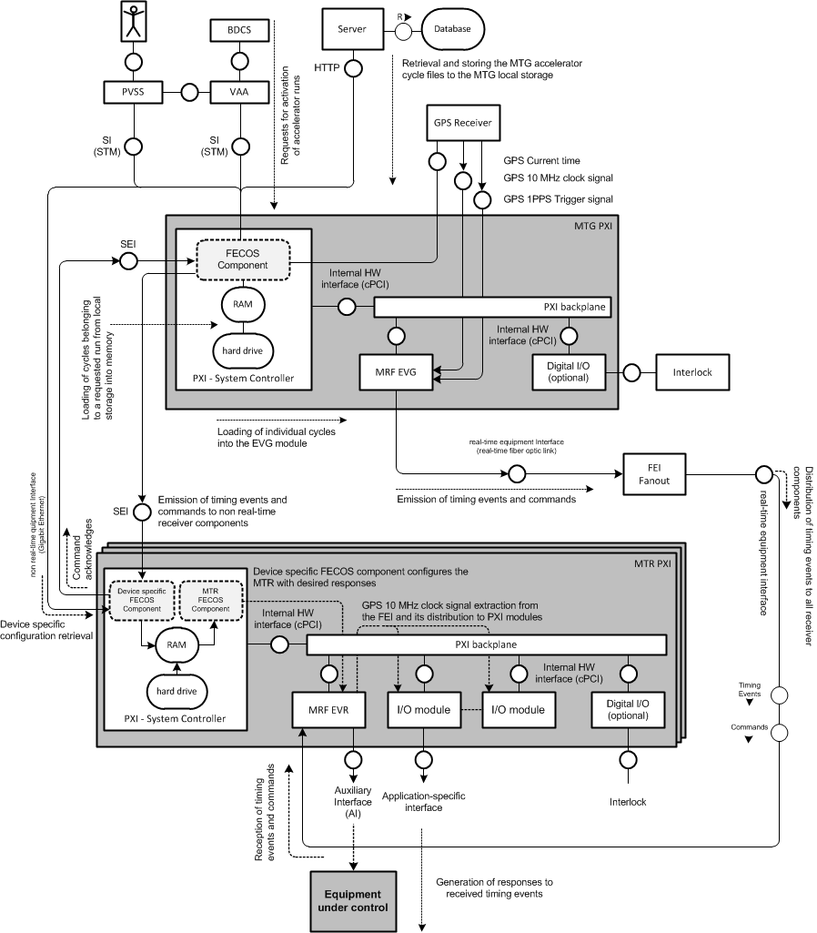
Quick overview
VAA Activates a Run (+ run file)
MTG redistributes the Run file with a list of cycles
MTG Generates timing events from the requested cycle
VAA requests the generation of a cycle from the run list
Receiver components generate responses
(digital signals, irq, triggers…)
Notes:
-VAA (Virtual Accelerator Alocator) – activates run (composed of multiple accelerator cyles, and each cycle of events)
-MTG lets everybody know about whats going to happen (which cycles are going to be generated)
-after that MTG receives acknowledgments from all receivers-devices
-VAA requests actual generation of cycles
-MTG start generating cycles by emitting events over fiber optics and MAPS
-MTR generates responses to events (either backplane, GPIOs, software…)

Slide 4
1) What has been done so far
GREEN – task went well
ORANGE – slight issues with the task
RED – task was underestimated, more effort spent

Slide 5
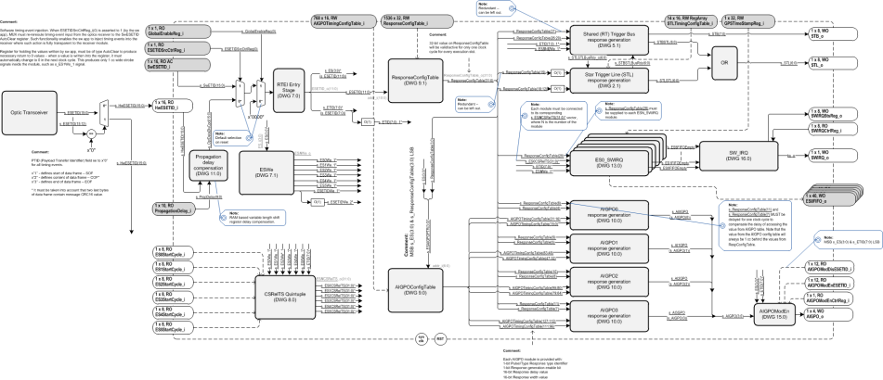
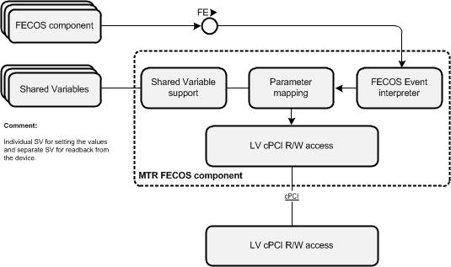
1) What has been done so far
Timing Receiver architecture
  FPGA and SW architecture
REDNET MTR XML (fml) configuration file
  interface defined via shared variables
Timing receiver SW implementation
  Dynamically loaded FECOS component
  Interface to other FECOS components running on the crate
  Interface to WinCC OA via shared variables(!)
    Interface implemented partially
Notes:
-completed MTR arch.
-this fml actually defines shared variables through which it is configured, no static parameters
-interface through which e.g. PCC can configure MTR on the fly
-(!) not yet finalized

Slide 6
1) What has been done so far
Timing receiver HW implementation
  Response generation is implemented
    Pulse/toggle on auxiliary interface (4 optic/TTL outputs)
    Pulses on PXI star trigger lines from MRF EVR to other cards
    Timing event distribution to other cards over PXI shared RT trigger bus on PXI backplane
    Distribution of received timing events to FECOS components
  Command reception must be implemented(!)
    HW resource issues to store all data associated with ActivateRun
    Solved by introduction of “Lightweight” ActivateRun command
MTR Design documentation
  Interfaces and functionality defined, the documentation needs to be updated
Notes:
-hardware implementation in FPGA
MTR cannot yet receive commands from MTG
ActivateRun issue – lightweight over fiber (payload was too big), payload is emitted only through MAPS

Slide 7
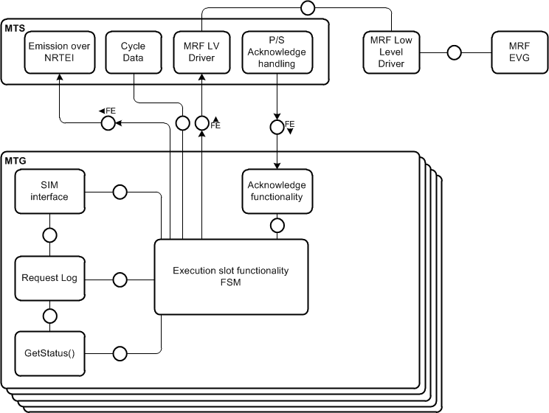
1) What has been done so far
Main Timing Master
  Architecture and interface design
    Fruitful collaboration with MA team
      VAA can access and control each execution slot individually - more flexibility
      Each component for individual execution
      slot is independent
Notes:
VAA doesn’t communicate with only one component but with 5 individual components, one for each execution slot

Slide 8
2) What is working
Main Timing Receiver
  Generation of responses to received timing events on all interfaces
    Auxiliary interface
    Shared real-time trigger bug
    Shared trigger lines
    Software IRQ
  SW injection of timing events from LV
    provides generation of timing sequences locally on the receiver
  10MHz clock distribution
    MRF EVR extracts clock signal from optic link and distributes it over PXI backplane to other cards (PCC FlexRIO Modules)
  Full receiver configuration
    by other FECOS components
    from configuration in shared variables
Notes:
-MTR is finished
-SW injection used for simulating MTG when it is not phisicaly present in the system
-10 MHz clock – used for sychronizing the PCC
-MTR configured with FECOS events on the fly and over shared variables during configuration phase (configure command)

Slide 9
2) What is working
Main Timing Generator
  SIM interface to VAA
    GetStatus request is supported to always return OK status
  MRF EVG low level device support
    Allows access to registers and memory in MRF EVG FPGA
Notes:
-how VAA talks to MTG (how requests look like)
-for testing purposes (hello world like), MTG always responds with OK status on GetStatus request
-low level support for MTG - driver

Slide 10
3) What needs to be done
MTG configuration from XML file
  definition of MTG fml file
MTG LabView FECOS components
  SIM interface to VAA(s)
  MAPS interface to receivers
  Acknowledge functionality
  Integration with scratchpad
MTG FPGA implementation
  RT cycle generation and emission over real-time equipment interface
Documentation
  Design documentation
  Test cases

Slide 11
3) What needs to be done
Deliverables in the following period
Notes:
This is how REDNET will progress over the following months. First the MTR is being finalized, the MTG development follows and at the end, all the tests and reports will be provided.
The design documentation will be written and finalized during MTR and MTG development when all the requests are accepted and can be put into the document.

Slide 12
Thank you for your attention
Questions?

