Slide 1

XML Device Description
Workshop

Slide 2

MACS configuration chain
XML documents for device definition
Database filled from XML documents
Configuration created in RMS
Configuration exported to configuration files
Configuration files are read by the individual systems
MACS
XML
File
RMS
DB
config
files
Importer
Exporter

Slide 3
Documents and directories
Word Document ES-YYMMDD-a-XXX_DeviceClassName.docx
XML Document ES-YYMMDD-b-XXX_DeviceClassName.xml
MACS SVN root folder: sdp/documents/Deployment/Configuration
Under Configuration a folder for each logical subsystem
Subsystem folder contains folders for each individual device class
Each device class folder contains three standard folders:
  doc
  img
  review

Slide 4
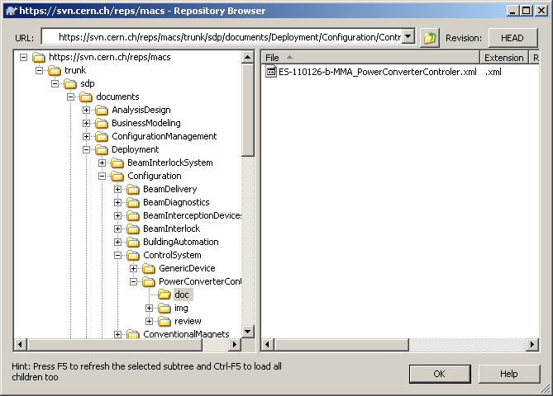
Example folder structure

Slide 5
Word Document
Purpose
Interfaces
Operations model
  how to operate the device
  By how the device is operated
References to other documents

Slide 6
XML Document
Document header
  Document title
  Document number
  Author
  Data of creation
  Abstract
  Document dependency (optional)
Document body
  Device class definition
  Device instantiation
  Instance value definition

Slide 7
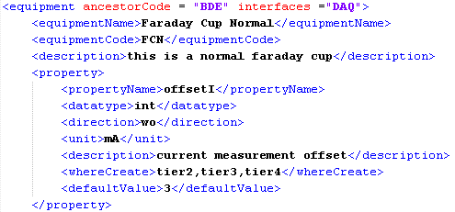
Device class definition
Inheritance and interfaces
Class name and three letter code
Description
Properties

Slide 8
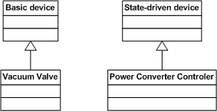
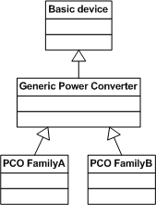
Inheritance
Device class can inherit directly from basic device or state-driven device
Device class can inherit from a intermediate class

Slide 9
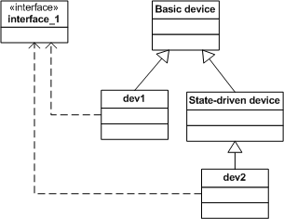
Interfaces
Devices can implement interfaces

Slide 10
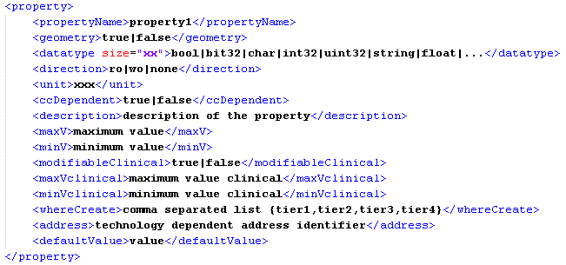
Property definition

Slide 11
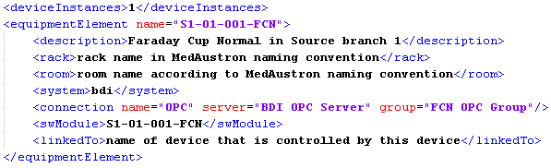
Device instantiation
Number of instances
Instance name and description
Rack and Room (optional)
WinCC OA system and connection
Software Module and controlled devices (optional)

Slide 12
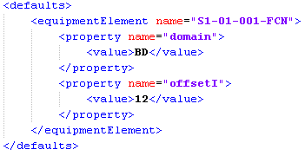
  Instance value definition
Define property values for each particular instance

Slide 13
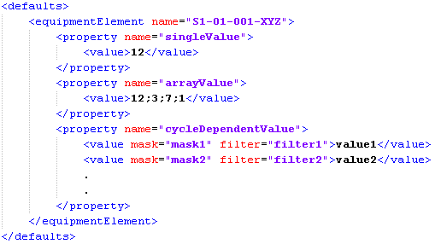
Value definition

Slide 14
Templates
Word document
Basic device XML
State driven device XML
https://svn.cern.ch/reps/macs/trunk/sdp/documents/Deployment/Configuration/ControlSystem/GenericDevice/doc

Slide 15
Practical Example:
Vacuum Sector Valve
Basic device
Class Code: VVS
One bool input property: open
Two bool output properties: isOpen, isClosed

