Slide 1


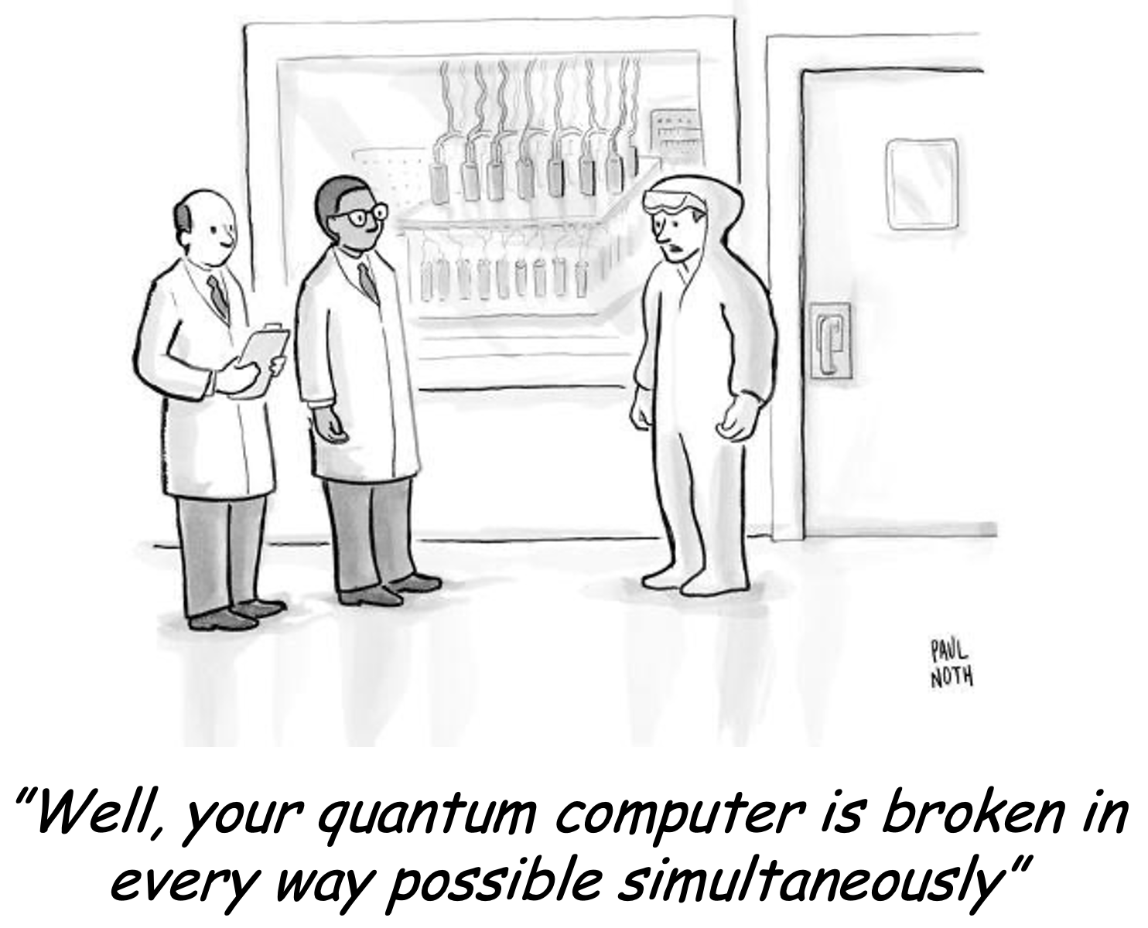
Reinforcement learning in CERN’s accelerators and beyond
M. Schenk, M. Grossi, V. Kain, K. Li, S. Vallecorsa
CERN, Switzerland
E. F. Combarro
University of Oviedo, Spain
BE Seminar 29. September 2023

Slide 2
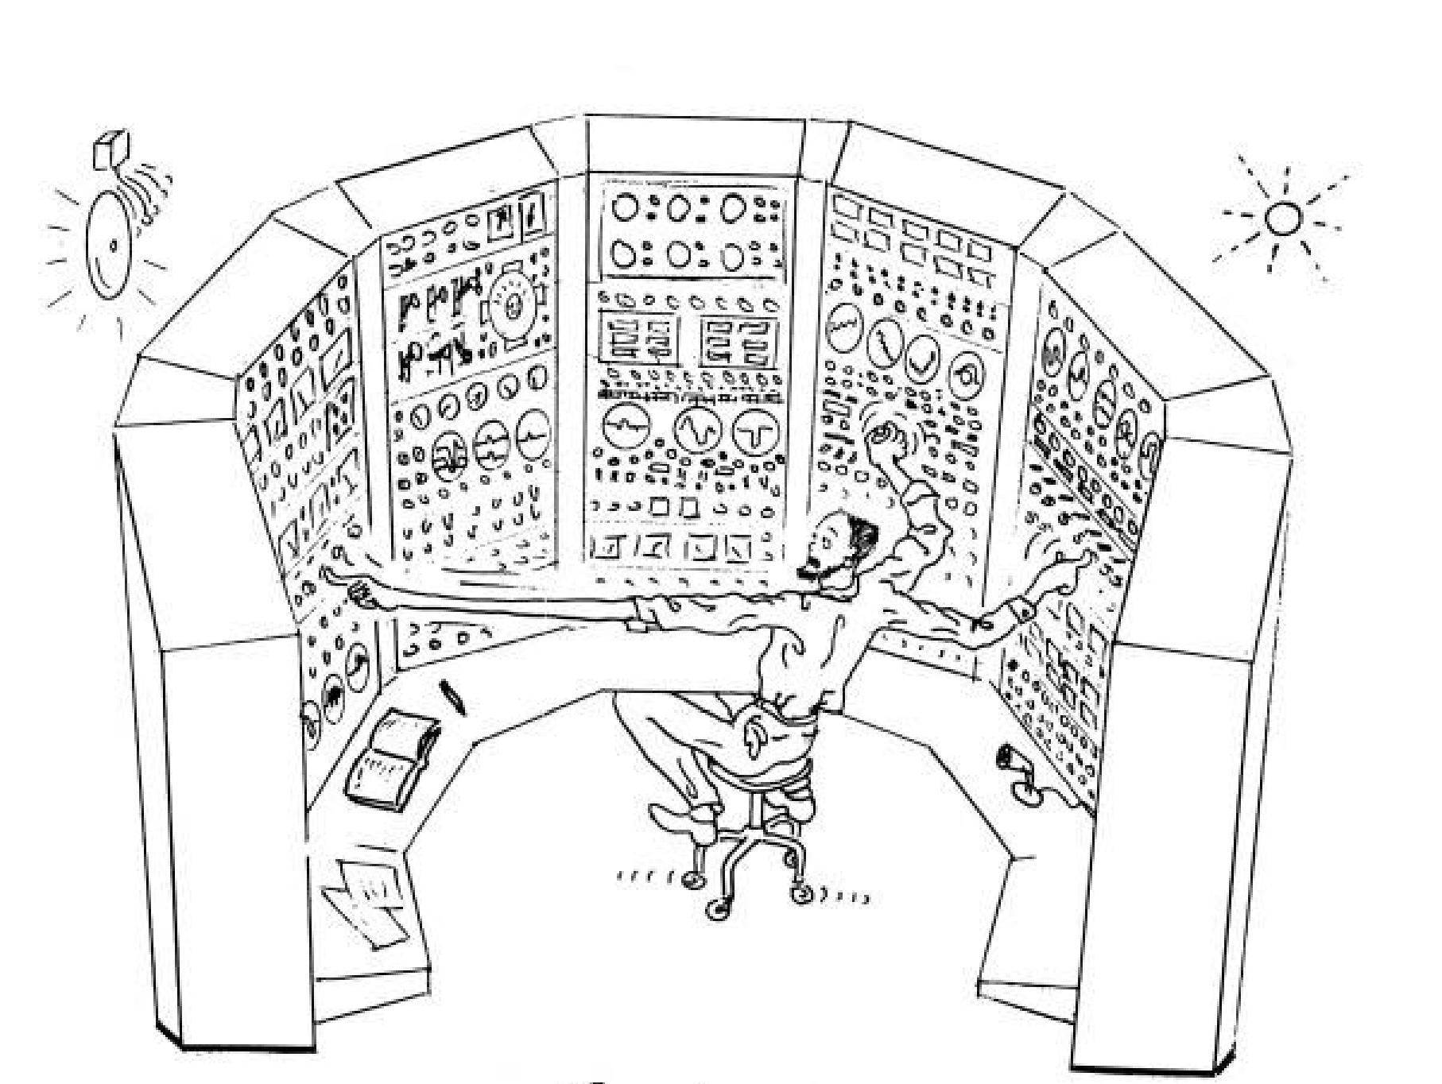
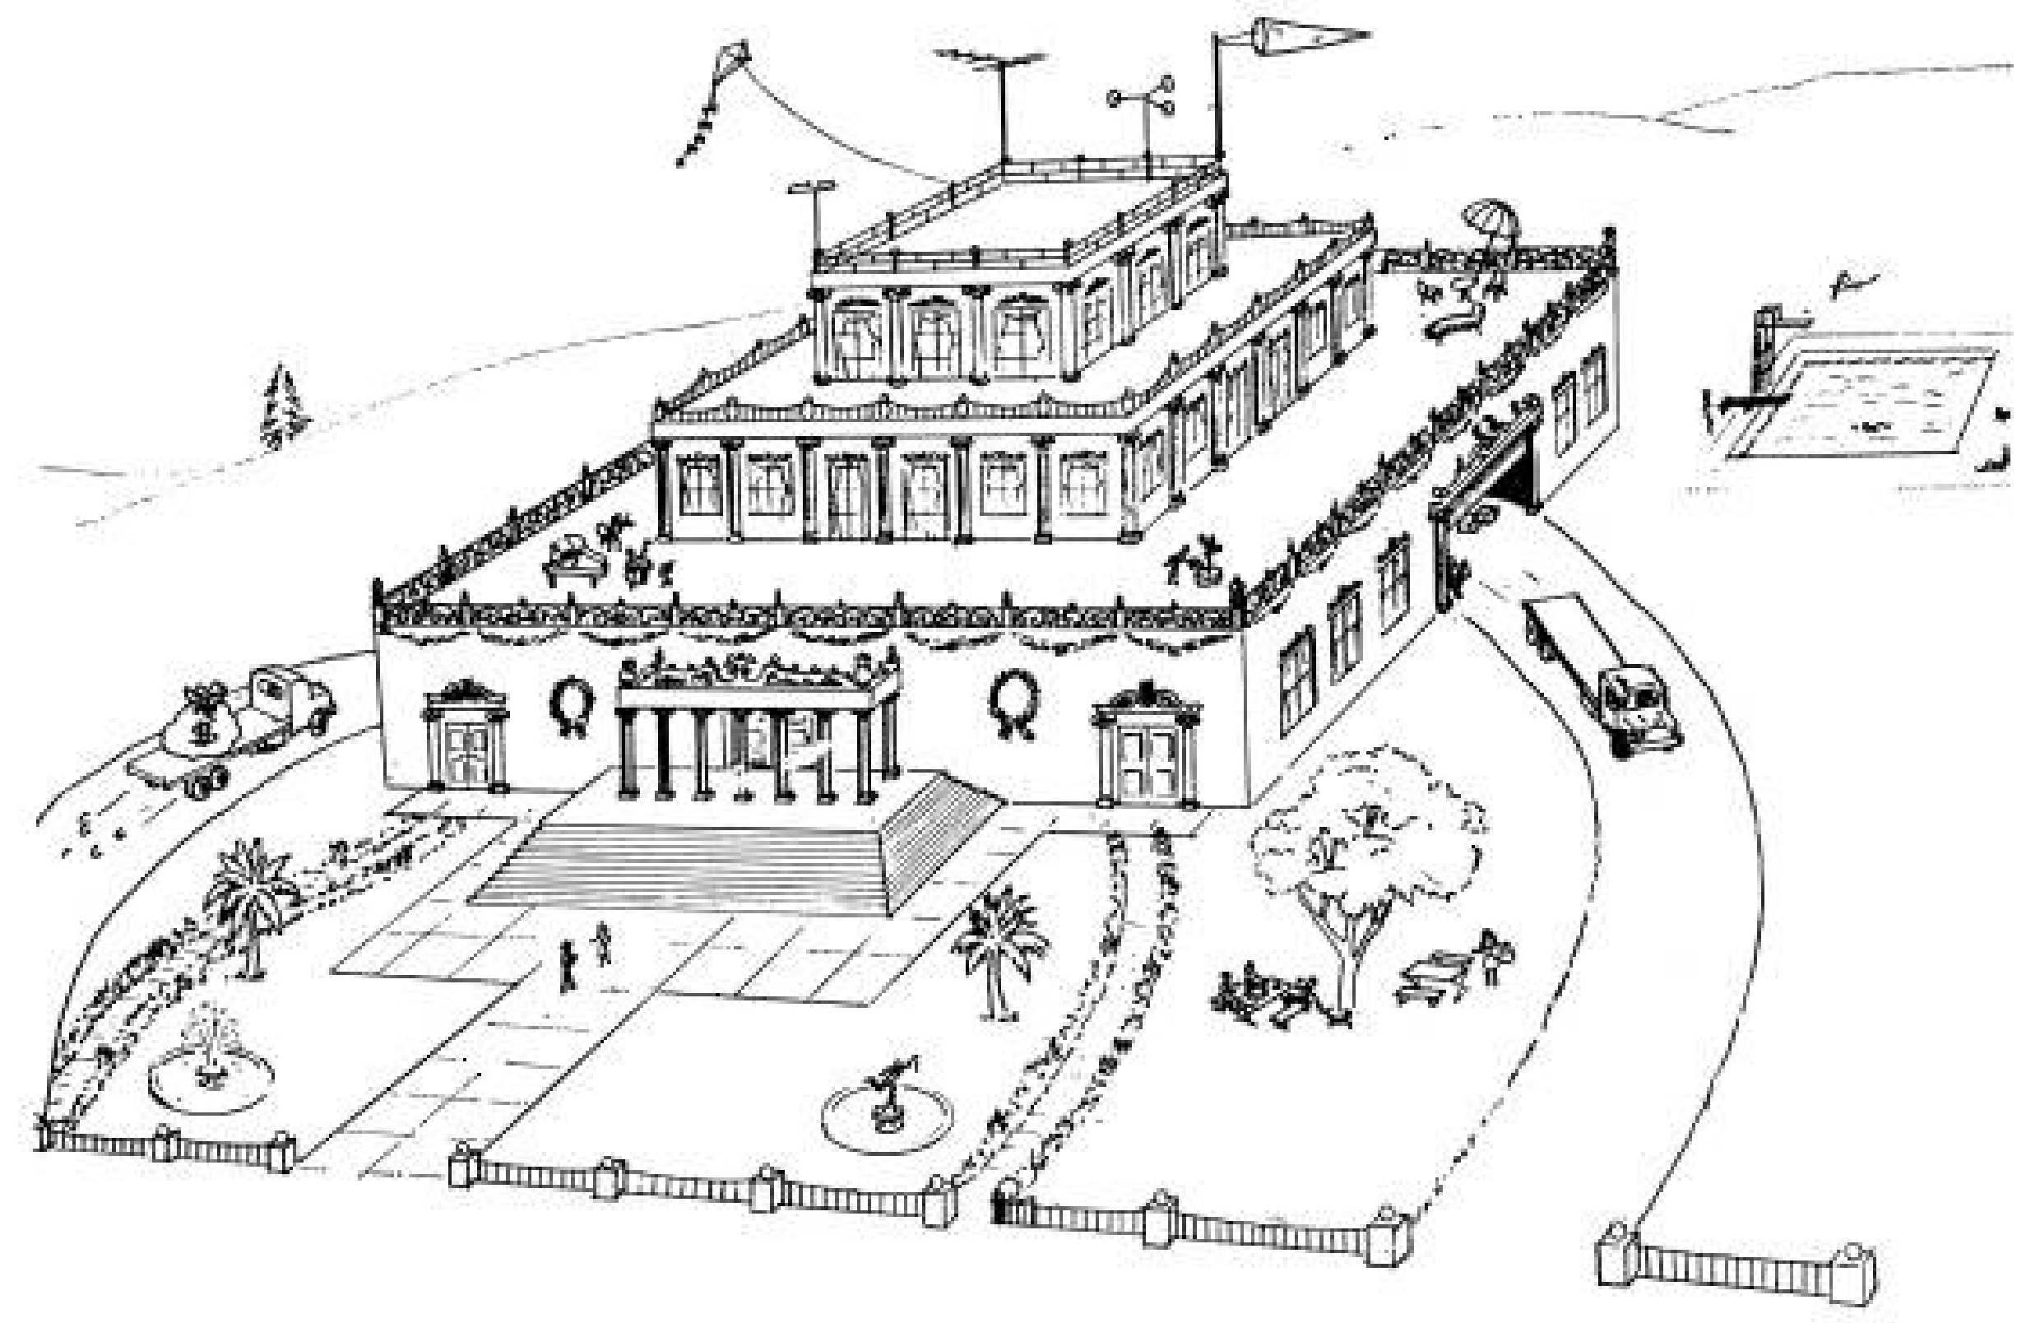
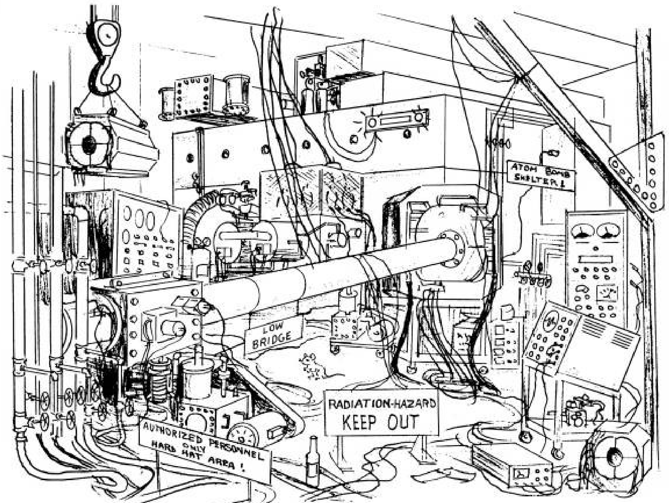
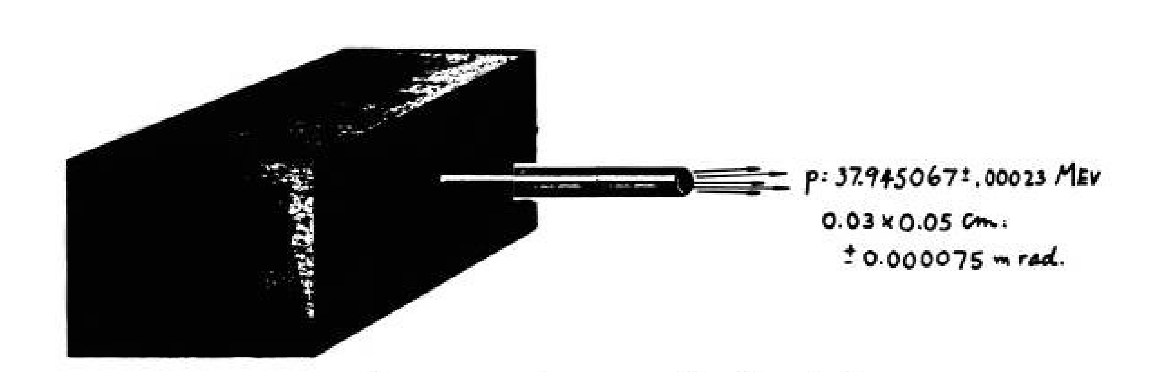
Accelerators seen by the …
… machine operators & and beam physicists
… funding agency
… visitors
… experimental physicist
D. L. Judd & R. MacKenzie, “The Cyclotron, as seen by”

Slide 3
Accelerators seen by the …
… machine operators & and beam physicists
… funding agency
… visitors
… experimental physicist
D. L. Judd & R. MacKenzie, “The Cyclotron, as seen by”

Slide 4
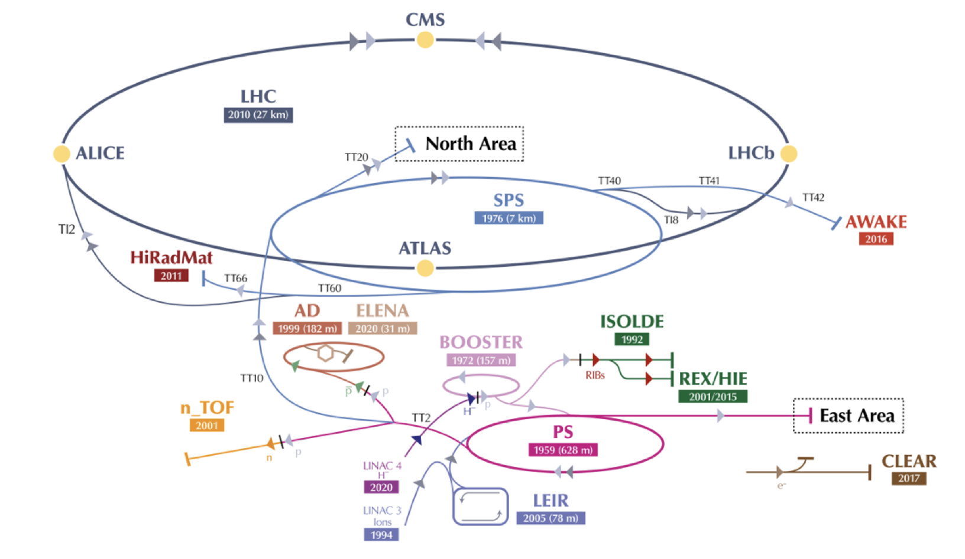
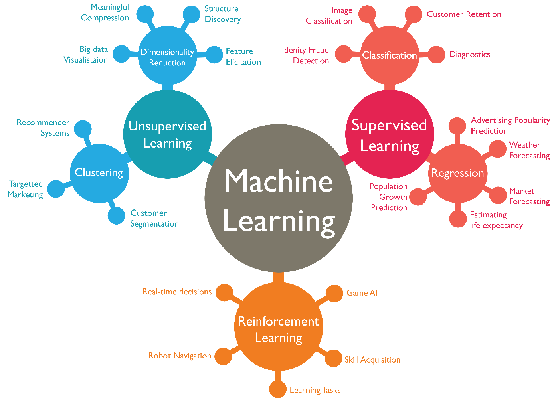
Introduction
Motivation
CERN maintains dense & diverse physics program
Imposes challenges on accelerator operation
Machine availability & beam quality critical for experiments to reach physics objectives
Broad spectrum of machine & beam types requiring high flexibility and efficient parameter tuning
Ideally, machine operation based on physics models
Not always possible: complexity, completeness, online evaluation, ...
Explore new technologies
What does the optimization & ML toolbox have to offer?
Will discuss specific aspects of reinforcement learning (RL) today

Slide 5
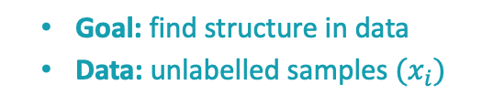
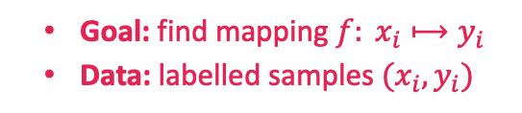
Introduction
RL and the machine learning landscape
  Goal: find mapping $f: x_{i}⟼y_{i}$
  Data: labelled samples $(x_{i}, y_{i})$
  Goal: find structure in data
  Data: unlabelled samples $(x_{i})$
Other approaches
Classic control
Numerical and Bayesian optimization, (GP-)MPC, fuzzy logic, etc.
Some of them very suitable for accelerator-related problems
  Goal: learn to take optimal decisions
  Data: agent actively interacts with environment collecting samples & rewards
Image source

Slide 6
Contents
    Introduction
    Reinforcement learning
    Beyond classical RL
    Results
    Conclusions & outlook

Slide 7
Contents
    Introduction
    Reinforcement learning
    Beyond classical RL
    Results
    Conclusions & outlook

Slide 8
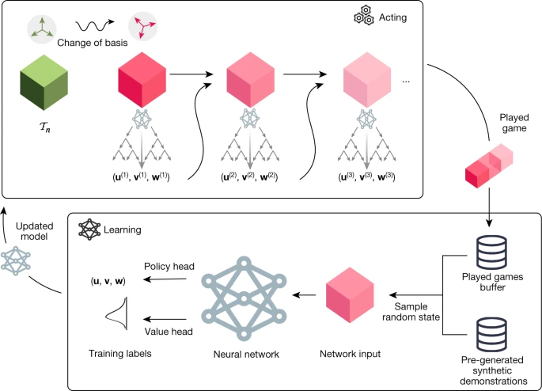
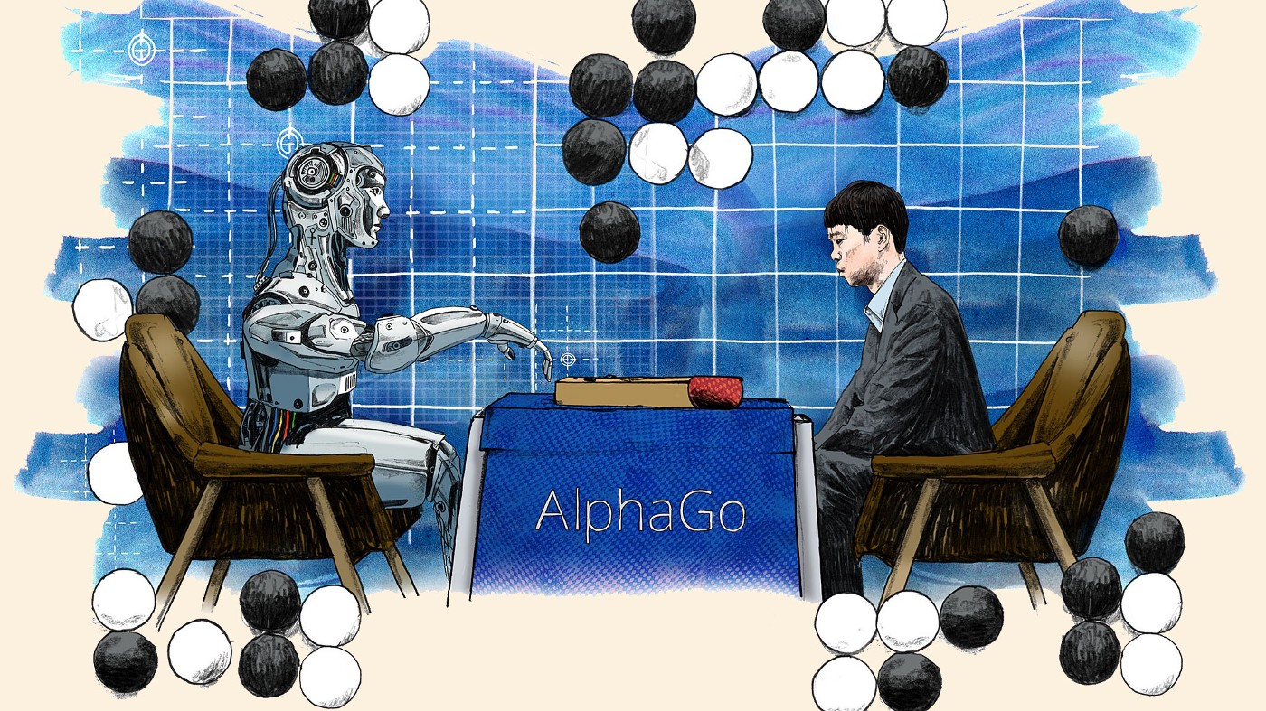
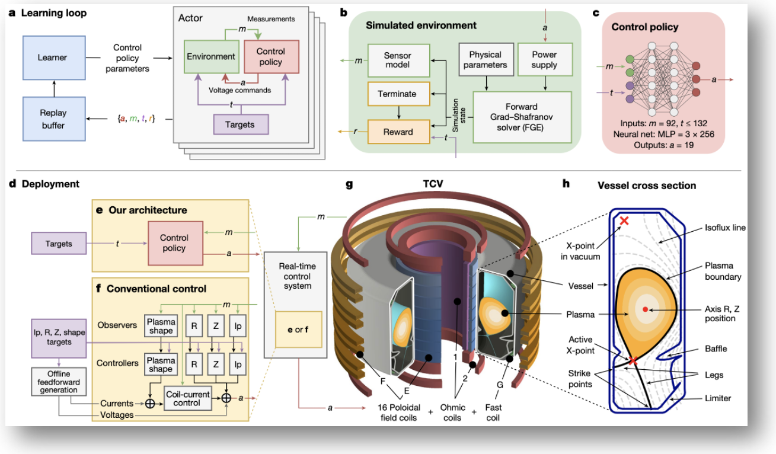
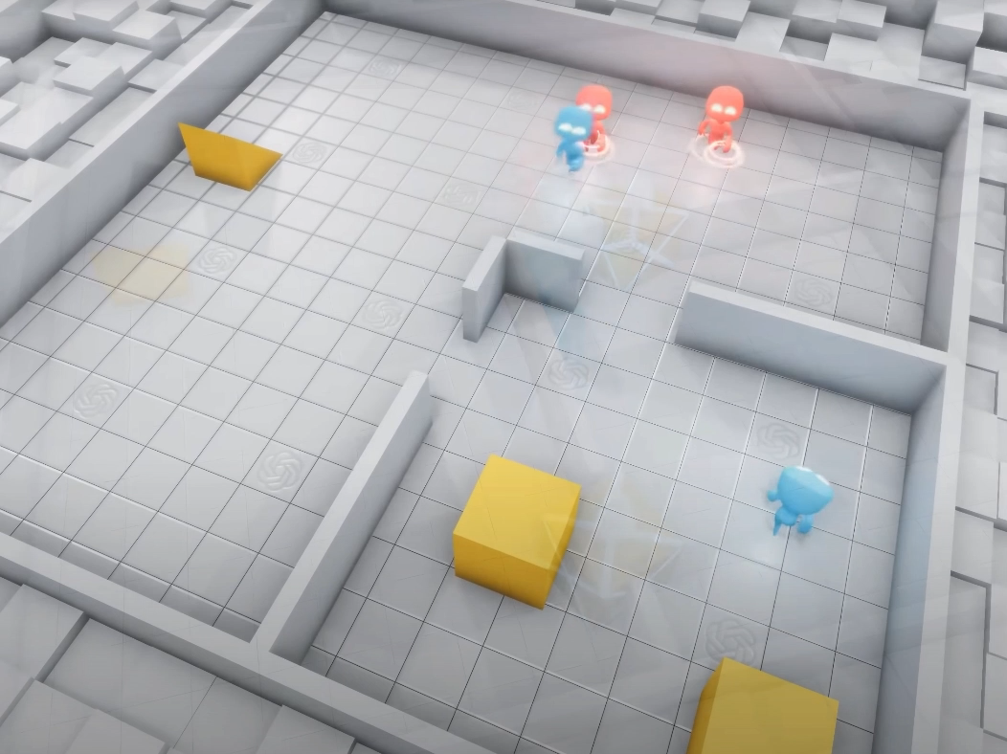
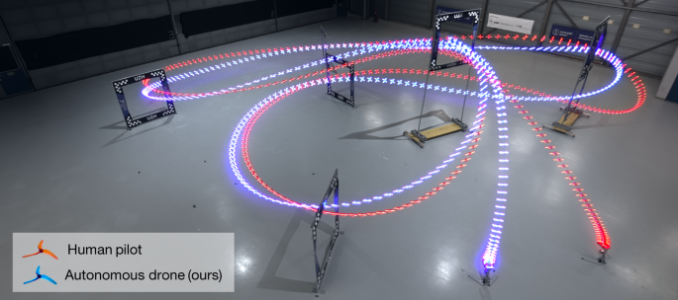
Reinforcement learning (RL)
DeepMind, 2022: AlphaTensor
Improve computational efficiency of matrix multiplication
Benefits countless fields
RL agent discovered more efficient algorithms than developed by humans
State-of-the-art
DeepMind & EPFL, 2022: Tokamak control
Maintaining plasma within tokamak requires high-dimensional, high-frequency, closed-loop control using magnetic actuator coils
RL agent successfully trained as magnetic controller
DeepMind, 2016: AlphaGo
UZH & Intel Labs, 2023: Drone racing
RL agent beats human drone racing champions in real environment
Training in simulations with mixed-in residual models from real data
OpenAI, 2019: Hide and seek
and more …

Slide 9
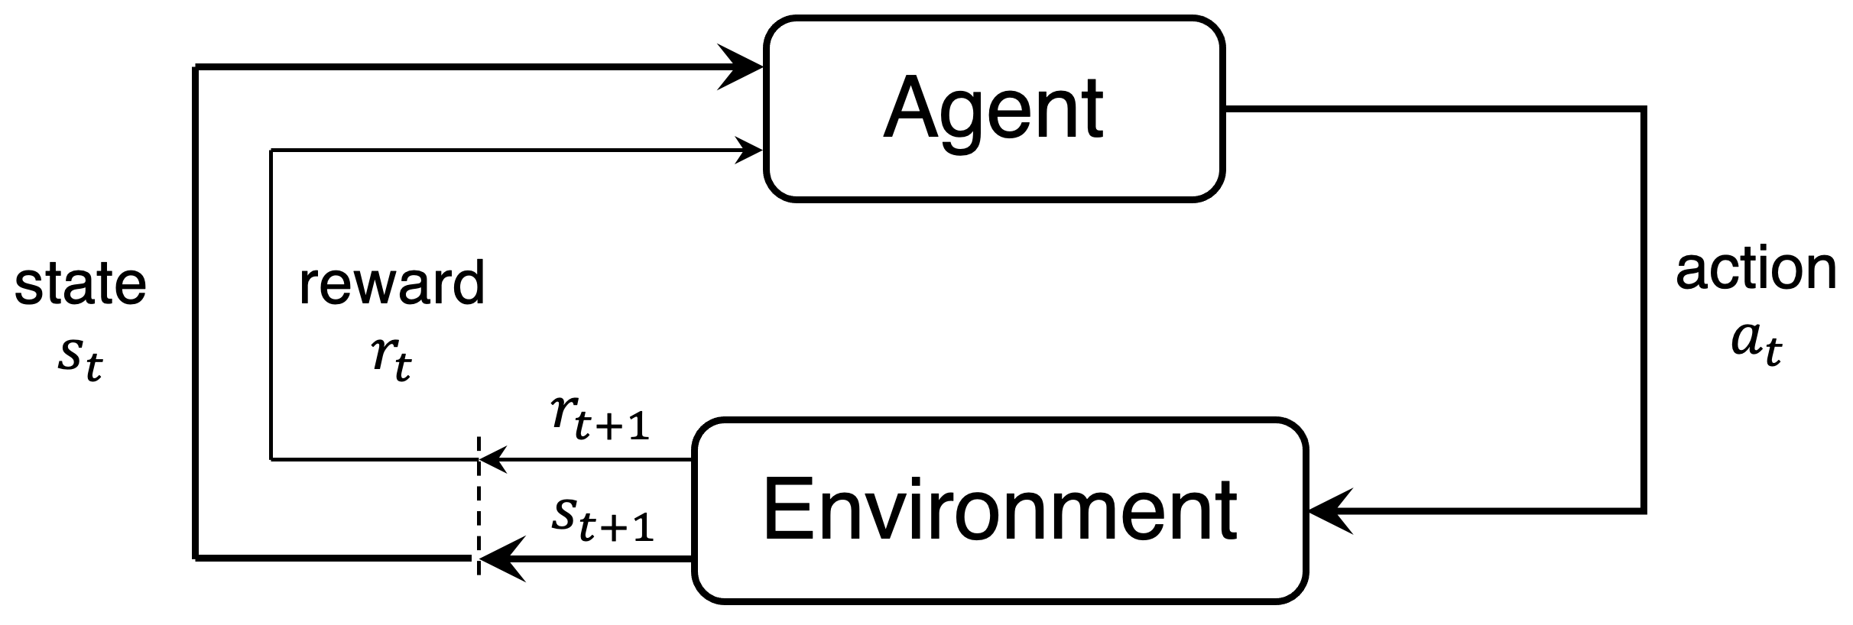
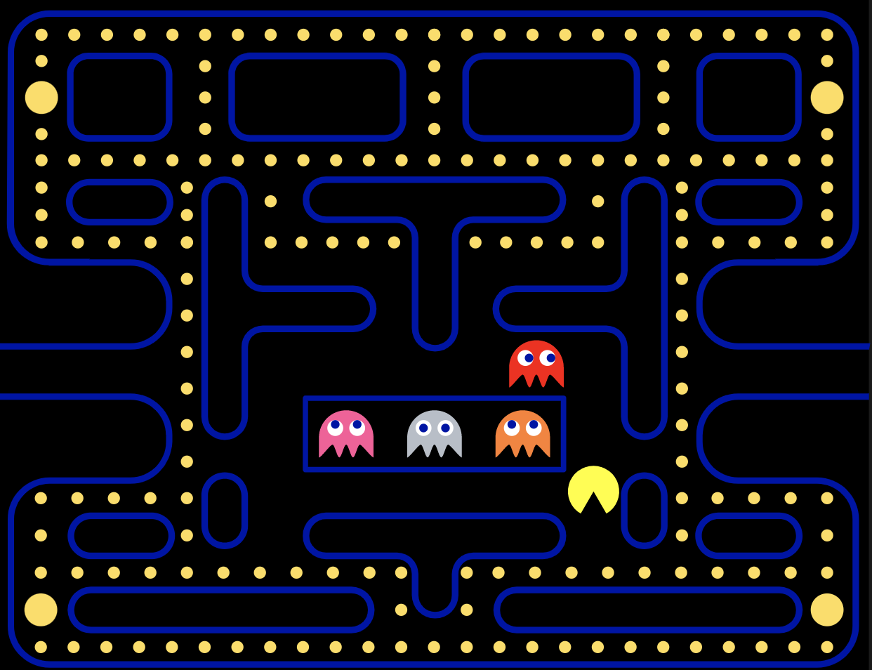
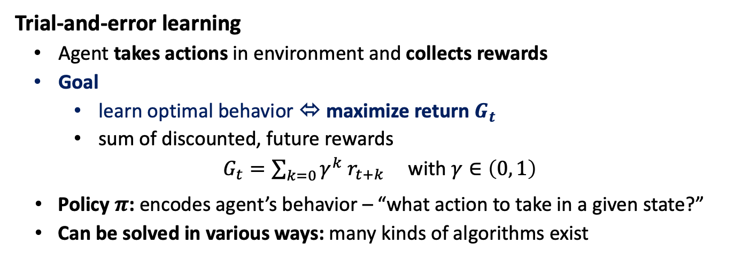
Reinforcement learning (RL)
... in a nutshell
Trial-and-error learning
Agent takes actions in environment and collects rewards
Goal
  learn optimal behavior ⬄ maximize return $G_{t}$
  sum of discounted, future rewards
$G_{t}=\sum_{k=0}{γ^{k} r_{t+k}}$ with $γ∈\left(0, 1\right)$
Policy $π$: encodes agent’s behavior – “what action to take in a given state?”
Can be solved in various ways: many kinds of algorithms exist
Sutton & Barto
Example: Pacman
State: where am I? Where are ghosts, snacks, cookies?
Actions: up, down, left, right
Reward: food (+), ghosts (-)
Return: how much food am I going to eat over time
Policy: given state, should I go up, down, left, or right?

Slide 10
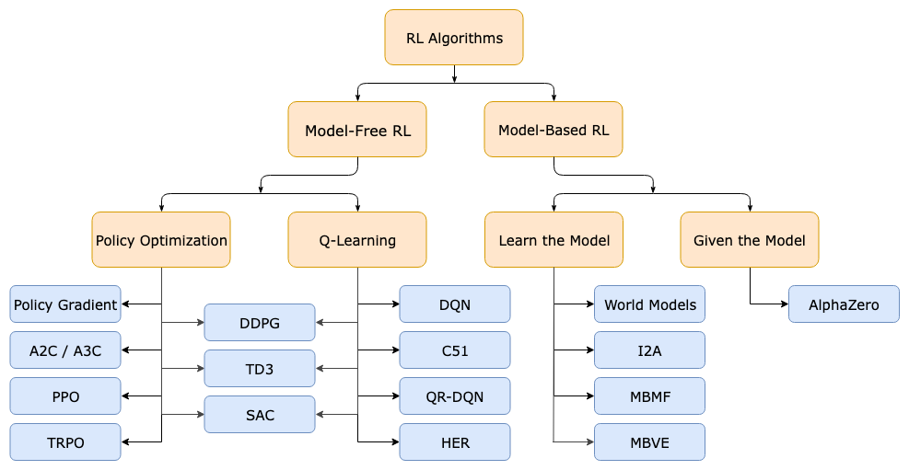
Reinforcement learning (RL)
Algorithm zoo
OpenAI – spinning up
Focus on Q-learning
  Can understand a large selection of RL algorithms, and this talk
  Also covers algorithms mostly employed for CERN RL applications so far

Slide 11
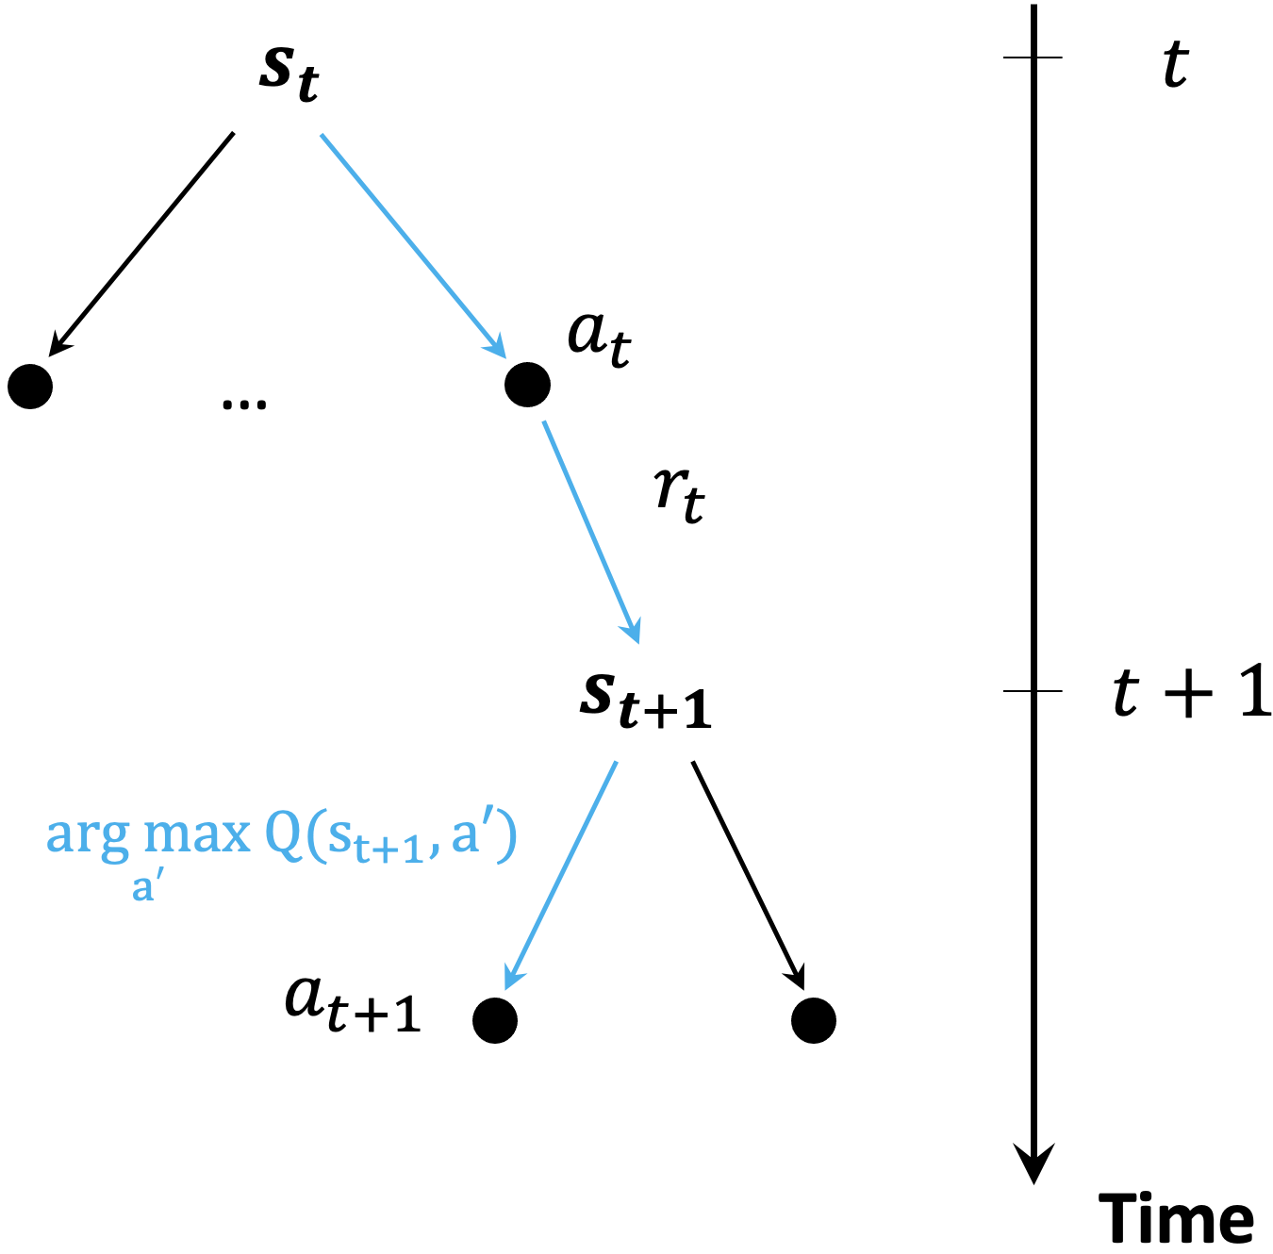
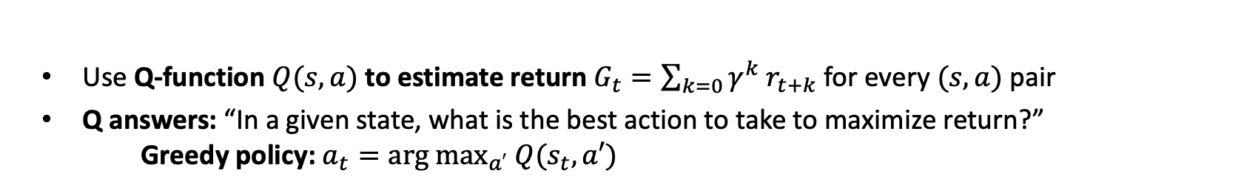
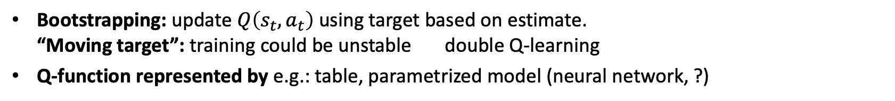
Q-learning
How does it work?
Use Q-function $Q(s,a)$ to estimate return $G_{t}=\sum_{k=0}{γ^{k} r_{t+k}}$ for every $(s, a)$ pair
Q answers: “In a given state, what is the best action to take to maximize return?”
Greedy policy: $a_{t}=arg max_{a′} Q(s_{t},a′)$
Learning Q
Iterative approach based on temporal difference (TD) rule using collected agent-environment interactions
$$!$$
$Q\left(s_{t}, a_{t}\right)=r_{t}+γ max_{a′}$ $Q\left(s_{t+1}, a^{′}\right)$
learning rate
TD error
$$Q\left(s_{t}, a_{t}\right)←Q\left(s_{t},a_{t} \right)+α [r_{t}+γmax_{a′}{Q\left(s_{t+1}, a^{′}\right)−Q(s_{t}, a_{t})]}$$
target (new best guess)
old
prediction
Bootstrapping: update $Q\left(s_{t},a_{t}\right)$ using target based on estimate.
“Moving target”: training could be unstable double Q-learning
Q-function represented by e.g.: table, parametrized model (neural network, ?)

Slide 12
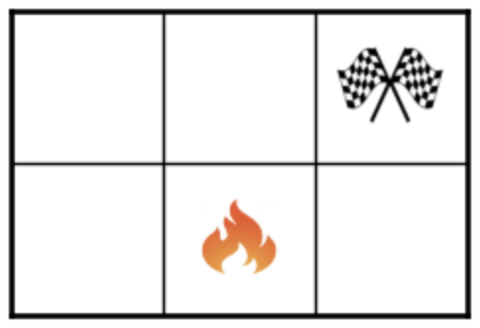
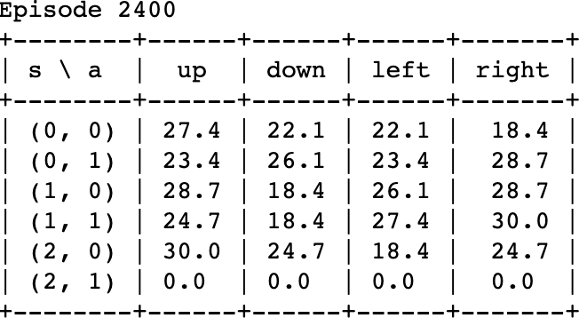
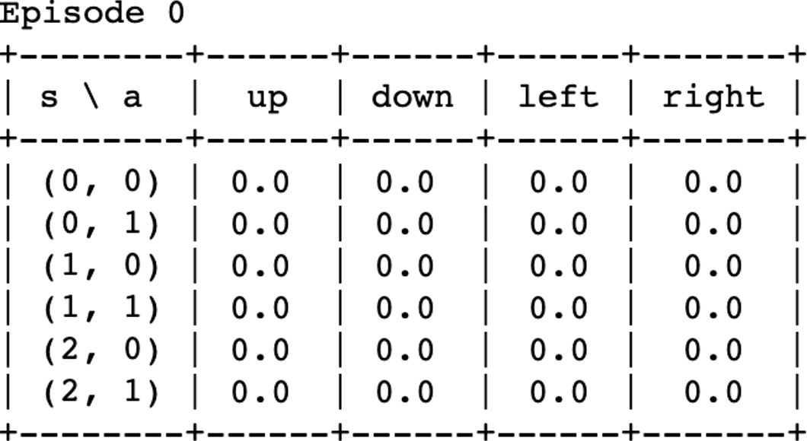
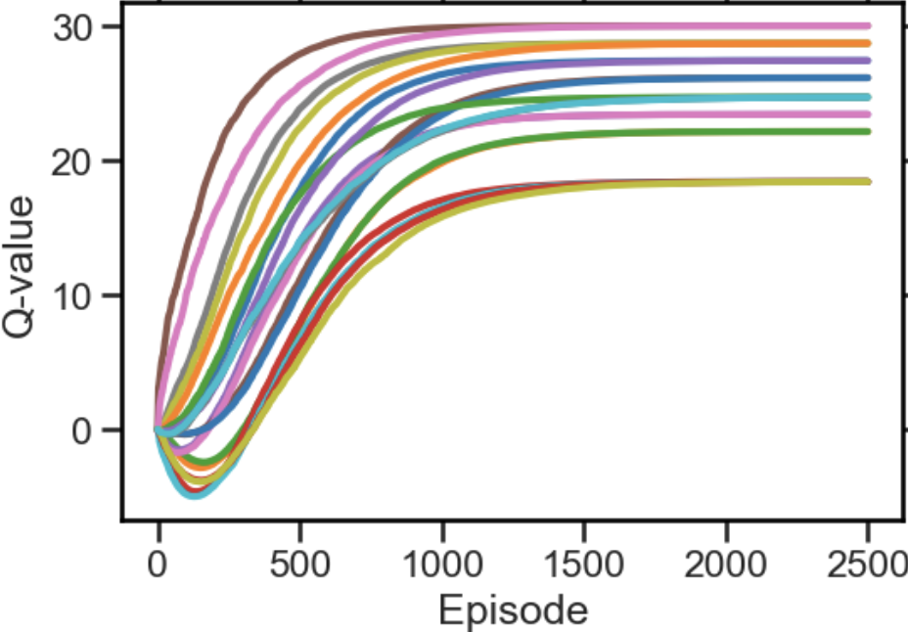
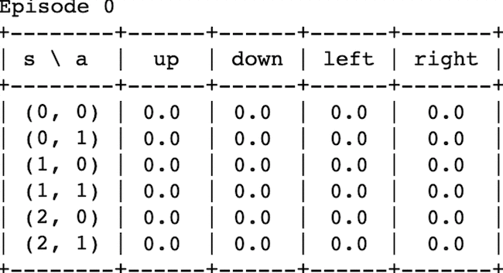
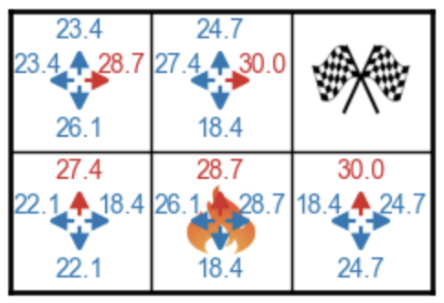
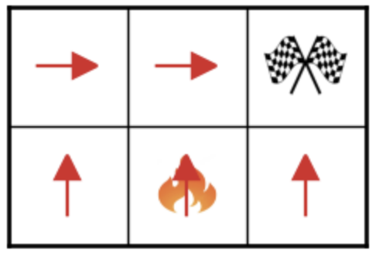
Q-learning
N.B.: we often deal with (large) continuous state-action spaces
An example: Q-table
-1
+30
-10
-5
$$Q\left(s_{t}, a_{t}\right)←Q\left(s_{t},a_{t} \right)+α [r_{t}+γmax_{a′}{Q\left(s_{t+1}, a^{′}\right)−Q(s_{t}, a_{t})]}$$
greedy
policy
RL lecture @TU Darmstadt

Slide 13
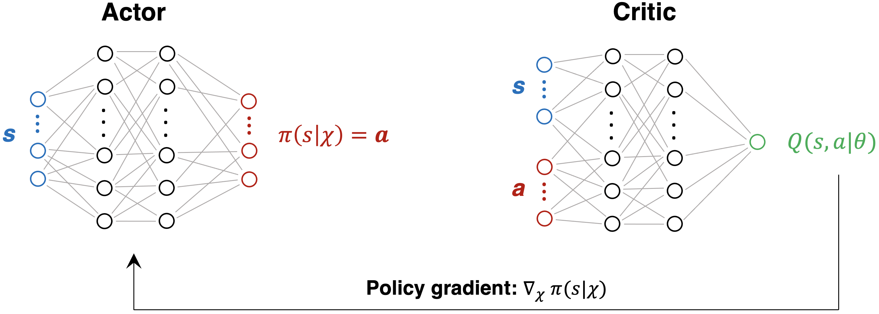




Q-learning
Deep Q-learning (DQN)
$$Q(s, a_{1})$$
$$Q(s, a_{m−1})$$
$$Q(s, a_{m})$$
Q-function of continuous or very large state-spaces can no longer be represented by a table
Replace table by a neural network: deep Q-learning (DQN)
  universal function approximator
  great interpolator (e.g. for unseen states)
Train network weights using temporal difference learning
Does not yet solve the continuous action problem: see e.g. actor-critic schemes

Slide 14
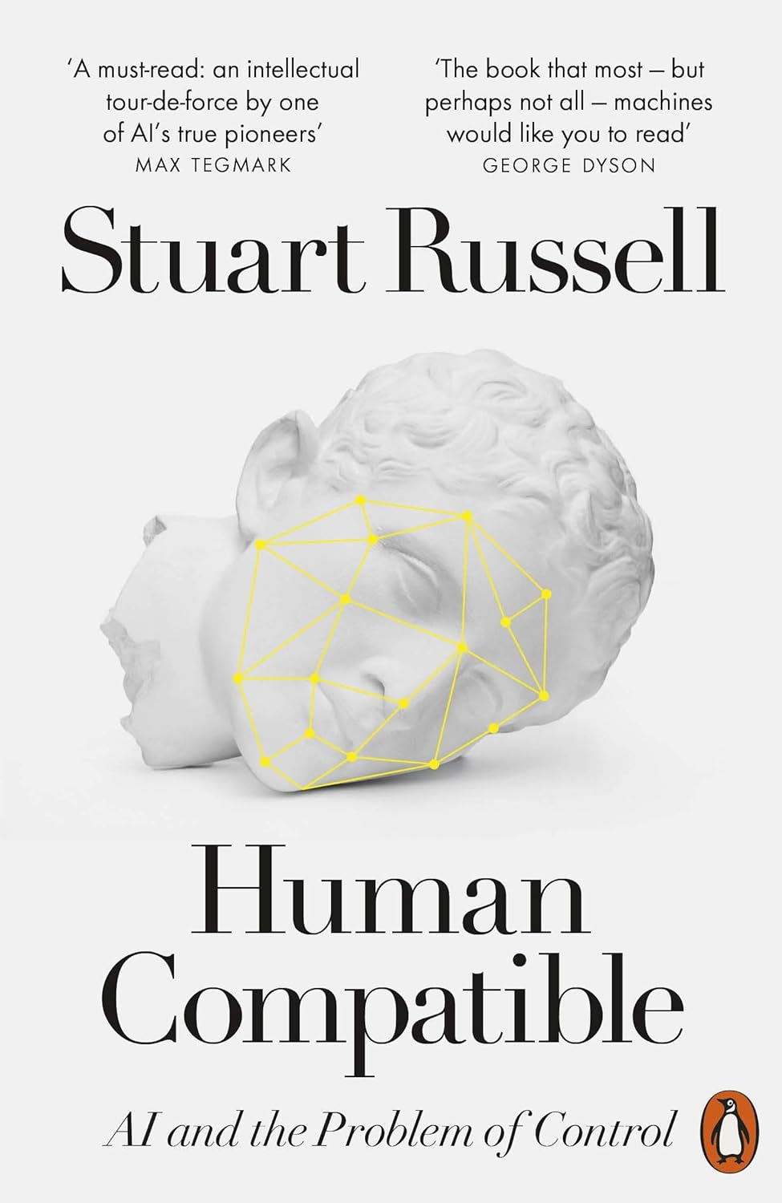

RL challenges
… for accelerator applications, but not only
    Sample efficiency
      How many agent-environment interactions are required for convergence?
      Relevant for particle accelerator control given cost of beam time (online training)
    Reward engineering
      Alignment: getting the objective right
      “Making sure the agent does what we want it to do”
    State definition
      Ideally “fully observable”
      Limited beam instrumentation
      Can be a real RL show-stopper
    Parameter drifts
      Dependencies we can not easily include in our state
    Safety
      Particularly a concern during exploration
      There are ways to add safety to RL agents
https://arxiv.org/abs/2205.10330

Slide 15
RL challenges
… for accelerator applications, but not only
    Sample efficiency
      How many agent-environment interactions are required for convergence?
      Relevant for particle accelerator control given cost of beam time (online training)
    Reward engineering
      Alignment: getting the objective right
      “Making sure the agent does what we want it to do”
    State definition
      Ideally “fully observable”
      Limited beam instrumentation
      Can be a real RL show-stopper
    Parameter drifts
      Dependencies we can not easily include in our state
    Safety
      Particularly a concern during exploration
      There are ways to add safety to RL agents
Focus today
https://arxiv.org/abs/2205.10330

Slide 16
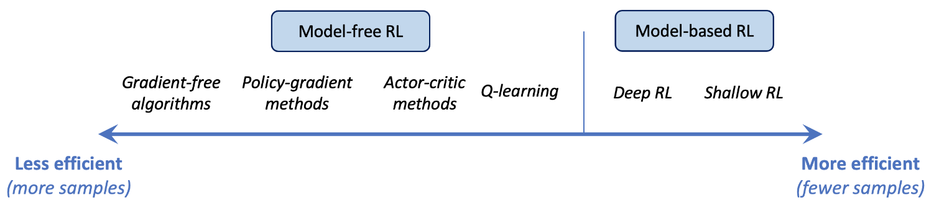
RL challenges
Sample efficiency
  How to improve sample efficiency?
  Reliable simulations / surrogate models
  Train RL agent on model, then deploy in real world (sim2real)
  Choice of algorithm
    Model-based RL: learn model explicitly and train agent on that (= planning)
    Quantum RL?
quantum RL (?)

Slide 17
Contents
    Introduction
    Reinforcement learning
    Beyond classical RL
    Results
    Conclusions & outlook

Slide 18
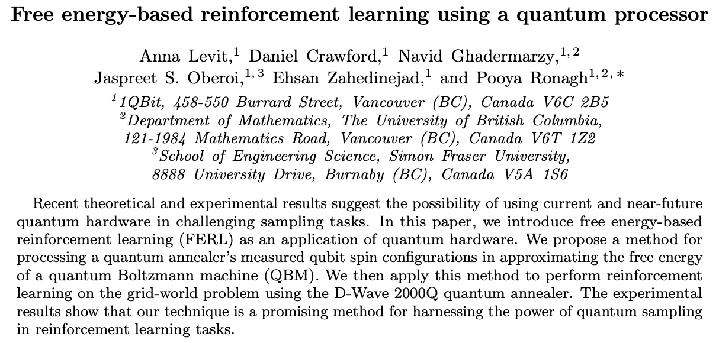
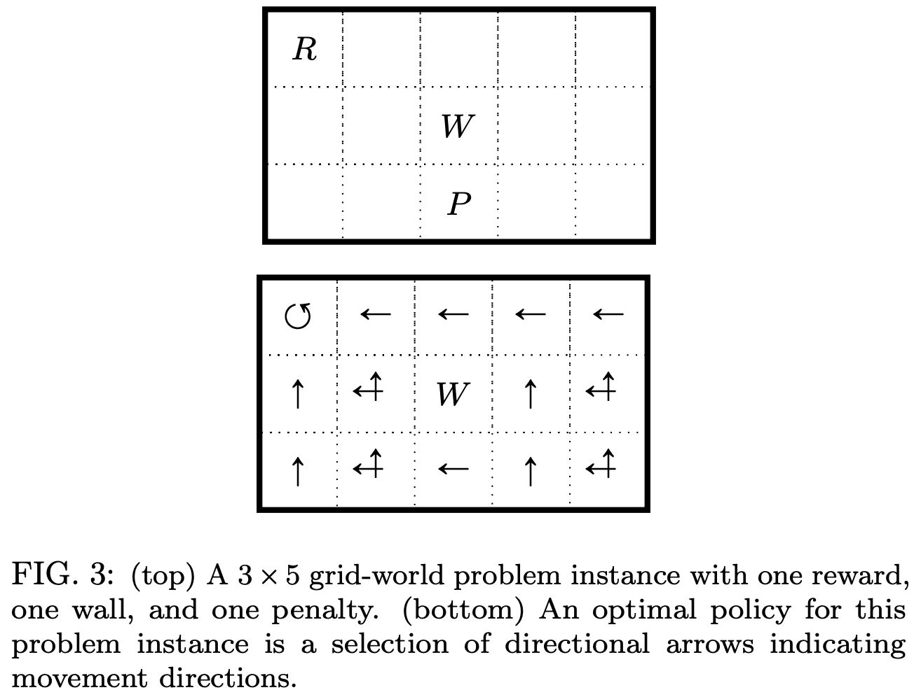
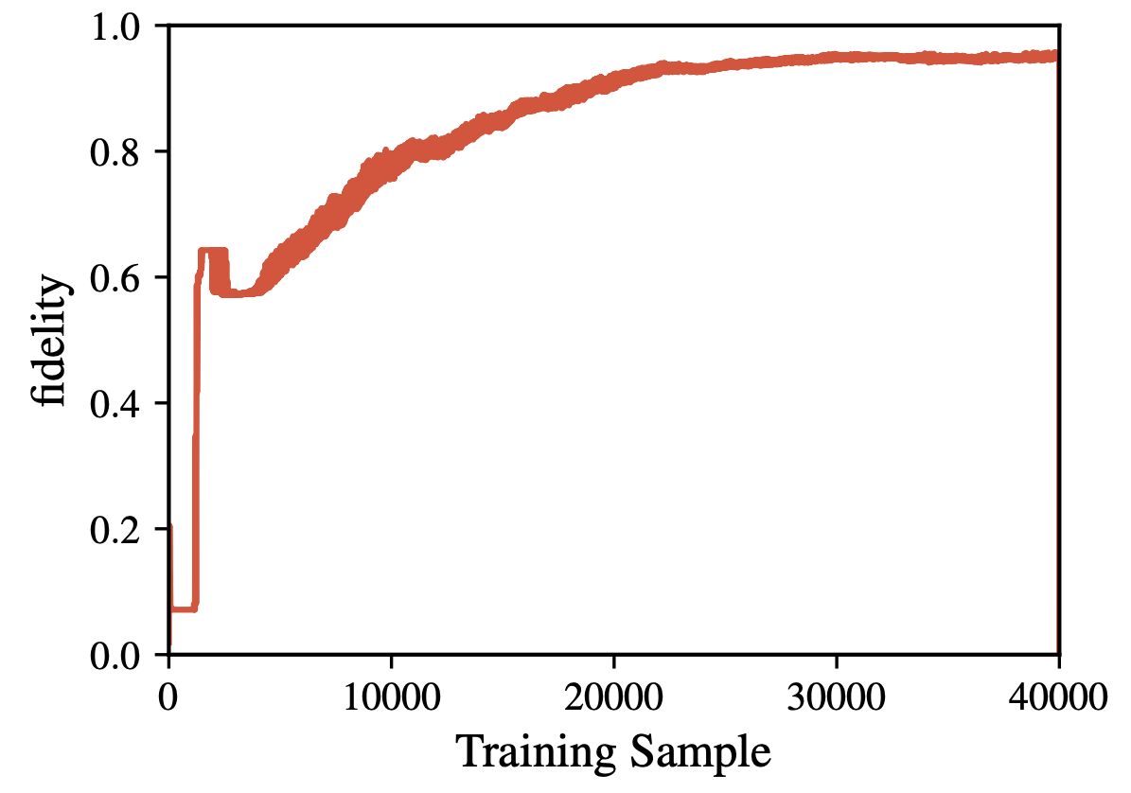
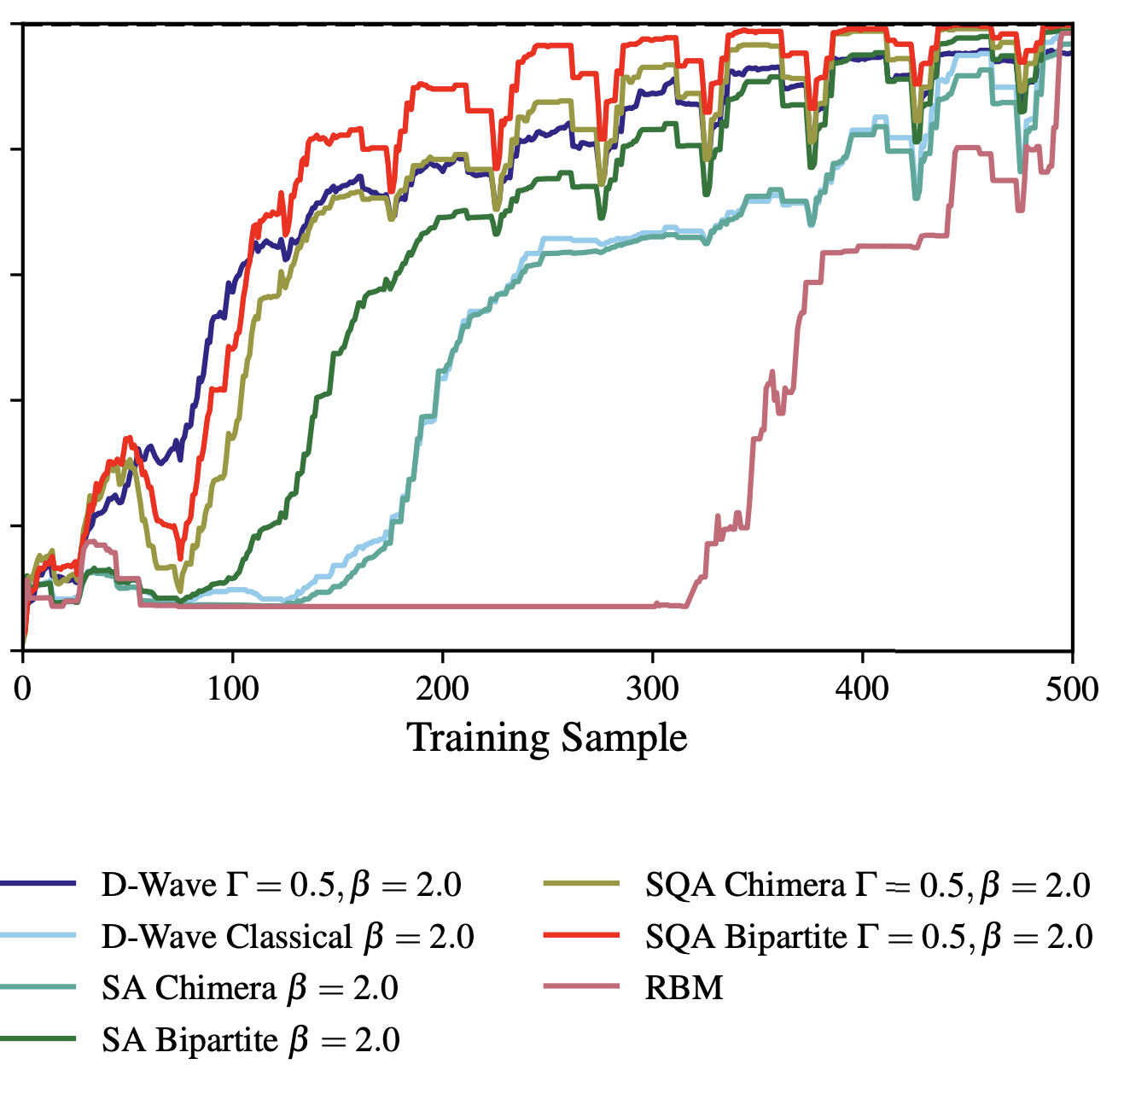
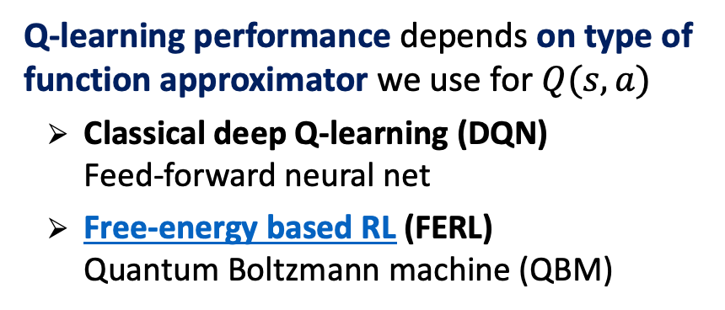

Beyond classical RL
Free energy based approach
    Q-learning performance depends on type of function approximator we use for $Q(s,a)$
      Classical deep Q-learning (DQN)
      Feed-forward neural net
      Free-energy based RL (FERL)
      Quantum Boltzmann machine (QBM)
$$π^{∗}$$
DQN
FERL
https://arxiv.org/pdf/1706.00074.pdf

Slide 19
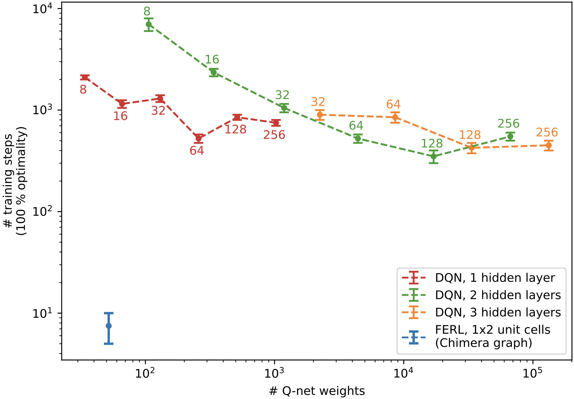
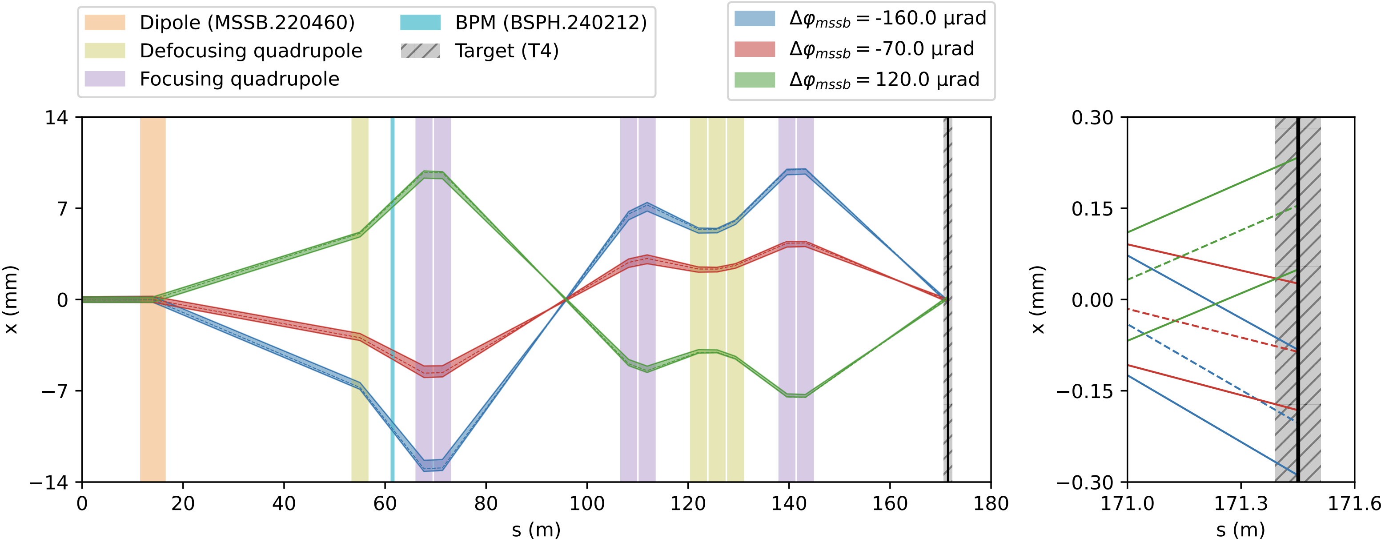
Beyond classical RL
Motivation: 1st study for 1D beam steering
    This looks interesting
    How does FERL work?
    Quantum Boltzmann machine combined with quantum annealing
    Can we test it on other accelerator physics problems?
    Our first attempt: 1D beam steering problem for SPS NA
    Continuous state: beam position (1D)
    Discrete action: ±Δ on magnet kick angle (1D)
    Reward: amount of beam on target
1D beam steering
North Area transfer line
DQN
300x fewer network parameters
50x fewer training steps
FERL

Slide 20
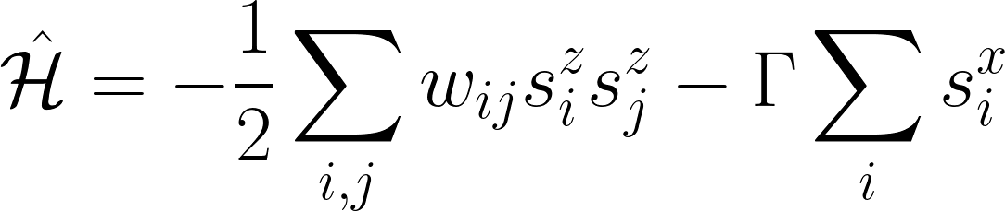
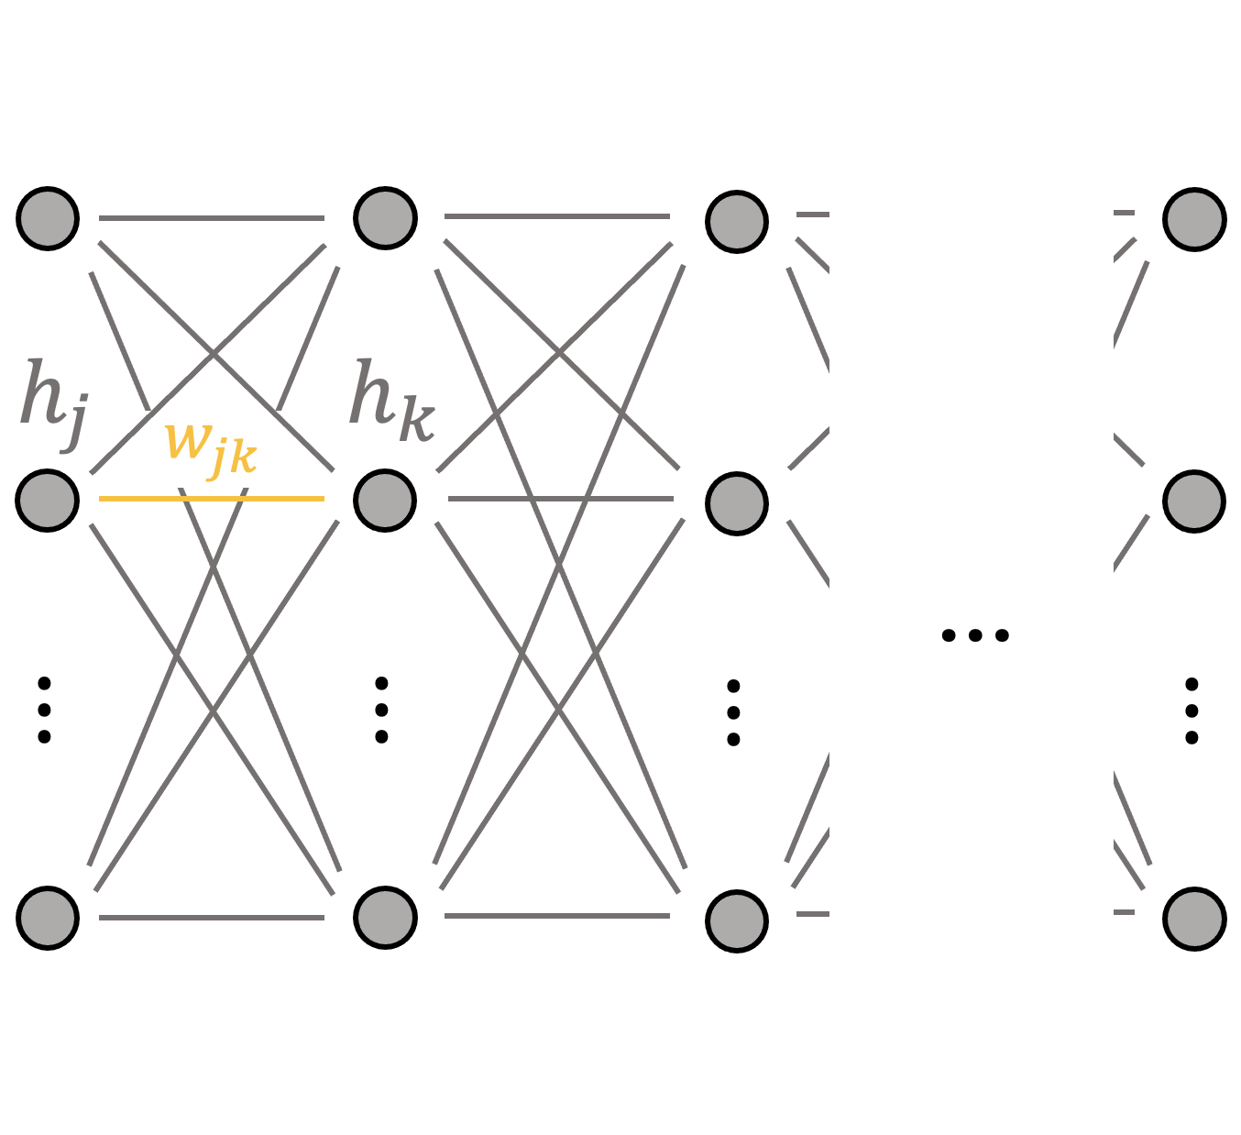
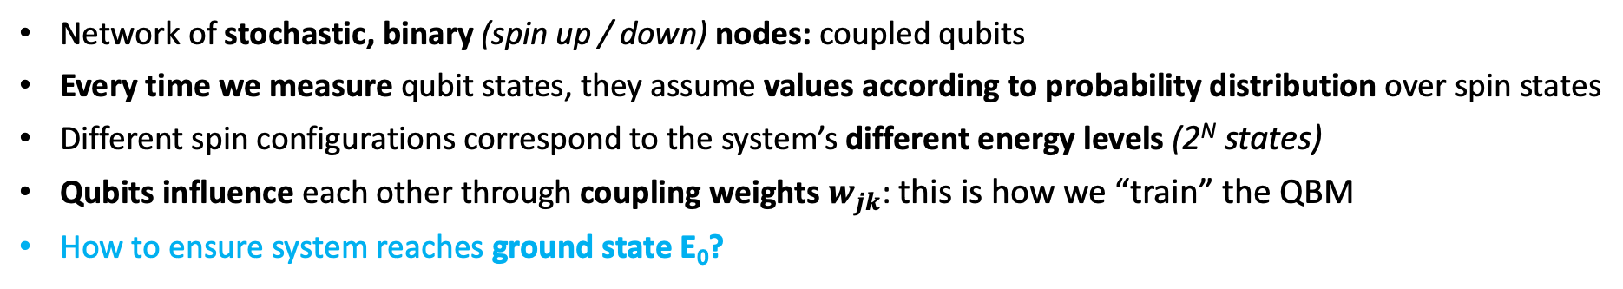
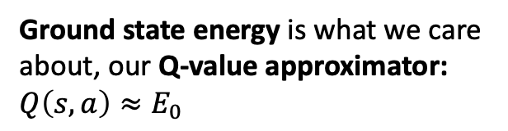
Beyond classical RL
Hamiltonian of Ising spin model
Quantum Boltzmann machine
E
…
E₃
…
E₂
Ground state energy is what we care about, our Q-value approximator: $Q\left(s,a\right)≈E_{0}$
E₁
E₀
c
Network of stochastic, binary (spin up / down) nodes: coupled qubits
Every time we measure qubit states, they assume values according to probability distribution over spin states
Different spin configurations correspond to the system’s different energy levels (2^{N} states)
Qubits influence each other through coupling weights $w_{jk}$: this is how we “train” the QBM
How to ensure system reaches ground state E₀?
(simulated) quantum annealing

Slide 21
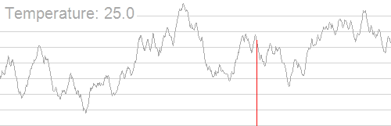
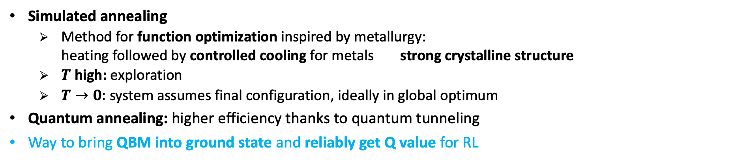
Beyond classical RL
Annealing: looking for the system’s ground state
Simulated annealing
  Method for function optimization inspired by metallurgy:
  heating followed by controlled cooling for metals strong crystalline structure
  $T$ high: exploration
  $T→0:$ system assumes final configuration, ideally in global optimum
Quantum annealing: higher efficiency thanks to quantum tunneling
Way to bring QBM into ground state and reliably get Q value for RL
Energy E
  Think of objective function as landscape with hills and valleys
Thermal annealing
Quantum annealers
Different type of quantum computer: non-gate based
More qubits, but not as generic as gate-based QPUs
Suited for quadratic minimization problems
quantum annealing
(tunneling allowed)
Spin configuration c

Slide 22


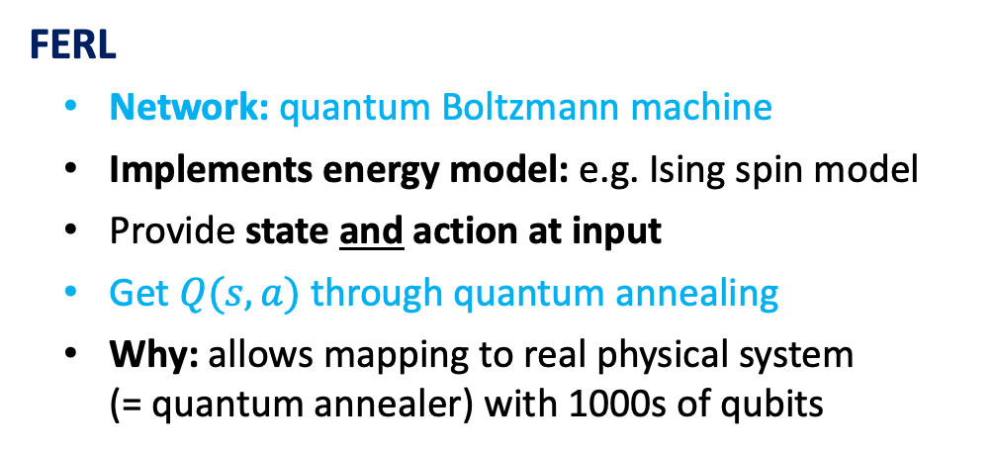
Beyond classical RL
Comparison to deep Q-learning
Difference lies in how we approximate and predict Q
DQN
Network: typically fully connected feed-forward
Provide state at input
Q-value estimates at output for discrete set of actions
$$Q(s, a_{1})$$
$$Q(s, a_{m−1})$$
$$Q(s, a_{m})$$
FERL
Network: quantum Boltzmann machine
Implements energy model: e.g. Ising spin model
Provide state and action at input
Get $Q(s, a)$ through quantum annealing
Why: allows mapping to real physical system
(= quantum annealer) with 1000s of qubits

Slide 23

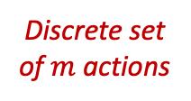
Beyond classical RL
Developing a hybrid actor-critic scheme for continuous action-space problems
Q-learning: only discrete action-space environments
Accelerator optimization requires continuous action space develop hybrid actor-critic algorithm
Based on Deep Deterministic Policy Gradient family: DDPG, TD3, etc.
  QBM replaces classical critic, train with FERL approach
  Does it work? Can we exploit high learning efficiency of FERL?
  Intuitively: if critic learns faster, should benefit actor training via policy gradient
Q-learning
DDPG family
$$Q(s, a_{1})$$
QBM
Classical
$$∈ℝ^{n}$$
$$Q(s, a_{m−1})$$
$$Q(s, a_{m})$$
Discrete set of $m$ actions

Slide 24
Contents
    Introduction
    Reinforcement learning
    Beyond classical RL
    Results
    Conclusions & outlook

Slide 25
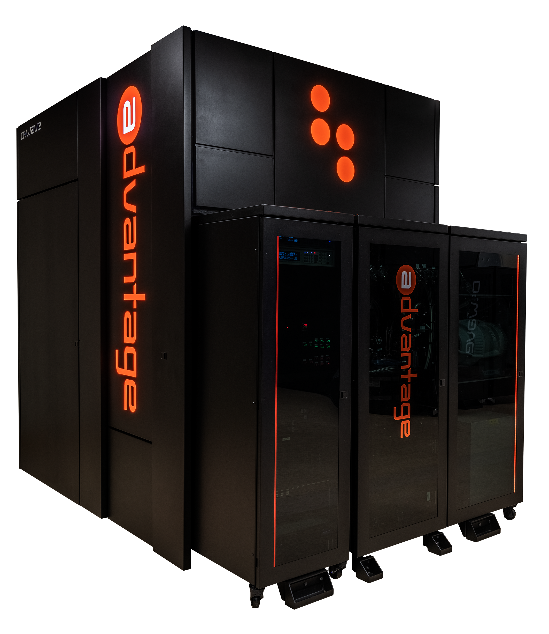
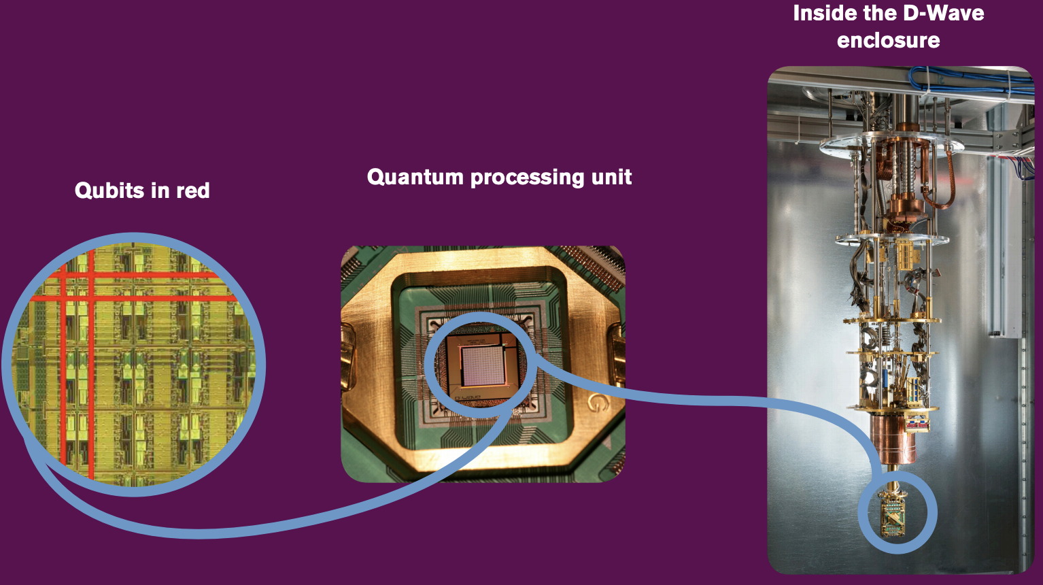
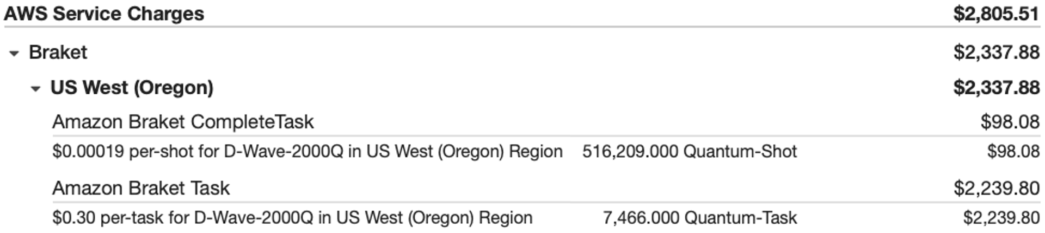
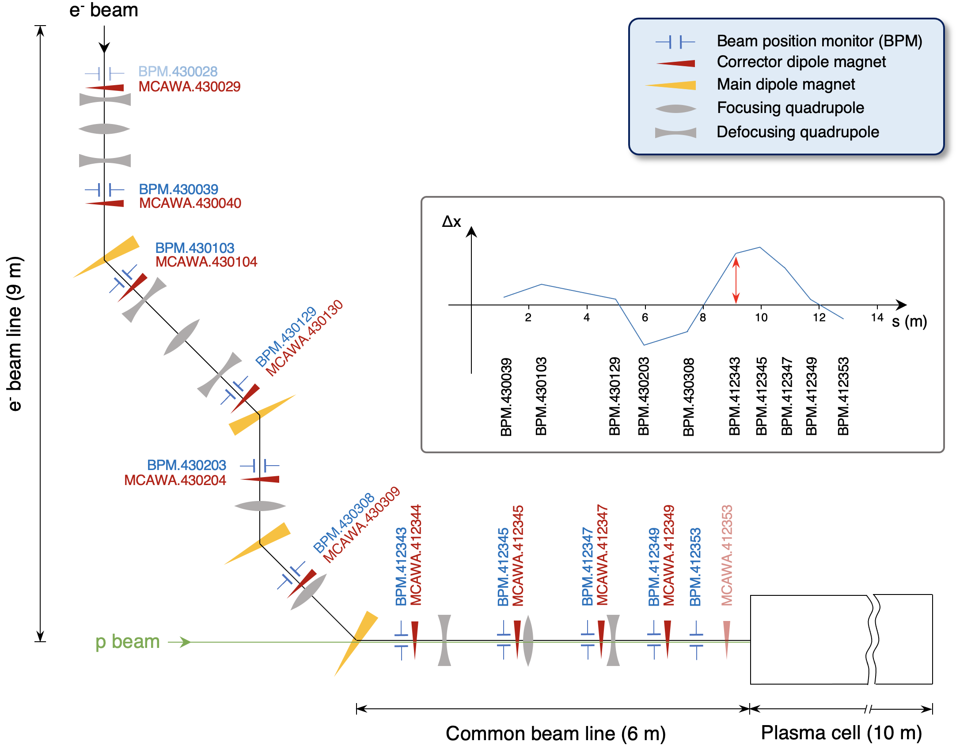


2nd study: 10D continuous beam steering
RL problem and training on quantum annealer
Framing the RL problem
Action: deflection angles at 10 correctors
State: beam positions at 10 BPMs
Objective: minimize beam trajectory rms
reward: negative rms from 10 BPMs
🤯
Training: on D-Wave Advantage quantum annealer (QA)
Objective
Exploring & learning
Success

Slide 26


2nd study: 10D continuous beam steering
Evaluation
Real (QA) vs simulated (SQA) quantum annealing
But it works ☺ !
Hyperparameter tuning with simulated quantum annealing
Consistent performance on simulated line
Agents minimize rms in 1 step for 60 – 70 % cases
Both also perform fine on real beamline
SQA-agent better on real line compared to QA agent
Simulated beam line
Real beam line

Slide 27


2nd study: 10D continuous beam steering
Comparison to a classical actor-critic
Slight improvement in terms of sample efficiency
50 vs 70 interactions
Very few interactions sufficient for both approaches
Dynamics potentially too simple (linear problem)
Move towards non-linear RL benchmarks

Slide 28

3rd study: Cart-Pole v1
Overview
Cart-Pole v1: official env from classic control problems domain
  Continuous state (4D): cart position & velocity, pole angle & angular velocity
  Discrete action (1D): push cart left or right
  Reward: +1 per iteration
  Max. episode length: 500 iterations
Non-linear dynamics
Agents
  Deep Q-learning: various architectures optimized with ray-tune
  FERL: 2x2 unit cell QBM (32 qubits), simulated QA and on D-Wave

Slide 29


3rd study: Cart-Pole v1
Comparing DQN vs FERL
Deep Q-learning
FERL (simulated QA)
Preliminary

Slide 30



3rd study: Cart-Pole v1
Comparing with D-Wave hardware
Deep Q-learning
FERL (simulated QA)
FERL (trained on D-Wave)
Preliminary
before
after
Big gain in sample efficiency and robustness for FERL vs DQN
Similar performance on D-Wave hardware

Slide 31

3rd study: Cart-Pole v1
Incredibly fast convergence
Next: how about non-linear continuous action problems?
More detailed study on FERL
Distribution of episode length before and after different numbers of training iterations
  50 independent agents
  40 evaluation episodes
Same 40 initial states for every agent
N_{train} = 100: all agents optimal

Slide 32




4th study: Pendulum-v1
Continuous action space
Classic DDPG (baseline)

Slide 33
Contents
    Introduction
    Reinforcement learning
    Beyond classical RL
    Results
    Conclusions & outlook

Slide 34
Some speculation
Why we think FERL could be more efficient than a classical approach?
Based on observations made …
Thought 1
  QBMs have higher expressivity compared to classical networks:
  every node is defined by a probability distribution, rather than a simple marix multiplication
  Hence require fewer nodes than classical networks to represent Q-function
  This means fewer parameters to fit and hence less training data needed
  N.B.: classical network with few nodes failed to solve the task
Thought 2
  QBM training itself is more efficient, i.e. fewer weight updates needed to reach convergence
  Reason: quantum annealing finds global optimum more reliably

Slide 35



Final remarks & outlook
RL is powerful, but comes with a number of challenges, such as achieving good sample efficiency
Depends on Q-approximator & algorithm:
FERL shown to be more sample efficient than classical approach
Developed hybrid actor-critic to solve continuous action problems
Successfully trained on simulated & real quantum annealer
and evaluated on simulated & real AWAKE beam line
FERL on non-linear Cart-Pole problem shows very fast convergence
Outlook: try different quantum hardware, progress on non-linear continuous action problem, explore alternative algorithm(s)
Questions?

Slide 36
Backup

Slide 37



Beyond classical RL
Motivation: 1st study for 1D beam steering
Online Learning
Learn directly from latest experience
Highly correlated data
Agent learns from each interaction once and discards it immediately after
10³ x fewer
Experience Replay
Save transitions into memory buffer
Sample batch B from buffer to train agent at every step
50 x fewer
https://www.endtoend.ai/paper-unraveled/cer/

Slide 38

3rd study: Cart-Pole v1
Coupling weights evolution: simulated vs real QA
QBM coupling weights trained with SQA and on QPU
  Similar distribution and convergence time scales

Slide 39




Alternative approaches
RL with QAOA
QAOA: Quantum Approximate Optimization Algorithm
Solver for combinatorial optimization problems: finds spin configuration with minimum energy; not based on annealing, but more generic gate-based QPU
Can solve quadratic unconstrained binary optimization (QUBO) problems
Works well, but simulations compute-intensive (~5.5 h for 100 interactions)
On hardware (e.g. IBM), could be affected by noise
Training
Evaluation

Slide 40


Alternative approaches: quantum fuzzy logic controller
Evaluation on AWAKE beam line
Alternative control algorithm
Fuzzy Logic is used to develop control systems based on linguistic rules highly interpretable
Quantum Fuzzy Control System (G. Acampora, R. Schiattarella, A. Vitiello)
Exploit exponential advantage in computing fuzzy rules on quantum computers
Successfully evaluated on AWAKE beam line (no training required)
Evaluation: on AWAKE beam line
Objective reached typically in 1 step

Slide 41




QUBO formulation
QUBO: quadratic unconstrained binary optimization problems
The kind of problems that quantum computers (annealers) solve efficiently
Example with 3 qubits
$$f\left(x_{1},x_{2},x_{3}\right)=−3x_{1}+x_{1} x_{2} −x_{2} x_{3}$$
QUBO matrix
  On diagonal terms describe self-couplings, i.e. biases
  Off diagonal terms describe quadratic couplings between qubits
Run annealing 5000 times
Corresponds to our solution table
$$Q=\left[\begin{matrix}−3 & 1 & 0 \\ 0 & 0 & −1 \\ 0 & 0 & 0\end{matrix}\right]$$

