Slide 1
AMBER
BO and TN groups
P. Zuccon
5 Settembre 2023

Slide 2
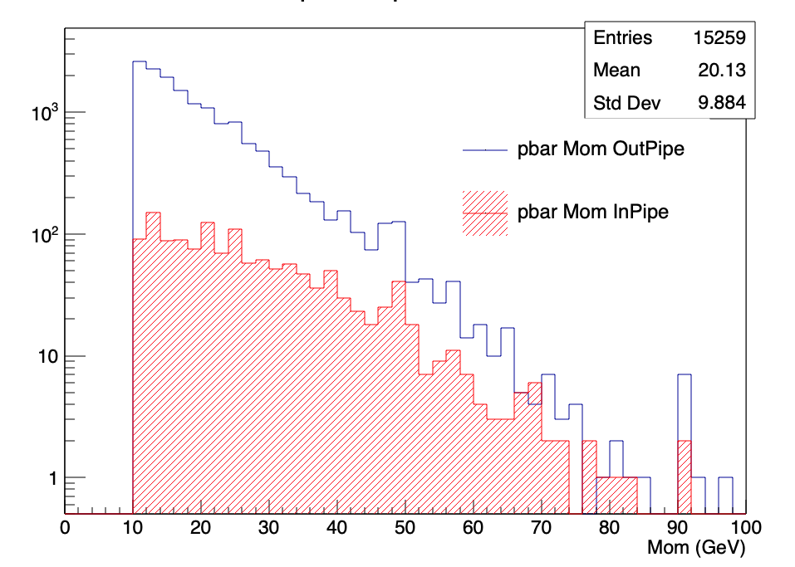
Preparation to the 2023 data taking
Tracks above Cherenkov threshold
Development of MC simulation for the pbar setup
Study of the RICH beam pipe effect.
Estimation of the duration of data taking for each beam energy
Typical RICH mult 6.7 Tracks
Additional RICH
mult without pipe
0.4 Tracks

Slide 3
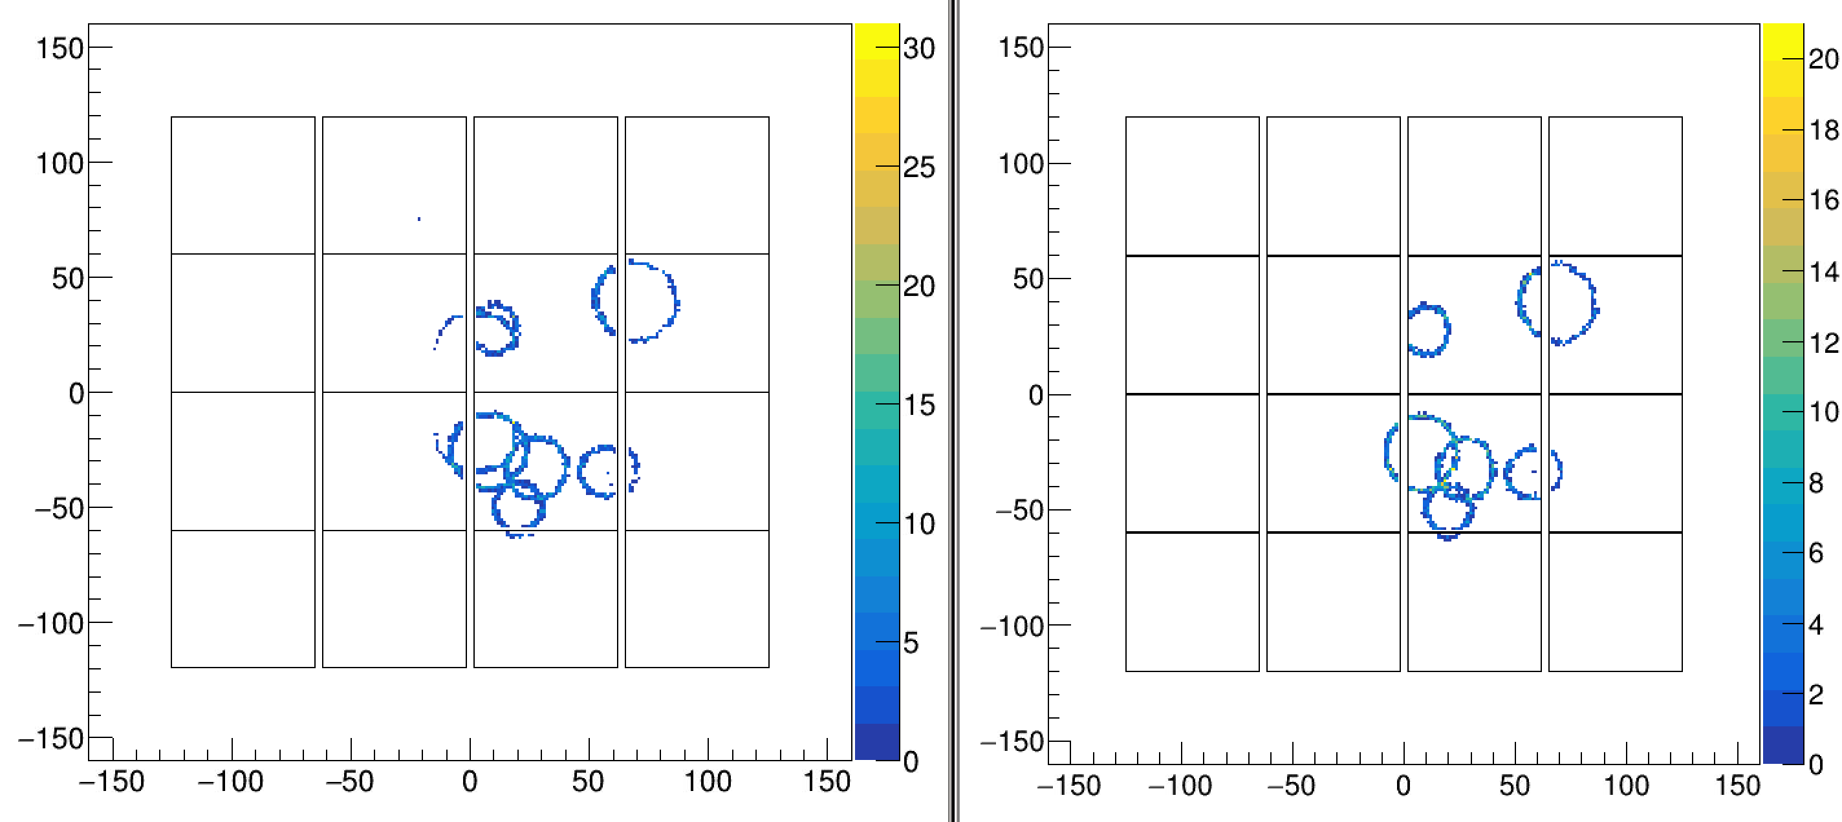
Beam Pipe effect
Yes Beam Pipe
No Beam Pipe
additional ring

Slide 4
Run 2023
Physics Coordinator (TN) presence 70% of time from May 5th to June 15th
TN + BO total of 25.8 equivalent shifts delivered during the data taking
In collaboration with TO managed to deploy the data reconstruction on the new setup
Start the Alignment procedure
Control the delivery of the calibration data

Slide 5
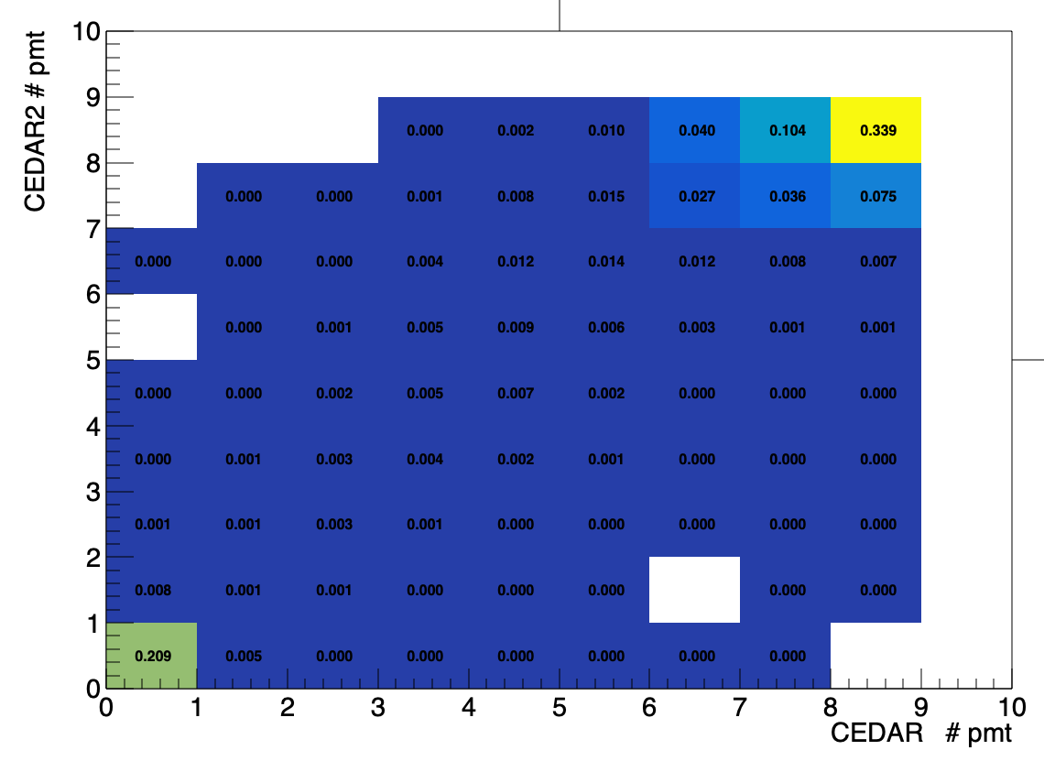
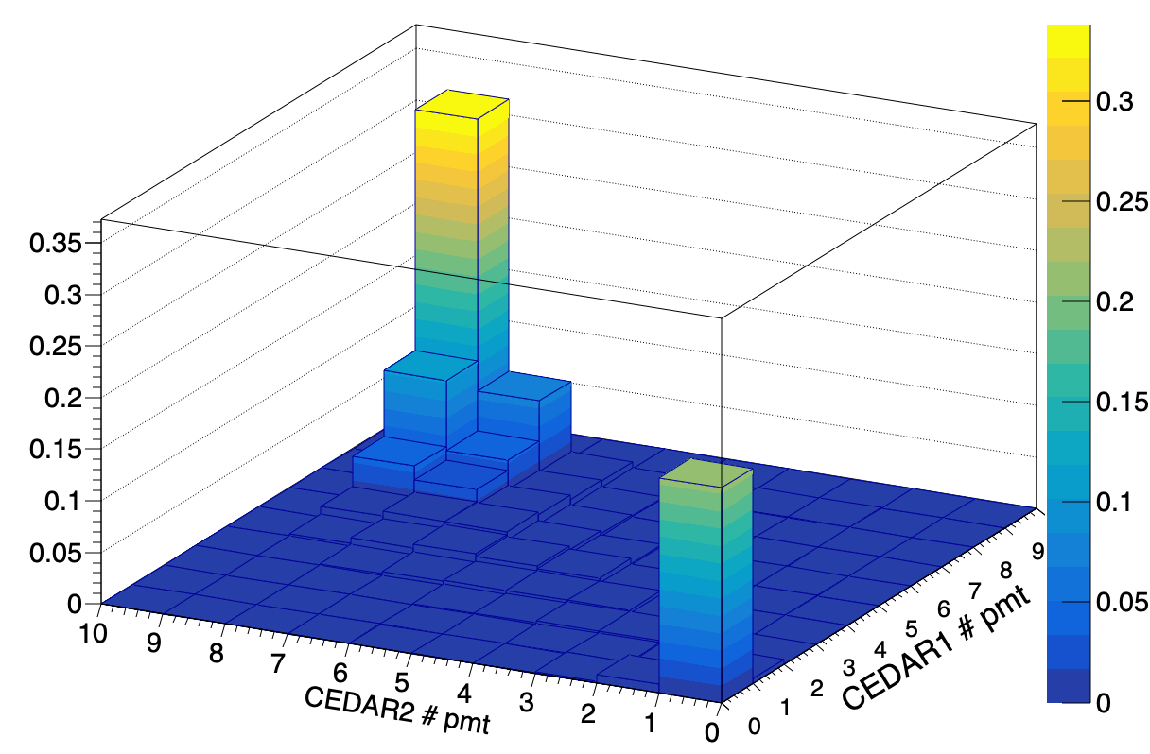
CEDAR Selection p 190 GeV/c
CEDAR1 >= 6 pmts
CEDAR2 >= 7 pmts
62.6%

Slide 6
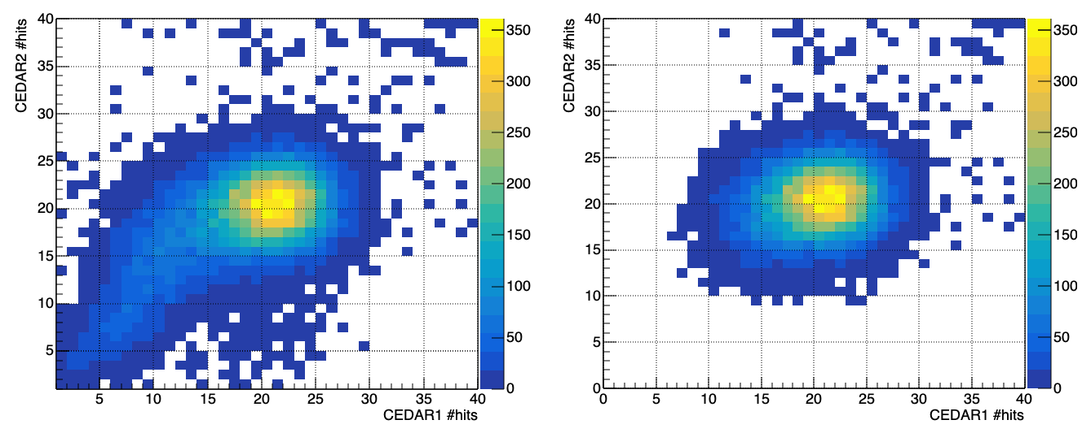
Effect of the CEDAR selection cut
Before N pmt cut
After N pmt cut
Total number of CEDARs hits
Total number of CEDARs hits

Slide 7
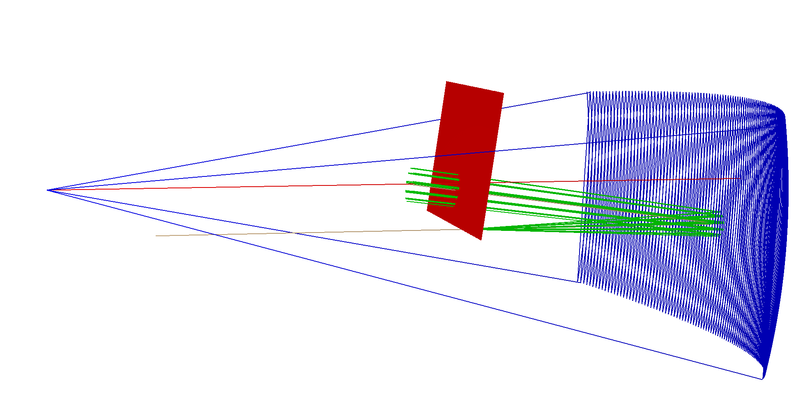
Analysis tool
RICH fast simulation:
ROOT based
Allow prediction of photons on detector plane
Particle identification
Simulation of multiple particle RICH ring production
Whole event particle identification

Slide 8
Requests for 2024
Missioni per supportare il possibile run di misura di cross section di pbar in interazioni p-p ( bersaglio di idrogeno liquido).
Supporto alla analisi dati (meeting al CERN e in Italia) e alla disseminazione dei risultati ( conferenze e pubblicazioni)

