Slide 1
Training vs Quadrant in MQXFS
Susana Izquierdo Bermudez

Slide 2
General considerations
Training strategy:
MQXFS3a/b/c and MQXFS5 trained protecting with EE+QH
The rest of the magnets use QH+CLIQ up to Iult, QH + EE from Iult to Iss
The CLIQ parameters for the training are 200 V/50 mF, which corresponds to a peak current of about 2 kA
Conductors with different layouts, in some cases, coils already trained in a previous assembly (in bold in the table below)
 | Training strategy | Coil ordering
 |  | Q1 | Q2 | Q3 | Q4
MQXFS3a/b | QH + EE | 7 | 105 | 107 | 106 |  | RRP 108-127
MQXFS3c |  | 107 | 106 | 8 | 105 |  | RRP 144-169
MQXFS5a |  | 203 | 205 | 204 | 206 |  | RRP 132-169
MQXFS4a/b/c | QH+CLIQ up to I_{ult}, QH + EE from I_{ult} to I_{ss} | 109 | 111 | 108 | 110 |  | PIT 192
MQXFS6a |  | 209 | 210 | 208 | 212 |  | PIT 192 Bundle
MQXFS6b/c/d |  | 204 | 210 | 203 | 212
MQXFS7a-f |  | 211 | 114 | 113 | 207
MQXFS8 |  | 115 | 210 | 116 | 212

Slide 3
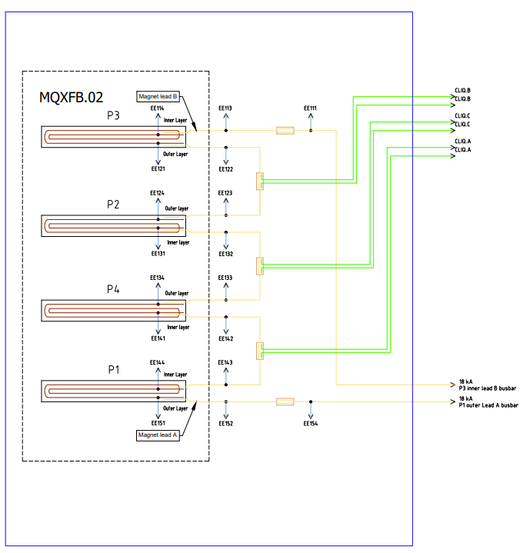
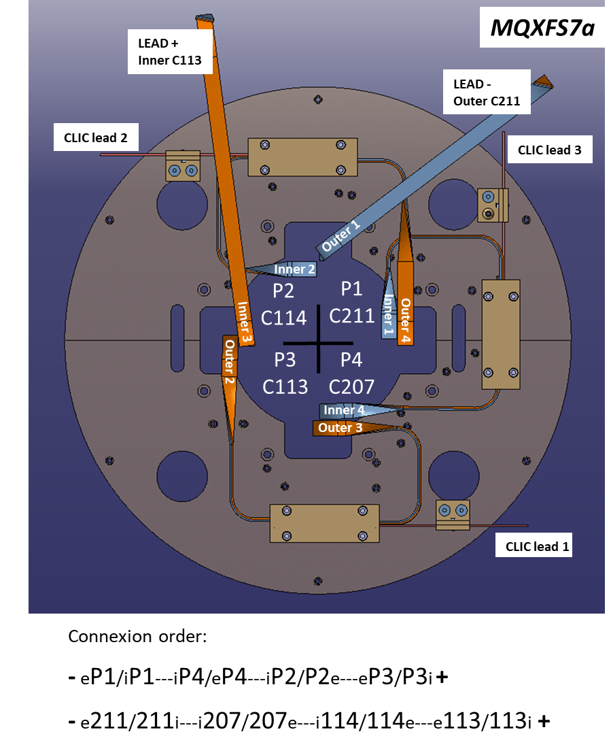
Connection scheme long vs short
Basically the same for MQXFB and MQXFS, except for MQXFS3 where the connection was different, but it was not used for the training
Magnet connection polarity: B is positive, A is negative.
CLIQ connection polarity: B is positive, A is negative.
Quench heater connection polarity: B is positive, A is negative.

Slide 4
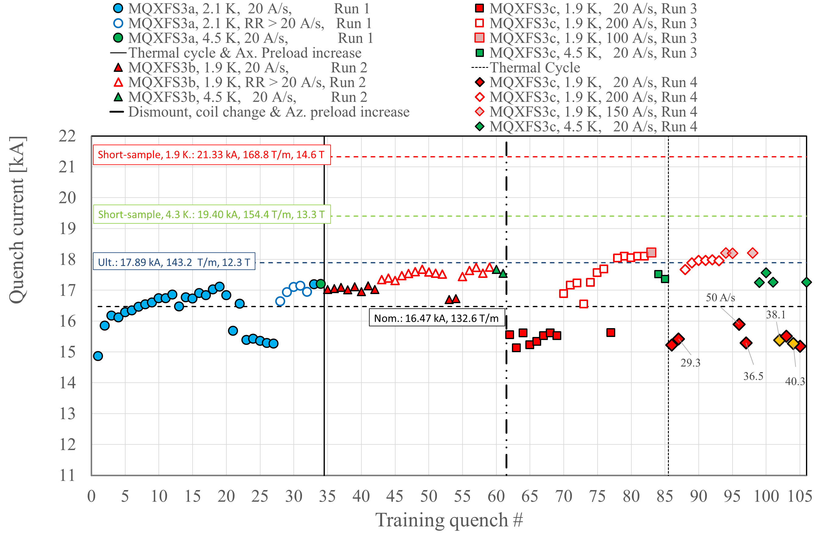
MQXFS3
I will look only at the first part of the training of S3a (up to ≈17 kA)

Slide 5
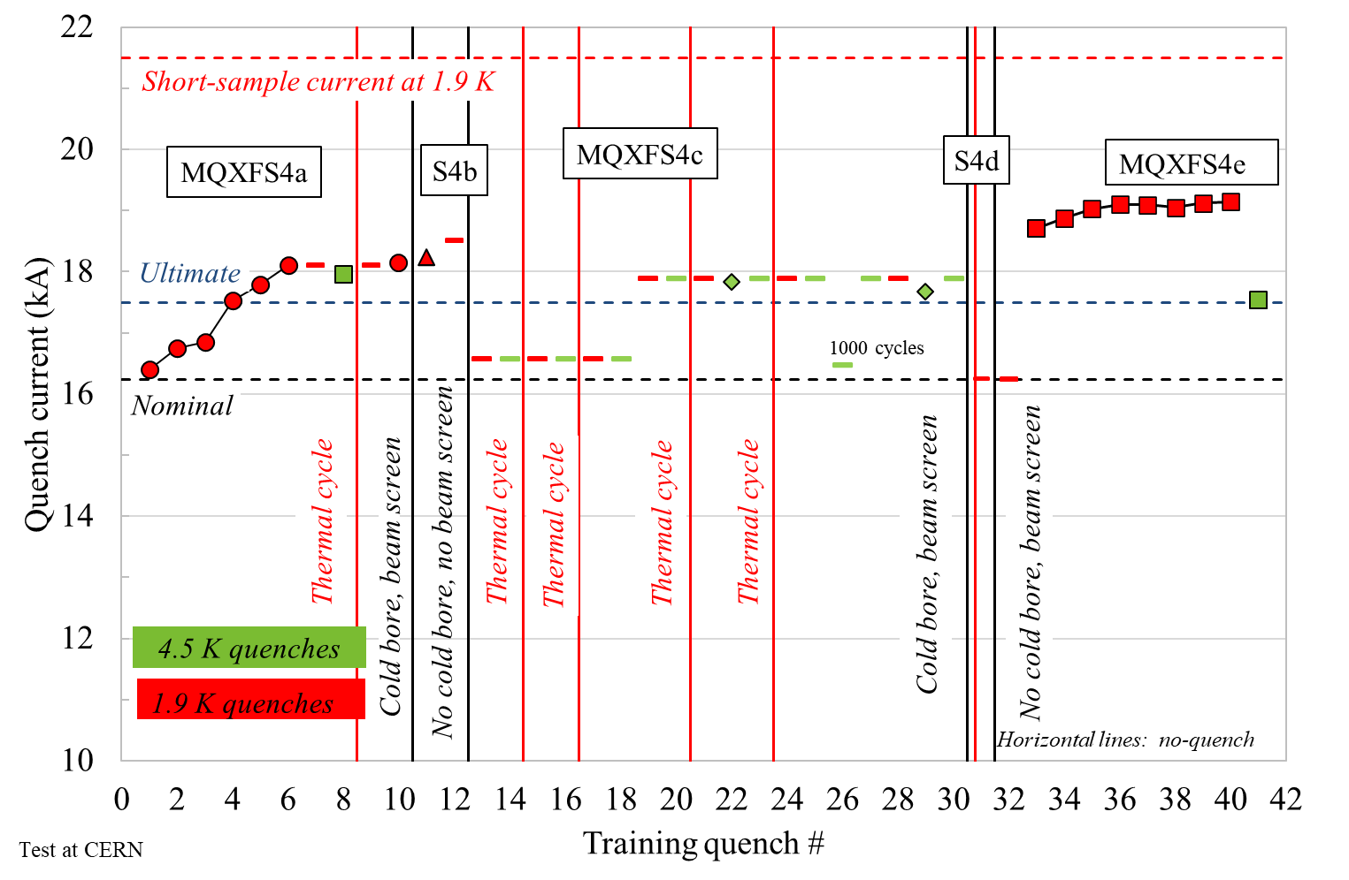
MQXFS4

Slide 6
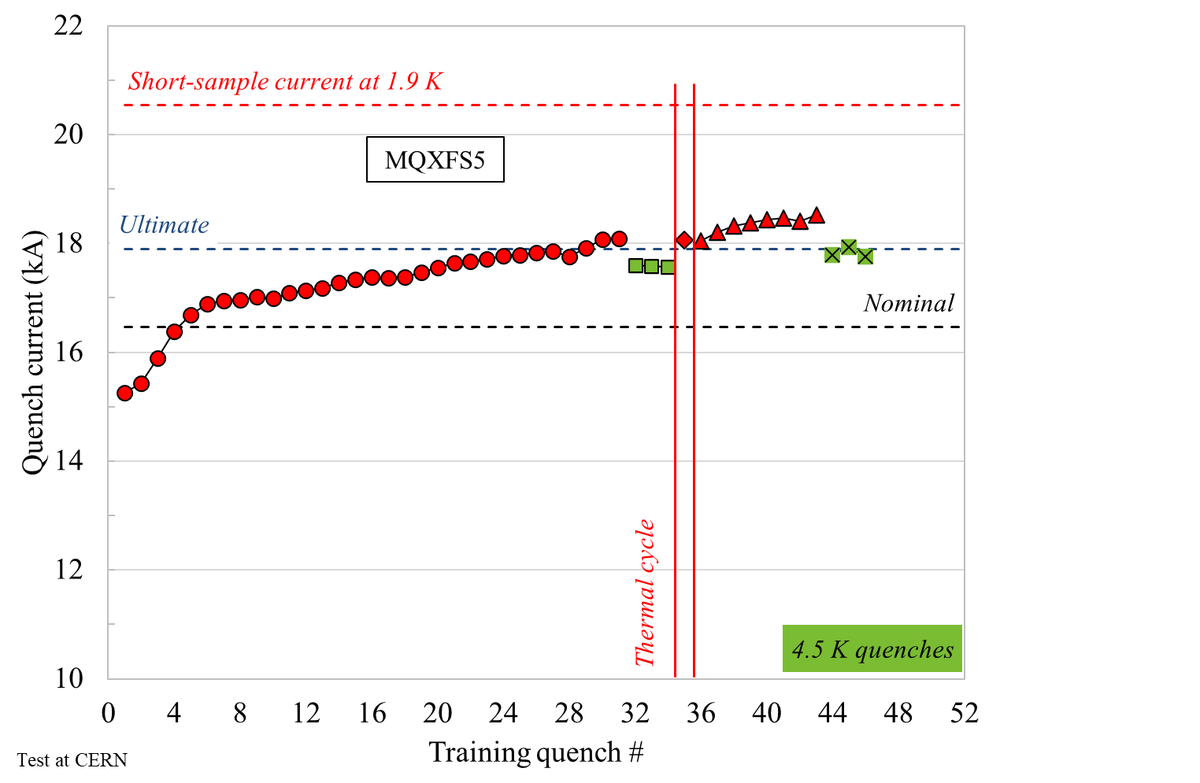
MQXFS5

Slide 7
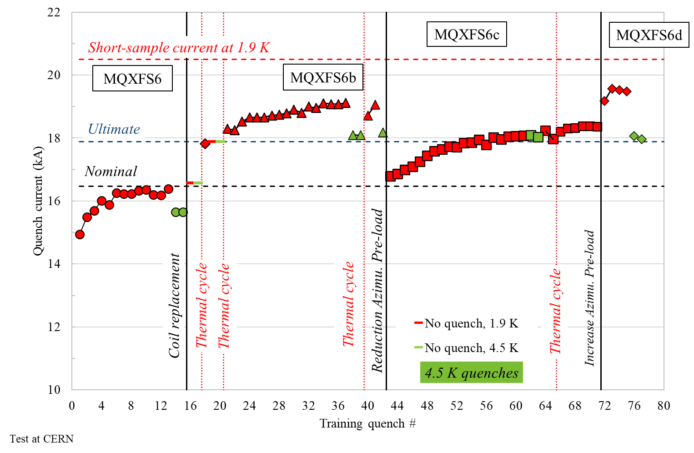
MQXFS6

Slide 8
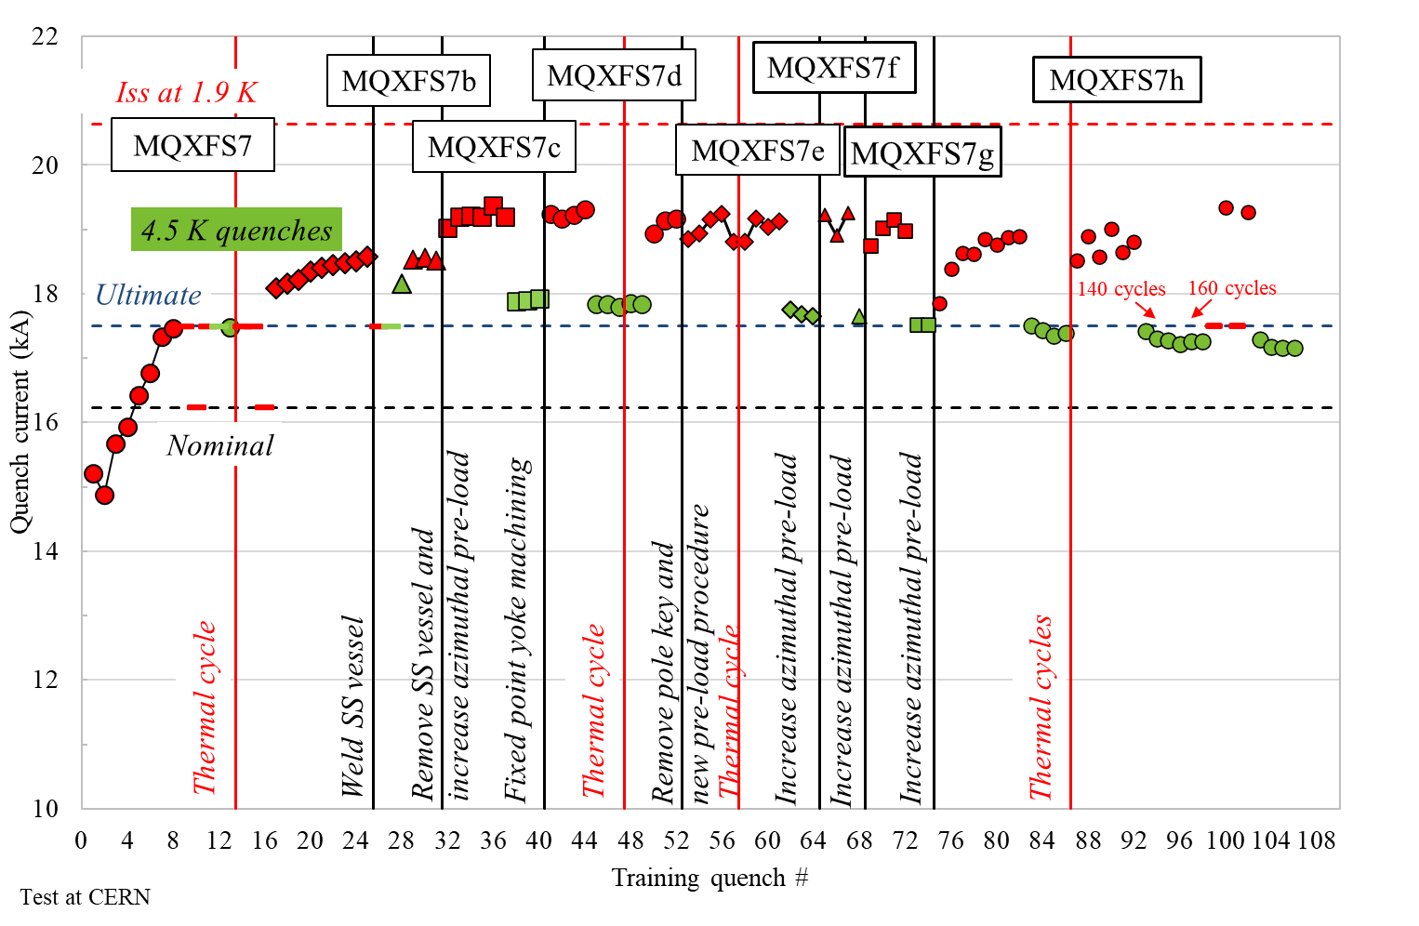
MQXFS7

Slide 9
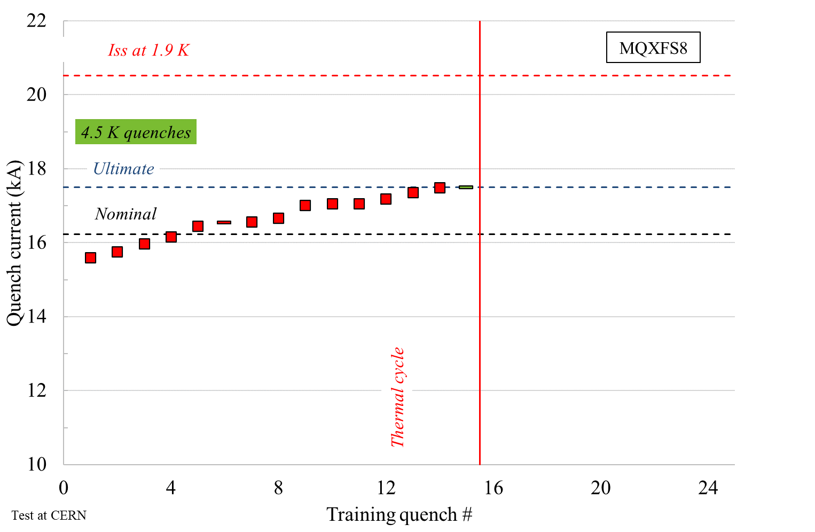
MQXFS8
Not trained yet to Imax

Slide 10
First quench
 | Training | First Quench
 | strategy | Q1 | Q2 | Q3 | Q4
MQXFS3a/b | QH + EE | 7 | 105 | 107 | 106
MQXFS3c |  | 107 | 106 | 8 | 105
MQXFS5a |  | 203 | 205 | 204 | 206
MQXFS4a/b/c | QH+CLIQ up to I_{ult}, QH + EE from Iult to Iss | 109 | 111 | 108 | 110
MQXFS6a |  | 209 | 210 | 208 | 212
MQXFS6b/c/d |  | 204 | 210 | 203 | 212
MQXFS7a-f |  | 211 | 114 | 113 | 207
MQXFS8 |  | 115 | 210 | 116 | 212

Slide 11
# quenches to reach I_{target} and I_{max}
For the coils assembled in a previous magnet (bold), I also count for the quenches in the previous run (s)
n.a. means not applicable because the magnet did not reach ultimate current
 | Training | # quenches to 16.5 kA (excluding 1st quench)
 | strategy | Q1 |  | Q2 |  | Q3 |  | Q4
MQXFS3a/b | QH + EE | 7 | 0 | 105 | 5 | 107 | 1 | 106 | 0
MQXFS5a |  | 203 | 0 | 205 | 1 | 204 | 1 | 206 | 1
MQXFS4a/b/c | QH+CLIQ up to I_{ult}, QH + EE from Iult to Iss | 109 | 0 | 111 | 0 | 108 | 0 | 110 | 0
MQXFS6a (didn't reached 16.5 kA) |  | 209 | 2 | 210 | 0 | 208 | 12 | 212 | 0
MQXFS6b/c/d |  | 204 | 1 | 210 | 0 | 203 | 0 | 212 | 0
MQXFS7a |  | 211 | 3 | 114 | 0 | 113 | 0 | 207 | 1
MQXFS8 |  | 115 | 4 | 210 | 0 | 116 | 0 | 212 | 0
 | Training | # quenches to 17.5 kA (excluding 1st quench)
 | strategy | Q1 |  | Q2 |  | Q3 |  | Q4
MQXFS3a/b (didn't reached 17.5 kA) | QH + EE | 7 | n.a | 105 | n.a | 107 | n.a | 106 | n.a
MQXFS5a |  | 203 | 4 | 205 | 6 | 204 | 2 | 206 | 7
MQXFS4a/b/c | QH+CLIQ up to I_{ult}, QH + EE from Iult to Iss | 109 | 0 | 111 | 0 | 108 | 2 | 110 | 0
MQXFS6a (didn't reached 16.5 kA) |  | 209 | n.a | 210 | n.a | 208 | n.a | 212 | n.a
MQXFS6b |  | 204 | 1 | 210 | 0 | 203 | 0 | 212 | 0
MQXFS7a |  | 211 | 6 | 114 | 0 | 113 | 0 | 207 | 2
MQXFS8 |  | 115 | 12 | 210 | 0 | 116 | 0 | 212 | 0

Slide 12
# quenches to reach I_{max}
 | Imax | Training | # quenches to Imax (excluding 1st quench)
 |  | strategy | Q1 |  | Q2 |  | Q3 |  | Q4
MQXFS3a/b (didn't reached 17.5 kA) | n.a. | QH + EE | 7 | n.a | 105 | n.a | 107 | n.a | 106 | n.a
MQXFS5a | 18529 |  | 203 | 10 | 205 | 12 | 204 | 4 | 206 | 10
MQXFS4a/b/e | 19148 | QH+CLIQ up to I_{ult}, QH + EE from Iult to Iss | 109 | 5 | 111 | 2 | 108 | 5 | 110 | 3
MQXFS6a (didn't reached 16.5 kA) | n.a. |  | 209 | n.a | 210 | n.a | 208 | n.a | 212 | n.a
MQXFS6b | 19117 |  | 204 | 7 | 210 | 4 | 203 | 15 | 212 | 5
MQXFS7a | 18576 |  | 211 | 8 | 114 | 3 | 113 | 2 | 207 | 3
MQXFS8 | n.a. |  | 115 | n.a | 210 | n.a | 116 | n.a | 212 | n.a
Quenches at 4.5 K not considered

