Slide 1
EFT Measurements at the LHC
Jon Butterworth
Oct 2023
Benasque
I am not an EFT expert, and there are many of them here…so apologies in advance for omissions, mistakes, dim questions…

Slide 2
Data and Methods
Warsaw basis and simplifications of it
Fits to particle-level, or detector-level data
W, Z, h, γ, top (multilepton) measurements in several combinations
Often extract each coefficient assuming all others are zero
Scale Λ = 1 TeV commonly used.
Various assumptions on flavour structure
Some examples…

Slide 3
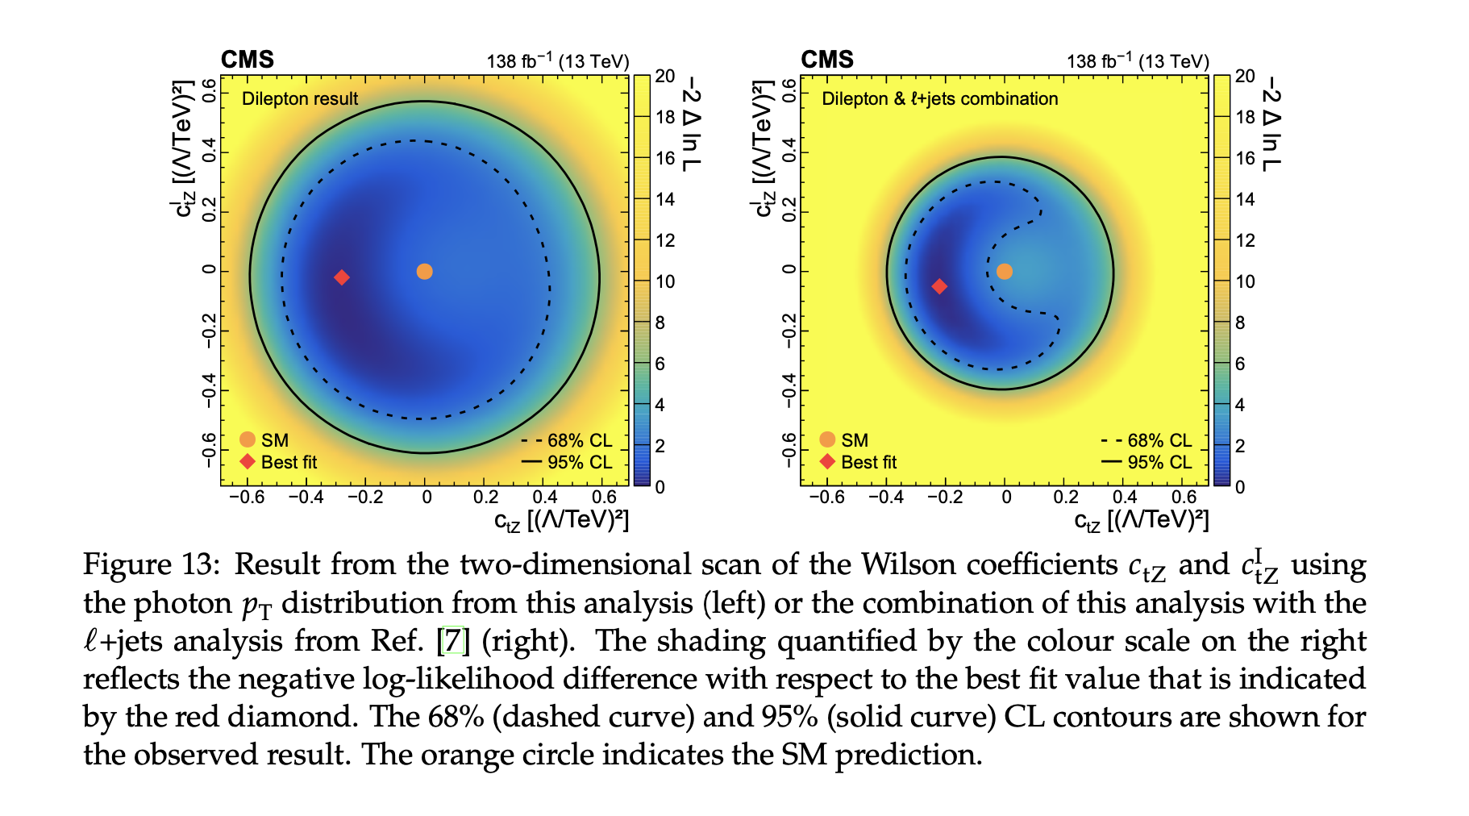
Top antitop + photon
CMS 2201.07301
Measure differential cross sections at particle-level, including the key photon p_{T} distribution
Extract constraints on effective tZ couplings in Warsaw basis, fixing tγ coupling to SM.
EFT interpretation is done via reconstructed level data (would this be reproducible from the measured cross sections?)

Slide 4
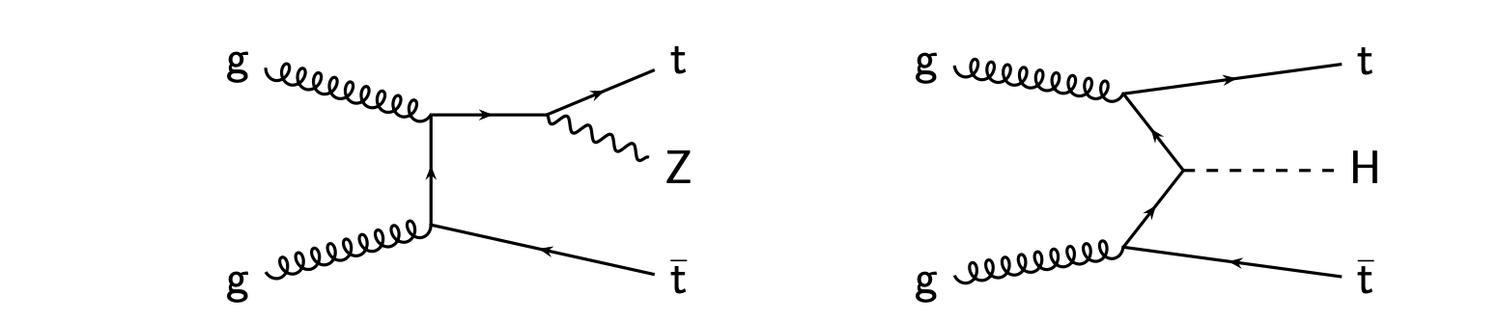
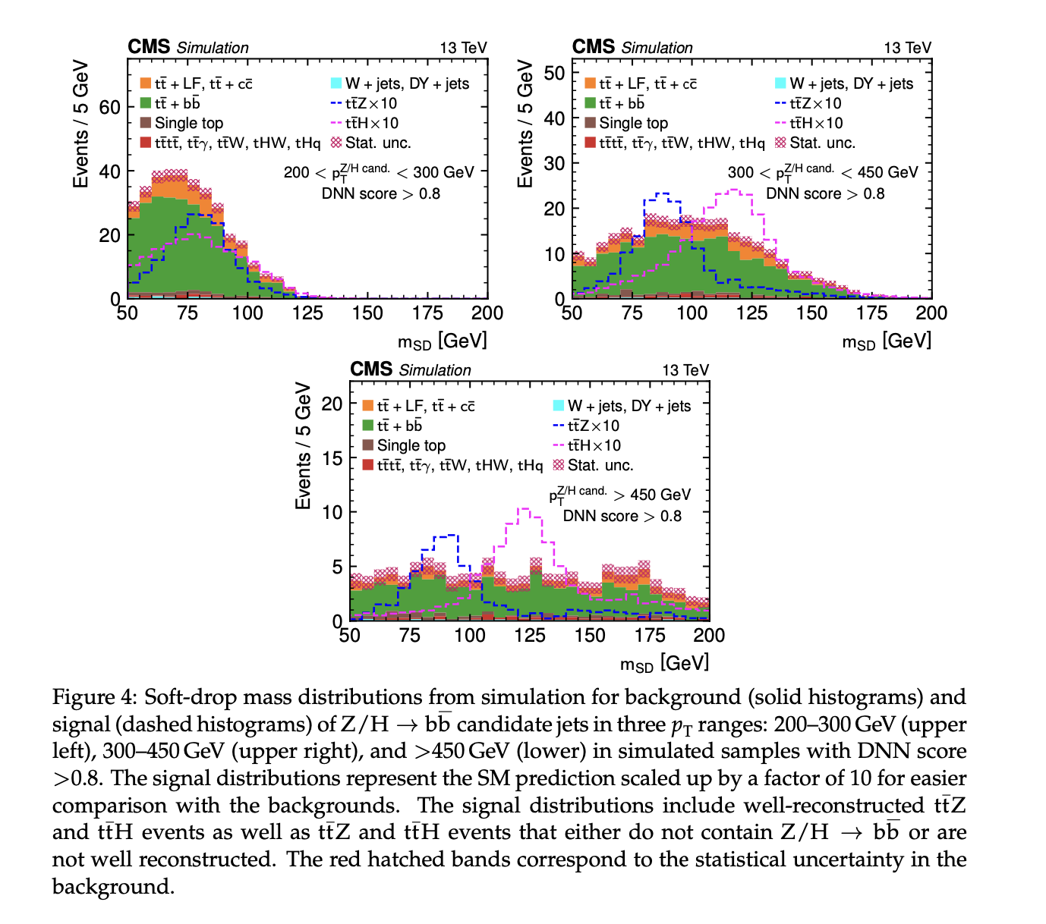
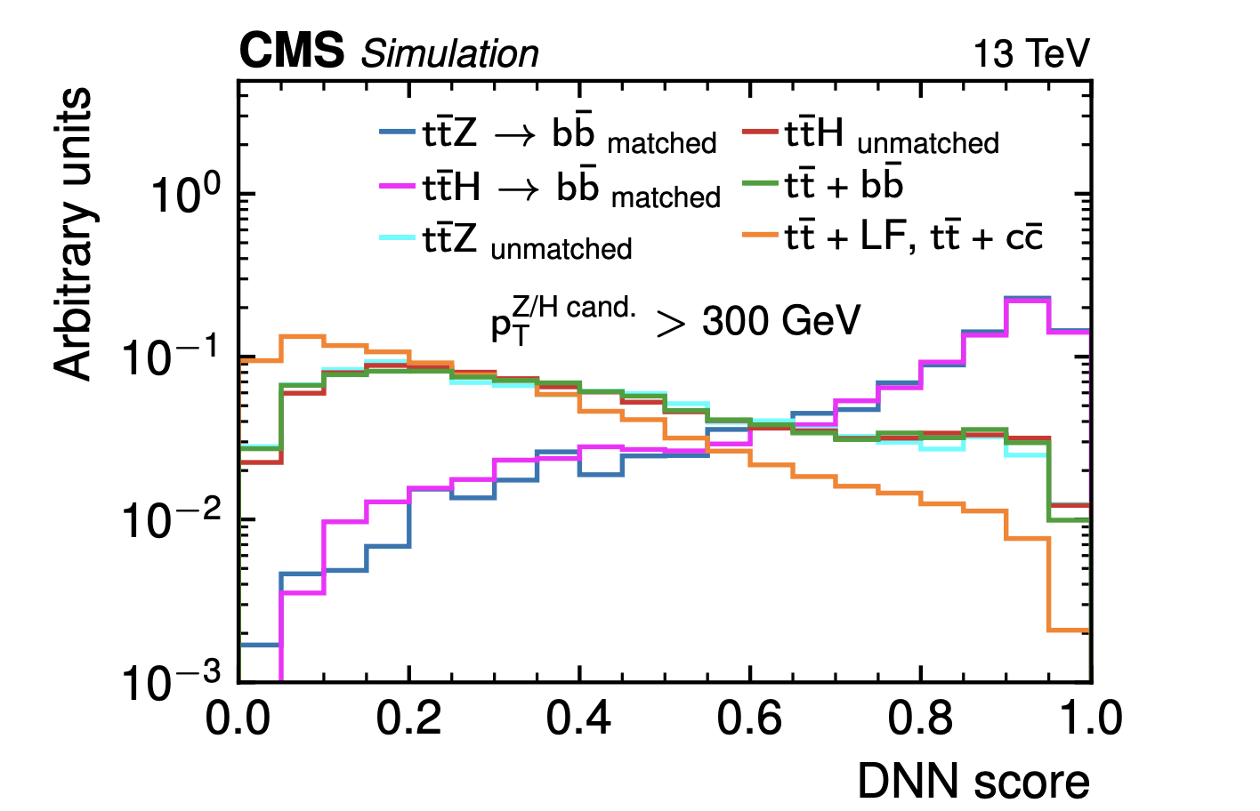
Top-antitop + (boosted Z or h)
CMS 2208.12837
DNN and softdrop mass used to reject top backgrounds (ttbb) at detector level

Slide 5
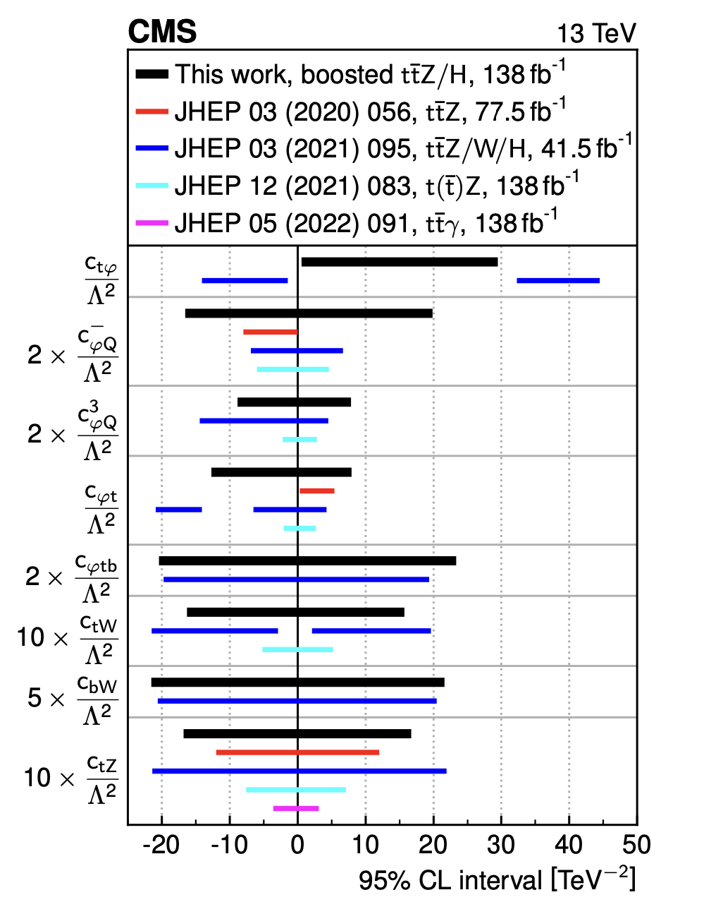
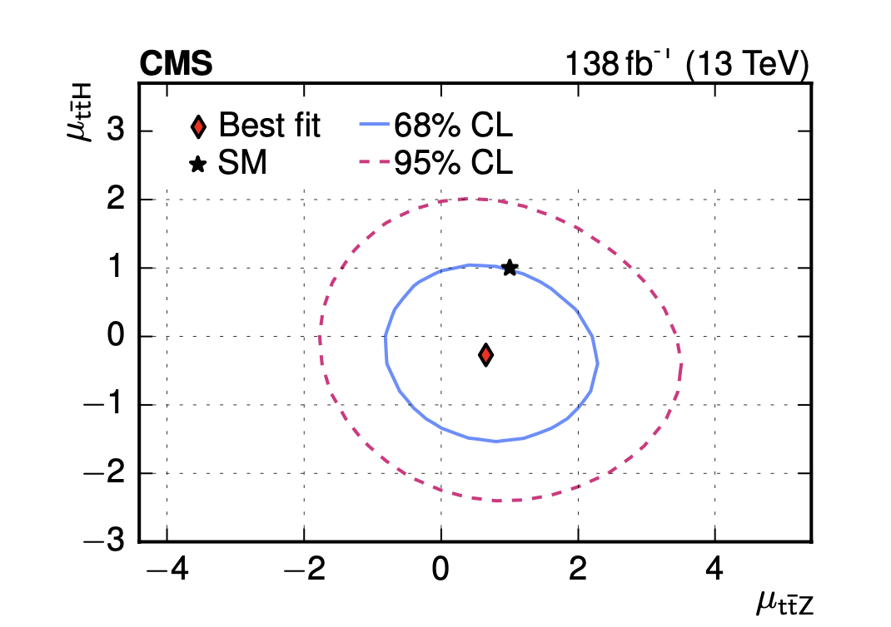
Top-antitop + (boosted Z or h)
CMS 2208.12837
DNN and softdrop mass used to reject top backgrounds (ttbb) at detector level

Slide 6
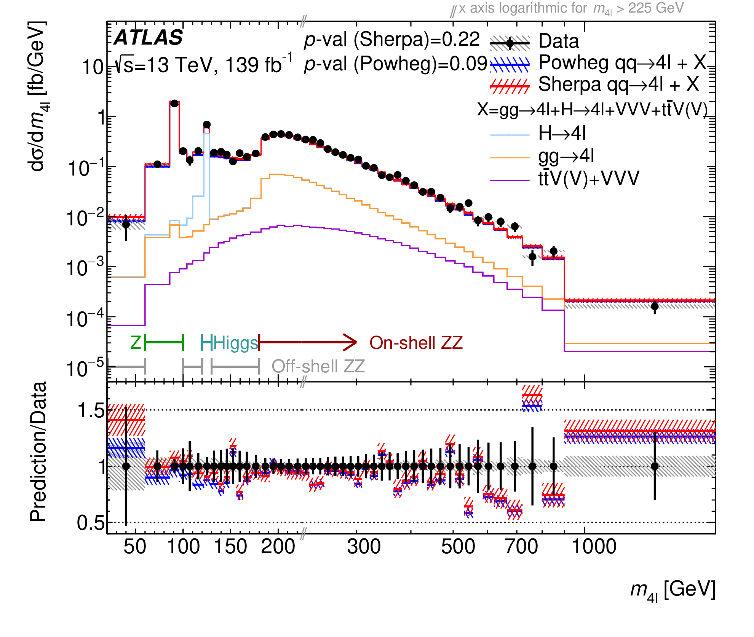
Four-lepton inclusive cross section (again)
arXiv:2103.01918
Particle-level measurement defined entirely by final state (all events with at least four leptons passing cuts are signal).
Sliced many ways into momentum and angular variables

Slide 7
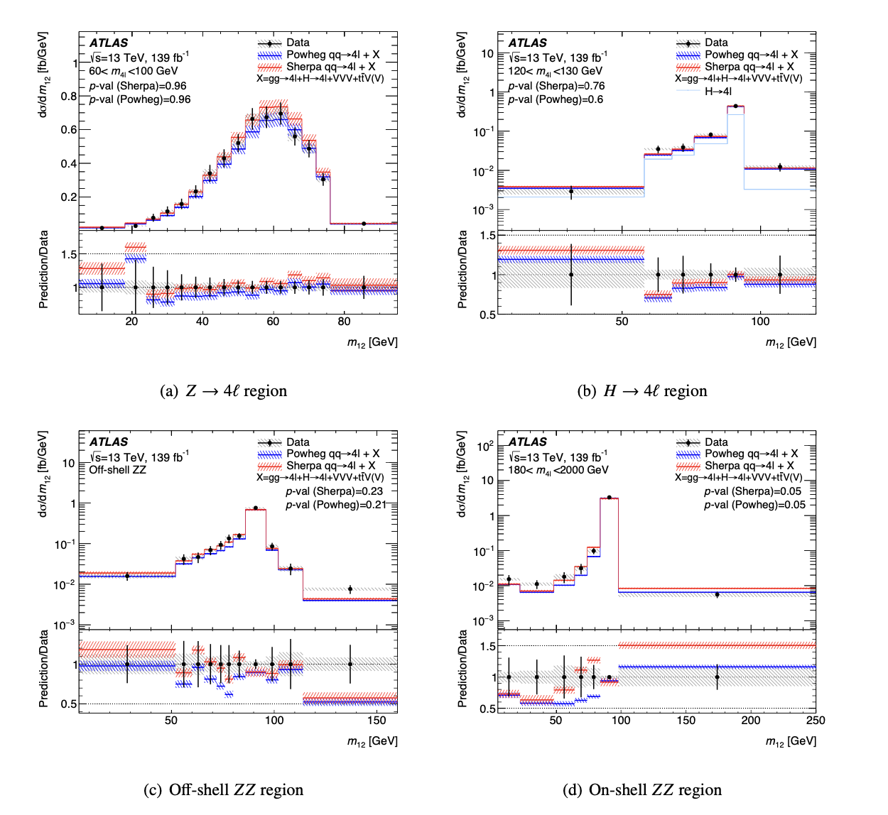
Four-lepton inclusive cross section
arXiv:2103.01918
Particle-level measurement defined entirely by final state (all events with at least four leptons passing cuts are signal).
Sliced many ways into momentum and angular variables

Slide 8
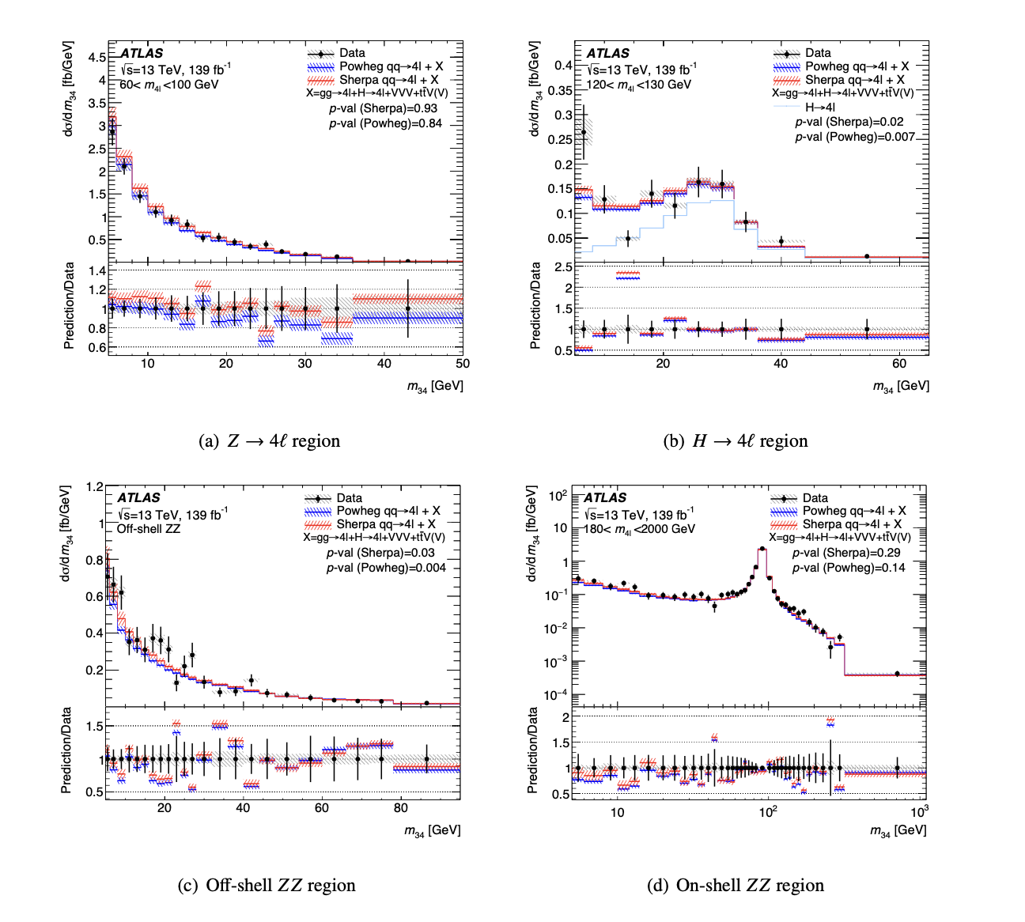
Four-lepton inclusive cross section
arXiv:2103.01918
Particle-level measurement defined entirely by final state (all events with at least four leptons passing cuts are signal).
Sliced many ways into momentum and angular variables

Slide 9
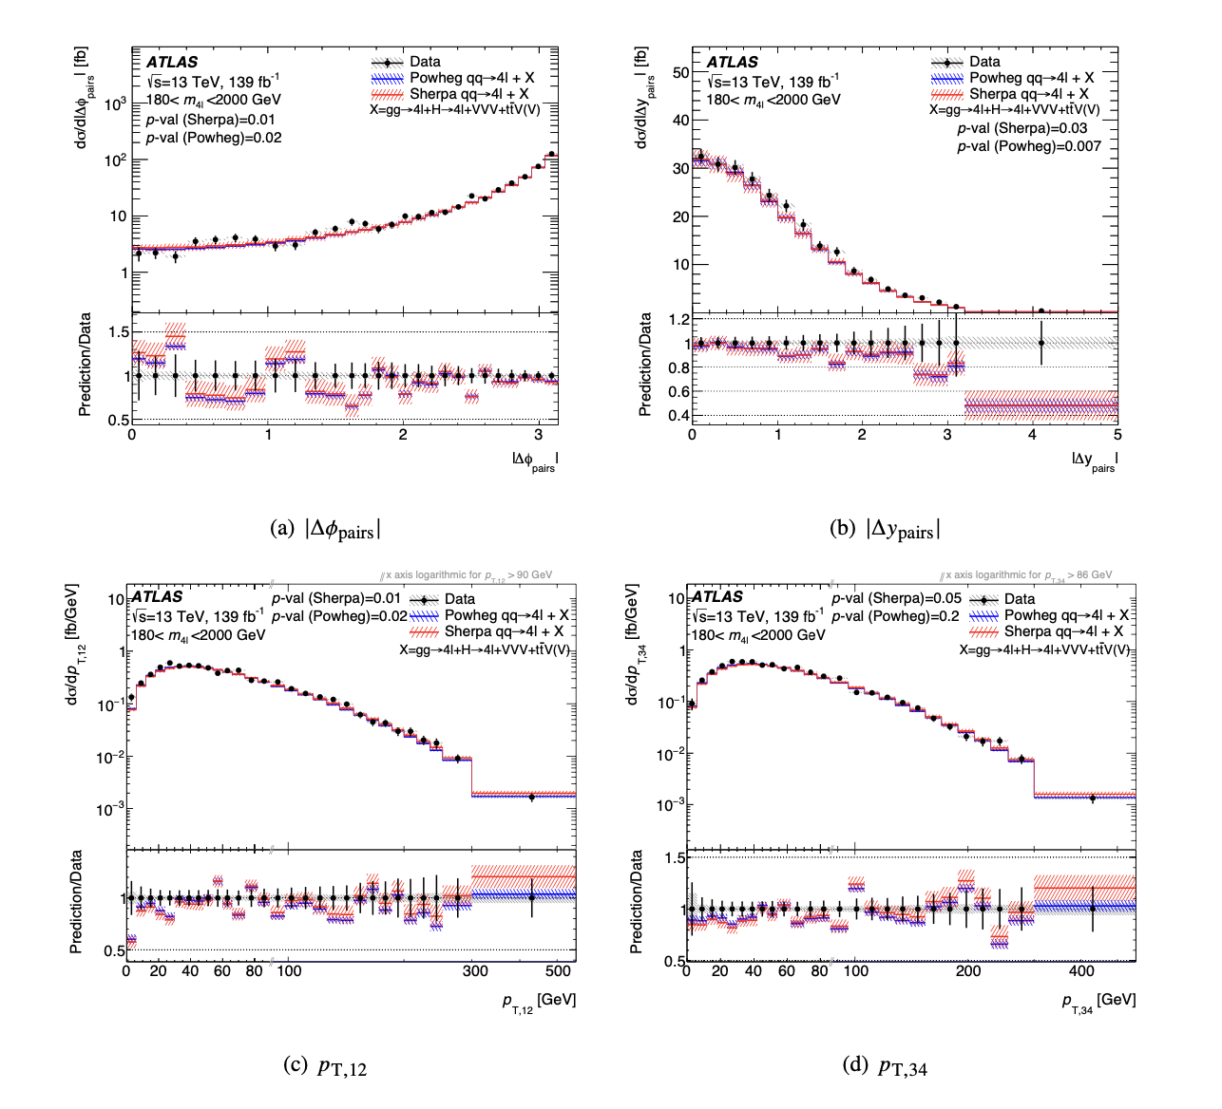
Four-lepton inclusive cross section
arXiv:2103.01918
Particle-level measurement defined entirely by final state (all events with at least four leptons passing cuts are signal).
Sliced many ways into momentum and angular variables

Slide 10
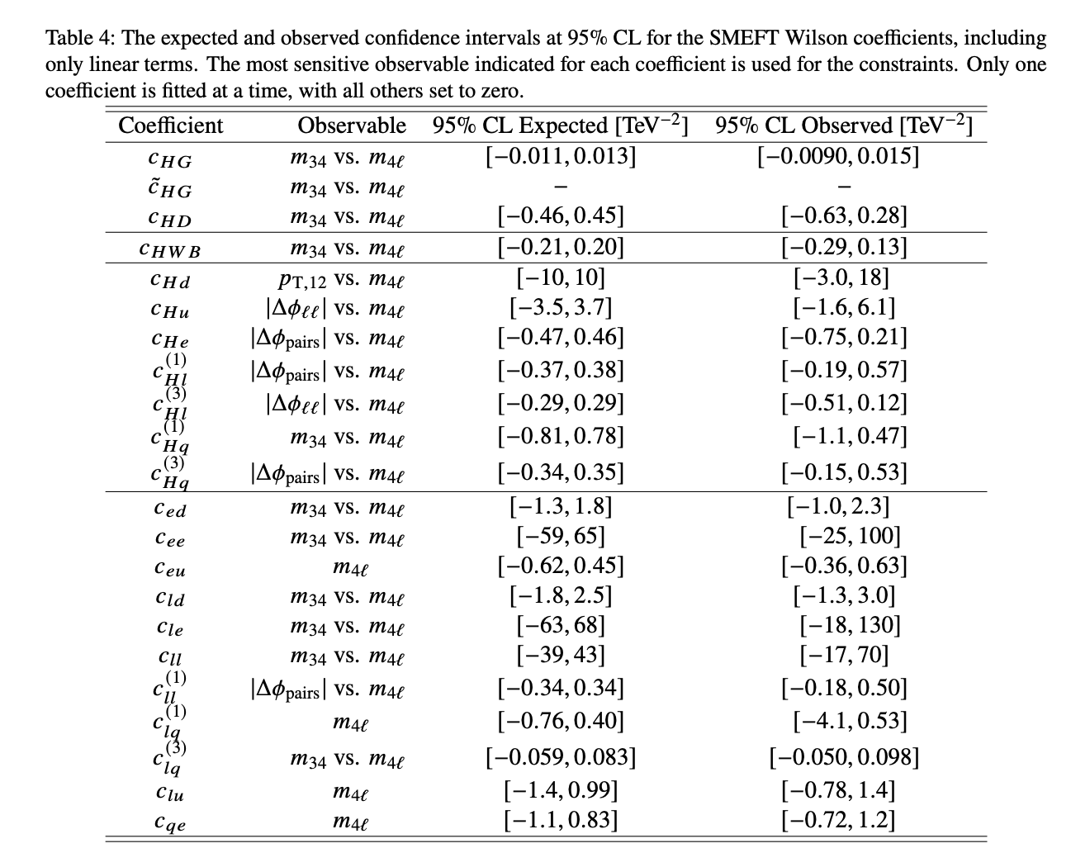
Four-lepton inclusive cross section
Interpreted in EFT framework by fitting the measured cross sections: 22 coefficients (one by one with others set to zero)
  three affecting Higgs couplings: 𝑐_{𝐻𝐺}, 𝑐 ̃_{𝐻𝐺}, 𝑐_{𝐻𝐷};
  one affecting gauge boson couplings: 𝑐 _{𝐻𝑊𝐵};
  seven affecting the 𝑍 → ll vertex
  eleven from four-fermion interactions (contact terms):
Obtained from fits to published cross sections, so reproducible/repeatable if you don’t like the assumptions or theory input.

Slide 11
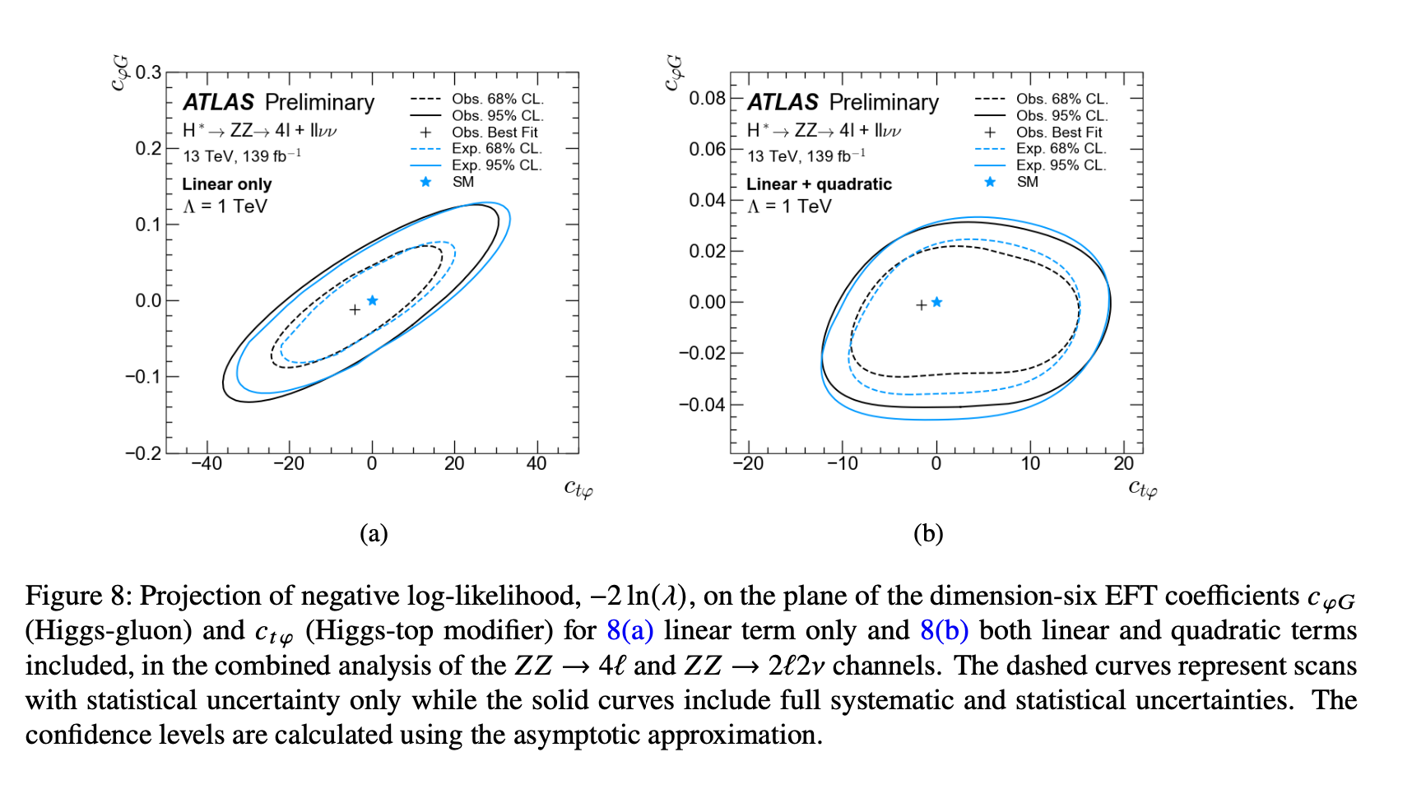
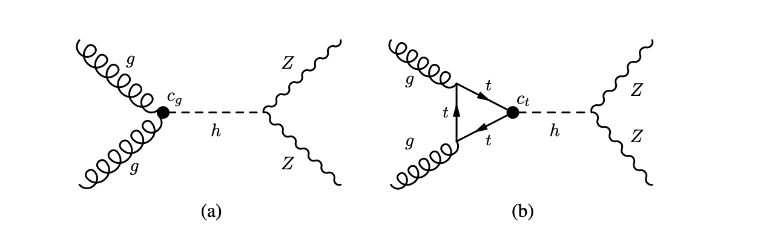
Off-shell Higgs → ZZ
ATL-PHYS-PUB-2023-012 (ZZ→4l, ZZ→2l 2v
c_{g} – c_{t.} and Warsaw basis
NN used at detector-level to identify the “off-shell Higgs processes”, including “interfering background”.

Slide 12
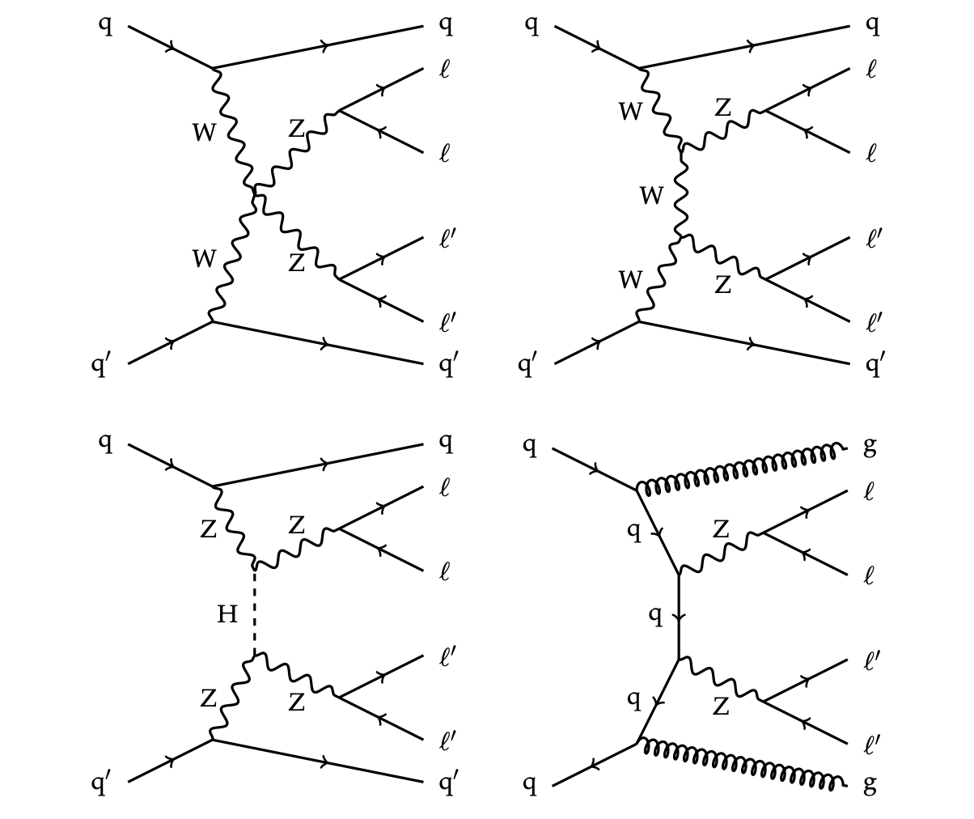
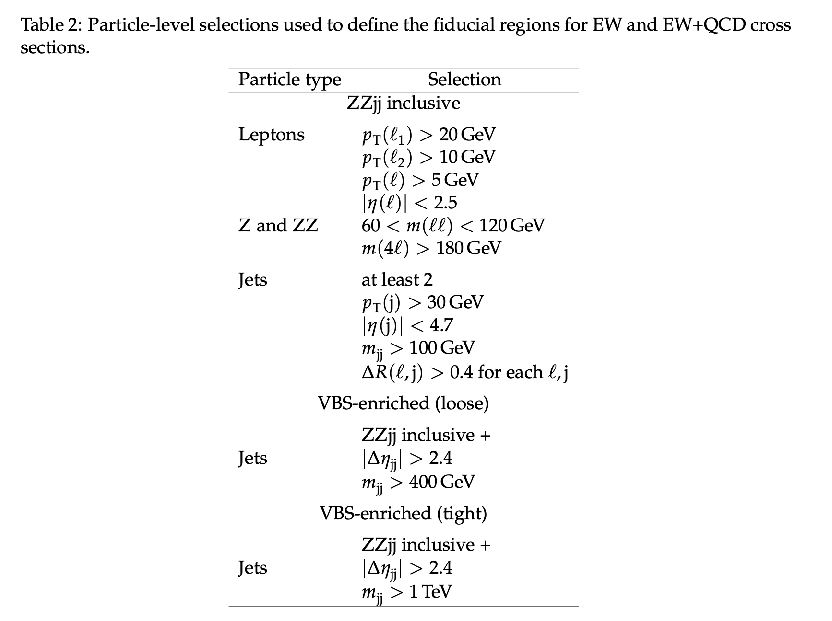
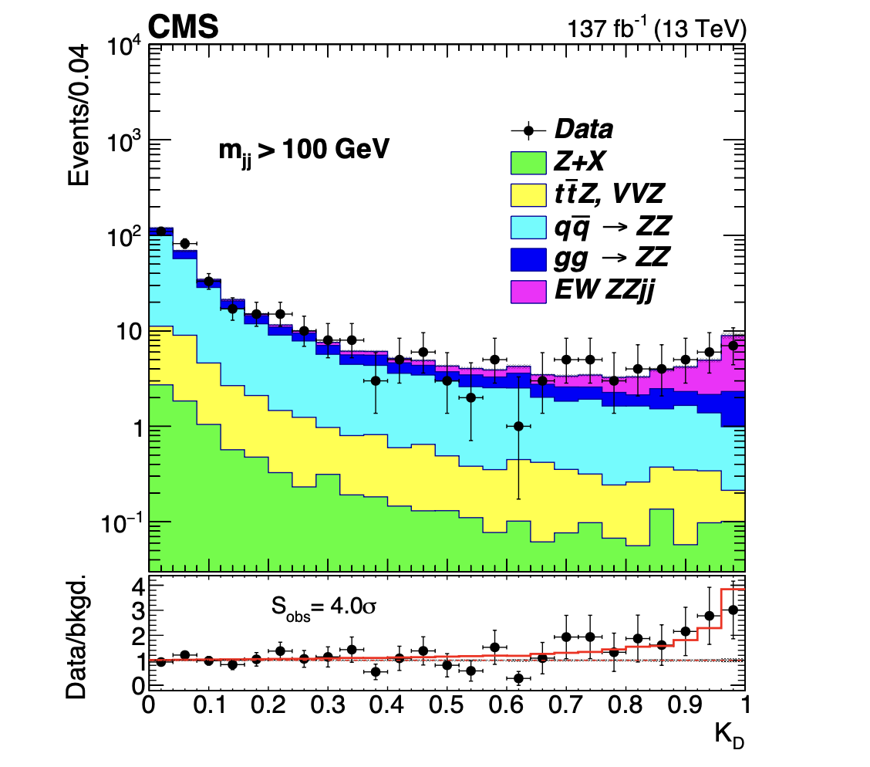
Electroweak ZZ scattering
Four leptons (again) and two jets: CMS 2008.07013
Matrix element discriminant to extract EW contribution

Slide 13
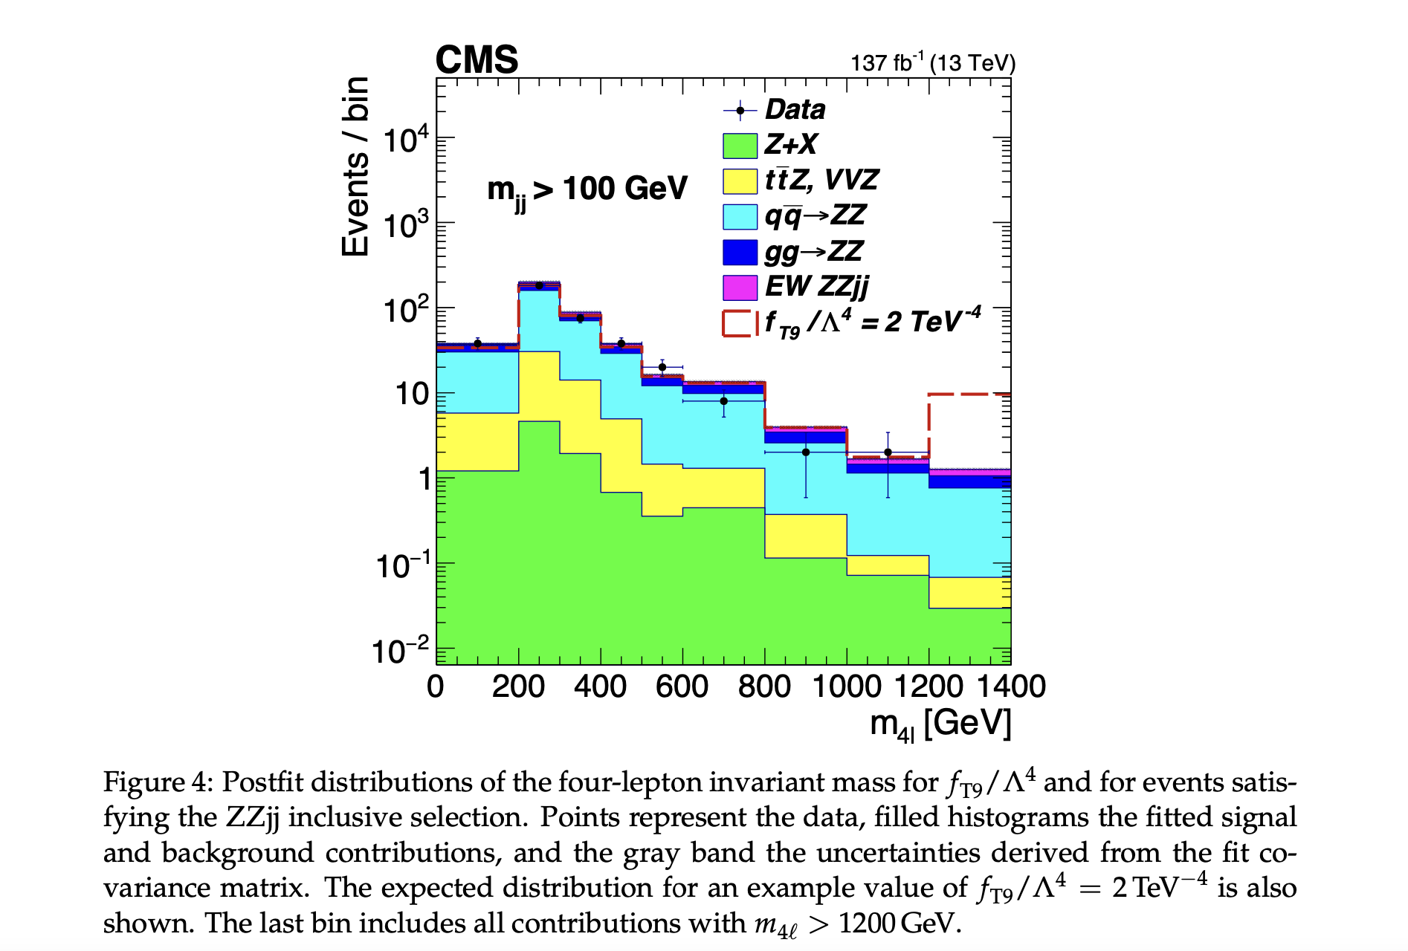
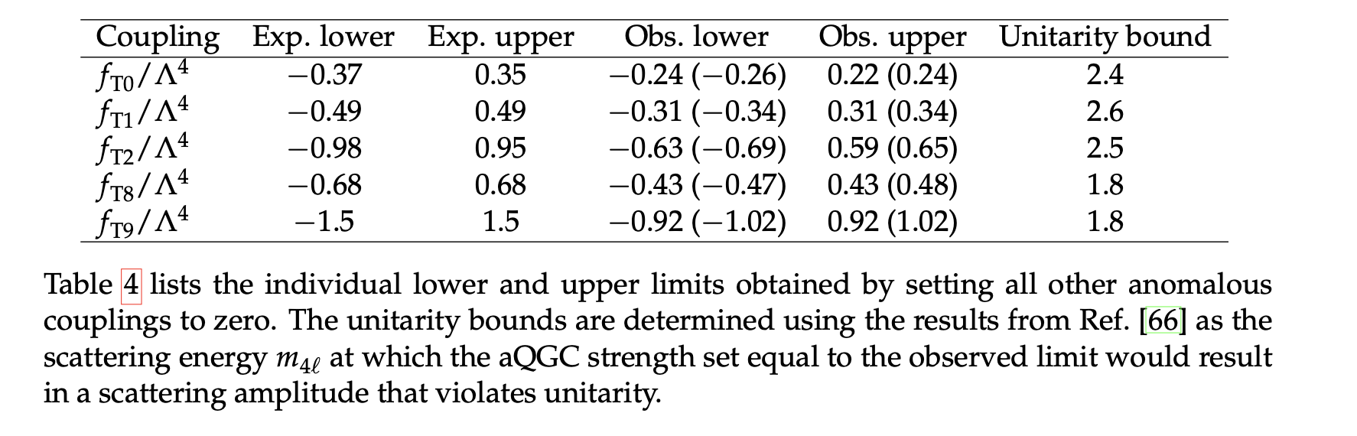
Electroweak ZZ scattering
Fit to detector-level four-lepton mass

Slide 14
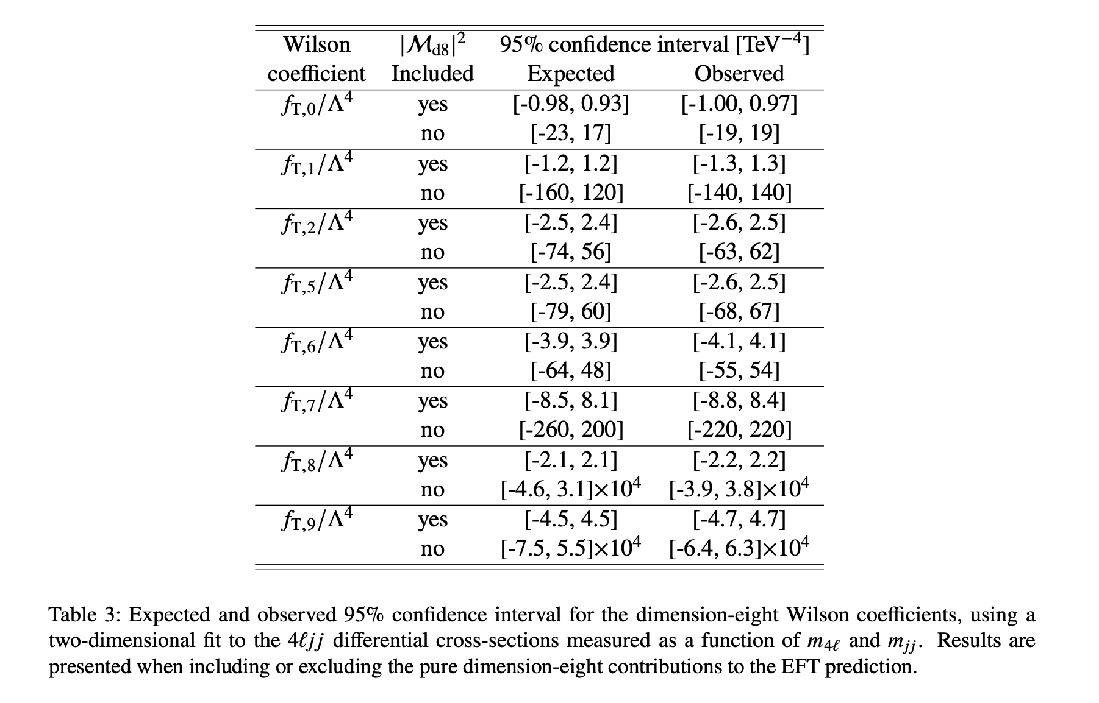
Electroweak ZZ scattering
ATLAS 2308.12324
Fit to particle-level four-lepton mass

Slide 15
Electroweak ZZ scattering
CMS 2008.07013
ATLAS 2308.12324

Slide 16
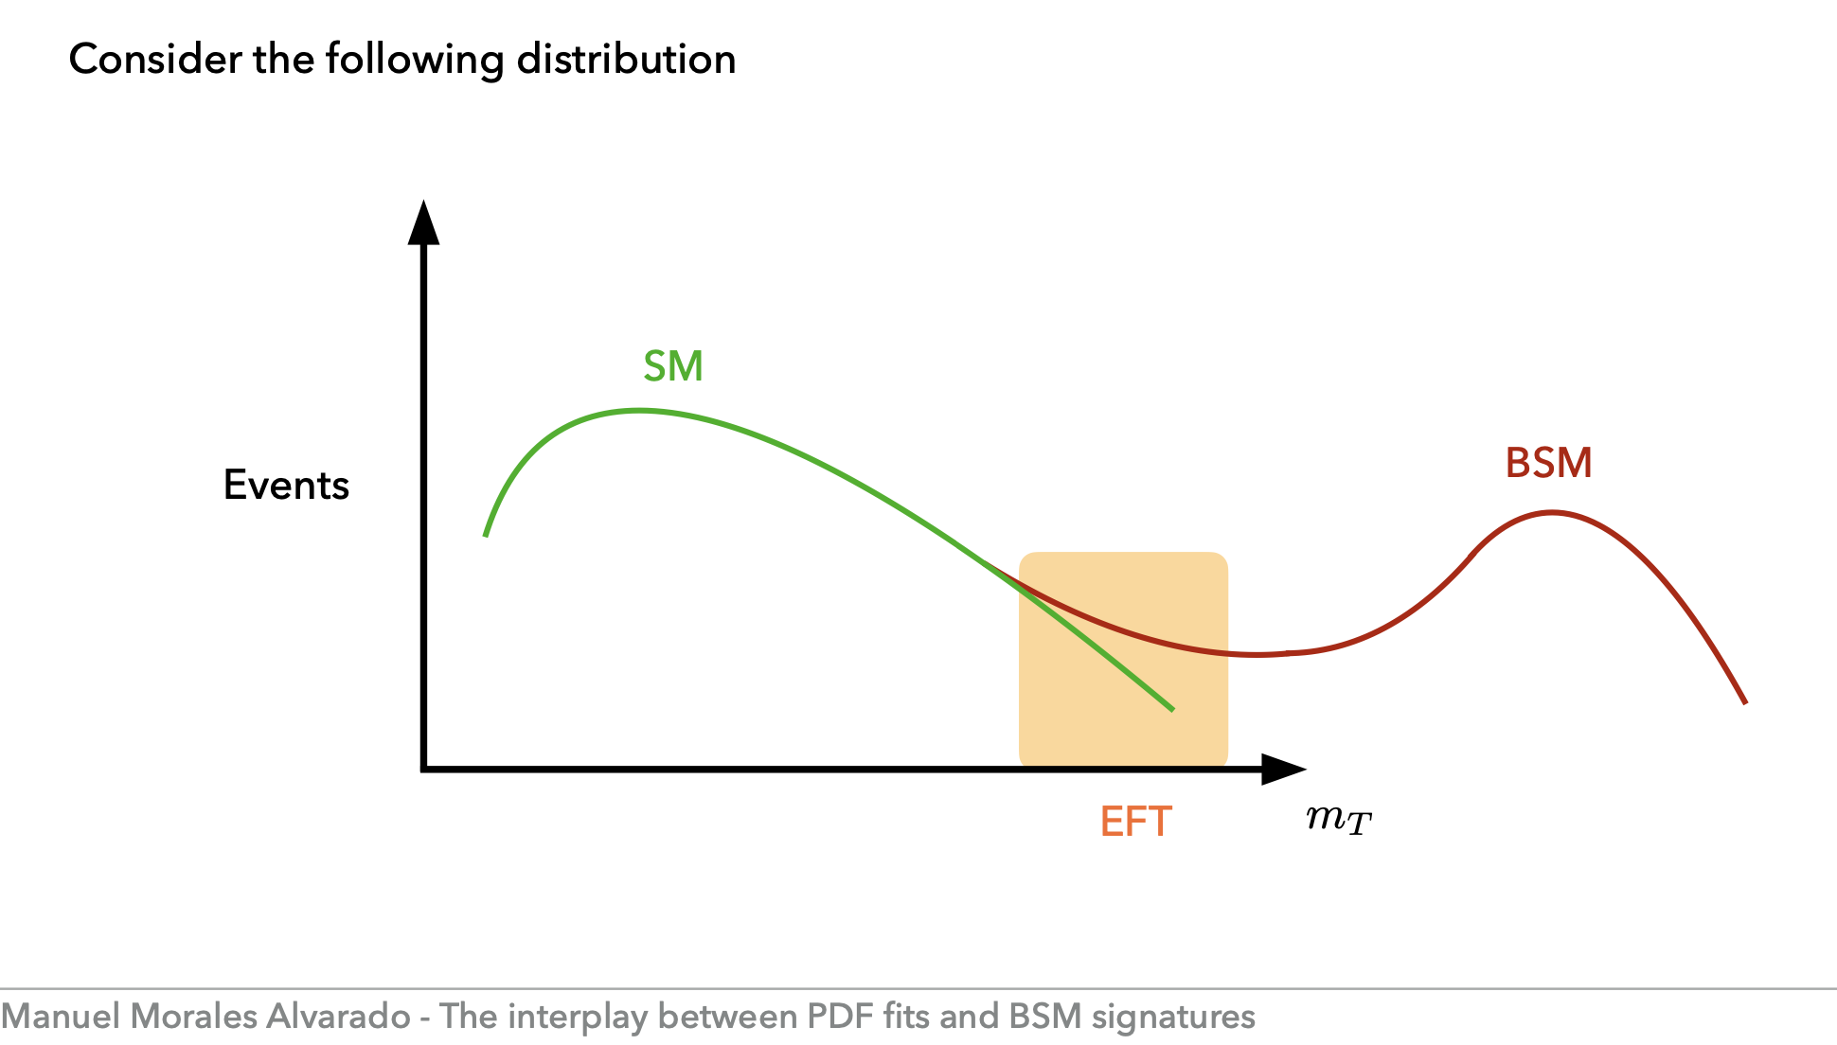
Overflow bins
What if we are in this
region?
No longer model-agnostic?

Slide 17
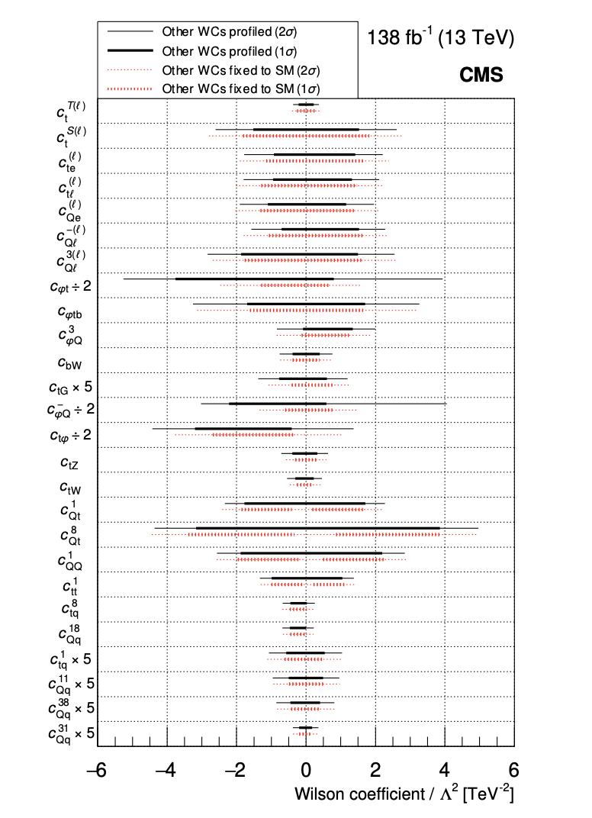
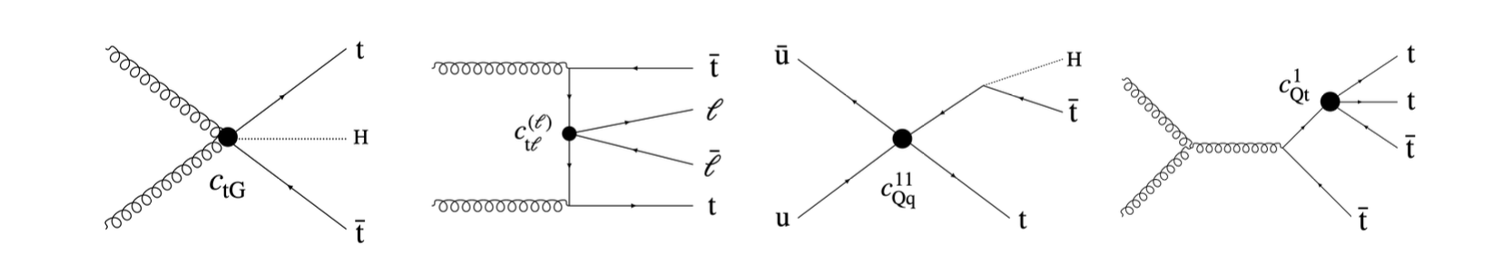
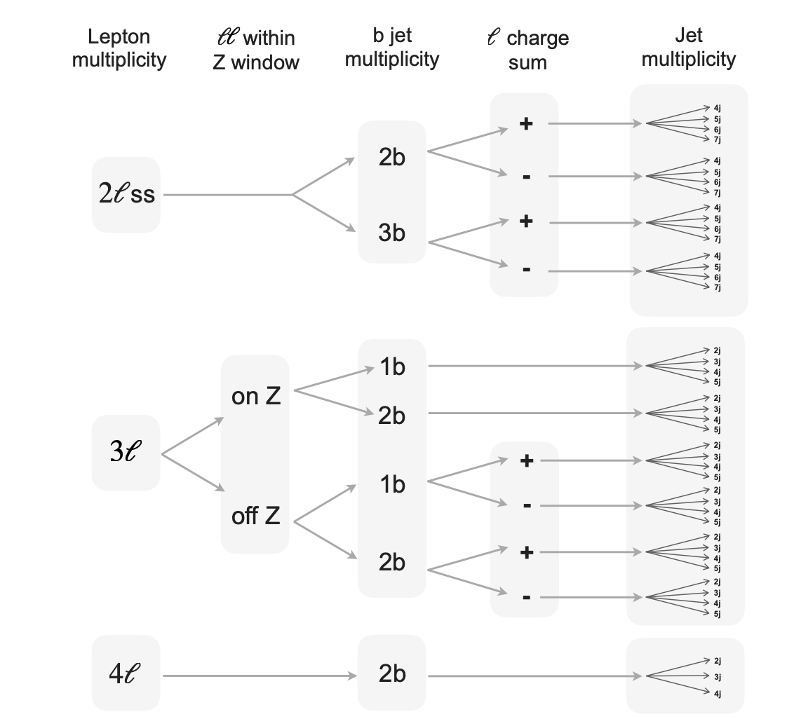
Top anti-top plus leptons
CMS 2307.15761
Fits to detector level distributions

Slide 18
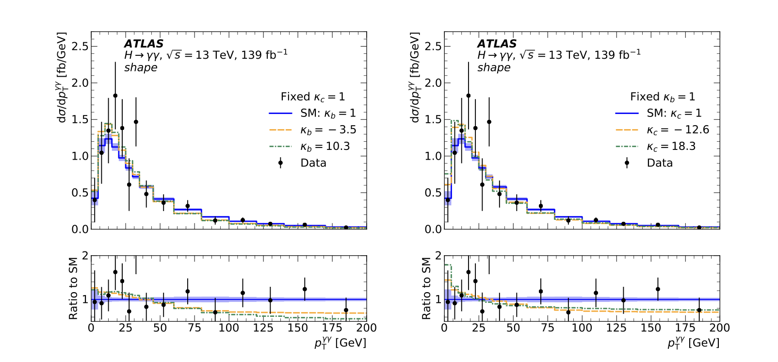
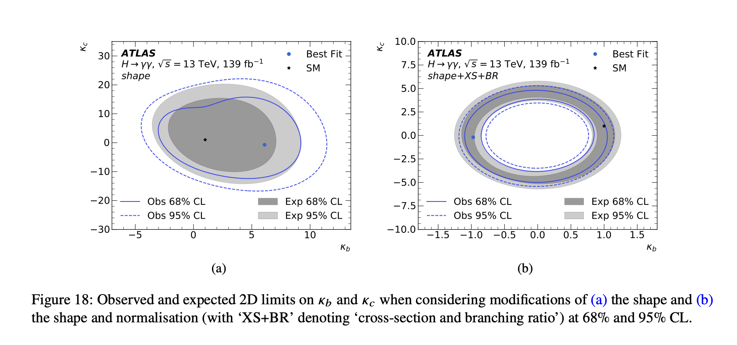
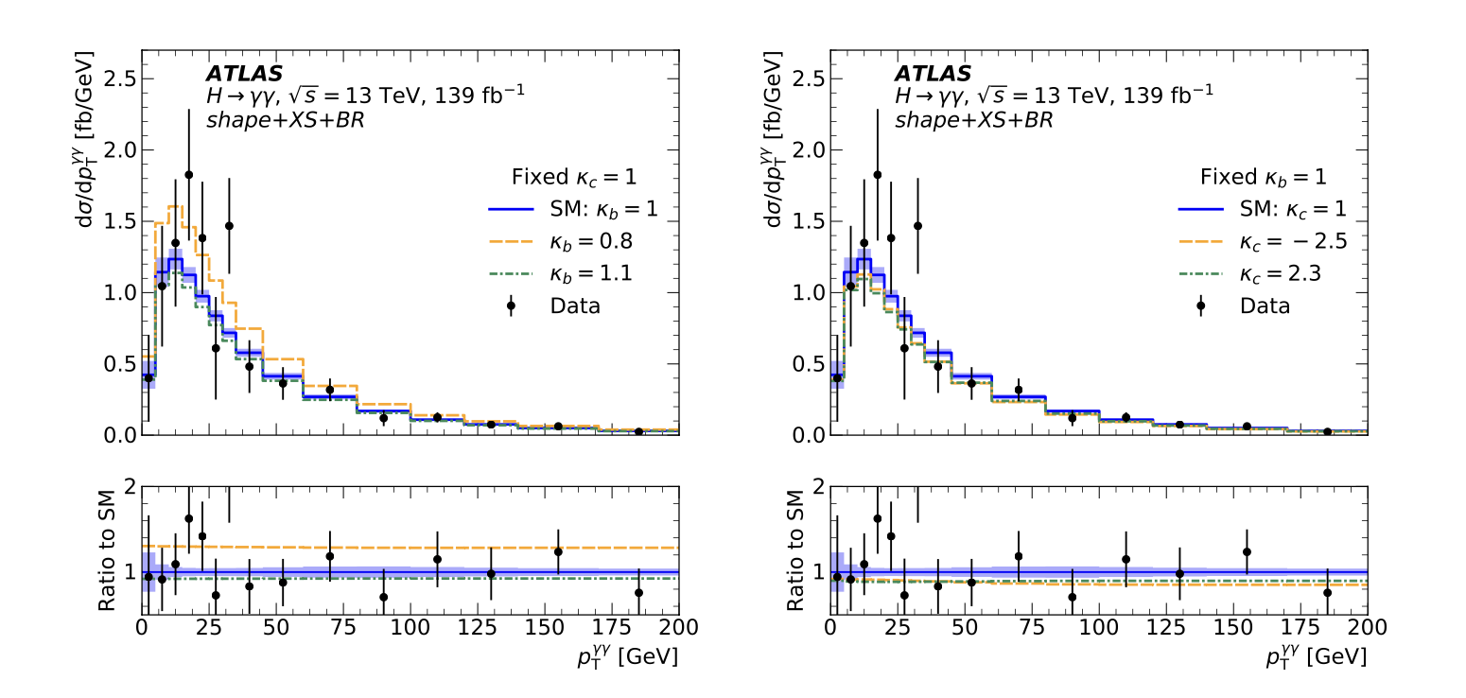
Higgs to γγ
ATLAS 2202.00487 - fits to fiducial cross sections (see Andy’s talk Monday)

Slide 19
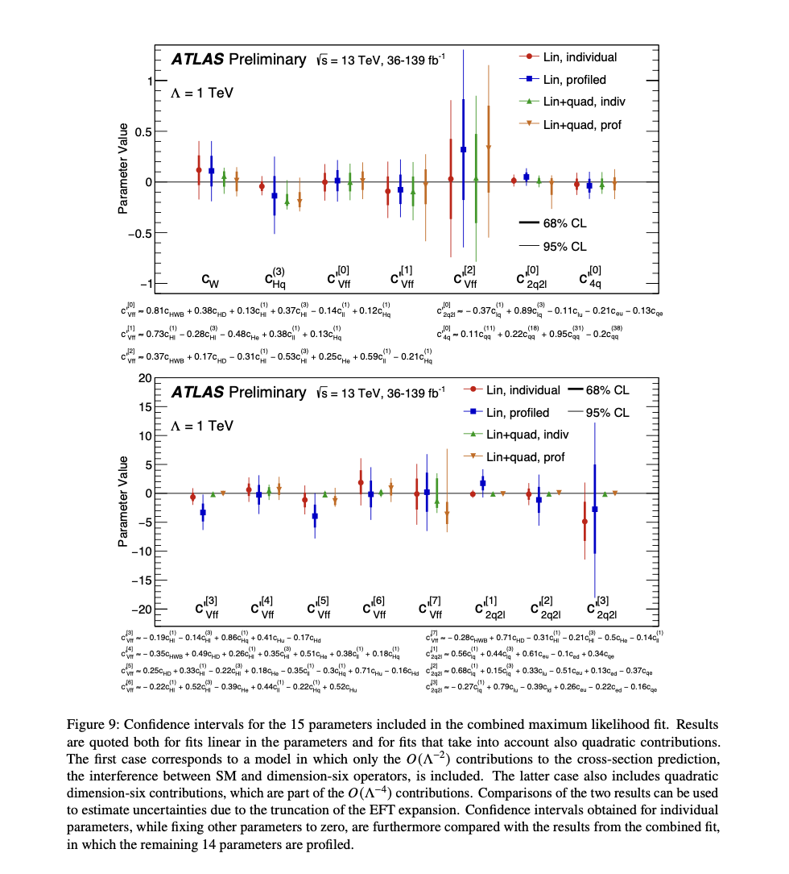
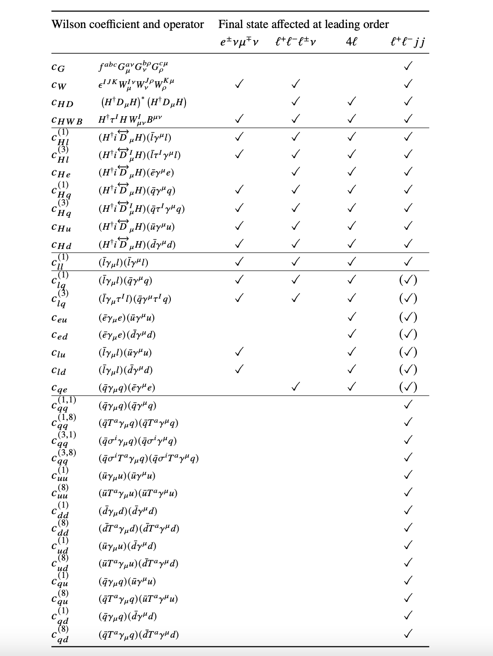
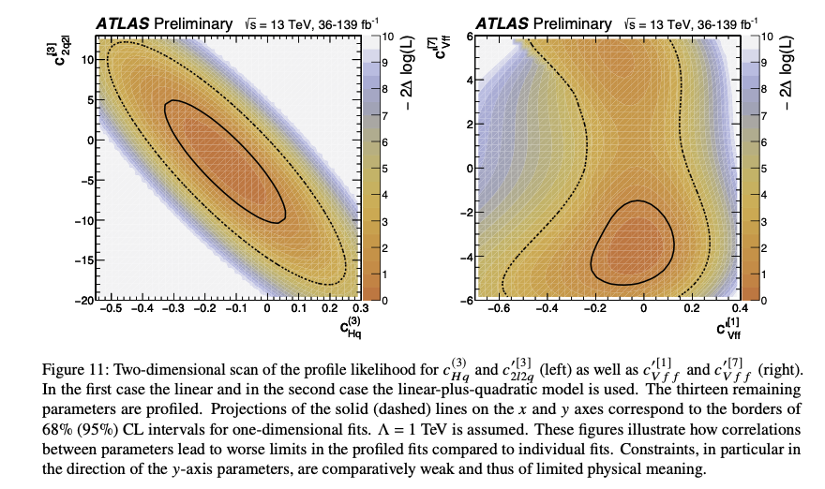
Diboson and Z+jj Cross sections
ATL-PHYS-PUB-2021-022
Includes WW, WZ, 4L, Z+2j measurements
Fits multiple differential particle-level cross sections

Slide 20
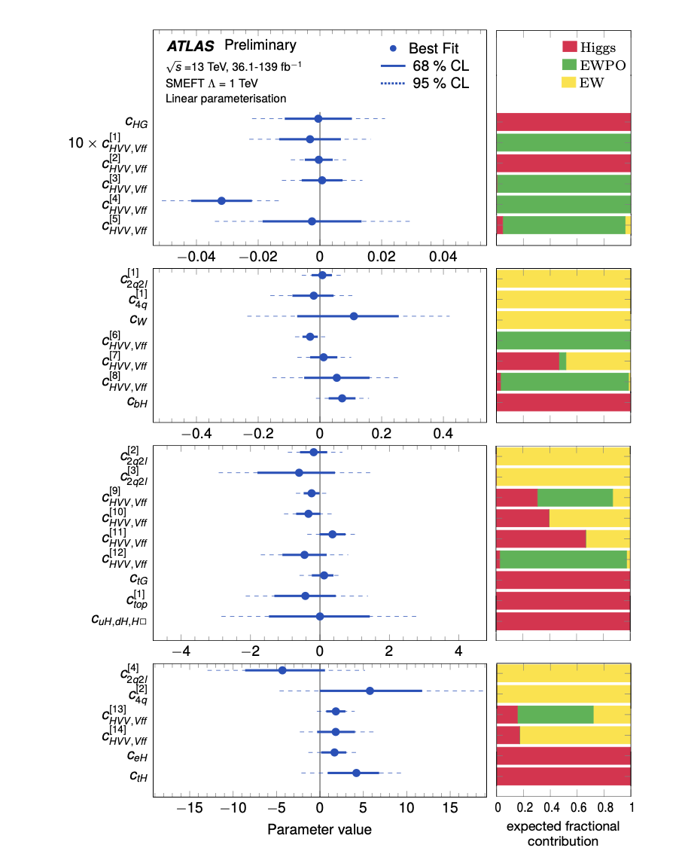
Combination of H, V production and decay with EW precision observables
“first ATLAS global EFT fit”
ATL-PHYS-PUB-2022-037
= ATL-PHYS-PUB-2021-022 plus ATLAS Higgs STXS plus LEP and SLD electroweak precision observables (fb asymmetries, Z width…)

Slide 21
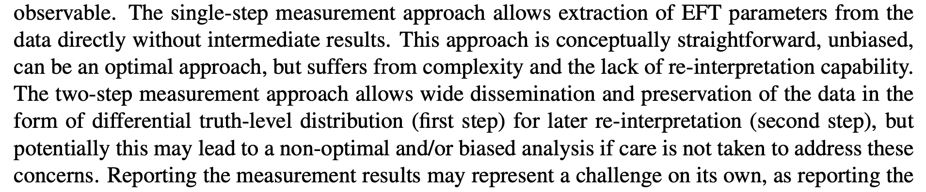
Summary
A lot going on (including things missed, probably), with some agreed benchmarks
  EFT interpretation will be a feature of many of our measurements for the foreseeable future
  Combinations also appearing, based on fiducial particle-level cross sections and STXS, and including constraints from other experiments
  Should a new, higher scale be adopted for default comparisons? Low scale could hide non-perturbatively-large coefficients behind a small C/Λ²
Particle- vs detector-level
  See some discussion in “LHC EFT WG Report: Experimental Measurements and Observables” arXiv:2211.08353. Personally I think the discussion of bias is in the body of the a little… biased. Though the summary is fair:.
  Particle level is nice (reproducible/re-doable later) but sometimes less sensitive because we require several events in a bin in order to unfold it, and the sensitivity is dominated by tails
  Can we “unfold” (almost) empty bins?
  Should these overflow bins really be used? (Connected to choice of scale?)
Meaningful/motivated ways to constrain more than Wilson coefficient at a time. Several 2D fits. How at a time many is sensible?
Role of PDFs…

