Slide 1
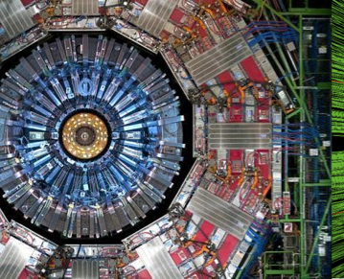
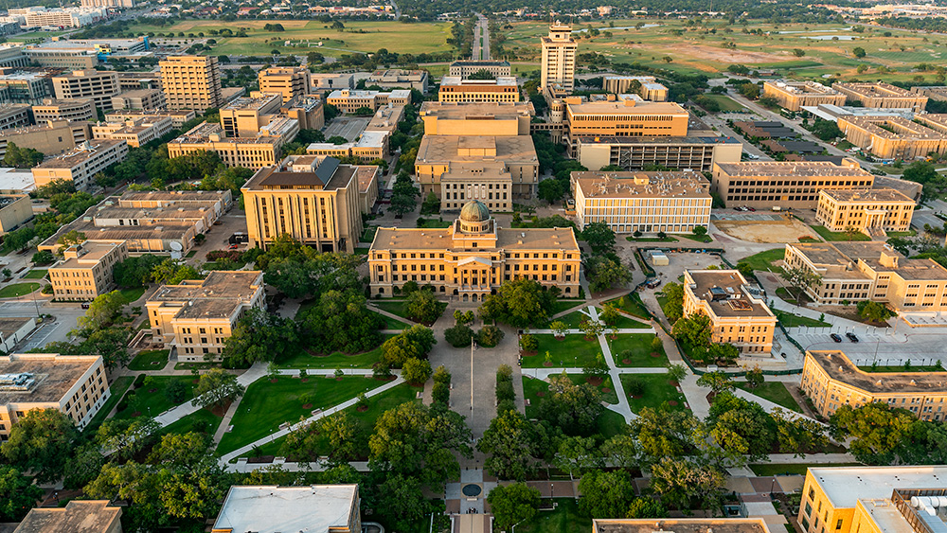
Texas A&M CMS Group Intro
Alexei Safonov
Email: safonov@tamu.edu

Slide 2
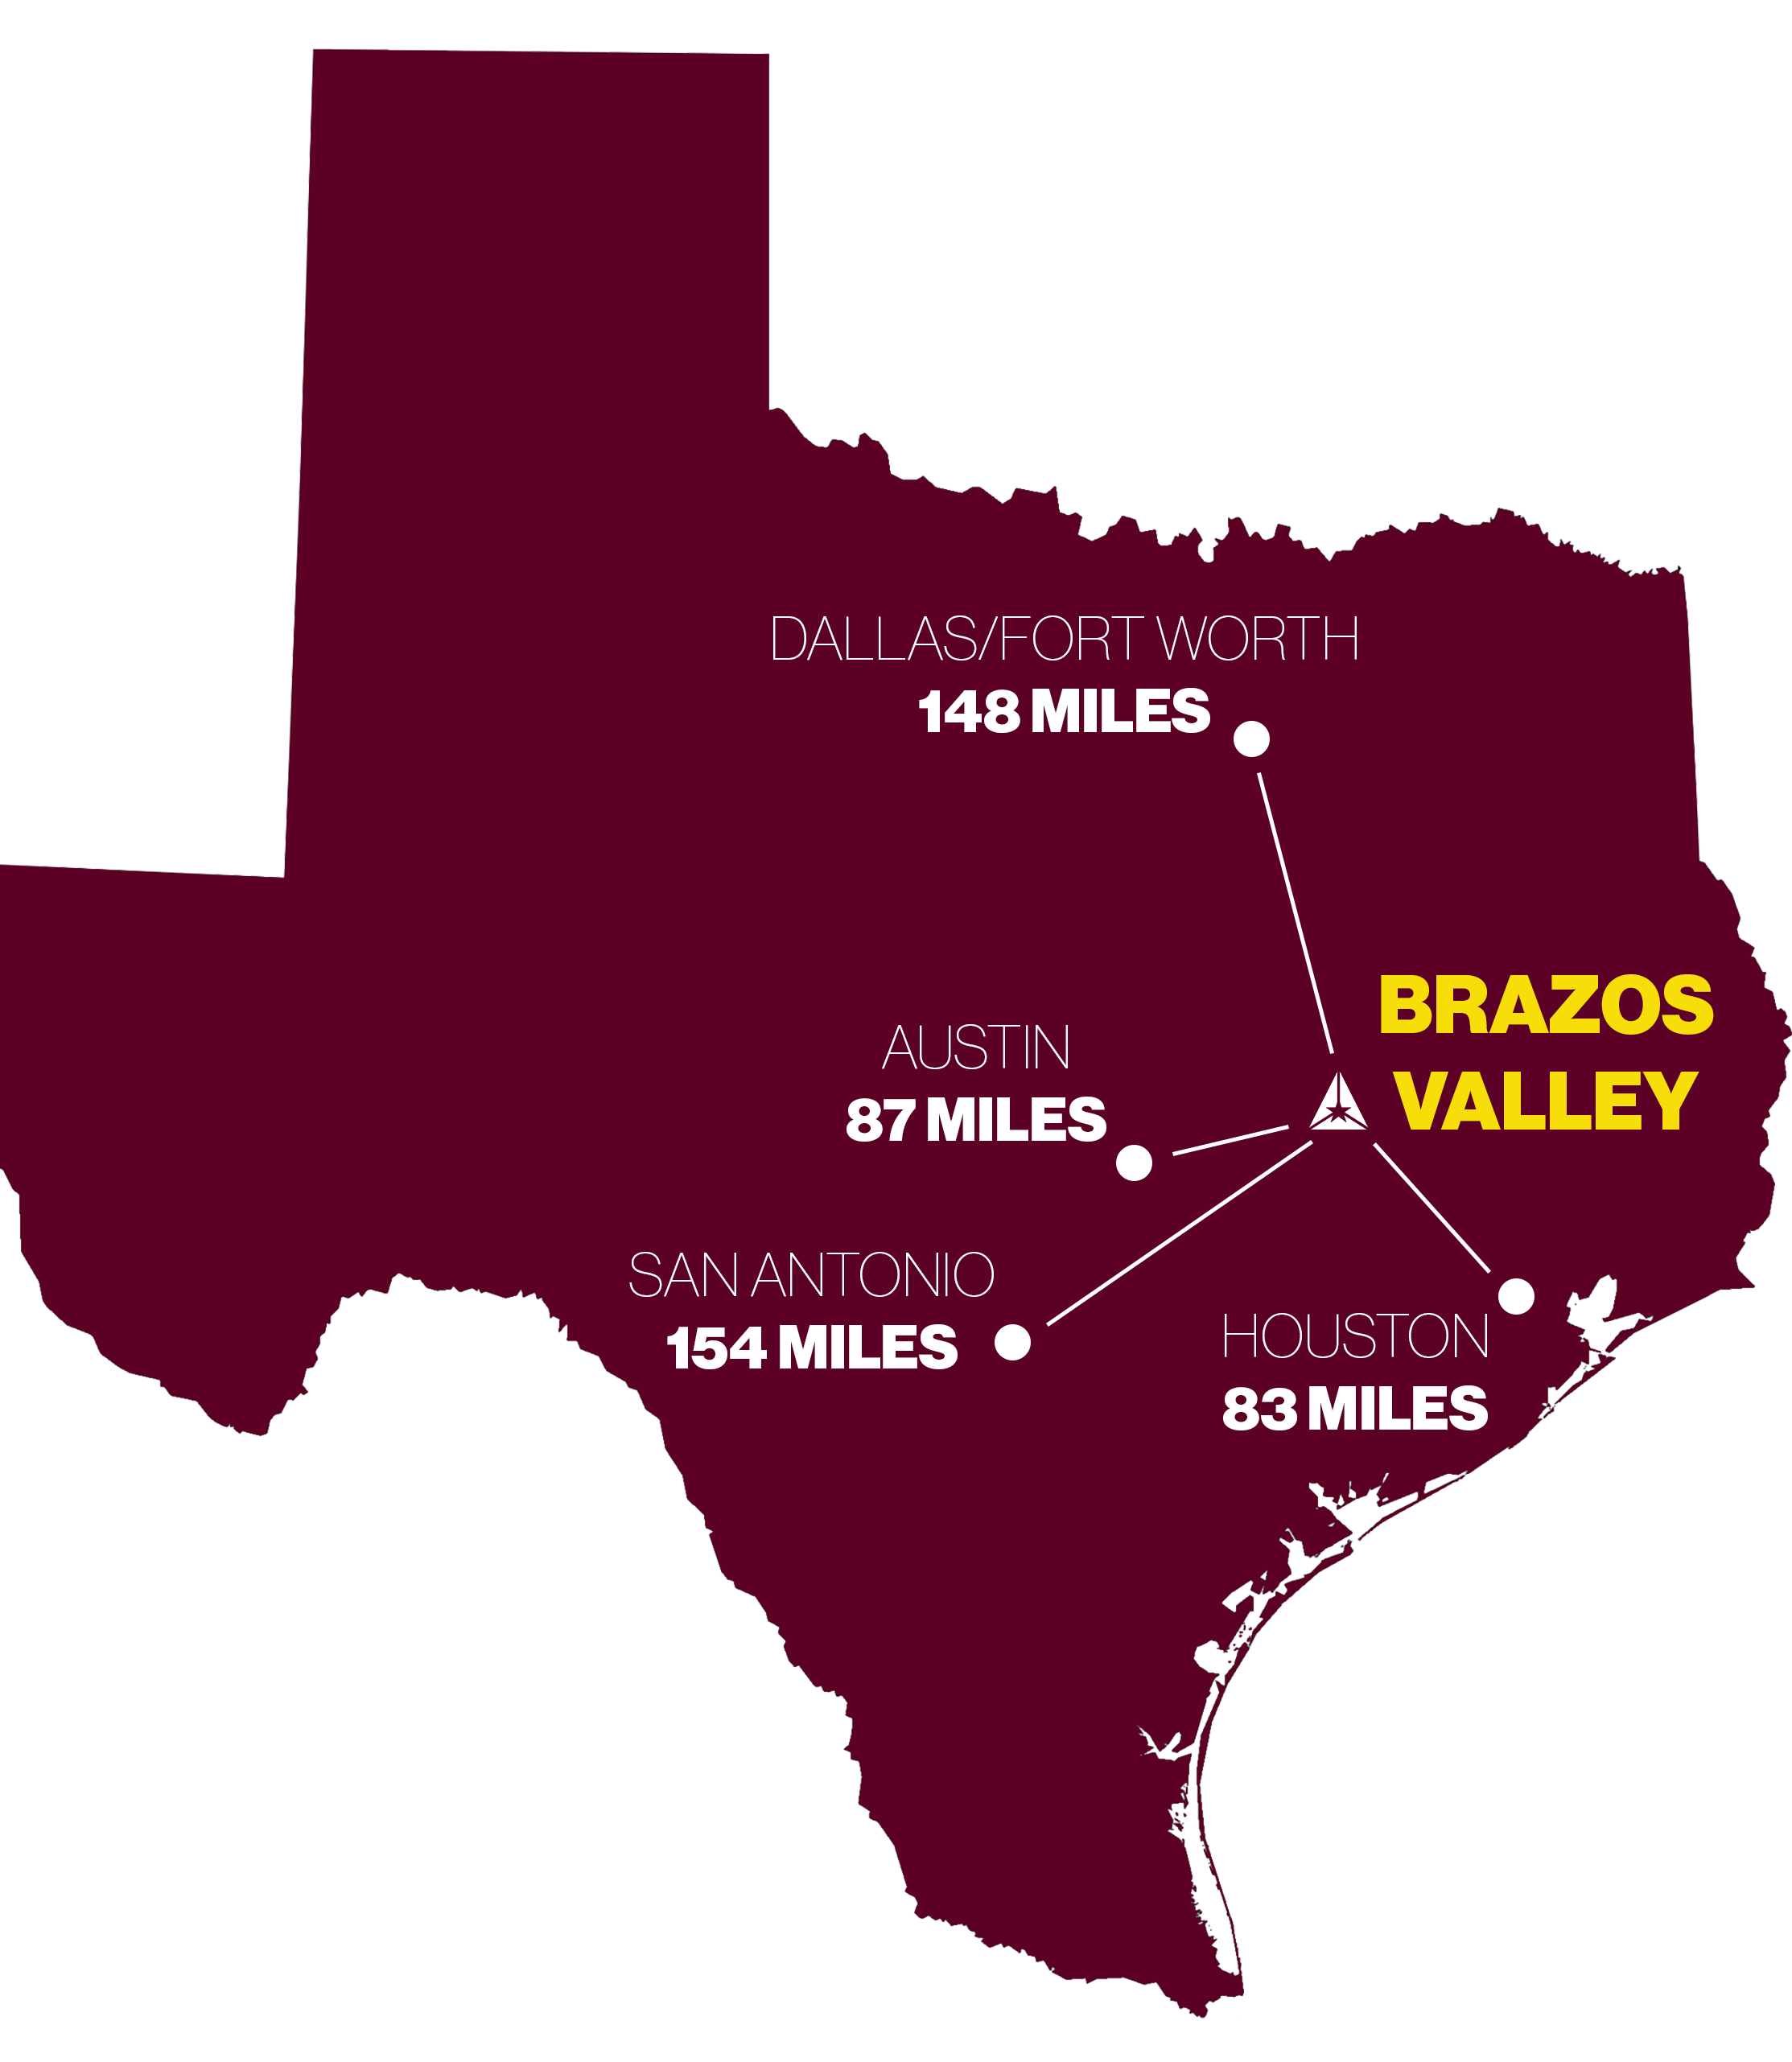
Welcome
Texas A&M University (TAMU) is the largest University in the U.S.A.
Main campus: College Station, TX
  A college town with the population heavily dominated by students
  About 90 minutes to Austin or Houston
Physics & Astronomy Department:
  Astronomy,
  Atomic, Molecular and Optical Physics
  Condensed Matter
  HEP
  Nuclear Physics

Slide 3
High Energy Physics
HEP program’s home is Mitchell Institute for Fundamental Science and Astronomy
HEP Programs:
  Formal theory (supergravity, stirngs etc.)
  Phenomenology
  CMS
  SuperCDMS
  LUX/DUNE

Slide 4
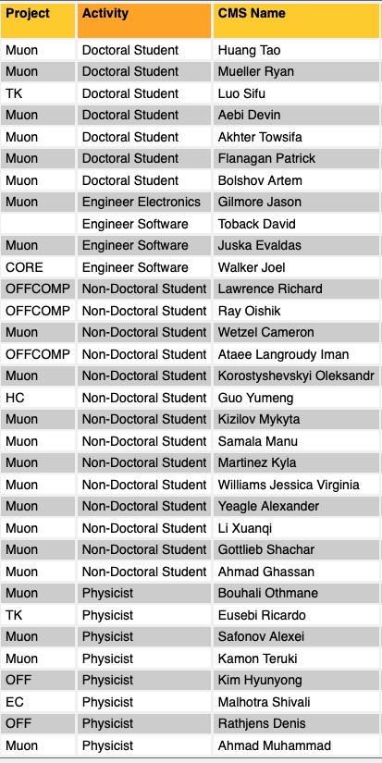
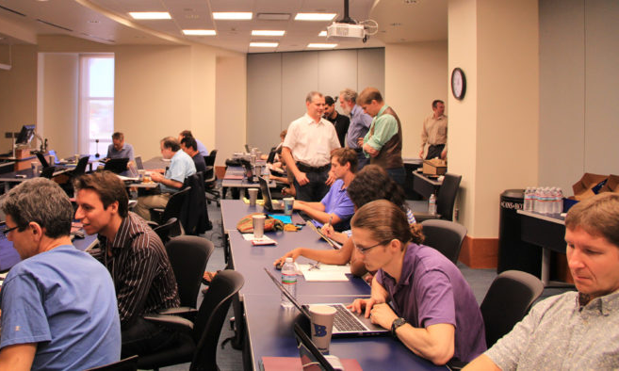
Texas A&M CMS Group
PIs: Ricardo Eusebi, Teruki Kamon, Alexei Safonov
  Will grow to 4 PIs by September 2024
R&D team leads: Jason Gilmore and Evaldas Juska
Postdocs, graduate, undergraduate students

Slide 5

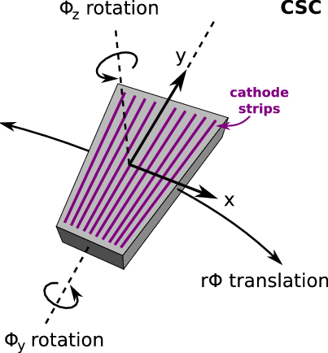
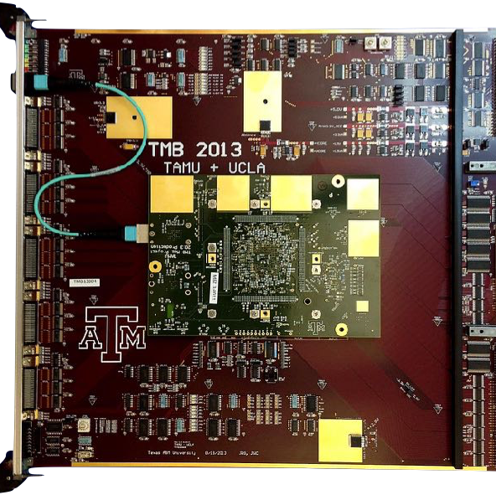
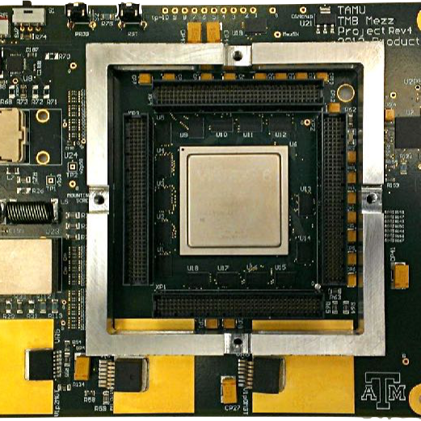
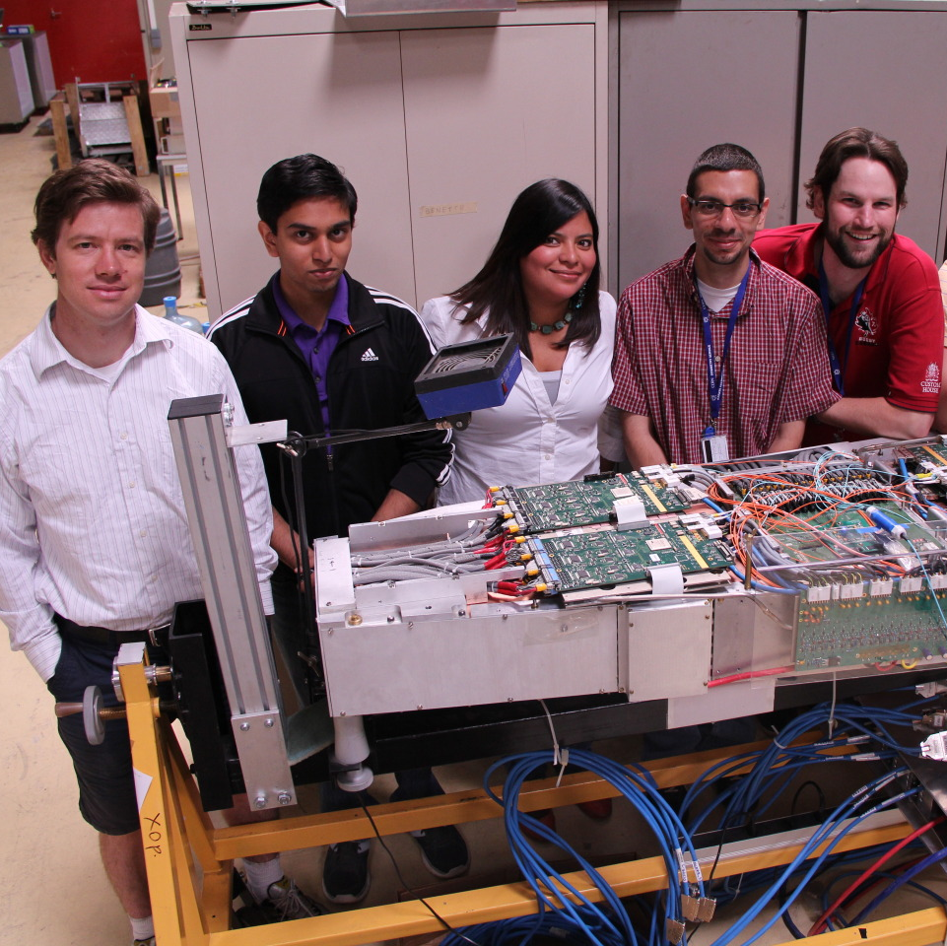
CMS Activities: Instrumentation, Upgrades and Operations
Cathode Strip Chambers (CSC)
  Current: Gilmore is Electronics Coordinator, Ahmad is Deputy Run Coordinator
Gaseous Electron Multiplier (GEM)
  Current: Juska is Deputy Electronics Coordinator
  Past: Deputy project manager (Safonov), DPG Coordinator (Kamon)
Muon alignment – TAMU’s solo responsibility
  Kim – Muon alignment coordinator
In-house electronics lab at Texas A&M – building electronics for CMS
  CSC Optical Trigger Motherboards (OTMB) -2014, 2-019 and -2025
  GEM Optohybrids boards
  CSC and GEM HL-LHC Backend Systems

Slide 6
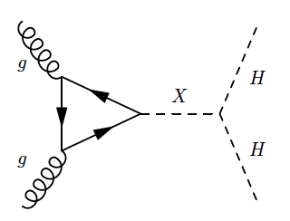
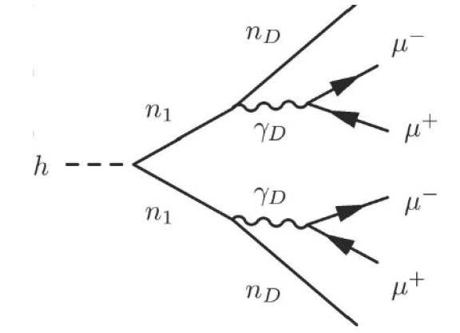
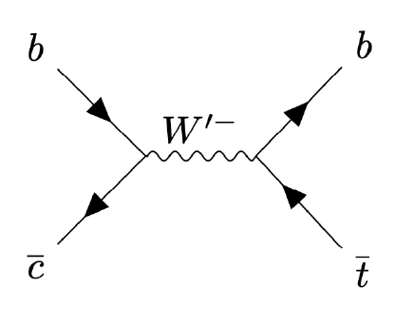
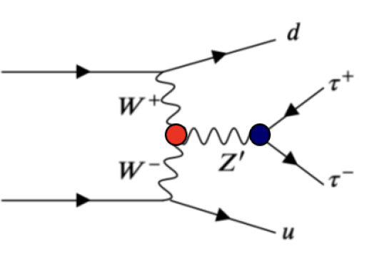
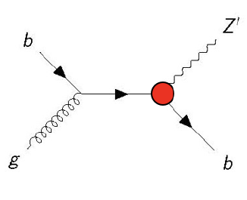
CMS Physics
New physics in Higgs sector, Z-prime, W-prime, searches for dark sectors in multi-muon decays

Slide 7
New Assistant Research Scientist Position
A career type position, i.e. intended as a long-term job
  No time caps, eventual promotion to Associate Research Scientist and Full Research Scientist;
  Initiated with the seed funding covering 5-7 years, long term support from a combination of funds of the CMS group at TAMU
  Formally reports to the PI/Team leader (Safonov)
Job description: we expect this person to engage primarily in physics analysis tasks; collaborate with and provide guidance to students and postdocs; work with the PIs on developing group’s planning in physics realm; service tasks at the level required for authorship – details to be discussed; other options could be negotiable at the time of hire or as we go
Location: we prefer this position to be posted in Texas, but this could be negotiable

